Slide 1












Mastering the Present Simple Tense
A Comprehensive Guide to Understanding and Using Present Simple Tense

Slide 2

Table of contents
Lesson Introduction
Uses of Present Simple Tense
Forms of Present Simple Tense
Examples of Present Simple Tense
Interactive Exercises
Common Misconceptions
Grasping the Present Simple Tense
Interactions with Different Verb Types
Regular and Irregular Verbs
Confident Usage of Present Simple Tense
01
02
03
04
05
06
07
08
09
10

Slide 3



Lesson Introduction
Lesson Introduction
Importance of Present Simple
Uses of Present Simple
Learning Objectives
Interactive Learning
Welcome to our in-depth exploration of the Present Simple tense! This fundamental aspect of English grammar is crucial for effective communication and forms the backbone of many more complex language structures.
Crucial for effective communication
Forms the backbone of many complex language structures
Express habitual actions
Convey general truths
Schedule events
Understand various uses of Present Simple
Recognize different forms and nuances
Gain confidence in using the tense accurately
Engage in examples and exercises
Address common misconceptions
Explore interactions with different verb types
01
02
03
04
05
Mastering the Present Simple Tense

Slide 4

Uses of Present Simple Tense
Expressing Habitual Actions
Stating General Truths
The Present Simple tense is used to describe actions that are repeated regularly or habits.
For example, "She reads a book every night before bed."
It is used to express facts that are generally true.
For instance, "The sun rises in the east."
Expressing Habitual Actions
Stating General Truths
The Present Simple tense is used to describe actions that are repeated regularly or habits.
For example, "She reads a book every night before bed."
It is used to express facts that are generally true.
For instance, "The sun rises in the east."
Mastering the Present Simple Tense

Slide 5

Forms of Present Simple Tense
Regular Verbs
Irregular Verbs
For most verbs, simply add "-s" to the base form for third-person singular subjects (he, she, it).
Example: He plays football every weekend.
Irregular verbs have unique forms for the third-person singular subject.
Example: She goes to the gym every morning.
Negative Form
Questions
Third-Person Singular
Use "do not" (don't) or "does not" (doesn't) before the base form of the verb.
Example: They do not play video games on weekdays.
Invert the subject and "do" or "does" to form questions.
Example: Do you like ice cream?
Remember to add "-s" or "-es" to the base form of the verb for third-person singular subjects.
Example: She reads a book every night.
Mastering the Present Simple Tense

Slide 6
Examples of Present Simple Tense
STRENGTHS
WEAKNESSES
Clearly indicates habitual actions and routines.
Easy to understand and use in everyday conversations.
Limited to present time reference only.
Can be confusing when used with non-habitual actions.
S
W
OPPORTUNITIES
THREATS
O
T
Provides a foundation for learning more complex tenses.
Enhances clarity in writing and speaking.
Overuse may lead to monotony in language.
Incorrect usage can change the intended meaning drastically.
Mastering the Present Simple Tense

Slide 7
Interactive Exercises
STRENGTHS
WEAKNESSES
Engaging and interactive exercises to reinforce learning
Immediate feedback on responses to enhance understanding
Varied question formats to cater to different learning styles
Limited scope for personalized feedback in group settings
Potential for technical issues with online platforms
Difficulty in assessing subjective aspects of language proficiency
S
W
OPPORTUNITIES
THREATS
O
T
Integration of multimedia elements for enhanced engagement
Collaboration with peers for peer-to-peer learning
Expansion of exercises to cover real-life scenarios for practical application
Student disengagement due to repetitive exercises
Inadequate time allocation for thorough practice
Misinterpretation of exercise instructions leading to incorrect responses
Mastering the Present Simple Tense

Slide 8
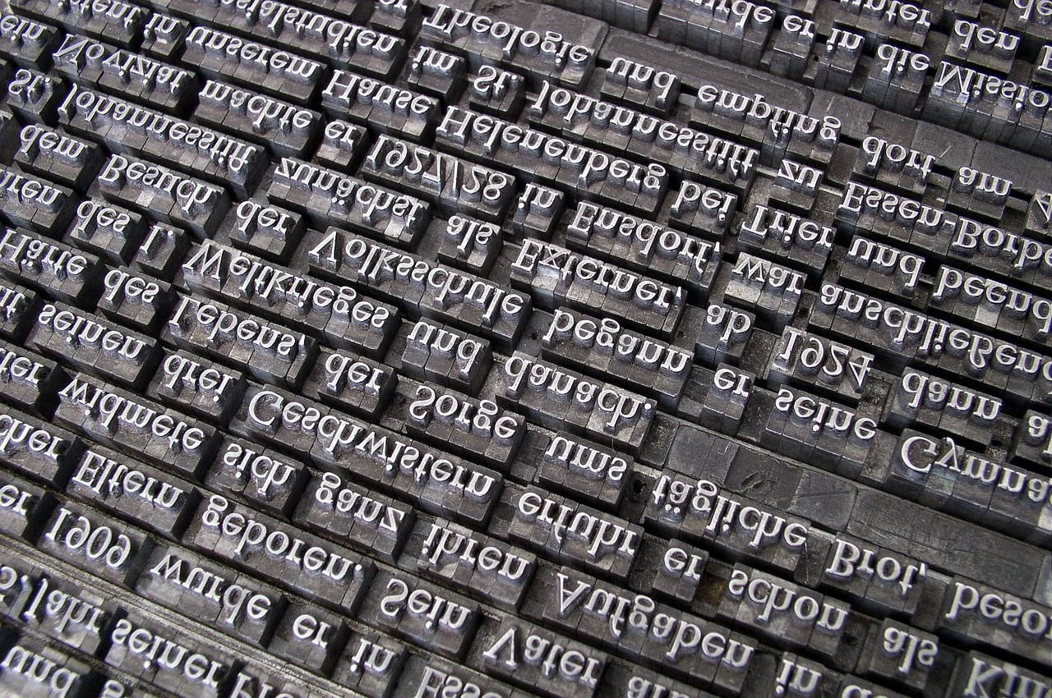
Common Misconceptions
Present Simple is only used for actions happening now
Present Simple is only for the present tense
While the Present Simple can describe actions happening now, it is also used for habitual actions, general truths, and scheduled events.
The Present Simple can also be used to talk about future events, especially when they are part of a timetable or schedule.
Every sentence with "always" or "usually" is in the Present Simple
Present Simple is always easy to identify
Present Simple is only for singular subjects
While these adverbs often accompany the Present Simple, they can also be used with other tenses to indicate frequency.
Sometimes, the Present Simple can be confused with other tenses, especially in complex sentences or with irregular verbs.
The Present Simple is used for both singular and plural subjects, with slight variations in the verb form.
Mastering the Present Simple Tense

Slide 9
Grasping the Present Simple Tense
STRENGTHS
WEAKNESSES
Essential for effective communication
Forms the backbone of many complex language structures
Indispensable tool in everyday conversations and academic writing
Requires understanding of various uses and forms
Common misconceptions may arise
S
W
OPPORTUNITIES
THREATS
O
T
Enhance language proficiency
Improve clarity and precision in communication
Misuse leading to confusion
Difficulty in mastering for some learners
Mastering the Present Simple Tense

Slide 10
Interactions with Different Verb Types
Regular Verbs
Irregular Verbs
Regular verbs follow a predictable pattern in the Present Simple tense, where the base form of the verb is used for all persons except for the third person singular, which adds an "-s" or "-es" at the end.
For example, "I play tennis every weekend" or "She watches movies on Fridays."
Irregular verbs do not follow the standard rules for conjugation in the Present Simple tense.
Each irregular verb has its unique forms for different persons.
For instance, "I go to the gym every morning" or "They have breakfast together every day."
Modal Verbs
Phrasal Verbs
Modal verbs, such as "can," "may," "must," etc., do not change their form in the Present Simple tense.
They are always followed by the base form of the main verb.
For example, "She can speak French fluently" or "We must finish the project by Friday."
Phrasal verbs consist of a main verb and one or more particles (prepositions or adverbs).
In the Present Simple tense, phrasal verbs are used in the same way as regular or irregular verbs.
For instance, "He gets up early every morning" or "They look after their pets carefully."
Mastering the Present Simple Tense

Slide 11
Regular and Irregular Verbs
STRENGTHS
WEAKNESSES
Regular verbs follow a predictable pattern when conjugating in the Present Simple tense.
Irregular verbs add variety and nuance to language usage.
Memorizing irregular verb forms can be challenging for language learners.
Overusing regular verbs may lead to repetitive language usage.
S
W
OPPORTUNITIES
THREATS
O
T
Practice and exposure can help improve mastery of both regular and irregular verbs.
Using a variety of verbs enhances the richness of language expression.
Incorrect verb usage can impact the clarity and accuracy of communication.
Neglecting to differentiate between regular and irregular verbs may hinder language proficiency.
Mastering the Present Simple Tense

Slide 12
Confident Usage of Present Simple Tense
STRENGTHS
WEAKNESSES
Clear and straightforward usage in expressing habits and routines.
Helps convey general truths and facts.
Useful for discussing scheduled events and timetables.
Can be confusing when used with certain adverbs of frequency.
Limited in expressing ongoing or continuous actions.
Requires attention to subject-verb agreement.
S
W
OPPORTUNITIES
THREATS
O
T
Practice using the Present Simple in daily conversations.
Explore how this tense is used in different contexts like storytelling or reporting.
Utilize online resources for additional exercises and reinforcement.
Overreliance on the Present Simple may lead to monotony in speech or writing.
Incorrect usage can affect the clarity and accuracy of communication.
Lack of varied examples and practice may hinder mastery of this tense.
Mastering the Present Simple Tense

