Slide 1

Gestión del Tiempo y Herramientas Digitales para el Éxito Académico y Personal
Estrategias y aplicaciones para mejorar la productividad, priorizar tareas y mantener un equilibrio en la vida diaria

Slide 2
Table of Contents
Introduction to Time Management
Why Time Management Matters
Digital Tools for Time Management
Creating a Schedule
Prioritizing Tasks
Time Management Apps
Staying Focused
Collaborative Time Management
Reflection and Self-Assessment
Digital Citizenship
Common Time Management Mistakes
Overcoming Obstacles
Conclusion
04
05
06
07
08
09
10
11
12
13
14
15
16

Slide 3
Table of Contents
Next Steps
Additional Resources
Final Thoughts
Assessment and Evaluation
Conclusion and Final Thoughts
17
18
19
20
21

Slide 4
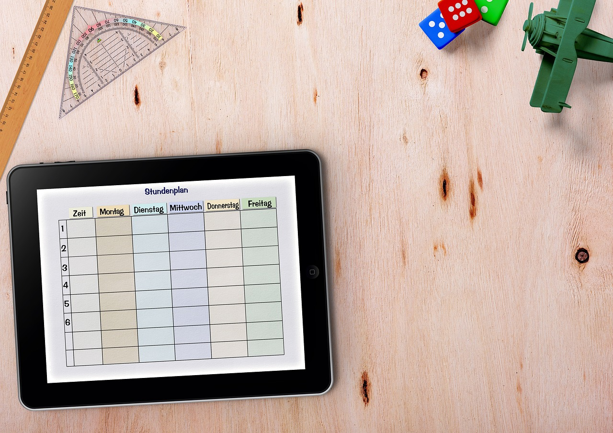
Introduction to Time Management
Importance of Time Management
Role of Digital Tools
Focus of the Lesson
Effective time management is crucial for academic success and personal productivity.
It allows individuals to achieve their goals efficiently and maintain a balanced lifestyle.
Digital tools and strategies can help students prioritize tasks and manage their time more efficiently.
These tools provide structured approaches to organizing and tracking activities.
In this lesson, we will explore various digital tools and strategies to enhance time management and efficiency.
Students will learn practical methods to improve their productivity.
4
Gestión del Tiempo y Herramientas Digitales para el Éxito Académico y Personal

Slide 5

Why Time Management Matters
Boosts Academic Success
Enhances Productivity
Improves academic performance and reduces stress.
Time management allows students to allocate sufficient time for studying and relaxation.
Enhances productivity and efficiency.
Effective time management ensures tasks are completed promptly and with focus.
Achieves Goals
Builds Life Skills
Helps students achieve their goals and priorities.
Prioritizing tasks helps students stay aligned with their objectives.
Develops essential life skills for personal and professional success.
Time management fosters discipline and organizational abilities crucial for future endeavors.
5
Gestión del Tiempo y Herramientas Digitales para el Éxito Académico y Personal

Slide 6

Digital Tools for Time Management
Calendars for Scheduling
To-Do List Applications
Time Management Apps
Google Calendar and Apple Calendar are popular tools for organizing daily schedules.
They allow users to set reminders, share events, and sync across devices for seamless planning.
Trello and Todoist help users manage tasks effectively with customizable boards and lists.
These tools are ideal for prioritizing tasks and tracking progress in real-time.
RescueTime and Focus@Will assist in analyzing and improving productivity.
They provide insights into time usage and offer features to minimize distractions.
Project Management Software
Browser Extensions for Focus
Asana and Basecamp are designed for collaborative project planning and execution.
They enable teams to assign tasks, set deadlines, and monitor project milestones efficiently.
StayFocusd and LeechBlock help users limit time spent on distracting websites.
These extensions are customizable and aim to enhance focus during work hours.
6
Gestión del Tiempo y Herramientas Digitales para el Éxito Académico y Personal

Slide 7
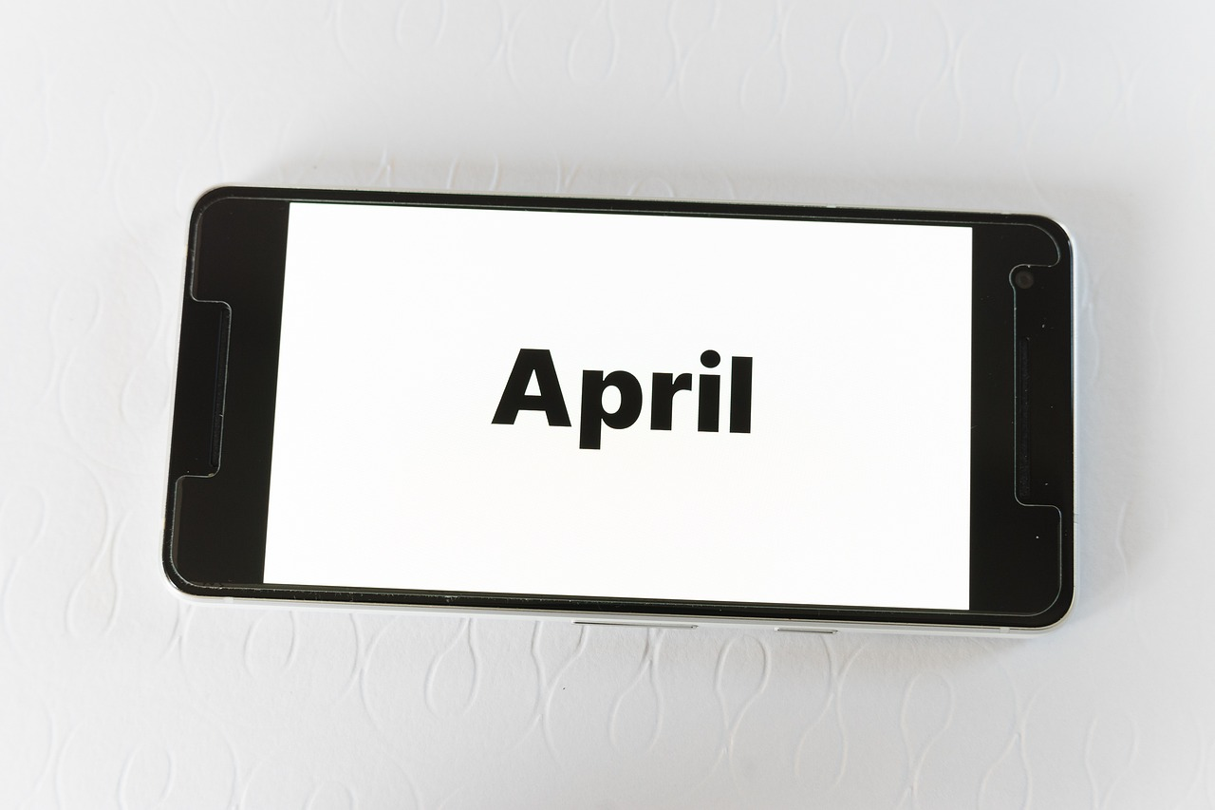
Creating a Schedule
Setting Goals and Priorities
Time Allocation
Set clear goals and priorities.
This helps in focusing on what truly matters and ensures efficient use of time.
Allocate time for each task and activity.
This ensures that every important task gets the attention it deserves.
Organizational Tools
Regular Adjustments
Use a calendar or planner to stay organized.
These tools help in visualizing your schedule and avoiding overlaps.
Review and adjust the schedule regularly.
This allows for flexibility and ensures the schedule remains effective.
7
Gestión del Tiempo y Herramientas Digitales para el Éxito Académico y Personal

Slide 8
Prioritizing Tasks
Using the Eisenhower Matrix
Focusing on High-Priority Tasks
Breaking Down Large Tasks
Tracking Tasks with a To-Do List
Use the Eisenhower Matrix to categorize tasks.
This helps in distinguishing between urgent and important tasks.
Focus on high-priority tasks first.
This ensures that critical tasks are completed on time.
Break down large tasks into smaller, manageable chunks.
This makes complex tasks easier to handle and less overwhelming.
Use a to-do list to keep track of tasks and deadlines.
This helps in staying organized and meeting deadlines effectively.
8
Gestión del Tiempo y Herramientas Digitales para el Éxito Académico y Personal

Slide 9
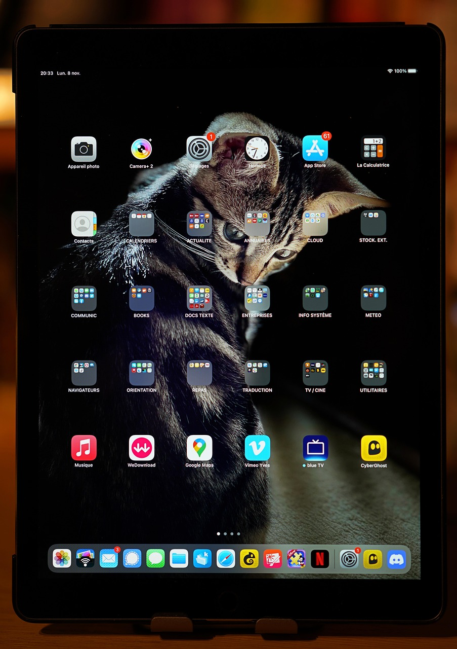
Time Management Apps
RescueTime
Focus@Will
Tracks time spent on tasks and activities.
Helps users understand their productivity patterns.
Provides background music to help students focus.
Uses scientifically designed soundtracks to enhance concentration.
Todoist
Trello
A task management app with prioritization and scheduling features.
Allows users to organize tasks efficiently and set reminders.
A project management tool with boards, lists, and cards.
Enables collaboration and visualization of workflows.
9
Gestión del Tiempo y Herramientas Digitales para el Éxito Académico y Personal

Slide 10

Staying Focused
01
Pomodoro Technique
Use the Pomodoro Technique: work in focused 25-minute increments.
This method helps maintain concentration and productivity.
02
Regular Breaks
Take regular breaks to avoid burnout.
Short pauses can refresh your mind and improve efficiency.
03
Minimize Distractions
Minimize distractions: turn off notifications, log out of social media.
This ensures a more focused and uninterrupted work session.
04
Website Blockers
Use a website blocker: StayFocusd, LeechBlock.
These tools help you avoid time-wasting websites and stay on track.
10
Gestión del Tiempo y Herramientas Digitales para el Éxito Académico y Personal

Slide 11

Collaborative Time Management
01
Utilize Project Management Tools
Use project management software: Asana, Basecamp.
These tools help streamline task allocation and progress tracking.
02
Shared Calendars for Coordination
Create a shared calendar: Google Calendar, Apple Calendar.
This ensures everyone is aware of key dates and deadlines.
03
Task Assignment and Deadlines
Assign tasks and deadlines: Trello, Todoist.
This promotes accountability and clarity within the team.
04
Effective Team Communication
Communicate with team members: Slack, email.
These platforms facilitate seamless collaboration and updates.
11
Gestión del Tiempo y Herramientas Digitales para el Éxito Académico y Personal

Slide 12

Reflection and Self-Assessment
Reflecting on Time Management
Identifying Improvement Areas
Reflect on time management habits and goals.
Consider how effectively you have been using your time and what changes might be necessary.
Identify areas for improvement.
Pinpoint specific habits or practices that could be optimized for better time management.
Setting New Goals
Adjusting Strategies
Set new goals and priorities.
Define clear objectives to align your time management with your personal and professional aspirations.
Adjust time management strategy as needed.
Adapt your approach to better meet your evolving needs and circumstances.
12
Gestión del Tiempo y Herramientas Digitales para el Éxito Académico y Personal

Slide 13
Digital Citizenship
Online Safety and Etiquette
Responsible Technology Use
Online safety involves protecting personal information and being cautious about sharing sensitive data.
Etiquette online includes respectful communication and avoiding harmful or offensive behavior.
Responsible technology use means utilizing devices and platforms in a way that benefits oneself and others.
It also includes understanding the impact of excessive screen time and balancing digital activities with offline life.
Cyberbullying Prevention
Digital Footprint Management
Preventing cyberbullying requires awareness of its signs and taking steps to support victims.
It also involves promoting kindness and standing against harassment in digital spaces.
Managing one's digital footprint includes being mindful of the content shared online.
It also involves understanding how online actions can affect personal and professional reputation.
13
Gestión del Tiempo y Herramientas Digitales para el Éxito Académico y Personal

Slide 14

Common Time Management Mistakes
01
Procrastination
03
Poor Prioritization
Procrastination is a common pitfall in time management.
It often leads to missed deadlines and increased stress.
Failing to prioritize tasks effectively can lead to wasted time.
Important tasks may be overlooked in favor of less critical ones.
02
Multitasking
04
Inadequate Scheduling
Multitasking can reduce overall productivity.
It often results in errors and incomplete tasks.
Inadequate scheduling can disrupt workflow and cause delays.
It often results in a lack of clarity and direction in daily activities.
14
Gestión del Tiempo y Herramientas Digitales para el Éxito Académico y Personal

Slide 15
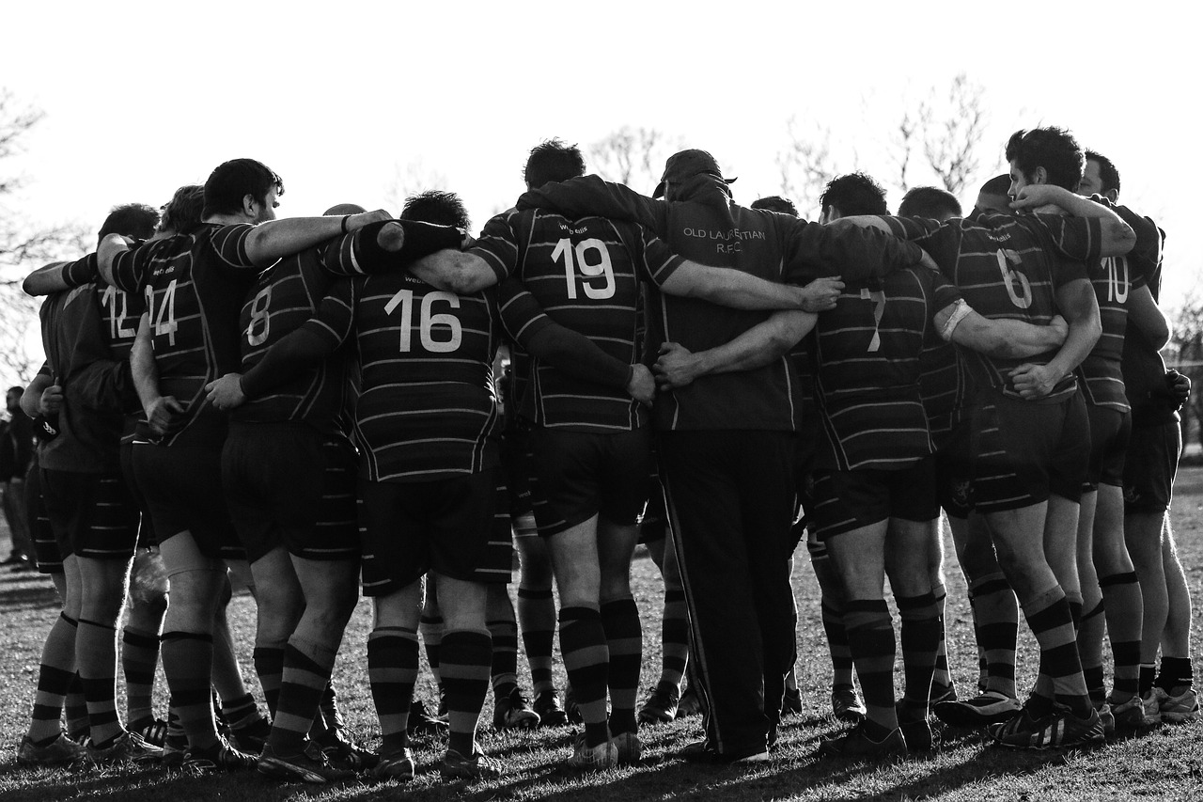
Overcoming Obstacles
Identifying Obstacles
Developing Strategies
Recognize common challenges such as procrastination, distractions, and lack of motivation.
Understanding these barriers is the first step to overcoming them effectively.
Break tasks into smaller, manageable chunks and use tools like timers to stay focused.
Implement a reward system to maintain motivation and track progress.
Seeking Support
Reviewing and Adjusting
Reach out to friends, family, or teachers for encouragement and guidance.
Building a support network can provide accountability and emotional strength.
Regularly evaluate the effectiveness of your strategies and make necessary adjustments.
Flexibility ensures continuous improvement in overcoming obstacles.
15
Gestión del Tiempo y Herramientas Digitales para el Éxito Académico y Personal

Slide 16
Conclusion
Importance of Time Management
Role of Digital Tools
Applying Learned Skills
Effective time management is crucial for academic success and personal productivity.
It enables students to achieve their goals and maintain a balanced lifestyle.
Digital tools and strategies can help students prioritize tasks and manage their time more efficiently.
These tools provide structured approaches to handle academic and personal responsibilities.
By applying the skills and knowledge learned in this lesson, students can improve their time management and efficiency.
This empowers them to make the most of their time and achieve better results.
16
Gestión del Tiempo y Herramientas Digitales para el Éxito Académico y Personal

Slide 17
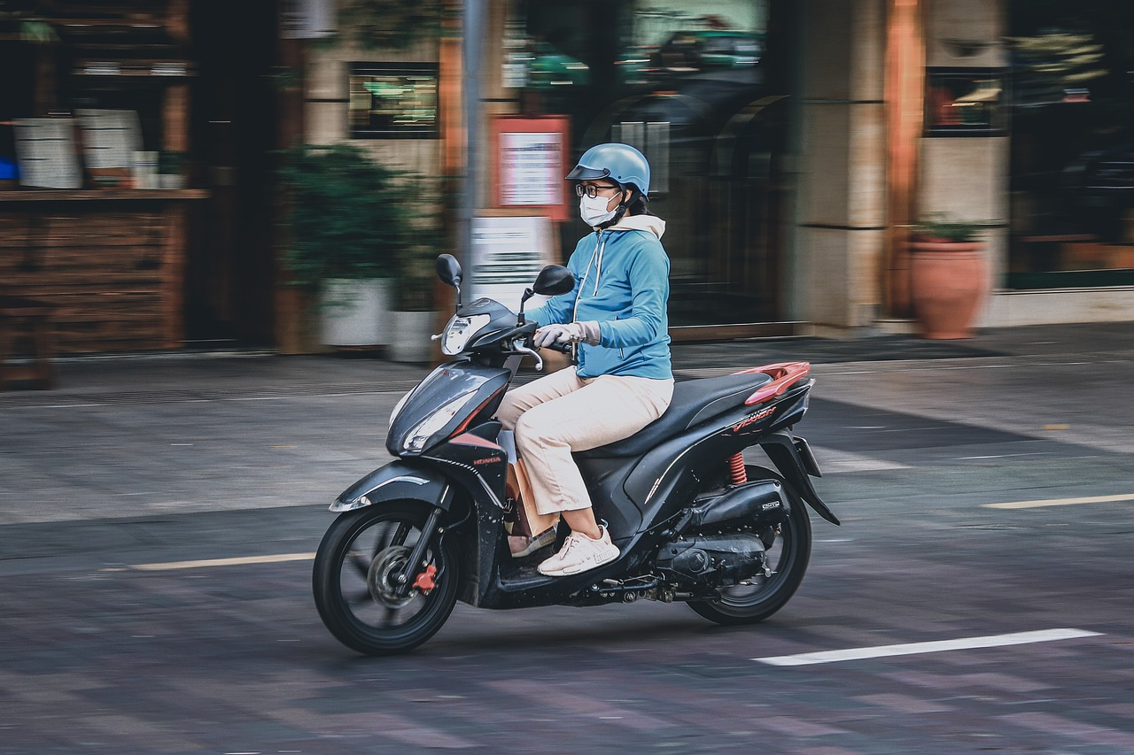
Next Steps
Applying Skills to Daily Life
Exploring New Digital Tools
Sharing Knowledge with Others
Apply the skills and knowledge learned in this lesson to daily life.
This ensures practical implementation and continuous improvement.
Continue to explore and learn about new digital tools and strategies.
This fosters adaptability and keeps you updated with technological advancements.
Share knowledge and skills with others: friends, family, peers.
This promotes collaboration and collective growth.
17
Gestión del Tiempo y Herramientas Digitales para el Éxito Académico y Personal

Slide 18

Additional Resources
Online Tutorials and Guides
Explore platforms like YouTube, Udemy, and Coursera for a variety of tutorials.
These resources cover diverse topics to enhance your skills and knowledge.
Time Management Tools
Utilize apps like RescueTime, Todoist, and Trello to organize your tasks.
These tools help in tracking productivity and managing time effectively.
Books and Articles
Read 'The 7 Habits of Highly Effective People' and 'Getting Things Done' for insights.
These books provide strategies to improve personal and professional efficiency.
Websites and Blogs
Visit Lifehacker, Productivityist, and Time Management Ninja for practical tips.
These platforms offer advice on improving productivity and managing time.
18
Gestión del Tiempo y Herramientas Digitales para el Éxito Académico y Personal

Slide 19
Final Thoughts
Developing Time Management Skills
Leveraging Digital Tools
Achieving Goals and Well-Being
Time management is a skill that can be developed and improved with practice and patience.
It requires consistent effort and a willingness to adapt strategies over time.
Digital tools and strategies can help students prioritize tasks and manage their time more efficiently.
These tools provide structure and support for better organization.
By applying the skills and knowledge learned in this lesson, students can achieve their goals and improve their overall well-being.
This approach fosters both personal and academic success.
19
Gestión del Tiempo y Herramientas Digitales para el Éxito Académico y Personal

Slide 20

Assessment and Evaluation
Quiz or Test
Project or Assignment
Quiz or test to assess understanding of time management concepts.
This helps in gauging the theoretical grasp of the subject.
Project or assignment to apply time management skills.
It provides a practical approach to implementing learned strategies.
Self-Assessment and Reflection
Peer Assessment and Feedback
Self-assessment and reflection to evaluate progress and identify areas for improvement.
This encourages personal growth and self-awareness.
Peer assessment and feedback to evaluate teamwork and collaboration.
It fosters mutual understanding and collective improvement.
20
Gestión del Tiempo y Herramientas Digitales para el Éxito Académico y Personal

Slide 21

Conclusion and Final Thoughts
Importance of Time Management
Role of Digital Tools
Achieving Goals and Well-being
Effective time management is crucial for academic success and personal productivity.
It enables students to allocate their time effectively and focus on their priorities.
Digital tools and strategies can help students prioritize tasks and manage their time more efficiently.
These tools provide a structured approach to organizing and tracking academic responsibilities.
By applying the skills and knowledge learned in this lesson, students can achieve their goals and improve their overall well-being.
This approach fosters a balanced lifestyle and enhances personal growth.
21
Gestión del Tiempo y Herramientas Digitales para el Éxito Académico y Personal

