Slide 1

Japan under the Tokugawa Shogunate: Isolation, Society, and Modernization
Exploring the Impact of Foreign Policy from Sakoku to the Meiji Restoration

Slide 2
Japan under the Tokugawa Shogunate: Isolation, Society, and Modernization
2
Table of Contents
Introduction to Japan under the Shogun
The Tokugawa Shogunate's Foreign Policy
Key Events and Factors
Impact on Japanese Society
Modernization and Westernization
Historical Significance
Contemporary Relevance
Conclusion
Assessment and Evaluation
Extension Activities
Resources and References
Parent Engagement
Reflection and Evaluation
04
05
06
07
08
09
10
11
12
13
14
15
16

Slide 3
Japan under the Tokugawa Shogunate: Isolation, Society, and Modernization
3
Table of Contents
Next Steps
Conclusion and Final Thoughts
References and Bibliography
17
18
19

Slide 4
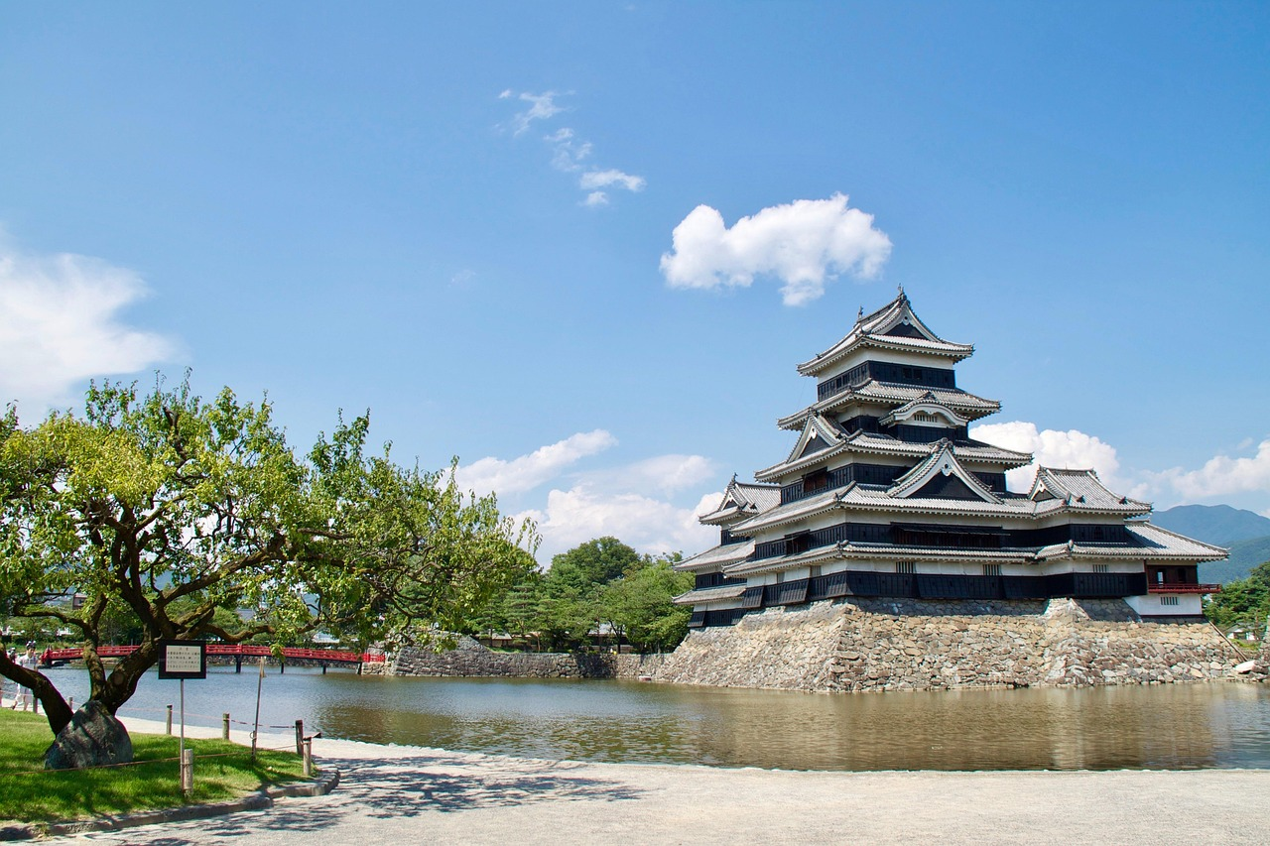
Japan under the Tokugawa Shogunate: Isolation, Society, and Modernization
4
Introduction to Japan under the Shogun
The Era of the Tokugawa Shogunate
Social Hierarchy and Isolationism
A Time of Peace and Stability
Japan under the shogun refers to the period of Japanese history from 1603 to 1868.
During this time, the country was ruled by the Tokugawa Shogunate, a feudal military government.
The Tokugawa Shogunate maintained power through a strict social hierarchy.
It also implemented an isolationist foreign policy to limit contact with the outside world.
This period is significant in Japanese history for its relative peace and stability.
However, it also marked a time of limited interaction with other nations.

Slide 5

Japan under the Tokugawa Shogunate: Isolation, Society, and Modernization
5
The Tokugawa Shogunate's Foreign Policy
Isolationism Under Sakoku
Restricted Contact with the World
The Tokugawa Shogunate's foreign policy was marked by sakoku, a period of isolationism lasting from 1633 to 1853.
This policy aimed to prevent the spread of Christianity and consolidate the shogunate's power.
Sakoku limited Japan's interaction with the outside world, including trade and cultural exchange.
This isolation was a deliberate effort to control foreign influence and maintain domestic stability.
Trade Exceptions for Dutch and Chinese
Impact of Sakoku on Japan
Despite the isolation, the Dutch and Chinese were permitted to trade with Japan.
Their trade was strictly confined to the port of Nagasaki, ensuring controlled foreign interaction.
The sakoku policy shaped Japan's development by minimizing external influences.
This isolation allowed the Tokugawa Shogunate to focus on internal governance and societal order.

Slide 6
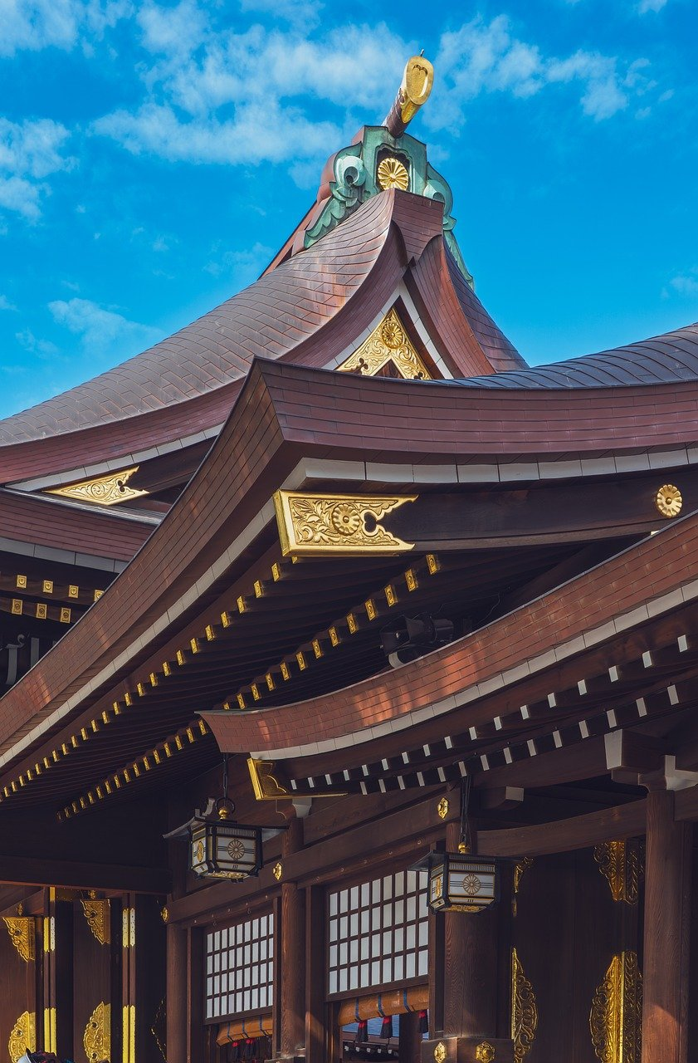
Japan under the Tokugawa Shogunate: Isolation, Society, and Modernization
6
Key Events and Factors
Commodore Perry's Arrival
The Meiji Restoration
The arrival of Commodore Matthew Perry in 1853 marked a significant turning point in Japan's foreign policy.
This event led to the signing of the Treaty of Kanagawa and the eventual opening of Japan to the world.
The Meiji Restoration of 1868 led to the collapse of the Tokugawa Shogunate.
It also initiated the modernization of Japan, transforming its political and social structures.
Internal Influences on Policy
Implications of Policy Changes
The Tokugawa Shogunate's foreign policy was influenced by internal factors, such as the growing influence of the Meiji faction.
There was also a need to balance national interests with international obligations.
The policy had significant social, economic, and cultural implications for Japan.
These included the modernization of the country and the emergence of new social classes.

Slide 7
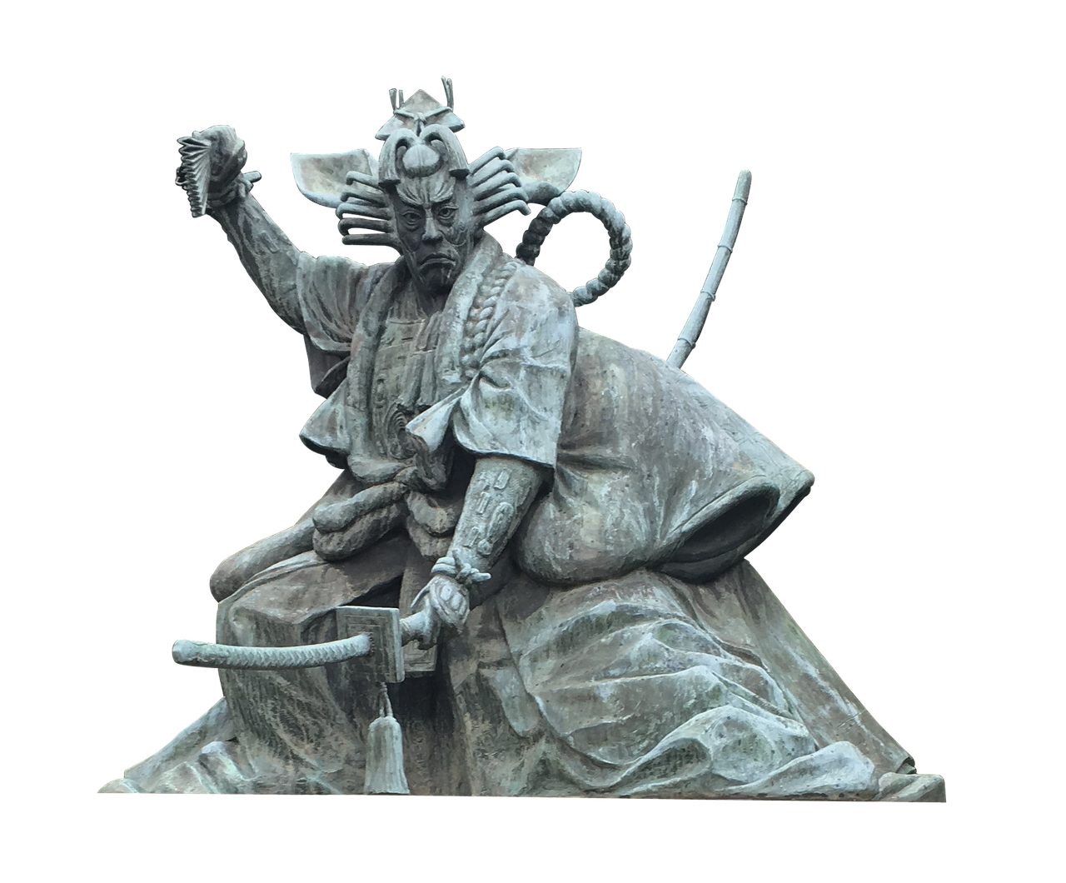
Japan under the Tokugawa Shogunate: Isolation, Society, and Modernization
7
Impact on Japanese Society
Isolation and Cultural Preservation
Urban and Technological Growth
Social Hierarchy and Economic Shifts
The Tokugawa Shogunate's foreign policy had a significant impact on Japanese society, including the limitation of contact with the outside world.
This policy preserved traditional Japanese culture.
The policy also led to the growth of urban centers, such as Edo (modern-day Tokyo).
It spurred the development of new technologies and industries.
The social hierarchy of Japan was also affected, with the samurai class maintaining power and influence.
Meanwhile, the merchant class grew in wealth and importance.

Slide 8
Japan under the Tokugawa Shogunate: Isolation, Society, and Modernization
8
Modernization and Westernization
Adoption of Western Practices
Economic Growth and Global Power
Diplomatic Relations and International Participation
The Meiji Restoration marked the beginning of Japan's modernization and Westernization, as the country adopted Western technologies, institutions, and values.
This transformation laid the foundation for Japan's rapid development and integration into the global community.
The modernization of Japan led to significant economic growth and the emergence of Japan as a major world power.
This economic transformation was pivotal in establishing Japan's influence on the international stage.
The country's foreign policy became more outward-looking, with Japan establishing diplomatic relations with Western countries.
Japan also began participating in international organizations, reflecting its growing role in global affairs.

Slide 9
Japan under the Tokugawa Shogunate: Isolation, Society, and Modernization
9
Historical Significance
Preservation and Urban Growth
Modernization and Global Influence
Modernization and Global Influence
The Tokugawa Shogunate's foreign policy has significant historical importance, as it marked a period of relative peace and stability in Japan, but also limited contact with the outside world.
This policy shaped Japan's historical trajectory by fostering internal development while isolating it from global influences.
The policy's impact on Japanese society, including the preservation of traditional culture and the growth of urban centers, is still evident today.
This dual effect contributed to a unique blend of traditional and urbanized societal structures in Japan.
The modernization of Japan following the Meiji Restoration has had a lasting impact on the country's economy, politics, and culture.
This transformation continues to shape Japan's place in the world today, highlighting its adaptability and global significance.

Slide 10

Japan under the Tokugawa Shogunate: Isolation, Society, and Modernization
10
Contemporary Relevance
Insights into International Relations
The study of the Tokugawa Shogunate's foreign policy has contemporary relevance, as it provides insights into the complexities of international relations and the challenges of cultural exchange.
This historical perspective helps in understanding the dynamics of global interactions and the importance of balancing domestic and international priorities.
Impact of Modernization and Westernization
Japan's modernization and Westernization have had a lasting impact on the country's economy, politics, and culture.
These transformations continue to shape Japan's place in the world today, influencing its global identity and interactions.
Historical Legacy in Foreign Policy
The country's foreign policy continues to be influenced by its historical experiences, including the legacy of the Tokugawa Shogunate.
The impact of the Meiji Restoration also plays a significant role in shaping Japan's diplomatic strategies and international relations.

Slide 11

Japan under the Tokugawa Shogunate: Isolation, Society, and Modernization
11
Conclusion
Impact of Tokugawa Shogunate's Foreign Policy
Insights from Historical Analysis
In conclusion, the Tokugawa Shogunate's foreign policy was a complex and multifaceted phenomenon that had significant impacts on Japanese society and the country's place in the world.
The study of this period provides valuable insights into the complexities of international relations, cultural exchange, and the challenges of modernization and Westernization.
The Tokugawa era offers a lens to understand the intricate dynamics of isolation and engagement with the global community.
This historical period underscores the enduring relevance of balancing tradition with the pressures of external influence.

Slide 12

Japan under the Tokugawa Shogunate: Isolation, Society, and Modernization
12
Assessment and Evaluation
Understanding Tokugawa Shogunate's Foreign Policy
Diverse Assessment Tasks
Critical Thinking and Historical Connections
Communication and Collaboration Skills
Students will be assessed on their understanding of the Tokugawa Shogunate's foreign policy.
They will explore its impact on Japanese society.
The assessment will include a range of tasks, such as source analysis, essay writing, and presentations.
These tasks aim to evaluate students' comprehensive understanding of the topic.
Students will be evaluated on their ability to think critically.
They must make connections between the historical context and contemporary issues.
The assessment will evaluate students' ability to communicate effectively.
It will also assess their capacity to work collaboratively.

Slide 13

Japan under the Tokugawa Shogunate: Isolation, Society, and Modernization
13
Extension Activities
Multimedia Presentation on Foreign Policy Significance
Debate or Role-Play on Historical Negotiations
Debate or Role-Play on Historical Negotiations
Students can conduct further research on the Tokugawa Shogunate's foreign policy and its impact on Japanese society.
This activity allows students to delve deeper into historical contexts and understand the broader implications of isolationist policies.
Students can create a multimedia presentation, such as a video or podcast, that explores the significance of the Tokugawa Shogunate's foreign policy.
This creative approach helps students engage with the material in an interactive and modern format.
Students can participate in a debate or role-play activity that simulates the negotiations between the Tokugawa Shogunate and Western powers.
This activity encourages critical thinking and helps students understand the complexities of historical diplomacy.

Slide 14

Japan under the Tokugawa Shogunate: Isolation, Society, and Modernization
14
Resources and References
Research Resources for Tokugawa Shogunate
Support from the Australian Curriculum
Online Resources for Primary Sources
Students can use a range of resources, including textbooks, academic articles, and primary sources, to research the Tokugawa Shogunate's foreign policy.
These resources provide a comprehensive understanding of historical contexts and policy decisions.
The Australian Curriculum provides a range of resources and support materials for teaching and learning about the Tokugawa Shogunate's foreign policy.
These materials are designed to enhance students' knowledge and engagement with historical studies.
Students can also use online resources, such as the Japanese Ministry of Foreign Affairs website, to access primary sources and information about Japan's foreign policy.
These online platforms offer direct access to historical documents and insights into Japan's diplomatic history.

Slide 15
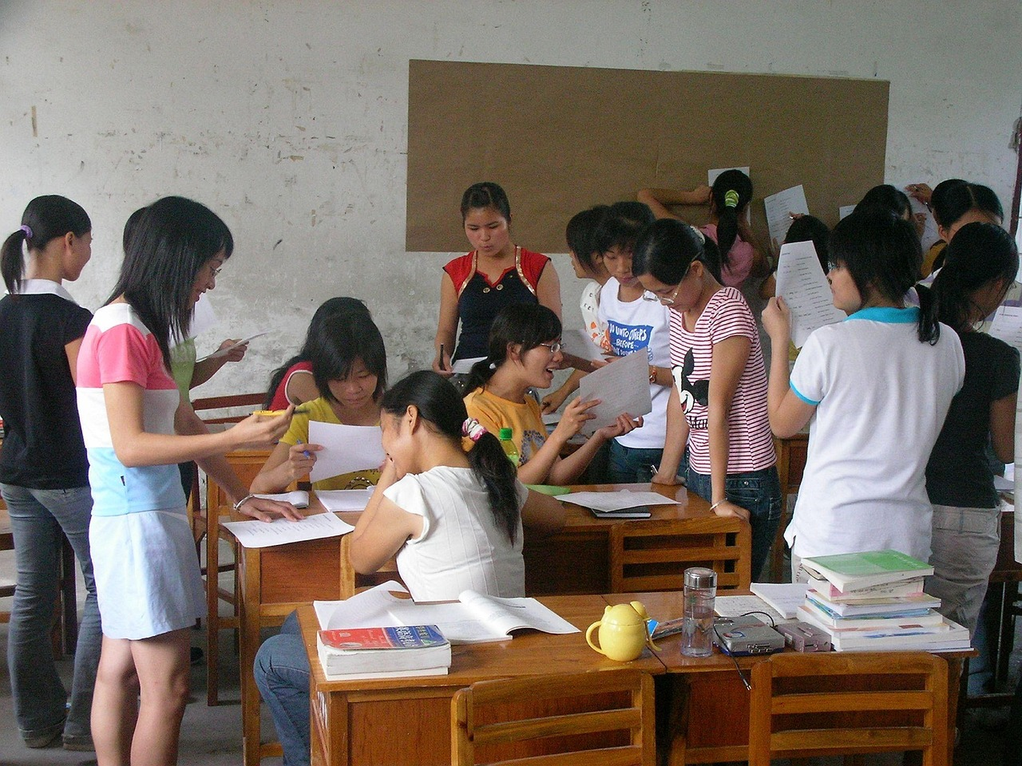
Japan under the Tokugawa Shogunate: Isolation, Society, and Modernization
15
Parent Engagement
Encouraging Critical Thinking
Facilitating Discussions and Debates
Collaborating with Schools
Parents can support their child's learning by encouraging them to ask questions and think critically about the Tokugawa Shogunate's foreign policy.
This approach fosters a deeper understanding and engagement with historical concepts.
Parents can provide opportunities for their child to engage in discussions and debates about the significance of the Tokugawa Shogunate's foreign policy.
Such activities help children develop communication and analytical skills.
The school can provide parents with regular updates and progress reports on their child's learning.
Parents are invited to attend parent-teacher conferences and other events to stay involved.

Slide 16

Japan under the Tokugawa Shogunate: Isolation, Society, and Modernization
16
Reflection and Evaluation
Student Self-Reflection
Teacher Evaluation of Lesson Effectiveness
School-Level Impact Assessment
Students can reflect on their learning by completing a self-assessment task, such as a reflective journal or a self-assessment rubric.
This allows them to critically analyze their understanding and progress.
The teacher can evaluate the effectiveness of the lesson by collecting feedback from students and observing their participation and engagement.
This helps in identifying areas for improvement and ensuring better learning outcomes.
The school can evaluate the impact of the lesson on student learning outcomes, such as improved understanding of the Tokugawa Shogunate's foreign policy and its significance.
This provides a broader perspective on the lesson's success and its contribution to educational goals.

Slide 17

Japan under the Tokugawa Shogunate: Isolation, Society, and Modernization
17
Next Steps
Exploring the Meiji Restoration
Student Research Opportunities
Critical Thinking and Connections
The next step in the lesson is to explore the Meiji Restoration and the modernization of Japan.
This period marked significant changes in Japanese society and governance.
Students can conduct further research on the Meiji Restoration and its impact on Japanese society.
This will help them gain a deeper understanding of the historical transformations.
The teacher can provide opportunities for students to think critically and make connections between the historical context and contemporary issues.
This approach encourages students to relate past events to modern-day scenarios.

Slide 18

Japan under the Tokugawa Shogunate: Isolation, Society, and Modernization
18
Conclusion and Final Thoughts
Impact of Tokugawa Shogunate's Foreign Policy
Insights from Historical Analysis
In conclusion, the Tokugawa Shogunate's foreign policy was a complex and multifaceted phenomenon that had significant impacts on Japanese society and the country's place in the world.
The study of this period provides valuable insights into the complexities of international relations, cultural exchange, and the challenges of modernization and Westernization.
The Tokugawa era offers a lens to understand the intricate dynamics of isolation and engagement in shaping a nation's identity.
It underscores the enduring relevance of historical foreign policies in informing contemporary global interactions.

Slide 19
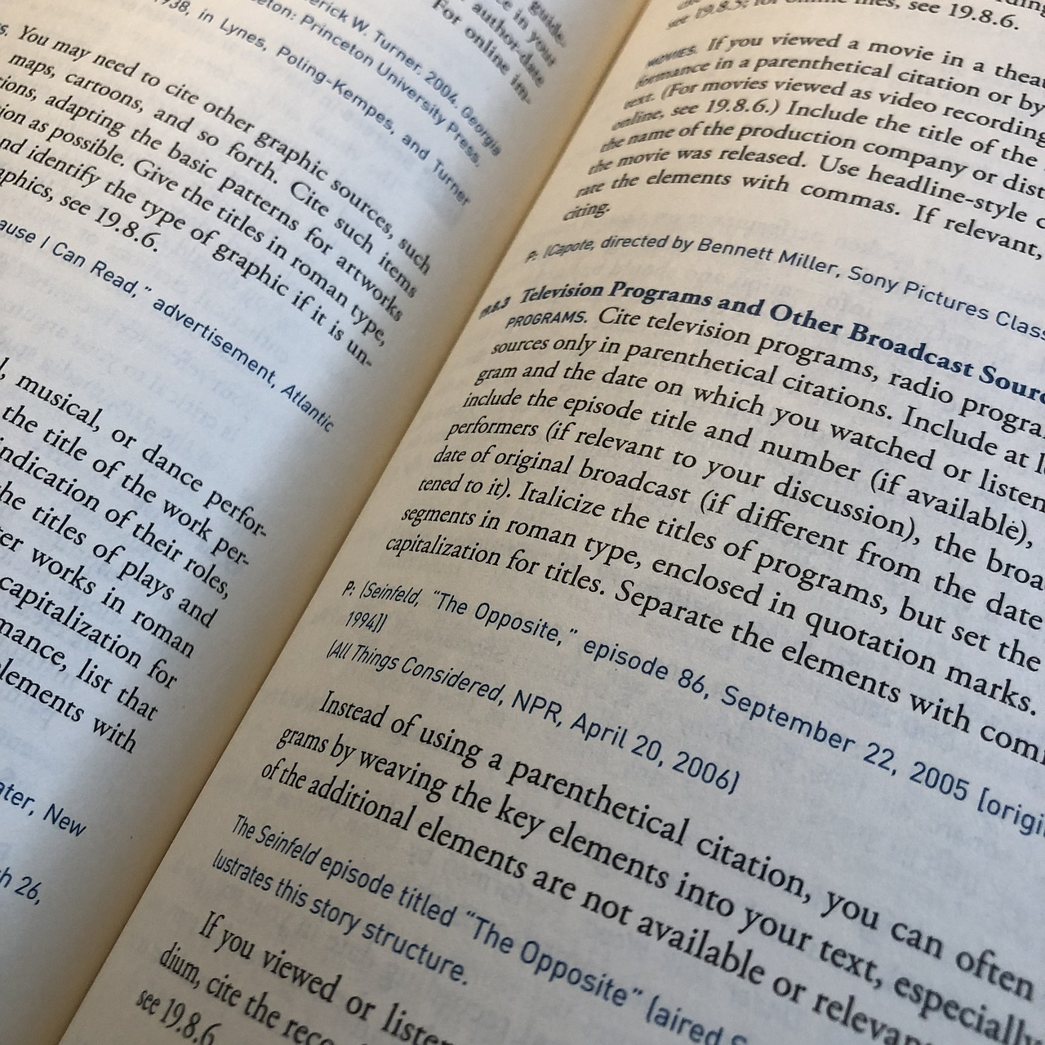
Japan under the Tokugawa Shogunate: Isolation, Society, and Modernization
19
References and Bibliography
Australian Curriculum Reference
The Australian Curriculum. (2019). History.
Retrieved from <https://www.australiancurriculum.edu.au/f-10-curriculum/humanities-and-social-sciences/history/>
Japan's Foreign Policy Resource
Japan Ministry of Foreign Affairs. (n.d.). Japan's Foreign Policy.
Retrieved from <https://www.mofa.go.jp/policy/other/bluebook/>
Historical Insight on Japan
Totman, C. (2014). A History of Japan.
Wiley Blackwell.

