Slide 1


Exploring Village Dynamics: A Comprehensive Overview
An In-Depth Analysis of Historical, Cultural, Economic, and Social Aspects of Village Life

Slide 2
Table of contents
Introduction to Village Adoption
Historical Background of the Village
Geographical Features of the Village
Demographics of the Village
Cultural Heritage and Traditions
Economic Activities in the Village
Educational Facilities and Opportunities
Healthcare Services in the Village
Infrastructure and Utilities
Community Organizations and Leadership
Strengths and Weaknesses of the Village
Opportunities and Threats for Development
Comparing Village Life: Past vs Present
01
02
03
04
05
06
07
08
09
10
11
12
13

Slide 3
Table of contents
Political Environment and Governance
Economic Environment and Opportunities
Social Environment and Community Dynamics
Technological Advancements and Access
Environmental Factors and Sustainability
Legal Framework and Regulations
Summary and Future Prospects
14
15
16
17
18
19
20

Slide 4

Introduction to Village Adoption
Introduction to Village Adoption
Concept of Village Adoption
Significance of Village Adoption
Potential Impact on the Community
Exploring Village Dynamics: A Comprehensive Overview

Slide 5
Historical Background of the Village
Major Development
Cultural Shift
In 1905, the construction of the main road connected the village to nearby towns, facilitating trade and communication.
The 1990s saw a significant cultural shift as younger generations began to migrate to urban areas, leading to a decline in the village's population and a transformation in its social dynamics.
02
04
Founding Year
Population Growth
01
03
The village was established in 1800 by a group of settlers seeking fertile land and a community-oriented lifestyle.
By the 1950s, the village's population had increased to approximately 1,200 residents, driven by agricultural expansion and improved living conditions.
Exploring Village Dynamics: A Comprehensive Overview

Slide 6
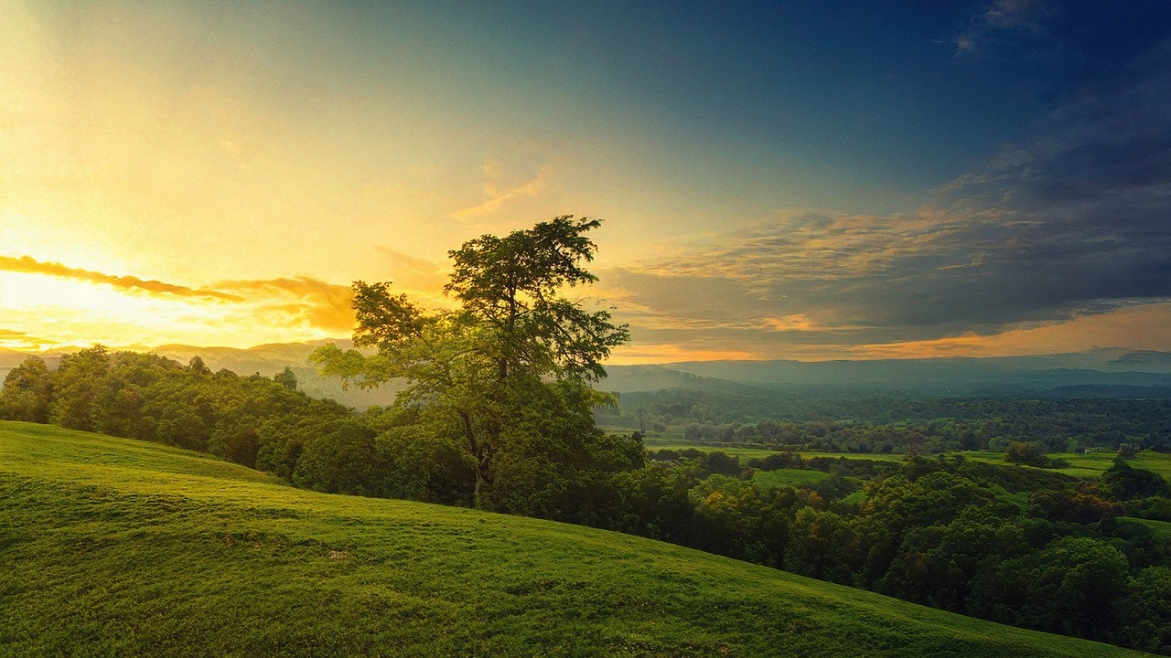
Geographical Features of the Village
01
02
03
Location and Accessibility
Landscape and Natural Resources
Climate
Situated in the foothills of Mount Olympus, the village is approximately 15 kilometers from the nearest town.
Accessible via a network of winding roads, making it a serene getaway for visitors.
Characterized by lush green valleys and flowing rivers, the village is surrounded by dense forests rich in biodiversity.
The area is known for its fertile soil, supporting agriculture, particularly olive and grape cultivation.
The village experiences a Mediterranean climate, with hot, dry summers and mild, wet winters.
Average annual rainfall is about 600 mm, contributing to the lush vegetation and agricultural productivity.
Exploring Village Dynamics: A Comprehensive Overview

Slide 7
Demographics of the Village
Total Population
Age Distribution
Gender Ratio
1,200
35%
52% Female, 48% Male
The village has a total population of 1,200 residents, reflecting a close-knit community with strong social ties.
A significant portion of the population, 35%, consists of children aged 0-14 years, indicating a youthful demographic that supports future growth and development.
The village exhibits a gender ratio of 52% female to 48% male, showcasing a balanced community structure that contributes to diverse social dynamics.
Exploring Village Dynamics: A Comprehensive Overview

Slide 8
Cultural Heritage and Traditions
01
02
03
04
Cultural Practices
Festivals
Traditional Attire
Local Cuisine
Emphasis on community gatherings and storytelling traditions that strengthen social bonds.
Annual Harvest Festival: Celebrated every September, attracting over 500 visitors, showcasing local music, dance, and crafts.
Distinctive clothing styles, such as the 'Fustanella' for men and 'Karagouna' for women, reflecting the village's historical roots.
Signature dishes include 'Moussaka' and 'Dolmades,' made from locally sourced ingredients, highlighting the village's agricultural heritage.
Exploring Village Dynamics: A Comprehensive Overview

Slide 9

Economic Activities in the Village
01
02
03
Agriculture
Handicrafts
Local Businesses
Crop Production: The village primarily cultivates olives and grapes, contributing to local and export markets.
Livestock Farming: Small-scale dairy and meat production, with an emphasis on traditional methods.
Artisanal Products: Local artisans create handmade pottery and textiles, reflecting the village's cultural heritage.
Market Presence: Handicrafts are sold at regional fairs, attracting tourists and supporting the local economy.
Family-owned Shops: Small grocery stores and cafes serve the community, providing essential goods and services.
Tourism Services: Bed and breakfasts and guided tours promote the village's natural beauty and historical sites, enhancing economic growth.
Exploring Village Dynamics: A Comprehensive Overview

Slide 10
Educational Facilities and Opportunities
Primary Education
Secondary Education
Higher Education Opportunities
Scholarship Programs
01
The village hosts a well-established primary school.
Catering to approximately 150 students.
Providing foundational education in a nurturing environment.
02
Following primary education, students can attend the local secondary school.
Serves around 100 students.
Offers a curriculum that includes both academic and vocational training.
03
For those seeking higher education, partnerships with nearby towns allow access to community colleges and universities.
An estimated 30% of graduates pursue further studies.
04
The village has initiated scholarship programs aimed at supporting talented students.
With an annual budget of $10,000, ensuring financial constraints do not hinder educational advancement.
Exploring Village Dynamics: A Comprehensive Overview

Slide 11

Healthcare Services in the Village
01
02
03
Healthcare Facilities
Availability of Medical Professionals
Common Health Issues
Local clinic with basic medical services
Pharmacy providing essential medications
One full-time doctor serving the village
Two nurses available for daily healthcare needs
High prevalence of respiratory infections (affecting 30% of the population)
Chronic conditions such as diabetes and hypertension noted in 25% of residents
Exploring Village Dynamics: A Comprehensive Overview

Slide 12

Infrastructure and Utilities
01
02
Roads and Transportation
Electricity Supply
Well-maintained access roads connecting the village to nearby towns.
Average road width: 3.5 meters, facilitating two-way traffic.
Reliable electricity provided by a local cooperative.
Coverage: 95% of households, with an average consumption of 150 kWh per month.
01
02
Water Supply
Sanitation Facilities
Main water source: a nearby river, treated and distributed through a network of pipes.
Daily water supply: approximately 200 liters per household.
Implementation of a community sewage system to ensure proper waste management.
Access to sanitation: 90% of households equipped with modern toilets.
Exploring Village Dynamics: A Comprehensive Overview

Slide 13

Community Organizations and Leadership
01
02
03
Local Governance Structure
Community Organizations
Key Leaders
The village is governed by a council consisting of 7 elected members.
Regular meetings are held monthly to discuss community issues and development plans.
Cultural Association of Village X
Focuses on preserving local traditions and organizing cultural events.
Engages over 100 members from various age groups.
Village Development Committee
Works on infrastructure projects and community welfare initiatives.
Mayor of Village X
Elected for a 4-year term, currently serving his second term.
Advocates for sustainable development and community engagement.
President of the Cultural Association
A local historian, actively involved in educational programs for youth.
Exploring Village Dynamics: A Comprehensive Overview

Slide 14
Strengths and Weaknesses of the Village
Strengths
Weaknesses
Strong community spirit with over 80% of residents participating in local events and initiatives, fostering a sense of belonging and collaboration.
Limited access to healthcare facilities, with the nearest hospital located 30 kilometers away, impacting residents' health and well-being.
SW
OT
Opportunities
Threats
Potential for eco-tourism development, leveraging the village's natural beauty and cultural heritage to attract visitors and boost the local economy.
Increasing depopulation trend, with a 15% decline in the population over the last decade, posing challenges for community sustainability and local services.
Exploring Village Dynamics: A Comprehensive Overview

Slide 15
Opportunities and Threats for Development
Strengths
Weaknesses
Strong community ties and cultural heritage that foster collaboration and support among villagers.
Limited access to modern infrastructure and technology, which can hinder economic growth and development.
SW
OT
Opportunities
Threats
Potential for eco-tourism development, leveraging the village's natural beauty and cultural uniqueness to attract visitors and generate income.
Risk of depopulation as younger generations migrate to urban areas for better job opportunities, leading to a decline in local workforce and community vitality.
Exploring Village Dynamics: A Comprehensive Overview

Slide 16
Comparing Village Life: Past vs Present
Past Village Life
Present Village Life
Traditional agricultural practices dominated, with most families relying on subsistence farming.
Community gatherings were frequent, fostering strong social ties.
Limited access to modern technology; reliance on manual tools and natural resources.
Communication was primarily face-to-face or through letters.
Increased diversification in occupations, with many villagers engaging in tourism, crafts, and remote work.
Social interactions are often facilitated through digital platforms.
Widespread use of smartphones and the internet, enhancing connectivity and access to information.
Modern farming techniques and machinery have improved productivity and efficiency.
Exploring Village Dynamics: A Comprehensive Overview

Slide 17

Political Environment and Governance
Political
Local Governance Structure: The village is governed by a council consisting of elected representatives from various community sectors, ensuring that local voices are heard in decision-making processes.
Exploring Village Dynamics: A Comprehensive Overview

Slide 18
Economic Environment and Opportunities
Political
Local Governance Support: The village benefits from a stable local government that encourages community development initiatives, providing grants and resources for small businesses.
Exploring Village Dynamics: A Comprehensive Overview

Slide 19

Social Environment and Community Dynamics
Political
The village operates under a local governance system that encourages community participation.
Recent elections saw a voter turnout of 75%, indicating strong civic engagement among residents.
Exploring Village Dynamics: A Comprehensive Overview

Slide 20
Technological Advancements and Access
Political
Government Initiatives: Local government policies promoting digital literacy and infrastructure development have led to increased access to technology in villages, with initiatives like subsidized internet services.
Exploring Village Dynamics: A Comprehensive Overview

Slide 21
Environmental Factors and Sustainability
Political
The local government has implemented policies promoting sustainable agricultural practices, encouraging farmers to adopt organic methods.
This has led to a 30% increase in organic crop production over the past five years.
Exploring Village Dynamics: A Comprehensive Overview

Slide 22

Legal Framework and Regulations
Political
Local Governance: The village operates under the jurisdiction of local government regulations, which dictate land use, zoning laws, and community development initiatives. For example, the village council must approve any new construction projects, ensuring they align with regional planning policies.
Exploring Village Dynamics: A Comprehensive Overview

Slide 23
Summary and Future Prospects
Village Identity and Culture
Demographic Trends
Economic Development
The presentation highlighted the unique cultural heritage of the village, showcasing its traditions, festivals, and local customs that foster community spirit.
Key demographic shifts were discussed, revealing a population of approximately 1,200 residents, with a notable increase in younger families moving to the area.
The village's economic landscape was examined, emphasizing the growth of local businesses and the potential for sustainable tourism to enhance economic stability.
Community Engagement
Future Prospects
Active participation in community initiatives was identified as a crucial factor for village cohesion, with over 75% of residents involved in local decision-making processes.
Looking ahead, the village aims to implement eco-friendly practices and infrastructure improvements, with a goal of increasing green spaces by 30% over the next five years.
Exploring Village Dynamics: A Comprehensive Overview

