Slide 1
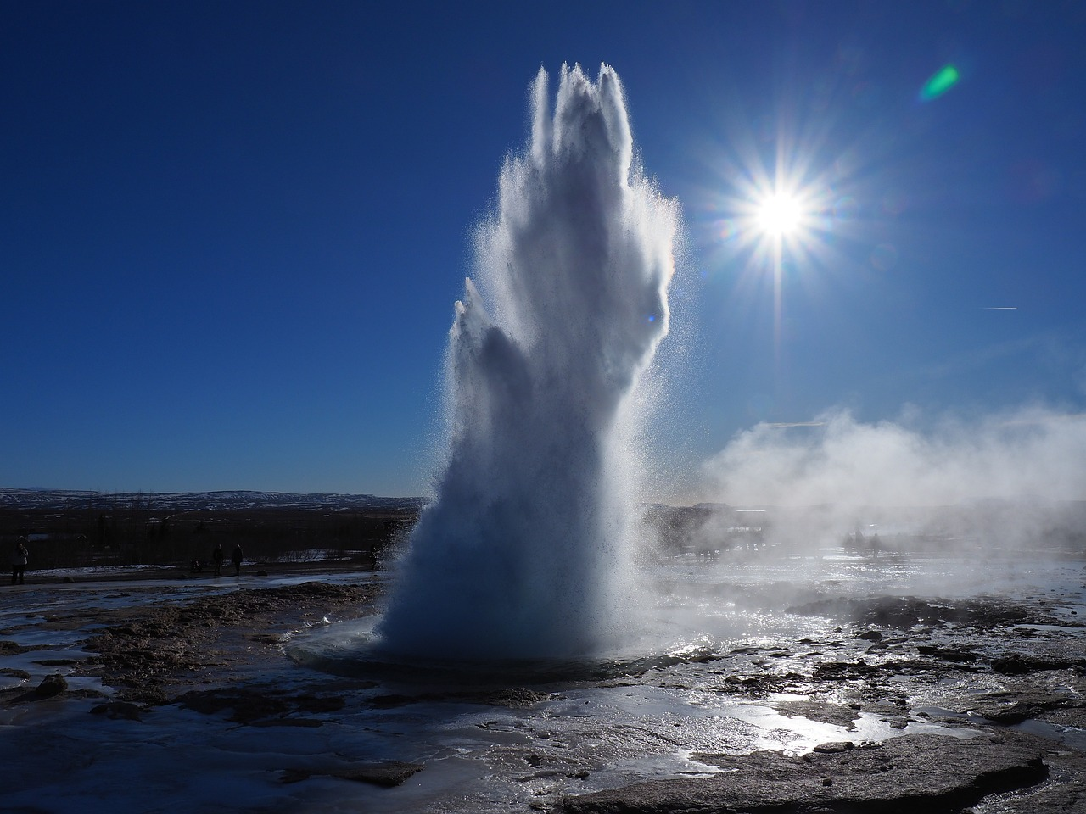
Explorando las Fuentes y Usos del Agua en Nuestra Comunidad
Comprendiendo la Conservación, el Ciclo del Agua y la Importancia del Agua para un Futuro Sostenible

Slide 2
Table of Contents
Introduction to Exploring Water Sources and Us…
What is Water Conservation?
Water Sources
The Water Cycle
Water Uses in the Community
Importance of Water Conservation
Water Filtration Experiment
Guided Practice: Water Source Sorting
Independent Practice: Water Use Drawing
Extension Task: Design a Water Conservation Po…
ELL Support: Vocabulary Building
Special Needs Adaptation: Tactile Water Cycle
Conclusion
04
05
06
07
08
09
10
11
12
13
14
15
16

Slide 3
Table of Contents
Assessment and Feedback
Next Steps
Reflection Questions
Teaching Tips
Key Takeaways
17
18
19
20
21

Slide 4
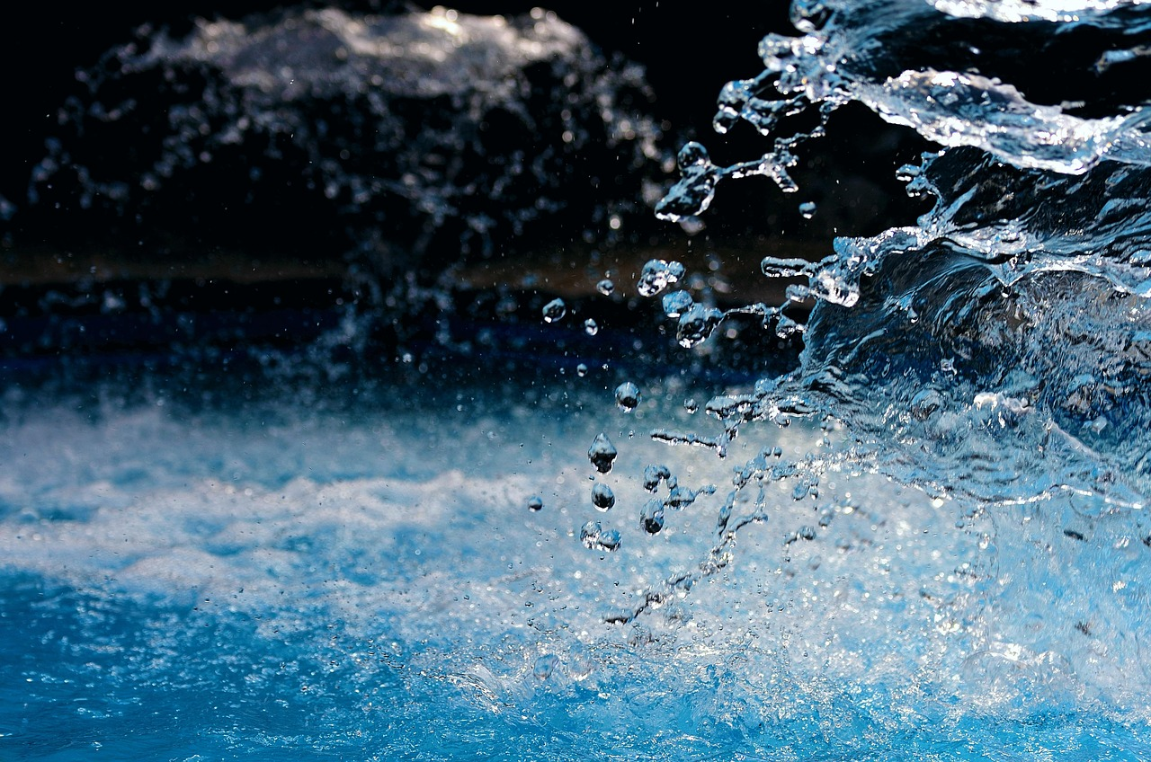
Introduction to Exploring Water Sources and Uses
Welcome to Our Lesson
Interactive Learning Activities
Importance of Water Conservation
Welcome to our lesson on exploring water sources and uses in our community!
Today, we will learn about the different sources of water, how water is used, and why it's essential to conserve water.
We will have fun activities, discussions, and experiments.
These will help us understand this important topic.
Understanding water sources and uses is crucial for our community.
Conserving water ensures sustainability for future generations.
4
Explorando las Fuentes y Usos del Agua en Nuestra Comunidad

Slide 5
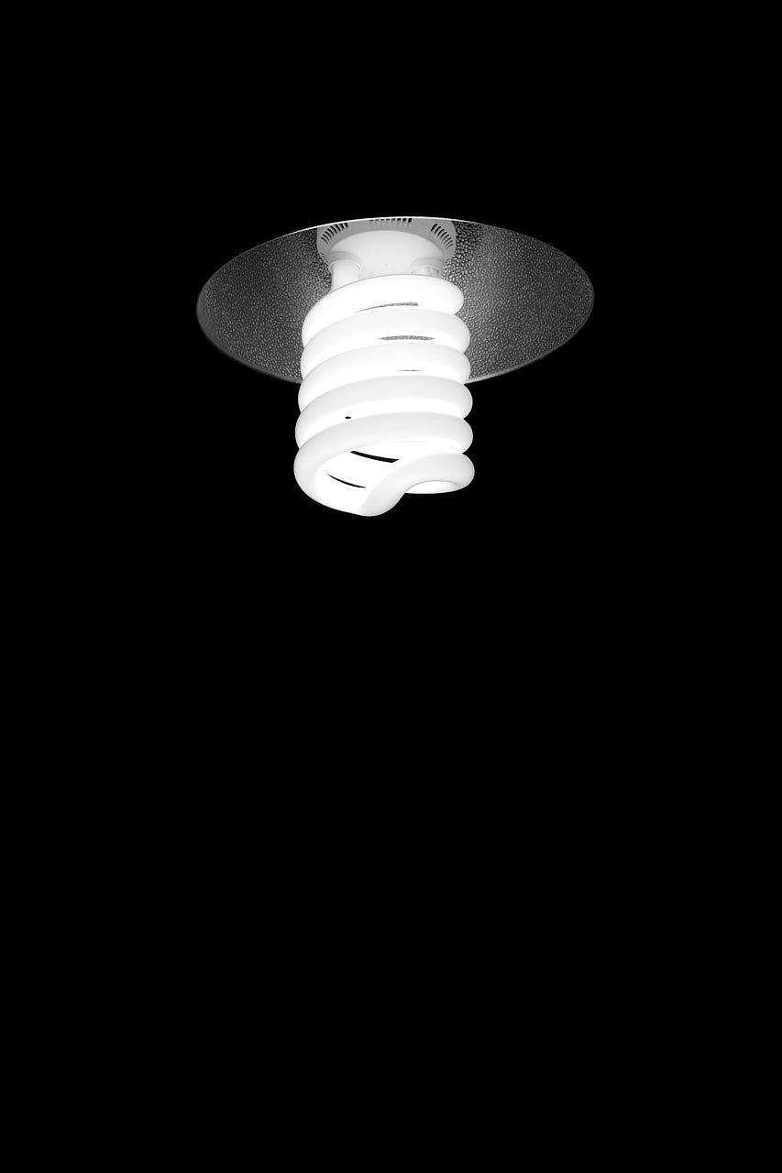
What is Water Conservation?
Understanding Water Conservation
Ways to Conserve Water
Water conservation is the practice of using water efficiently to reduce waste and protect this vital resource.
It is essential for ensuring the sustainability of water for future generations.
We can conserve water by fixing leaks, using water-efficient appliances, and reducing water usage during daily activities.
These actions help minimize water waste and promote responsible usage.
5
Explorando las Fuentes y Usos del Agua en Nuestra Comunidad

Slide 6
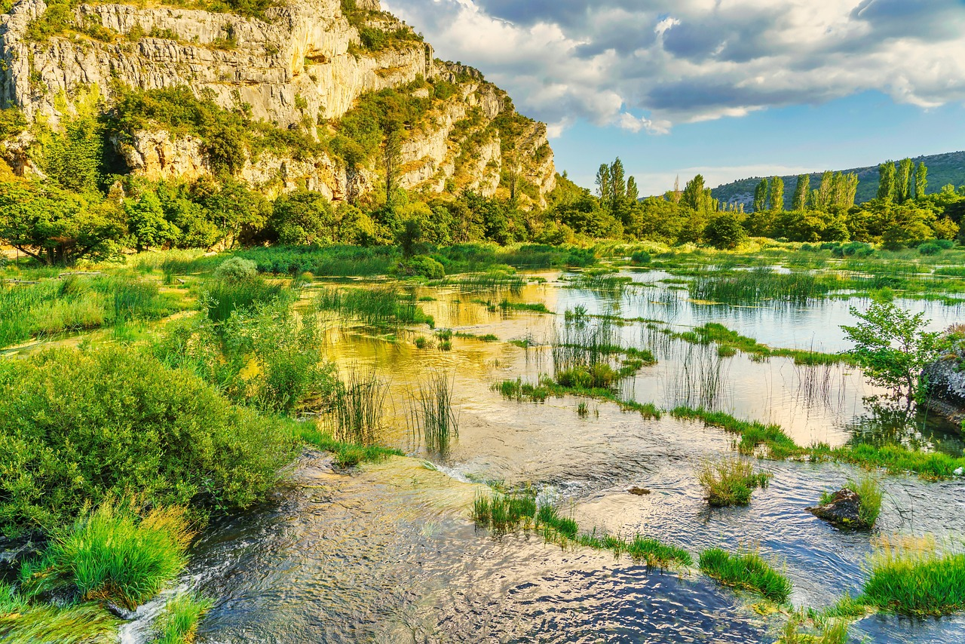
Water Sources
Rivers
Lakes
Rivers are natural flowing bodies of water that often start at high elevations.
They flow towards oceans, providing essential water resources for ecosystems and human use.
Lakes are bodies of fresh or saltwater surrounded by land.
They serve as habitats for diverse species and are vital for water storage and recreation.
Oceans
Groundwater
Oceans are the largest water bodies, covering over 70% of the Earth's surface.
They play a crucial role in regulating the planet's climate and supporting marine life.
Groundwater is water located beneath the Earth's surface in soil and fractured rock formations called aquifers.
It is a critical source of fresh water for drinking, agriculture, and industrial use.
6
Explorando las Fuentes y Usos del Agua en Nuestra Comunidad

Slide 7
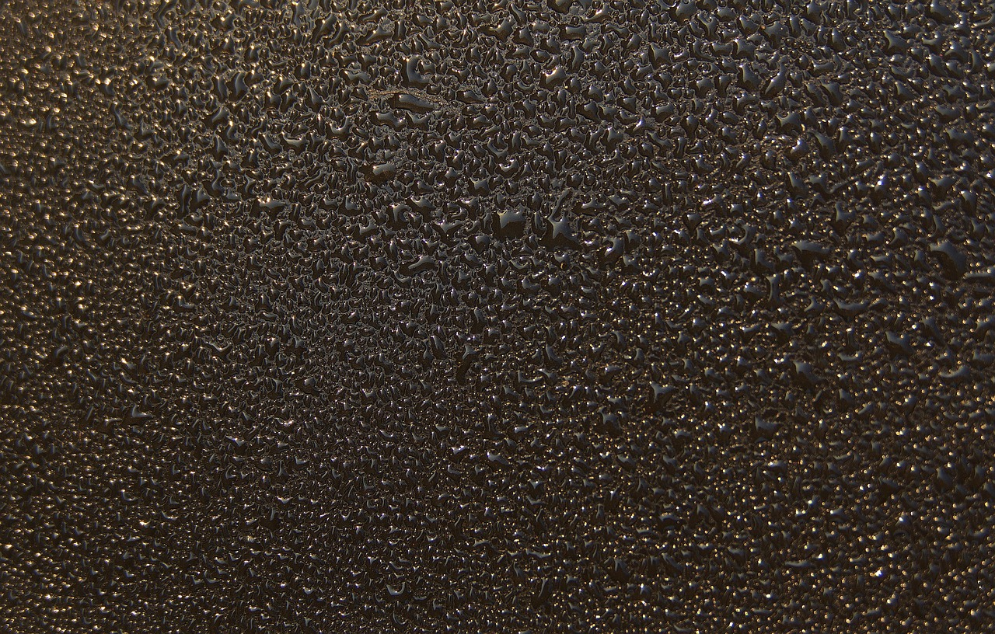
The Water Cycle
Evaporation
Condensation
Evaporation: the process by which water turns into vapor.
This is the first step in the water cycle.
Condensation: the process by which water vapor turns back into liquid water.
This step forms clouds in the atmosphere.
Precipitation
Runoff
Precipitation: water that falls to the Earth as rain, snow, or hail.
This is how water returns to the Earth's surface.
Runoff: the flow of water that occurs when the ground is infiltrated with water, and the excess water flows over the land.
This process helps distribute water across the land.
7
Explorando las Fuentes y Usos del Agua en Nuestra Comunidad

Slide 8
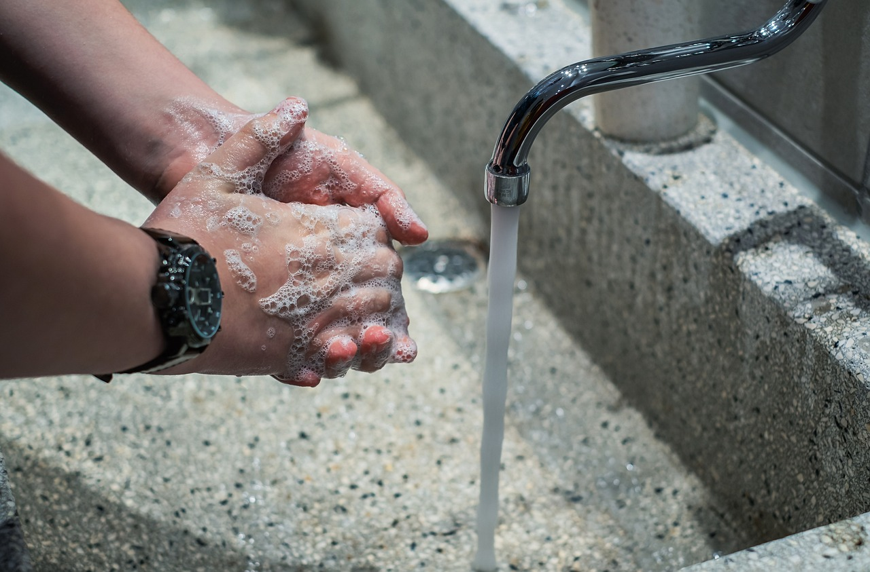
Water Uses in the Community
Drinking Water
Washing and Cleaning
Watering Plants
Essential for human consumption.
Provides hydration and supports overall health.
Water is used for personal hygiene, cleaning, and washing clothes.
Ensures cleanliness and prevents the spread of diseases.
Water is used for irrigation and to support plant growth.
Helps maintain green spaces and agricultural productivity.
8
Explorando las Fuentes y Usos del Agua en Nuestra Comunidad

Slide 9
Importance of Water Conservation
Water as a Limited Resource
Energy Savings Through Conservation
Practical Steps for Conservation
Water is a limited resource, and conserving it helps ensure that there is enough water for future generations.
Simple practices such as fixing leaks and using water-efficient appliances can significantly contribute to water conservation.
Conserving water reduces the energy needed to treat and transport water.
This reduction in energy usage also helps lower environmental impact.
Simple practices such as fixing leaks and using water-efficient appliances can significantly contribute to water conservation.
These actions are easy to implement and make a big difference in preserving water resources.
9
Explorando las Fuentes y Usos del Agua en Nuestra Comunidad

Slide 10
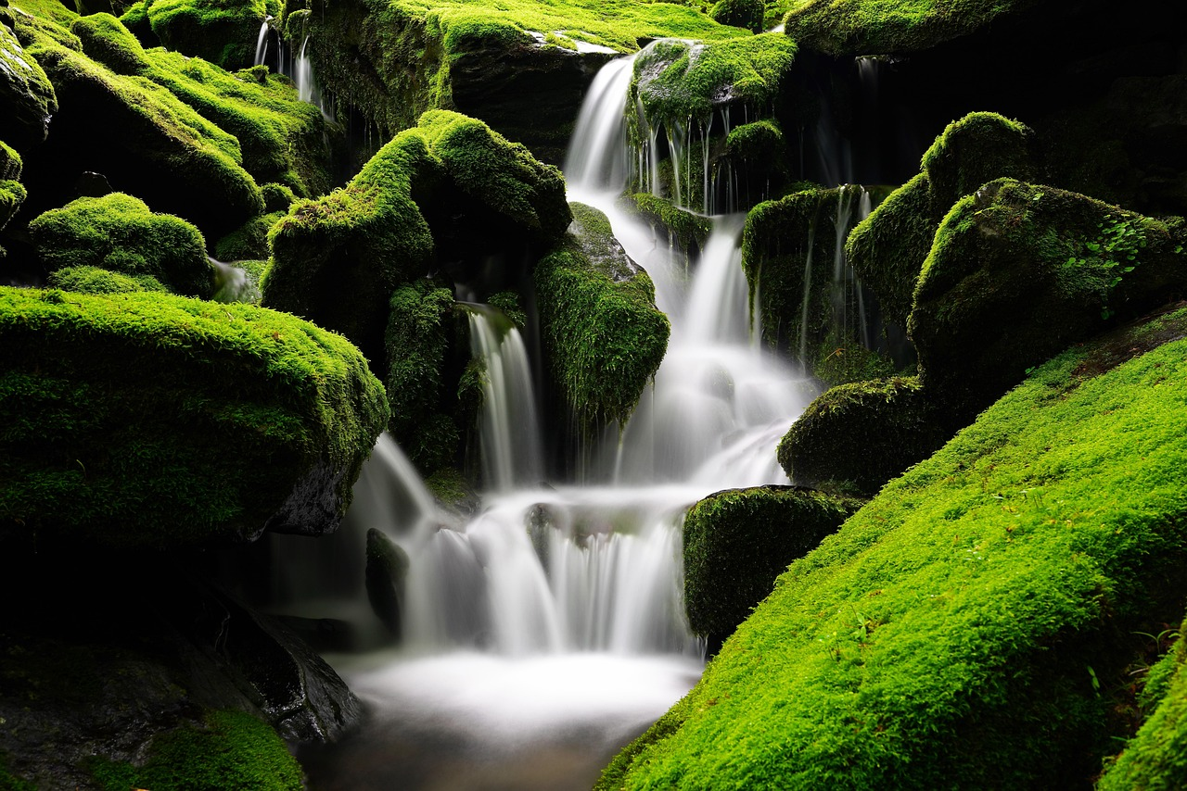
Water Filtration Experiment
Overview of the Experiment
Materials and Purpose
We will conduct a simple water filtration experiment using sand, gravel, and small rocks to clean dirty water.
This activity will help us understand the process of water purification and the importance of clean water.
The experiment uses natural materials like sand, gravel, and rocks to simulate water filtration.
It demonstrates the significance of clean water and how filtration works in real life.
10
Explorando las Fuentes y Usos del Agua en Nuestra Comunidad

Slide 11
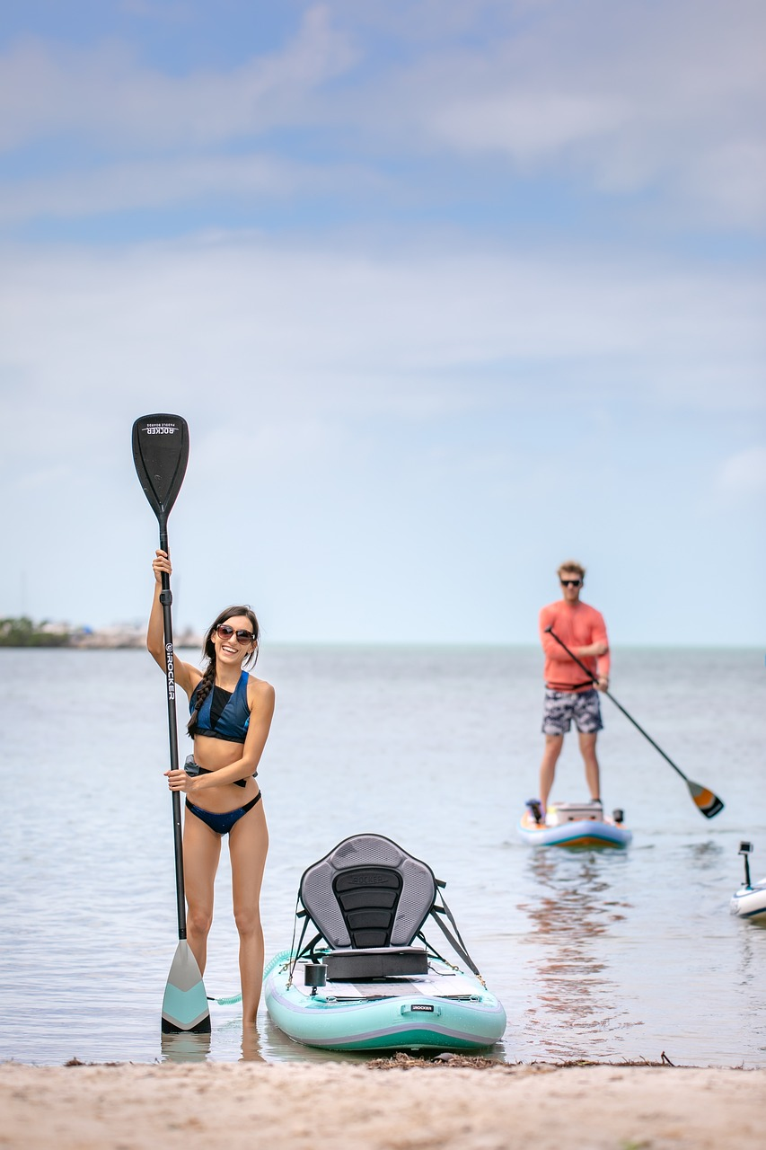
Guided Practice: Water Source Sorting
Sorting Water Sources
Activity Objective
We will sort pictures or cards representing different water sources (rivers, lakes, oceans, groundwater) into categories.
This activity will help us recognize and identify different water sources.
This activity aims to enhance our understanding of various water sources.
By categorizing, we can better appreciate the diversity of water sources.
11
Explorando las Fuentes y Usos del Agua en Nuestra Comunidad

Slide 12
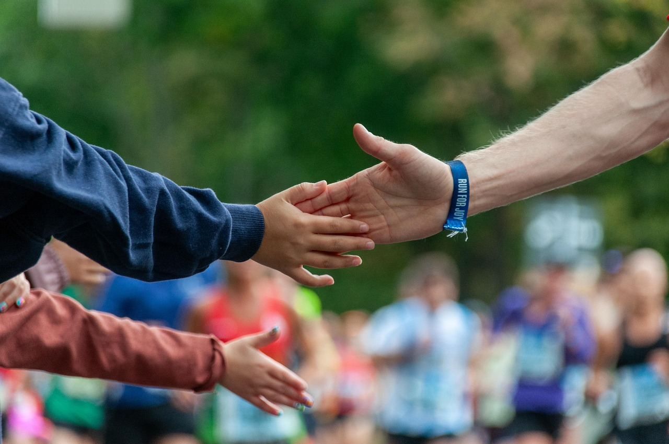
Independent Practice: Water Use Drawing
Drawing and Labeling Activity
Understanding Water Usage
We will draw and label a picture showing different ways water is used in our community.
This activity will help us understand how water is used in our daily lives.
This activity will help us understand how water is used in our daily lives.
We will draw and label a picture showing different ways water is used in our community.
12
Explorando las Fuentes y Usos del Agua en Nuestra Comunidad

Slide 13
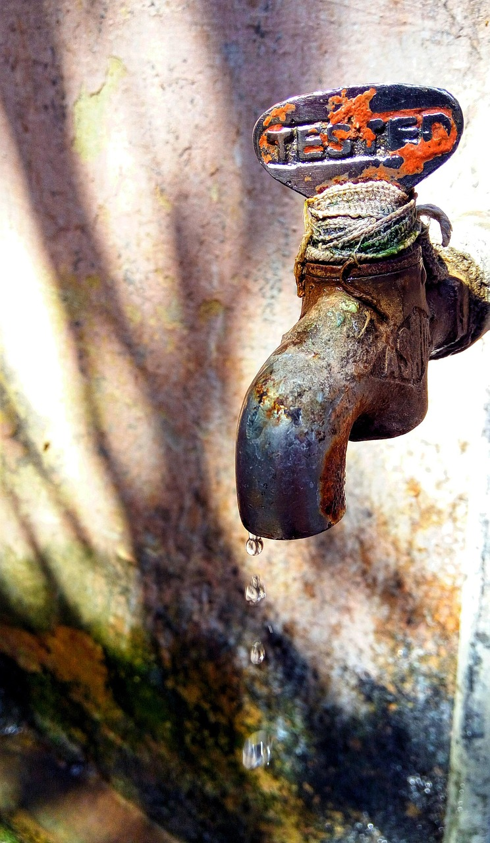
Extension Task: Design a Water Conservation Poster
1
Poster Design Objective
We will design a poster about water conservation, including at least three tips on how to save water.
This activity will help us apply what we have learned and promote water conservation in our community.
2
Community Engagement
This activity will help us apply what we have learned and promote water conservation in our community.
We will design a poster about water conservation, including at least three tips on how to save water.
13
Explorando las Fuentes y Usos del Agua en Nuestra Comunidad

Slide 14
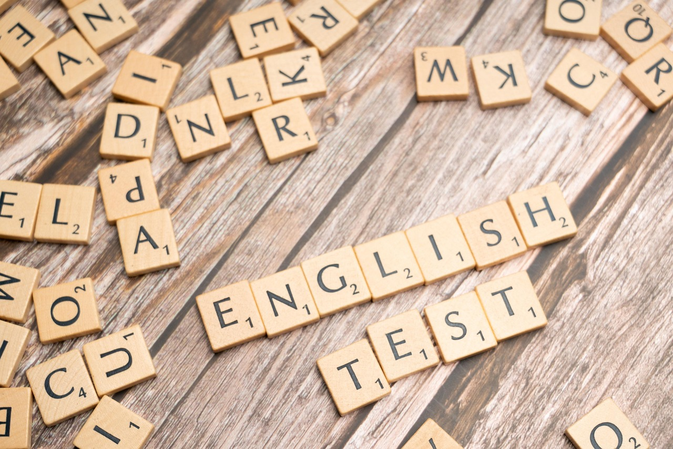
ELL Support: Vocabulary Building
1
Matching Vocabulary with Definitions
We will match vocabulary related to water sources and uses with their definitions.
This activity will help English language learners build their vocabulary and understand key concepts.
2
Activity Purpose
This activity is designed to support English language learners.
It focuses on building vocabulary and understanding key concepts related to water.
14
Explorando las Fuentes y Usos del Agua en Nuestra Comunidad

Slide 15
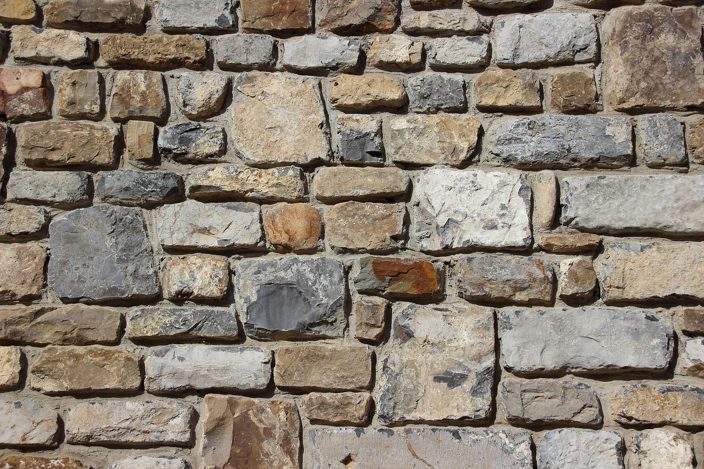
Special Needs Adaptation: Tactile Water Cycle
Creating a Tactile Diagram
Understanding the Water Cycle
We will create a tactile diagram of the water cycle using play dough or clay.
This activity will help students with special needs understand the water cycle and its different stages.
This activity focuses on the different stages of the water cycle.
It is designed to enhance comprehension for students with special needs.
15
Explorando las Fuentes y Usos del Agua en Nuestra Comunidad

Slide 16
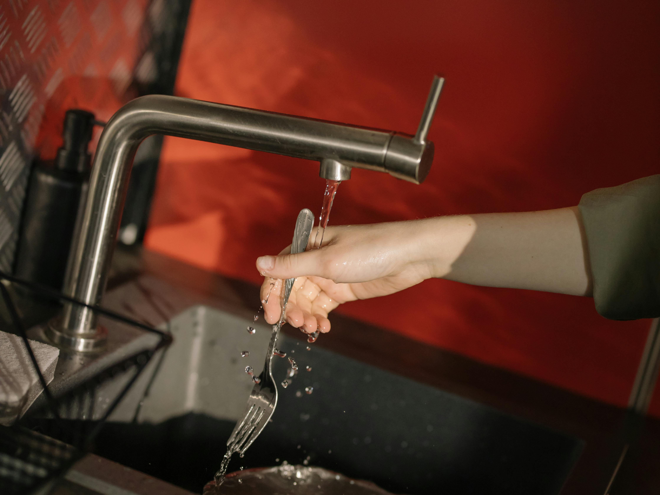
Conclusion
Key Learnings
Call to Action
We have learned about the different sources of water, how water is used, and why it's essential to conserve water.
Remember, every small action counts, and we can all make a difference by conserving water in our daily lives.
Every small action counts, and we can all make a difference by conserving water in our daily lives.
We have learned about the different sources of water, how water is used, and why it's essential to conserve water.
16
Explorando las Fuentes y Usos del Agua en Nuestra Comunidad

Slide 17
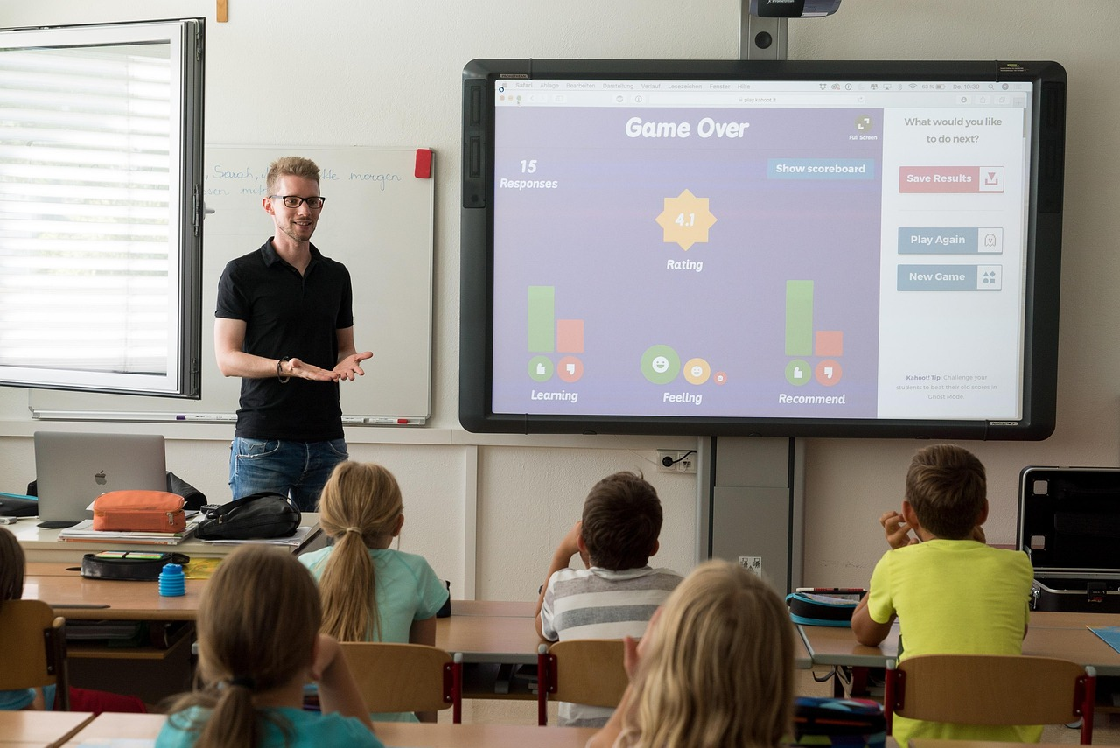
Assessment and Feedback
Understanding Key Concepts
Enhancing Knowledge
We will assess our understanding of the key concepts through quizzes, class discussions, and activities.
Feedback will be provided to help us improve our knowledge and understanding of water sources and uses.
We will assess our understanding of the key concepts through quizzes, class discussions, and activities.
Feedback will be provided to help us improve our knowledge and understanding of water sources and uses.
17
Explorando las Fuentes y Usos del Agua en Nuestra Comunidad

Slide 18
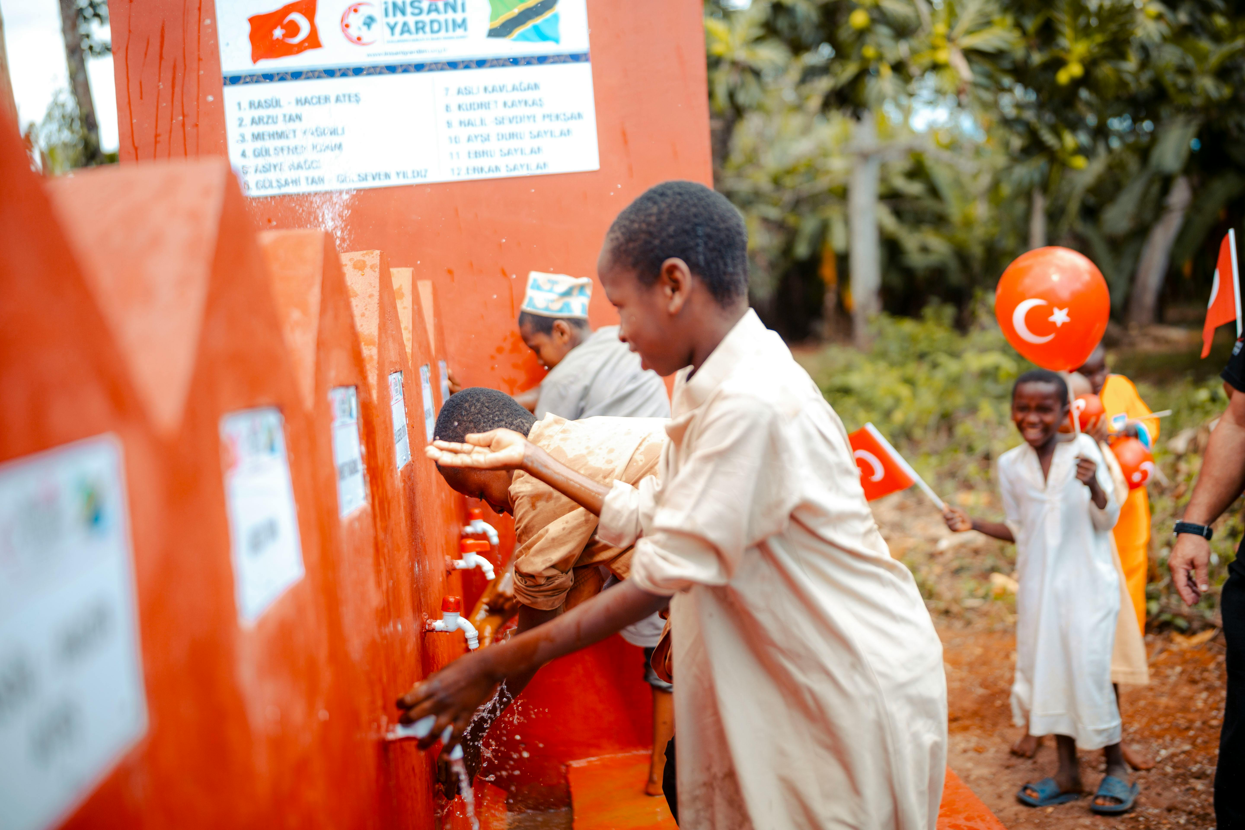
Next Steps
Learning About Water Sources
Promoting Water Conservation
We will continue to learn about water sources and uses in our community through follow-up lessons.
This will help us understand the importance of water in our daily lives.
We will apply what we have learned to make a positive impact in our community and promote water conservation.
Our efforts will aim to ensure sustainable water use for future generations.
18
Explorando las Fuentes y Usos del Agua en Nuestra Comunidad

Slide 19
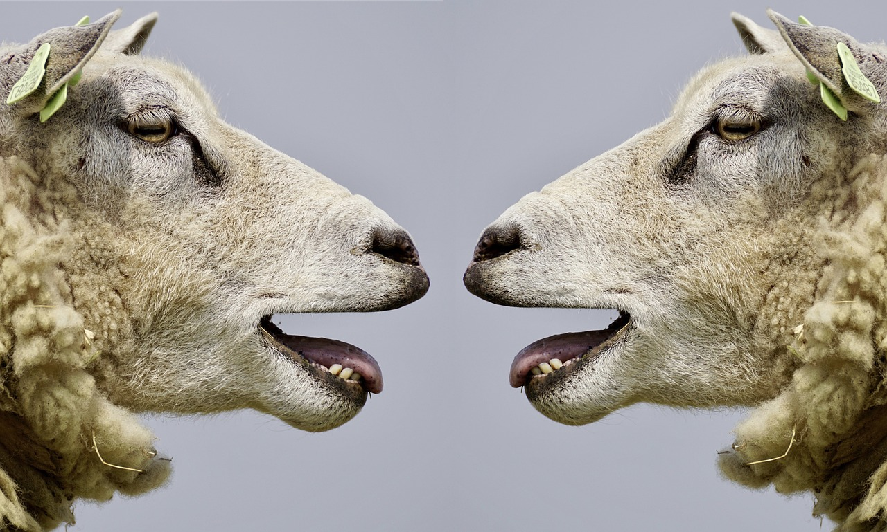
Reflection Questions
Understanding Community Water Sources
Applying Knowledge for Positive Change
What did we learn about water sources and uses in our community?
How can we apply what we have learned to make a positive impact in our community?
What did we learn about water sources and uses in our community?
How can we apply what we have learned to make a positive impact in our community?
19
Explorando las Fuentes y Usos del Agua en Nuestra Comunidad

Slide 20
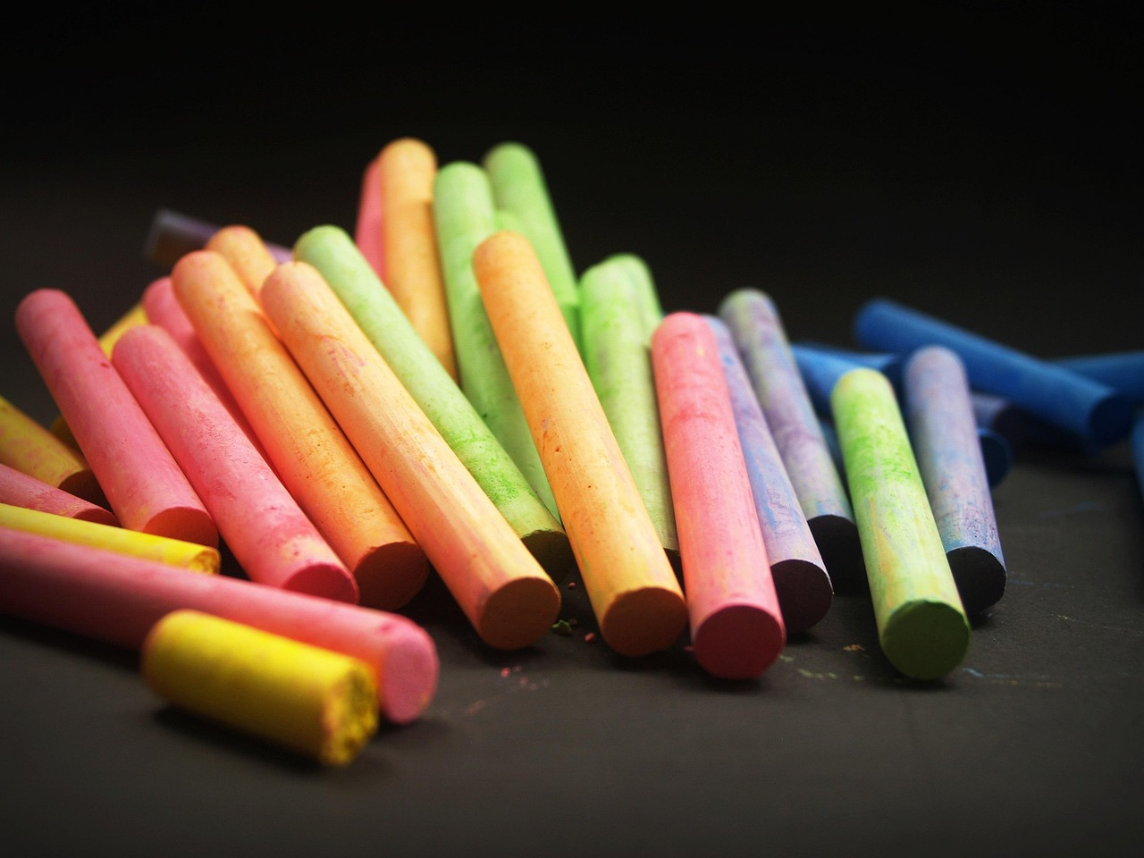
Teaching Tips
1
Engaging Students
Use visual aids and hands-on activities to engage students and promote learning.
Provide opportunities for students to ask questions and explore their curiosity.
2
Promoting Curiosity
Provide opportunities for students to ask questions and explore their curiosity.
Use visual aids and hands-on activities to engage students and promote learning.
20
Explorando las Fuentes y Usos del Agua en Nuestra Comunidad

Slide 21
Key Takeaways
Understanding Water Sources and Usage
The Importance of Water Conservation
We have learned about the different sources of water and how water is used in our community.
This knowledge helps us appreciate the role of water in our daily lives.
We understand the importance of water conservation and can apply what we have learned to make a positive impact.
By conserving water, we contribute to a sustainable future for our community.
21
Explorando las Fuentes y Usos del Agua en Nuestra Comunidad

