Slide 1

Exploring Spring Mechanics
From Theory to Practice: Hooke's Law, Spring Constant, and Real-World Applications

Slide 2
Table of contents
01
02
03
04
05
06
07
08
09
10
11
Title Slide: Investigating Spring Mechanics
Lesson Objectives: Understand Hooke's Law and Spring Consta…
Theoretical Background: Hooke's Law and Spring Constant Def…
Experimental Setup: Materials and Safety Equipment
Experimental Procedure: Step-by-Step Methodology and Key Te…
Data Collection Template: Sample Data Table and Graphing In…
Mathematical Analysis: Calculating Spring Constant and Erro…
Real-World Applications: Aerospace, Automotive, Biomedical,…
Common Experimental Challenges: Precision, Non-Linearity, E…
Advanced Exploration: Non-Linear Behaviors, Material Scienc…
Key Takeaways: Measurement Importance, Scientific Method, T…

Slide 3
Table of contents
12
13
14
15
16
Conclusion: Recap of Experiment, Skills Developed, Further …
Q&A: Discussion, Reflection, Resources
Design Recommendations: Color Scheme, Graphics, Fonts, Diag…
Visual Elements: Graphs, Diagrams, Images, Infographics, Mo…
Technical Considerations: Graphics Quality, Transitions, Sp…

Slide 4

1
Title Slide: Investigating Spring Mechanics
Investigating Spring Mechanics
Experimental Determination of Spring Constant
Exploring Spring Mechanics

Slide 5

2
Lesson Objectives: Understand Hooke's Law and Spring Constant
Understand Hooke's Law and Spring Constant
Gain a comprehensive understanding of Hooke's Law and its significance in spring mechanics.
Explore the concept of the spring constant (k) and its role in determining the behavior of springs.
Develop the skills to design and conduct experiments to measure the spring constant accurately.
Learn precise measurement techniques to analyze force-displacement relationships in spring systems.
Exploring Spring Mechanics

Slide 6

3
Theoretical Background: Hooke's Law and Spring Constant Definition
01
Hooke's Law
02
Spring Constant (k) Definition
Describes the relationship between the force applied to a spring and the resulting displacement.
Mathematically represented as F = kx, where F is the force, k is the spring constant, and x is the displacement.
Represents the stiffness of a spring, indicating how much force is needed to produce a unit displacement.
Measured in units of force per unit length (N/m or lbf/in).
03
Key Concepts
Force: The external load applied to the spring.
Displacement: The change in length of the spring from its equilibrium position.
Elastic Deformation: The ability of the spring to return to its original shape after the force is removed.
Exploring Spring Mechanics

Slide 7

4
Experimental Setup: Materials and Safety Equipment
01
Materials Needed
02
Safety Equipment Highlighted
Calibrated spring
Precision digital scale
Measurement stand
Weight set (50g-500g)
Digital calipers
Safety goggles
Lab coat
Gloves
Closed-toe shoes
Exploring Spring Mechanics

Slide 8
5
Experimental Procedure: Step-by-Step Methodology and Key Techniques
01
02
03
04
05
Prepare Measurement Apparatus
Attach Initial Weight
Measure Displacement
Record Data
Repeat with Incremental Weights
Set up measurement stand securely.
Ensure calibrated spring is attached correctly.
Verify precision digital scale is zeroed.
Select initial weight from the weight set.
Gently attach weight to the spring.
Allow system to stabilize before measurements.
Use digital calipers to measure initial displacement.
Record initial position of the spring.
Avoid any external disturbances during measurement.
Document weight applied and corresponding displacement.
Ensure accurate and consistent data recording.
Note any observations or anomalies.
Increase weight systematically in small increments.
Measure displacement for each weight added.
Maintain uniform testing conditions throughout.
Exploring Spring Mechanics

Slide 9

6
Data Collection Template: Sample Data Table and Graphing Instructions
01
Sample Data Table
02
Graphing Instructions
Weight Applied: 50g, 100g, 150g, 200g
Displacement: 2.5 cm, 5.0 cm, 7.5 cm, 10.0 cm
Calculated Force: 0.49 N, 0.98 N, 1.47 N, 1.96 N
X-Axis: Displacement (cm)
Y-Axis: Force (N)
Plotting: Plot the calculated force values against the displacement values.
Trend Line: Use a linear regression to determine the slope, which represents the spring constant (k).
Graph Type: Create a scatter plot with a best-fit line to visualize the force-displacement relationship.
Exploring Spring Mechanics

Slide 10

7
Mathematical Analysis: Calculating Spring Constant and Error Analysis
01
Mathematical Analysis: Calculating Spring Constant and Error Analysis
02
Linear Regression Technique
Use Hooke's Law equation: F = kx
Spring constant (k) represents stiffness
Calculate k using force and displacement data
Plot force vs. displacement graph
Perform linear regression analysis
Determine slope as the spring constant (k)
03
Error Analysis Methods
04
Graphical Representation
Identify sources of error in data
Evaluate uncertainties in measurements
Calculate error propagation in k
Graph force-displacement data points
Include best-fit line from regression
Highlight error bars for data points
Exploring Spring Mechanics

Slide 11

8
Real-World Applications: Aerospace, Automotive, Biomedical, Instruments
01
Aerospace
02
Automotive
Springs are used in landing gear systems to absorb impact forces during landing.
They are crucial in satellite deployment mechanisms for controlled release.
Suspension systems rely on springs for smooth rides and stability.
Clutch systems in vehicles utilize springs for engagement and disengagement.
03
Biomedical
04
Instruments
Prosthetic limbs incorporate springs for natural movement and support.
Medical devices like insulin pumps use springs for precise mechanisms.
Springs are integral in precision instruments for calibration and accuracy.
Musical instruments like pianos and guitars use springs for sound modulation.
Exploring Spring Mechanics

Slide 12

9
Common Experimental Challenges: Precision, Non-Linearity, Errors, Strategies
01
Precision
02
Non-Linearity
Ensuring accurate measurement tools
Minimizing human error in data collection
Understanding deviations from Hooke's Law
Addressing spring behavior at extreme forces
03
Errors
04
Strategies
Identifying sources of measurement inaccuracies
Implementing error analysis techniques
Calibration of equipment before experiments
Conducting multiple trials for data validation
Exploring Spring Mechanics

Slide 13

10
Advanced Exploration: Non-Linear Behaviors, Material Science, Modeling, Research
01
Non-Linear Spring Behaviors
02
Material Science Connections
Understanding complex spring responses beyond linear relationships.
Investigating hysteresis and damping effects in spring mechanics.
Exploring the influence of material properties on spring behavior.
Studying the impact of material composition on spring performance.
03
Computational Modeling
04
Future Research Directions
Utilizing simulation software to predict non-linear spring responses.
Implementing finite element analysis for advanced spring design.
Investigating novel materials for enhanced spring performance.
Exploring dynamic modeling of springs under varying conditions.
Exploring Spring Mechanics

Slide 14

11
Key Takeaways: Measurement Importance, Scientific Method, Theory-Practice Connection, Critical Thinking
01
Measurement Importance
02
Scientific Method
Accurate measurements crucial for determining spring constants.
Precision in data collection enhances experimental reliability.
Systematic approach essential for valid results.
Hypothesis formulation, experimentation, analysis, and conclusion.
03
Theory-Practice Connection
04
Critical Thinking
Applying theoretical concepts to practical experiments.
Observing real-world implications of spring mechanics theories.
Evaluating data critically for meaningful interpretations.
Encouraging questioning and exploration in physics experiments.
Exploring Spring Mechanics

Slide 15
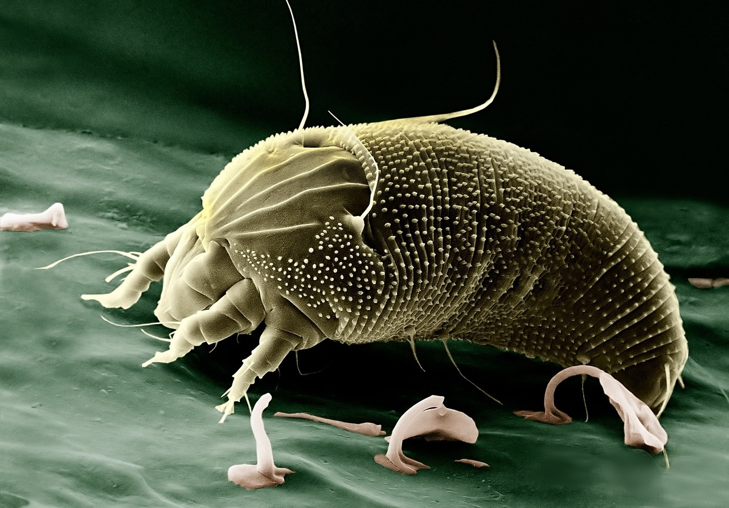
12
Conclusion: Recap of Experiment, Skills Developed, Further Exploration
01
Recap of Experiment
02
Skills Developed
Successfully applied Hooke's Law (F = kx) to determine the spring constant.
Collected precise data on force-displacement relationships using calibrated equipment.
Demonstrated the elastic deformation of the spring under varying weights.
Enhanced experimental design skills through planning and executing the investigation.
Improved measurement techniques for accurate data collection.
Analyzed and interpreted data to draw meaningful conclusions.
03
Further Exploration
Investigate non-linear spring behaviors for a deeper understanding of spring mechanics.
Explore connections to material science for real-world applications.
Consider computational modeling to simulate complex spring systems.
Future research directions could focus on advanced spring properties and applications.
Exploring Spring Mechanics

Slide 16

13
Q&A: Discussion, Reflection, Resources
01
Discussion Prompt
02
Reflection Questions
What challenges did you encounter during the experiment?
How did you ensure accuracy in your measurements?
How does Hooke's Law apply to real-world scenarios?
What improvements could be made to the experimental setup?
03
Additional Resources
Online simulations for further exploration
Recommended readings on spring mechanics
Exploring Spring Mechanics

Slide 17
14
Design Recommendations: Color Scheme, Graphics, Fonts, Diagrams, Style, Readability, Images
01
Color Scheme
02
Graphics
03
Fonts
Utilize a harmonious color palette with physics-themed hues like deep blue, vibrant green, and metallic silver.
Incorporate diagrams illustrating spring mechanics, force-displacement relationships, and Hooke's Law for visual clarity.
Opt for clear, sans-serif fonts like Arial or Helvetica to enhance readability, especially for technical terms and data.
04
Diagrams
05
Style
Include labeled diagrams of the experimental setup, spring components, and measurement techniques for better understanding.
Maintain a consistent visual style throughout the presentation to create a cohesive and professional look.
Exploring Spring Mechanics

Slide 18
15
Visual Elements: Graphs, Diagrams, Images, Infographics, Modeling
01
Graphs displaying force-displacement relationship
02
Diagram illustrating spring mechanics
03
Images showcasing experimental apparatus
Clear visualization of Hooke's Law in action
Breakdown of elastic deformation and spring constant concept
Detailed view of calibrated spring, digital scale, and measurement stand
04
Infographics explaining key concepts
05
Modeling simulations demonstrating spring mechanics
Visual representation of force, displacement, and spring behavior
Computational visualization of spring constant determination
Exploring Spring Mechanics

Slide 19

16
Technical Considerations: Graphics Quality, Transitions, Speaker Notes, Presentation Preparation
01
Graphics Quality
02
Transitions
Use high-resolution images and graphics for clarity.
Ensure diagrams and illustrations are visually appealing and easy to understand.
Utilize consistent slide transitions for a seamless flow.
Avoid overly flashy transitions that may distract from the content.
03
Speaker Notes
04
Presentation Preparation
Include detailed explanations in speaker notes for each slide.
Speaker notes should provide additional context and talking points for the presenter.
Rehearse the presentation to ensure smooth delivery.
Familiarize yourself with the content and key points.
Check technical equipment and ensure everything is set up correctly before the presentation.
Exploring Spring Mechanics

