Slide 1


Exploring Fire and Learning: A Journey Through History and Innovation
From the Great Fire of London to Modern Fire Safety and Dyslexia Support Features

Slide 2
Table of contents
The Great Fire of Londo…
London in 1666: A City …
How the Fire Started
Understanding Fire Scie…
From Destruction to Rec…
Modern Fire Safety
What Did We Learn?
Key Dyslexia Support Fe…
High-contrast design
Clear, simple fonts
01
02
03
04
05
06
07
08
09
10

Slide 3
Table of contents
Visual storytelling
Color-coded information
Simple, clear bullet po…
Visual city layout diag…
Audio descriptions avai…
Tactile fire spread mod…
Visual fire progression…
Break complex concepts …
Use consistent color co…
Provide visual metaphors
11
12
13
14
15
16
17
18
19
20

Slide 4
Table of contents
Use of mind mapping
Graphic organizers
Alternative assessment …
Text-to-speech options
Interactive digital pla…
Adaptive learning techn…
Safe reflection environ…
Multiple expression met…
Positive reinforcement
21
22
23
24
25
26
27
28
29

Slide 5
The Great Fire of London: A Historical Adventure
01
02
03
04
05
The Catastrophe Unfolds
Rapid Spread
City in Chaos
Rebuilding Efforts
Legacy and Lessons
Date: September 2, 1666
Location: Bakery on Pudding Lane
Cause: Accidental spark ignites the fire
Impact: Wooden buildings fuel the flames
Acceleration: Winds aid in quick expansion
Challenge: Limited firefighting capabilities
Destruction: Over 13,000 houses burned
Devastation: St. Paul's Cathedral among the casualties
Aftermath: City left in ruins
Leadership: Sir Christopher Wren spearheads reconstruction
Innovation: Introduction of new building regulations
Transformation: London transitions to stone and brick
Resilience: Communities adapt and rebuild
Progress: Improved infrastructure and safety measures
Reflection: Learning from history to prevent future disasters
Exploring Fire and Learning: A Journey Through History and Innovation
1

Slide 6
London in 1666: A City of Wood and Risk
Wooden buildings packed closely together
Narrow streets with limited fire protection
Dry summer created perfect fire conditions
London in 1666: A City of Wood and Risk
Exploring Fire and Learning: A Journey Through History and Innovation
2

Slide 7
How the Fire Started
STEP 01
STEP 02
STEP 03
STEP 04
September 2, 1666
Accidental Spark
Rapid Spread
Wind Influence
A fire ignites in a bakery on Pudding Lane.
The fire is caused by an accidental spark.
The fire quickly spreads due to the abundance of wooden buildings.
Strong winds contribute to the rapid growth of the fire.
Exploring Fire and Learning: A Journey Through History and Innovation
3

Slide 8
Understanding Fire Science
01
02
03
04
05
The Fire Triangle
Factors Contributing to Fire Spread
Impact of Urban Layout
Acceleration of Fire
Dyslexia Support
Fuel + Oxygen + Heat
Wooden buildings provide abundant fuel
Narrow streets concentrate oxygen
High temperatures facilitate rapid spread
Break complex concepts into smaller parts
Use consistent color coding
Provide visual metaphors
Exploring Fire and Learning: A Journey Through History and Innovation
4

Slide 9
From Destruction to Reconstruction
STEP 01
STEP 02
STEP 03
STEP 04
Sir Christopher Wren led rebuilding efforts
New building regulations introduced
Stone and brick replaced wood
Wider streets and improved infrastructure
Renowned architect overseeing reconstruction
Implementing innovative urban planning solutions
Focus on fire-resistant materials
Improved safety standards for future structures
Transition to more durable and fireproof materials
Enhancing structural integrity and longevity
Enhancing accessibility and safety
Reducing fire risks and improving urban planning
Exploring Fire and Learning: A Journey Through History and Innovation
5

Slide 10
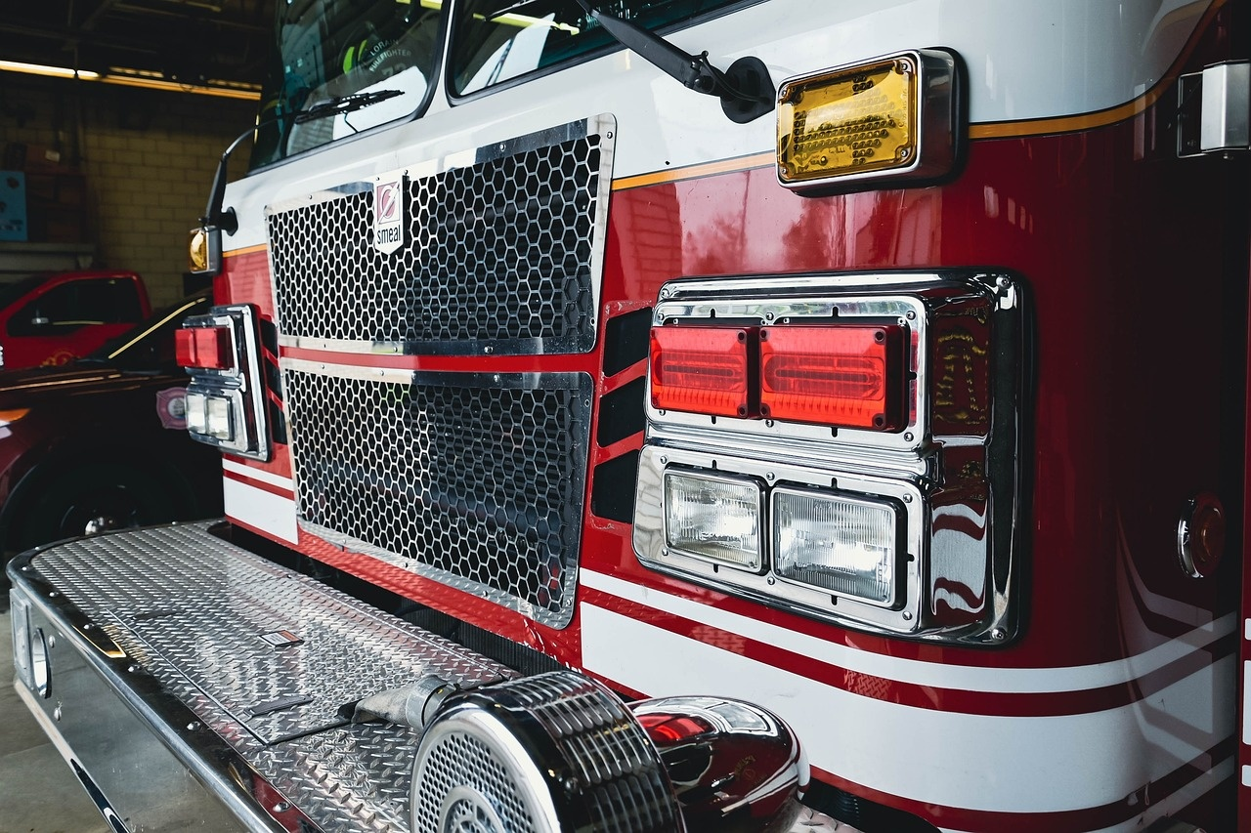
Modern Fire Safety
Modern Fire Safety
Technological Accommodations
Smoke detectors
Fire extinguishers
Emergency evacuation plans
Building material regulations
Text-to-speech options
Interactive digital platforms
Adaptive learning technologies
Exploring Fire and Learning: A Journey Through History and Innovation
6

Slide 11
What Did We Learn?
Historical events have the power to transform societies.
Communities can rebuild and adapt in the face of adversity.
Learning from past challenges is crucial for progress.
What Did We Learn?
Exploring Fire and Learning: A Journey Through History and Innovation
7

Slide 12
Key Dyslexia Support Features
01
02
03
04
05
OpenDyslexic Font
High-Contrast Color Scheme
Clear, Spaced Layout
Multisensory Learning Indicators
Cognitive Support Strategies
A font designed to increase readability for readers with dyslexia.
Utilizes colors that are easy to distinguish for better readability.
Ensures text and elements are well-spaced to avoid visual clutter.
Incorporates visual, auditory, and tactile elements to enhance learning.
Techniques to aid memory, attention, and processing speed.
Exploring Fire and Learning: A Journey Through History and Innovation
8

Slide 13
Bold Color Scheme
Utilize high-contrast colors like black and white for improved readability.
Clear Font Choices
Opt for sans-serif fonts for better legibility, such as Arial or OpenDyslexic.
Structured Layout
Maintain a well-organized and spacious design to reduce visual clutter.
Visual Emphasis
Use bold headings and visual elements to highlight key information effectively.
High-contrast design
Exploring Fire and Learning: A Journey Through History and Innovation
9

Slide 14
Clear, simple fonts
Utilize OpenDyslexic font
Maintain a high-contrast color scheme
Ensure a clear and spaced layout
Improved readability
Better visual clarity
Enhance comprehension
Implement multisensory learning indicators
Employ cognitive support strategies
Diverse learning styles
Break down complex concepts
Exploring Fire and Learning: A Journey Through History and Innovation
10

Slide 15
Utilize engaging infographics
Simplify complex data
Enhance visual appeal
Incorporate relevant historical images
Provide context
Enhance relatability
Create interactive timelines
Engage audience
Showcase progression
Use color-coded illustrations
Highlight key points
Improve retention
Implement animated storytelling techniques
Capture attention
Enhance understanding
Visual storytelling
Exploring Fire and Learning: A Journey Through History and Innovation
11

Slide 16
Color-coded information
Green
Blue
Orange
Red
1
2
3
4
Represents the wooden buildings packed closely together.
Signifies the narrow streets with limited fire protection.
Indicates the dry summer conditions that created perfect fire conditions.
Highlights the Fire Triangle concept: Fuel + Oxygen + Heat.
Exploring Fire and Learning: A Journey Through History and Innovation
12

Slide 17
Simple, clear bullet points
OpenDyslexic Font
High-Contrast Color Scheme
Clear, Spaced Layout
Improved readability
Better visibility
Easier comprehension
Multisensory Learning Indicators
Cognitive Support Strategies
Enhanced understanding
Break down complex concepts
Exploring Fire and Learning: A Journey Through History and Innovation
13

Slide 18
01
02
03
Street Layout
Building Density
Fire Spread Pathways
Narrow, winding streets
Limited space between buildings
Lack of open areas for fire breaks
Crowded wooden structures
Buildings interconnected closely
High risk of fire spreading rapidly
Potential routes for fire propagation
Impact of wind direction on fire movement
Illustration of how fire engulfed neighborhoods
Visual city layout diagrams
Exploring Fire and Learning: A Journey Through History and Innovation
14

Slide 19
Audio descriptions available
STEP 01
STEP 02
STEP 03
STEP 04
Detailed narration of historical events
Explanation of key figures involved
Description of architectural changes post-fire
Insights into fire safety advancements
Provide a comprehensive account of the events leading up to, during, and after the fire.
Introduce and explain the roles of significant individuals who were involved in the events.
Detail the architectural modifications and improvements made following the fire.
Discuss the advancements in fire safety protocols and technologies that were implemented as a result of the fire.
Exploring Fire and Learning: A Journey Through History and Innovation
15

Slide 20
Multisensory Learning
Physical models representing fire propagation
Interactive tactile simulations for hands-on exploration
Braille descriptions for visually impaired students
Tactile fire spread models
Exploring Fire and Learning: A Journey Through History and Innovation
16

Slide 21
Visual fire progression maps
01
02
03
04
05
Initial Spark
Rapid Spread
Accelerated Growth
Firefighting Struggles
Destruction and Aftermath
Ignites fire in bakery on Pudding Lane on September 2, 1666.
Fire spreads through wooden buildings due to abundant fuel.
Winds accelerate fire growth, engulfing neighboring structures.
Firefighters struggle to contain the blaze as it consumes large areas of London.
Destruction continues for days until the fire subsides, leaving a devastated cityscape.
Exploring Fire and Learning: A Journey Through History and Innovation
17

Slide 22
Break complex concepts into smaller parts
Identify the main components of the concept
Analyze each component individually
Understand the relationships between the components
Simplify each component to its core elements
Reassemble the components into a cohesive understanding
Exploring Fire and Learning: A Journey Through History and Innovation
18

Slide 23
Use consistent color coding
STEP 01
STEP 02
STEP 03
STEP 04
Key Points
Implementation Tips
Benefits
Remember
Consistent color coding enhances visual organization.
Helps in categorizing information effectively.
Improves accessibility for individuals with dyslexia.
Facilitates quick comprehension and retention of content.
Assign specific colors to different categories or themes.
Use color variations for emphasis but maintain a clear hierarchy.
Ensure color choices are accessible and distinguishable for all users.
Test color combinations for readability and contrast.
Enhances overall visual appeal of the presentation.
Supports cognitive processing and information recall.
Promotes inclusivity and accommodates diverse learning styles.
Consistency in color coding is key to creating a cohesive and engaging presentation.
Exploring Fire and Learning: A Journey Through History and Innovation
19

Slide 24
Provide visual metaphors
Burning Candle
Growing Flame
Phoenix Rising
Fire Triangle Diagram
1
2
3
4
Represents the initial spark that ignited the Great Fire of London.
Symbolizes the rapid spread of the fire through the wooden buildings of London.
Reflects the city's resilience and rebuilding efforts after the devastating fire.
Illustrates the concept of the Fire Triangle - Fuel + Oxygen + Heat - that contributed to the fire's intensity.
Exploring Fire and Learning: A Journey Through History and Innovation
20

Slide 25
Use of mind mapping
01
02
03
04
05
Start with a central theme
Branch out into key subtopics
Connect with details
Use visual elements
Encourage participation
Choose a topic related to the Great Fire of London.
Identify causes, impact, and aftermath of the fire.
Add relevant details and historical facts to each subtopic.
Incorporate colors, symbols, and images to enhance memory retention.
Promote active participation and creativity in creating the mind map.
Exploring Fire and Learning: A Journey Through History and Innovation
21

Slide 26
Mind Mapping
Encourages visual organization of ideas and concepts.
Concept Maps
Help students connect and understand relationships between different elements.
Venn Diagrams
Useful for comparing and contrasting information.
Flowcharts
Aid in visualizing processes and sequences of events.
Graphic organizers
Exploring Fire and Learning: A Journey Through History and Innovation
22

Slide 27
Alternative assessment methods
STEP 01
STEP 02
STEP 03
STEP 04
Performance-Based Assessments
Project-Based Assessments
Portfolio Assessments
Peer Assessments
Practical demonstrations of fire safety knowledge.
Simulated emergency scenarios for response evaluation.
Research projects on historical fire incidents.
Designing fire safety plans for different settings.
Compilation of fire safety reflections and learnings.
Showcase of creative solutions to fire-related challenges.
Collaborative evaluation of fire safety presentations.
Constructive feedback on fire prevention strategies.
Exploring Fire and Learning: A Journey Through History and Innovation
23

Slide 28
Text-to-speech options
01
02
03
04
05
Enhancing accessibility for students with dyslexia
Providing auditory support for reading materials
Enabling personalized learning experiences
Facilitating comprehension of complex texts through audio
Supporting independent learning and study habits
Exploring Fire and Learning: A Journey Through History and Innovation
24

Slide 29

Interactive digital platforms
Text-to-speech options
Interactive learning tools
Adaptive learning technologies
Enhancing accessibility for auditory learners.
Engaging students through hands-on activities.
Personalizing the learning experience for individual needs.
Exploring Fire and Learning: A Journey Through History and Innovation
25

Slide 30
Text-to-speech options
Enhancing accessibility for auditory learners.
Interactive digital platforms
Engaging students through interactive learning experiences.
Adaptive learning technologies
Personalizing learning paths based on individual progress.
Multisensory learning tools
Catering to diverse learning styles for improved comprehension.
Adaptive learning technologies
Exploring Fire and Learning: A Journey Through History and Innovation
26

Slide 31
Safe Reflection Environments
Quiet spaces for contemplation
Journals for personal reflections
Group discussions for shared insights
Artistic expression through drawings or poems
Safe reflection environments
Exploring Fire and Learning: A Journey Through History and Innovation
27

Slide 32
Visual Storytelling
Utilizing images, infographics, and diagrams to convey information.
Interactive Activities
Engaging students through hands-on experiments and simulations.
Role-Playing
Encouraging students to act out historical scenarios for deeper understanding.
Creative Writing
Allowing students to express their knowledge through narratives and poems.
Multiple expression methods
Exploring Fire and Learning: A Journey Through History and Innovation
28

Slide 33
Encouraging words and praise
for students' efforts in understanding historical events.
Rewarding active participation
in discussions and activities related to the Great Fire of London lesson.
Providing constructive feedback
to guide students towards improvement.
Celebrating small victories
and milestones achieved during the learning process.
Positive reinforcement
Exploring Fire and Learning: A Journey Through History and Innovation
29

