Slide 1

Global Warming: Understanding Its Causes, Effects, and Solutions
A Comprehensive Exploration of Climate Change and Its Impact on Our Planet

Slide 2
Table of contents
Understanding Global Warming: Exploring its Impact …
What is Global Warming?
Understanding the Carbon Cycle
The Great Barrier Reef Under Threat
The Alarming Rate of Sea-Level Rise
Geological Changes Associated with Global Warming
Addressing Global Warming: Mitigation and Adaptatio…
The Maldives: A Nation Under Threat
Calculating Your Carbon Footprint
Simulating the Carbon Cycle
01
02
03
04
05
06
07
08
09
10

Slide 3
Table of contents
Proposing a Policy to Reduce Carbon Emissions
Reflecting on the Future of Our Planet
Quiz: Global Warming and the Carbon Cycle
Debate: Economic Growth vs. Environmental Protection
The Great Barrier Reef: A Case Study
Rising Sea Levels and Coastal Erosion
Geological Changes and Human Activities
Mitigation and Adaptation Strategies: A Global Pers…
Conclusion: Understanding Global Warming and its Im…
Next Steps: Taking Action Against Global Warming
11
12
13
14
15
16
17
18
19
20

Slide 4
Understanding Global Warming: Exploring its Impact on the Great Barrier Reef, Rising Sea Levels, and Geological Changes
The Great Barrier Reef at Risk
Rising Sea Levels
Geological Changes
Global warming leads to coral bleaching, threatening biodiversity and marine ecosystems.
Sea levels are projected to rise by up to 1 meter by 2100, endangering coastal communities and habitats.
Increased temperatures contribute to coastal erosion and altered geological formations, impacting human settlements.
Global Implications
Call to Action
The effects of global warming extend beyond local environments, influencing global weather patterns and economies.
Understanding these impacts is crucial for developing effective strategies to mitigate global warming and protect vulnerable ecosystems.
Global Warming: Understanding Its Causes, Effects, and Solutions
1

Slide 5

What is Global Warming?
Definition of Global Warming
Role of Greenhouse Gases
Human Activities Contributing to Global Warming
Global warming refers to the long-term rise in Earth's average surface temperature.
Primarily driven by human activities, especially the burning of fossil fuels.
Greenhouse gases, such as carbon dioxide (CO2) and methane (CH4), trap heat in the atmosphere.
Increased concentrations of these gases enhance the greenhouse effect, leading to higher temperatures.
Major contributors include industrial processes, deforestation, and transportation.
These activities release significant amounts of greenhouse gases, exacerbating climate change.
Global Warming: Understanding Its Causes, Effects, and Solutions
2

Slide 6
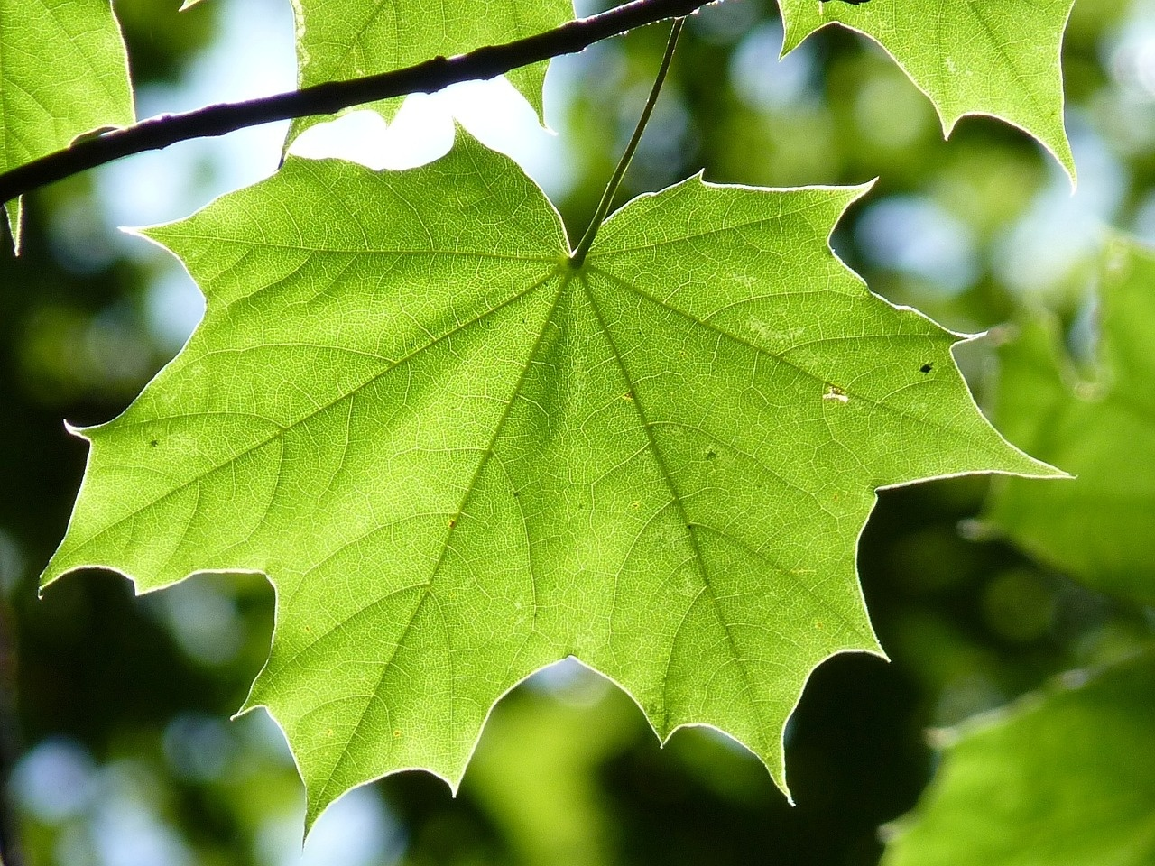
Understanding the Carbon Cycle
Basic Components of the Carbon Cycle
Photosynthesis and Respiration
Human Impact and Mitigation Strategies
Carbon is exchanged among the atmosphere, oceans, soil, and living organisms.
Key processes include photosynthesis, respiration, decomposition, and combustion.
Photosynthesis: Plants absorb carbon dioxide (CO2) from the atmosphere and convert it into glucose and oxygen using sunlight.
Respiration: Organisms release CO2 back into the atmosphere by breaking down glucose for energy.
Human activities, such as burning fossil fuels and deforestation, increase atmospheric CO2 levels, disrupting the natural carbon cycle.
Mitigation Strategies: Promote renewable energy, enhance carbon sequestration through reforestation, and implement carbon pricing to reduce emissions.
Global Warming: Understanding Its Causes, Effects, and Solutions
3

Slide 7
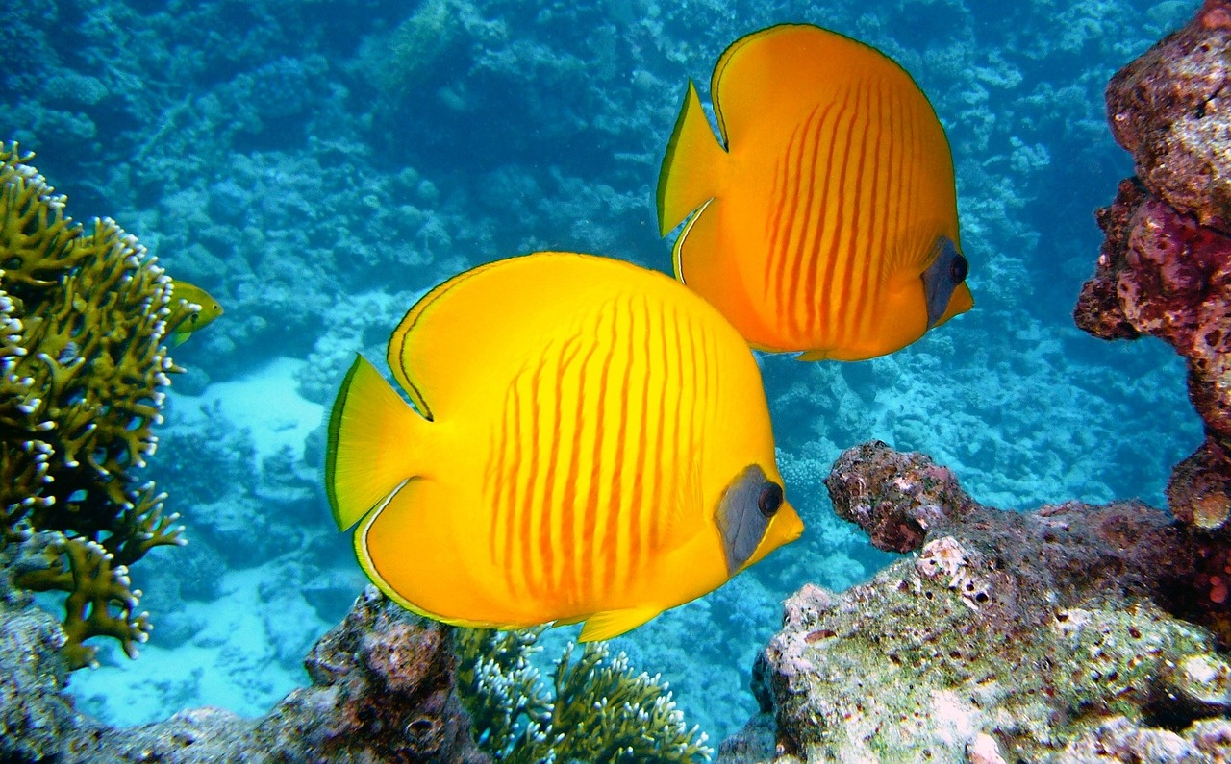
The Great Barrier Reef Under Threat
Effects of Global Warming on the Reef
Coral Bleaching: Causes and Consequences
Case Studies and Solutions
Rising sea temperatures lead to increased coral stress and mortality.
Ocean acidification weakens coral structures, making them more susceptible to damage.
Causes:
Elevated water temperatures trigger the expulsion of symbiotic algae (zooxanthellae) from coral.
Pollution and nutrient runoff exacerbate stress on coral ecosystems.
Consequences:
Loss of biodiversity as coral reefs provide habitat for numerous marine species.
Case Study: 2016 Mass Bleaching Event
Over 90% of the northern Great Barrier Reef experienced bleaching.
Proposed Solutions:
Implementing marine protected areas to reduce human impact.
Promoting coral restoration projects and sustainable tourism practices.
Global Warming: Understanding Its Causes, Effects, and Solutions
4

Slide 8
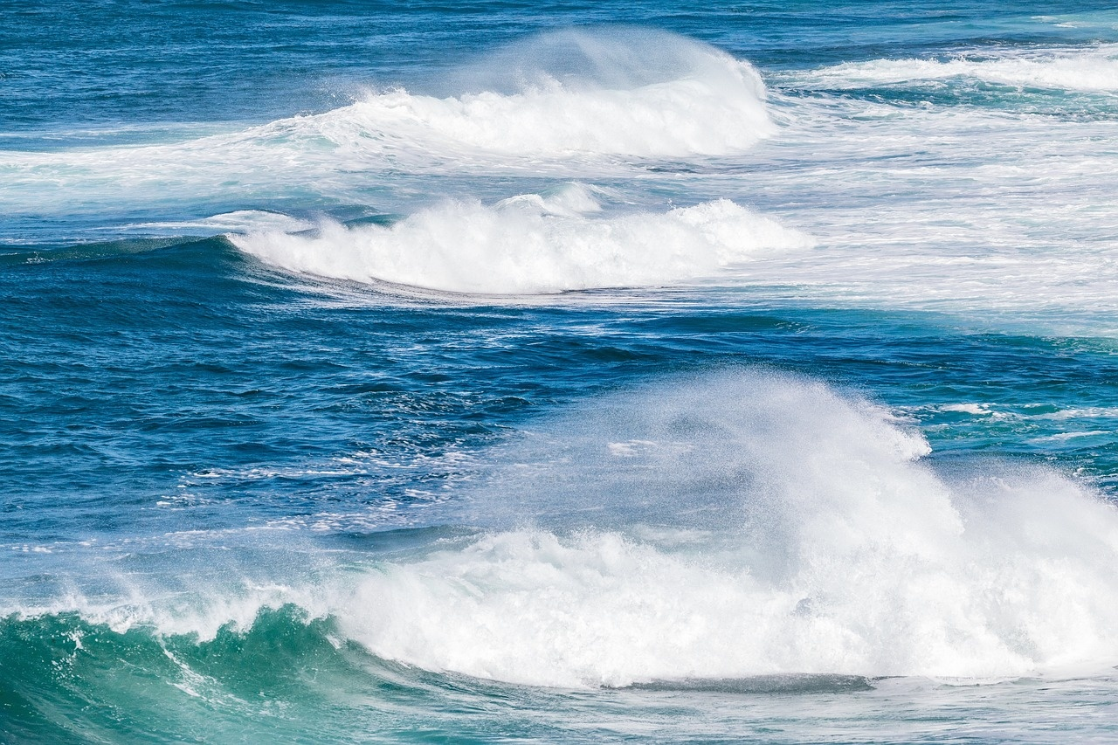
The Alarming Rate of Sea-Level Rise
Understanding Sea-Level Rise
Impacts on Coastal Communities and Ecosystems
Mitigation Strategies and New Solutions
Causes: Melting glaciers and ice sheets, thermal expansion of seawater due to warming.
Current Rate: Average global sea level has risen about 8-9 inches (20-23 cm) since 1880, with projections of up to 2 feet (0.6 meters) by 2100.
Vulnerability: Over 600 million people live in low-lying coastal areas at risk of flooding.
Ecosystem Disruption: Loss of habitats for marine and coastal species, increased salinity affecting freshwater sources.
Current Efforts: Coastal defenses, managed retreat, and restoration of natural barriers like mangroves.
Proposed Solutions: Investment in innovative technologies (e.g., floating cities), enhanced global cooperation for climate resilience, and stricter emissions regulations.
Global Warming: Understanding Its Causes, Effects, and Solutions
5

Slide 9
Geological Changes Associated with Global Warming
Basic Geological Changes
Effects on Coastal Ecosystems
Adaptation Strategies
Increased erosion and sedimentation due to rising sea levels.
Melting glaciers and permafrost leading to land subsidence.
Altered river patterns and sediment transport affecting landscapes.
Loss of habitat for marine and coastal species due to habitat degradation.
Increased salinity affecting freshwater ecosystems and agriculture.
Disruption of food chains and biodiversity loss in coastal regions.
Implementing managed retreat in vulnerable coastal areas.
Restoring natural barriers like mangroves and wetlands to protect shorelines.
Developing infrastructure that can withstand geological changes, such as elevated buildings and flood defenses.
Global Warming: Understanding Its Causes, Effects, and Solutions
6

Slide 10
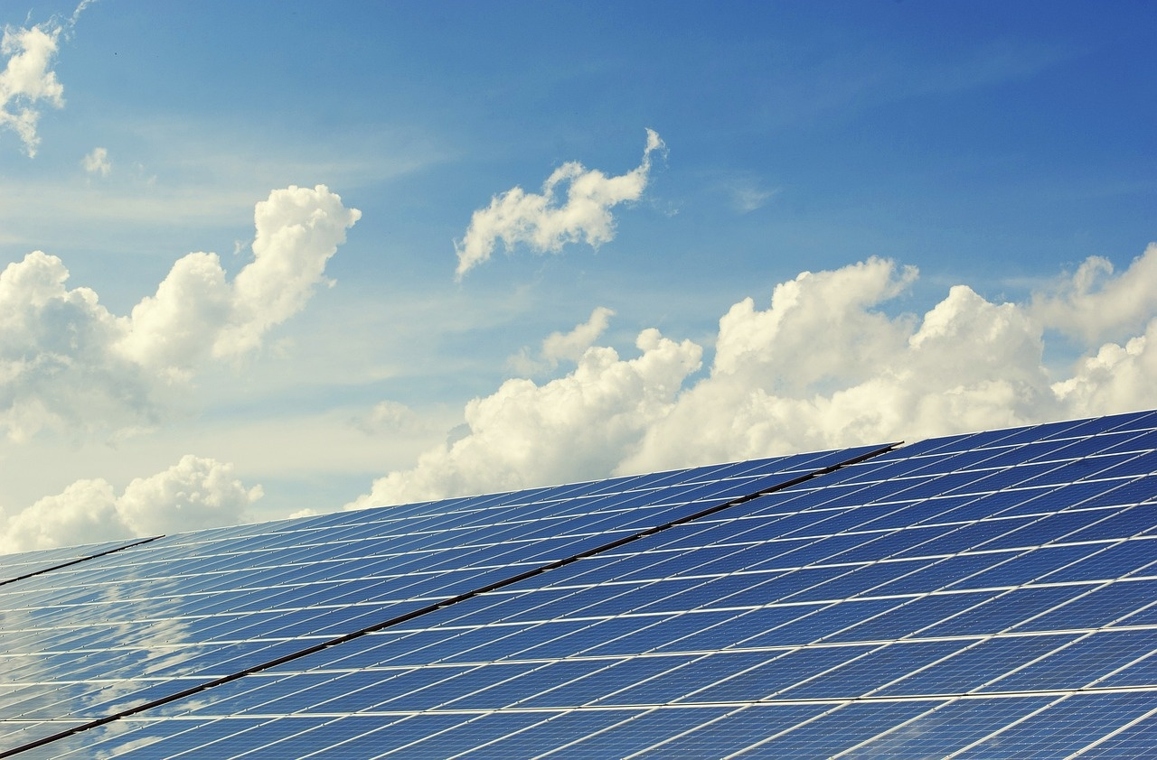
Addressing Global Warming: Mitigation and Adaptation Strategies
Reducing Carbon Footprint
Importance of Sustainable Practices
Evaluating Current Strategies and Proposing New Solutions
Implement energy-efficient technologies in homes and businesses.
Promote the use of public transportation, cycling, and walking to reduce emissions.
Encourage sustainable agriculture and forestry to preserve ecosystems.
Advocate for the adoption of renewable energy sources, such as solar and wind.
Assess the effectiveness of existing policies and initiatives in reducing greenhouse gas emissions.
Explore innovative solutions, such as carbon capture technology and reforestation efforts, to enhance climate resilience.
Global Warming: Understanding Its Causes, Effects, and Solutions
7

Slide 11
The Maldives: A Nation Under Threat
Impacts of Sea-Level Rise
Economic and Social Implications
Adaptation Strategies
Coastal erosion threatening inhabited islands
Increased flooding and loss of arable land
Potential displacement of 100,000 residents by 2050
Tourism-dependent economy at risk, contributing 28% to GDP
Loss of livelihoods for fishing communities
Strain on infrastructure and public services
Construction of sea walls and elevated buildings
Development of artificial islands for relocation
Investment in sustainable tourism and eco-friendly practices
Global Warming: Understanding Its Causes, Effects, and Solutions
8

Slide 12
Calculating Your Carbon Footprint
01
02
03
Step 1: Use a Simplified Calculator
Step 2: Analyze with an Advanced Calculator
Step 3: Design a Personalized Reduction Plan
Begin by using a basic carbon footprint calculator to understand the concept.
This tool will help you estimate your overall carbon emissions based on daily activities such as transportation, energy use, and waste production.
Next, utilize a more advanced carbon footprint calculator that provides a detailed analysis of your individual carbon footprint.
This tool will break down your emissions by category, allowing you to see which areas contribute most to your overall footprint.
Finally, based on the insights gained from the calculators, create a personalized plan to reduce your carbon footprint.
This plan should include specific actions you can take, such as reducing energy consumption, using public transport, or adopting a plant-based diet, tailored to your lifestyle and preferences.
Global Warming: Understanding Its Causes, Effects, and Solutions
9

Slide 13
Simulating the Carbon Cycle
01
02
03
Step 1: Introduce the Carbon Cycle
Step 2: Analyze Human Impact
Step 3: Propose Mitigation Strategies
Utilize a simple interactive simulation to illustrate the fundamental components of the carbon cycle, including processes such as photosynthesis, respiration, and decomposition.
This foundational understanding sets the stage for deeper analysis.
Transition to a more complex simulation that allows students to manipulate variables related to human activities, such as fossil fuel consumption and deforestation.
This step will help students visualize and understand the significant impact these activities have on the carbon cycle and global warming.
Encourage students to design and propose actionable strategies aimed at mitigating the negative effects of human activities on the carbon cycle.
This could include initiatives like reforestation, carbon capture technologies, or changes in energy consumption patterns, fostering critical thinking and problem-solving skills.
Global Warming: Understanding Its Causes, Effects, and Solutions
10

Slide 14
Proposing a Policy to Reduce Carbon Emissions
01
02
03
Understanding Policy-Making
Importance of Policy Changes
Designing a Comprehensive Policy
Introduce the concept of policy-making as a structured process that involves identifying issues, formulating solutions, and implementing changes to address societal challenges, particularly in the context of environmental sustainability.
Discuss how effective policy changes are crucial in reducing carbon emissions, highlighting successful examples from around the world that demonstrate the positive impact of regulatory frameworks on emission reductions and climate change mitigation.
Propose a comprehensive policy that includes measures such as carbon pricing, investment in renewable energy, and incentives for sustainable practices, aimed at significantly reducing carbon emissions and fostering a transition to a low-carbon economy.
Global Warming: Understanding Its Causes, Effects, and Solutions
11

Slide 15
Reflecting on the Future of Our Planet
01
02
03
Recognizing the Urgency of Action
Understanding the Implications for Future Generations
Proposing a Plan for Action
Global warming poses a significant threat to our planet.
Rising temperatures lead to extreme weather events, loss of biodiversity, and disruptions to food and water supplies.
It is crucial to acknowledge that the choices we make today will shape the world for future generations.
The consequences of global warming will disproportionately affect younger generations.
Challenges include increased natural disasters, economic instability, and health risks.
By failing to address these issues now, we risk leaving a legacy of environmental degradation and social inequity.
To mitigate the effects of global warming, we must adopt both individual and collective strategies.
This includes reducing our carbon footprints through sustainable practices.
Advocating for policy changes and participating in community initiatives aimed at environmental conservation.
Global Warming: Understanding Its Causes, Effects, and Solutions
12

Slide 16
Quiz: Global Warming and the Carbon Cycle
01
02
03
Foundation: Basic Understanding Assessment
Core: Analysis and Evaluation Skills Assessment
Extension: Critical Thinking and Problem-Solving Skills Assessment
Create a simple quiz with multiple-choice questions to assess students' basic knowledge of global warming and the carbon cycle.
Example questions could include: What is the primary greenhouse gas responsible for global warming?
Which process removes carbon dioxide from the atmosphere?
Develop a more complex quiz that includes scenario-based questions requiring students to analyze and evaluate the effects of human activities on the carbon cycle.
Example questions could include: How does deforestation impact the carbon cycle?
Evaluate the effectiveness of carbon offset programs in mitigating climate change.
Design a quiz that challenges students to apply critical thinking and problem-solving skills.
This could involve open-ended questions or case studies where students propose solutions to real-world issues related to global warming and the carbon cycle.
Example prompts could include: Propose a community initiative to reduce carbon emissions in your local area.
Analyze a recent policy change aimed at addressing climate change and suggest improvements.
Global Warming: Understanding Its Causes, Effects, and Solutions
13

Slide 17
Debate: Economic Growth vs. Environmental Protection
Economic Growth
Environmental Protection
Proponents argue that economic growth is essential for improving living standards.
Creates jobs and fosters innovation.
A strong economy can provide resources for environmental protection.
Technological advancements can mitigate environmental impacts.
Critics contend that prioritizing economic growth leads to environmental degradation.
Resource depletion and climate change are significant concerns.
Sustainable practices and policies should take precedence.
Advocates for a shift towards green economies and renewable energy sources.
Global Warming: Understanding Its Causes, Effects, and Solutions
14

Slide 18
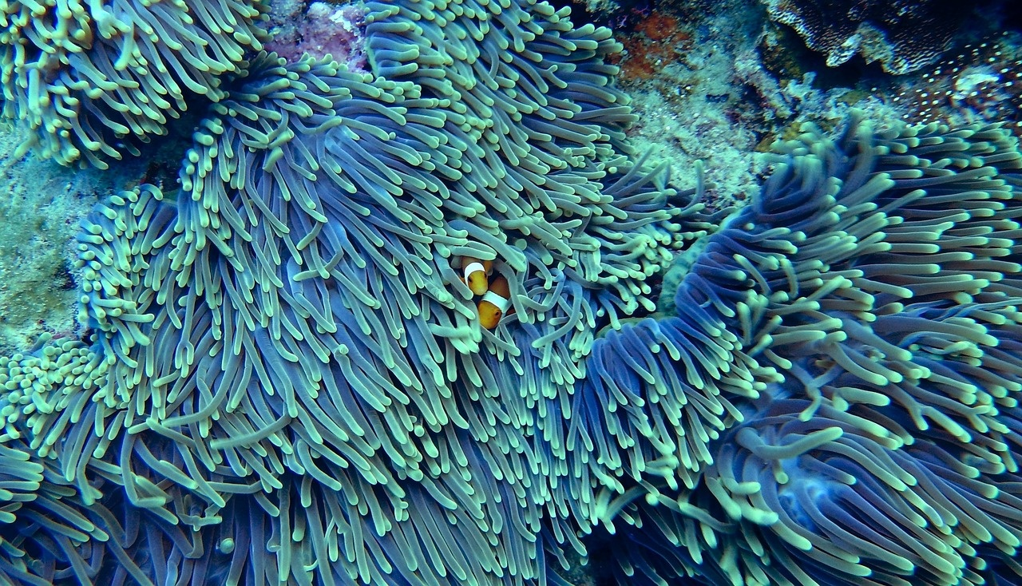
The Great Barrier Reef: A Case Study
Ecosystem Overview
Impacts of Global Warming
Conservation Efforts and Solutions
The Great Barrier Reef is the world's largest coral reef system, home to thousands of marine species.
It plays a crucial role in biodiversity, supporting ecosystems that provide food, habitat, and breeding grounds.
Rising sea temperatures lead to coral bleaching, threatening the survival of coral species and associated marine life.
Ocean acidification affects coral growth and resilience, disrupting the entire marine ecosystem.
Current initiatives include marine protected areas and restoration projects aimed at rehabilitating damaged reefs.
Proposed solutions involve reducing carbon emissions, promoting sustainable tourism, and enhancing community engagement in conservation efforts.
Global Warming: Understanding Its Causes, Effects, and Solutions
15

Slide 19

Rising Sea Levels and Coastal Erosion
Basic Effects of Sea-Level Rise
Economic and Social Implications
Current Adaptation Strategies and New Solutions
Increased flooding and storm surges threaten coastal infrastructure.
Loss of habitat for plants, animals, and even human communities.
Saltwater intrusion into freshwater sources, affecting drinking water supplies.
Displacement of communities leading to increased migration and social tensions.
Economic losses in tourism, fishing, and real estate sectors.
Increased costs for disaster response and infrastructure repair.
Evaluation of seawalls and levees: effectiveness and limitations.
Proposal for nature-based solutions, such as restoring mangroves and wetlands.
Encouragement of community-led adaptation plans that incorporate local knowledge and needs.
Global Warming: Understanding Its Causes, Effects, and Solutions
16

Slide 20
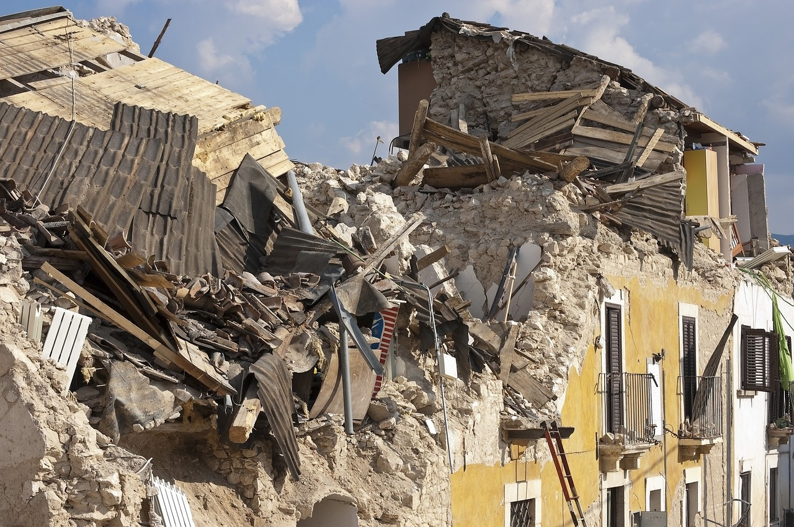
Geological Changes and Human Activities
Introduction to Geological Changes
Impacts on Ecosystems and Human Settlements
Case Studies and Mitigation Strategies
Human activities, such as mining, deforestation, and urbanization, significantly alter geological processes.
These changes can lead to soil erosion, land degradation, and altered natural landscapes.
Disruption of natural habitats affects biodiversity and ecosystem services.
Increased flooding and landslides threaten human settlements, particularly in vulnerable areas.
Case Study: The Netherlands - Innovative flood management techniques to combat land subsidence.
Mitigation Strategies - Implementing sustainable land-use practices and restoring natural habitats to enhance resilience against geological changes.
Global Warming: Understanding Its Causes, Effects, and Solutions
17

Slide 21
Mitigation and Adaptation Strategies: A Global Perspective
Global Cooperation
International Agreements
Evaluating Current Efforts and Proposing New Solutions
Importance of collaborative efforts among nations to combat climate change.
Role of international organizations in facilitating dialogue and action.
Overview of key agreements such as the Paris Agreement and their objectives.
Assessment of commitments made by countries and their impact on global warming.
Analysis of the effectiveness of existing global initiatives in reducing emissions.
Suggestions for innovative strategies, including technology transfer and financial support for developing nations.
Global Warming: Understanding Its Causes, Effects, and Solutions
18

Slide 22
Conclusion: Understanding Global Warming and its Impacts
The Urgency of Addressing Global Warming
Implications for Ecosystems and Human Societies
Call to Action for Individuals and Communities
Global warming poses a significant threat to our planet, necessitating immediate action to mitigate its effects and protect future generations.
The impacts of global warming are profound, leading to biodiversity loss, altered weather patterns, and increased vulnerability of human communities, particularly in coastal regions.
Collective efforts, such as reducing carbon footprints and advocating for sustainable practices, are essential in combating global warming and fostering a healthier planet.
Global Warming: Understanding Its Causes, Effects, and Solutions
19

Slide 23
Next Steps: Taking Action Against Global Warming
01
02
03
Recognize the Urgency of Action
Embrace Individual and Collective Responsibility
Innovate and Implement New Solutions
Understand that global warming is a pressing issue that requires immediate attention.
Acknowledge the scientific consensus on climate change and its potential catastrophic effects on our planet.
Realize that every action counts.
Individuals can reduce their carbon footprint through lifestyle changes.
Collective efforts, such as community initiatives and policy advocacy, can drive significant change at a larger scale.
Evaluate the effectiveness of current strategies and explore innovative solutions.
Consider renewable energy technologies, carbon capture methods, and sustainable practices.
Encourage collaboration among governments, businesses, and communities to develop and implement these solutions effectively.
Global Warming: Understanding Its Causes, Effects, and Solutions
20

