Slide 1

Comprehensive Overview of Electromagnetic Fields and Forces
Fundamentals, Properties, Applications, and Safety in Electromagnetism

Slide 2
Table of Contents
Introduction to Electromagnetic Fields and For…
What are Electromagnetic Fields?
Properties of Electromagnetic Fields
Electric and Magnetic Fields
Electromagnetic Forces
Real-Life Applications of Electromagnetic Fiel…
Electromagnetic Induction
Electromagnetic Waves
Electromagnetic Safety
Common Errors and Misconceptions
Conclusion
Summary
Key Takeaways
04
05
06
07
08
09
10
11
12
13
14
15
16

Slide 3
Table of Contents
Reflection Questions
Next Steps
Additional Resources
Assessment and Evaluation
Conclusion and Final Thoughts
17
18
19
20
21

Slide 4

Introduction to Electromagnetic Fields and Forces
Fundamentals of Electromagnetic Fields
Exploring Electromagnetic Properties
Significance of Electromagnetic Forces
Electromagnetic fields and forces are fundamental concepts in physics with numerous applications in everyday life.
Understanding these concepts is crucial for advanced studies in physics and engineering.
In this lesson, we will explore the properties of electromagnetic fields.
We will also examine the differences between electric and magnetic fields.
The importance of electromagnetic forces will be highlighted.
These forces play a vital role in various scientific and engineering applications.
4
Comprehensive Overview of Electromagnetic Fields and Forces

Slide 5

What are Electromagnetic Fields?
Definition of Electromagnetic Fields
Creation of Electromagnetic Fields
Electromagnetic fields are areas around charged particles or objects where the force of electromagnetism can be detected.
They are fundamental to understanding the interaction of electric and magnetic forces.
They are created by the interaction of electric and magnetic fields.
This interaction is a cornerstone of electromagnetism.
Types of Electromagnetic Fields
Examples of Electromagnetic Fields
Electromagnetic fields can be either static or dynamic.
Static fields do not change over time, while dynamic fields vary.
Examples include the Earth's magnetic field and the electromagnetic field around a wire carrying an electric current.
These examples illustrate the natural and man-made presence of such fields.
5
Comprehensive Overview of Electromagnetic Fields and Forces

Slide 6

Properties of Electromagnetic Fields
Direction of Electromagnetic Fields
Direction of Electromagnetic Fields
The strength of an electromagnetic field is measured in units of teslas or gauss.
This property determines the intensity of the field at a given point.
The direction of an electromagnetic field is measured in degrees.
It indicates the orientation of the field in space.
Range of Electromagnetic Fields
Overview of Electromagnetic Field Properties
The range of an electromagnetic field is the distance over which the field can be detected.
This property defines the spatial extent of the field's influence.
Electromagnetic fields have several properties, including strength, direction, and range.
These properties collectively describe the behavior and characteristics of the field.
6
Comprehensive Overview of Electromagnetic Fields and Forces

Slide 7
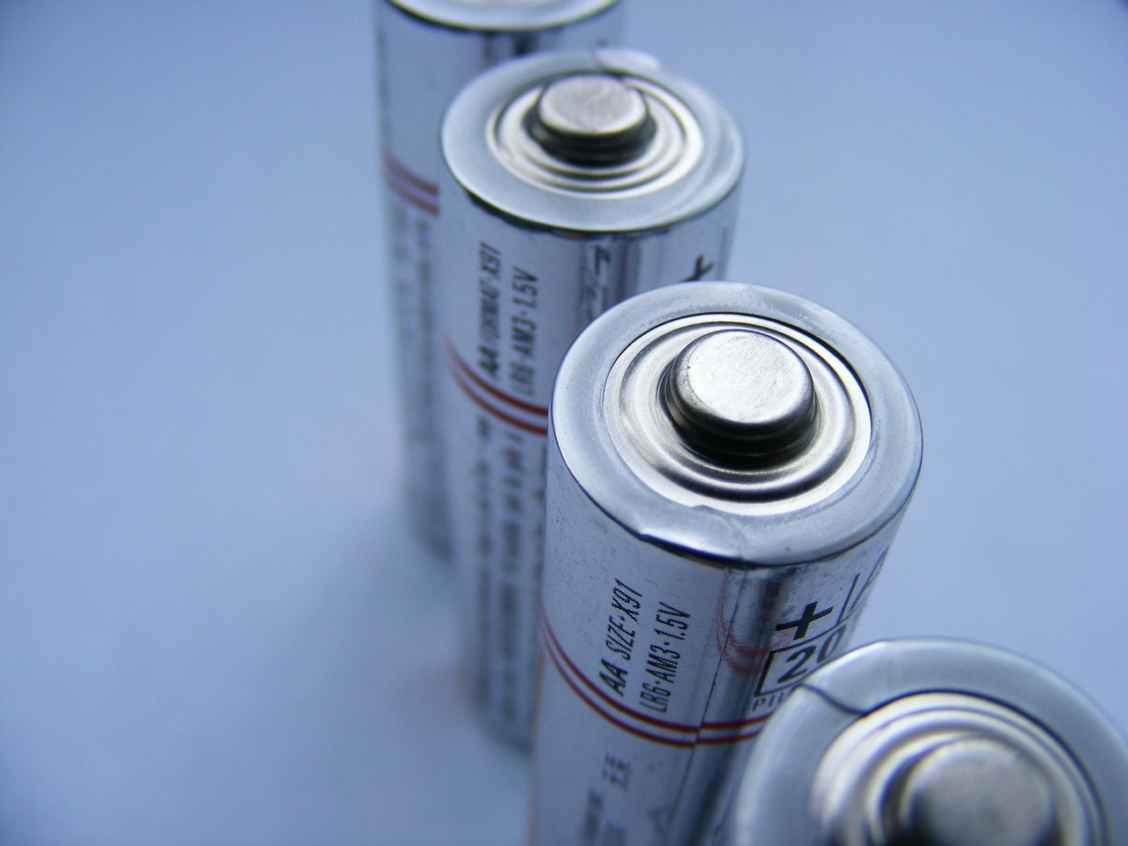
Electric and Magnetic Fields
01
Electric Fields and Charged Particles
Electric fields are produced by charged particles.
They are a fundamental aspect of electromagnetic phenomena.
02
Magnetic Fields and Moving Charges
Magnetic fields are produced by moving charges.
This relationship is key to understanding magnetism.
03
Distinct Yet Interconnected Fields
Electric and magnetic fields are closely related but distinct.
Their interaction is crucial for understanding various physical phenomena.
04
Applications in Technology and Nature
The interaction between electric and magnetic fields is essential for the behavior of charged particles.
It also underpins the operation of electric motors and generators.
7
Comprehensive Overview of Electromagnetic Fields and Forces

Slide 8

Electromagnetic Forces
01
Definition of Electromagnetic Forces
Electromagnetic forces are the interactions between electromagnetic fields and charged particles or objects.
These forces can manifest as either attractive or repulsive depending on the nature of the charges involved.
02
Factors Influencing Electromagnetic Forces
The strength of electromagnetic forces depends on the intensity of the electromagnetic fields.
It also relies on the amount of charge present in the interacting particles or objects.
03
Applications in Everyday Life
Electromagnetic forces are integral to the functioning of electric motors and generators.
These forces enable the conversion of electrical energy into mechanical energy and vice versa.
04
Significance of Electromagnetic Forces
Electromagnetic forces are fundamental to many natural and technological phenomena.
They play a crucial role in shaping interactions at both microscopic and macroscopic levels.
8
Comprehensive Overview of Electromagnetic Fields and Forces

Slide 9
Real-Life Applications of Electromagnetic Fields and Forces
Medical Imaging Techniques
Wireless Communication Systems
Electricity Generation and Transmission
Technological and Engineering Applications
Electromagnetic fields and forces are used in medical imaging techniques such as MRI and CT scans.
These technologies rely on electromagnetic principles to create detailed images of the human body.
Electromagnetic fields and forces are used in wireless communication systems, such as radio and mobile phones.
They enable the transmission of information over long distances without physical connections.
Electromagnetic fields and forces are used in electricity generation and transmission.
This includes the operation of power plants and the distribution of electricity to homes and businesses.
Electromagnetic fields and forces have numerous other applications in technology and engineering.
These applications span a wide range of industries, driving innovation and efficiency.
9
Comprehensive Overview of Electromagnetic Fields and Forces

Slide 10
Electromagnetic Induction
01
Understanding Electromagnetic Induction
Electromagnetic induction is the process by which a changing magnetic field induces an electric field.
This phenomenon is fundamental to the principles of electromagnetism.
02
Applications in Electrical Devices
Electromagnetic induction is crucial in the operation of generators, motors, and transformers.
These devices rely on the induced electric field to function effectively.
03
Practical Uses in Modern Technology
Electromagnetic induction has numerous practical applications, including the generation of electricity and the operation of electric vehicles.
It plays a vital role in powering modern technological advancements.
04
Significance in Electromagnetic Theory
Electromagnetic induction is an important concept in understanding the behavior of electromagnetic fields and forces.
This understanding is essential for advancements in physics and engineering.
10
Comprehensive Overview of Electromagnetic Fields and Forces

Slide 11

Electromagnetic Waves
01
Introduction to Electromagnetic Waves
03
Applications of Electromagnetic Waves
Electromagnetic waves are waves that propagate through the electromagnetic field.
They are fundamental to understanding various phenomena in physics and technology.
Electromagnetic waves are integral to wireless communication systems.
They are also used in medical imaging techniques.
02
Types of Electromagnetic Waves
04
Significance of Electromagnetic Waves
Electromagnetic waves can be classified into radio waves, microwaves, infrared radiation, visible light, ultraviolet radiation, X-rays, and gamma rays.
Each type has distinct properties and applications.
Electromagnetic waves play a crucial role in modern technologies.
Their study helps in advancing scientific and technological innovations.
11
Comprehensive Overview of Electromagnetic Fields and Forces

Slide 12

Electromagnetic Safety
Understanding Electromagnetic Safety
Applications of Electromagnetic Safety
Electromagnetic safety is the practice of reducing the risks associated with electromagnetic fields.
It is crucial in protecting electronic devices from electromagnetic interference and reducing radiation exposure in various settings.
Electromagnetic safety plays a vital role in medical and industrial environments.
It ensures the protection of sensitive equipment and minimizes health risks associated with radiation exposure.
Safety Measures in Electromagnetic Fields
Designing Technologies with Safety in Mind
Personal protective equipment, such as gloves and safety glasses, are essential for electromagnetic safety.
Safety protocols, including limiting exposure to electromagnetic radiation, are implemented to reduce risks.
Electromagnetic safety is a key consideration in the development of technologies using electromagnetic fields.
This ensures that devices are both effective and safe for users and the environment.
12
Comprehensive Overview of Electromagnetic Fields and Forces

Slide 13

Common Errors and Misconceptions
Misconception About Electric and Magnetic Fields
Misconception About Propagation of Electromagnetic Waves
One common error is the misconception that electric and magnetic fields are separate entities.
This misunderstanding can be addressed by demonstrating their interdependence in electromagnetic phenomena.
Another common error is the misconception that electromagnetic waves require a medium to propagate.
Clarifying this can involve explaining the nature of wave propagation in a vacuum.
Misconception About Electromagnetic Fields in Applications
Remediation Through Examples and Explanations
A third common error is the misconception that electromagnetic fields are only relevant in high-voltage applications.
Educators can provide examples of everyday low-voltage applications to counter this belief.
These errors can be remediated by providing students with examples and explanations of how electric and magnetic fields interact.
Additionally, educators can illustrate how electromagnetic waves propagate in various scenarios.
13
Comprehensive Overview of Electromagnetic Fields and Forces

Slide 14

Conclusion
Importance of Electromagnetic Fields
Applications in Everyday Life
Deeper Understanding of the Physical World
Understanding electromagnetic fields and forces is crucial for advanced studies in physics and engineering.
These concepts form the foundation for numerous technological advancements.
Electromagnetic fields and forces have numerous applications in everyday life, including medical imaging, wireless communication, and electricity generation.
These applications demonstrate the practical significance of mastering these concepts.
By mastering the concepts of electromagnetic fields and forces, students can develop a deeper understanding of the physical world.
This knowledge helps appreciate the importance of these concepts in various technologies and applications.
14
Comprehensive Overview of Electromagnetic Fields and Forces

Slide 15

Summary
01
Understanding Electromagnetic Fields
Electromagnetic fields are areas around charged particles or objects where the force of electromagnetism can be detected.
Electric and magnetic fields are closely related but distinct.
02
Interactions of Electromagnetic Forces
Electromagnetic forces are the interactions between electromagnetic fields and charged particles or objects.
These forces play a crucial role in the behavior of charged particles.
03
Applications in Technology and Engineering
Electromagnetic fields and forces have numerous applications in technology and engineering.
Examples include medical imaging, wireless communication, and electricity generation.
04
Significance in Modern Innovations
The study of electromagnetic fields is essential for advancing modern technologies.
It enables breakthroughs in various fields, enhancing everyday life.
15
Comprehensive Overview of Electromagnetic Fields and Forces

Slide 16
Key Takeaways
Electromagnetic Fields Defined
Electric and Magnetic Fields
Electromagnetic Forces
Electromagnetic fields are areas around charged particles or objects where the force of electromagnetism can be detected.
These fields are fundamental to understanding the behavior of charged particles in various environments.
Electric and magnetic fields are closely related but distinct.
Each field has unique properties and plays a specific role in electromagnetic interactions.
Electromagnetic forces are the interactions between electromagnetic fields and charged particles or objects.
These forces are essential in numerous natural and technological processes.
16
Comprehensive Overview of Electromagnetic Fields and Forces

Slide 17
Reflection Questions
1
Properties of Electromagnetic Fields
2
Technological Applications
What are the properties of electromagnetic fields?
How do electric and magnetic fields interact?
What are the applications of electromagnetic fields and forces in technology and engineering?
How can electromagnetic safety be ensured in various applications?
3
Field Interactions
4
Safety Measures
How do electric and magnetic fields interact?
What are the properties of electromagnetic fields?
How can electromagnetic safety be ensured in various applications?
What are the applications of electromagnetic fields and forces in technology and engineering?
17
Comprehensive Overview of Electromagnetic Fields and Forces

Slide 18

Next Steps
1
Electromagnetic Induction
The next lesson will cover electromagnetic induction and its applications.
This topic explores how changing magnetic fields can induce electric currents.
2
Electromagnetic Waves
The next lesson will cover electromagnetic waves and their properties.
This includes understanding their behavior and significance in various contexts.
3
Applications in Engineering
The next lesson will cover the applications of electromagnetic fields and forces in engineering and technology.
This will highlight their role in modern technological advancements.
18
Comprehensive Overview of Electromagnetic Fields and Forces

Slide 19

Additional Resources
01
Textbooks and Online Resources
Textbooks and online resources can provide additional information on electromagnetic fields and forces.
These materials serve as foundational tools for understanding the subject.
02
Simulations and Games
Simulations and games can help students visualize and interact with electromagnetic fields and forces.
They offer an engaging way to explore complex concepts.
03
Real-Life Examples and Case Studies
Real-life examples and case studies can help students appreciate the applications of electromagnetic fields and forces.
These examples bridge the gap between theory and practical use.
04
Online Forums and Discussion Groups
Online forums and discussion groups can provide a platform for students to ask questions and share ideas.
They foster collaborative learning and peer support.
19
Comprehensive Overview of Electromagnetic Fields and Forces

Slide 20

Assessment and Evaluation
01
Projects and Presentations
03
Self-Assessment and Peer Review
Quizzes and tests can be used to assess students' understanding of electromagnetic fields and forces.
These tools provide a structured way to measure knowledge retention and comprehension.
Class discussions and group work can be used to assess students' critical thinking and problem-solving skills.
These activities foster collaboration and the exchange of diverse perspectives.
02
Projects and Presentations
04
Self-Assessment and Peer Review
Projects and presentations can be used to evaluate students' ability to apply their knowledge in practical scenarios.
They encourage creativity and the application of theoretical concepts to real-world problems.
Self-assessment and peer review can be used to help students reflect on their own learning and identify areas for improvement.
They promote self-awareness and constructive feedback among students.
20
Comprehensive Overview of Electromagnetic Fields and Forces

Slide 21
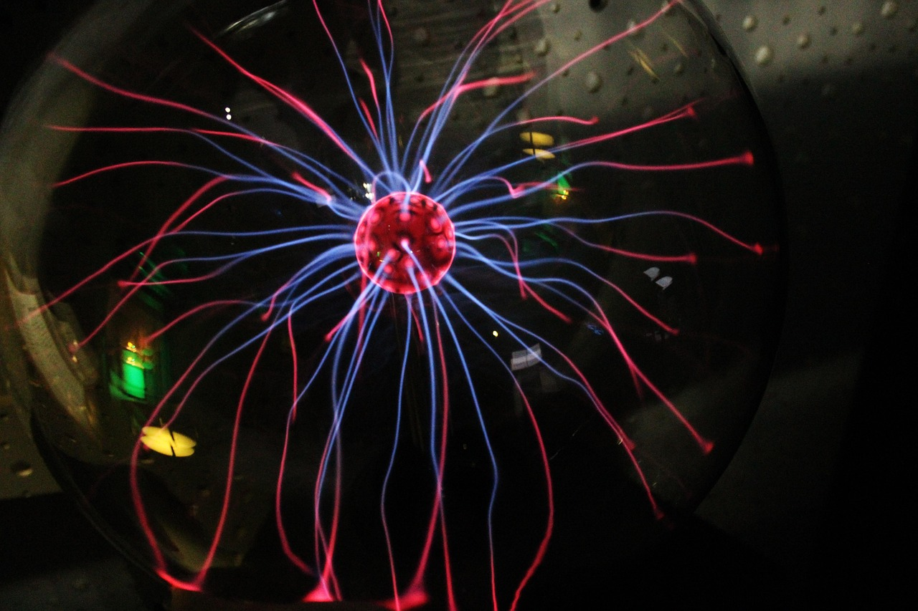
Conclusion and Final Thoughts
1
Importance of Electromagnetic Fields
Understanding electromagnetic fields and forces is crucial for advanced studies in physics and engineering.
These concepts form the foundation for numerous scientific and technological advancements.
2
Applications in Everyday Life
Electromagnetic fields and forces have numerous applications in everyday life, including medical imaging, wireless communication, and electricity generation.
These technologies rely on the principles of electromagnetism to function effectively.
3
Educational and Technological Impact
By mastering the concepts of electromagnetic fields and forces, students can develop a deeper understanding of the physical world.
This knowledge highlights the importance of these concepts in various technologies and applications.
21
Comprehensive Overview of Electromagnetic Fields and Forces

