Slide 1


Unraveling the Mystery of Midnight Radio
Exploring the Enigmatic Signals and Perils in a Coastal Town

Slide 2
Table of contents
Setting
Main Characters
Central Conflict
Plot Elements
Maya Chen
Marcus Thompson
Abandoned Radio Station
Coastal Town
Mysterious Signals
Investigating the Broadcasts
01
02
03
04
05
06
07
08
09
10

Slide 3
Table of contents
Dangerous Occurrences
Parents' Disappearance
Radio Station Closure
Coded Messages
Investigation Progress
Lighthouse Nearby
Maya's Curiosity
Static's Past
Dangerous Threats
Midnight Radio Station
11
12
13
14
15
16
17
18
19
20

Slide 4

Setting
Coastal Town
Located by the sea
Crashing waves
Salty air
Abandoned Radio Station
Perched on a cliff
Overlooking the town and the ocean
Timeframe
Mysterious signals broadcast only between 2:00 and 3:00 AM
Atmosphere
A sense of eerie quietude
Envelops the station and its surroundings
Isolation
The station stands alone
Surrounded by rugged cliffs and wild nature
Unraveling the Mystery of Midnight Radio
1

Slide 5

Main Characters
Maya Chen
Marcus "Static" Thompson
17-year-old aspiring journalist
Wears oversized vintage sweaters and horn-rimmed glasses
Known for her insatiable curiosity and inability to let mysteries rest
Parents disappeared three years ago while investigating a story
70-year-old former radio DJ
Weather-worn face with kind eyes
Lives in a lighthouse nearby
Refuses to talk about the night the station closed 30 years ago
Unraveling the Mystery of Midnight Radio
2

Slide 6
Maya's Pursuit
Central Conflict
Maya's relentless pursuit of the truth about her parents' disappearance leads her to investigate the mysterious broadcasts from the abandoned radio station.
01
Coded Messages
The coded messages hidden within the broadcasts hint at a dark secret from the past, driving Maya to unravel the enigma behind the midnight transmissions.
02
Escalating Dangers
03
As Maya delves deeper into the mystery, she faces escalating dangers that threaten not only her quest for answers but also the very existence of the radio station.
Ominous Forces
04
The ominous forces at play seek to silence the station and prevent Maya from uncovering the truth, creating a suspenseful battle between curiosity and hidden adversaries.
Unraveling the Mystery of Midnight Radio
3

Slide 7

Plot Elements
Introduction to Midnight Radio Station
Maya Chen's Investigation
Abandoned radio station on a cliff
Mysterious signals broadcast between 2:00 and 3:00 AM
Maya's parents disappeared while investigating a story
Maya's curiosity drives her to uncover the truth behind the broadcasts
Marcus "Static" Thompson
Central Conflict
Former radio DJ with a secretive past
Lives in a nearby lighthouse and holds key information
Maya's pursuit of the truth leads to dangerous encounters
Threats to the station's existence escalate as Maya gets closer to uncovering the coded messages
Unraveling the Mystery of Midnight Radio
4

Slide 8

Maya Chen
Maya Chen
17-year-old aspiring journalist
Wears oversized vintage sweaters and horn-rimmed glasses
Known for her insatiable curiosity and inability to let mysteries rest
Parents disappeared three years ago while investigating a story
Unraveling the Mystery of Midnight Radio
5

Slide 9

Marcus Thompson
Role
Former radio DJ known as "Static"
Age
70 years old
Appearance
Weather-worn face with kind eyes
Residence
Lives in a lighthouse nearby
Mysterious Past
Refuses to talk about the night the station closed 30 years ago
Unraveling the Mystery of Midnight Radio
6

Slide 10

Abandoned Radio Station
Location
Situated atop a cliff in a small coastal town.
Broadcasting Hours
Mysterious signals transmitted only between 2:00 and 3:00 AM.
History
Station closed 30 years ago under mysterious circumstances.
Current State
Dilapidated building with broken windows and overgrown vegetation.
Atmosphere
Eerie and unsettling ambiance surrounds the station.
Unraveling the Mystery of Midnight Radio
7

Slide 11

Coastal Town
Location
Atmosphere
Situated on the rugged coastline
Overlooks the vast expanse of the ocean
Abandoned radio station perched on a cliff
Salty sea breeze
Sound of crashing waves
Hauntingly beautiful backdrop
Community
Architecture
Tight-knit community of fishermen and artists
Whispers about strange broadcasts
Midnight radio station mysteries
Quaint cottages with weathered shingles
Cobblestone streets
Imposing lighthouse where Marcus 'Static' Thompson resides
Unraveling the Mystery of Midnight Radio
8

Slide 12

Mysterious Signals
Eerie Tones
Residents report hearing faint, otherworldly melodies intertwined with static.
Unexplained Patterns
Strange sequences of beeps and clicks have been recorded by amateur radio enthusiasts.
Cryptic Messages
Listeners claim to have deciphered snippets of conversations in unknown languages.
Frequency Fluctuations
The signal strength varies unpredictably, adding to the enigmatic nature of the broadcasts.
Unraveling the Mystery of Midnight Radio
9

Slide 13
Maya's Discovery
Investigating the Broadcasts
Maya stumbles upon an old journal in the radio station
Hints at a connection between the broadcasts and her parents' investigation
01
Decoding the Messages
Maya enlists the help of a cryptographer
Decipher the coded messages hidden within the broadcasts
02
Encountering Static
03
Marcus 'Static' Thompson opens up about the night the station closed
Reveals crucial information about the mysterious broadcasts
Unraveling the Past
04
Maya delves deeper into the history of the radio station
Uncovers dark secrets linking the broadcasts to a long-forgotten tragedy
Unraveling the Mystery of Midnight Radio
10

Slide 14

Dangerous Occurrences
Mysterious Power Outages
Unexplained Equipment Malfunctions
During Maya's late-night investigations at the radio station, sudden power outages occur, plunging the area into darkness and adding an eerie atmosphere to the already mysterious broadcasts.
As Maya delves deeper into decoding the messages, the radio equipment starts malfunctioning on its own, emitting strange noises and interfering with the signals, making it difficult for her to decipher the messages.
Sinister Shadows
Threatening Messages
While exploring the abandoned station, Maya catches glimpses of shadowy figures lurking in the corners, disappearing as quickly as they appear, leaving her unsettled and questioning if she's truly alone in the station.
Maya receives cryptic messages warning her to stay away from the radio station, written in an old-fashioned script that matches the station's historical records, heightening the sense of danger surrounding her investigation.
Unraveling the Mystery of Midnight Radio
11

Slide 15
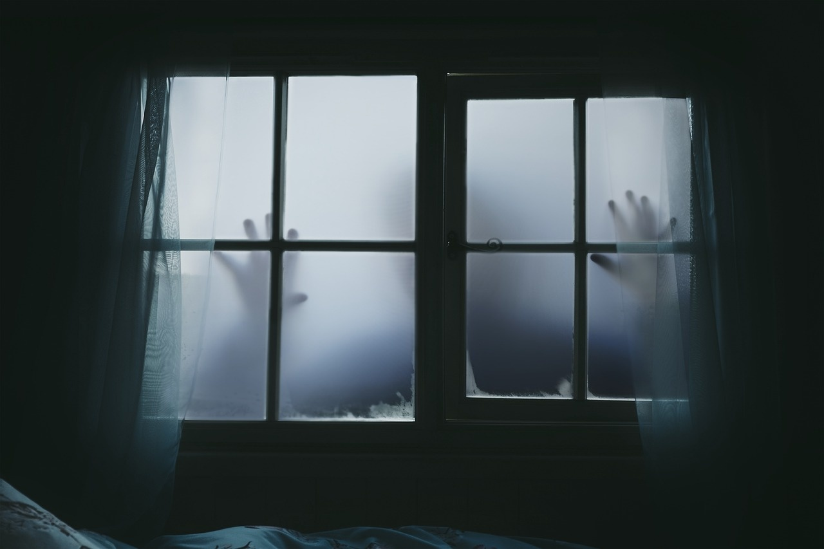
Parents' Disappearance
Maya's parents, investigative journalists, went missing three years ago while looking into a story related to the abandoned radio station.
The last known location of Maya's parents was traced to the mysterious radio station atop the cliff.
Despite extensive search efforts, no concrete leads or clues have surfaced regarding the whereabouts of Maya's parents.
Maya's relentless pursuit of the truth about her parents' disappearance drives her to uncover the secrets hidden within the midnight radio broadcasts.
The unresolved mystery surrounding her parents' vanishing fuels Maya's determination to solve the puzzle of the midnight radio station.
Unraveling the Mystery of Midnight Radio
12

Slide 16

Radio Station Closure
Mysterious Disappearance
Marcus's Silence
Maya's parents vanished without a trace while investigating a story at the radio station.
Marcus "Static" Thompson, the former radio DJ, refuses to discuss the events leading to the station's closure 30 years ago.
Unexplained Circumstances
Lingering Secrets
The closure of the radio station remains shrouded in mystery, with no clear explanation for its sudden shutdown.
Despite years passing, the secrets surrounding the station's closure continue to haunt the small coastal town.
Unraveling the Mystery of Midnight Radio
13

Slide 17

Coded Messages
Frequency 107.9 MHz
The specific frequency where the coded messages are transmitted.
Repeated Patterns
Maya notices recurring patterns in the broadcasts, hinting at a hidden message.
Binary Code
Some messages seem to be encoded in binary, requiring decoding.
Morse Code
Occasional bursts of Morse code add another layer of complexity to the messages.
Hidden Coordinates
Coordinates embedded within the broadcasts lead Maya to mysterious locations.
Unraveling the Mystery of Midnight Radio
14

Slide 18
01
Interview with Marcus "Static" Thompson
Investigation Progress
Gathered insights on the history of the radio station
Uncovered potential connections to Maya's parents' investigation
02
Decoding the Mysterious Broadcasts
Identified recurring patterns in the coded messages
Discovered references to local landmarks and historical events
03
Exploration of the Abandoned Radio Station
Found hidden compartments and old equipment
Recovered a journal hinting at past secrets
Unraveling the Mystery of Midnight Radio
15

Slide 19

Lighthouse Nearby
Marcus "Static" Thompson
Coastal Setting
Connection to Maya's Investigation
Lives in a lighthouse near the abandoned radio station.
Former radio DJ with a mysterious past.
Refuses to discuss the events of the station's closure 30 years ago.
The lighthouse overlooks the cliff where the radio station stands.
Provides a beacon of light in the darkness of the night.
Symbolizes safety and guidance amidst the unknown.
Maya seeks answers from Marcus about the station's history.
The lighthouse serves as a constant presence in Maya's quest for the truth.
Represents a link between the past and present mysteries.
Unraveling the Mystery of Midnight Radio
16

Slide 20

Maya's Curiosity
Maya's Curiosity
Maya's insatiable curiosity led her to uncover a hidden compartment in her parents' old desk.
She found a faded photograph of her parents standing in front of the mysterious radio station.
Determined to solve the puzzle, Maya decoded a message that hinted at a secret room within the station.
Despite warnings from Marcus 'Static' Thompson, Maya ventured into the abandoned station late one night.
Inside, she discovered a journal belonging to her parents, detailing their investigation into the coded broadcasts.
Maya's curiosity intensified as she realized the messages were connected to her parents' disappearance.
Unraveling the Mystery of Midnight Radio
17

Slide 21

Static's Past
Radio Legacy
Mysterious Disappearance
Marcus "Static" Thompson was a renowned radio DJ at the Midnight Radio Station for over 20 years.
Static abruptly stopped broadcasting 30 years ago, leaving behind a trail of unanswered questions.
Lighthouse Dweller
Silent Secrets
After the station's closure, Static retreated to the nearby lighthouse, where he now lives a reclusive life.
Despite numerous inquiries, Static remains tight-lipped about the events leading to the station's shutdown.
Unraveling the Mystery of Midnight Radio
18

Slide 22

Dangerous Threats
Mysterious Disappearances
Unexplained Power Outages
Strange Figures Lurking
Several townspeople have gone missing after listening to the midnight broadcasts.
The town experiences frequent power outages coinciding with the broadcast hours.
Residents report seeing shadowy figures near the radio station late at night.
Unraveling the Mystery of Midnight Radio
19

Slide 23
Setting
Midnight Radio Station
Small coastal town
Abandoned radio station atop a cliff
Mysterious signals broadcast only between 2:00 and 3:00 AM
01
Main Characters
Maya Chen: 17-year-old aspiring journalist
Marcus 'Static' Thompson: 70-year-old former radio DJ
02
Central Conflict
03
Maya investigates mysterious broadcasts with coded messages from the past
Dangerous occurrences threaten to silence the station forever as Maya gets closer to the truth
Plot Elements
04
Mystery unfolds as Maya deciphers coded messages
Dangerous occurrences escalate, threatening the station's existence
Unraveling the Mystery of Midnight Radio
20

