Slide 1

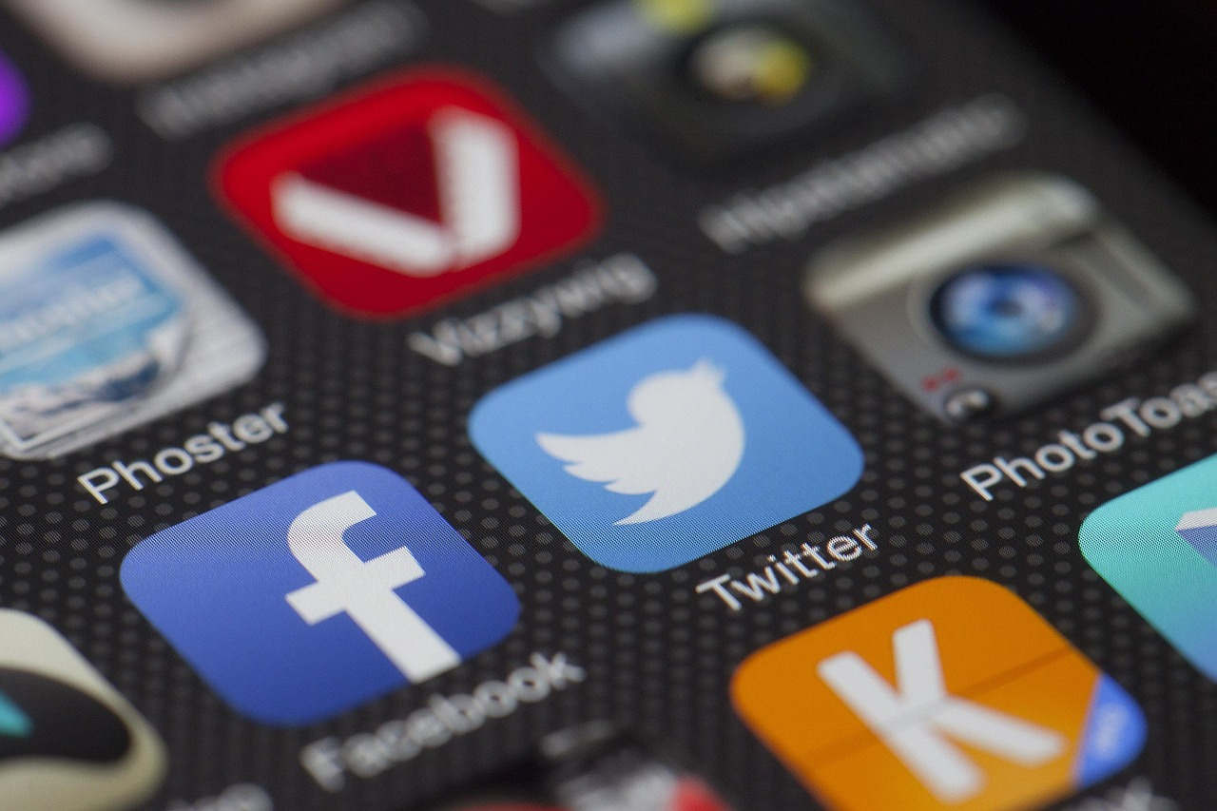
Deep Learning: Foundations and Applications in Image and Speech Recognition
Exploring Neural Networks, Frameworks, and Future Innovations

Slide 2
Table of Contents
Introduction to Deep Learning
Convolutional Neural Networks (CNNs)
Recurrent Neural Networks (RNNs)
Deep Learning Frameworks
Image Recognition using CNNs
Speech Recognition using RNNs
Transfer Learning
Deep Learning Applications
Challenges and Limitations
Future Developments
Conclusion
References
Glossary
04
05
06
07
08
09
10
11
12
13
14
15
16

Slide 3
Table of Contents
Summary
Final Thoughts
Next Steps
17
18
19

Slide 4
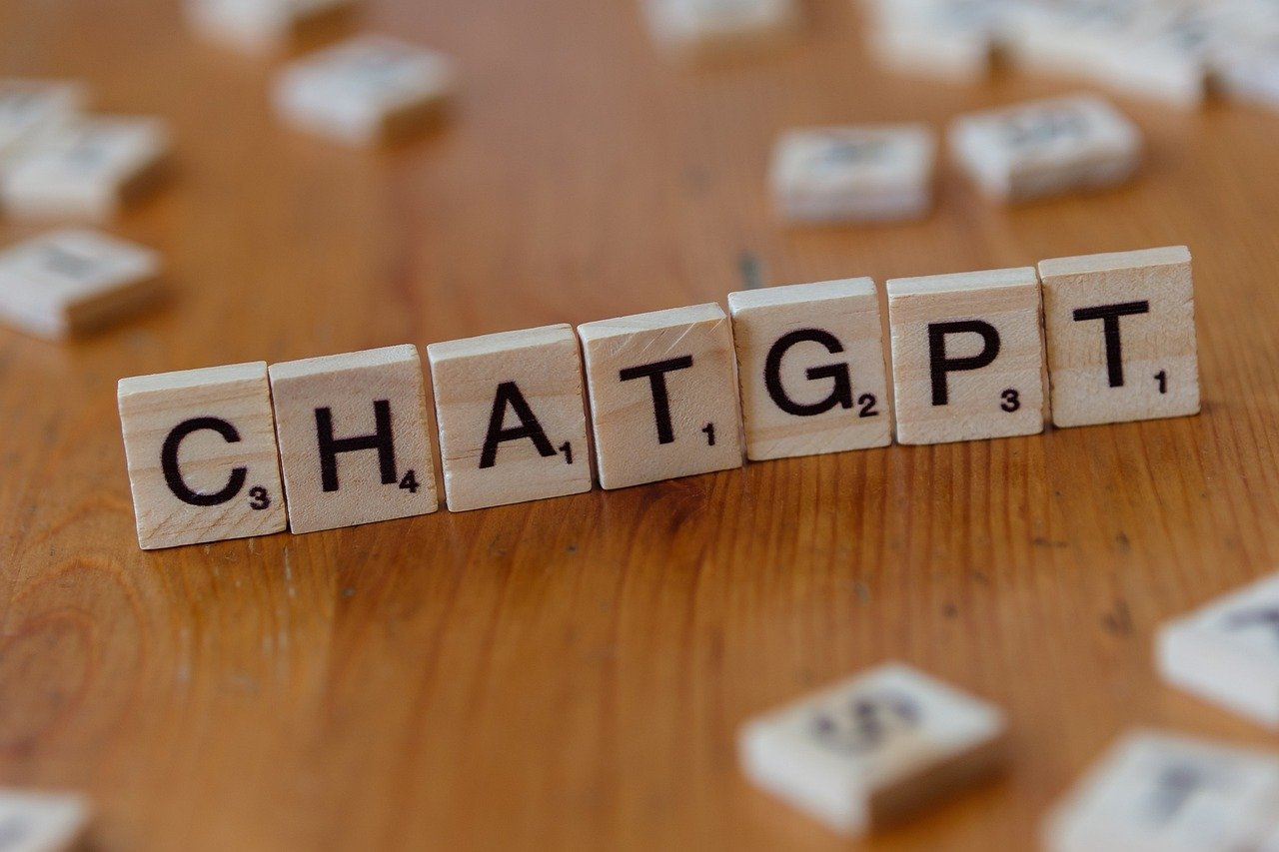
Introduction to Deep Learning
Understanding Deep Learning
Applications Across Industries
Focus of the Presentation
Deep learning is a subset of machine learning that uses neural networks with multiple layers to analyze and interpret complex data, such as images and speech.
It enables machines to learn from vast amounts of data and make predictions or decisions without explicit programming.
Deep learning techniques have numerous applications in various industries, including healthcare, finance, and transportation.
These applications range from diagnosing diseases to fraud detection and autonomous vehicles.
This presentation will introduce the fundamental concepts and techniques of deep learning for image and speech recognition.
Attendees will gain insights into how deep learning models are trained and applied in real-world scenarios.
4
Deep Learning: Foundations and Applications in Image and Speech Recognition

Slide 5
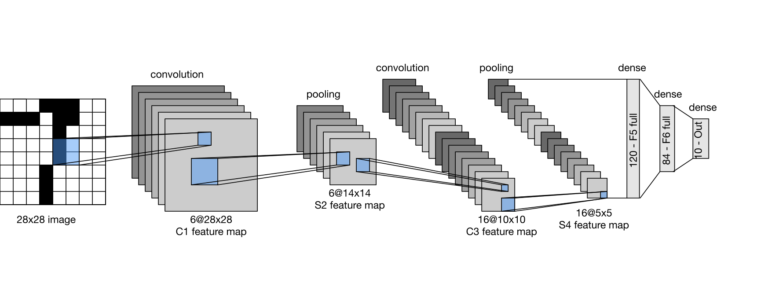
Convolutional Neural Networks (CNNs)
Introduction to CNNs
Core Components of CNNs
CNNs are a type of neural network designed to process data with spatial hierarchies, such as images.
They are specifically tailored to handle structured data like images effectively.
CNNs use convolutional and pooling layers to extract features from images.
These layers help in identifying patterns and reducing the dimensionality of the data.
Applications of CNNs
Examples of CNN Architectures
CNNs are commonly used for image recognition tasks, such as image classification and object detection.
Their ability to learn spatial hierarchies makes them ideal for these tasks.
Examples of CNNs include LeNet, AlexNet, and VGGNet.
These architectures have been pivotal in advancing the field of computer vision.
5
Deep Learning: Foundations and Applications in Image and Speech Recognition

Slide 6
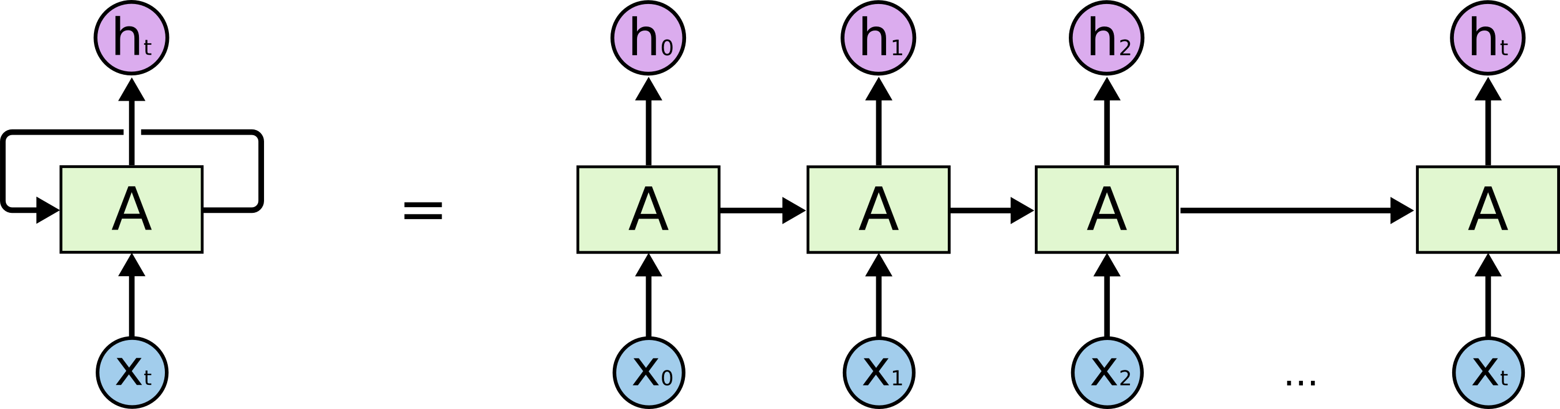
Recurrent Neural Networks (RNNs)
Understanding RNNs
Temporal Relationships in Data
RNNs are a type of neural network designed to process sequential data, such as speech or text.
They are specifically built to handle data where order and context are important.
RNNs use recurrent layers to capture temporal relationships and dependencies in data.
This makes them particularly effective for tasks involving sequences.
Applications in Speech Recognition
Examples of RNN Architectures
RNNs are commonly used for speech recognition tasks, such as speech-to-text and language modeling.
These applications leverage the ability of RNNs to understand sequential patterns.
Examples of RNNs include Simple RNN, LSTM, and GRU.
Each of these architectures has unique features tailored to specific use cases.
6
Deep Learning: Foundations and Applications in Image and Speech Recognition

Slide 7
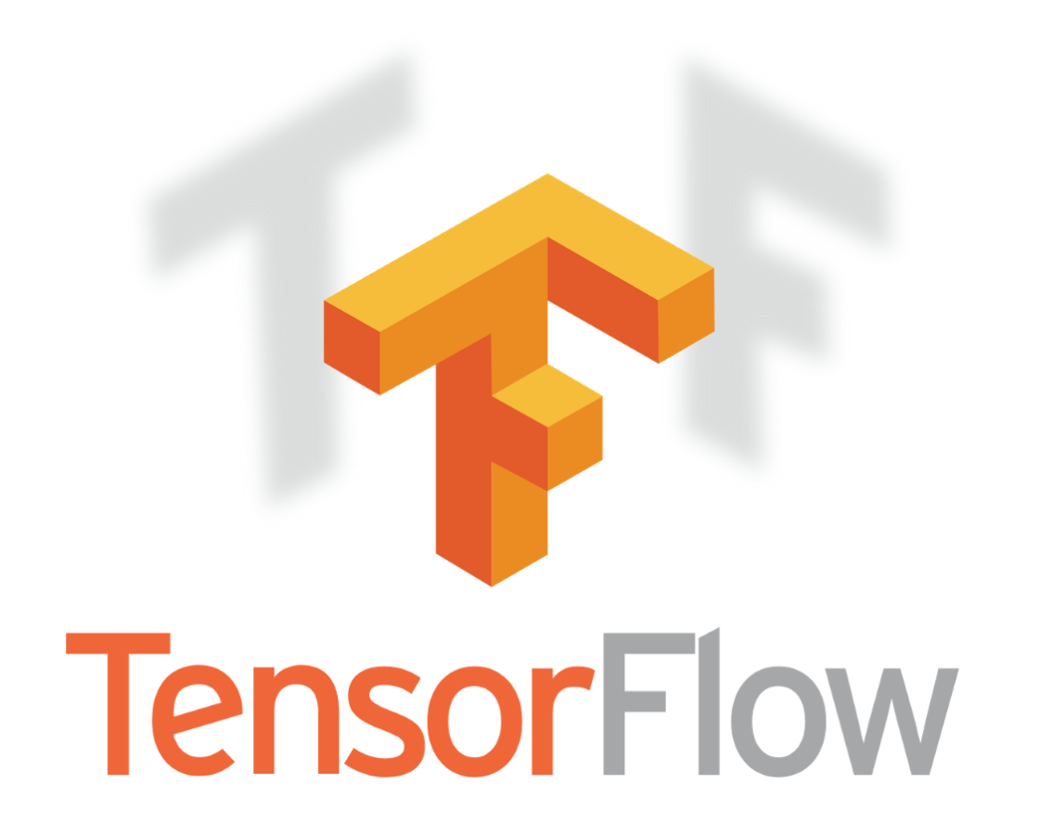
Deep Learning Frameworks
TensorFlow by Google
PyTorch by Facebook
Keras: A High-Level API
TensorFlow is an open-source software library for deep learning.
It was developed by Google.
PyTorch is an open-source software library for deep learning.
It was developed by Facebook.
Keras is a high-level neural networks API.
It can run on top of TensorFlow or PyTorch.
7
Deep Learning: Foundations and Applications in Image and Speech Recognition

Slide 8
Image Recognition using CNNs
Understanding Image Recognition
Role of CNNs in Image Recognition
Applications of Image Recognition
Training CNNs for Accuracy
Image recognition is the ability of a computer system to identify and classify objects within images.
It plays a crucial role in enabling machines to interpret visual data effectively.
CNNs are commonly used for image recognition tasks, such as image classification and object detection.
These neural networks are designed to process and analyze visual data efficiently.
Examples of image recognition applications include self-driving cars, facial recognition systems, and medical diagnosis.
These technologies demonstrate the practical impact of image recognition in various industries.
CNNs can be trained using large datasets, such as ImageNet, to achieve high accuracy.
The availability of extensive labeled data is essential for improving model performance.
8
Deep Learning: Foundations and Applications in Image and Speech Recognition

Slide 9
Speech Recognition using RNNs
Understanding Speech Recognition
Role of RNNs in Speech Recognition
Speech recognition is the ability of a computer system to transcribe spoken language into text.
It enables machines to interpret and process human speech effectively.
RNNs are commonly used for speech recognition tasks, such as speech-to-text and language modeling.
Their sequential data processing capabilities make them ideal for handling audio inputs.
Applications of Speech Recognition
Training RNNs for High Accuracy
Examples of speech recognition applications include virtual assistants, voice-controlled devices, and language translation.
These technologies enhance user interaction and accessibility.
RNNs can be trained using large datasets, such as LibriSpeech, to achieve high accuracy.
Extensive training ensures better performance in real-world scenarios.
9
Deep Learning: Foundations and Applications in Image and Speech Recognition

Slide 10
Transfer Learning
Introduction to Transfer Learning
Methods of Transfer Learning
Applications of Transfer Learning
Transfer learning is a technique that allows deep learning models to leverage pre-trained models and adapt them to new tasks.
It enables models to utilize existing knowledge for solving new problems efficiently.
Transfer learning can be used to fine-tune pre-trained models on new datasets.
Alternatively, pre-trained models can serve as feature extractors for new tasks.
Examples of transfer learning applications include image classification, object detection, and speech recognition.
These applications demonstrate the versatility and power of transfer learning in various domains.
10
Deep Learning: Foundations and Applications in Image and Speech Recognition

Slide 11
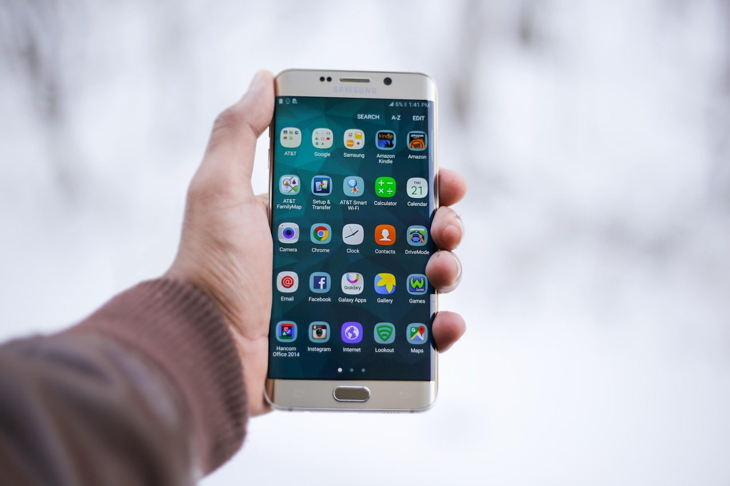
Deep Learning Applications
Applications in Various Industries
Deep learning techniques have numerous applications in various industries, including healthcare, finance, and transportation.
Examples of deep learning applications include medical diagnosis, predictive maintenance, and self-driving cars.
Enhancing Task Efficiency
Deep learning techniques can be used to improve the efficiency and accuracy of various tasks, such as image recognition, speech recognition, and natural language processing.
These advancements enable better performance in both consumer and enterprise-level applications.
Driving Innovation in Products
Deep learning techniques can also be used to develop new products and services, such as virtual assistants and language translation systems.
These innovations are transforming the way people interact with technology.
Impact on Everyday Life
The integration of deep learning into various domains is reshaping industries and enhancing user experiences.
From healthcare to transportation, its influence is becoming increasingly pervasive.
11
Deep Learning: Foundations and Applications in Image and Speech Recognition

Slide 12
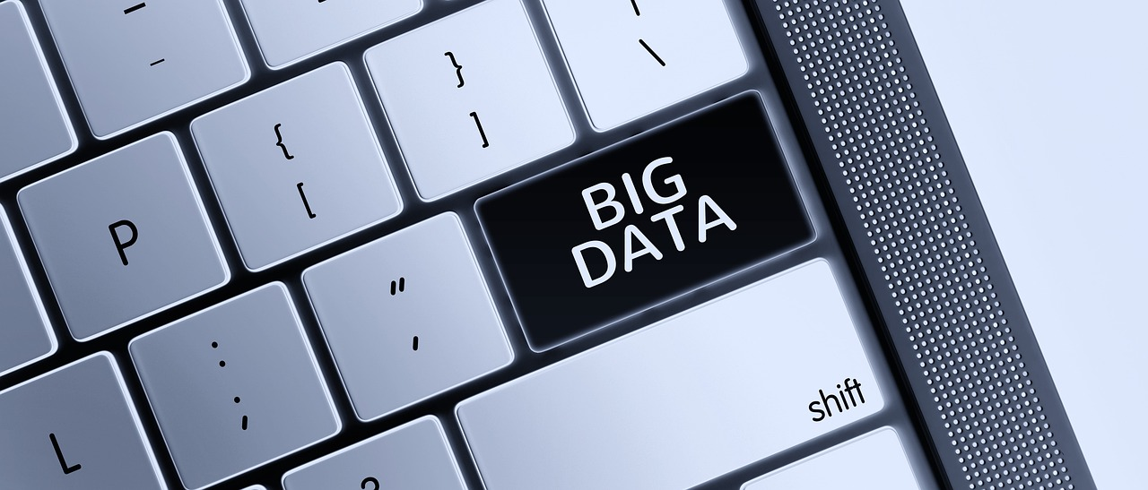
Challenges and Limitations
Data Requirements
Deep learning techniques require large amounts of data to train and validate models.
This can be a significant challenge in domains where data is scarce or expensive to obtain.
Computational Demands
Deep learning techniques can be computationally expensive and require significant resources.
This includes high-performance hardware and energy consumption, which may not be accessible to all.
Bias and Evaluation
Deep learning techniques can be vulnerable to bias and errors, and require careful evaluation and testing.
Ensuring fairness and accuracy in models is a critical and ongoing challenge.
12
Deep Learning: Foundations and Applications in Image and Speech Recognition

Slide 13

Future Developments
Advanced Architectures
Future developments in deep learning techniques include the use of more advanced architectures, such as transformers and graph neural networks.
These architectures promise to enhance the capabilities of deep learning systems.
Efficient Training Methods
Future developments in deep learning techniques also include the use of more efficient training methods, such as transfer learning and meta-learning.
These methods aim to reduce computational costs while improving model performance.
Enhanced Recognition Models
Future developments in deep learning techniques will enable the development of more accurate and efficient models for image and speech recognition tasks.
This progress will significantly impact applications in various industries.
13
Deep Learning: Foundations and Applications in Image and Speech Recognition

Slide 14

Conclusion
Revolutionizing Image and Speech Recognition
Exploring Applications and Future Developments
Deep learning techniques have revolutionized the field of image and speech recognition, enabling computers to learn from data and make accurate predictions.
This presentation has introduced the fundamental concepts and techniques of deep learning for image and speech recognition.
This presentation has explored the applications and future developments of these techniques.
Deep learning continues to shape the future of technology with its transformative potential.
14
Deep Learning: Foundations and Applications in Image and Speech Recognition

Slide 15
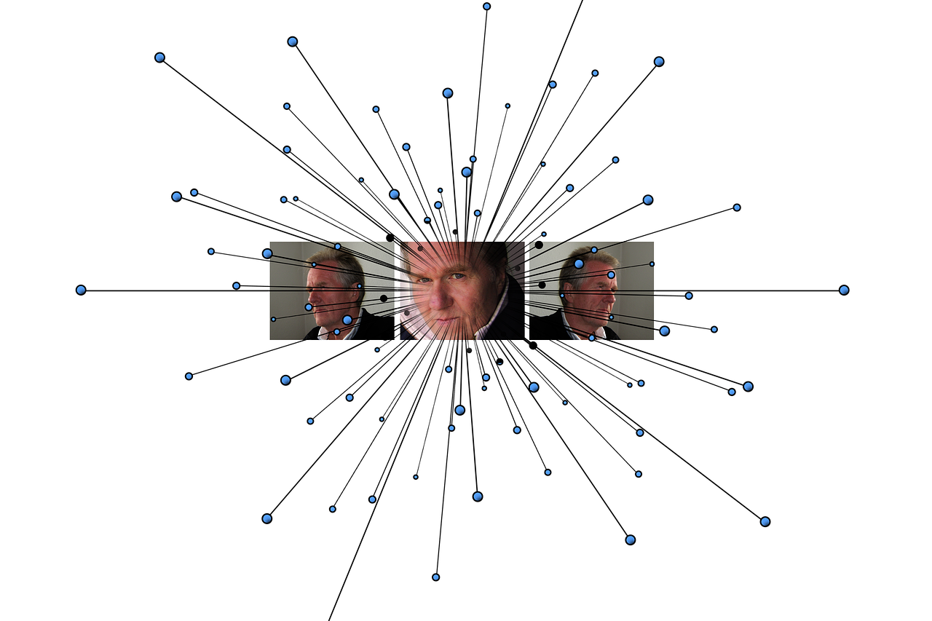
References
Deep Learning Foundations
Visual Recognition Breakthroughs
Speech Recognition Advancements
"Deep Learning" by Ian Goodfellow, Yoshua Bengio, and Aaron Courville.
A comprehensive resource on the principles and applications of deep learning.
"Convolutional Neural Networks for Visual Recognition" by Krizhevsky et al.
A seminal work that revolutionized image classification and object detection.
"Recurrent Neural Networks for Speech Recognition" by Graves et al.
An influential study on the use of RNNs for processing sequential data in speech.
15
Deep Learning: Foundations and Applications in Image and Speech Recognition

Slide 16
Glossary
Neural Network
A computer system inspired by the structure and function of the human brain.
It mimics the way neurons interact to process information.
Deep Learning
A subset of machine learning that uses neural networks with multiple layers to analyze and interpret complex data.
It enables machines to learn from vast amounts of data and make predictions.
Convolutional Neural Network (CNN)
A type of neural network designed to process data with spatial hierarchies, such as images.
It is widely used in image recognition and computer vision tasks.
Recurrent Neural Network (RNN)
A type of neural network designed to process sequential data, such as speech or text.
It is particularly effective for tasks involving time-series or language modeling.
16
Deep Learning: Foundations and Applications in Image and Speech Recognition

Slide 17
Summary
Applications of Deep Learning
Data Requirements and Challenges
Model Vulnerabilities
Deep learning techniques have numerous applications in image and speech recognition.
CNNs and RNNs are commonly used for image and speech recognition tasks.
Deep learning techniques require large amounts of data to train and validate models.
These techniques can be computationally expensive and vulnerable to bias and errors.
Deep learning models are susceptible to biases introduced during training.
Errors in predictions can arise due to insufficient or flawed data.
17
Deep Learning: Foundations and Applications in Image and Speech Recognition

Slide 18

Final Thoughts
Revolutionizing Industries
Addressing Challenges
Deep learning techniques have the potential to revolutionize various industries and applications.
Further research and development are needed to improve the efficiency and accuracy of deep learning models.
Further research is required to address the challenges and limitations of these techniques.
Improving efficiency and accuracy remains a key focus for the future of deep learning.
18
Deep Learning: Foundations and Applications in Image and Speech Recognition

Slide 19
Next Steps
Exploring Deep Learning Applications
Developing and Deploying Models
Explore the applications of deep learning techniques in various industries and applications.
Understand how these techniques can transform traditional processes and create innovative solutions.
Develop and deploy deep learning models for image and speech recognition tasks using popular frameworks such as TensorFlow and PyTorch.
Leverage these frameworks to build efficient and scalable solutions for real-world problems.
19
Deep Learning: Foundations and Applications in Image and Speech Recognition

