Slide 1
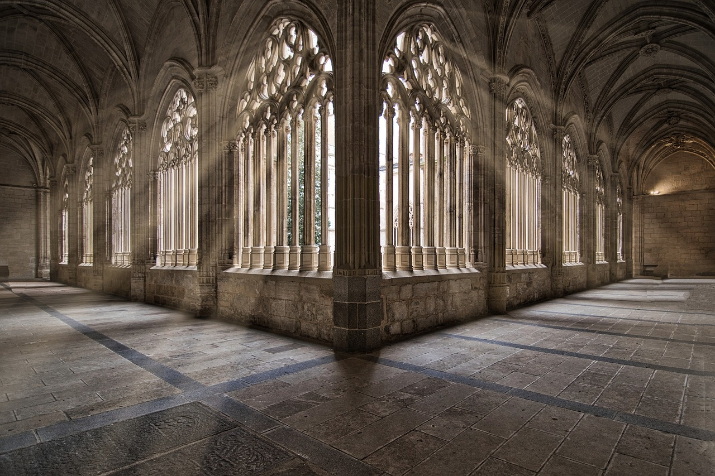
Exploring Turkey's Architectural Marvels
A Journey Through History, Culture, and Innovation

Slide 2
Table of contents
01
02
03
04
05
06
07
08
09
10
11
Title Slide: Architectural Wonders of Turkey
Introduction to Turkey's Architectural Landscape
Hagia Sophia - Historical Overview
Hagia Sophia - Architectural Highlights
Blue Mosque - Cultural Significance
Blue Mosque - Architectural Innovations
Cappadocia - Geological Architectural Wonder
Descriptive Language Development
Interdisciplinary Learning Approach
Student Exploration Activities
Digital Integration

Slide 3
Table of contents
12
13
14
15
16
17
18
19
20
21
Assessment and Reflection
Key Takeaways
Conclusion
Q&A and Resources
Design Recommendations
Export Requirements
List of Key Architectural Terms
Geographical Significance of Turkey
Comparative Analysis of Architectural Styles
Cultural Impact of Turkish Architecture

Slide 4
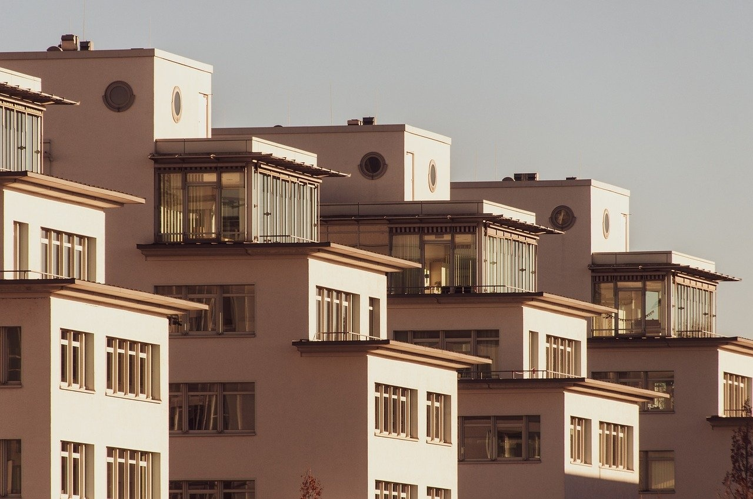
1
Title Slide: Architectural Wonders of Turkey
Architectural Wonders of Turkey
Architectural Wonders of Turkey: A Descriptive Language Expedition
Exploring Turkey's Architectural Marvels

Slide 5

2
Introduction to Turkey's Architectural Landscape
01
Geographical Crossroads of Civilizations
02
Intersection of Cultural and Historical Influences
Turkey's strategic location bridging Europe and Asia
Influence of various empires and cultures on architectural styles
Blend of Byzantine, Ottoman, and Islamic architectural elements
Reflects the rich tapestry of Turkey's history and heritage
03
Architectural Diversity as a Storytelling Medium
Buildings narrate tales of conquests, religious shifts, and artistic evolution
Each structure holds layers of history waiting to be explored
Exploring Turkey's Architectural Marvels

Slide 6
3
Hagia Sophia - Historical Overview
01
Originally Byzantine cathedral (537 CE)
02
Symbol of Byzantine architecture and Christianity
03
Transformed to Ottoman mosque
04
Reflects Islamic architectural influences
05
Now a museum
Represents a blend of religious and cultural history
Exploring Turkey's Architectural Marvels

Slide 7
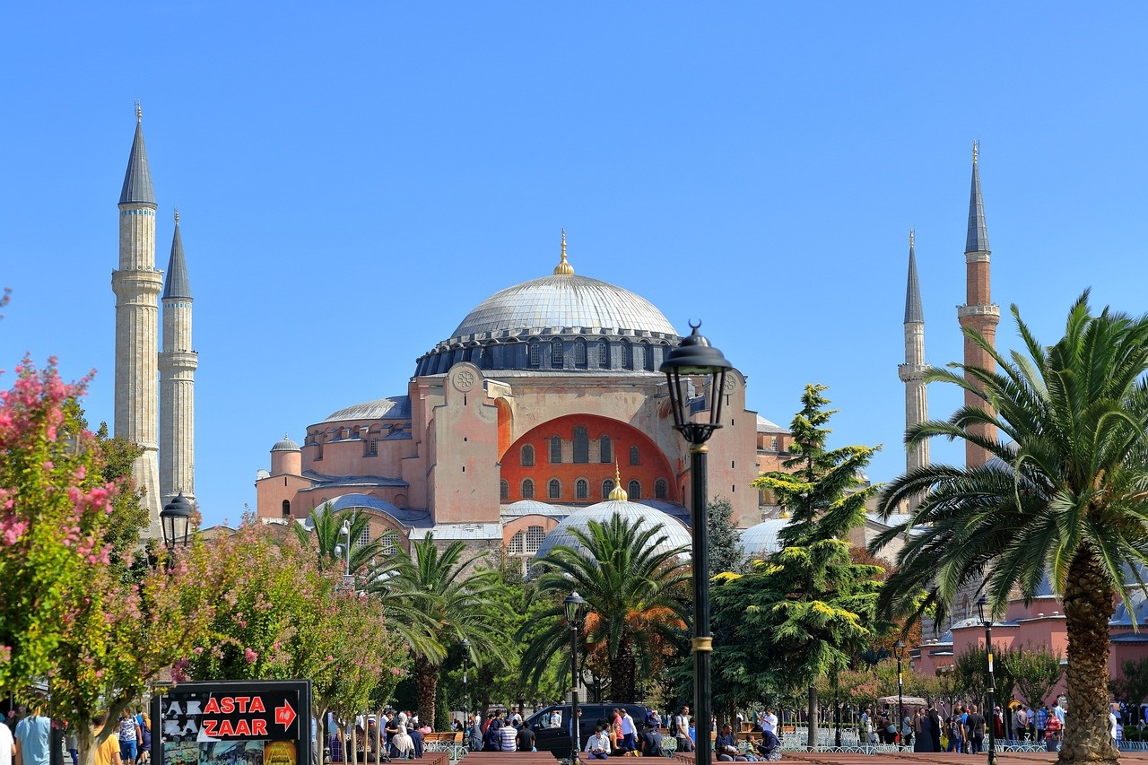
4
Hagia Sophia - Architectural Highlights
Massive Central Dome
Pendentive Engineering
Byzantine Architectural Complexity
Intricate Mosaic Details
Exploring Turkey's Architectural Marvels

Slide 8
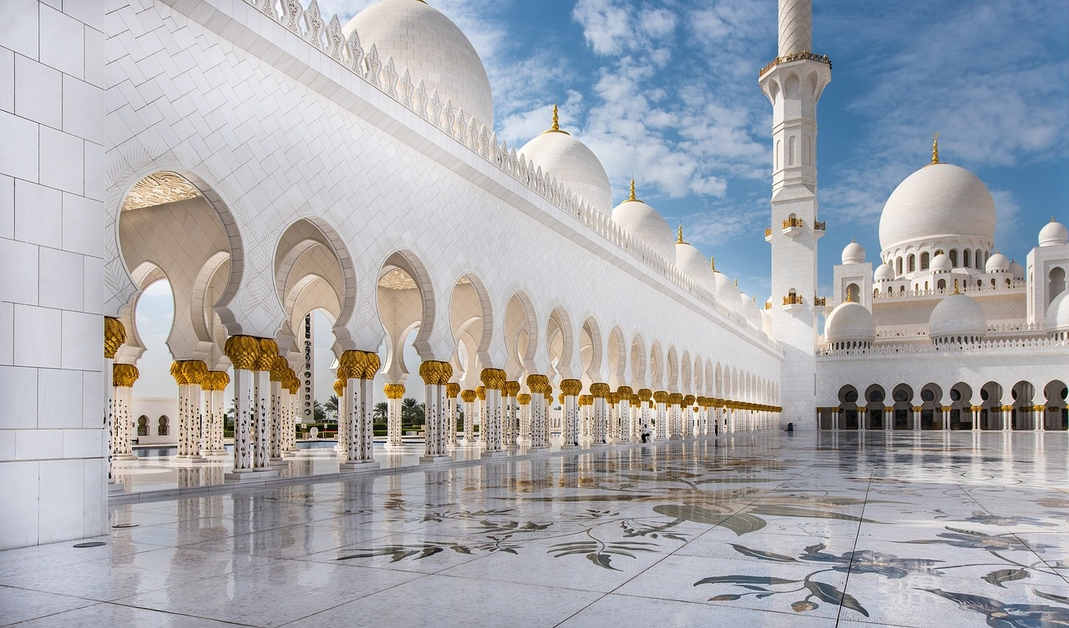
5
Blue Mosque - Cultural Significance
Blue Mosque - Cultural Significance
Six elegant minarets
Cascading dome design
Ottoman architectural principles
Intricate blue tile work
Exploring Turkey's Architectural Marvels

Slide 9
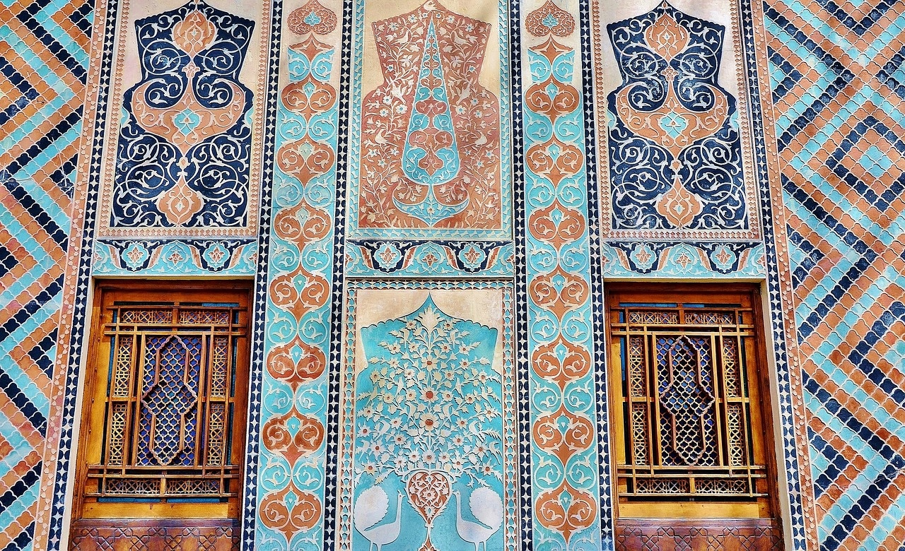
6
Blue Mosque - Architectural Innovations
01
Mathematical Precision
02
Geometric Patterns
The Blue Mosque's design incorporates precise mathematical calculations to achieve perfect symmetry and balance.
Intricate geometric patterns adorn the mosque, reflecting the Islamic art tradition and enhancing its aesthetic appeal.
03
Spiritual Symbolism
04
Architectural Harmony
The architectural elements symbolize various spiritual concepts, creating a space that inspires contemplation and reverence.
The mosque's design achieves a harmonious blend of different architectural styles, creating a unified and majestic structure.
Exploring Turkey's Architectural Marvels

Slide 10

7
Cappadocia - Geological Architectural Wonder
01
Geological Formation
02
Panoramic Visual
Volcanic eruption origins
Millions of years of erosion
"Fairy chimney" rock formations
Natural architectural landscape
Image showcasing Cappadocia's unique landscape
Exploring Turkey's Architectural Marvels

Slide 11

8
Descriptive Language Development
01
Enhancing Vocabulary with Advanced Architectural Terminology
02
Learning Sensory Description Techniques for Vivid Imagery
Learn and use terms like 'buttress', 'cantilever', 'clerestory', and 'tracery'.
Understand the significance of these terms in architectural design.
Practice using these terms in descriptive writing.
Use sensory details to describe architectural features.
Incorporate sight, sound, touch, and even smell into descriptions.
Create immersive experiences through detailed sensory language.
03
Integrating Cultural Context into Descriptive Language
04
Developing Skills in Comparative Analysis for Architectural Features
Understand the historical and cultural significance of architectural styles.
Incorporate cultural references to enhance descriptions.
Compare and contrast architectural features from different cultures.
Learn to identify and describe key architectural features.
Compare features across different architectural styles and periods.
Develop critical thinking skills through comparative analysis.
Exploring Turkey's Architectural Marvels

Slide 12
9
Interdisciplinary Learning Approach
Geography
History
Linguistics
Understanding Turkey's diverse landscapes
Tracing the evolution of Turkish architecture through historical periods
Developing descriptive language skills to articulate architectural details
Cultural Studies
Art and Design
Investigating the cultural significance embedded in architectural marvels
Studying the artistic elements of Turkish architecture
Exploring Turkey's Architectural Marvels

Slide 13

10
Student Exploration Activities
01
Virtual Landmark Tours
02
Descriptive Writing Challenges
Explore iconic Turkish architectural sites through virtual tours.
Engage in descriptive writing exercises to capture the essence of architectural marvels.
03
Multimedia Presentation Creation
04
Comparative Architectural Analysis
Develop multimedia presentations showcasing architectural wonders with creative visuals.
Analyze and compare architectural styles, influences, and innovations across different landmarks.
Exploring Turkey's Architectural Marvels

Slide 14

11
Digital Integration
Digital Integration
Technology-Enhanced Learning:
Virtual reality experiences
Augmented reality annotations
Interactive mapping
Collaborative digital platforms![Screenshots of digital learning tools](image-link)
Exploring Turkey's Architectural Marvels

Slide 15

12
Assessment and Reflection
01
Architectural Terminology
02
Descriptive Language in Architectural Analysis
Reflect on the architectural terminology learned
Identify key terms related to architectural styles and features
Evaluate the effectiveness of using descriptive language in architectural analysis
03
Cultural Context Integration
04
Comparative Analysis Skills
Analyze how cultural influences shape architectural design
Reflect on the significance of cultural narratives in architectural storytelling
Compare and contrast different architectural styles and periods
Assess the ability to draw parallels between architectural marvels
Exploring Turkey's Architectural Marvels

Slide 16
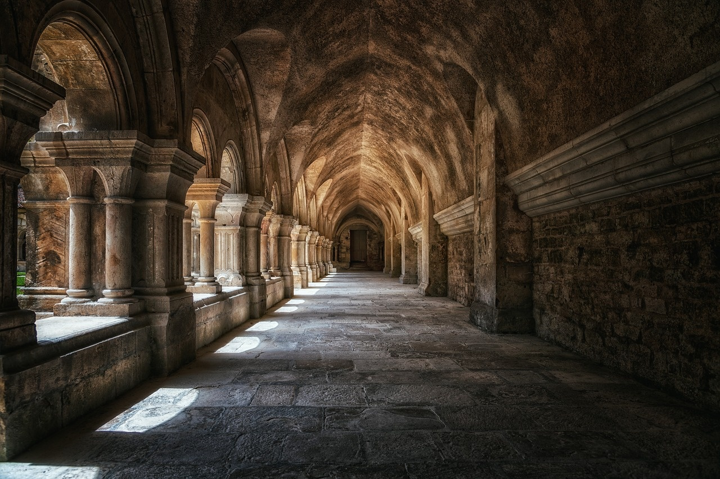
13
Key Takeaways
01
Understanding the architectural complexity of Turkey
02
Developing advanced descriptive language skills
03
Appreciating the cultural significance of Turkish architecture
04
Embracing an interdisciplinary learning approach
Exploring Turkey's Architectural Marvels

Slide 17
14
Conclusion
Turkey's Architectural Marvels
Exploring Iconic Landmarks
Architecture as Storytelling
Showcase a rich tapestry of history, culture, and innovation.
Hagia Sophia, Blue Mosque, and Cappadocia reveal intricate beauty and significance.
Connects past and present in a tangible way.
Diverse Architectural Styles
Enduring Legacy and Global Impact
Reflect Turkey's unique position at the crossroads of civilizations.
Turkey's architectural wonders leave a lasting impression.
Exploring Turkey's Architectural Marvels

Slide 18

15
Q&A and Resources
01
Q&A Session
02
Additional Learning Resources
Address any questions or clarifications on Turkey's architectural marvels.
Encourage audience engagement and discussion.
Explore Recommended Websites for in-depth information.
Virtual Tour Links for immersive experiences.
Further Reading Suggestions for continued learning.
Contact Information for inquiries and collaborations.
03
QR Codes
Scan for quick access to digital resources.
Enhance learning through interactive platforms.
Exploring Turkey's Architectural Marvels

Slide 19

16
Design Recommendations
01
Color Palette
02
Image Quality
Utilize warm earth tones like terracotta, azure blues, and sandy yellows inspired by Turkish architectural hues.
Ensure all visuals are high-resolution and professionally shot to showcase intricate architectural details effectively.
03
Font Selection
04
Background Patterns
Opt for clean, sans-serif fonts for readability, such as Arial or Helvetica, to maintain a professional look.
Incorporate subtle architectural motifs like arabesque designs or geometric patterns as backgrounds for a cohesive theme.
Exploring Turkey's Architectural Marvels

Slide 20

17
Export Requirements
01
Obtain an Export License
02
Understand Tariff and Duty Rates
Check with relevant authorities
Ensure compliance with regulations
Research applicable rates
Factor in additional costs
03
Packaging and Labeling
04
Documentation
Follow international standards
Include necessary information
Prepare commercial invoice
Arrange for customs clearance
Exploring Turkey's Architectural Marvels

Slide 21
18
List of Key Architectural Terms
01
Fenestration
02
Balustrade
03
Cornice
The arrangement of windows in a building.
A row of small columns topped by a rail, used as a decorative railing on a staircase or balcony.
A decorative molding that crowns a building or furniture.
04
Pilaster
05
Crenellation
A rectangular column that projects slightly from a wall and is used for decorative purposes.
A pattern along the top of a wall with alternating solid sections and gaps, often seen in medieval fortifications.
Exploring Turkey's Architectural Marvels

Slide 22

19
Geographical Significance of Turkey
01
Crossroads of Civilizations
02
Cultural and Historical Influences
Situated at the intersection of Europe and Asia
Bridging the East and the West
Rich tapestry of influences from various empires
Byzantine, Ottoman, and Roman heritage
03
Architectural Diversity as a Storytelling Medium
Reflects the country's diverse history and culture
Varied architectural styles and influences
Exploring Turkey's Architectural Marvels

Slide 23
20
Comparative Analysis of Architectural Styles
Hagia Sophia
Blue Mosque
Architectural Style: Byzantine and Ottoman fusion
Key Features: Massive central dome, intricate mosaic details
Cultural Influence: Reflects Byzantine and Islamic architectural traditions
Architectural Style: Ottoman architecture
Key Features: Six elegant minarets, intricate blue tile work
Cultural Influence: Symbolizes Ottoman architectural principles and design aesthetics
Exploring Turkey's Architectural Marvels

Slide 24
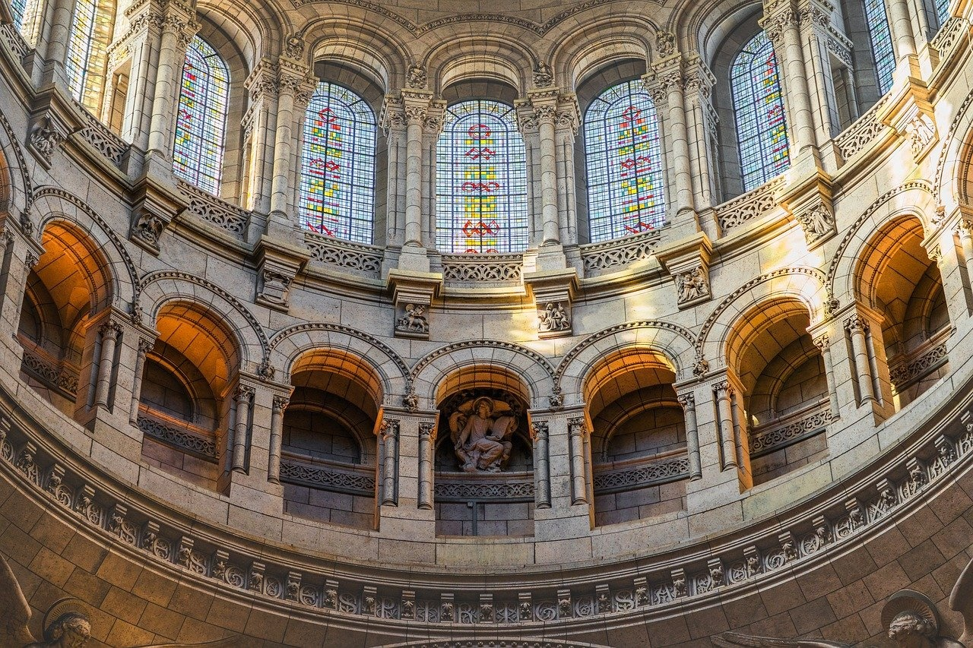
21
Cultural Impact of Turkish Architecture
01
Preservation of Heritage
02
Symbolism and Identity
Turkish architecture reflects a blend of various cultural influences.
Preservation efforts highlight the importance of historical continuity.
Architectural designs serve as symbols of cultural identity.
Structures like the Hagia Sophia represent a fusion of diverse traditions.
03
Tourism and Cultural Exchange
Turkish architecture attracts tourists from around the world.
Facilitates cultural exchange and appreciation of heritage.
Exploring Turkey's Architectural Marvels

