Slide 1

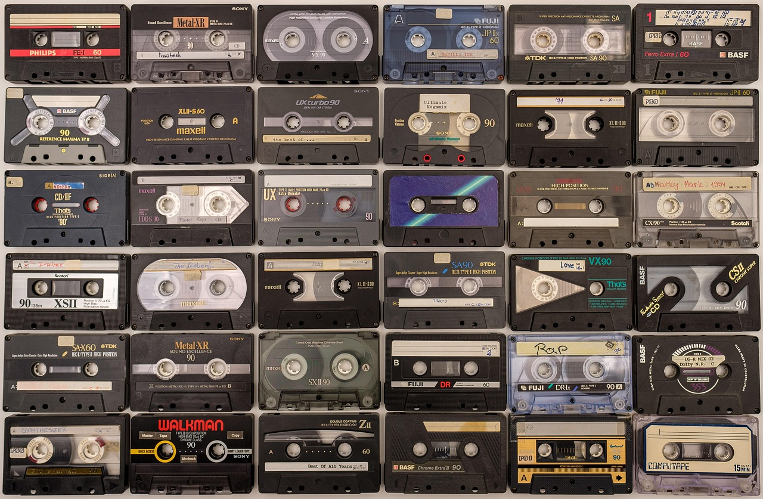
Electricity and Magnetism: Fundamental Principles and Applications
Exploring the Basics, Everyday Relevance, and Technological Impact

Slide 2
Table of Contents
Introduction to Electricity and Magnetism Fund…
What is Electricity?
Electric Fields
Magnetism
Magnetic Fields
Relationship Between Electricity and Magnetism
Electric Circuits
Conductors and Insulators
Resistance and Ohm's Law
Series and Parallel Circuits
Applications of Electricity and Magnetism
Safety Considerations
Conclusion
04
05
06
07
08
09
10
11
12
13
14
15
16

Slide 3
Table of Contents
Assessment and Evaluation
Extension Activities
Parent Engagement
Reflection and Next Steps
Final Thoughts
17
18
19
20
21

Slide 4

Introduction to Electricity and Magnetism Fundamentals
Fundamental Concepts
Everyday Relevance
Lesson Overview
Introduction to the fundamental concepts of electricity and magnetism.
These concepts form the basis for understanding various physical phenomena.
Importance of understanding electricity and magnetism in everyday life.
These principles are integral to modern technology and daily activities.
Overview of the lesson plan and objectives.
This provides a roadmap for what will be covered and achieved.
4
Electricity and Magnetism: Fundamental Principles and Applications

Slide 5
What is Electricity?
Definition of Electricity
Types of Electric Charge
Examples of Electricity in Everyday Life
Importance of Electricity in Modern Technology
Electricity is a form of energy resulting from the existence of charged particles such as electrons or protons.
It can be static, as in static electricity, or dynamic, as in electric current.
Electric charge comes in two types: positive and negative.
These charges interact to create electric forces and fields.
Electricity powers household appliances like refrigerators, televisions, and lights.
It is also used in transportation systems such as electric trains and cars.
Electricity is the backbone of modern technology, enabling innovations like computers and smartphones.
It supports critical infrastructure such as hospitals, communication networks, and industrial machinery.
5
Electricity and Magnetism: Fundamental Principles and Applications

Slide 6
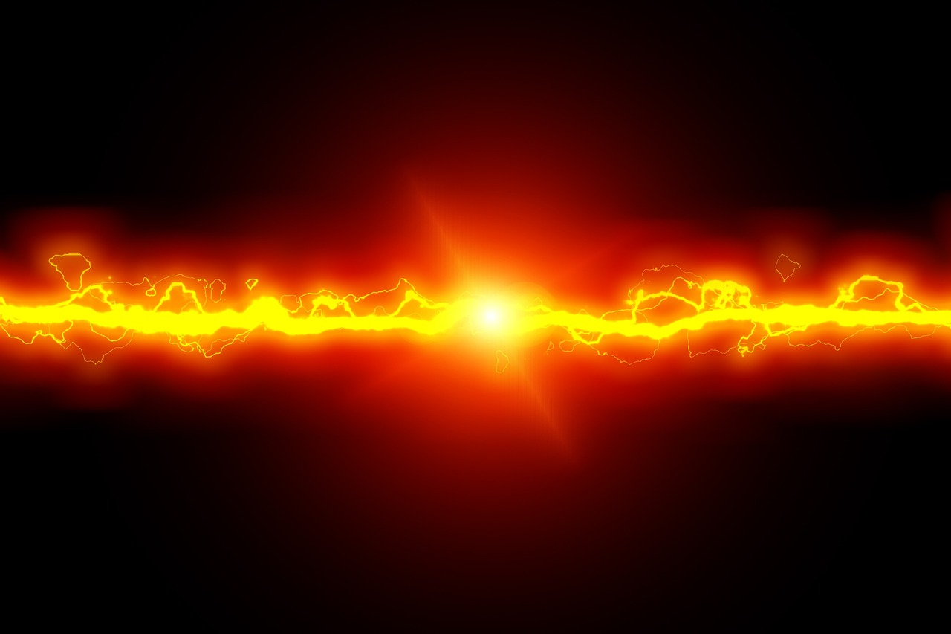
Electric Fields
How Electric Fields Are Created
How Electric Fields Are Created
Examples of Electric Fields in Everyday Life
Electric fields are regions around charged particles where forces are exerted on other charges.
They are a fundamental concept in physics, describing how charges interact at a distance.
Electric fields are generated by charged particles, such as electrons and protons.
They can also be created by changing magnetic fields, as described by Maxwell's equations.
Electric fields are present in devices like capacitors and lightning during storms.
They also play a role in technologies such as photocopiers and electric fences.
6
Electricity and Magnetism: Fundamental Principles and Applications

Slide 7
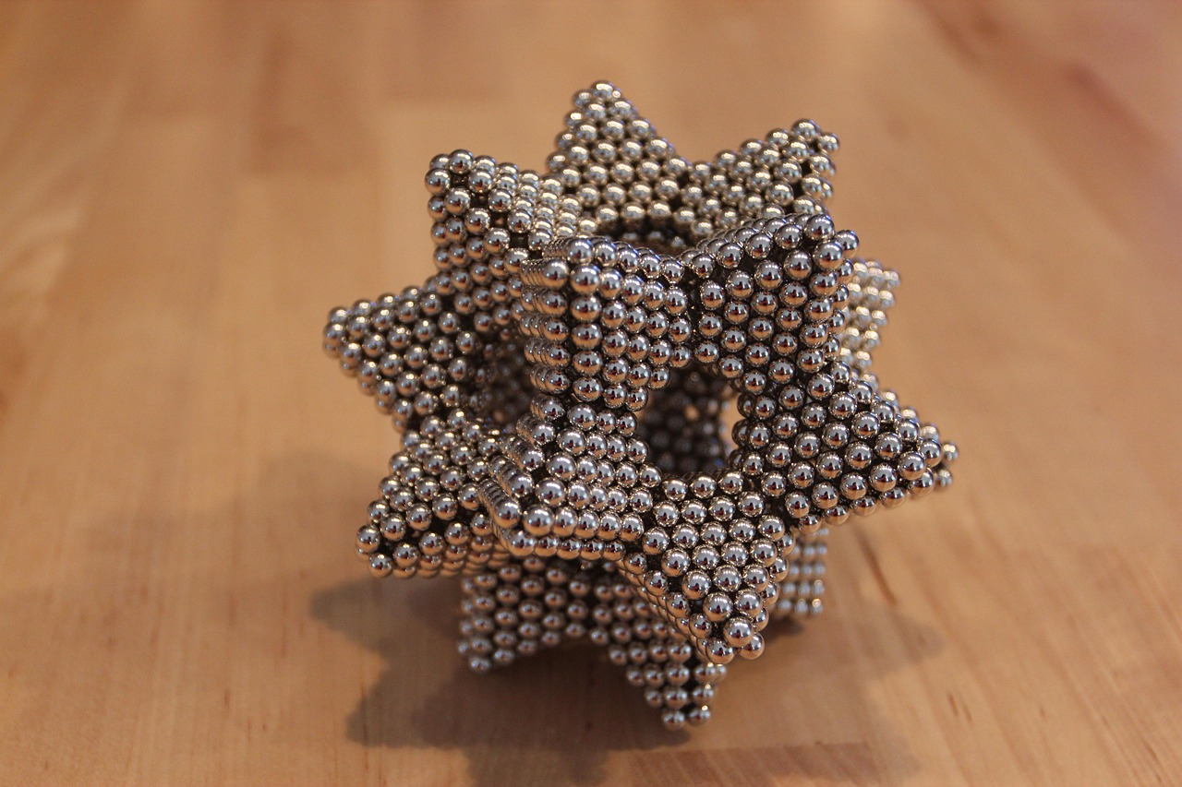
Magnetism
1
Definition of Magnetism
Magnetism is a physical phenomenon produced by the motion of electric charge, resulting in attractive and repulsive forces between objects.
It is a fundamental force of nature that plays a crucial role in various scientific and technological applications.
2
Types of Magnets
Magnets can be classified into permanent magnets, which retain their magnetic properties, and temporary magnets, which exhibit magnetism only under certain conditions.
Permanent magnets are commonly used in devices like speakers, while temporary magnets are often utilized in electromagnets.
3
Examples of Magnetism in Everyday Life
Magnetism is evident in everyday objects such as refrigerator magnets and magnetic strips on credit cards.
It is also used in advanced technologies like MRI machines and maglev trains, showcasing its diverse applications.
7
Electricity and Magnetism: Fundamental Principles and Applications

Slide 8

Magnetic Fields
1
Creation of Magnetic Fields
Magnetic fields are invisible forces that arise due to the motion of electric charges.
They are fundamental to the study of electromagnetism and play a crucial role in various physical phenomena.
2
How Magnetic Fields Are Created
Magnetic fields are generated by moving electric charges or by magnetic materials.
For example, a current flowing through a wire produces a magnetic field around it.
3
Examples in Everyday Life
Magnetic fields are present in everyday items like refrigerator magnets and compasses.
They are also used in advanced technologies such as MRI machines and electric motors.
8
Electricity and Magnetism: Fundamental Principles and Applications

Slide 9
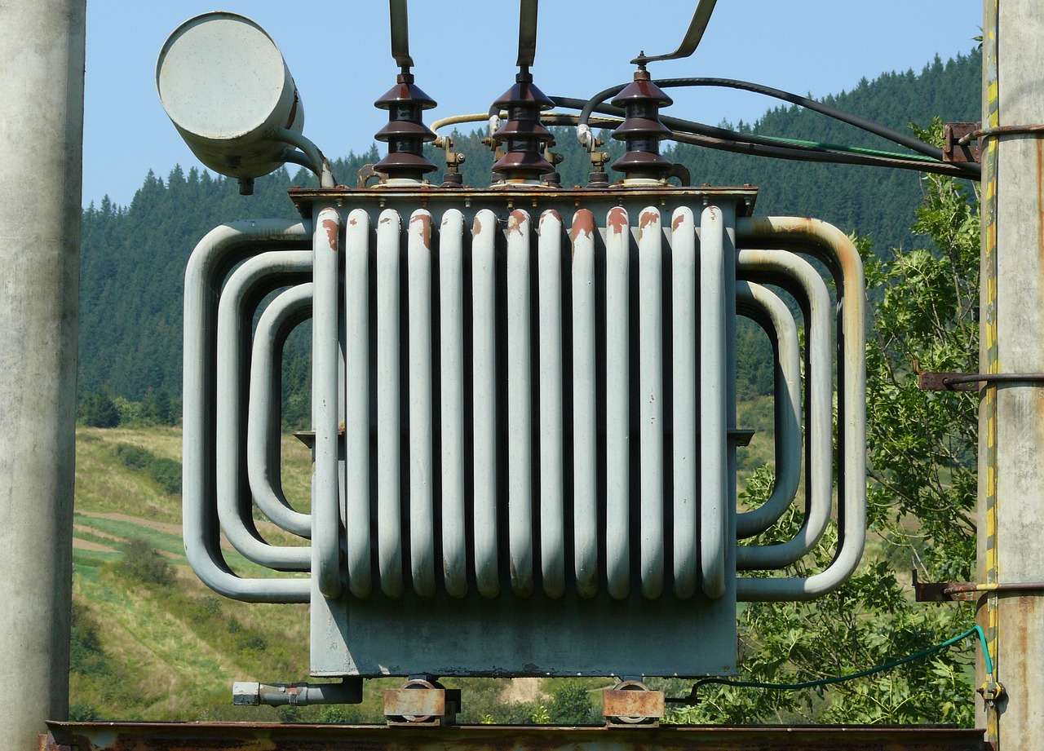
Relationship Between Electricity and Magnetism
1
2
3
How a Changing Magnetic Field Induces an Electric Current
Examples of Electromagnetic Induction in Everyday Life
Examples of Electromagnetic Induction in Everyday Life
Electromagnetic induction is the process by which a changing magnetic field generates an electric current.
This phenomenon is a cornerstone of the relationship between electricity and magnetism.
A changing magnetic field creates a force that drives electrons, resulting in an electric current.
This principle is the basis for technologies like electric generators and transformers.
Electromagnetic induction is used in devices such as induction cooktops and wireless charging systems.
These applications demonstrate the practical importance of the interplay between electricity and magnetism.
9
Electricity and Magnetism: Fundamental Principles and Applications

Slide 10
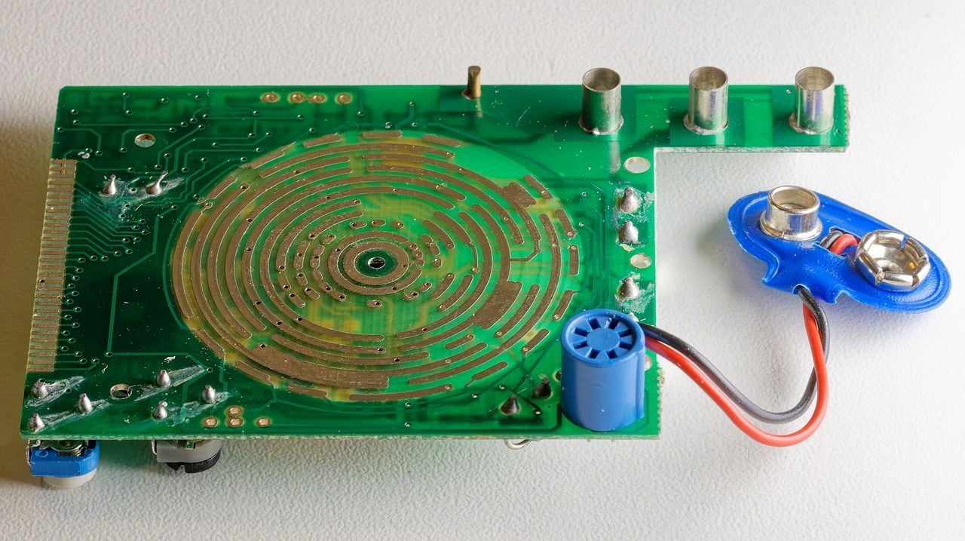
Electric Circuits
Components of an Electric Circuit
Examples of Electric Circuits in Everyday Life
Examples of Electric Circuits in Everyday Life
Electric circuits are pathways through which electric current flows.
They consist of interconnected components that allow electricity to perform work.
An electric circuit includes batteries, wires, and devices.
These components work together to enable the flow of electricity.
Electric circuits are found in household appliances like refrigerators and televisions.
They are also present in portable devices such as smartphones and laptops.
10
Electricity and Magnetism: Fundamental Principles and Applications

Slide 11

Conductors and Insulators
Definition of Conductors and Insulators
Examples of Conductors and Insulators
Importance in Electric Circuits
Conductors are materials that allow the flow of electric current through them, while insulators resist the flow of electric current.
These properties are essential in determining how materials are used in electrical applications.
Common conductors include metals like copper and aluminum, while insulators include materials like rubber and glass.
These examples highlight the contrasting properties of conductors and insulators in practical use.
Conductors and insulators play a crucial role in the design and safety of electric circuits.
They ensure the efficient flow of electricity while preventing unwanted current leakage.
11
Electricity and Magnetism: Fundamental Principles and Applications

Slide 12

Resistance and Ohm's Law
1
Understanding Resistance
Definition of resistance
Examples of resistance in everyday life
2
Ohm's Law Explained
Ohm's Law: V=IR
Definition of resistance
3
Practical Applications of Resistance
Examples of resistance in everyday life
Ohm's Law: V=IR
12
Electricity and Magnetism: Fundamental Principles and Applications

Slide 13
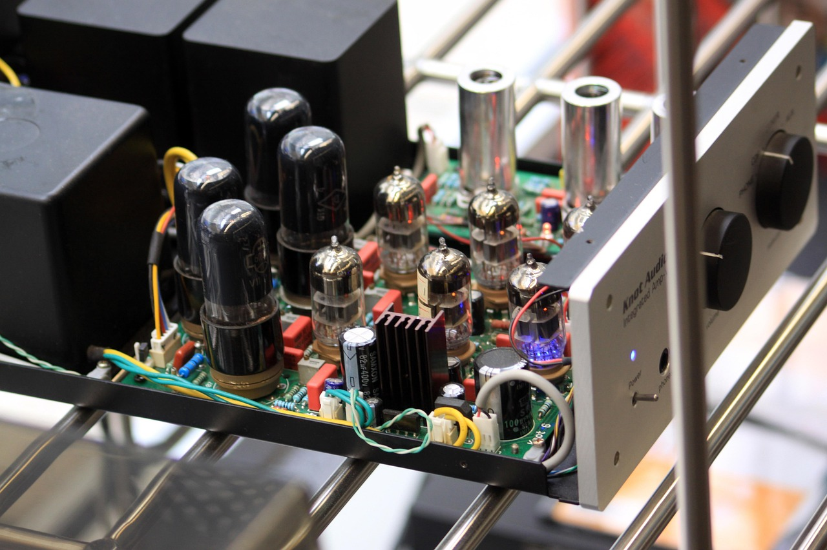
Series and Parallel Circuits
1
Definition of Series and Parallel Circuits
Definition of series and parallel circuits.
Examples of series and parallel circuits.
2
Examples of Series and Parallel Circuits
Examples of series and parallel circuits.
Importance of series and parallel circuits in everyday life.
3
Importance in Everyday Life
Importance of series and parallel circuits in everyday life.
Definition of series and parallel circuits.
13
Electricity and Magnetism: Fundamental Principles and Applications

Slide 14
Applications of Electricity and Magnetism
01
Electricity and Magnetism in Everyday Life
Examples of electricity and magnetism in everyday life
Importance of electricity and magnetism in modern technology
02
Technological Advancements
Applications of electricity and magnetism in medicine and transportation
Future developments and innovations in electricity and magnetism
03
Medical Applications
Applications of electricity and magnetism in medicine and transportation
Examples of electricity and magnetism in everyday life
04
Innovations and Future Trends
Future developments and innovations in electricity and magnetism
Importance of electricity and magnetism in modern technology
14
Electricity and Magnetism: Fundamental Principles and Applications

Slide 15

Safety Considerations
1
2
3
Importance of Safety
Handling Electrical Equipment
Emergency Procedures
Importance of safety when working with electricity and magnetism.
Precautions to take when handling electrical equipment.
Precautions to take when handling electrical equipment.
Emergency procedures in case of electrical shock or other accidents.
Emergency procedures in case of electrical shock or other accidents.
Importance of safety when working with electricity and magnetism.
15
Electricity and Magnetism: Fundamental Principles and Applications

Slide 16
Conclusion
Key Concepts Recap
Practical Relevance
Summary of key concepts learned in the lesson
Importance of understanding electricity and magnetism in everyday life
Electricity and magnetism play a crucial role in modern technology and daily activities.
Understanding these principles enhances problem-solving and innovation in various fields.
16
Electricity and Magnetism: Fundamental Principles and Applications

Slide 17

Assessment and Evaluation
Importance of Evaluation and Feedback
Examples of Assessment Questions and Projects
Examples of Assessment Questions and Projects
Quizzes, tests, and projects are common methods used to assess learning.
These tools help educators gauge students' understanding and progress.
Evaluation and feedback play a crucial role in improving learning outcomes.
They provide insights into areas of strength and opportunities for growth.
Assessment questions can range from multiple-choice to open-ended formats.
Projects often involve creative and practical applications of learned concepts.
17
Electricity and Magnetism: Fundamental Principles and Applications

Slide 18

Extension Activities
Examples of Extension Activities
Importance of Hands-On Learning
Resources for Further Exploration
Examples of extension activities include building a homemade battery and creating a magnetic levitation system.
These activities encourage creativity and practical application of scientific principles.
Hands-on learning and experimentation are crucial for understanding complex concepts.
They provide an engaging way to explore and apply knowledge in real-world scenarios.
There are numerous resources available for those interested in extension activities.
These resources can guide learners in expanding their knowledge and skills effectively.
18
Electricity and Magnetism: Fundamental Principles and Applications

Slide 19

Parent Engagement
Significance of Parent Engagement
Ways Parents Can Support Learning
Parent engagement plays a crucial role in enhancing student learning and academic success.
It fosters a supportive environment that encourages students to excel in their studies.
Parents can assist with homework and ensure students understand their assignments.
Attending parent-teacher conferences helps parents stay informed about their child's progress and needs.
19
Electricity and Magnetism: Fundamental Principles and Applications

Slide 20

Reflection and Next Steps
Reflection on the Lesson
Future Exploration
Reflection on the lesson and what was learned.
Next steps: future lessons and topics to explore.
Reflection on the lesson and what was learned.
Next steps: future lessons and topics to explore.
20
Electricity and Magnetism: Fundamental Principles and Applications

Slide 21
Final Thoughts
Understanding Electricity and Magnetism
Final thoughts and conclusions on the importance of understanding electricity and magnetism.
Electricity and magnetism are fundamental forces that shape the world around us, influencing technology, nature, and daily life.
21
Electricity and Magnetism: Fundamental Principles and Applications

