Slide 1

Empowering the Mind: Harnessing Self-Belief through Guided Imagery and Affirmations
A Comprehensive Journey to Transformative Personal Growth and Resilience

Slide 2


Table of contents
Introduction to Self-Belief
What is Guided Imagery?
What are Affirmations?
Benefits of Guided Imagery and Affirmations
Guided Imagery Exercise
Creating Personal Affirmations
Using Affirmations Effectively
Overcoming Negative Self-Talk
Building Resilience
Conclusion
Additional Resources
Next Steps
Final Thoughts
01
02
03
04
05
06
07
08
09
10
11
12
13

Slide 3
Table of contents
References
Appendix
14
15

Slide 4

Introduction to Self-Belief
Confidence in Abilities
Achieving Goals
Practicing Self-Belief
Self-belief is the foundation of confidence in our skills and talents.
It empowers us to take risks and face challenges head-on.
Self-belief is crucial for setting and reaching our personal and professional goals.
It helps us stay motivated and resilient in the face of obstacles.
We can enhance our self-belief through techniques like guided imagery and affirmations.
Regular practice can lead to a stronger sense of self and improved performance.
1
Empowering the Mind: Harnessing Self-Belief through Guided Imagery and Affirmations

Slide 5

What is Guided Imagery?
Mental Visualization
Achieving Goals
Overcoming Challenges
Guided imagery is a powerful tool for relaxation and self-reflection.
It involves using descriptive language to create a mental image or scenario.
Guided imagery can help us visualize ourselves achieving our goals.
This technique enhances motivation and focus towards our aspirations.
Guided imagery can assist in overcoming challenges we face.
By visualizing success, we can build resilience and confidence.
2
Empowering the Mind: Harnessing Self-Belief through Guided Imagery and Affirmations

Slide 6

What are Affirmations?
Positive Statements
Focus on Strengths
Challenge Negativity
Affirmations are positive statements that affirm and reinforce a desired outcome or behavior.
They help create a positive mindset and encourage personal growth.
Affirmations can help us focus on our strengths and abilities.
By recognizing our positive traits, we can boost our confidence.
Affirmations can be used to challenge negative self-talk and build self-esteem.
They serve as a reminder to replace doubt with positivity.
3
Empowering the Mind: Harnessing Self-Belief through Guided Imagery and Affirmations

Slide 7

Benefits of Guided Imagery and Affirmations
Stress Relief
Enhanced Focus
Guided imagery helps to reduce stress and anxiety by promoting relaxation.
It allows individuals to visualize peaceful scenes, leading to a calmer state of mind.
Engaging in affirmations can improve focus and concentration.
By reinforcing positive thoughts, individuals can minimize distractions and stay on task.
Boosted Confidence
Increased Resilience
Affirmations can significantly increase self-confidence and self-esteem.
Regularly repeating positive statements helps to reshape self-perception.
Guided imagery fosters resilience and motivation in challenging situations.
It encourages individuals to visualize success, enhancing their ability to cope with adversity.
4
Empowering the Mind: Harnessing Self-Belief through Guided Imagery and Affirmations

Slide 8

Guided Imagery Exercise
Comfortable Position
Peaceful Visualization
Sensory Engagement
Find a comfortable seated position.
Close your eyes and take a deep breath.
Imagine yourself in a peaceful and safe place.
Visualize the details of this serene environment.
Use all your senses to create a vivid mental image.
Focus on what you see, hear, smell, and feel.
5
Empowering the Mind: Harnessing Self-Belief through Guided Imagery and Affirmations

Slide 9

Creating Personal Affirmations
Strengths Assessment
Improvement Goals
Affirmation Statement
Identify your unique skills and talents.
Reflect on how they contribute to your success.
Identify areas for personal growth.
Set measurable objectives to track progress.
Create a positive statement reflecting your goals.
Use present tense to reinforce belief in your abilities.
6
Empowering the Mind: Harnessing Self-Belief through Guided Imagery and Affirmations

Slide 10
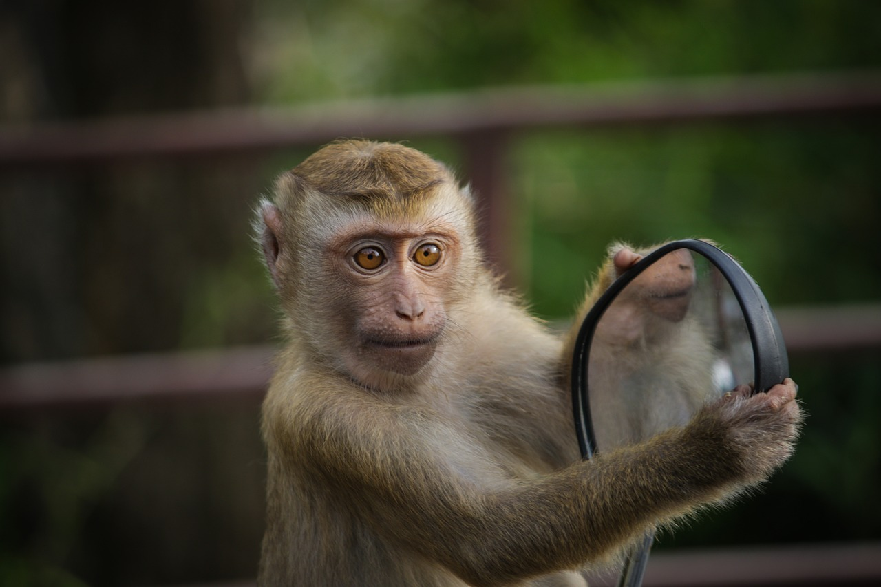
Using Affirmations Effectively
Regular Practice
Present Tense
Emotional Focus
Repeat your affirmations daily to reinforce positive beliefs.
Incorporate them into your routine, especially during stressful moments.
Use affirmations in the present tense to create a sense of immediacy.
This helps to visualize the desired outcome as if it is already happening.
Connect with the feelings behind your affirmations for greater impact.
Visualize the emotions associated with achieving your goals.
7
Empowering the Mind: Harnessing Self-Belief through Guided Imagery and Affirmations

Slide 11

Overcoming Negative Self-Talk
Challenge Negativity
Embrace Positivity
Cultivate Kindness
Identify negative self-talk patterns and question their validity.
Replace self-criticism with constructive feedback.
Use positive affirmations to counteract negative thoughts.
Focus on your strengths and achievements regularly.
Practice self-compassion by treating yourself as you would a friend.
Engage in activities that promote self-care and well-being.
8
Empowering the Mind: Harnessing Self-Belief through Guided Imagery and Affirmations

Slide 12
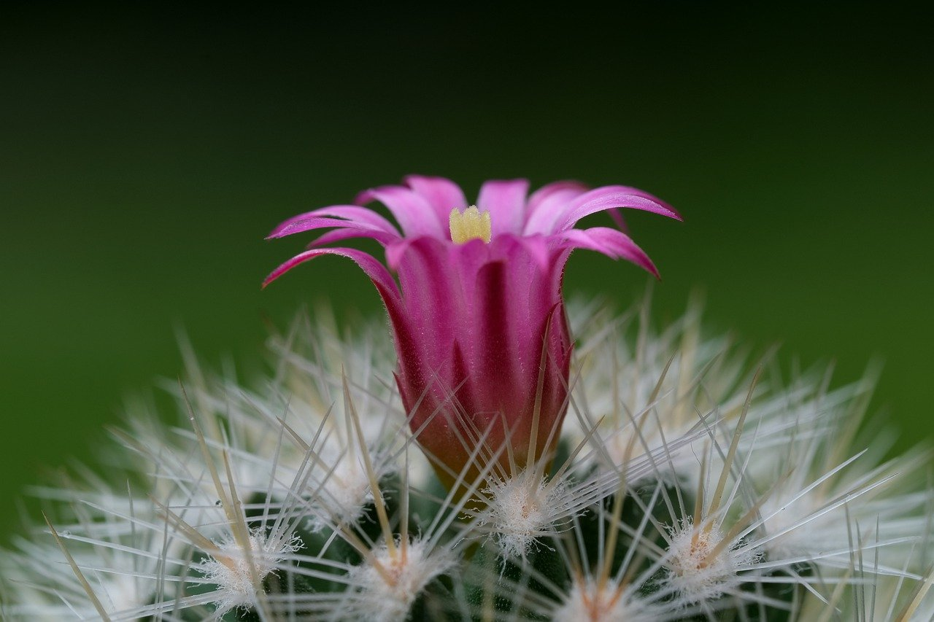
Building Resilience
Growth Mindset
Self-Care
Supportive Network
Embrace challenges as opportunities for growth.
Learn from failures and persist in the face of setbacks.
Prioritize your well-being through regular self-care practices.
Engage in activities that rejuvenate your mind and body.
Surround yourself with positive and encouraging individuals.
Build relationships that foster growth and resilience.
9
Empowering the Mind: Harnessing Self-Belief through Guided Imagery and Affirmations

Slide 13

Conclusion
Power of Self-Belief
Building Resilience
Self-belief is a powerful tool for achieving our goals.
It helps us overcome challenges and face obstacles with confidence.
Practicing guided imagery and affirmations can enhance our self-belief.
This practice fosters a more positive and resilient mindset.
10
Empowering the Mind: Harnessing Self-Belief through Guided Imagery and Affirmations

Slide 14

Additional Resources
Guided Imagery
Affirmation Tools
Self-Belief Literature
Explore recordings and scripts for guided imagery. These tools promote relaxation and positive visualization, enhancing mental clarity and emotional well-being.
Utilize affirmation cards and worksheets to reinforce positive self-talk. Integrate them into daily routines for a lasting impact.
Read literature on self-belief and resilience. Gain insights and strategies to cultivate self-worth and perseverance.
11
Empowering the Mind: Harnessing Self-Belief through Guided Imagery and Affirmations

Slide 15

Next Steps
Practice Regularly
Build Community
Continue to practice guided imagery and affirmations on a consistent basis.
Set aside time each day to focus on your mental well-being.
Share your experiences and insights with others to foster a supportive environment.
Engage with like-minded individuals to enhance your journey.
12
Empowering the Mind: Harnessing Self-Belief through Guided Imagery and Affirmations

Slide 16

Final Thoughts
Self-Belief Journey
Practice for Change
Self-belief is a continuous journey that requires patience and perseverance.
Embrace the ups and downs as part of your growth process.
Consistent practice is essential for fostering positive change in your life.
Set small, achievable goals to build momentum and confidence.
13
Empowering the Mind: Harnessing Self-Belief through Guided Imagery and Affirmations

Slide 17

References
Source List
Further Learning
Smith, J. (2020). Understanding Data Science. Tech Press.
Johnson, A. (2021). The Future of AI. Innovation Publishing.
Coursera: Data Science Specialization by Johns Hopkins University.
edX: Artificial Intelligence MicroMasters Program by Columbia University.
14
Empowering the Mind: Harnessing Self-Belief through Guided Imagery and Affirmations

Slide 18

Appendix
Guided Imagery
Affirmation Worksheets
Includes scripts for visualization techniques.
Helps in relaxation and mental clarity.
Provides templates for positive affirmations.
Encourages self-reflection and personal growth.
15
Empowering the Mind: Harnessing Self-Belief through Guided Imagery and Affirmations

