Slide 1
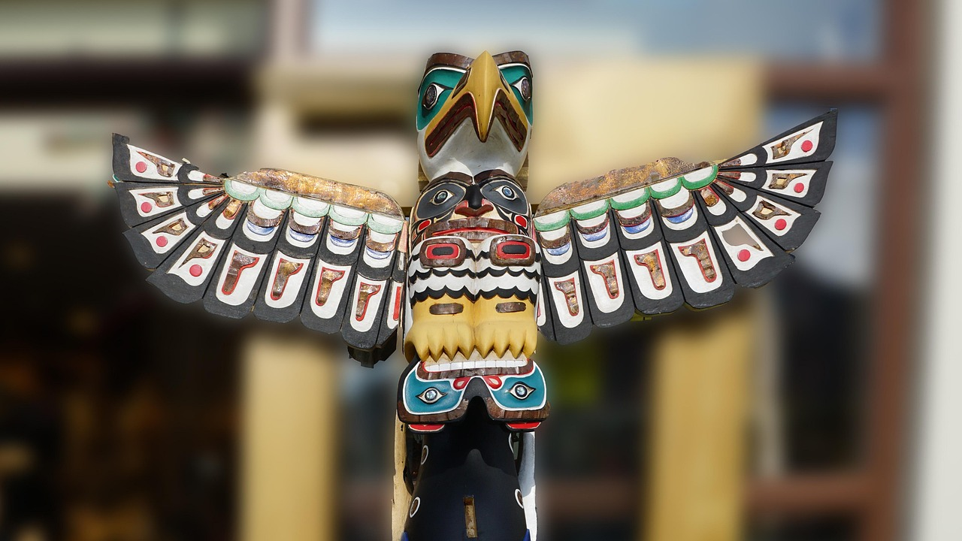
Exploring the Rich Tapestry of First Nations Storytelling
A Comprehensive Guide to Engaging with Imaginative Narratives and Cultural Heritage

Slide 2
Exploring the Rich Tapestry of First Nations Storytelling
2
Table of Contents
Introduction to Imaginative Stories of First N…
Lesson Objectives
Key Vocabulary
Teaching Strategies
Lesson Introduction
Guided Practice
Independent Practice
Assessment and Evaluation
Conclusion
Extension Activities
Parent Engagement
Safety Considerations
Reflection Questions
04
05
06
07
08
09
10
11
12
13
14
15
16

Slide 3
Exploring the Rich Tapestry of First Nations Storytelling
3
Table of Contents
Next Steps
17

Slide 4
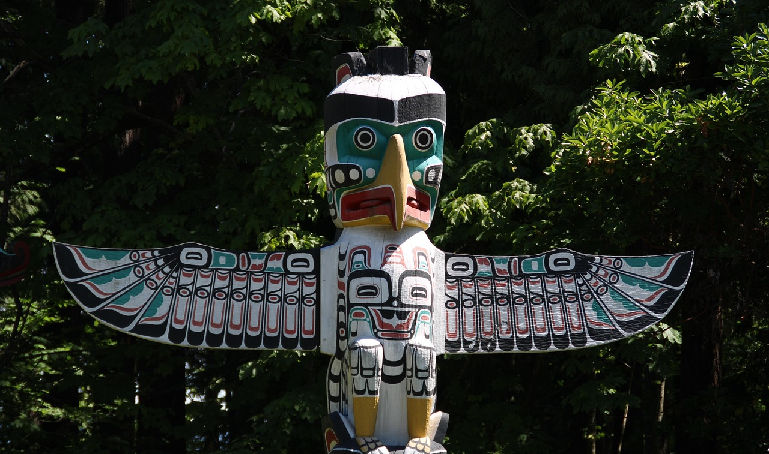
Exploring the Rich Tapestry of First Nations Storytelling
4
Introduction to Imaginative Stories of First Nations Peoples
Cultural Exploration
Literary Heritage
Empathy Development
This lesson invites students to explore imaginative stories from First Nations cultures.
It aims to foster cross-cultural understanding and appreciation.
Students will engage with the storytelling traditions that shape First Nations identities.
These narratives reveal the rich history and values of these communities.
Delving into these stories helps students build empathy for diverse experiences.
It encourages connections with the wisdom and traditions of First Nations peoples.

Slide 5

Exploring the Rich Tapestry of First Nations Storytelling
5
Lesson Objectives
Character Recall
Cultural Themes
Students will recall the main characters and events in a First Nations story.
This enhances their understanding of the narrative context.
Students will understand the cultural significance of the story.
This helps them appreciate its deeper meanings.
Visual Creation
Literary Analysis
Students will create a visual representation of the story.
This encourages creativity and personal expression.
Students will analyze the story for literary devices.
This develops their critical thinking and analytical skills.

Slide 6
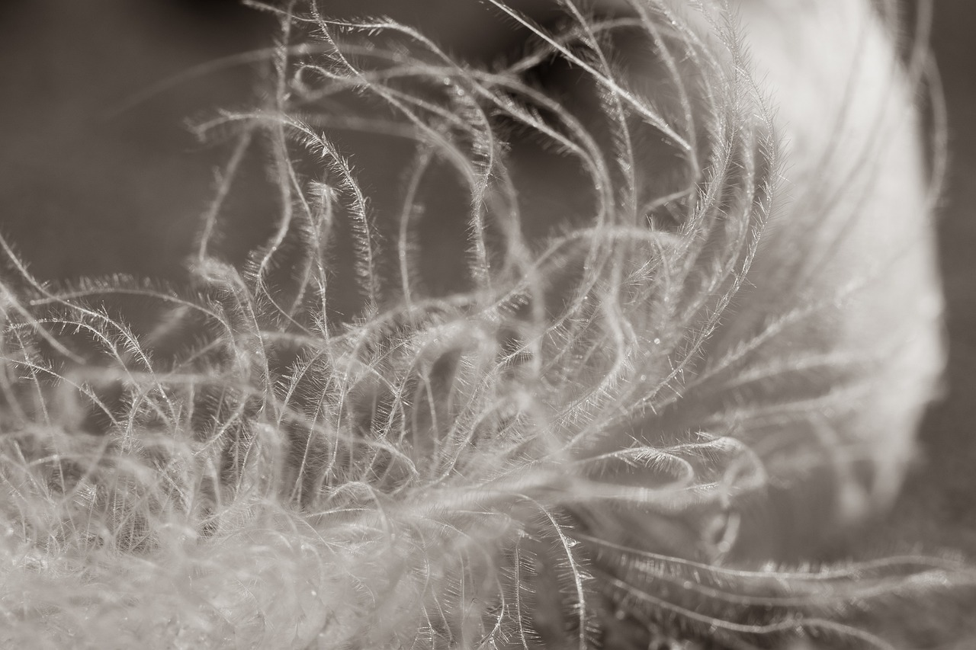
Exploring the Rich Tapestry of First Nations Storytelling
6
Key Vocabulary
Creative Narrative
Indigenous Peoples
Cultural Importance
Underlying Message
Literary Techniques
An imaginative story uses creativity to convey meaning and themes.
It often explores ideas that resonate with the audience.
Indigenous peoples of Australia include Aboriginal and Torres Strait Islander communities.
These groups have rich cultural histories and traditions.
Cultural significance emphasizes the importance of stories within specific cultures.
These narratives often reflect the values and beliefs of the community.
The theme represents the central idea or message conveyed in a story.
It often provides insight into human experiences and societal issues.
Common literary techniques include symbolism, which adds depth to the narrative.
Foreshadowing builds anticipation for future events in the story.

Slide 7
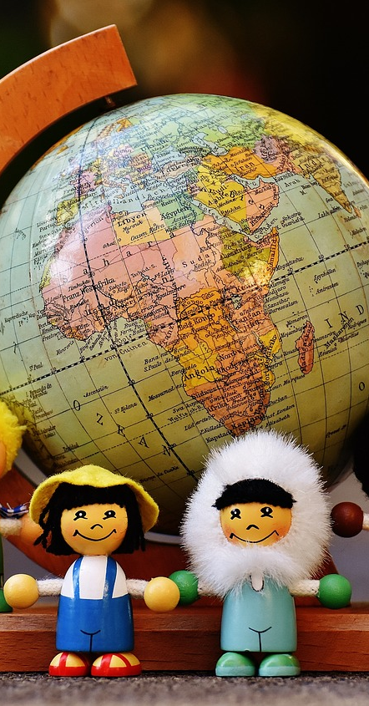
Exploring the Rich Tapestry of First Nations Storytelling
7
Teaching Strategies
Cultural Engagement
Visual Support
Provide students with opportunities to immerse themselves in First Nations cultures.
This engagement fosters a deeper understanding and appreciation of diverse perspectives.
Use visual aids such as pictures, videos, or diagrams to support students' understanding.
These tools help contextualize the stories and enhance comprehension.
Vocabulary Focus
Language Skills
Provide explicit instruction on key vocabulary and concepts related to the stories.
This focus ensures students grasp essential terms that enrich their learning experience.
Provide opportunities for students to develop their oral language skills.
Activities like class discussions, role-plays, or presentations encourage active participation.

Slide 8

Exploring the Rich Tapestry of First Nations Storytelling
8
Lesson Introduction
Acknowledgement of Country
Imaginative Stories
Lesson Objectives
We acknowledge the Gadigal people of the Eora Nation as the traditional owners of this land.
We honor their ongoing connection to the community and their rich cultural heritage.
Imaginative stories are vital in First Nations cultures, serving to convey history and values.
For instance, the Rainbow Serpent story illustrates creation and the significance of water in their culture.
Students will explore storytelling techniques, focusing on imagery and themes.
They will gain an understanding of the role of oral traditions in preserving cultural identity.

Slide 9

Exploring the Rich Tapestry of First Nations Storytelling
9
Guided Practice
Fluent Reading
Targeted Vocabulary
Critical Thinking
Visual Story Mapping
Creative Role-Play
The teacher will read a selected story aloud to the class.
Using inflection, expression, and pauses, the teacher will model fluent reading.
The teacher will provide explicit vocabulary instruction.
This will target words and phrases that may be unfamiliar to students.
The teacher will ask open-ended questions about the story.
These questions will prompt students to think critically about the themes.
Students will create a visual map of the story.
They will identify key events, characters, and settings.
Students will act out a scene from the story.
This activity encourages imagination and creativity in bringing characters to life.

Slide 10

Exploring the Rich Tapestry of First Nations Storytelling
10
Independent Practice
Picture Analysis
Event Ordering
Students will describe a picture from the story.
They should use simple vocabulary and sentence structures.
Students will put a series of events from the story in order.
Transitional words and phrases should support their sequencing.
Imaginative Storytelling
Critical Review
Students will write their own imaginative story.
They can use themes and motifs from the original story as inspiration.
Students will write a review of the story.
They should evaluate the plot, characters, and themes using critical thinking skills.

Slide 11

Exploring the Rich Tapestry of First Nations Storytelling
11
Assessment and Evaluation
Ongoing Monitoring
Comprehensive Evaluation
Collaborative Feedback
The teacher will monitor students' progress through ongoing assessments, including observations and quizzes.
The teacher will evaluate comprehension using diverse methods, such as tests and writing tasks.
Students will conduct self-assessments and provide peer feedback using structured checklists.

Slide 12

Exploring the Rich Tapestry of First Nations Storytelling
12
Conclusion
Cultural Empathy
Literary Engagement
This lesson plan promotes understanding and empathy across cultures.
It highlights the literary traditions of Aboriginal and Torres Strait Islander communities.
Imaginative stories from First Nations peoples enhance comprehension and fluency skills.
Students will also cultivate critical thinking and creativity through these narratives.

Slide 13

Exploring the Rich Tapestry of First Nations Storytelling
13
Extension Activities
Author Insights
Story Analysis
Creative Expression
Students will research a First Nations author and their contributions to literature.
They will create a presentation covering the author's background and notable works.
Students will analyze a complex imaginative story from a First Nations perspective.
They will focus on literary devices such as theme and character.
Students will create a project inspired by the imaginative story they analyzed.
This could be a visual art piece, a poem, or a short script.

Slide 14

Exploring the Rich Tapestry of First Nations Storytelling
14
Parent Engagement
Reading Strategies
Classroom Support
Child Progress Reports
Parents will attend a reading workshop to learn strategies for supporting their child's reading development at home.
These strategies will help enhance their child's reading skills and foster a love for reading.
Parents will have opportunities to volunteer in the classroom, assisting with reading activities.
This involvement provides one-on-one support to students and strengthens the home-school connection.
Parents will receive regular progress updates regarding their child's reading development.
These reports will highlight strengths and challenges, ensuring parents are informed and engaged.

Slide 15

Exploring the Rich Tapestry of First Nations Storytelling
15
Safety Considerations
Safety Considerations
Individual Support
The teacher will foster a classroom that values respect and inclusivity. Clear protocols will be established to handle any issues that arise.
The teacher will recognize and address the unique needs of each student. Tailored support will be provided to ensure everyone can participate fully.

Slide 16

Exploring the Rich Tapestry of First Nations Storytelling
16
Reflection Questions
Engaging Strategies
Adapting Lessons
Extending Learning
Incorporate storytelling and hands-on activities that reflect the cultural heritage of Aboriginal and Torres Strait Islander students.
These approaches connect learning to their community and personal experiences.
Implement guided reading sessions tailored to individual student needs to enhance fluency.
Use visual aids and interactive materials to support comprehension for students struggling with reading.
Offer mentorship programs that connect high-performing students with professionals in their fields of interest.
Create opportunities for students to lead projects that challenge their critical thinking and creativity.

Slide 17

Exploring the Rich Tapestry of First Nations Storytelling
17
Next Steps
Indigenous Stories
Critical Thinking
Teacher Support
This lesson will explore traditional Indigenous stories and their cultural significance.
Students will engage with these stories to understand their importance.
Students will develop critical thinking skills through discussions and activities.
They will learn to appreciate diverse perspectives.
The teacher will provide tailored support and explicit instruction.
This will meet the diverse needs of the class.

