Slide 1












Understanding Punctuation Marks
Exploring the Basics and Usage of Common Punctuation Marks

Slide 2

Table of contents
Lesson Introduction
Subject Knowledge
Punctuation marks
Common punctuation marks
Period
Comma
Question mark
Exclamation point
Apostrophe
Quotation marks
01
02
03
04
05
06
07
08
09
10

Slide 3
Lesson Introduction
STRENGTHS
WEAKNESSES
Punctuation marks are the symbols we use to organize and clarify the meaning of written language.
They help to separate words, phrases, and sentences, and indicate the flow of ideas.
Incorrect usage of punctuation marks can lead to confusion and misinterpretation of the intended message.
S
W
OPPORTUNITIES
THREATS
O
T
Students have the opportunity to enhance their writing skills by mastering the use of punctuation marks.
Improved punctuation can elevate the quality of their written work and make it more impactful.
Neglecting the importance of punctuation may result in ineffective communication and hinder the overall clarity of written text.
Understanding Punctuation Marks

Slide 4
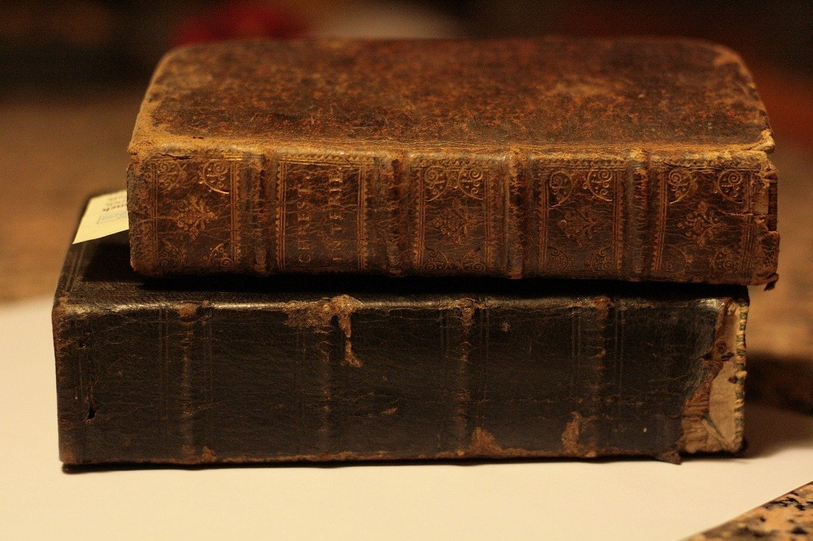
Subject Knowledge
Definition
Common Punctuation Marks
Punctuation marks are the symbols we use to organize and clarify the meaning of written language.
They help to separate words, phrases, and sentences, and indicate the flow of ideas.
The most common punctuation marks are the period (.), comma (,), question mark (?), exclamation point (!), apostrophe ('), and quotation marks (" ").
Each mark serves a specific purpose and helps to convey the intended message.
Understanding Punctuation Marks

Slide 5
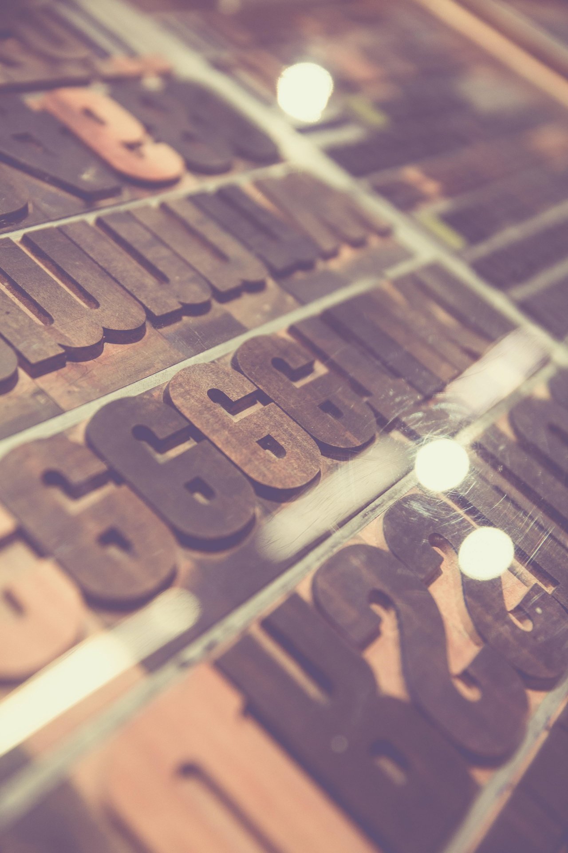
Punctuation marks
Punctuation Marks
Punctuation marks are the symbols we use to organize and clarify the meaning of written language.
They help to separate words, phrases, and sentences, and indicate the flow of ideas.
Common Punctuation Marks
The most common punctuation marks are the period (.), comma (,), question mark (?), exclamation point (!), apostrophe ('), and quotation marks (" ").
Each mark serves a specific purpose and helps to convey the intended message effectively.
Understanding Punctuation Marks

Slide 6
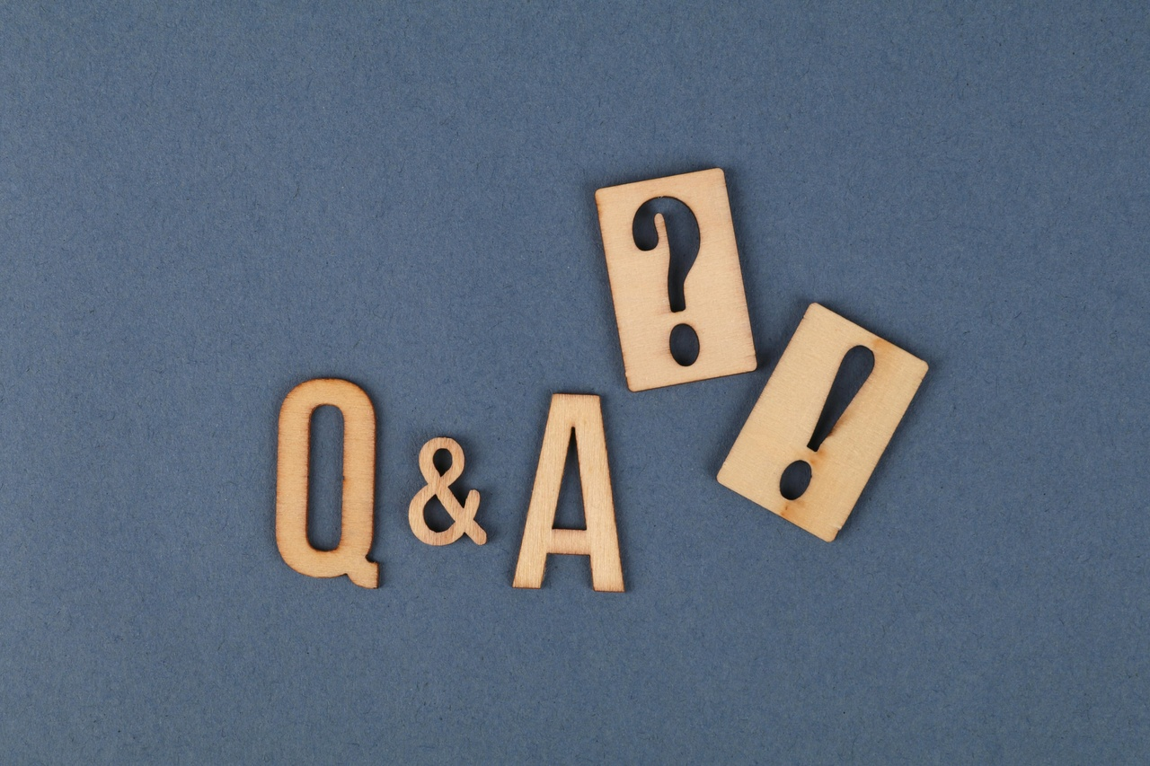
Common punctuation marks
Period (.)
Comma (,)
Used to indicate the end of a sentence.
Separates items in a list or clauses in a sentence.
Question Mark (?)
Exclamation Point (!)
Apostrophe (')
Denotes a question or inquiry.
Adds emphasis or indicates strong emotion.
Shows possession or contraction.
Understanding Punctuation Marks

Slide 7



Period
The period (.)
End of a sentence
Abbreviations
Quotation marks
Clear communication
One of the most commonly used punctuation marks in English writing.
Used to indicate the end of a sentence that is a statement or a command.
Used in abbreviations, such as "Mr." for Mister and "etc." for et cetera.
Always place the period inside the closing quotation mark at the end of a sentence when using quotation marks.
Using the period correctly is crucial for clear and effective communication in written language.
01
02
03
04
05
Understanding Punctuation Marks

Slide 8
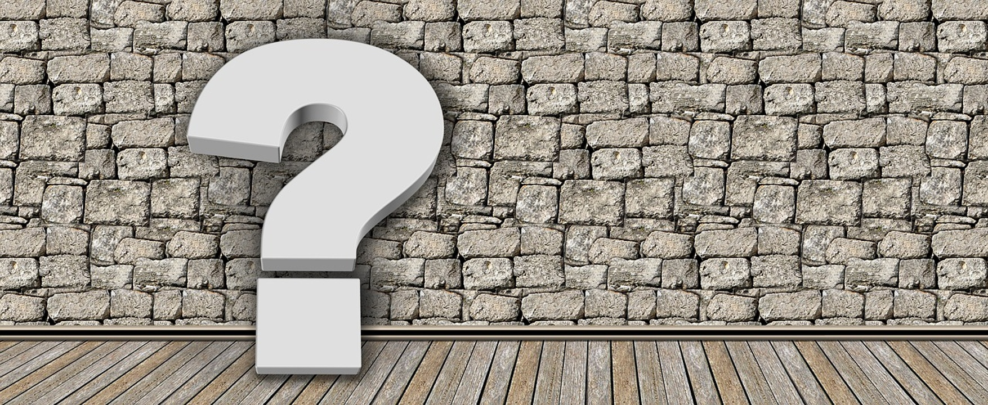
Comma
The comma (,) is a versatile punctuation mark
Essential for avoiding confusion and ensuring clarity
Used to indicate a pause in a sentence
Separate items in a list
Clarify the meaning of a sentence
Separating elements such as clauses, phrases, and items in a series
Enhances the flow of a sentence
Common uses of the comma
Mastering the comma
Improves overall readability
Before coordinating conjunctions in compound sentences
After introductory phrases
To set off non-essential information
Crucial for achieving punctuation perfection in your writing
Understanding Punctuation Marks

Slide 9
Question mark
STRENGTHS
WEAKNESSES
Indicates a direct question in a sentence.
Adds curiosity and engagement to written communication.
Overuse can lead to unclear or confusing writing.
Must be used appropriately to avoid misinterpretation.
S
W
OPPORTUNITIES
THREATS
O
T
Enhances reader understanding by signaling an inquiry.
Can be used creatively in dialogue or rhetorical questions.
Misplacement can alter the intended meaning of a sentence.
Incorrect usage may undermine the credibility of the writer.
Understanding Punctuation Marks

Slide 10
Exclamation point
STRENGTHS
WEAKNESSES
Adds emphasis and excitement to a sentence.
Conveys strong emotions such as surprise, joy, or urgency.
Overuse can diminish its impact and come across as insincere.
In formal writing, excessive use may be considered inappropriate.
S
W
OPPORTUNITIES
THREATS
O
T
Enhances storytelling by creating a sense of drama.
Can be used creatively in marketing to grab attention.
Misuse can lead to misinterpretation of tone.
Incorrect placement may alter the intended meaning of a sentence.
Understanding Punctuation Marks

Slide 11
Apostrophe
STRENGTHS
WEAKNESSES
Indicates possession or ownership in nouns (e.g., Sarah's book).
Used in contractions to combine words (e.g., can't for cannot).
Misuse can lead to confusion or change in meaning.
Overuse can make writing appear informal or incorrect.
S
W
OPPORTUNITIES
THREATS
O
T
Enhances clarity and precision in writing.
Allows for creative expression in literature and dialogue.
Incorrect placement can alter the intended message.
Lack of understanding may result in grammatical errors.
Understanding Punctuation Marks

Slide 12
Quotation marks
STRENGTHS
WEAKNESSES
Quotation marks are used to indicate direct speech or a quotation from another source.
They help to distinguish between the speaker's words and the rest of the text.
Quotation marks add clarity and authenticity to written content.
Incorrect usage of quotation marks can lead to confusion or misinterpretation of the intended meaning.
Overuse of quotation marks may distract the reader and diminish the impact of the quoted text.
Different style guides may have varying rules on when and how to use quotation marks, leading to potential inconsistencies.
S
W
OPPORTUNITIES
THREATS
O
T
Learning the proper usage of quotation marks can enhance the quality of writing and improve communication skills.
Mastering the nuances of quotation marks can elevate the professionalism of written work.
Utilizing quotation marks effectively can add credibility and authority to research papers, articles, and essays.
Misplaced or missing quotation marks can result in plagiarism accusations or misattribution of ideas.
Inconsistent use of quotation marks within a document may undermine the overall coherence and readability.
Ignoring the rules of quotation marks could impact the integrity and accuracy of the information being conveyed.
Understanding Punctuation Marks

