Slide 1
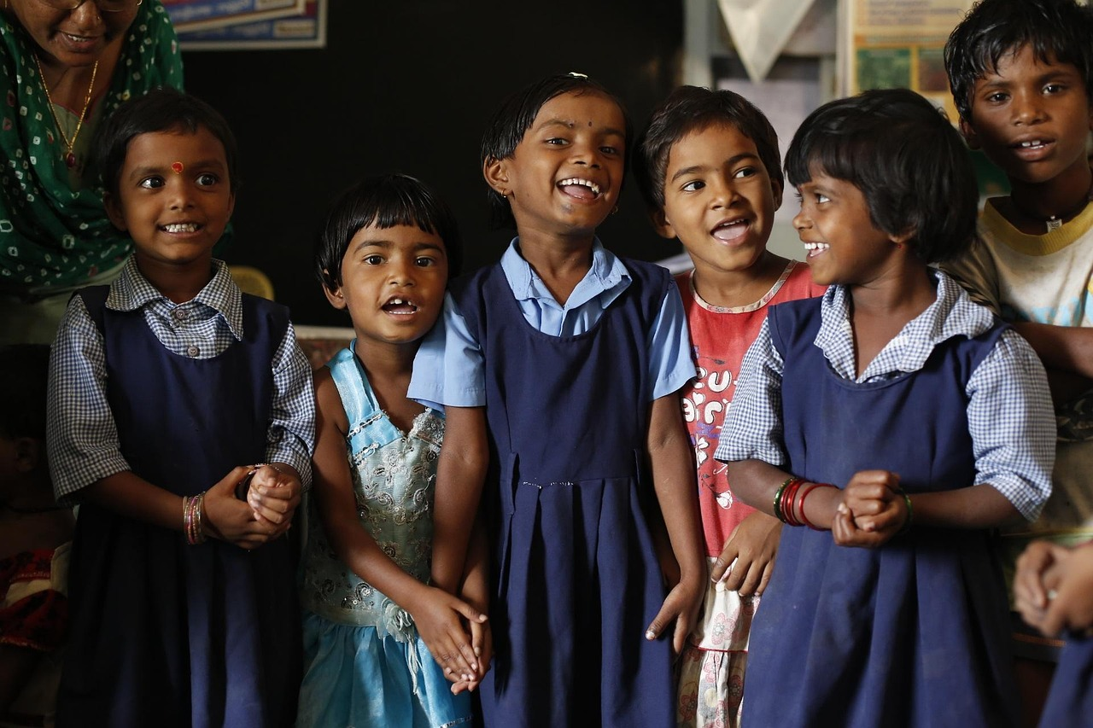

Understanding and Celebrating Cultural Heritage
Building Empathy, Tolerance, and Harmony in a Diverse Classroom Community

Slide 2
Understanding and Celebrating Cultural Heritage
2
Table of Contents
Introduction to Cultural Heritage
Why is Cultural Heritage Important?
Cultural Heritage in the Classroom
Key Concepts
Cultural Heritage Activities
Cultural Heritage Project
Assessment and Evaluation
Extension Activities
Conclusion
Reflection Questions
Next Steps
Teaching Tips
Key Takeaways
04
05
06
07
08
09
10
11
12
13
14
15
16

Slide 3
Understanding and Celebrating Cultural Heritage
3
Table of Contents
Parent Engagement
Safety Considerations
Conclusion and Final Thoughts
17
18
19

Slide 4
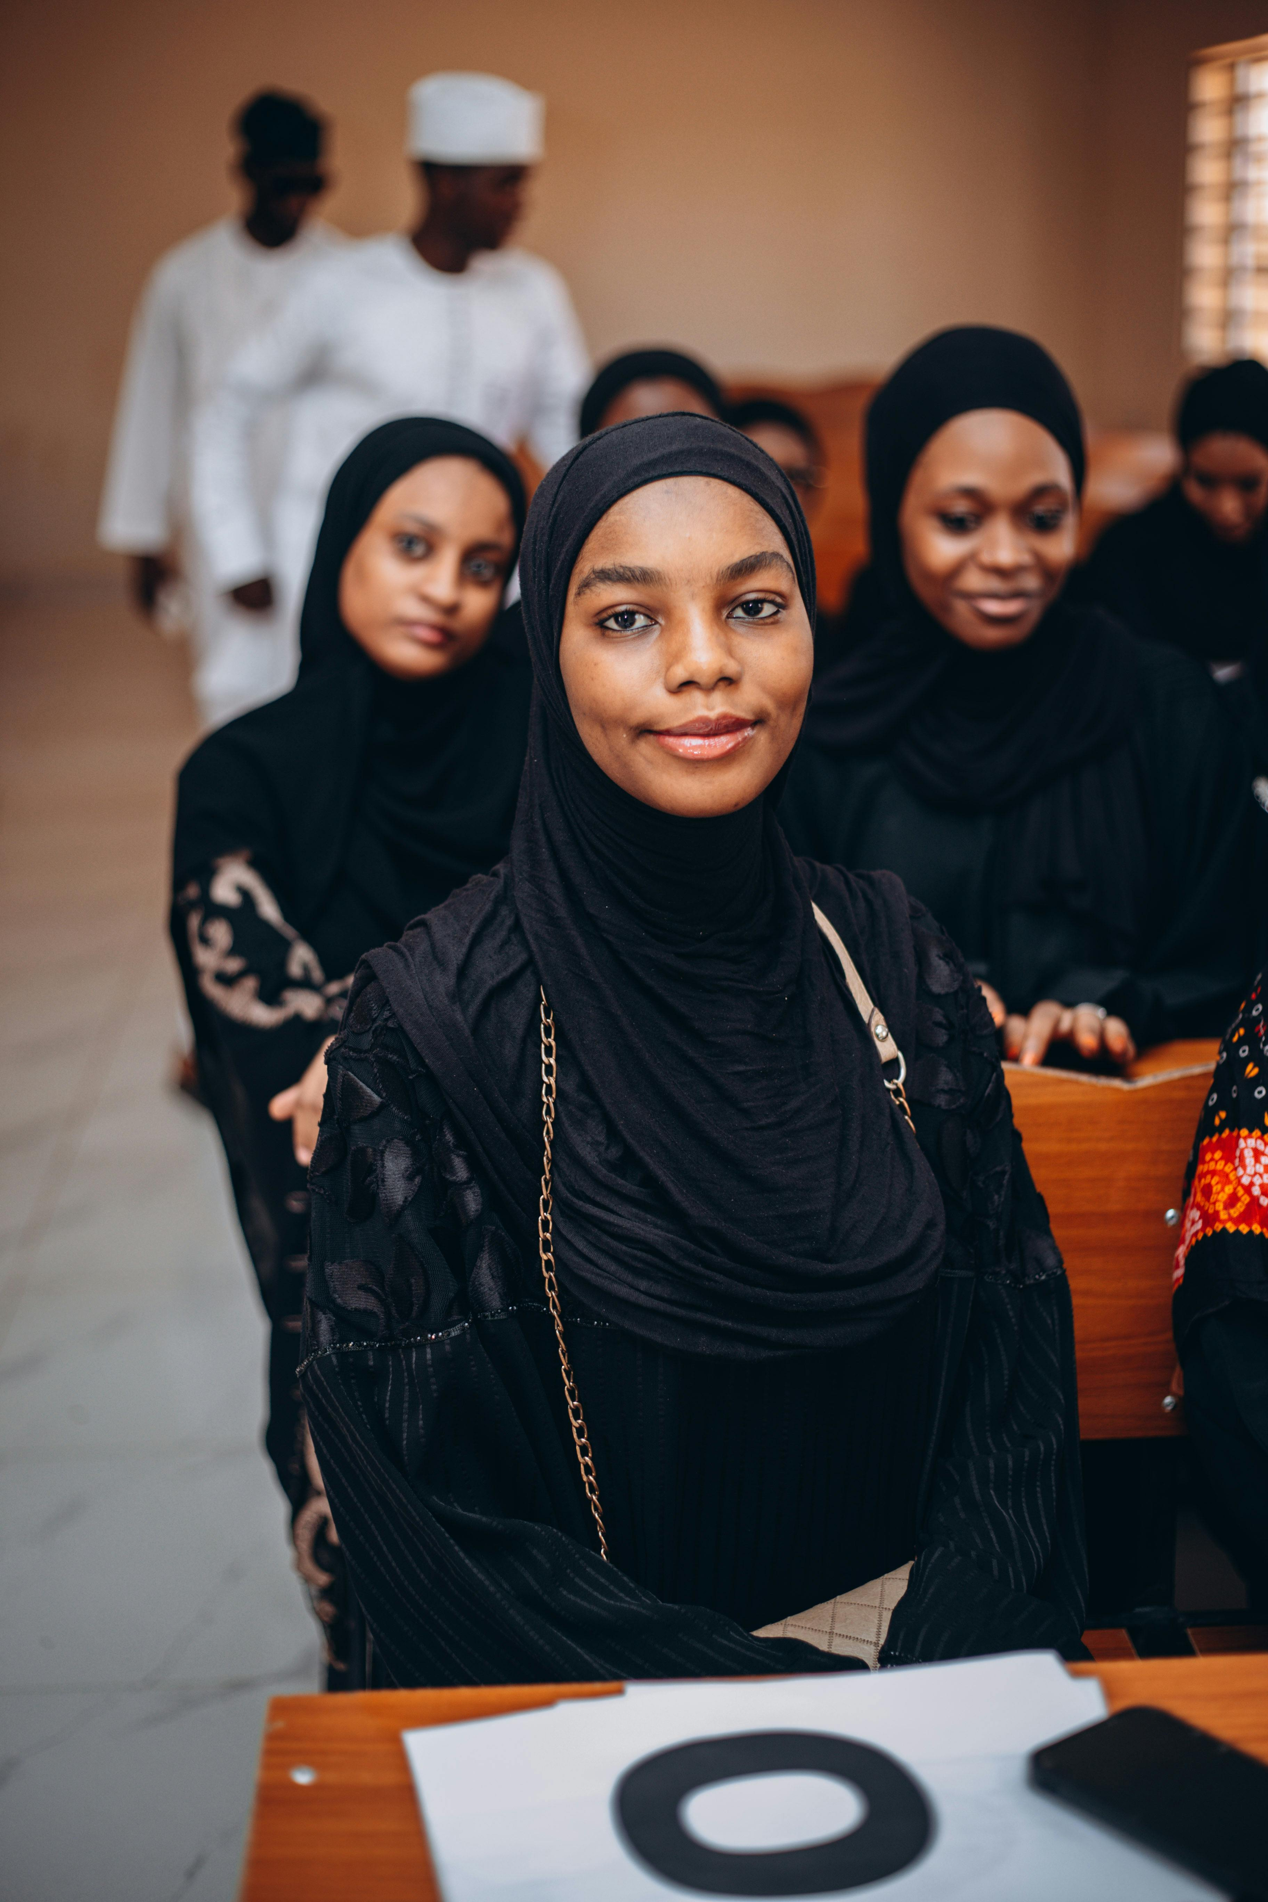
Understanding and Celebrating Cultural Heritage
4
Introduction to Cultural Heritage
Understanding Cultural Heritage
Exploring Classroom Heritage
The Importance of Cultural Awareness
Cultural heritage refers to the customs, traditions, language, and values of a particular group of people.
It is essential to understand and appreciate cultural heritage to build positive relationships and develop a sense of identity and belonging.
In this lesson, we will explore the cultural heritage of our classroom.
We will learn about the diverse backgrounds of our peers.
Understanding cultural heritage helps in fostering mutual respect and appreciation.
It plays a key role in creating a sense of belonging and identity.

Slide 5
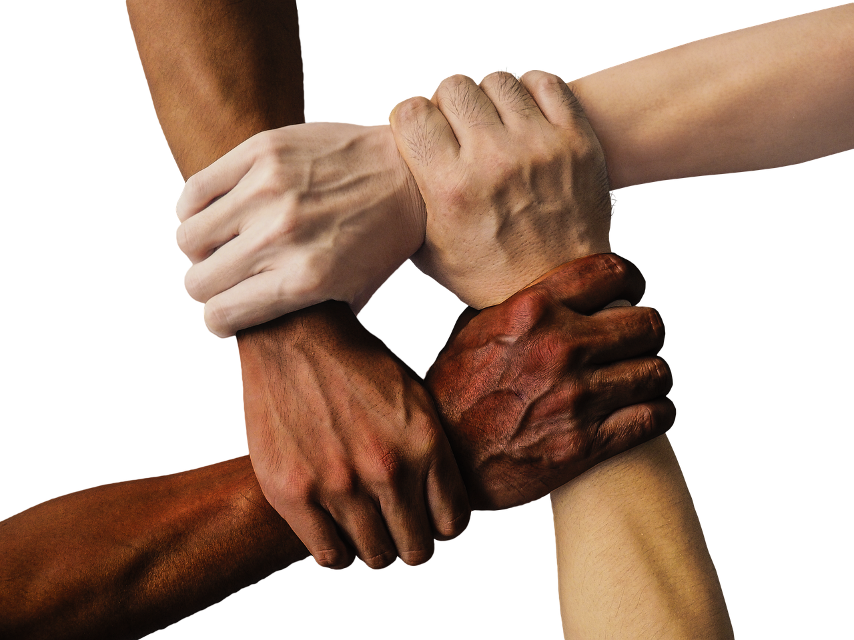
Understanding and Celebrating Cultural Heritage
5
Why is Cultural Heritage Important?
Understanding Our Place in the World
Promoting Cultural Awareness
Cultural heritage helps us understand our place in the world.
It connects us with others who share similar experiences and values.
It promotes cultural awareness and appreciation.
This helps in breaking down social and cultural barriers.
Celebrating Human Differences
Fostering Empathy and Tolerance
Cultural heritage is a vital part of our shared human experience.
It is essential to respect and celebrate our differences.
By learning about cultural heritage, we can develop empathy.
This also fosters tolerance and understanding.

Slide 6
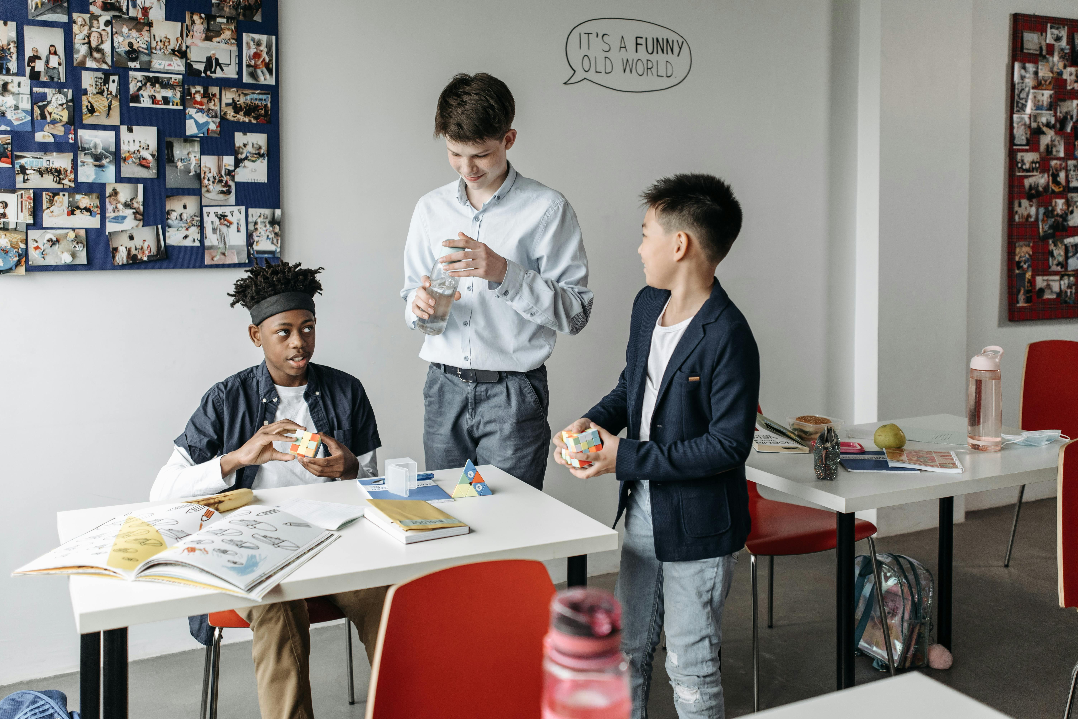
Understanding and Celebrating Cultural Heritage
6
Cultural Heritage in the Classroom
Diverse Classroom Community
Celebrating Cultural Heritage
Building Harmony Through Sharing
Our classroom is a diverse and inclusive community, with students from different cultural backgrounds.
We will learn about and celebrate the cultural heritage of our peers, including their traditions, customs, and values.
We will learn about and celebrate the cultural heritage of our peers, including their traditions, customs, and values.
By sharing and learning about each other's cultural heritage, we can build a stronger and more harmonious classroom community.
By sharing and learning about each other's cultural heritage, we can build a stronger and more harmonious classroom community.
Our classroom is a diverse and inclusive community, with students from different cultural backgrounds.

Slide 7
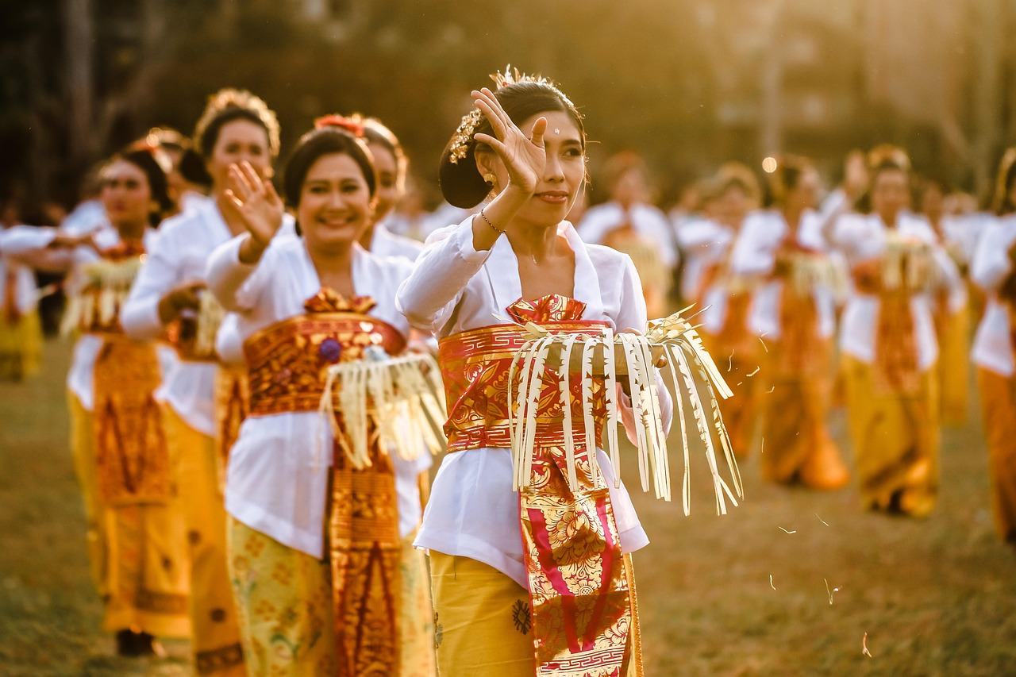
Understanding and Celebrating Cultural Heritage
7
Key Concepts
Culture
Heritage
Tradition
Custom
Symbol
The customs, traditions, and values of a particular group of people.
Culture shapes the way individuals interact and perceive the world around them.
The history and traditions of a person's family and community.
Heritage connects individuals to their roots and provides a sense of identity.
A custom or practice that is passed down from generation to generation.
Traditions often serve as a bridge between the past and the present.
A usual practice or way of doing something.
Customs vary widely across different societies and reflect their unique characteristics.
An object or image that represents something else.
Symbols often carry deep meanings and are used to convey complex ideas.

Slide 8
Understanding and Celebrating Cultural Heritage
8
Cultural Heritage Activities
Cultural Sharing Circle
Family Tree Exploration
Cultural Artifact Sorting
Family Cultural Timeline
Students will share their cultural heritage and traditions with the class.
This activity encourages understanding and appreciation of diverse backgrounds.
Students will create a family tree to learn about their ancestors and cultural heritage.
This helps them connect with their roots and understand generational links.
Students will sort cultural artifacts into categories and learn about their significance.
This activity fosters knowledge about the importance of cultural symbols.
Students will create a timeline of their family's cultural history.
This provides a visual representation of their heritage across generations.

Slide 9
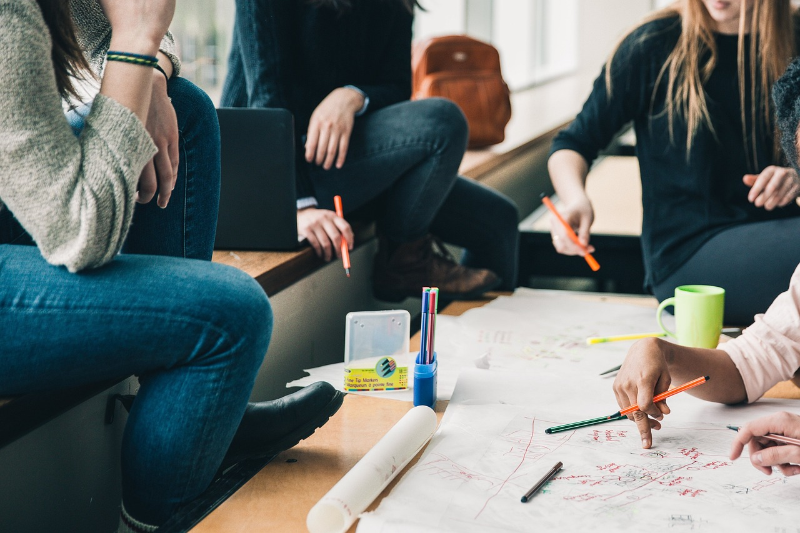
Understanding and Celebrating Cultural Heritage
9
Cultural Heritage Project
Project Creation
Class Presentation
Cultural Exploration
Students will create a project that showcases their cultural heritage, such as a poster, model, or presentation.
The project will include information about their cultural background, traditions, and customs.
Students will present their project to the class.
They will share their cultural heritage with their peers.
The project encourages students to explore and express their cultural identity.
It serves as a platform for celebrating diversity within the classroom.

Slide 10

Understanding and Celebrating Cultural Heritage
10
Assessment and Evaluation
Class Participation Assessment
Cultural Heritage Project Evaluation
Students will be assessed on their participation in class activities and discussions.
This evaluation will focus on their engagement and contributions during lessons.
The cultural heritage project will be evaluated on its content, creativity, and presentation.
This ensures a comprehensive review of the students' efforts and originality.
Peer Appreciation Assessment
Instructional Adjustment Based on Assessment
Students will also be assessed on their ability to share and appreciate the cultural heritage of their peers.
This aspect highlights the importance of mutual respect and understanding in the classroom.
The assessment will be used to inform future lessons and adjust instruction to meet the needs of all students.
This approach aims to create a more tailored and effective learning experience.

Slide 11
Understanding and Celebrating Cultural Heritage
11
Extension Activities
Traditional Clothing and Textiles
Cultural Festivals and Celebrations
Family Histories and Genealogy
Students will learn about and create traditional clothing and textiles from different cultures.
This activity will help them understand the significance of clothing in cultural identity.
Students will research and present on a festival or celebration from their own cultural background or one they are interested in learning more about.
This will encourage them to explore and appreciate diverse traditions and practices.
Students will create a family tree or timeline and share stories about their ancestors and cultural heritage.
This activity fosters a deeper connection to their roots and personal history.

Slide 12
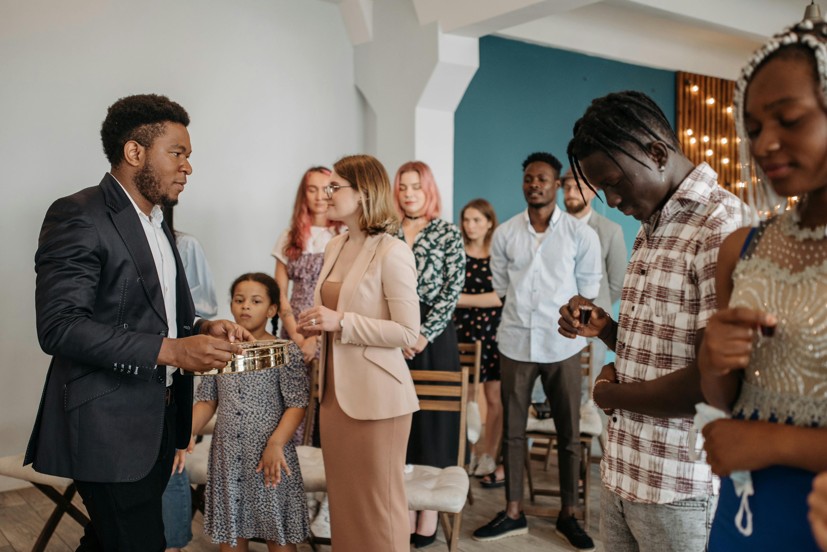
Understanding and Celebrating Cultural Heritage
12
Conclusion
Cultural Heritage's Role in Human Experience
Building a Harmonious Community
In conclusion, cultural heritage is an essential part of our shared human experience, and it is vital to understand and appreciate the diverse backgrounds of our peers.
By learning about and celebrating cultural heritage, we can build a stronger and more harmonious classroom community and promote empathy, tolerance, and understanding.
By learning about and celebrating cultural heritage, we can build a stronger and more harmonious classroom community and promote empathy, tolerance, and understanding.
In conclusion, cultural heritage is an essential part of our shared human experience, and it is vital to understand and appreciate the diverse backgrounds of our peers.

Slide 13
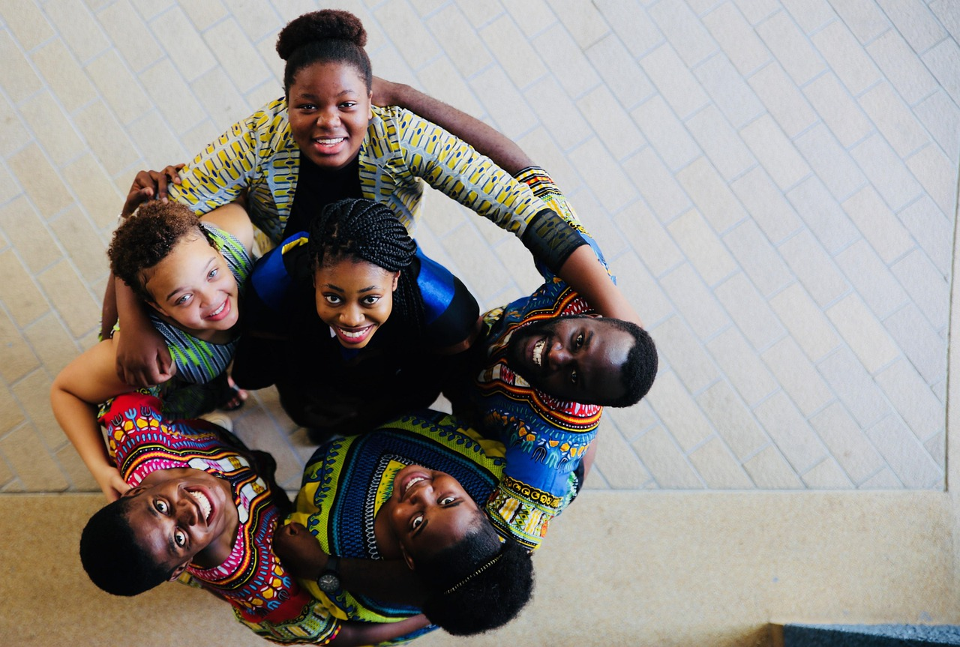
Understanding and Celebrating Cultural Heritage
13
Reflection Questions
Learning About Cultural Heritage
Sharing and Celebrating Heritage
What did you learn about cultural heritage in this lesson?
How can you apply what you learned to your everyday life?
What are some ways you can share and celebrate your cultural heritage with others?
How can you respect and appreciate the cultural heritage of your peers?
Applying Cultural Knowledge
Respecting Peer Heritage
How can you apply what you learned to your everyday life?
What are some ways you can share and celebrate your cultural heritage with others?
How can you respect and appreciate the cultural heritage of your peers?
What did you learn about cultural heritage in this lesson?

Slide 14
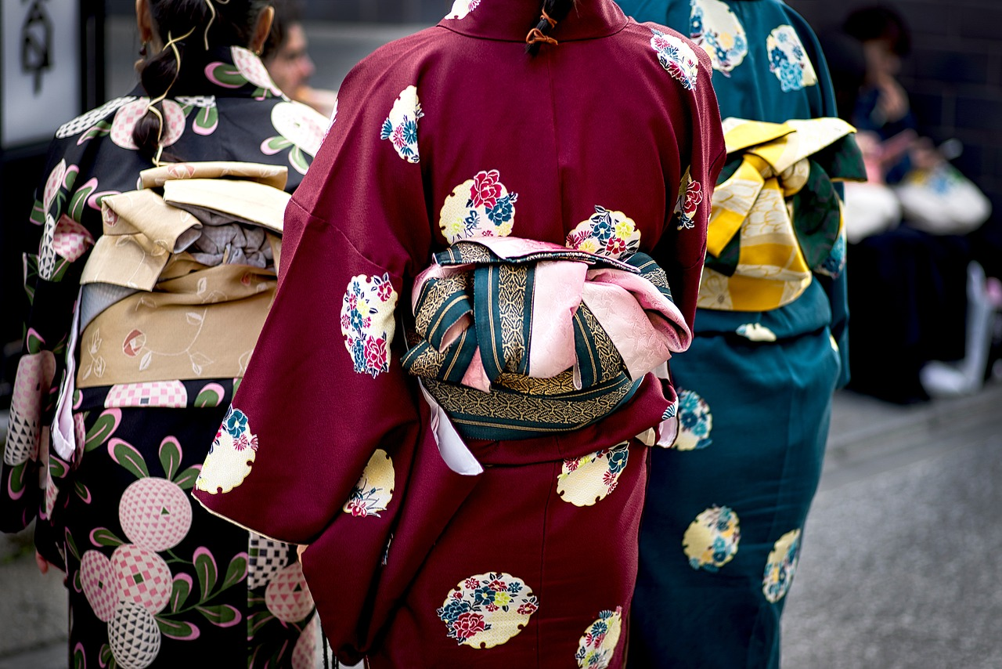
Understanding and Celebrating Cultural Heritage
14
Next Steps
Exploring Cultural Textiles
The next lesson will focus on traditional clothing and textiles from different cultures.
Students will learn about and create traditional clothing and textiles, and share their projects with the class.
Creative Projects and Sharing
Students will learn about and create traditional clothing and textiles, and share their projects with the class.
The lesson will also include opportunities for students to reflect on what they have learned and how they can apply it to their everyday lives.
Reflection and Application
The lesson will also include opportunities for students to reflect on what they have learned and how they can apply it to their everyday lives.
The next lesson will focus on traditional clothing and textiles from different cultures.

Slide 15
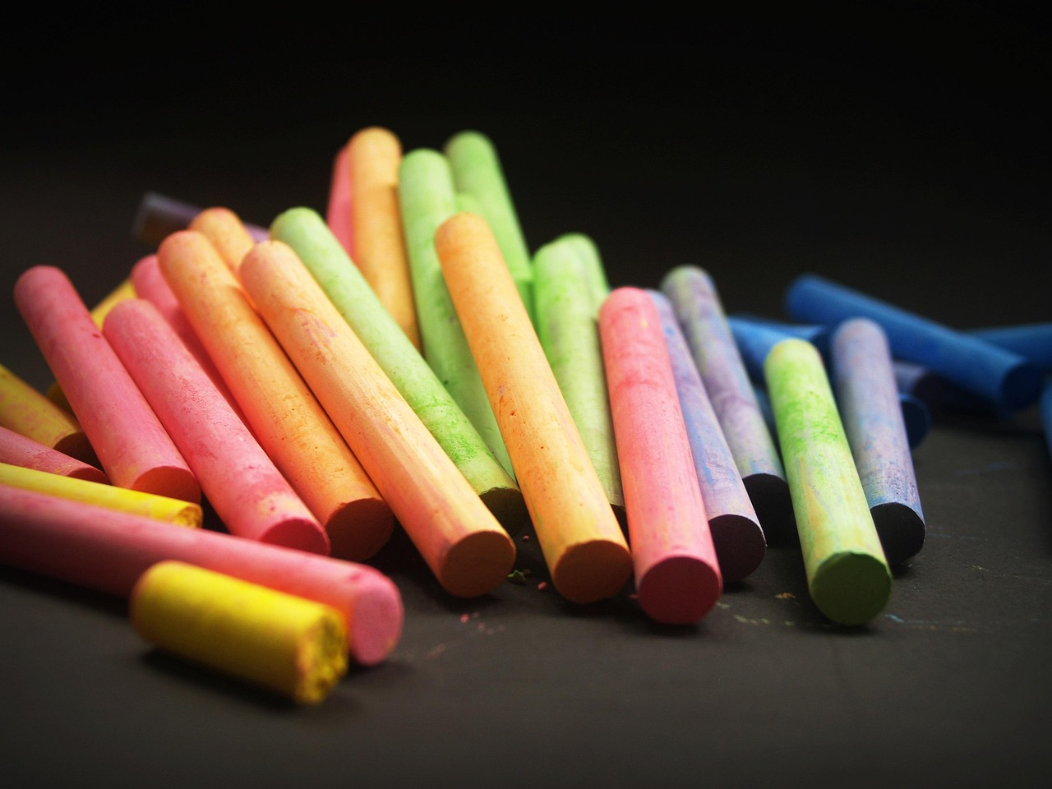
Understanding and Celebrating Cultural Heritage
15
Teaching Tips
Engaging Cultural Practices
Student Interaction and Reflection
Interactive Learning Techniques
Adaptable Teaching Strategies
Use visual aids and storytelling to introduce students to different cultural practices and traditions.
Make the lesson hands-on and interactive, with opportunities for students to participate and engage with the material.
Encourage student sharing and reflection, and provide opportunities for students to ask questions and seek feedback.
Be flexible and adaptable, and adjust instruction to meet the needs of all students.
Make the lesson hands-on and interactive, with opportunities for students to participate and engage with the material.
Use visual aids and storytelling to introduce students to different cultural practices and traditions.
Be flexible and adaptable, and adjust instruction to meet the needs of all students.
Encourage student sharing and reflection, and provide opportunities for students to ask questions and seek feedback.

Slide 16
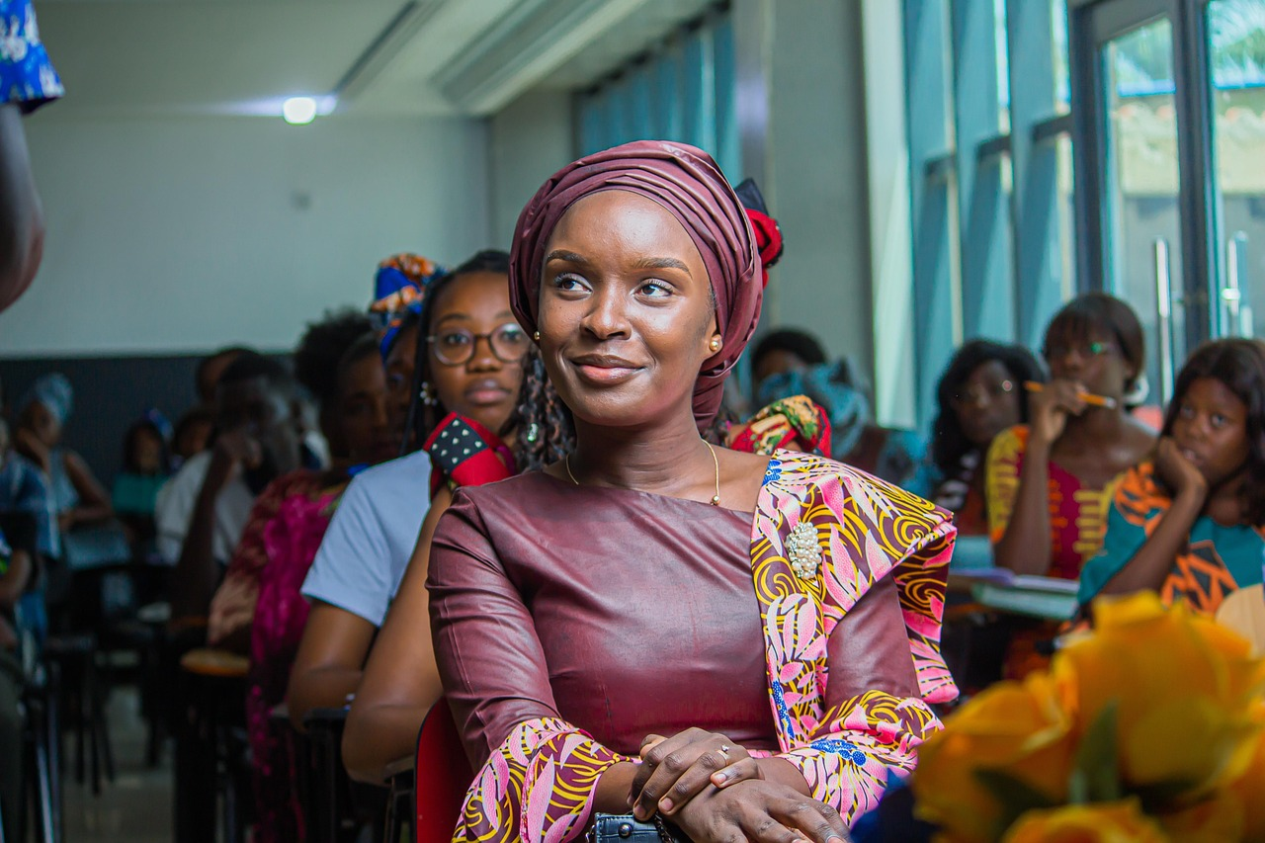
Understanding and Celebrating Cultural Heritage
16
Key Takeaways
Understanding Cultural Heritage
Celebrating Diversity
Respecting Cultural Heritage
Cultural heritage is an essential part of our shared human experience, and it is vital to understand and appreciate the diverse backgrounds of our peers.
By learning about and celebrating cultural heritage, we can build a stronger and more harmonious classroom community and promote empathy, tolerance, and understanding.
By learning about and celebrating cultural heritage, we can build a stronger and more harmonious classroom community and promote empathy, tolerance, and understanding.
Students will be able to identify and share their own cultural heritage, and respect and appreciate the cultural heritage of their peers.
Students will be able to identify and share their own cultural heritage, and respect and appreciate the cultural heritage of their peers.
Cultural heritage is an essential part of our shared human experience, and it is vital to understand and appreciate the diverse backgrounds of our peers.

Slide 17
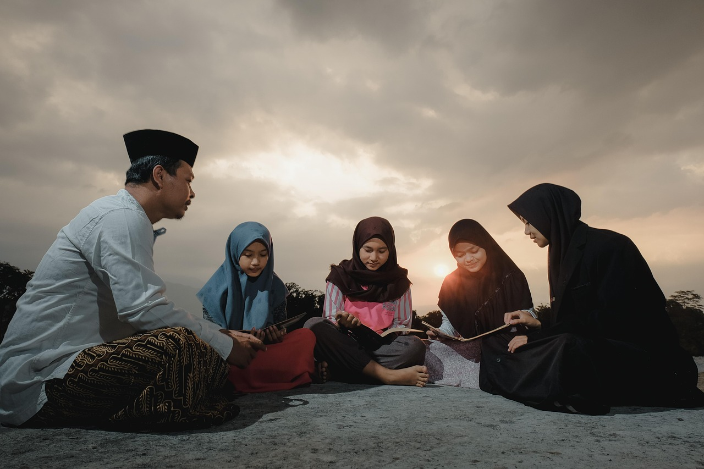
Understanding and Celebrating Cultural Heritage
17
Parent Engagement
Encouraging Cultural Exploration
Parent-Teacher Collaboration
Fostering Dialogue at Home
Parents can support their child's learning by asking them about their cultural heritage and traditions.
Parents can also share their own cultural heritage and traditions with their child, and encourage them to ask questions and seek feedback.
The teacher will provide opportunities for parents to engage with the lesson.
This can include volunteer opportunities or parent-teacher conferences.
Parents are encouraged to create an open environment for discussing cultural heritage.
This helps children feel more connected to their identity and learning.

Slide 18

Understanding and Celebrating Cultural Heritage
18
Safety Considerations
Inclusive and Respectful Environment
Student Safety and Support
The teacher will ensure that the classroom environment is inclusive and respectful, with minimal distractions and hazards.
The teacher will also be aware of any cultural sensitivities or protocols that may need to be observed.
The teacher will take steps to ensure that all students feel safe and supported.
This includes being mindful of cultural sensitivities and maintaining a respectful atmosphere.

Slide 19
Understanding and Celebrating Cultural Heritage
19
Conclusion and Final Thoughts
Understanding Cultural Heritage
Promoting Empathy and Tolerance
In conclusion, this lesson on cultural heritage has provided students with a deeper understanding and appreciation of the diverse backgrounds of their peers.
The teacher will continue to build on this lesson, providing opportunities for students to learn about and celebrate cultural heritage.
The teacher will continue to build on this lesson, providing opportunities for students to learn about and celebrate cultural heritage.
This approach promotes empathy, tolerance, and understanding in the classroom.

