Slide 1


Mastering YouTube: From Basics to Success
A Comprehensive Guide to Creating, Engaging, and Growing Your YouTube Channel

Slide 2
Mastering YouTube: From Basics to Success
2
Table of Contents
Introduction to YouTube
Why Learn About YouTube?
YouTube Basics
Creating a YouTube Channel
Uploading Videos
Engaging with the Community
YouTube Safety and Etiquette
Content Creation Best Practices
YouTube Analytics
Monetization on YouTube
Live Streaming on YouTube
Advanced YouTube Features
Conclusion
04
05
06
07
08
09
10
11
12
13
14
15
16

Slide 3
Mastering YouTube: From Basics to Success
3
Table of Contents
Summary
Reflection Questions
Next Steps
Additional Resources
Final Thoughts
17
18
19
20
21

Slide 4

Mastering YouTube: From Basics to Success
4
Introduction to YouTube
Overview of YouTube
Features of YouTube
YouTube's Global Reach
YouTube is a video-sharing platform with over 2 billion monthly active users.
It was founded in 2005 and acquired by Google in 2006.
YouTube offers a wide range of features for its users.
These include creating and managing channels, uploading and sharing videos, and engaging with the community.
With over 2 billion monthly active users, YouTube has a massive global audience.
This makes it one of the most influential platforms for video content.

Slide 5

Mastering YouTube: From Basics to Success
5
Why Learn About YouTube?
Educational and Recreational Benefits
Learning about YouTube is essential for both educational and recreational purposes.
It provides opportunities to explore diverse content and gain knowledge in various fields.
Skill Development Opportunities
It helps develop important skills such as communication, creativity, and critical thinking.
These skills are valuable for personal growth and professional success.
Enhancing Online Safety
Understanding how to use YouTube effectively can enhance online safety and digital citizenship.
It promotes responsible usage and awareness of digital platforms.

Slide 6

Mastering YouTube: From Basics to Success
6
YouTube Basics
Understanding a YouTube Channel
Creating Your Channel
A YouTube channel is a user's personal space on the platform.
It serves as a hub for uploading videos, creating playlists, and engaging with the community.
To create a channel, you need a Google account.
Follow the sign-up process to set up your personal space on YouTube.
Customizing Your Channel
Engaging with the Community
You can personalize your channel with a profile picture, banner, and bio.
These elements help represent your identity and attract viewers.
Uploading videos and creating playlists are key ways to connect with your audience.
Engagement fosters a sense of community and encourages interaction.

Slide 7

Mastering YouTube: From Basics to Success
7
Creating a YouTube Channel
Choosing a Unique Username
Customizing Your Channel Appearance
Choose a unique and relevant username for your channel.
This will help establish your brand identity and make your channel memorable.
Customize your profile picture, banner, and bio to reflect your brand.
A cohesive look will make your channel more appealing to viewers.
Optimizing Your Bio with Keywords
Setting Your Channel Privacy
Add relevant keywords to your bio to help people find your channel.
This improves your channel's visibility in search results.
Make sure your channel is set to public or private, depending on your preferences.
This ensures your content is shared according to your intended audience.

Slide 8

Mastering YouTube: From Basics to Success
8
Uploading Videos
Uploading from Various Devices
Optimizing Video Details
Enhancing Accessibility
Meeting Platform Standards
You can upload videos from your computer, phone, or tablet.
Make sure your video is in the correct format and meets YouTube's guidelines.
Add a title, description, and tags to your video to help people find it.
These details improve your video's visibility and searchability.
You can also add subtitles, closed captions, and translations to your video.
This makes your content accessible to a wider audience.
Ensure your video complies with YouTube's guidelines.
This helps avoid issues during the upload process.

Slide 9

Mastering YouTube: From Basics to Success
9
Engaging with the Community
Engage Through Interaction
You can comment, like, and subscribe to channels to engage with the community.
Respond to comments on your videos to build a positive community.
Leverage Social Media
Use social media to promote your channel and videos.
This helps in reaching a broader audience and increasing visibility.
Collaborate for Growth
Collaborate with other creators to reach a wider audience.
Partnerships can introduce your content to new viewers.
Foster Community Spirit
Engaging with your audience builds trust and loyalty.
A positive community encourages more interaction and growth.

Slide 10

Mastering YouTube: From Basics to Success
10
YouTube Safety and Etiquette
Adhering to YouTube's Guidelines
Respectful Interactions
Always follow YouTube's community guidelines and terms of service.
These rules ensure a safe and enjoyable platform for everyone.
Be respectful and kind in your comments and interactions with others.
This fosters a positive and welcoming community.
Protecting Personal Information
Reporting Inappropriate Behavior
Never share personal or sensitive information online.
This helps safeguard your privacy and security.
Report any harassment, bullying, or inappropriate content to YouTube.
This helps maintain a safe environment for all users.

Slide 11

Mastering YouTube: From Basics to Success
11
Content Creation Best Practices
Planning and Scripting
Production Quality
Plan and script your videos to ensure they are engaging and informative.
This helps in delivering a clear and structured message to your audience.
Use good production quality, including sound and video.
High-quality production enhances viewer experience and keeps them engaged.
Editing for Impact
Optimizing for Visibility
Edit your videos to make them concise and polished.
Well-edited videos hold the audience's attention and convey professionalism.
Optimize your video titles, descriptions, and tags for better visibility.
This improves discoverability and attracts a larger audience.

Slide 12

Mastering YouTube: From Basics to Success
12
YouTube Analytics
Track Video Performance
Optimize Content Strategy
Understand Audience Behavior
YouTube Analytics helps you track your video's performance and audience engagement.
You can see metrics such as views, likes, comments, and earnings.
Use Analytics to adjust your content strategy and improve your videos.
It provides insights to make data-driven decisions for better results.
Analytics reveals how viewers interact with your content.
This helps in tailoring videos to match audience preferences.

Slide 13

Mastering YouTube: From Basics to Success
13
Monetization on YouTube
Ways to Monetize Your Channel
Monetization Requirements
Adhering to Policies
You can monetize your YouTube channel through ads, sponsorships, and merchandise sales.
These methods provide diverse revenue streams for creators.
You need to meet YouTube's monetization requirements, including 1,000 subscribers and 4,000 watch hours.
These thresholds ensure that channels are active and engaging.
Make sure you follow YouTube's monetization policies and guidelines.
Compliance is essential to maintain your channel's monetization status.

Slide 14

Mastering YouTube: From Basics to Success
14
Live Streaming on YouTube
Broadcast Live Video
Engage and Build Community
Ensure Quality and Stability
Live streaming allows you to broadcast live video content to your audience.
You can use live streaming to engage with your audience, promote your channel, and build a community.
You can use live streaming to engage with your audience, promote your channel, and build a community.
Make sure you have a stable internet connection and good production quality.
Make sure you have a stable internet connection and good production quality.
Live streaming allows you to broadcast live video content to your audience.

Slide 15

Mastering YouTube: From Basics to Success
15
Advanced YouTube Features
Advanced Features Overview
Engagement Tools
Guidelines and Policies
YouTube has many advanced features, including end screens, cards, and annotations.
You can use these features to enhance your videos and engage with your audience.
End screens and cards are tools to keep your audience engaged.
They allow you to link to other videos, playlists, or external websites.
Make sure you follow YouTube's guidelines and policies when using these features.
This ensures your content remains compliant and avoids potential issues.

Slide 16

Mastering YouTube: From Basics to Success
16
Conclusion
Importance of YouTube
Creating a Successful Channel
Learning about YouTube is essential for both educational and recreational purposes.
It serves as a platform to gain knowledge and enjoy entertainment.
By following the tips and best practices outlined in this presentation, you can create a successful YouTube channel.
Engaging with the community is key to building a strong presence on the platform.

Slide 17

Mastering YouTube: From Basics to Success
17
Summary
Launching Your YouTube Channel
Create a YouTube channel and customize your profile.
Ensure your channel reflects your brand or personal identity effectively.
Engaging with Your Audience
Upload high-quality videos and engage with the community.
Respond to comments and foster a sense of connection with your viewers.
Adhering to Guidelines
Follow YouTube's guidelines and policies to ensure a safe and positive experience.
Stay updated on any changes to the platform's rules to avoid violations.

Slide 18

Mastering YouTube: From Basics to Success
18
Reflection Questions
Learning from YouTube
Overcoming Challenges
Applying Knowledge
What did you learn about YouTube from this presentation?
How can you apply what you learned to your own YouTube channel or online activity?
What are some challenges or obstacles you may face when using YouTube?
How can you overcome them?
How can you apply what you learned to your own YouTube channel or online activity?
What did you learn about YouTube from this presentation?

Slide 19

Mastering YouTube: From Basics to Success
19
Next Steps
Launching Your YouTube Channel
Create a YouTube channel and start uploading videos.
This is the first step to establishing your presence on the platform.
Community Engagement
Engage with the community and build a positive reputation.
Interacting with viewers helps in creating a loyal audience base.
Skill Development
Continue to learn and improve your skills to become a successful YouTuber.
Constant growth is key to staying relevant and achieving long-term success.

Slide 20
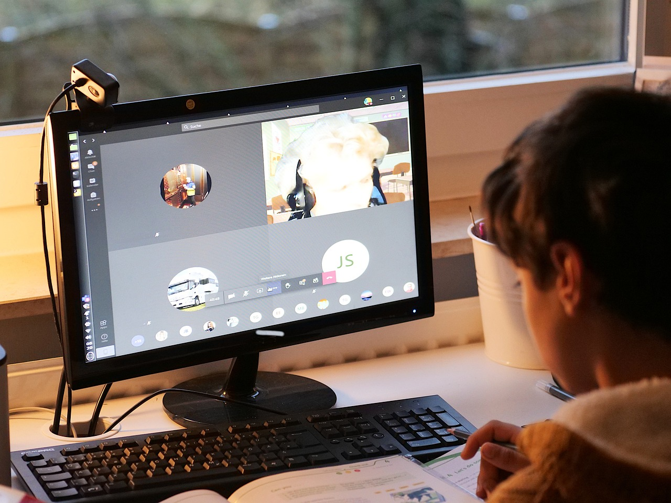
Mastering YouTube: From Basics to Success
20
Additional Resources
YouTube Creator Academy
YouTube Help
Online Safety Guidelines
A free online course that provides tips and resources for creating high-quality YouTube videos.
This platform is ideal for creators looking to enhance their video production skills.
A resource that provides answers to frequently asked questions and troubleshooting tips.
It is a go-to guide for resolving common issues faced by YouTube users.
A handout that provides tips and best practices for staying safe online.
This resource is essential for maintaining privacy and security in the digital space.

Slide 21

Mastering YouTube: From Basics to Success
21
Final Thoughts
Adhering to YouTube Guidelines
Commitment to Growth
Remember to always follow YouTube's guidelines and policies to ensure a safe and positive experience.
This ensures your content remains compliant and fosters a welcoming environment for all viewers.
Keep learning and improving your skills to become a successful YouTuber and online citizen.
Continuous growth helps you stay relevant and achieve long-term success in the digital space.

