Slide 1

Exploring Linguistic Frontiers in Space
A Journey Through Language Education and Creative Writing in the Context of Space Odyssey

Slide 2
Table of contents
01
02
03
04
05
06
07
08
09
10
11
Title Slide: Space Odyssey: Linguistic Frontiers
Lesson Objectives
Lesson Structure Overview
Vocabulary Exploration
Grammatical Focus
Phonetic Precision
Creative Writing Workshop
Group Collaboration
Digital Learning Integration
Assessment Strategies
Parent and Home Learning

Slide 3
Table of contents
12
13
14
15
16
17
18
19
20
21
Conclusion
Final Inspirational Slide
Benefits of Learning Space Language
Steps to Mastering Scientific Vocabulary
SWOT Analysis of Language Exploration
Revenue Growth in Language Education
Benefits vs. Challenges of Space Linguistics
PESTEL Analysis: Language Education Market
Summary of Space Odyssey Lesson Plan
Language Learning Pyramid

Slide 4
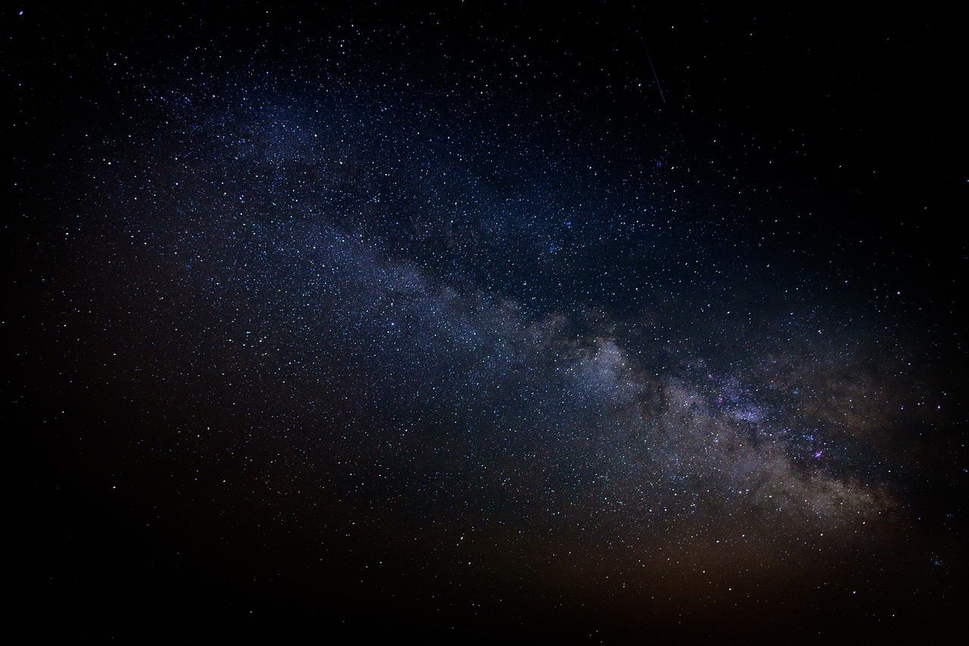
1
Title Slide: Space Odyssey: Linguistic Frontiers
Space Odyssey: Linguistic Frontiers
Exploring Language and Scientific Imagination for ESL Learners
Exploring Linguistic Frontiers in Space

Slide 5

2
Lesson Objectives
01
Linguistic Development Goals
02
Scientific Communication Objectives
Master present perfect and preterite verb tenses
Enhance scientific vocabulary
Improve phonetic pronunciation
Develop narrative construction skills
Understand space exploration terminology
Connect linguistic structures with scientific communication
Explore imagination's role in technological advancement
Exploring Linguistic Frontiers in Space

Slide 6
3
Lesson Structure Overview
01
02
03
04
05
Warm-Up and Vocabulary Introduction (5 mins)
Grammatical Structure Exploration (8 mins)
Phonetic Exploration (5 mins)
Creative Writing Workshop (7 mins)
Reflection and Presentation (5 mins)
Engage students with a space-themed icebreaker activity.
Introduce key space-related terms like 'extraterrestrial' and 'propulsion'.
Dive into verb tense mastery focusing on present perfect and preterite.
Practice constructing sentences using the correct verb tenses in a space context.
Explore the pronunciation of challenging space vocabulary.
Practice differentiating sounds crucial for clear communication in scientific contexts.
Guide students in crafting science fiction narratives set in space.
Emphasize grammatical accuracy and imaginative scenario development.
Provide time for students to reflect on their learning.
Encourage students to present their creative writing pieces to the class.
Exploring Linguistic Frontiers in Space

Slide 7
4
Vocabulary Exploration
01
Extraterrestrial
02
Propulsion
03
Gravitational Field
Image representation: 👽
Pronunciation guide: /ˌɛkstrətəˈrɛstriəl/
Contextual usage example: Scientists are searching for extraterrestrial life in the universe.
Image representation: 🚀
Pronunciation guide: /prəˈpʌlʃən/
Contextual usage example: The spacecraft's propulsion system is powered by ion thrusters.
Image representation: 🌌
Pronunciation guide: /ˌɡrævɪˈteɪʃənəl fiːld/
Contextual usage example: The gravitational field of Earth keeps the moon in orbit.
04
Quantum Mechanics
05
Interstellar
Image representation: ⚛️
Pronunciation guide: /ˈkwɒntəm məˈkænɪks/
Contextual usage example: Quantum mechanics explains the behavior of particles at the atomic level.
Image representation: 🌠
Pronunciation guide: /ˌɪntərˈstɛlər/
Contextual usage example: The interstellar mission aims to explore planets beyond our solar system.
Exploring Linguistic Frontiers in Space

Slide 8
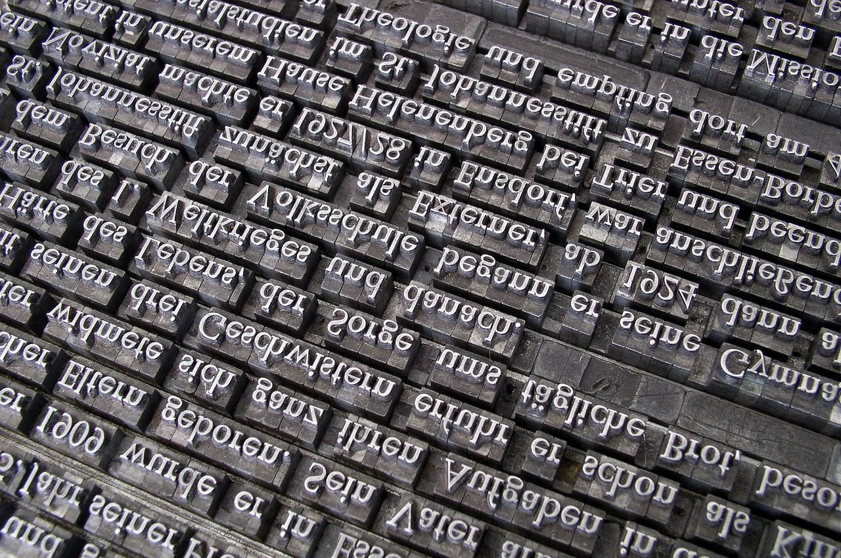
5
Grammatical Focus
01
Verb Tense Mastery
02
Example Scenarios
Present Perfect vs. Preterite
Temporal Precision in Scientific Communication
Interactive Transformation Exercises
"Scientists have discovered..." (Present Perfect)
"Astronauts travelled to..." (Preterite)
Exploring Linguistic Frontiers in Space

Slide 9

6
Phonetic Precision
01
Articulation Exercises
02
Vowel Sound Differentiation
Tongue Twisters for Clarity
Lip and Jaw Muscle Strengthening
Long vs. Short Vowel Sounds
Diphthong Pronunciation Practice
03
Consonant Clarity Techniques
Voiced vs. Voiceless Consonants
Fricative and Plosive Sounds Training
Exploring Linguistic Frontiers in Space

Slide 10
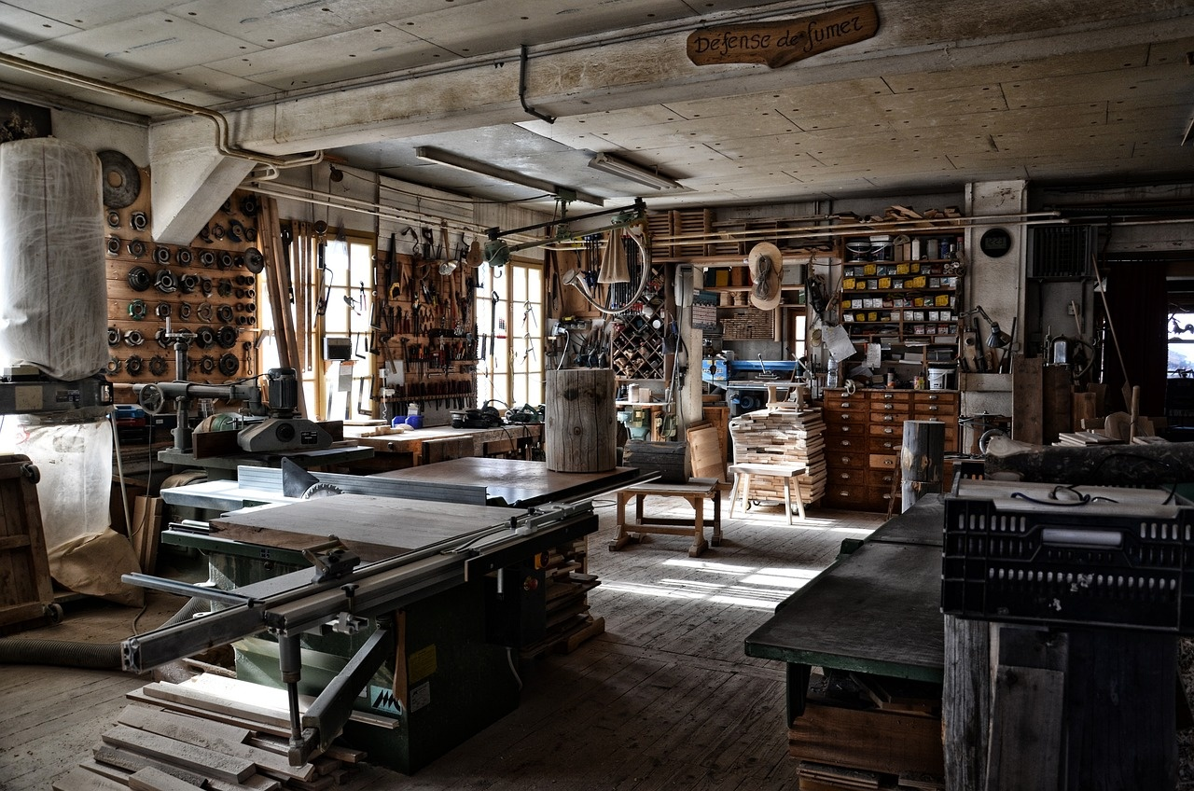
7
Creative Writing Workshop
01
Creative Writing Workshop
02
Grammatical Accuracy Focus
Frameworks for crafting engaging narratives
Emphasis on precise language usage
03
Imaginative Scenario Development
04
Assessment Criteria
Cultivating creativity in storytelling
Evaluating linguistic complexity and scientific accuracy
Exploring Linguistic Frontiers in Space

Slide 11
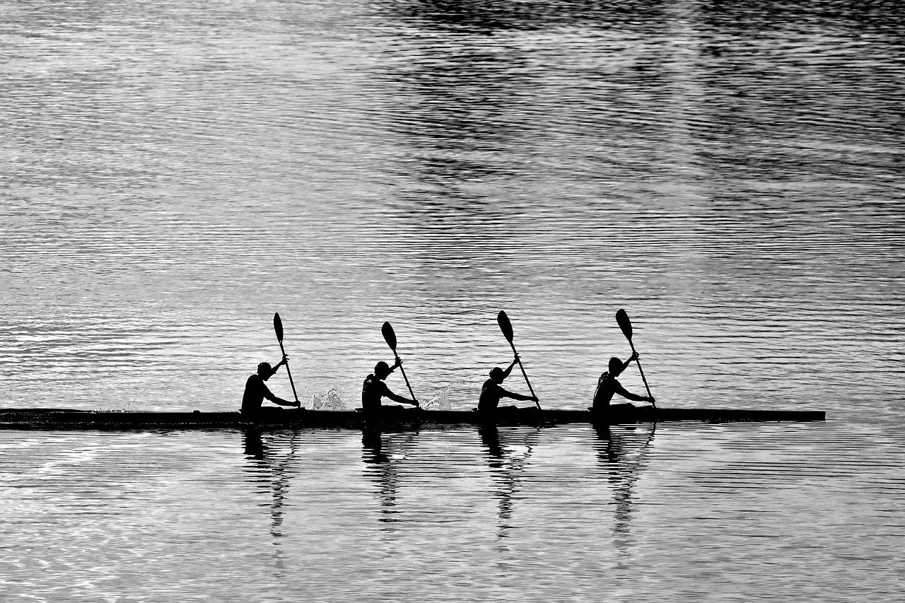
8
Group Collaboration
01
Group Collaboration
02
Team Roles
Team Roles in Space Narrative Project
Linguistic Architect
Creative Director
Research Coordinator
Presentation Strategist
03
Collaborative Learning Strategies
Defined Responsibilities
Integrated Skill Development
Exploring Linguistic Frontiers in Space

Slide 12

9
Digital Learning Integration
01
Digital Learning Integration
02
Augmented Reality Language Lab
Virtual Space Exploration Simulation - Immersive experience for understanding space concepts
Interactive engagement with space environments
Enhancing language skills through AR technology
Real-world application of linguistic knowledge
03
Collaborative Online Narrative Tools
04
Learning Objectives
Facilitating group storytelling projects
Encouraging teamwork and creativity
Vocabulary Enhancement - Interactive tools for expanding space-related lexicon
Contextual usage practice for better retention
Pronunciation Accuracy - Utilizing digital tools for precise phonetic training
Feedback mechanisms for improving articulation
Interactive Linguistic Exploration - Engaging platforms for exploring language in a space context
Exploring Linguistic Frontiers in Space

Slide 13

10
Assessment Strategies
01
Formative Assessment
02
Summative Assessment
Weekly Linguistic Checkpoints
Pronunciation Workshops
Digital Performance Portfolios
Science Fiction Writing Project
Oral Presentation
Comprehensive Grammar Examination
Exploring Linguistic Frontiers in Space

Slide 14
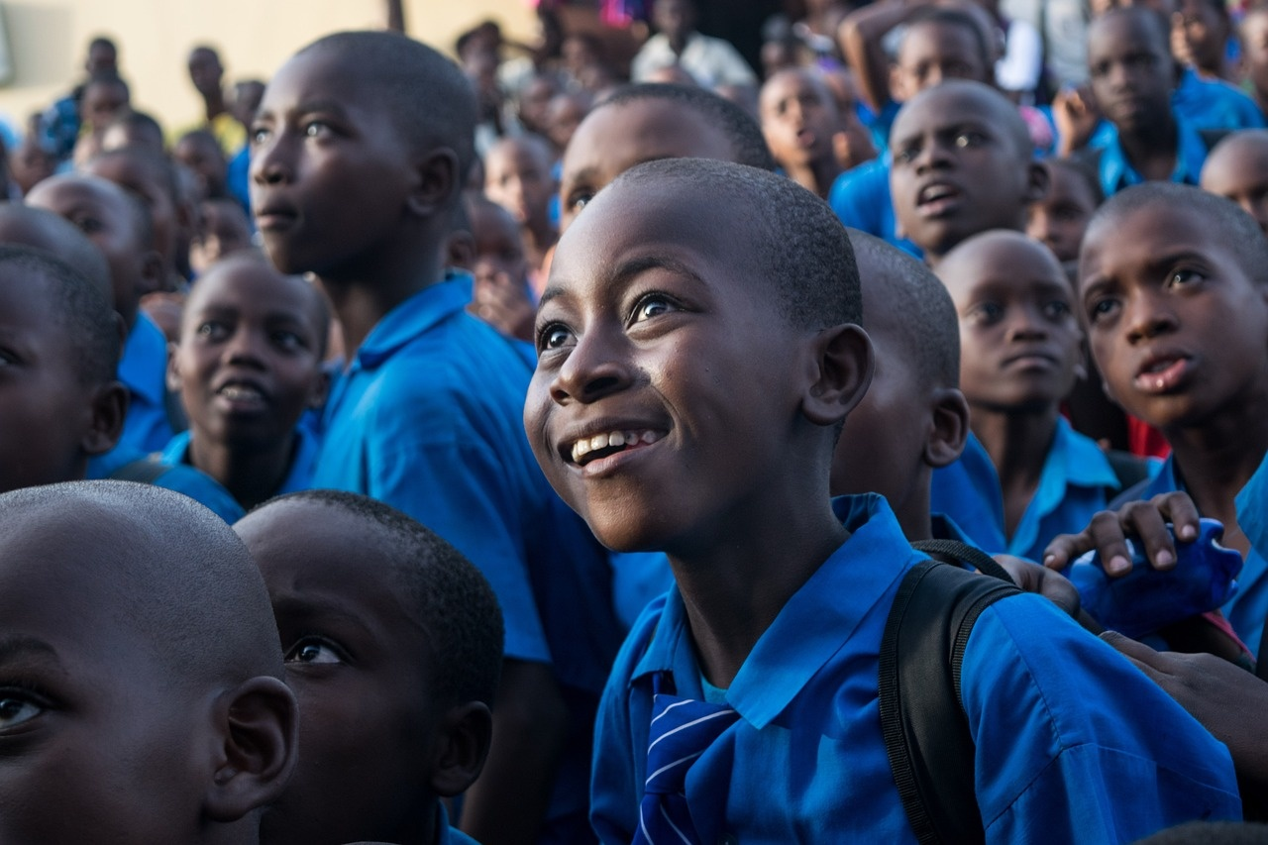
11
Parent and Home Learning
01
Engagement Strategies
02
Resources Provided
Family Science Exploration Nights
Bilingual Conversation Guides
Creative Writing Support
Monthly Reading Recommendations
Language Challenge Cards
Technological Innovation Workshops
Exploring Linguistic Frontiers in Space

Slide 15
12
Conclusion
Conclusion
Future Learning Pathways
Language bridges scientific exploration and human imagination.
Advanced Narrative Workshops
Key Takeaways
Design Recommendations
Language as a Transformative Tool
Cosmic color palette for visual appeal
Exploring Linguistic Frontiers in Space

Slide 16

13
Final Inspirational Slide
Final Inspirational Slide
Quote: "Language is the rocket that launches imagination into the universe of possibility"
Exploring Linguistic Frontiers in Space

Slide 17

14
Benefits of Learning Space Language
01
Enhanced Interdisciplinary Understanding
02
Cultural Appreciation
Develop a deeper comprehension of scientific concepts through language exploration.
Bridge the gap between linguistic and scientific knowledge for a holistic understanding.
Gain insights into different cultures and perspectives through space-related language studies.
Appreciate the diversity of languages used in space exploration and research.
03
Career Opportunities
04
Global Communication
Unlock potential career paths in space agencies, aerospace companies, and scientific research institutions.
Stand out in the job market with specialized language skills related to space exploration.
Connect with a worldwide community of space enthusiasts and professionals through a shared language.
Facilitate collaboration on international space missions and projects with proficient space language skills.
Exploring Linguistic Frontiers in Space

Slide 18
15
Steps to Mastering Scientific Vocabulary
01
02
03
04
Engage in Regular Reading
Utilize Flashcards for Memorization
Practice Pronunciation Aloud
Participate in Vocabulary Quizzes
Explore scientific articles, journals, and textbooks.
Focus on context to understand vocabulary in scientific settings.
Create flashcards with scientific terms on one side and definitions on the other.
Review regularly to reinforce vocabulary retention.
Use online resources for correct pronunciation guidance.
Record yourself to identify and improve pronunciation errors.
Join online platforms offering scientific vocabulary quizzes.
Challenge yourself regularly to enhance retention and application.
Exploring Linguistic Frontiers in Space

Slide 19
16
SWOT Analysis of Language Exploration
STRENTHS
WEAKNESSES
Diverse linguistic resources available
Integration of scientific terminology
Creative narrative development
Technological tools for pronunciation
Limited exposure to authentic scientific contexts
Pronunciation challenges for complex terms
Grammar intricacies may be overwhelming
Varied language proficiency levels
S
W
O
T
OPPORTUNITIES
THREATS
Collaborative learning opportunities
Digital platforms for interactive exploration
Incorporation of real-world space missions
Cultural exchange through language
Potential language barrier hindering comprehension
Misinterpretation of scientific concepts
Overemphasis on linguistic accuracy over creativity
Limited access to specialized language resources
Exploring Linguistic Frontiers in Space

Slide 20

17
Revenue Growth in Language Education
15%
Specialized Courses
Increased Enrollment
Expansion of Offerings
Enrollment up by 15% year-over-year. New student registrations at an all-time high.
Introduction of specialized language courses. Diversification of language programs to attract a wider audience.
Collaborations
Online Revenue
Partnerships with Institutions
Online Learning Platform
Collaborations with schools for language education programs. Joint initiatives with universities for language proficiency certifications.
Significant revenue generated from online language courses. Growth in subscriptions to virtual language learning resources.
Exploring Linguistic Frontiers in Space

Slide 21
18
Benefits vs. Challenges of Space Linguistics
Benefits
Challenges
Enhanced Interstellar Communication
Cultural Exchange Beyond Earth
Scientific Collaboration on a Global Scale
Linguistic Adaptation to Extraterrestrial Dialects
Communication Delays in Deep Space
Ensuring Accurate Translation of Technical Terminology
Exploring Linguistic Frontiers in Space

Slide 22
19
PESTEL Analysis: Language Education Market
P
E
S
T
E
L
Political
Economic
Social
Technological
Environmental
Legal
Government policies on language education
Regulations impacting language learning institutions
Affordability of language courses
Economic trends affecting language education demand
Cultural attitudes towards language learning
Demographic shifts influencing language preferences
Integration of technology in language learning
Online language learning platforms
Sustainability practices in language education
Impact of global environmental issues on language programs
Compliance with language education regulations
Intellectual property rights in language teaching materials
Exploring Linguistic Frontiers in Space

Slide 23
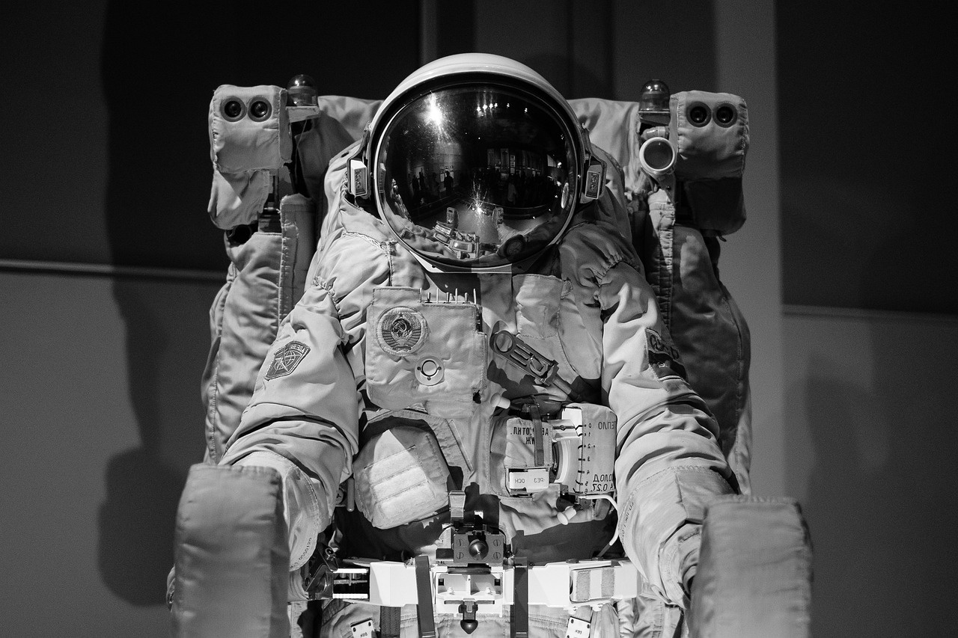
20
Summary of Space Odyssey Lesson Plan
Linguistic Development Goals
Master present perfect and preterite verb tenses
Enhance scientific vocabulary
Improve phonetic pronunciation
Develop narrative construction skills
Exploring Linguistic Frontiers in Space

Slide 24

21
Language Learning Pyramid
Foundational Skills
Grammar Fundamentals
Intermediate Proficiency
Cultural Understanding
Fluency and Mastery
Exploring Linguistic Frontiers in Space

