Slide 1
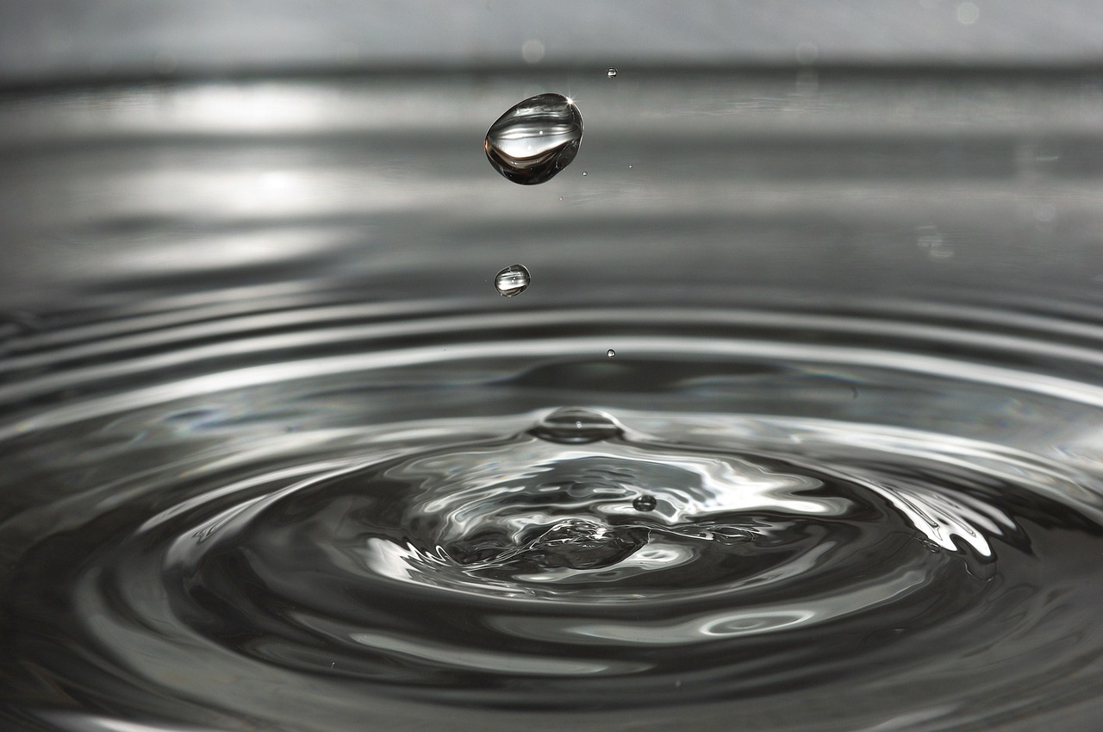
Understanding the Water Cycle
Exploring Its Stages, Importance, and Visual Analysis Techniques

Slide 2
Understanding the Water Cycle
2
Table of Contents
Slide 1: Introduction
Slide 2: What is the Water Cycle?
Slide 3: Stages of the Water Cycle
Slide 4: Visual Routines of Thought
Slide 5: Importance of the Water Cycle
Slide 6: Human Impact on the Water Cycle
Slide 7: Visual Routine 1 - Image Analysis
Slide 8: Visual Routine 2 - Diagrams
Slide 9: Visual Routine 3 - Charts
03
04
05
06
07
08
09
10
11

Slide 3

Understanding the Water Cycle
3
Slide 1: Introduction
Overview of the Presentation
Topics Covered
Objective of the Presentation
Welcome to the presentation on the water cycle and visual routines of thought!
This presentation is designed for 14-year-old students and aims to develop their knowledge and understanding of the water cycle and visual routines of thought.
The presentation will cover the importance of the water cycle.
It will also explore the different stages of the water cycle and how visual routines of thought can be used to understand and analyze the water cycle.
The goal is to enhance students' comprehension of the water cycle.
Additionally, it aims to introduce visual routines of thought as tools for analysis and understanding.

Slide 4

Understanding the Water Cycle
4
Slide 2: What is the Water Cycle?
Overview of the Water Cycle
The water cycle is the process by which water moves through the Earth's system.
It involves the movement of water from the oceans, lakes, and rivers to the atmosphere and back to the Earth.
Importance of the Water Cycle
The water cycle is essential for life on Earth.
It plays a crucial role in shaping our planet's climate and weather patterns.
Components of the Water Cycle
The water cycle includes processes such as evaporation, condensation, precipitation, and collection.
These processes ensure the continuous movement and recycling of water within the Earth's system.

Slide 5
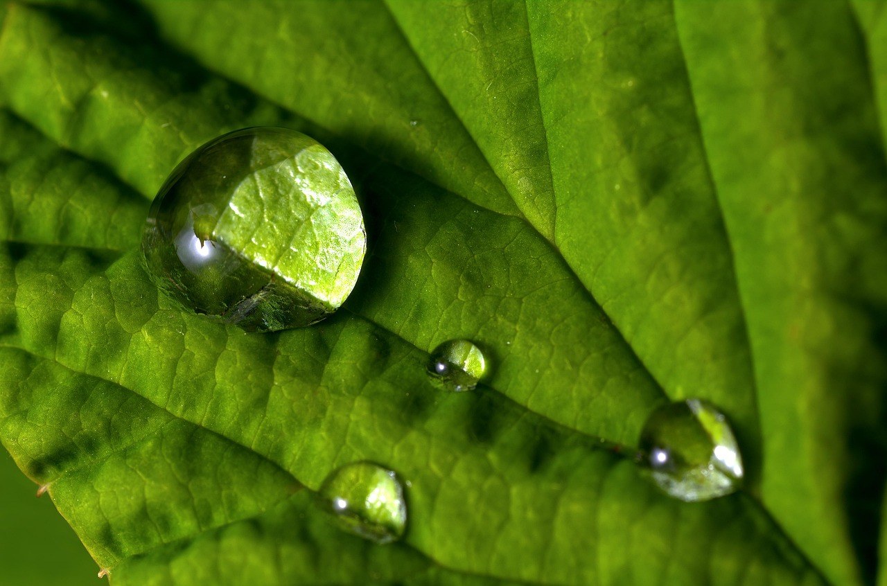
Understanding the Water Cycle
5
Slide 3: Stages of the Water Cycle
Evaporation Process
Formation of Clouds
Water from the oceans, lakes, and rivers evaporates into the atmosphere.
This marks the beginning of the water cycle as water transitions from liquid to vapor.
Water vapor in the atmosphere condenses into clouds.
This occurs when the air cools and the vapor changes back into liquid droplets.
Precipitation Events
Surface Runoff
Water falls back to the Earth as rain, snow, or hail.
This process returns water from the atmosphere to the surface.
Water flows over the land and into streams, rivers, and lakes.
This movement contributes to the redistribution of water across the Earth's surface.

Slide 6
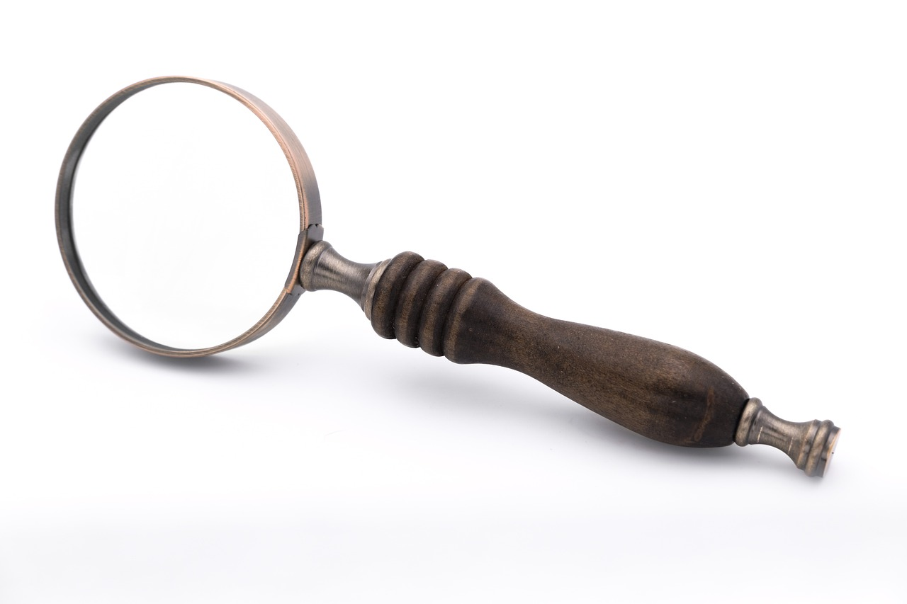
Understanding the Water Cycle
6
Slide 4: Visual Routines of Thought
Introduction to Visual Routines of Thought
Components of Visual Routines
Application Example: The Water Cycle
Visual routines of thought are strategies used to help students develop their critical thinking and problem-solving skills.
These routines leverage visual tools to facilitate understanding and analysis of complex ideas.
They involve the use of images, diagrams, and charts to analyze and understand complex concepts.
Such visual aids provide a structured approach to dissecting and interpreting information.
Visual routines of thought can be used to understand and analyze the water cycle.
This application demonstrates the effectiveness of visual tools in comprehending natural processes.

Slide 7
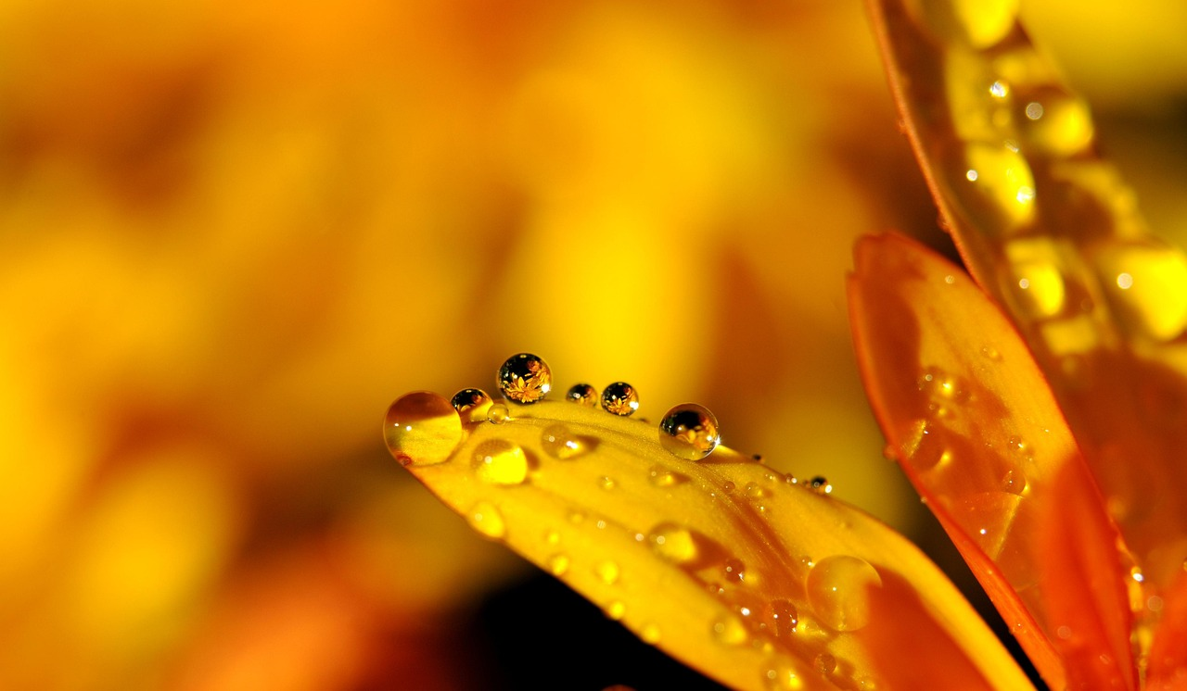
Understanding the Water Cycle
7
Slide 5: Importance of the Water Cycle
Essential Role of the Water Cycle
Impact on Climate and Weather
Global Heat and Moisture Distribution
The water cycle is essential for life on Earth.
It ensures the availability of water for all living organisms.
The water cycle plays a crucial role in shaping our planet's climate and weather patterns.
It influences atmospheric conditions and precipitation.
The water cycle helps to distribute heat and moisture around the globe.
This process maintains ecological balance and supports diverse ecosystems.

Slide 8
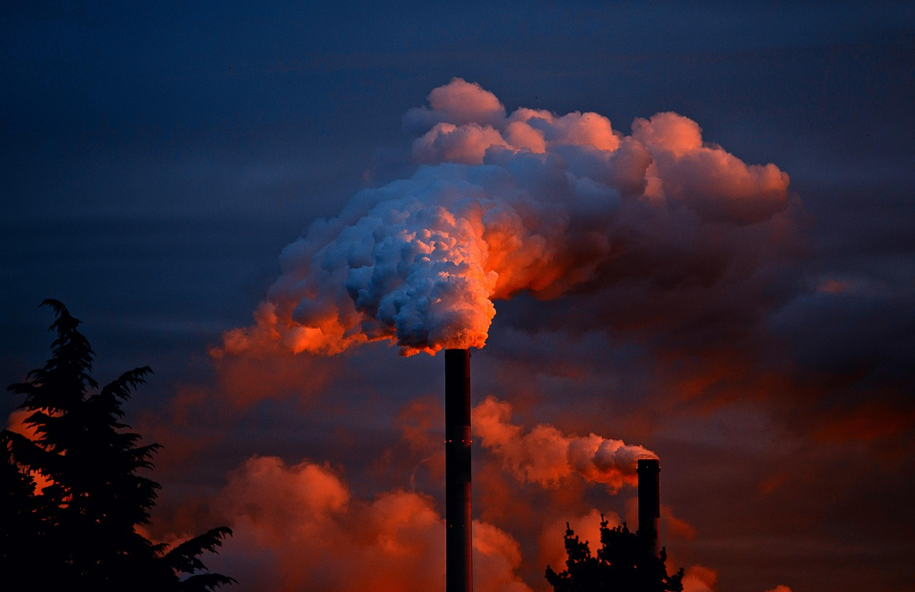
Understanding the Water Cycle
8
Slide 6: Human Impact on the Water Cycle
Human Activities and the Water Cycle
Understanding Human Impact
Key Factors of Impact
Human activities can impact the water cycle.
Deforestation, pollution, and climate change can all affect the water cycle.
It is essential to understand the impact of human activities on the water cycle.
Mitigating these effects is crucial for maintaining ecological balance.
Deforestation, pollution, and climate change are significant factors.
These activities alter the natural processes of the water cycle.

Slide 9
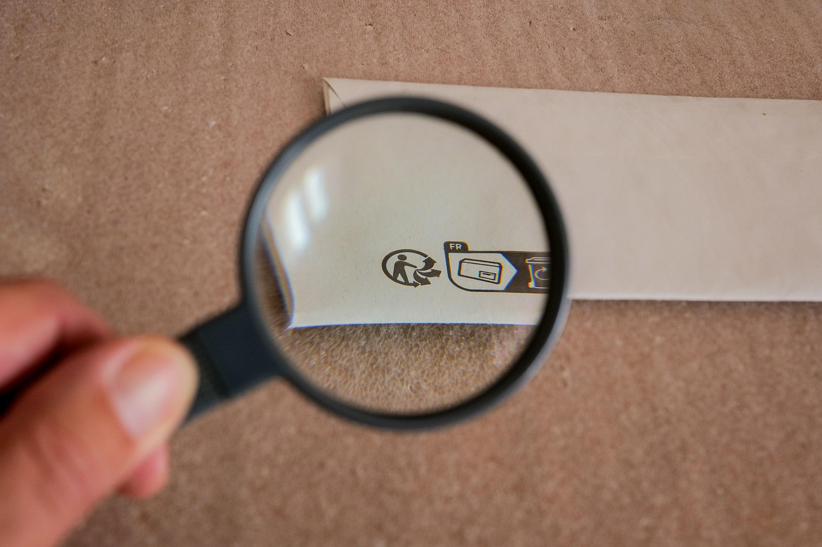
Understanding the Water Cycle
9
Slide 7: Visual Routine 1 - Image Analysis
Understanding Image Analysis
Image analysis is a visual routine of thought that involves analyzing images to understand a concept.
This method allows students to engage with visual content to extract meaningful insights.
Application in Learning Processes
Students can use image analysis to understand the different stages of the water cycle.
By examining images, learners can visually grasp complex processes and their interconnections.
Skill Development through Image Analysis
Image analysis can help students develop their critical thinking and problem-solving skills.
Engaging with visual routines enhances cognitive abilities and analytical thinking.

Slide 10
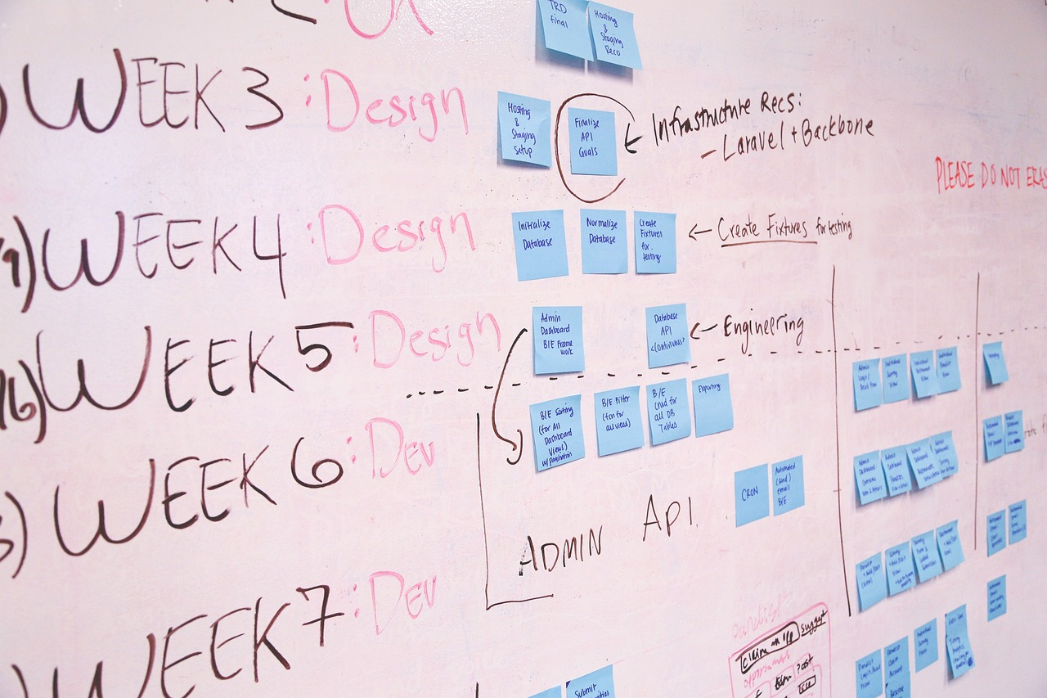
Understanding the Water Cycle
10
Slide 8: Visual Routine 2 - Diagrams
Understanding Concepts with Diagrams
Application in Learning Processes
Enhancing Cognitive Skills
Diagrams are a visual routine of thought that involves using diagrams to understand a concept.
They provide a structured way to visualize and analyze information effectively.
Students can use diagrams to understand the different stages of the water cycle.
This method aids in grasping complex processes through visual representation.
Diagrams can help students develop their critical thinking and problem-solving skills.
By engaging with visual tools, learners can improve their analytical abilities.

Slide 11

Understanding the Water Cycle
11
Slide 9: Visual Routine 3 - Charts
Understanding Concepts with Charts
Charts in Educational Contexts
Skill Development through Charts
Charts are a visual routine of thought that involves using charts to understand a concept.
They provide a structured way to analyze and interpret information effectively.
Students can use charts to understand the different stages of the water cycle.
This approach aids in visualizing processes and enhancing comprehension.
Charts can help students develop their critical thinking and problem-solving skills.
By engaging with visual data, learners can improve their analytical abilities.

