Slide 1
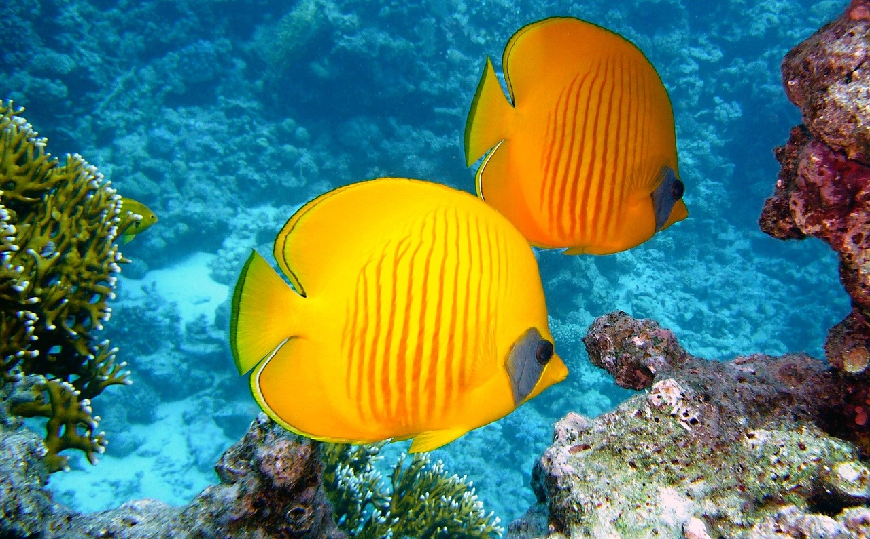



Exploring Marine Conservation: Preserving the Great Barrier Reef
A Comprehensive Journey Through Marine Ecosystems, Climate Change Impacts, and Conservation Efforts

Slide 2



Table of contents
Introduction to the Great Barrier Reef
Overview of Marine Ecosystems
Impact of Climate Change on Coral Reefs
Biodiversity in the Great Barrier Reef
Human Activities Threatening Marine Life
Importance of Coral Reefs
Challenges Facing the Great Barrier Reef
Ecosystem Resilience and Adaptation
Marine Conservation Efforts
Understanding Climate Science
The Role of Students in Environmental Protection
Exploring Marine Biodiversity
Case Study: Coral Bleaching Events
01
02
03
04
05
06
07
08
09
10
11
12
13

Slide 3
Table of contents
Protecting Endangered Species
Sustainable Practices for Marine Ecosystems
Global Efforts to Save Coral Reefs
Educational Initiatives for Marine Conservation
Innovations in Marine Research
Community Engagement in Environmental Conservation
Future Prospects for the Great Barrier Reef
14
15
16
17
18
19
20

Slide 4
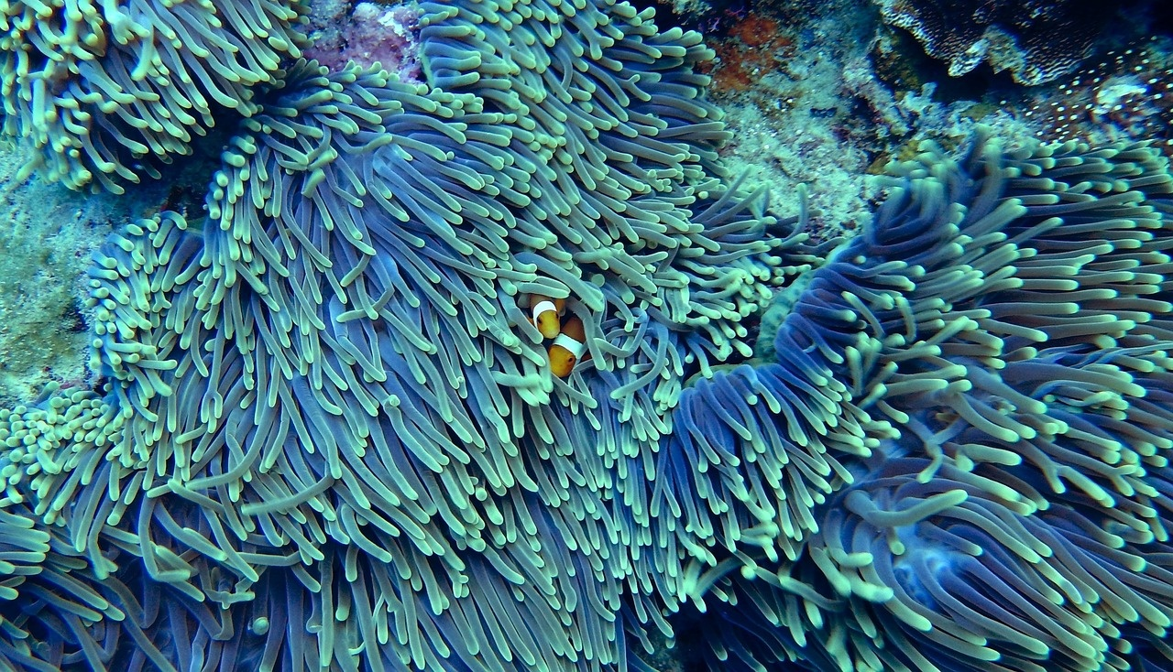
Introduction to the Great Barrier Reef
Location
Biodiversity
Situated along Australia's northeastern coastline.
Spans approximately 2,300 kilometers.
Home to over 1,500 species of fish.
Houses 411 types of hard coral.
Importance
Threats
Supports a wide array of marine life.
Generates billions in tourism revenue for Australia.
Facing challenges from climate change.
Vulnerable to coral bleaching events.
Exploring Marine Conservation: Preserving the Great Barrier Reef

Slide 5

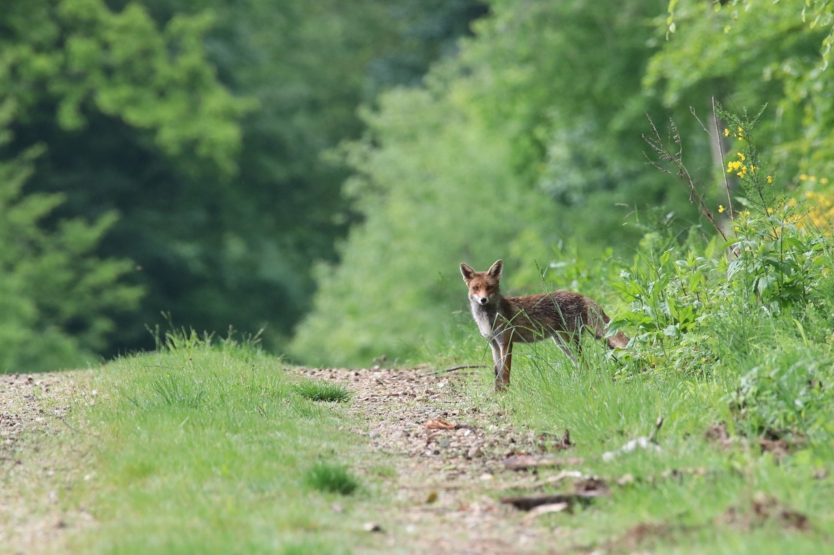
Overview of Marine Ecosystems
Coral Reefs
Known as the "rainforests of the sea"
Provide habitat for a quarter of all marine species
Highly sensitive to changes in water temperature and acidity
Mangrove Forests
Act as nurseries for fish and other marine life
Help protect coastlines from erosion and storm damage
Play a crucial role in carbon sequestration
Seagrass Meadows
Support diverse marine life, including seahorses and sea turtles
Improve water quality by trapping sediments and pollutants
Essential for the health of coastal ecosystems
Open Ocean
Largest marine ecosystem, covering about 70% of the Earth's surface
Home to a wide variety of marine species, from tiny plankton to massive whales
Plays a vital role in regulating the planet's climate
Exploring Marine Conservation: Preserving the Great Barrier Reef

Slide 6

Impact of Climate Change on Coral Reefs
Great Barrier Reef Bleaching
Projected Temperature Increase
Ocean Acidification
Intensified Cyclones and Storms
90%
2°C
Acidification
Extreme Weather Events
Percentage of the Great Barrier Reef affected by coral bleaching due to rising sea temperatures. Coral bleaching occurs when corals expel the algae living in their tissues, causing them to turn white and making them more susceptible to disease and death.
The projected increase in global temperatures by the end of the century, posing a significant threat to coral reef ecosystems. Even a small increase in temperature can lead to mass coral bleaching events and disrupt the delicate balance of marine life within the reef.
Ocean acidification due to increased carbon dioxide levels in the atmosphere is impacting coral reef growth and resilience. Acidification reduces the availability of calcium carbonate, essential for coral skeletons, leading to weakened coral structures and decreased reef biodiversity.
Intensified cyclones and storms, attributed to climate change, can physically damage coral reefs and hinder their ability to recover. Severe weather events can break apart coral structures, disrupt coral reproduction, and further stress already vulnerable reef ecosystems.
Exploring Marine Conservation: Preserving the Great Barrier Reef

Slide 7
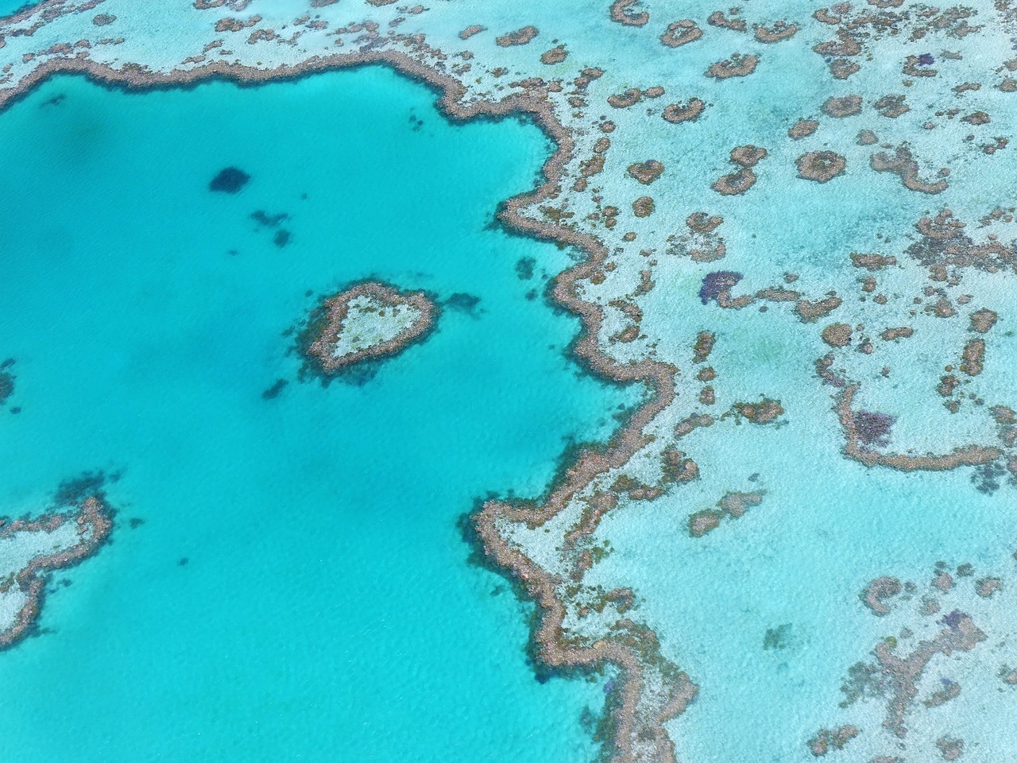
Biodiversity in the Great Barrier Reef
Over 1,500 Species of Fish
The Great Barrier Reef is home to a diverse range of fish species, including clownfish, angelfish, and parrotfish.
411 Species of Hard Coral
Hard corals play a crucial role in reef-building and provide habitat for numerous marine organisms within the ecosystem.
6 of the World's 7 Species of Marine Turtles
The Great Barrier Reef supports populations of green, hawksbill, loggerhead, leatherback, flatback, and olive ridley turtles.
30 Species of Whales, Dolphins, and Porpoises
The reef serves as a migratory route and feeding ground for various cetaceans, such as humpback whales and bottlenose dolphins.
1,625 Species of Fish
The reef is a hotspot for marine biodiversity, with a vast array of fish species contributing to the ecosystem's richness and complexity.
Exploring Marine Conservation: Preserving the Great Barrier Reef

Slide 8
Human Activities Threatening Marine Life
01
02
03
04
Overfishing
Pollution
Climate Change
Coastal Development
Excessive fishing practices deplete marine populations, disrupting the balance of marine ecosystems.
Chemical pollutants, plastic waste, and oil spills harm marine life and degrade habitats.
Rising sea temperatures and ocean acidification due to greenhouse gas emissions impact marine species and coral reefs.
Urbanization and coastal infrastructure projects lead to habitat destruction and pollution runoff into marine environments.
Exploring Marine Conservation: Preserving the Great Barrier Reef

Slide 9
Importance of Coral Reefs
Economic Value
Marine Species
Coastline Defense
Climate Mitigation
$7.6 Billion
25%
Protection
Carbon Sink
The annual economic value generated by the Great Barrier Reef through tourism, fishing, and research activities.
The percentage of marine species that rely on coral reefs for food, shelter, and breeding grounds, highlighting their crucial role in supporting marine biodiversity.
Coral reefs act as natural barriers, protecting coastlines from erosion, storms, and flooding, safeguarding communities and infrastructure.
Coral reefs absorb and store carbon dioxide, helping mitigate the impacts of climate change by reducing greenhouse gas levels in the atmosphere.
Exploring Marine Conservation: Preserving the Great Barrier Reef

Slide 10
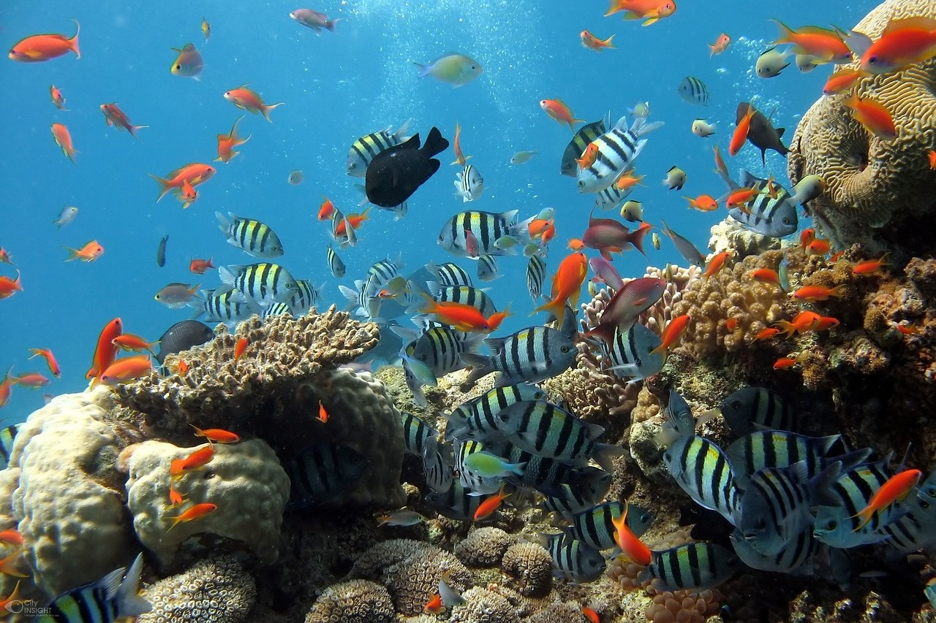
Challenges Facing the Great Barrier Reef
Coral Bleaching
Rising sea temperatures due to climate change are causing widespread coral bleaching events, threatening the health and survival of the coral reefs.
Ocean Acidification
Increased carbon dioxide levels in the atmosphere are being absorbed by the oceans, leading to acidification that weakens coral structures and inhibits reef growth.
Pollution
Runoff from agricultural activities, coastal development, and marine debris are introducing pollutants such as pesticides and plastics into the reef ecosystem, impacting marine life and water quality.
Overfishing
Unsustainable fishing practices, including illegal fishing and bycatch, are depleting fish populations and disrupting the delicate balance of the reef's food web.
Crown-of-Thorns Starfish
Outbreaks of these coral-eating starfish species pose a significant threat to the Great Barrier Reef, causing extensive damage to coral reefs.
Exploring Marine Conservation: Preserving the Great Barrier Reef

Slide 11
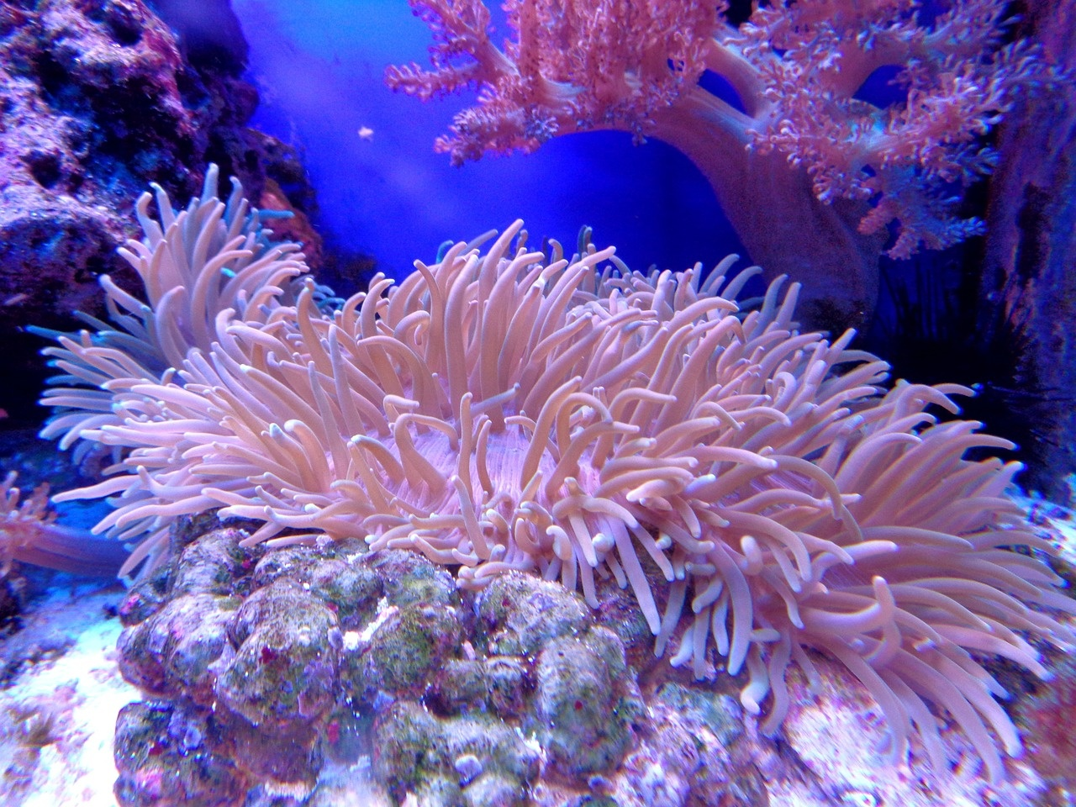
Ecosystem Resilience and Adaptation
Coral Bleaching Events
Adaptive Responses
Increased frequency due to rising sea temperatures
Threatens the health and diversity of coral reefs
Some coral species showing resilience to stress
Evolutionary adaptations to changing environmental conditions
Importance of Biodiversity
Human Intervention
Diverse ecosystems better equipped to withstand environmental pressures
Interconnected species support ecosystem resilience
Conservation efforts to restore damaged coral reefs
Sustainable practices to reduce human impact on marine ecosystems
Exploring Marine Conservation: Preserving the Great Barrier Reef

Slide 12
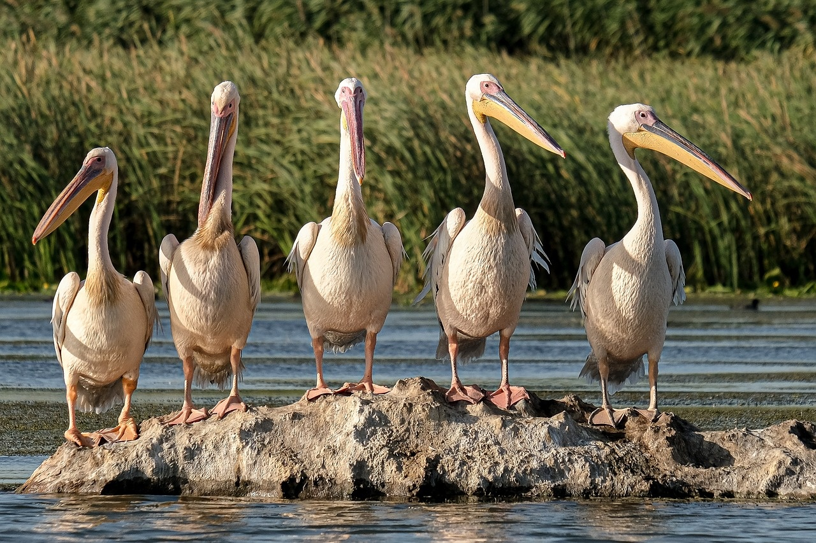
Marine Conservation Efforts
Establishment of Marine Protected Areas
The Great Barrier Reef Marine Park Authority manages the world's largest marine park, protecting a vast area of the reef ecosystem.
Reduction of Pollution
Initiatives to minimize agricultural runoff, plastic pollution, and other contaminants to improve water quality and preserve marine life.
Climate Change Mitigation
Implementing strategies to reduce carbon emissions and combat ocean acidification to safeguard the reef's delicate ecosystem.
Community Engagement and Education
Engaging local communities, stakeholders, and tourists in conservation efforts through awareness campaigns and sustainable practices.
Exploring Marine Conservation: Preserving the Great Barrier Reef

Slide 13
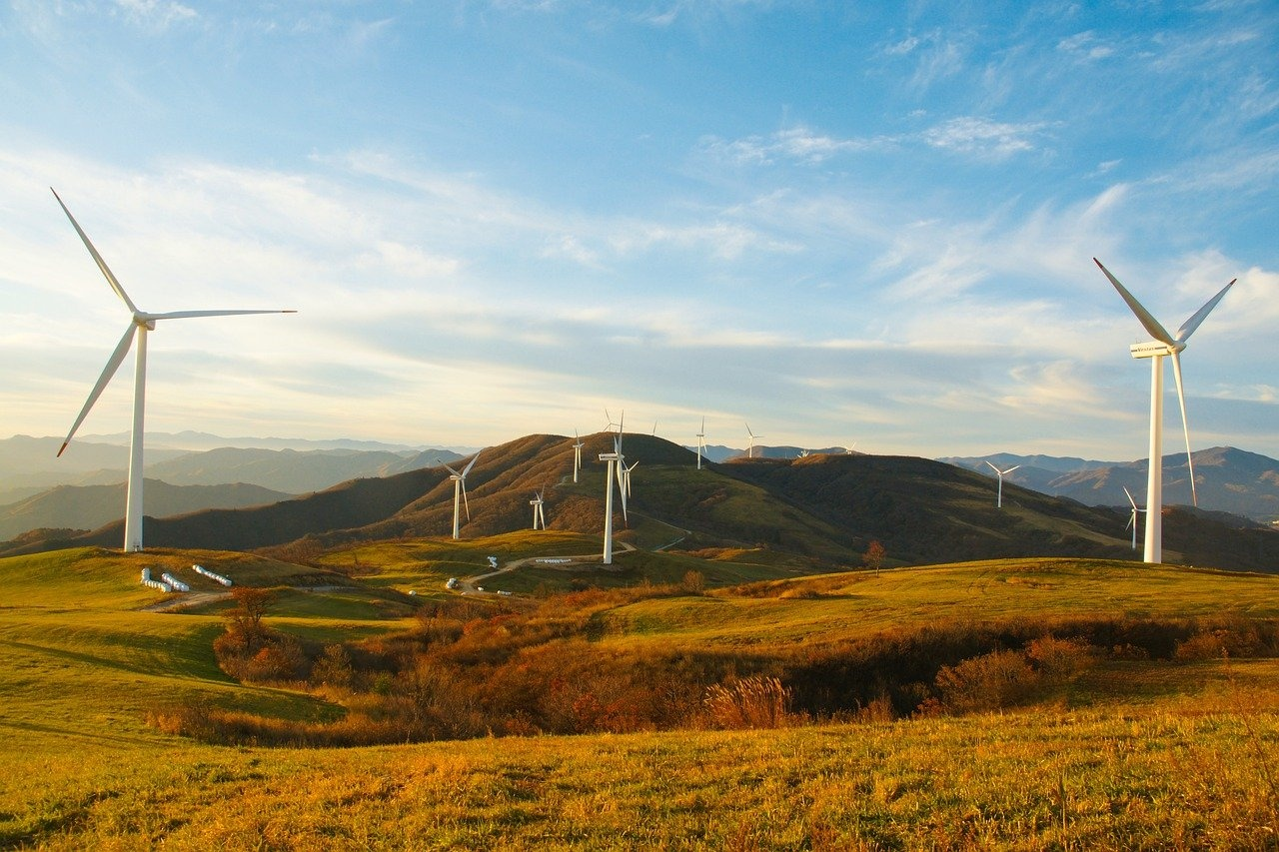
Understanding Climate Science
Greenhouse Effect
Carbon Footprint
The process by which greenhouse gases trap heat from the sun in the Earth's atmosphere.
The total amount of greenhouse gases emitted directly or indirectly by human activities.
Ocean Acidification
Global Warming
The ongoing decrease in the pH of the Earth's oceans, caused by the uptake of carbon dioxide from the atmosphere.
The long-term increase in Earth's average surface temperature due to human activities, primarily the burning of fossil fuels.
Exploring Marine Conservation: Preserving the Great Barrier Reef

Slide 14
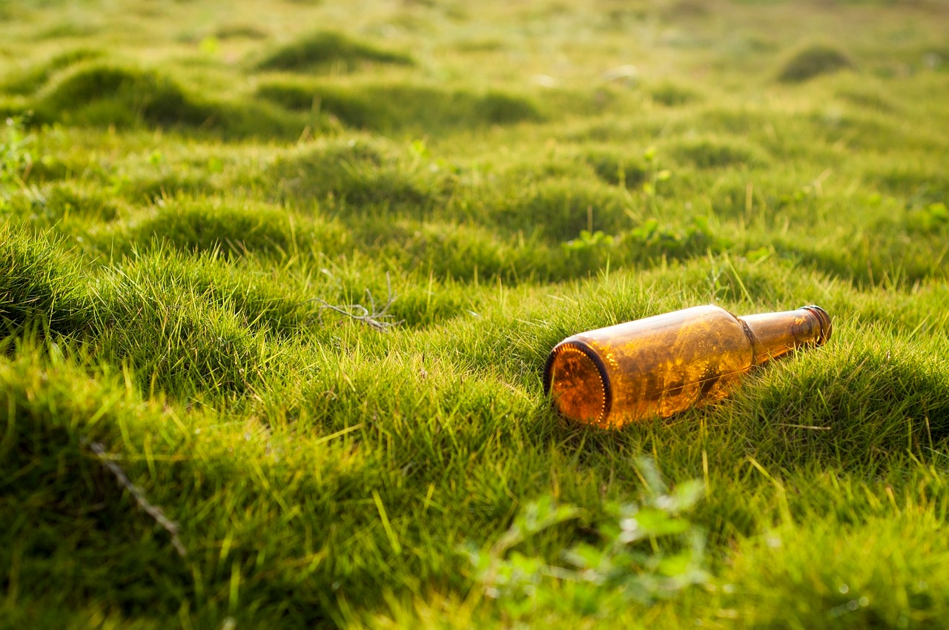
The Role of Students in Environmental Protection
Education and Awareness
Educating peers and communities about the importance of marine conservation.
Raising awareness about the threats facing the Great Barrier Reef and other marine ecosystems.
Advocacy and Activism
Participating in environmental campaigns and initiatives to protect marine life.
Engaging in lobbying efforts to influence policymakers to take action on climate change.
Sustainable Practices
Implementing eco-friendly habits in daily life to reduce carbon footprint.
Promoting sustainable seafood choices and reducing plastic pollution.
Research and Innovation
Conducting scientific research to better understand marine ecosystems and climate change impacts.
Developing innovative solutions to address environmental challenges affecting the Great Barrier Reef.
Exploring Marine Conservation: Preserving the Great Barrier Reef

Slide 15
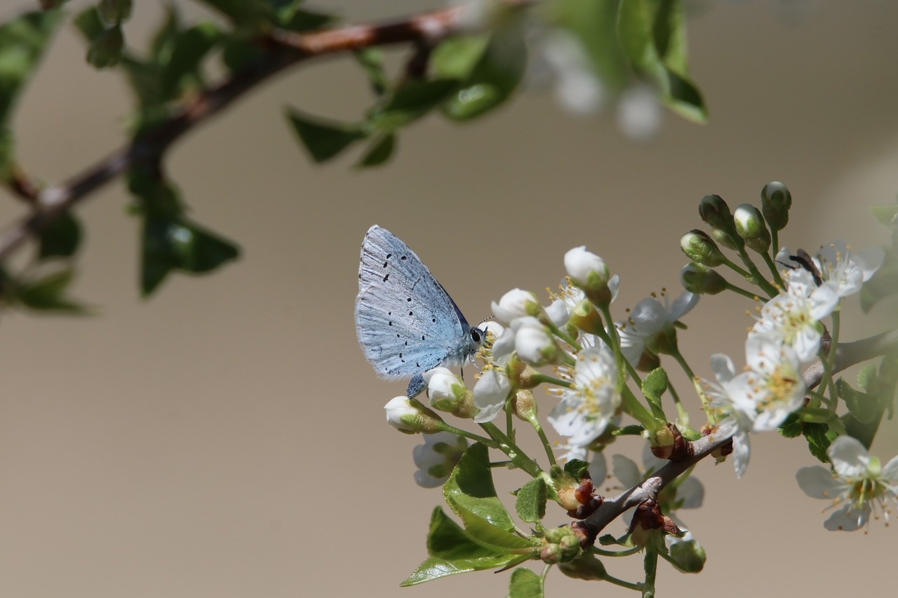
Exploring Marine Biodiversity
Rich Coral Diversity
Vibrant Fish Species
The Great Barrier Reef is home to over 600 types of corals, making it one of the most diverse coral reef ecosystems in the world.
With more than 1,500 species of fish, the reef supports a wide array of marine life, from colorful clownfish to majestic manta rays.
Unique Marine Invertebrates
Important Seagrass Meadows
The Great Barrier Reef is teeming with fascinating marine invertebrates, including sea stars, sea cucumbers, and giant clams.
Seagrass beds within the reef provide crucial habitats for various marine species, contributing to the overall biodiversity of the ecosystem.
Exploring Marine Conservation: Preserving the Great Barrier Reef

Slide 16
Case Study: Coral Bleaching Events
01
02
03
04
05
Definition of Coral Bleaching
Causes of Coral Bleaching
Impact on Marine Ecosystems
Frequency of Coral Bleaching Events
Mitigation Efforts
Coral bleaching is a phenomenon where coral reefs lose their vibrant colors due to stress, leading to the expulsion of symbiotic algae living within their tissues.
Elevated sea temperatures
Ocean acidification
Pollution
Overexposure to sunlight
Loss of biodiversity
Disruption of food chains
Decline in fish populations
Economic repercussions for communities dependent on reef ecosystems
The Great Barrier Reef has experienced multiple mass bleaching events in recent years, with severe episodes in 2016, 2017, and 2020.
Marine protected areas
Sustainable fishing practices
Reduction of greenhouse gas emissions
Restoration and rehabilitation projects
Exploring Marine Conservation: Preserving the Great Barrier Reef

Slide 17
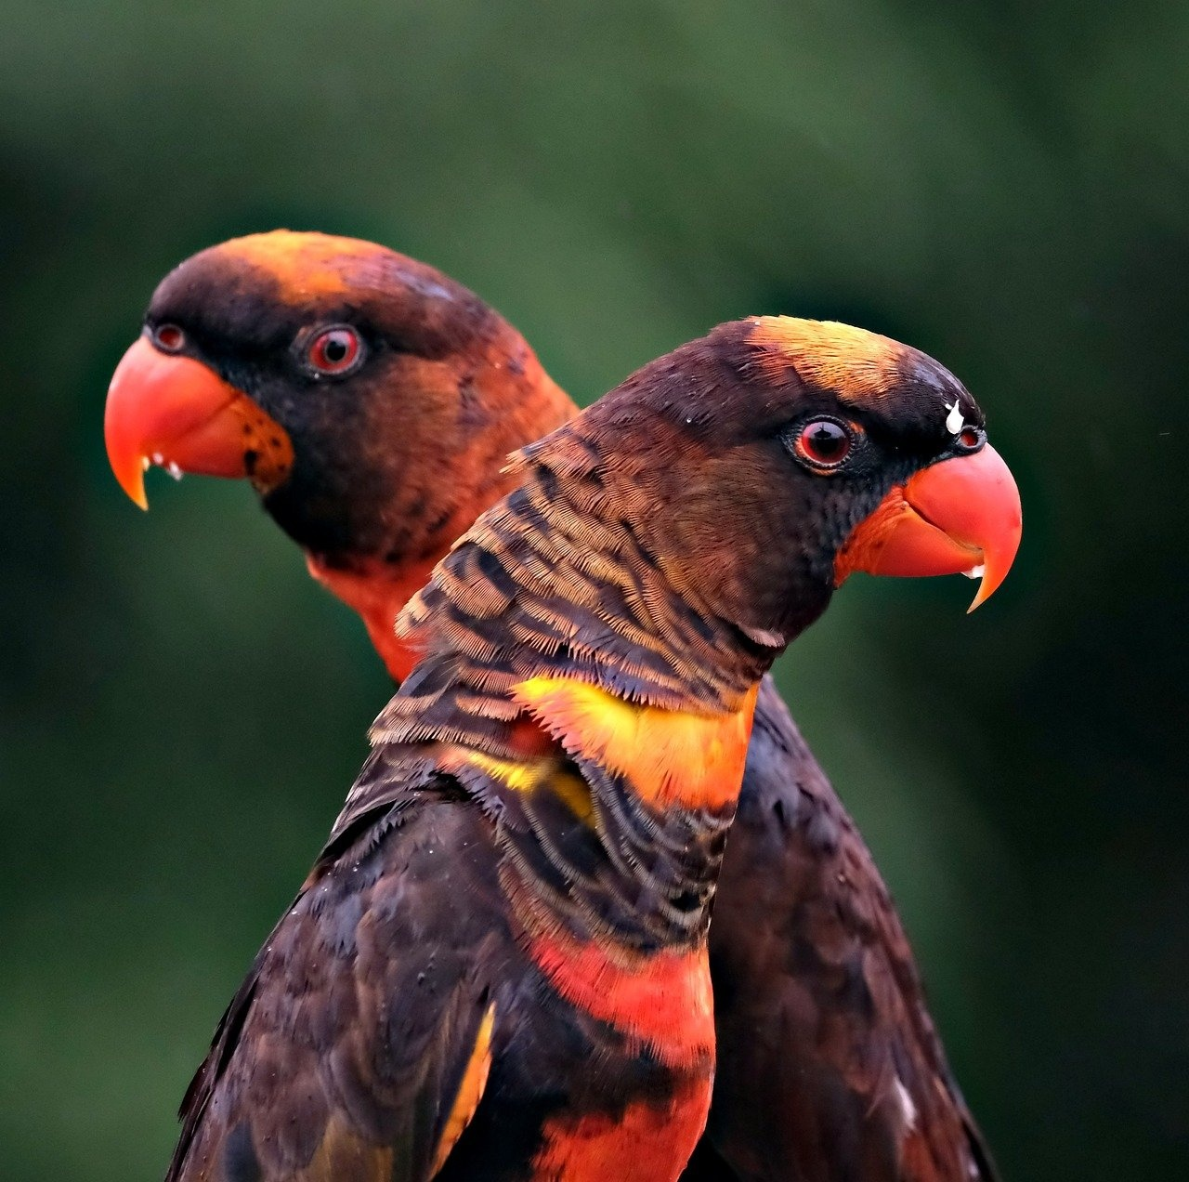
Protecting Endangered Species
Implementing Strict Conservation Measures
Enforcing regulations to protect endangered species within the Great Barrier Reef Marine Park.
Collaborating with Scientists and Researchers
Working with marine biologists and conservationists to study and protect vulnerable species.
Monitoring Population Trends
Tracking population sizes and behaviors of endangered species to inform conservation efforts.
Engaging in Community Education
Educating local communities and tourists about the importance of protecting endangered species.
Supporting Rehabilitation Programs
Funding and participating in programs that aim to rehabilitate and release endangered species back into their natural habitats.
Exploring Marine Conservation: Preserving the Great Barrier Reef

Slide 18
Sustainable Practices for Marine Ecosystems
01
02
03
04
05
Implementing Marine Protected Areas (MPAs)
Promoting sustainable fishing practices
Reducing plastic pollution
Supporting coral reef restoration projects
Educating local communities and tourists
Safeguard critical habitats
Preserve biodiversity
Prevent overfishing
Protect marine species
Community clean-up initiatives
Promote plastic alternatives
Enhance resilience
Boost biodiversity
Importance of marine conservation efforts
Exploring Marine Conservation: Preserving the Great Barrier Reef

Slide 19
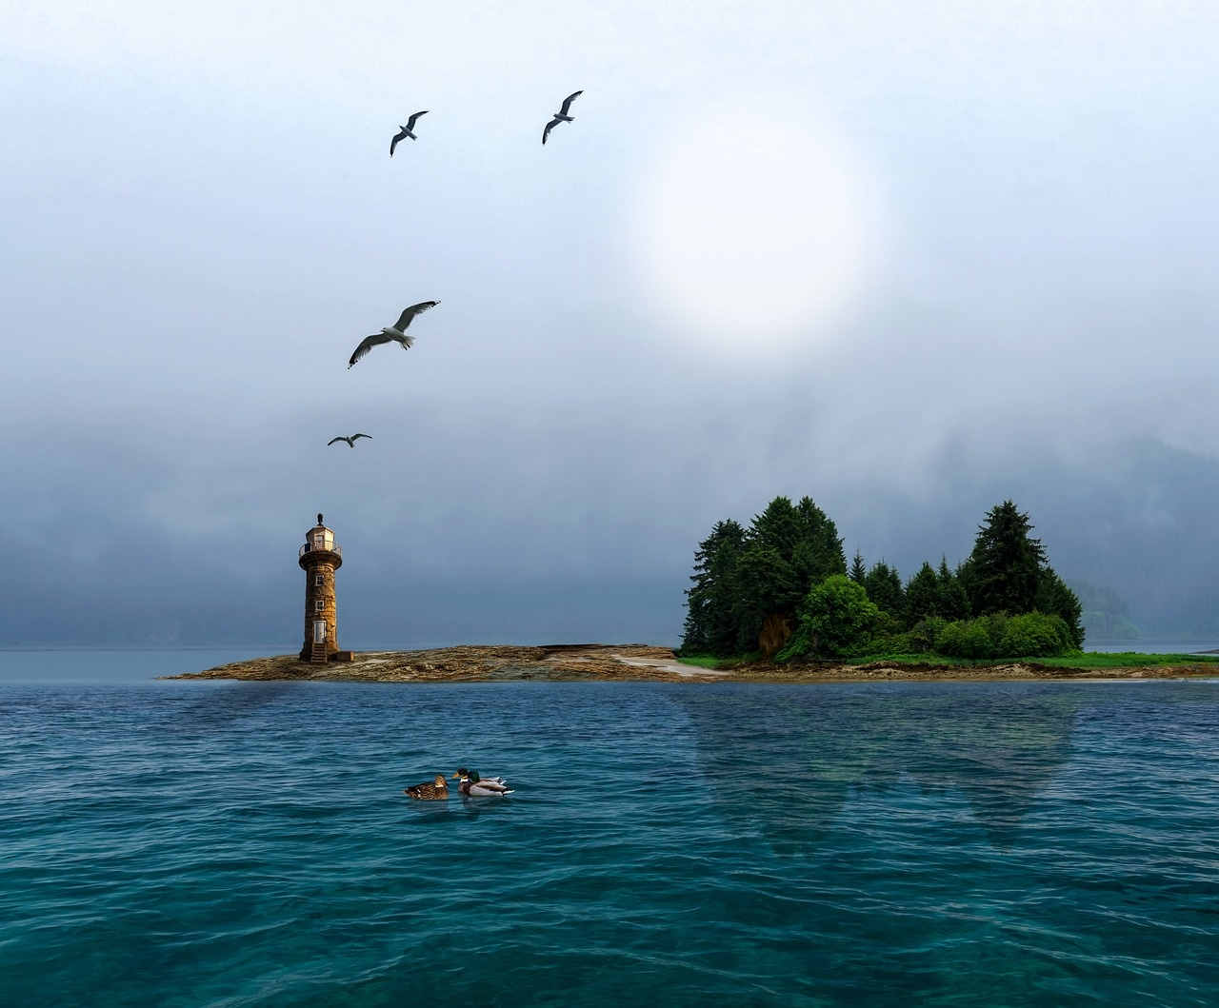
Global Efforts to Save Coral Reefs
International Collaboration
Sustainable Fishing Practices
Countries worldwide are joining forces to protect coral reefs.
Initiatives like the International Coral Reef Initiative (ICRI) promote conservation efforts.
Implementing regulations to prevent overfishing and protect reef ecosystems.
Encouraging sustainable fishing methods to reduce negative impacts on coral reefs.
Marine Protected Areas
Climate Change Mitigation
Establishing marine protected areas to safeguard coral reefs from human activities.
Enforcing regulations to limit destructive practices within these protected zones.
Addressing climate change to reduce the impact of rising sea temperatures on coral reefs.
Supporting initiatives to reduce carbon emissions and promote reef resilience.
Exploring Marine Conservation: Preserving the Great Barrier Reef

Slide 20
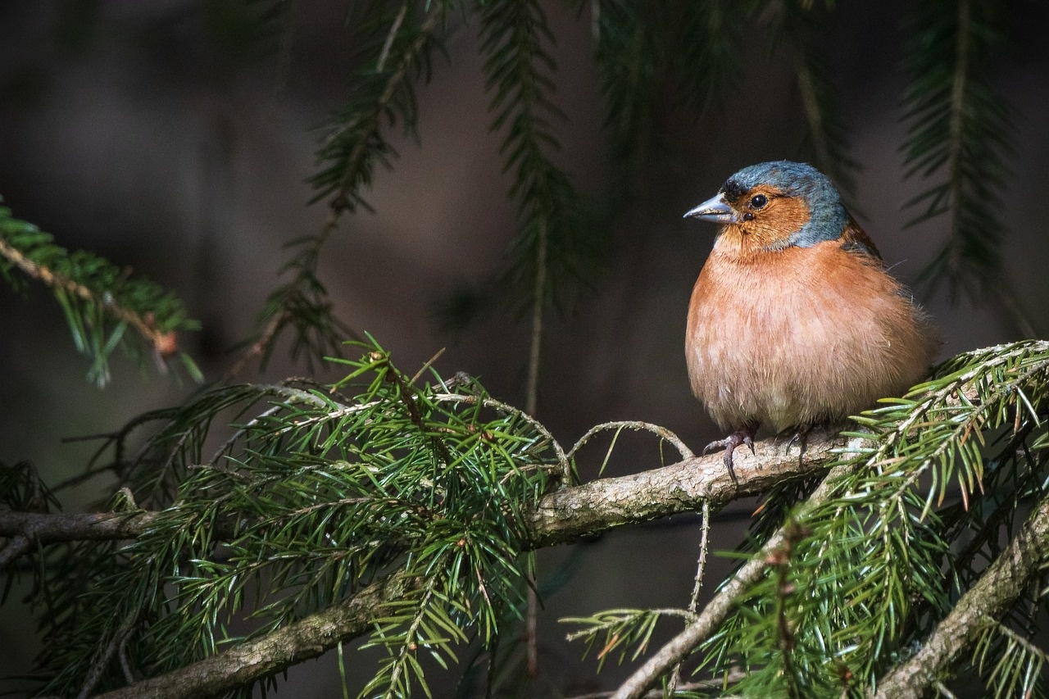
Educational Initiatives for Marine Conservation
Virtual Reality Field Trips
Engage students in immersive experiences to explore the Great Barrier Reef without physical presence.
Enhance understanding and appreciation for marine ecosystems.
Interactive Workshops
Conduct hands-on workshops focusing on marine conservation practices.
Learn coral reef restoration techniques and sustainable fishing methods.
Guest Speaker Series
Invite marine biologists, conservationists, and climate scientists.
Share expertise and insights on the importance of preserving marine biodiversity.
Ocean Literacy Curriculum
Integrate ocean literacy into the school curriculum.
Emphasize the significance of marine ecosystems and the impact of human activities on ocean health.
Community Beach Clean-ups
Organize community-driven initiatives to clean up beaches and coastal areas.
Raise awareness about the importance of reducing marine pollution.
Exploring Marine Conservation: Preserving the Great Barrier Reef

Slide 21
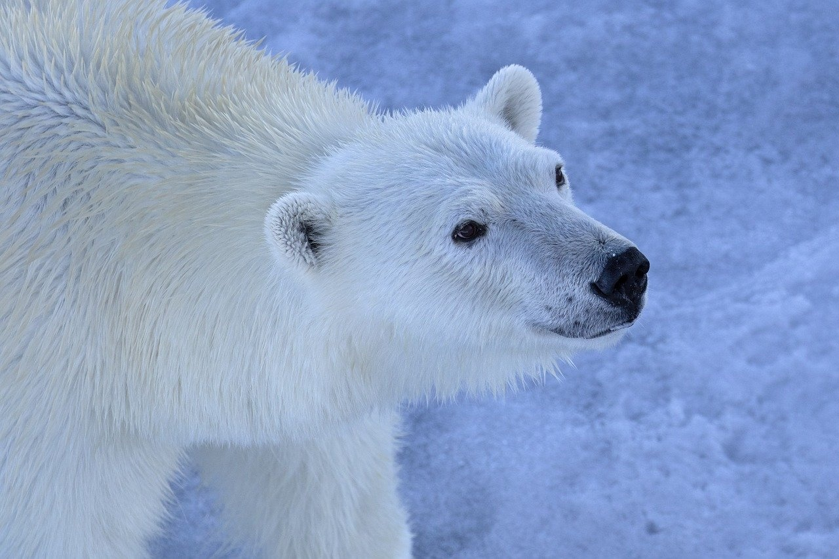
Innovations in Marine Research
Remote Sensing Technology
Coral Restoration Techniques
Utilizing satellite imagery and drones for monitoring and mapping coral reefs.
Enhancing data collection efficiency and accuracy in remote marine environments.
Implementing innovative methods such as coral gardening and 3D printing of coral structures.
Promoting the regeneration of damaged coral reefs and enhancing biodiversity.
Genetic Research and Coral Resilience
Artificial Intelligence in Marine Conservation
Studying the genetic makeup of corals to identify resilient species and traits.
Developing strategies to enhance the resilience of coral populations to climate change.
Applying AI algorithms to analyze large datasets for predicting coral bleaching events.
Enhancing decision-making processes for effective conservation efforts.
Exploring Marine Conservation: Preserving the Great Barrier Reef

Slide 22
Community Engagement in Environmental Conservation
01
02
03
04
05
Educational Workshops
Volunteer Programs
Collaboration with Indigenous Communities
Public Awareness Campaigns
Partnerships with Local Businesses
Organize workshops to educate the community about the importance of marine conservation and the specific threats facing the Great Barrier Reef.
Engage community members in hands-on conservation efforts such as coral planting, beach clean-ups, and monitoring marine life.
Partner with Indigenous groups to incorporate traditional ecological knowledge and practices into conservation initiatives.
Raise awareness through social media, local events, and educational campaigns to inspire action and behavior change.
Work with businesses to promote sustainable practices and reduce environmental impact on the reef ecosystem.
Exploring Marine Conservation: Preserving the Great Barrier Reef

Slide 23
Future Prospects for the Great Barrier Reef
Coral Population Decline
Economic Value
Coral Bleaching Events
Employment Support
2050
$6.4 Billion
2030
50,000 Jobs
By 2050, the Great Barrier Reef could lose up to 90% of its coral population due to the combined impacts of climate change, pollution, and ocean acidification.
The Great Barrier Reef generates an estimated $6.4 billion annually in economic value through tourism, fishing, and research activities, highlighting the importance of its preservation.
Scientists predict that by 2030, the Great Barrier Reef may experience more frequent and severe coral bleaching events if global warming continues at the current rate.
The reef supports over 50,000 jobs in various industries, emphasizing the need for sustainable conservation efforts to protect both the ecosystem and livelihoods.
Exploring Marine Conservation: Preserving the Great Barrier Reef

