Slide 1

Mastering the French Verb 'Être'
A Comprehensive Guide to Understanding and Using 'Être' in Everyday Communication

Slide 2
Table of contents
Introduction to the Verb "Être" in French
Forms of the Verb "Être"
Using the Verb "Être" in Sentences
Describing People and Places with the Verb "Être"
Expressing Emotions and Feelings with the Verb "Êtr…
Using the Verb "Être" in Real-Life Situations
Common Errors to Avoid
Practice Exercises
Conclusion
Assessment
01
02
03
04
05
06
07
08
09
10

Slide 3
Table of contents
Extension Activities
Parent Engagement
Safety Considerations
Reflection Questions
Next Steps
Key Takeaways
Final Thoughts
11
12
13
14
15
16
17

Slide 4
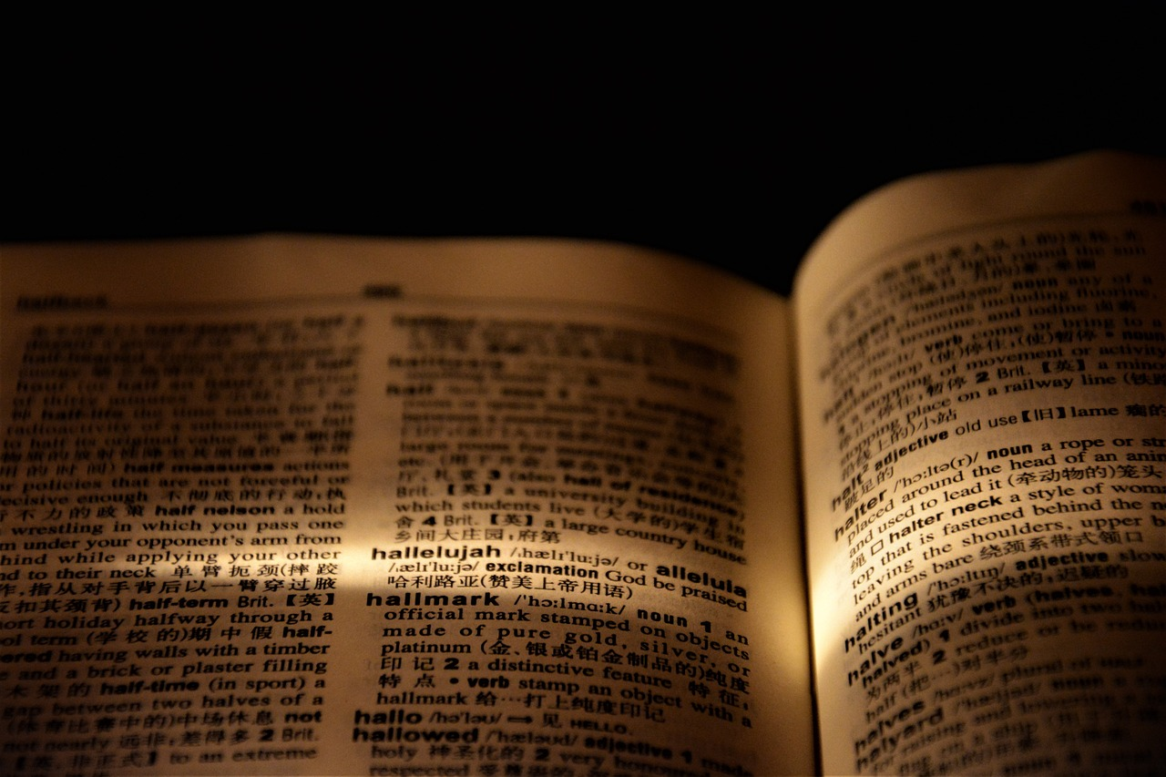
Mastering the French Verb 'Être'
1
Introduction to the Verb "Être" in French
Fundamental Concept
Irregular Forms
Essential for Sentences
The verb 'être' is a fundamental concept in French that describes people, places, and things. It serves as a building block for many sentences.
'Être' is an irregular verb with various forms: 'je suis', 'tu es', 'il est', 'elle est', 'nous sommes', 'vous êtes', and 'ils sont'. Each form corresponds to different subjects.
Understanding 'être' is crucial for constructing basic sentences in French. It is often used when introducing oneself or others.

Slide 5

Mastering the French Verb 'Être'
2
Forms of the Verb "Être"
Je suis
Tu es
Il est
Elle est
Nous sommes
Indicates who you are or your current state.
Example: Je suis étudiant. (I am a student.)
Addresses someone informally.
Example: Tu es mon ami. (You are my friend.)
Refers to a male person.
Example: Il est professeur. (He is a teacher.)
Refers to a female person.
Example: Elle est médecin. (She is a doctor.)
Indicates a group identity.
Example: Nous sommes heureux. (We are happy.)

Slide 6

Mastering the French Verb 'Être'
3
Using the Verb "Être" in Sentences
Identity Statement
Gender Identification
En tant que jeune garçon d'une petite ville, je trouve du bonheur à jouer au football avec mes amis chaque week-end. (As a young boy from a small town, I find joy in playing football with my friends every weekend.)
En tant que fille passionnée de littérature, je passe des heures à explorer des mondes imaginaires à travers les livres. (As a girl passionate about literature, I spend hours exploring imaginary worlds through books.)
Student Role
Teaching Profession
En tant qu'étudiant curieux, je m'efforce de comprendre les mystères de la science et de poser des questions qui m'aident à apprendre. (As a curious student, I strive to understand the mysteries of science and ask questions that help me learn.)
En tant qu'enseignante dévouée, je m'efforce d'éveiller la curiosité de mes élèves en leur racontant des histoires captivantes. (As a dedicated teacher, I strive to spark my students' curiosity by telling them captivating stories.)

Slide 7

Mastering the French Verb 'Être'
4
Describing People and Places with the Verb "Être"
Describing Tallness
Describing Shortness
Je suis grand (I am tall) and I enjoy playing basketball.
Il est grand (He is tall) and often reaches the top shelf.
Tu es petit (You are small) but you have a big personality.
Elle est petite (She is small) and loves to wear high heels.
Expressing Happiness
Expressing Sadness
Il est heureux (He is happy) when he spends time with friends.
Nous sommes heureux (We are happy) to celebrate special occasions together.
Elle est triste (She is sad) because she lost her favorite toy.
Ils sont tristes (They are sad) after saying goodbye to a friend.

Slide 8
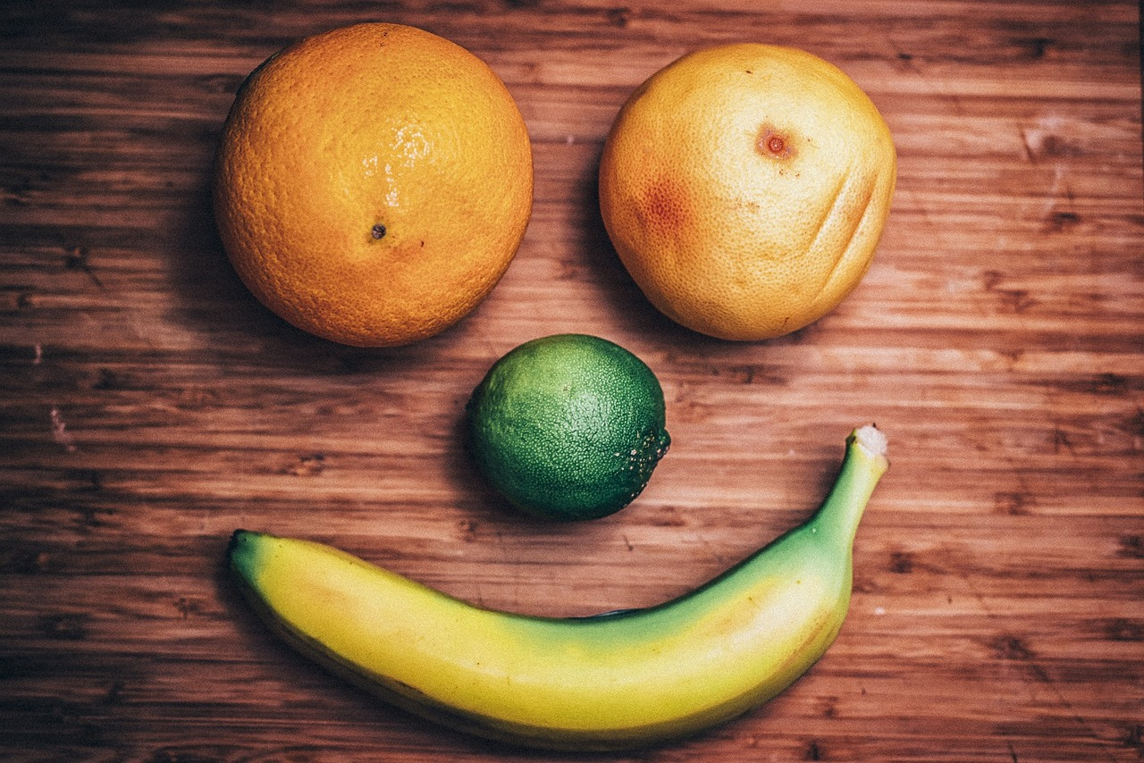
Mastering the French Verb 'Être'
5
Expressing Emotions and Feelings with the Verb "Être"
Fatigue
Excitation
Je suis fatigué (I am tired)
Shows tiredness.
Tu es excité (You are excited)
Shows enthusiasm.
Boredom
Happiness
Il est ennuyé (He is bored)
Shows lack of interest.
Elle est contente (She is happy)
Shows joy.

Slide 9

Mastering the French Verb 'Être'
6
Using the Verb "Être" in Real-Life Situations
Introducing Myself
Describing Others
Je m'appelle Marie, je suis une étudiante.
Il est un professeur, il est très gentil.
Expressing Emotions
Describing Places
Je suis triste parce que j'ai perdu mon chien.
La ville est grande et belle.

Slide 10

Mastering the French Verb 'Être'
7
Common Errors to Avoid
Verb Forms
Incorrect Usage
Confusing the various forms of 'être' can lead to misunderstandings.
Correct conjugation is vital for effective communication.
Using 'être' inappropriately can alter the meaning of a sentence.
Ensure the verb aligns with the subject in both number and gender.
Pronoun Errors
Context Misuse
Overlooking the appropriate pronoun when using 'être' can create confusion.
Always match 'être' with the correct subject pronoun.
Failing to consider context can result in incorrect usage of 'être'.
Always evaluate the situation to ensure proper application of 'être'.

Slide 11

Mastering the French Verb 'Être'
8
Practice Exercises
Complete the Sentence
Choose the Correct Verb
Je suis ____________ (I am ____________) - Think of an adjective that describes your mood or personality.
Complete the sentence with the correct form of the verb 'être': Je ____________ un étudiant (I ____________ a student).
Write a Self-Description
Create a Dialogue
Craft a short paragraph using the verb 'être' to describe your age, nationality, and interests.
Write a brief dialogue where you introduce yourself and a friend using the verb 'être'. Include names and a few details about each person.

Slide 12

Mastering the French Verb 'Être'
9
Conclusion
Core Verb
Building Blocks of Sentences
Practical Application
The verb 'être' serves as a cornerstone in the French language.
It plays a key role in describing identities and characteristics.
Mastering 'être' is vital for constructing coherent sentences.
It is essential for self-introduction and basic communication.
Engage with 'être' through real-life scenarios to solidify your understanding.
Contextual practice enhances fluency and confidence in speaking.

Slide 13

Mastering the French Verb 'Être'
10
Assessment
Quiz Yourself
Self Description
Complete a quiz to assess your understanding of the verb 'être'.
Test your knowledge with multiple-choice questions.
Write a short paragraph using the verb 'être' to describe yourself.
Focus on your personality traits and interests.
Introduce Yourself
Listening Practice
Engage in a conversation using the verb 'être' to introduce yourself and a friend.
Practice speaking clearly and confidently.
Listen to a conversation and identify the different forms of the verb 'être' used.
Pay attention to the context in which each form is applied.

Slide 14

Mastering the French Verb 'Être'
11
Extension Activities
Video Creation
Story Writing
Create a short video using the verb 'être' to describe a person or place. This activity encourages creativity while practicing language skills.
Write a short story using the verb 'être' to describe a character's journey. This helps in understanding character development and narrative structure.
Game Design
Poster Design
Create a game using the verb 'être' to practice grammar and vocabulary. This interactive approach makes learning fun and engaging.
Design a poster using the verb 'être' to describe a person, place, or thing. This visual project enhances comprehension and artistic expression.

Slide 15

Mastering the French Verb 'Être'
12
Parent Engagement
Practice 'Être'
Learning Resources
Parent-Teacher Conference
Encourage parents to practice the verb 'être' with their child at home.
This will help reinforce their understanding and usage of the verb.
Provide parents with resources and activities to support their child's learning.
These can include worksheets, online games, and recommended books.
Invite parents to attend a parent-teacher conference to discuss their child's progress.
This is an opportunity to address any concerns and celebrate achievements.

Slide 16

Mastering the French Verb 'Être'
13
Safety Considerations
Lesson Objectives
Special Needs Awareness
Ensure that all students understand the lesson objectives and activities clearly. This helps in setting the right expectations for the lesson.
Be aware of any students who may have special needs or requirements. This ensures that all students receive the support they need to succeed.
Classroom Rules
Emergency Preparedness
Establish clear rules and expectations for classroom behavior. This promotes a positive and respectful learning environment.
Be prepared for any unexpected situations or emergencies that may arise during the lesson. Having a plan in place ensures the safety of all students.

Slide 17
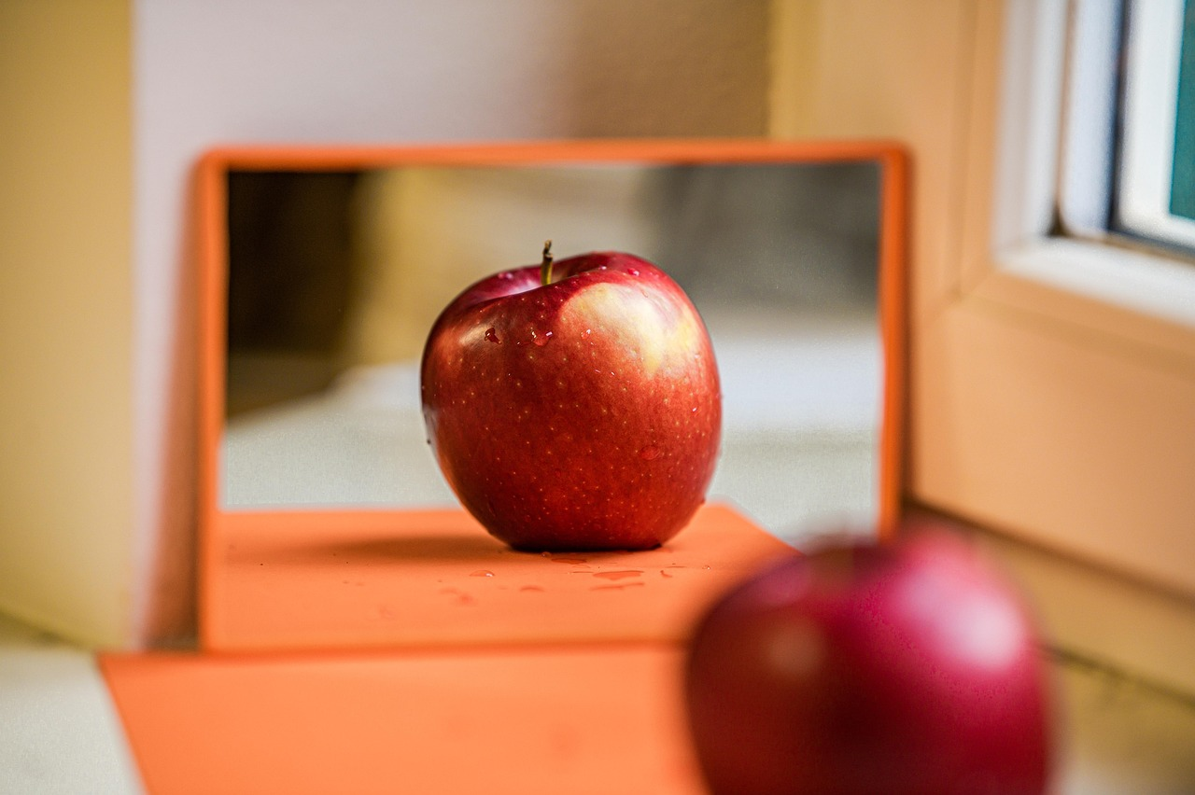
Mastering the French Verb 'Être'
14
Reflection Questions
Understanding 'Être'
Engagement Strategies
Students demonstrated a good grasp of the different forms of 'être'.
Most were able to construct sentences using the verb correctly.
Visual aids significantly enhanced student engagement during the lesson.
Interactive activities made the learning experience enjoyable and memorable.
Real-Life Application
Areas for Improvement
Students successfully applied the key takeaways in practical scenarios.
Many were able to use 'être' in conversations outside the classroom.
Some students struggled with specific forms of 'être'.
Additional practice and revision sessions may be beneficial.

Slide 18

Mastering the French Verb 'Être'
15
Next Steps
Using 'Avoir'
Descriptive Adjectives
Sentence Structure
Learn the conjugation of the verb 'avoir' in different tenses.
Practice using 'avoir' in sentences to express possession.
Understand how to use adjectives to describe nouns.
Explore the agreement of adjectives in gender and number.
Familiarize yourself with the basic structure of French sentences.
Identify the subject, verb, and object in simple sentences.

Slide 19

Mastering the French Verb 'Être'
16
Key Takeaways
Fundamental Verb
Essential for Sentences
The verb 'être' is essential in French for describing people, places, and things.
Mastering 'être' is vital for constructing basic sentences and self-introduction in French.
Different Forms
Practice in Context
The verb 'être' has forms: 'je suis', 'tu es', 'il est', 'elle est', 'nous sommes', 'vous êtes', 'ils sont.'
Practicing 'être' in sentences and conversations enhances your French skills.

Slide 20
Mastering the French Verb 'Être'
17
Final Thoughts
Mastering Être
Practice Regularly
Contextual Usage
The verb 'être' is essential for constructing basic sentences in French.
It is crucial for introducing oneself and expressing identity.
Consistent practice is key to mastering the verb 'être'.
Dedication will lead to improved French language skills.
Using 'être' in context helps reinforce learning.
Always try to incorporate it into everyday conversations.

