Slide 1
Introduction to Basic Addition and Subtraction
Understanding Fundamental Math Operations and Their Real-World Applications for Young Learners

Slide 2
Table of Contents
Welcome to Introduction to Basic Addition and …
Importance of Addition and Subtraction
Lesson Introduction
Teaching Script
Guided Practice Activities
Independent Practice Activities
Subject Knowledge
Extended Knowledge
Common Errors
Common FAQ
Objectives
Vocabulary
Resources
05
06
07
08
09
10
11
12
13
14
15
16
17

Slide 3
Table of Contents
Prior Knowledge
Differentiation Strategies
Cross-Curricular Links
Group Activities
Digital Integration
Review and Assessment
Summative Assessment
Homework
Extension Activities
Parent Engagement
Safety Considerations
Conclusion
Teaching Tips
18
19
20
21
22
23
24
25
26
27
28
29
30

Slide 4
Table of Contents
Key Takeaways
Reflection Questions
31
32

Slide 5

Welcome to Introduction to Basic Addition and Subtraction Concepts
Introduction to Basic Operations
Key Learning Objectives
Interactive Learning Approach
This lesson plan is designed to introduce 8-year-old students to the fundamental concepts of addition and subtraction.
By focusing on interactive and engaging activities, students will develop a solid understanding of these basic operations and their real-world applications.
The key learning objectives include recognizing the symbols and terminology associated with addition and subtraction.
Students will apply these operations to solve simple problems and demonstrate an understanding of the relationship between addition and subtraction.
The lesson emphasizes interactive and engaging activities to make learning enjoyable.
This approach ensures students grasp the concepts effectively while understanding their practical applications.
5
Introduction to Basic Addition and Subtraction

Slide 6

Importance of Addition and Subtraction
Everyday Applications
Skill Development
Addition and subtraction are essential for everyday life, from calculating the total cost of items to determining how much time is left until a favorite TV show starts.
These operations are not only crucial for academic success in mathematics but also play a critical role in everyday life.
Understanding addition and subtraction helps students develop problem-solving skills and critical thinking.
These foundational skills are indispensable for tackling real-world challenges effectively.
Foundation for Advanced Concepts
Academic and Practical Relevance
Addition and subtraction lay the groundwork for more complex math concepts that students will encounter in subsequent years.
Mastery of these operations ensures a smoother transition to higher-level mathematics.
These operations bridge the gap between academic learning and practical application.
They are indispensable tools for navigating both educational and everyday scenarios.
6
Introduction to Basic Addition and Subtraction

Slide 7
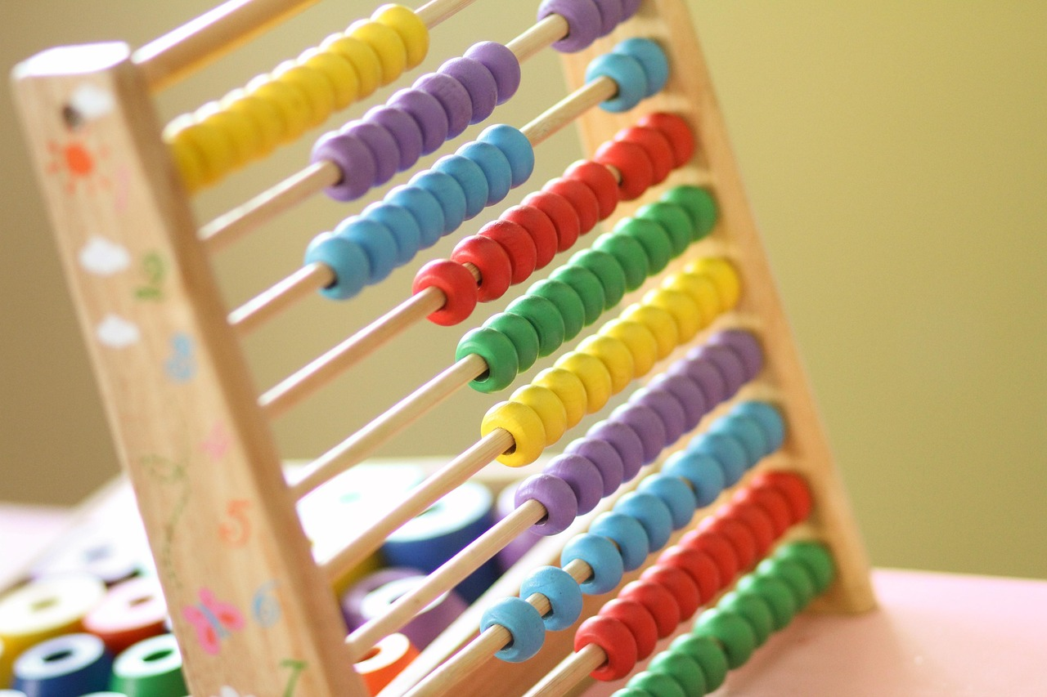
Lesson Introduction
Engaging Hook
Practical Applications
Real-Life Scenarios
The lesson will begin with a hook to capture the students' attention and spark their interest in mathematics.
This could involve a simple, real-life scenario where addition or subtraction is necessary, such as combining toys or sharing sweets among friends.
The importance of understanding addition and subtraction will be emphasized.
Highlighting their practical applications and relevance to everyday life.
Students will explore scenarios where addition and subtraction are used.
These examples will make the concepts relatable and engaging.
7
Introduction to Basic Addition and Subtraction

Slide 8
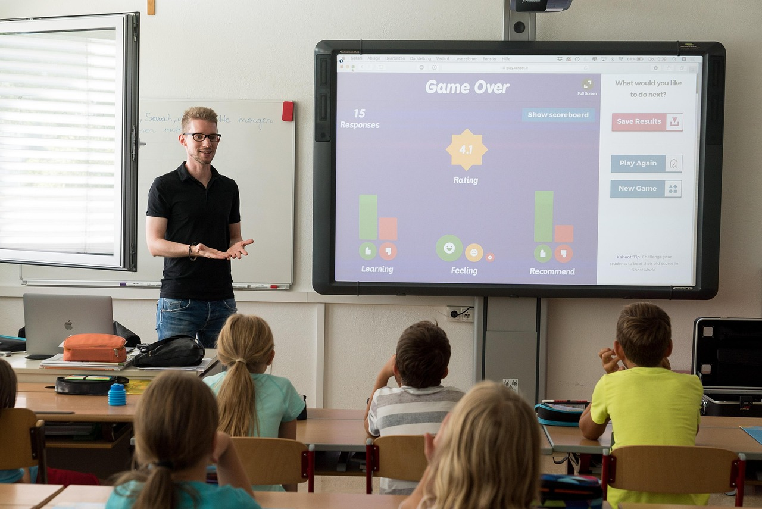
Teaching Script
Introduction and Hook
Direct Instruction
Guided Practice
Minutes 1-5: Begin the lesson with a fun, interactive hook to engage the students.
This sets the tone for the lesson and captures students' attention.
Minutes 6-10: Provide a clear and concise explanation of the concepts of addition and subtraction.
This ensures students understand the foundational concepts before moving forward.
Minutes 11-15: Engage the students in guided practice activities where they work in pairs or small groups.
This collaborative approach helps reinforce learning through peer interaction.
Independent Practice
Conclusion
Minutes 16-20: Provide students with independent practice worksheets that contain a mix of addition and subtraction problems.
This allows students to apply their knowledge individually and build confidence.
Wrap up the lesson by summarizing key points and addressing any questions.
This ensures students leave with a clear understanding of the material covered.
8
Introduction to Basic Addition and Subtraction

Slide 9
Guided Practice Activities
01
02
03
04
05
Number Line Activity
Counting Block Towers
Math Bingo
Story Problems
Math Scavenger Hunt
Create a large number line on the floor using tape or a long piece of paper.
This activity helps students visualize and practice addition and subtraction.
Provide students with counting blocks and have them work in pairs to build towers.
These towers represent addition and subtraction problems for hands-on learning.
Create bingo cards with numbers and have students play a game of math bingo.
This game reinforces number recognition and basic math operations in a fun way.
Use real-life story problems to help students apply addition and subtraction concepts.
This approach connects math to everyday situations, making it more relatable.
Create a math scavenger hunt around the classroom or school.
Incorporate addition and subtraction problems related to objects found in the environment.
9
Introduction to Basic Addition and Subtraction

Slide 10

Independent Practice Activities
Beginner Activity: Addition and Subtraction Worksheets
Intermediate Activity: Math Word Problems
Provide students with simple addition and subtraction worksheets that contain single-digit problems.
These worksheets help reinforce basic arithmetic skills in a structured format.
Create a set of word problems that require students to apply addition and subtraction concepts to solve real-life scenarios.
This activity encourages critical thinking and practical application of math skills.
Advanced Activity: Math Games
Challenge Activity: Create Your Own Math Problems
Provide students with math games that require strategic thinking and application of addition and subtraction concepts.
These games make learning math engaging and interactive for advanced learners.
Encourage advanced students to create their own addition and subtraction word problems and share them with the class.
This fosters creativity and a deeper understanding of mathematical concepts.
10
Introduction to Basic Addition and Subtraction

Slide 11

Subject Knowledge
The Concept of Subtraction
The Relationship Between Addition and Subtraction
Addition is a fundamental math operation that involves combining two or more numbers to find their total or sum.
It is one of the basic building blocks of arithmetic and is used in everyday calculations.
Subtraction is another fundamental math operation that involves finding the difference between two numbers.
It is essential for understanding how quantities decrease or change.
Real-World Applications of Addition and Subtraction
Real-World Applications of Addition and Subtraction
Addition and subtraction are closely related operations that are often used together to solve problems.
Understanding their relationship helps in developing problem-solving skills in mathematics.
Addition and subtraction are essential math operations that have numerous real-world applications.
They are used in areas such as budgeting, shopping, and measuring distances.
11
Introduction to Basic Addition and Subtraction

Slide 12
Extended Knowledge
1
Shopping Scenario
4
Combining Quantities
Imagine you have $10 to spend at a toy store.
You find a toy car that costs $5 and a pack of stickers that costs $2; calculate how much money will be left after buying both items.
In a classroom, there are 15 pencils in one jar and 20 pencils in another.
If all the pencils are combined into one box, calculate the total number of pencils.
2
Cooking Example
5
Missing Number Problems
A recipe for making cookies requires 2 cups of flour.
If you want to make half the recipe, determine how many cups of flour will be needed.
These are problems where a part of the equation is missing.
The student must fill in the missing part to complete the equation.
3
Time and Schedules
Understanding time intervals is crucial for daily routines.
This skill helps in managing tasks and appointments effectively.
12
Introduction to Basic Addition and Subtraction

Slide 13
Common Errors
Confusing Addition and Subtraction Symbols
Difficulty with Regrouping in Addition
Subtraction as Removal
Negative Numbers
Some students may initially confuse the "+" and "-" symbols, leading to incorrect calculations.
This misunderstanding can result in fundamental errors in basic arithmetic operations.
Students may struggle with regrouping (carrying over) when the sum of two digits exceeds 10.
This challenge often requires additional practice to master the concept of carrying over.
While subtraction is often introduced as "taking away", some students might not fully grasp that it can also represent comparison or finding the difference.
This dual interpretation can lead to confusion in understanding subtraction problems.
When introduced to subtraction involving negative numbers, students might find it challenging to understand that subtracting a negative number is equivalent to adding a positive number.
This concept is crucial for advancing in mathematics but can be difficult to grasp initially.
13
Introduction to Basic Addition and Subtraction

Slide 14
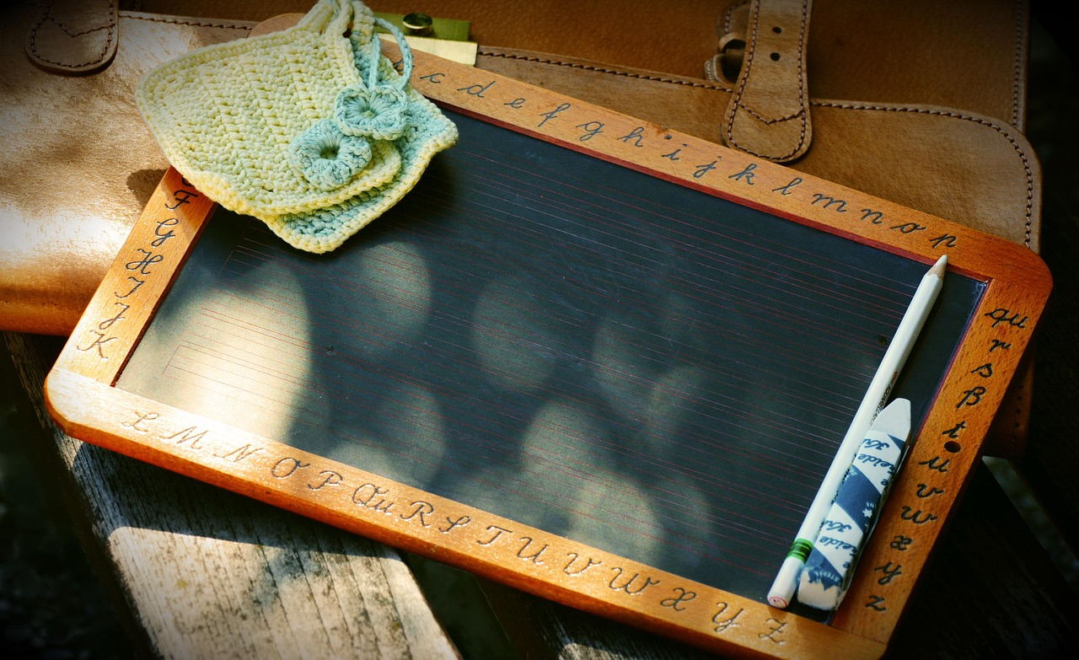
Common FAQ
Teaching Addition and Subtraction Together
Making Math Fun
Addressing Struggles with Regrouping
Why is it important to teach addition and subtraction together?
Teaching these concepts together helps students understand their interrelationship and builds a stronger mathematical foundation.
How can I make addition and subtraction fun for my students?
Incorporate games, interactive activities, and real-life scenarios to make learning engaging and enjoyable.
What if my student is struggling with the concept of regrouping in addition?
Use visual aids and step-by-step explanations to simplify the concept and build confidence.
Differentiating Symbols
The Role of Word Problems
How do I help my students remember the difference between addition and subtraction symbols?
Create mnemonic devices or use color coding to make the symbols more distinguishable and memorable.
What role do word problems play in teaching addition and subtraction?
Word problems help students apply mathematical concepts to real-world situations, enhancing comprehension and problem-solving skills.
14
Introduction to Basic Addition and Subtraction

Slide 15
Objectives
01
Knowledge/Remembering
Students will be able to recall and define the terms 'addition' and 'subtraction'.
They will identify their respective symbols (+ and -) with 100% accuracy.
02
Comprehension/Understanding
Students will demonstrate an understanding of addition as combining two or more numbers to find a total.
They will understand subtraction as finding the difference between two numbers.
03
Application/Applying
Students will apply addition and subtraction concepts to solve real-life problems.
This involves practical scenarios requiring mathematical solutions.
04
Analysis/Analyzing
Students will analyze simple math problems to determine whether addition or subtraction is required.
This skill helps in choosing the correct operation for problem-solving.
15
Introduction to Basic Addition and Subtraction

Slide 16
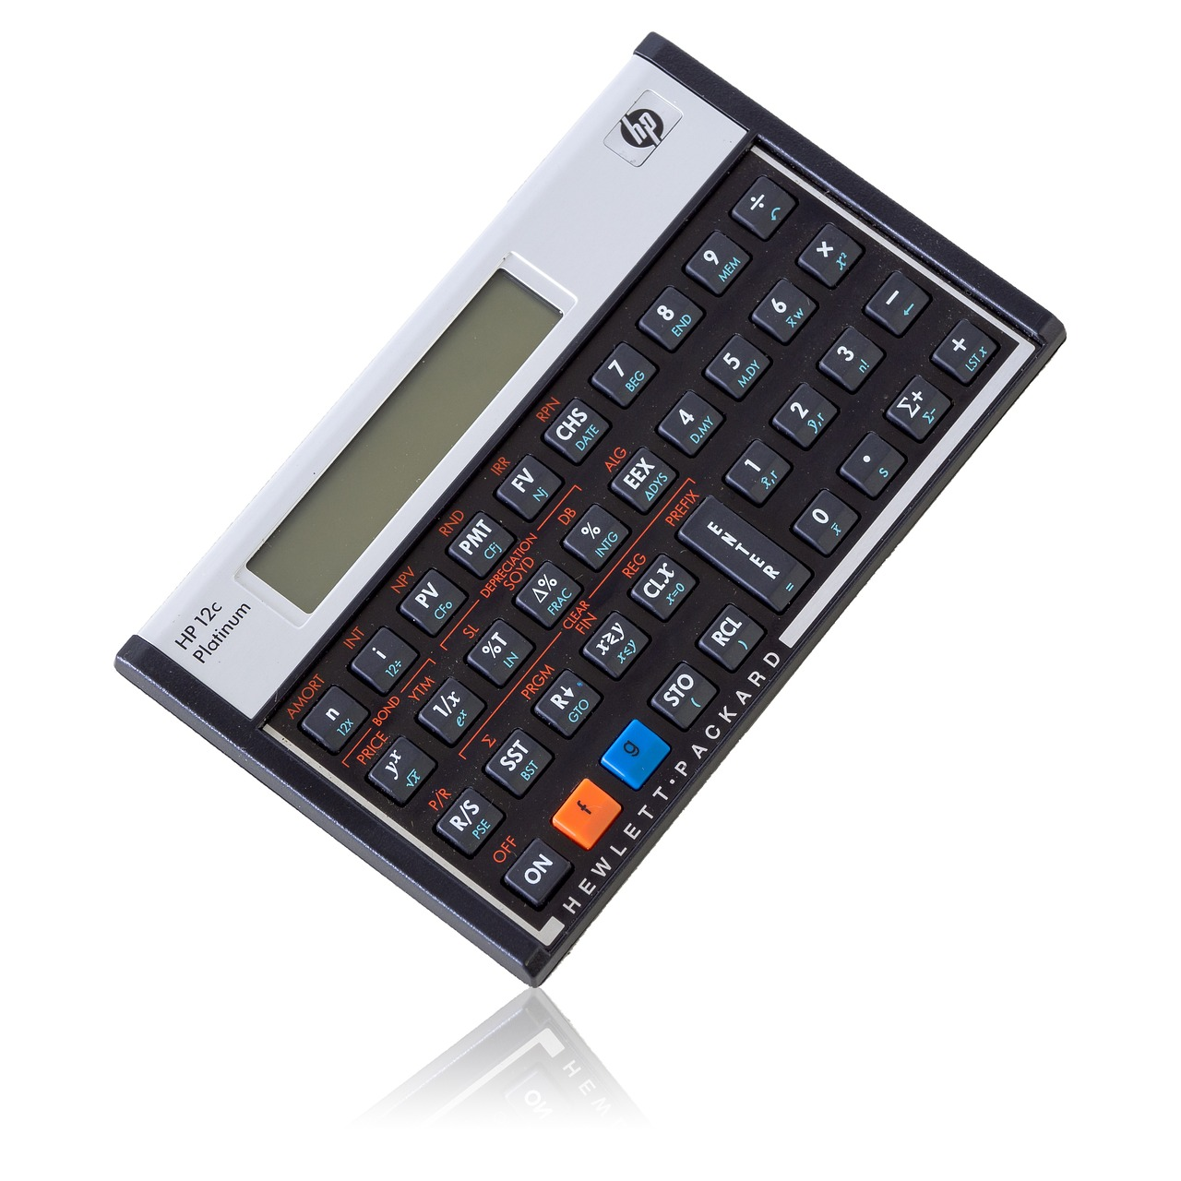
Vocabulary
1
Addition
4
Subtraction
The process of combining two or more numbers to find a total or sum.
It is one of the basic operations in mathematics.
The process of finding the difference between two numbers.
It is used to determine how much one number is less than another.
2
Sum
5
Difference
The total or result of an addition problem.
It represents the combined value of all numbers added together.
The result of a subtraction problem.
It shows the amount left after subtracting one number from another.
3
Math Operation
A symbol or action that is used to solve a math problem.
Examples include addition, subtraction, multiplication, and division.
16
Introduction to Basic Addition and Subtraction

Slide 17
Resources
1
2
3
4
5
Math Workbook
Number Line Printables
Counting Blocks
Math Games App
Whiteboard and Markers
A comprehensive workbook that includes practice problems and exercises for addition and subtraction.
It serves as a structured resource for students to practice and improve their math skills.
Printable number lines that can be used as a visual tool to help students solve addition and subtraction problems.
These printables are ideal for hands-on learning and enhancing problem-solving techniques.
Physical blocks that can be used to represent numbers and help students visualize the process of addition and subtraction.
They are effective for tactile learners and make abstract concepts more concrete.
A digital app that includes interactive math games and activities focused on addition and subtraction.
This app combines learning with fun, making math engaging for students.
A whiteboard and markers for demonstrating math problems and strategies.
These tools are versatile and can be used for both teaching and collaborative problem-solving.
17
Introduction to Basic Addition and Subtraction

Slide 18
Prior Knowledge
1
Number Sense
2
Basic Counting Skills
Students should have a solid understanding of numbers up to 100, including their sequence, recognition, and basic relationships.
This foundational knowledge is essential for progressing in mathematics.
The ability to count objects, both forwards and backwards, is fundamental.
This skill supports the development of arithmetic and problem-solving abilities.
3
Understanding of Basic Math Vocabulary
4
Ability to Compare Quantities
Familiarity with basic math terms such as 'more,' 'less,' 'altogether,' and 'take away' is vital.
These terms help students comprehend and communicate mathematical concepts effectively.
Students should be able to compare two quantities and determine which is more, less, or equal.
This ability is crucial for understanding relationships between numbers.
18
Introduction to Basic Addition and Subtraction

Slide 19

Differentiation Strategies
1
Visual, Auditory, Kinesthetic (VAK) Approach
4
Learning Centers
Incorporate a variety of teaching methods to cater to different learning styles.
This ensures that students engage with the material in ways that suit their preferences.
Set up learning centers that offer different activities tailored to various learning needs.
These centers provide opportunities for hands-on and interactive learning experiences.
2
Technology Integration
5
Peer-Assisted Learning
Utilize digital tools and apps that provide interactive addition and subtraction activities.
Technology enhances engagement and supports diverse learning styles effectively.
Pair students with peers who can offer support and guidance.
This strategy fosters collaboration and builds confidence among learners.
3
Modified Worksheets and Assessments
Provide modified worksheets and assessments for students who require extra support or challenges.
This approach ensures that all students can participate and succeed at their own level.
19
Introduction to Basic Addition and Subtraction

Slide 20

Cross-Curricular Links
Language Arts and Problem-Solving
Science and Quantitative Skills
Mathematics and language arts are closely linked, particularly in the area of problem-solving.
This connection enhances critical thinking and analytical skills in students.
Basic addition and subtraction are essential in science for measuring quantities, comparing data, and understanding patterns.
These skills help students analyze scientific experiments and interpret results effectively.
Social Studies Applications
Art, Design, and Mathematics
In social studies, students can apply addition and subtraction skills to understand population growth, calculate distances, or determine costs in historical contexts.
This integration fosters a deeper understanding of historical and geographical concepts.
Mathematics is inherent in art and design, particularly in concepts like symmetry, patterns, and geometry.
These mathematical principles inspire creativity and precision in artistic endeavors.
20
Introduction to Basic Addition and Subtraction

Slide 21
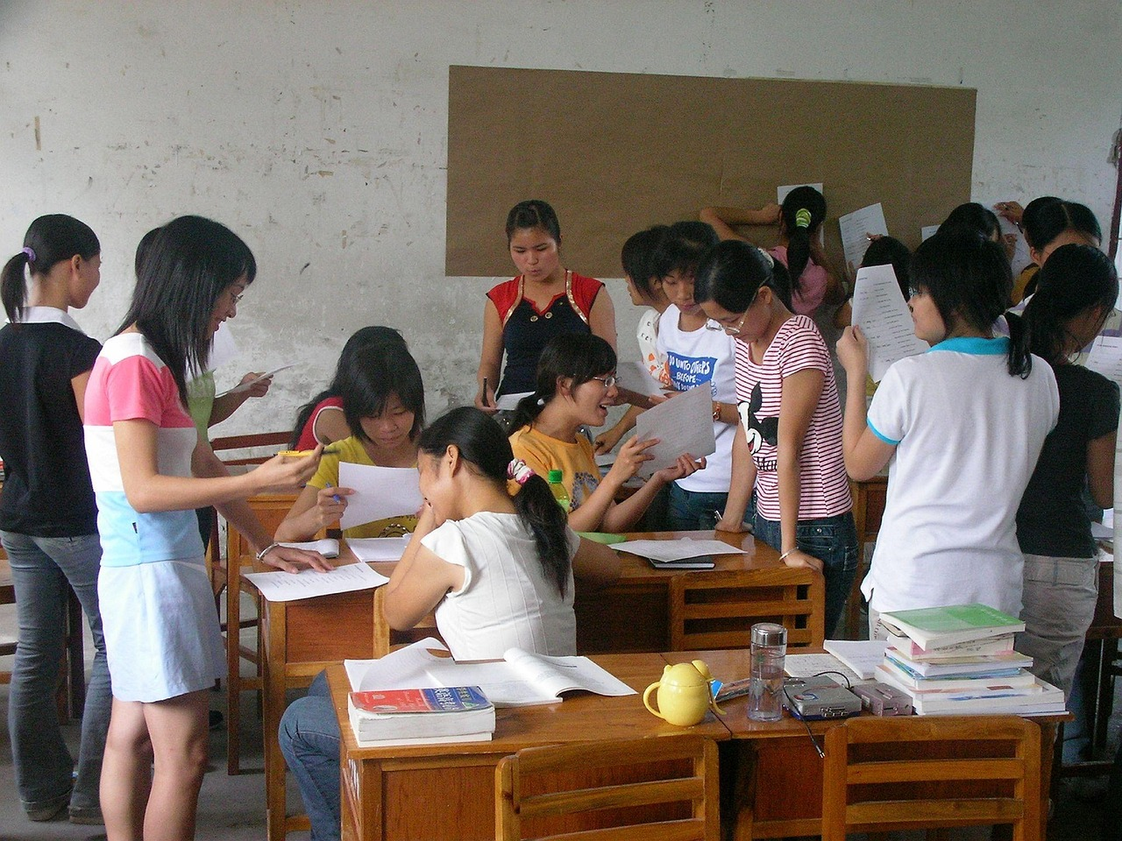
Group Activities
Math Treasure Hunt
Divide the class into small groups of 3-4 students and create a treasure hunt.
The clues should involve simple addition and subtraction problems.
Addition and Subtraction Bingo
Prepare bingo cards with numbers and simple math problems.
These problems should involve addition and subtraction.
Math Story Problems
Assign each group a set of story problems.
These problems should involve addition and subtraction in real-life scenarios.
Number Line Challenge
Set up a large number line in the classroom or outside.
Have teams move accordingly based on addition and subtraction problems called out.
21
Introduction to Basic Addition and Subtraction

Slide 22
Digital Integration
01
02
03
Math Apps
Online Math Games
Virtual Math Manipulatives
Utilize educational math apps like Math Games, Khan Academy Kids, or Splash Math.
These apps provide interactive and engaging ways for students to practice math skills.
Websites such as Coolmath or Math Playground offer a variety of online games and puzzles.
These games make learning math fun and interactive for students of all ages.
Tools like GeoGebra or virtual manipulatives on websites such as Math Open Reference.
These resources help students visualize and understand complex math concepts.
04
05
Math Video Lessons
Digital Quizzes and Tests
Utilize video platforms like YouTube or educational websites that offer video lessons on addition and subtraction.
These videos provide step-by-step explanations to enhance learning.
Create digital quizzes or tests using tools like Kahoot, Quizlet, or Google Forms.
These tools allow for interactive assessments and instant feedback.
22
Introduction to Basic Addition and Subtraction

Slide 23

Review and Assessment
Daily Math Drills
Formative Assessments
Math Journals
Begin each math class with a quick 5-10 minute drill of addition and subtraction problems.
These drills help reinforce basic arithmetic skills and prepare students for the day's lesson.
Regularly administer short, formative assessments to check students' understanding.
These assessments provide immediate feedback and help identify areas needing improvement.
Have students keep a math journal where they record their thoughts, questions, and insights about the math concepts they are learning.
This practice encourages reflection and deeper engagement with the material.
Peer Review
Self-Evaluation Checklists
Pair students up to review each other's work on math problems or projects.
This collaborative approach fosters communication and critical thinking skills.
Provide students with checklists of skills or concepts covered in the lesson.
These checklists enable students to track their progress and identify areas for improvement.
23
Introduction to Basic Addition and Subtraction

Slide 24
Summative Assessment
Mathematics Quiz
Problem-Solving Activity
Math Project
Class Presentation
A 10-question quiz that tests students' understanding of addition and subtraction concepts.
It serves as a quick evaluation of their grasp on these fundamental operations.
Students will be given a set of real-life scenarios that require the application of addition and subtraction skills to solve.
This activity emphasizes practical application and critical thinking.
Students will work on a project that involves creating a visual representation of addition and subtraction concepts.
This encourages creativity and deeper understanding of mathematical ideas.
Students will work in groups to prepare a short presentation that teaches their peers about a specific aspect of addition and subtraction.
This fosters collaboration and communication skills among students.
24
Introduction to Basic Addition and Subtraction

Slide 25
Homework
Math Treasure Hunt
Math Bingo
Math Story Problems
Create a treasure hunt with clues that involve simple addition and subtraction problems.
Engage students in solving math problems to find the next clue in the hunt.
Design bingo cards with numbers and simple math problems involving addition and subtraction.
Students solve problems to mark their cards and aim to complete a row or column.
Provide students with a set of story problems that involve addition and subtraction.
For example, 'If I have 5 pencils and I give 2 to my friend, how many pencils do I have left?'
25
Introduction to Basic Addition and Subtraction

Slide 26
Extension Activities
Math Scavenger Hunt
Designing Math Games
Math Art Project
Create a list of items around the house that can be used to practice addition and subtraction.
This activity encourages exploration and practical application of math concepts in everyday settings.
Encourage students to design their own math games involving addition and subtraction.
This fosters creativity and helps students engage with math in a fun and interactive way.
Ask students to create an art project that represents addition and subtraction.
This combines artistic expression with mathematical understanding for a unique learning experience.
26
Introduction to Basic Addition and Subtraction

Slide 27

Parent Engagement
Regular Progress Updates
Math Nights
Parent-Child Math Challenges
Establish a regular communication channel with parents to update them on their child's progress in math.
This ensures parents are informed and can support their child's learning effectively.
Organize math nights where parents and their children can participate in math activities together.
These events foster collaboration and make math learning enjoyable for families.
Design specific math challenges that parents and children can work on together at home.
This encourages teamwork and strengthens math skills in a fun and engaging way.
27
Introduction to Basic Addition and Subtraction

Slide 28

Safety Considerations
1
Classroom Organization
Ensure the classroom is organized to promote movement and interaction without posing a risk of tripping or collision.
Proper organization minimizes accidents and creates a safe learning environment.
2
Supervision During Activities
Supervise students closely during activities that involve manipulatives to prevent choking hazards.
Active supervision ensures safety and allows timely intervention in case of emergencies.
3
Material Safety Measures
Ensure all materials used are non-toxic and durable.
Using safe materials protects students from harmful substances and ensures longevity of resources.
28
Introduction to Basic Addition and Subtraction

Slide 29
Conclusion
1
2
3
Foundational Step in Mathematics
Creating a Positive Learning Environment
Encouraging Mathematical Engagement
Introduction to basic addition and subtraction concepts is a foundational step in students' mathematical journey.
Through engaging and interactive lessons, students can develop a deep understanding of these operations and their practical applications.
By creating a safe, supportive, and inclusive learning environment, teachers can foster a positive attitude towards mathematics.
This approach encourages students to view math as an accessible and enjoyable subject.
Interactive lessons play a crucial role in making mathematical concepts relatable.
Such methods help students connect theoretical knowledge with real-world applications.
29
Introduction to Basic Addition and Subtraction

Slide 30
Teaching Tips
Use Real-Life Scenarios
Visual Aids and Manipulatives
Storytelling
Games and Competitions
Peer Teaching
Incorporate real-life examples into lessons to demonstrate the practical applications of addition and subtraction.
This helps students understand how these concepts are used in everyday life.
Utilize visual aids and manipulatives to help students visualize the concepts.
These tools make abstract ideas more tangible and easier to grasp.
Engage students through storytelling where mathematical problems are embedded within a narrative.
This approach makes learning more engaging and relatable for students.
Incorporate mathematical games and competitions that focus on addition and subtraction.
These activities make learning fun and encourage healthy competition among students.
Encourage peer teaching by having students work in pairs or small groups to solve problems.
This fosters collaboration and allows students to learn from each other.
30
Introduction to Basic Addition and Subtraction

Slide 31
Key Takeaways
1
Understanding Addition and Subtraction Symbols
Students should recognize and explain the meaning of the plus sign (+) for addition and the minus sign (-) for subtraction.
This foundational knowledge is essential for building arithmetic skills.
2
Applying Addition and Subtraction to Problems
Students should be able to apply the concepts of addition and subtraction to solve simple math problems.
This demonstrates their ability to use mathematical operations in practical scenarios.
3
Recognizing the Relationship Between Operations
Students should begin to understand that addition and subtraction are inverse operations.
This insight helps in developing a deeper understanding of mathematical concepts.
31
Introduction to Basic Addition and Subtraction

Slide 32

Reflection Questions
1
Engagement and Effectiveness
Were the instructional methods and activities used in the lesson engaging and effective for all students?
How well did students demonstrate an understanding of the addition and subtraction concepts, and what areas of difficulty were observed?
2
Opportunities for Application
What opportunities were provided for students to apply mathematical thinking and problem-solving skills?
How could these opportunities be expanded in future lessons?
3
Student Understanding and Challenges
How well did students demonstrate an understanding of the addition and subtraction concepts?
What areas of difficulty were observed?
32
Introduction to Basic Addition and Subtraction

