Slide 1


Mastering Future Plans and Goals with 'Going To'
A Comprehensive Guide to Expressing Intentions and Making Predictions in English

Slide 2
Table of Contents
Introduction to Future Plans and Goals
What are Future Plans and Goals?
Introduction to the Present Continuous Tense w…
Formation of the Future Simple with "Going to"
Differences between "Going to" and "Will"
Using "Going to" in Context
Common Errors and Misconceptions
Guided Practice
Independent Practice
Role-Play Activity
Conclusion
Reflection Questions
Next Steps
04
05
06
07
08
09
10
11
12
13
14
15
16

Slide 3
Table of Contents
Additional Resources
Final Thoughts
Assessment and Evaluation
Conclusion and Final Thoughts
17
18
19
20

Slide 4

Introduction to Future Plans and Goals
Welcome to the World of Future Plans and Goals
Exploring Future Plans with 'Going To'
Achieving Your Goals with 'Going To'
Welcome to the world of future plans and goals!
In this lesson, we will explore the concept of future plans and goals with 'going to'.
By the end of this lesson, you will be able to use 'going to' correctly in sentences and create a personal plan for achieving your goals.
4
Mastering Future Plans and Goals with 'Going To'

Slide 5

What are Future Plans and Goals?
Definition of Future Plans and Goals
Types of Future Plans and Goals
Future plans and goals refer to what we want to achieve in the future.
They can be short-term or long-term, and can relate to various aspects of our lives, such as education, career, or personal development.
Benefits of Having Clear Goals
Empowerment Through Planning
Having clear future plans and goals helps us stay focused and motivated.
It also enables us to make informed decisions and take control of our lives.
5
Mastering Future Plans and Goals with 'Going To'

Slide 6

Introduction to the Present Continuous Tense with "Going to"
Purpose of the Present Continuous Tense with 'Going to'
Formation of the Tense
Example Usage
The present continuous tense with 'going to' is used to express future plans and intentions.
It is formed using the present simple of 'go' plus the infinitive of the main verb.
For example: 'I am going to study abroad next year'.
6
Mastering Future Plans and Goals with 'Going To'

Slide 7
Formation of the Future Simple with "Going to"
Structure of Future Simple with 'Going to'
Uses of 'Going to' in Future Simple
Example of 'Going to' in a Sentence
The future simple with 'going to' is formed using the present simple of 'go' plus the infinitive of the main verb.
It is used to make predictions about the future or to express intentions.
For example: 'I am going to meet my friends at the movies tonight'.
7
Mastering Future Plans and Goals with 'Going To'

Slide 8
Differences between "Going to" and "Will"
Usage of 'Going to'
Usage of 'Will'
Example Comparison
'Going to' is used for plans and intentions that are already decided.
'Will' is used for spontaneous decisions or promises.
'I'm going to meet my friends at the movies tonight' (already decided) vs. 'I'll meet you at the movies tonight' (spontaneous decision).
8
Mastering Future Plans and Goals with 'Going To'

Slide 9

Using "Going to" in Context
Contexts for Using 'Going to'
"Going to" can be used in various contexts, such as making plans, discussing future events, or expressing intentions.
Combining 'Going to' with Grammar and Vocabulary
It can be used in combination with other grammar and vocabulary to create a range of meanings and effects.
Examples of 'Going to' in Sentences
For example: "I'm going to the store" or "I'm going to buy some milk".
9
Mastering Future Plans and Goals with 'Going To'

Slide 10
Common Errors and Misconceptions
Confusion Between 'Going to' and 'Will'
Incorrect Usage with Verbs
Omission in Future Plans
Misuse with Past Tense Verbs
Confusing 'going to' with 'will' is a common error.
Using 'going to' incorrectly with verbs is another common mistake.
Forgetting to use 'going to' with future plans is also a common error.
Using 'going to' with past tense verbs is incorrect.
10
Mastering Future Plans and Goals with 'Going To'

Slide 11
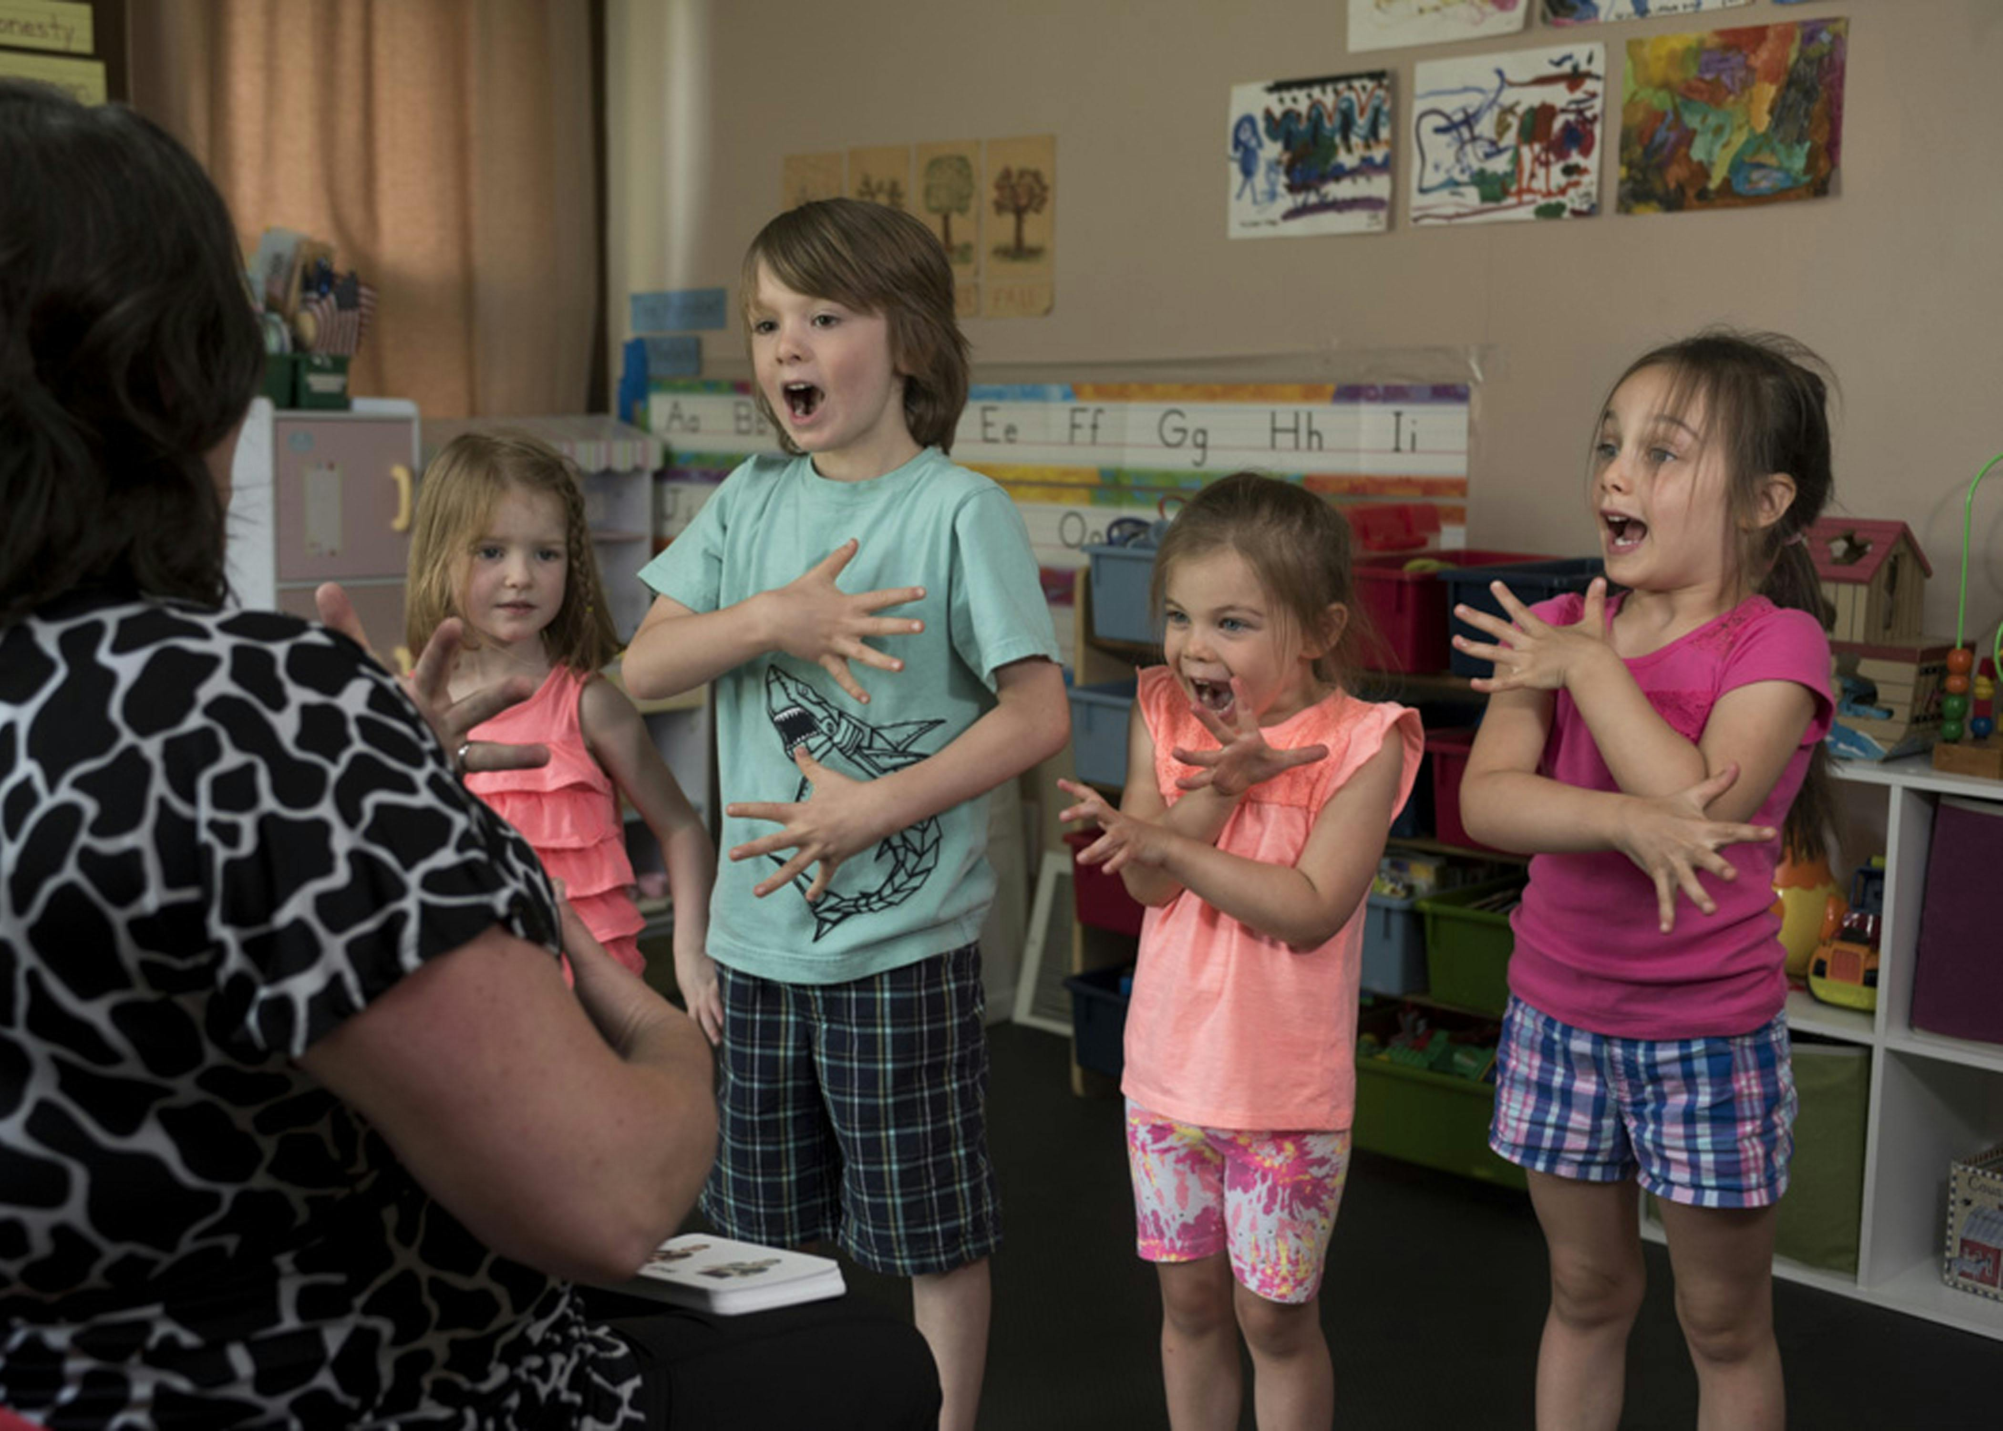
Guided Practice
Sentence Completion Activity
Complete the sentences with the correct form of 'going to'.
Usage Explanation Task
Identify and explain the correct usage of 'going to' in each sentence.
Collaborative Exercise
Work in pairs to complete the exercises and provide feedback to each other.
11
Mastering Future Plans and Goals with 'Going To'

Slide 12

Independent Practice
Essay Writing Task
Visual Representation Activity
Language Focus
Write a short essay about your future plans and goals using 'going to'.
Create a visual representation of your future plans and goals, such as a mind map or a diagram.
Use 'going to' to express your intentions and make predictions in the essay or visual representation.
12
Mastering Future Plans and Goals with 'Going To'

Slide 13

Role-Play Activity
Pair Activity
Using 'Going To'
Feedback and Encouragement
Divide into pairs and role-play a conversation about future plans and goals.
Use 'going to' to express your intentions and make predictions.
Encourage each other to use the correct form of 'going to' and provide feedback.
13
Mastering Future Plans and Goals with 'Going To'

Slide 14

Conclusion
Importance of 'Going to' in Language Learning
Mastering 'Going to' for Effective Communication
Practical Tips for Using 'Going to'
In conclusion, the concept of future plans and goals with 'going to' is a vital aspect of language learning.
By mastering this grammar structure, you can effectively express your intentions and make predictions.
Remember to practice using 'going to' in context and to create a personal plan for achieving your goals.
14
Mastering Future Plans and Goals with 'Going To'

Slide 15

Reflection Questions
Understanding Future Plans and Goals
What did you learn about the concept of future plans and goals with 'going to'?
Applying Knowledge in Daily Life
How can you apply this knowledge in your everyday life?
Expressing Intentions and Predictions
What are your future plans and goals, and how can you use 'going to' to express your intentions and make predictions?
15
Mastering Future Plans and Goals with 'Going To'

Slide 16

Next Steps
Practice Using 'Going To'
Continue to practice using 'going to' in context.
Personalized Learning Plan
Create a personalized learning plan to achieve your goals.
Express Intentions and Predictions
Use the language and grammar from this lesson to express your intentions and make predictions.
16
Mastering Future Plans and Goals with 'Going To'

Slide 17

Additional Resources
Online Grammar Guides
Language Learning Tools
Practice Exercises
Online grammar guides and resources.
Language learning apps and websites.
Practice exercises and quizzes to reinforce your learning.
17
Mastering Future Plans and Goals with 'Going To'

Slide 18

Final Thoughts
Language Learning Takes Time
Embrace Mistakes
Stay Motivated
Remember that learning a language takes time and practice.
Don't be afraid to make mistakes and ask for feedback.
Keep practicing and stay motivated to achieve your language learning goals.
18
Mastering Future Plans and Goals with 'Going To'

Slide 19

Assessment and Evaluation
Written Test Assessment
Role-Play Presentation
Learning Reflection
Complete a written test to assess your understanding of the concept of future plans and goals with 'going to'.
Participate in a role-play presentation to demonstrate your ability to use 'going to' in context.
Reflect on your learning and identify areas for improvement.
19
Mastering Future Plans and Goals with 'Going To'

Slide 20
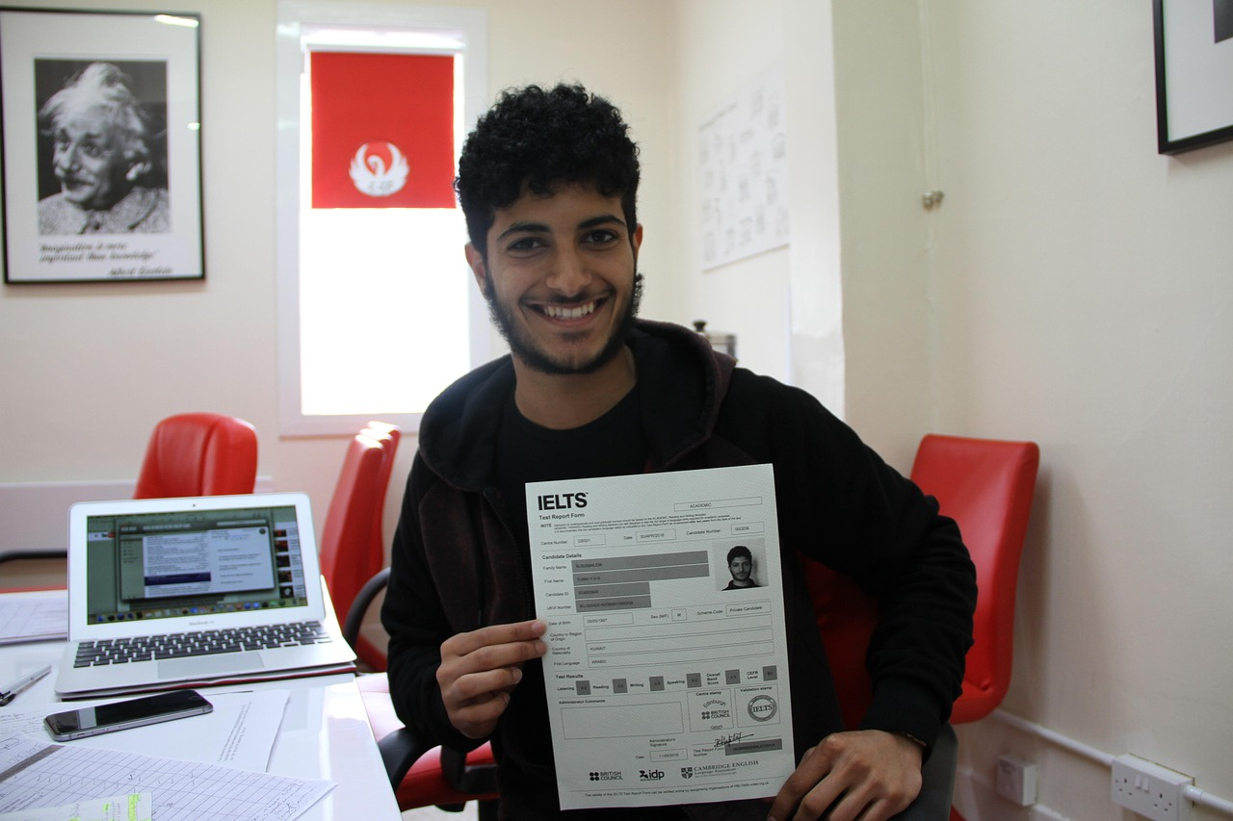
Conclusion and Final Thoughts
Essential Language and Skills
In conclusion, this lesson has provided you with the essential language and skills to express your future plans and goals with 'going to'.
Practice and Personal Planning
Remember to practice using 'going to' in context and to create a personal plan for achieving your goals.
Stay Motivated
Stay motivated and keep practicing to achieve your language learning goals.
20
Mastering Future Plans and Goals with 'Going To'

