Slide 1


Harnessing Physics for Effective Export Logistics
Exploring the Application of Newton's Laws in Real-World Export Scenarios

Slide 2
Table of Contents
Welcome to Export Requirements: Applying Physi…
Newton's Laws of Motion: A Quick Overview
Why Physics Matters in Export Logistics
Second Law of Motion: Force and Acceleration
Interactive Exercise: Calculating Force
Real-World Example: Cargo Ship Acceleration
Third Law of Motion: Action and Reaction
Interactive Exercise: Reaction Forces
Real-World Example: Airplane Cargo Loading
Packaging Design: Applying Both Laws
Interactive Challenge: Packaging Solutions
Optimizing Transportation: Force and Efficiency
Interactive Quiz: Physics in Logistics
04
05
06
07
08
09
10
11
12
13
14
15
16

Slide 3
Table of Contents
Case Study: Exporting Heavy Machinery
Physics and Sustainability in Exports
Interactive Brainstorm: Green Logistics
Key Takeaways: Second and Third Laws in Exports
Interactive Reflection: Applying Physics
Resources for Further Learning
Thank You and Next Steps
17
18
19
20
21
22
23

Slide 4

Welcome to Export Requirements: Applying Physics to Real Life
Introduction to the Presentation
Learning Objectives
Embarking on the Exploration
Welcome to your journey into understanding how the Second and Third Laws of Motion apply to real-world scenarios!
This presentation is designed to be interactive and beginner-friendly.
By the end, you'll have a solid grasp of how physics principles influence export processes and logistics.
This knowledge will empower you to see the connection between science and practical applications.
Let's dive into the fascinating world where science meets practicality!
Prepare to explore the intersection of physics and real-life scenarios.
4
Harnessing Physics for Effective Export Logistics

Slide 5
Newton's Laws of Motion: A Quick Overview
1
2
3
Introduction to Newton's Laws
Newton's First Law
Newton's Second and Third Laws
Newton's Laws of Motion are fundamental principles in classical mechanics.
They describe the relationship between the motion of an object and the forces acting upon it.
The First Law states that an object remains at rest or in uniform motion unless acted upon by an external force.
This principle is also known as the law of inertia.
The Second Law establishes that force equals mass times acceleration (F = ma).
The Third Law asserts that for every action, there is an equal and opposite reaction.
5
Harnessing Physics for Effective Export Logistics

Slide 6

Why Physics Matters in Export Logistics
The Role of Physics in Transportation
Packaging and Motion Impact
Efficiency in Export Operations
Export logistics involves the movement of goods, where forces act on vehicles and cargo.
Understanding these forces ensures the safe and efficient transportation of goods.
Proper packaging is crucial to protect goods from motion and impact during transit.
Physics principles guide the design of packaging to withstand these challenges.
Optimizing acceleration and minimizing resistance are key to cost-effective logistics.
Physics helps in achieving efficient and reliable export processes.
6
Harnessing Physics for Effective Export Logistics

Slide 7

Second Law of Motion: Force and Acceleration
Understanding the Formula
Application in Heavy Cargo Movement
The Second Law of Motion is expressed as F = ma, where Force equals Mass times Acceleration.
This formula is fundamental in analyzing how force impacts the movement of objects.
In exports, the Second Law is crucial for moving heavy cargo efficiently.
It helps determine the force required to transport goods safely.
Optimizing Transportation Forces
Enhancing Logistics Through Physics
Calculating the necessary force for transportation ensures safety and efficiency.
This application is vital for logistics and operational planning.
Understanding the Second Law of Motion aids in optimizing logistics processes.
It provides insights into adjusting acceleration for better safety and efficiency.
7
Harnessing Physics for Effective Export Logistics

Slide 8

Interactive Exercise: Calculating Force
20,000 N
Force Required for the Truck
A truck carrying 10,000 kg of goods accelerates at 2 m/s², requiring a force of 20,000 N according to the Second Law of Motion.
8
Harnessing Physics for Effective Export Logistics

Slide 9

Real-World Example: Cargo Ship Acceleration
Cargo Ships and Their Role in Global Trade
Massive Scale of Cargo Ships
Cargo ships are essential for transporting goods across oceans.
They play a crucial role in maintaining the flow of international commerce.
A typical cargo ship weighs millions of kilograms.
This immense mass requires careful engineering to ensure stability and efficiency.
Acceleration and Force in Maritime Engineering
Optimizing Fuel Efficiency Through Physics
Even small changes in a cargo ship's speed demand significant force.
Engineers apply principles of physics to manage these challenges effectively.
Engineers use the Second Law of Motion to design efficient engines.
This optimization ensures smooth sailing and reduces operational costs.
9
Harnessing Physics for Effective Export Logistics

Slide 10
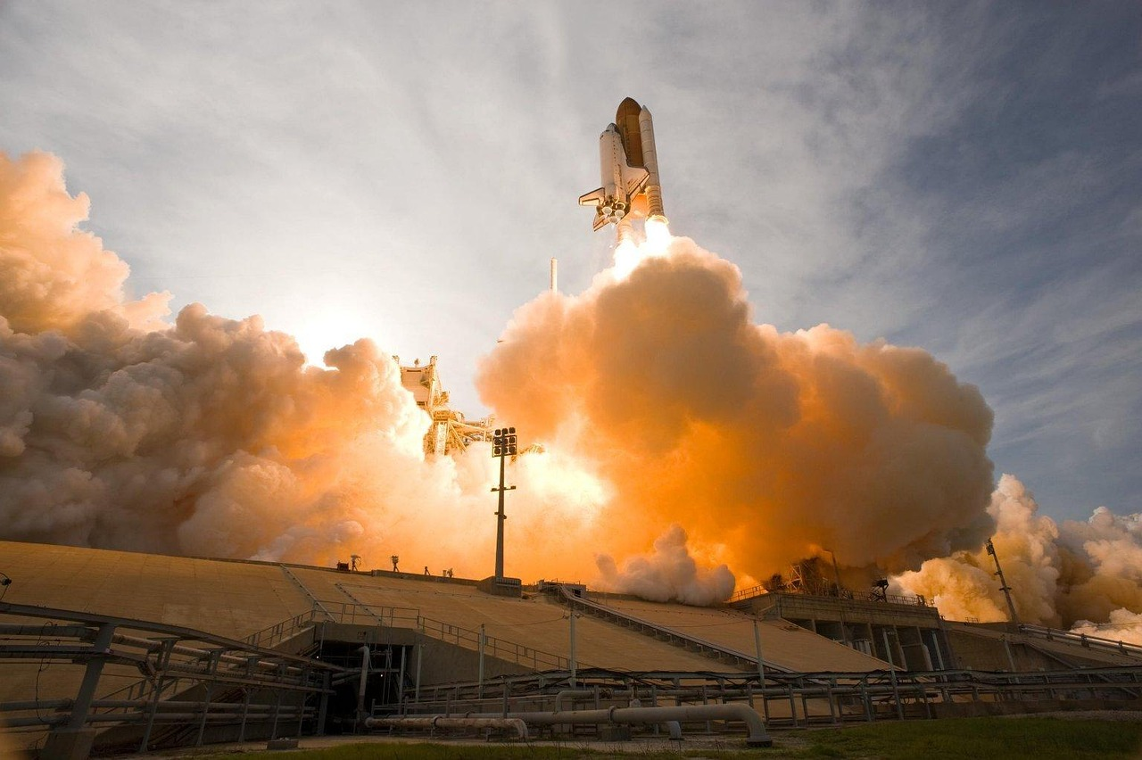
Third Law of Motion: Action and Reaction
01
Understanding the Principle
The Third Law of Motion states: For every action, there is an equal and opposite reaction.
This principle governs the interactions between objects in various scenarios.
02
Application in Packaging
In exports, packaging is designed to absorb impacts during transit.
This ensures the safety and integrity of the goods being transported.
03
Balancing Forces in Operations
During loading and unloading, forces are balanced to prevent accidents.
This application of the Third Law ensures operational safety.
04
Vehicle Design Considerations
Vehicles are designed to counteract road resistance effectively.
This ensures stability and efficiency during transportation.
10
Harnessing Physics for Effective Export Logistics

Slide 11

Interactive Exercise: Reaction Forces
4,900 N
Reaction Force Exerted by the Ground
The ground exerts a reaction force of 4,900 N on the forklift when lifting a 500 kg crate.
11
Harnessing Physics for Effective Export Logistics

Slide 12
Real-World Example: Airplane Cargo Loading
1
2
3
Understanding the Action
Reaction Forces in Play
Engineering for Safety
Airplanes rely on the Third Law during cargo loading.
Cargo weight presses down on the plane.
The plane’s structure pushes back with equal force.
This reaction ensures the plane can handle the cargo safely.
Engineers design planes to distribute forces evenly.
This design ensures safety and balance during air freight operations.
12
Harnessing Physics for Effective Export Logistics

Slide 13
Packaging Design: Applying Both Laws
Second Law: Material Durability
Third Law: Impact Absorption
Effective packaging utilizes the Second Law to ensure materials can withstand forces during acceleration and deceleration.
This principle is crucial for maintaining the integrity of the package contents during movement.
Materials are selected based on their ability to resist deformation under dynamic conditions.
Examples include reinforced containers designed to handle heavy goods without compromising structural integrity.
The Third Law is applied in packaging to absorb impact forces encountered during transit.
This ensures that the contents remain protected from shocks and vibrations.
Shock-absorbing materials are commonly used to mitigate the effects of sudden impacts.
These materials are essential for safeguarding fragile items during transportation.
13
Harnessing Physics for Effective Export Logistics

Slide 14

Interactive Challenge: Packaging Solutions
1
Scenario Overview
You’re exporting fragile glassware.
Consider the challenges in designing packaging to ensure safe transit.
2
Design Considerations
Focus on minimizing acceleration forces and absorbing impact during transit.
These factors are crucial to protect fragile items effectively.
3
Practical Tips
Utilize cushioning materials and secure items to prevent movement.
Collaborate and share ideas with others for constructive feedback.
14
Harnessing Physics for Effective Export Logistics

Slide 15

Optimizing Transportation: Force and Efficiency
01
Physics in Transportation
Physics principles are integral to enhancing transportation systems.
They provide insights into force and efficiency for vehicle design.
02
Second Law of Motion
The Second Law helps calculate the force required for efficient acceleration.
This ensures vehicles achieve optimal performance during motion.
03
Third Law of Motion
The Third Law aids in designing vehicles to counteract road resistance.
This improves stability and reduces energy loss during travel.
04
Examples of Optimization
Aerodynamic trucks are designed to reduce drag and improve fuel efficiency.
Electric engines are engineered to optimize force output for sustainable transportation.
15
Harnessing Physics for Effective Export Logistics

Slide 16

Interactive Quiz: Physics in Logistics
Interactive Quiz: Physics in Logistics
Test your knowledge!
Which law explains why a truck’s tires push back against the road?
16
Harnessing Physics for Effective Export Logistics
/

Slide 17
Case Study: Exporting Heavy Machinery
1
2
3
Understanding the Physics
Impact Absorption Design
Collaborative Efforts
Exporting heavy machinery involves complex physics.
Engineers apply principles such as the Second Law to calculate forces for cranes and trucks.
The Third Law is utilized to design packaging that absorbs impact during transit.
This ensures the machinery remains intact and functional upon delivery.
Engineers and logistics experts work together to ensure safe delivery.
Their collaboration addresses both technical and logistical challenges effectively.
17
Harnessing Physics for Effective Export Logistics

Slide 18

Physics and Sustainability in Exports
1
Optimizing Fuel Consumption
Applying the Second Law of Physics can help optimize acceleration.
This optimization leads to reduced fuel consumption in export logistics.
2
Reusable Packaging Design
The Third Law of Physics suggests designing reusable packaging.
Such packaging can absorb impact, enhancing sustainability in exports.
3
Benefits of Sustainable Practices
Sustainable practices in exports benefit both businesses and the planet.
These practices align with eco-friendly goals and improve operational efficiency.
18
Harnessing Physics for Effective Export Logistics

Slide 19

Interactive Brainstorm: Green Logistics
Physics Principles in Sustainable Exports
Energy-Efficient Transportation Systems
Explore how physics principles can enhance sustainability in export logistics.
Consider the use of lightweight materials to reduce force requirements and energy consumption.
Discuss the design of transportation systems that prioritize energy efficiency.
Engage with peers to share ideas and develop innovative solutions.
19
Harnessing Physics for Effective Export Logistics

Slide 20
Key Takeaways: Second and Third Laws in Exports
Second Law: Force and Acceleration
Third Law: Action and Reaction
Physics in Logistics and Packaging
Sustainability in Export Operations
The Second Law of Motion states that force impacts acceleration, which is crucial for transportation.
This principle is applied in export operations to optimize the movement of goods.
The Third Law of Motion highlights that action-reaction forces ensure stability and safety.
Export operations leverage this principle to maintain secure handling and transport of goods.
Physics principles are utilized to optimize logistics and packaging in export operations.
These applications enhance efficiency and reduce costs in the transportation process.
Understanding physical laws contributes to sustainable practices in export operations.
This includes reducing environmental impact through improved packaging and transportation methods.
20
Harnessing Physics for Effective Export Logistics

Slide 21

Interactive Reflection: Applying Physics
1
2
3
Exploring Newton's Laws in Daily Activities
Identifying Physics in Surroundings
Sharing Observations and Insights
Consider how Newton's Second Law, F=ma, explains the effort required to move objects of different masses.
Reflect on how Newton's Third Law, action and reaction, is evident when driving a car and interacting with the road.
Observe examples of Newton's Laws in your environment, such as the motion of objects when pushed or pulled.
Think about how forces interact in everyday scenarios, like opening a door or playing sports.
Discuss your reflections on how physics principles manifest in daily life tasks.
Share examples and insights with others to deepen understanding of these fundamental laws.
21
Harnessing Physics for Effective Export Logistics

Slide 22

Resources for Further Learning
Books for Physics Enthusiasts
Video Tutorials on Newton's Laws
Courses in Logistics and Supply Chain Management
Explore the book 'Physics for Engineers' by Paul Tipler.
This resource provides comprehensive insights into physics concepts tailored for engineering applications.
Discover online tutorials focusing on Newton's Laws of Motion.
These videos offer practical demonstrations and explanations to enhance understanding.
Enroll in programs dedicated to logistics and supply chain management.
These courses integrate physics principles into real-world logistical challenges.
22
Harnessing Physics for Effective Export Logistics

Slide 23
Thank You and Next Steps
Review Interactive Exercises
Apply Knowledge to Real-World Scenarios
Embark on Your Journey
Congratulations on completing this introduction!
Review the interactive exercises and case studies.
Apply what you’ve learned to real-world scenarios.
Stay curious and keep exploring the intersection of physics and exports!
Thank you for joining us—your journey has just begun!
Stay curious and keep exploring the intersection of physics and exports!
23
Harnessing Physics for Effective Export Logistics

