Slide 1
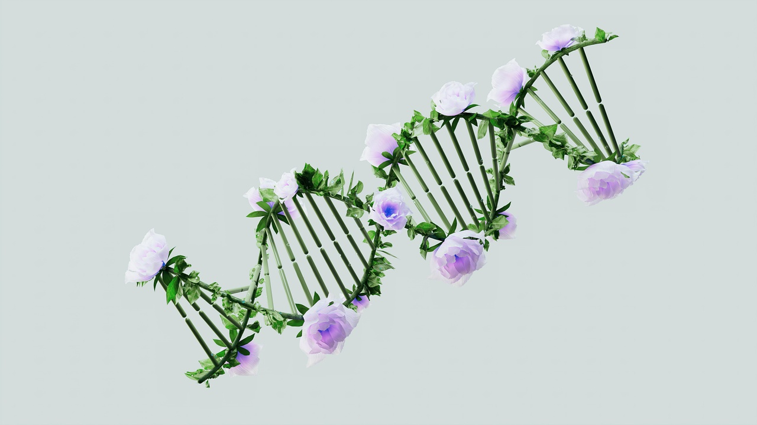
Exploring Genetic Diversity
A Journey Through Gametes, Meiosis, Recombination, Fertilization, Inheritance, and Ethical Considerations

Slide 2
Table of contents
01
02
03
04
05
06
07
08
09
10
11
Title Slide: Genetic Diversity Unveiled
What Are Gametes?
Meiosis - The Genetic Shuffling Process
Genetic Recombination Mechanics
Fertilization - Creating Genetic Uniqueness
Genetic Variation Sources
Probability of Genetic Combinations
Inheritance Patterns
Real-World Genetic Diversity
Technological Applications
Ethical Considerations

Slide 3
Table of contents
12
13
14
15
16
17
18
19
20
Conclusion: The Miracle of Genetic Diversity
Q&A and Further Exploration
Why We're All Different
Genetic Combination Mathematics
How Traits Are Passed Down
Genetic Variation in Action
Genetics in Modern Science
Genetic Research Ethics
The Moment of Genetic Fusion

Slide 4
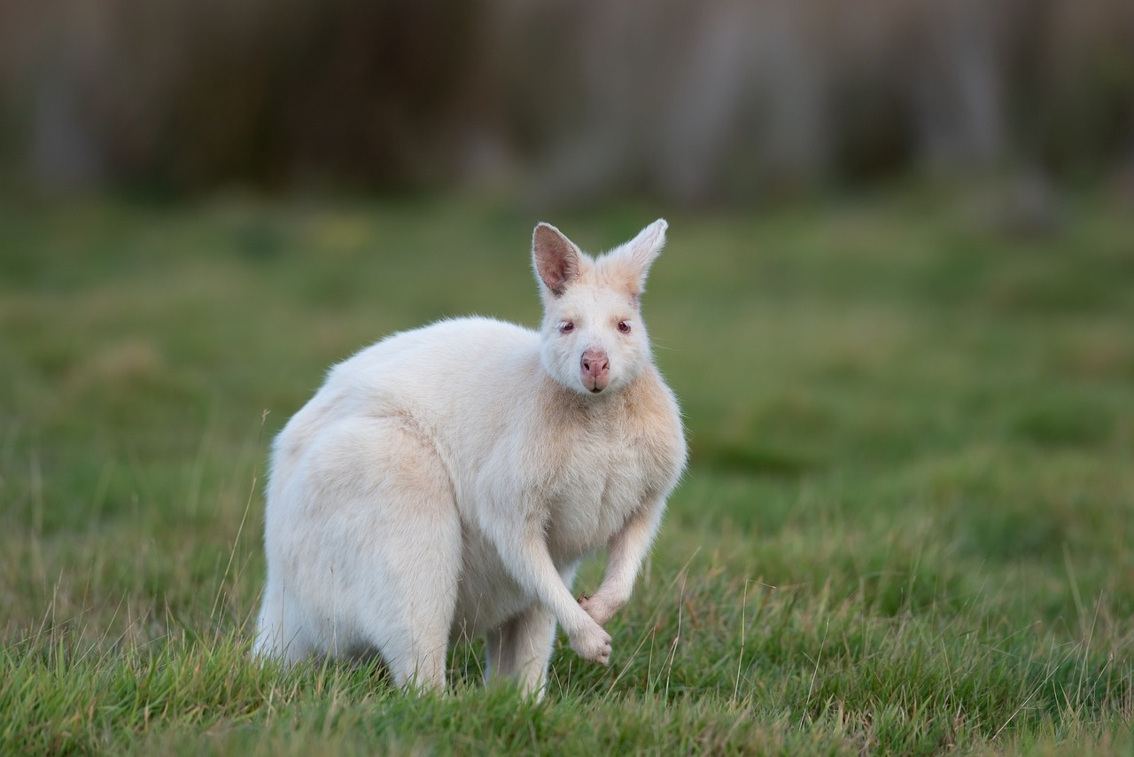
1
Title Slide: Genetic Diversity Unveiled
Genetic Diversity Unveiled: Exploring Gamete Formation and Fertilization
A Journey into Cellular Reproduction for Young Scientists
Exploring Genetic Diversity

Slide 5
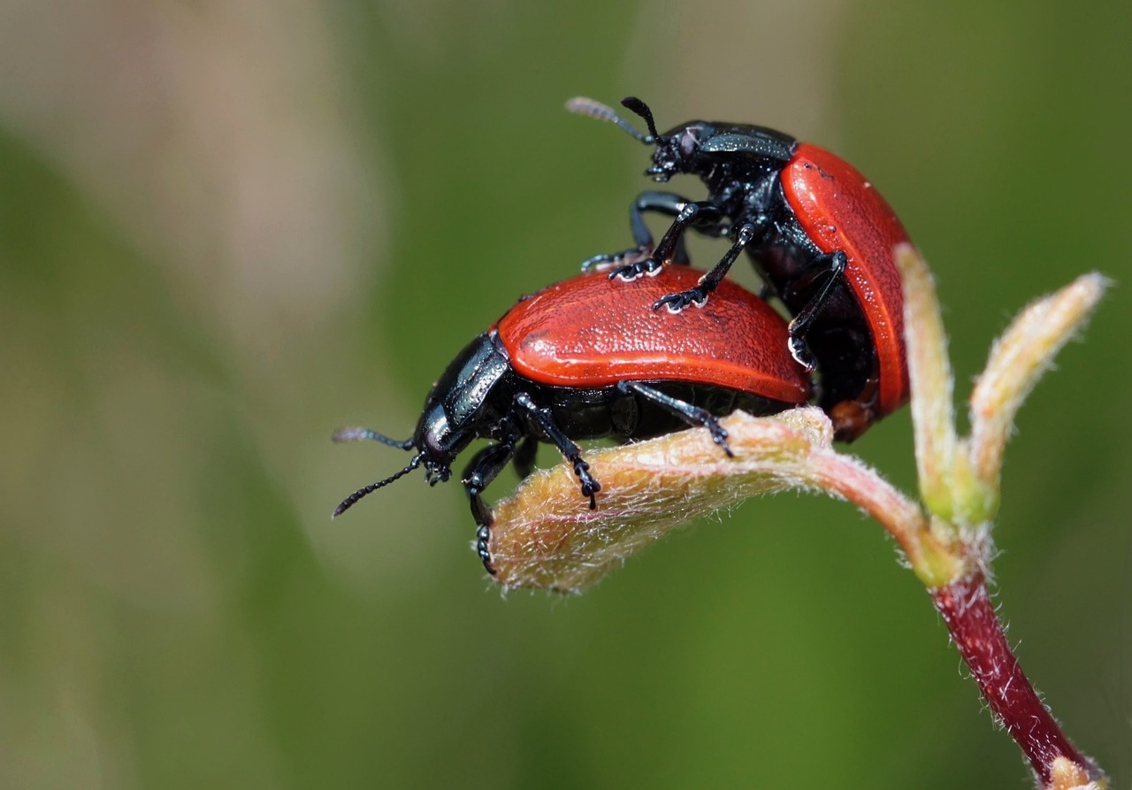
2
What Are Gametes?
01
What Are Gametes?
02
Key Points
Specialized reproductive cells containing half genetic material
Male gamete: Sperm cell
Female gamete: Egg cell
Contains 23 chromosomes in humans
Exploring Genetic Diversity

Slide 6
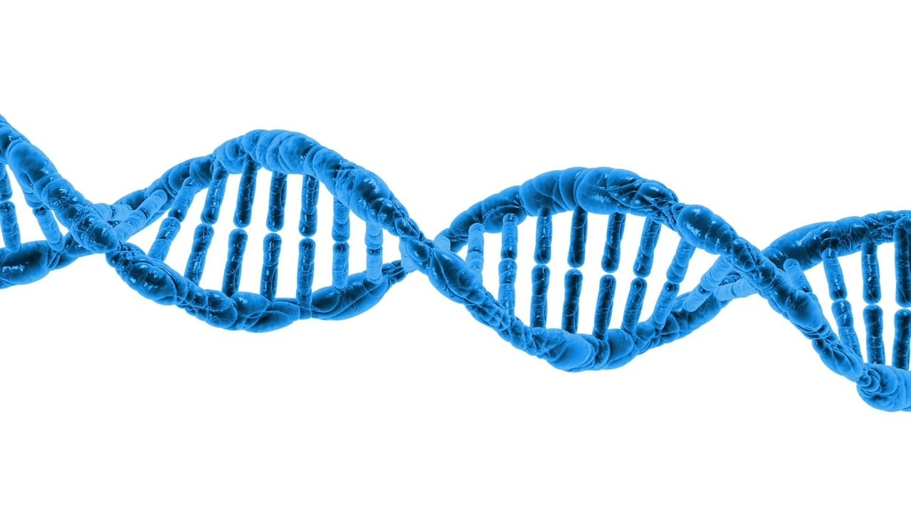
3
Meiosis - The Genetic Shuffling Process
Understanding Meiosis
Chromosome replication
Genetic material exchange
Chromosome separation
Exploring Genetic Diversity

Slide 7
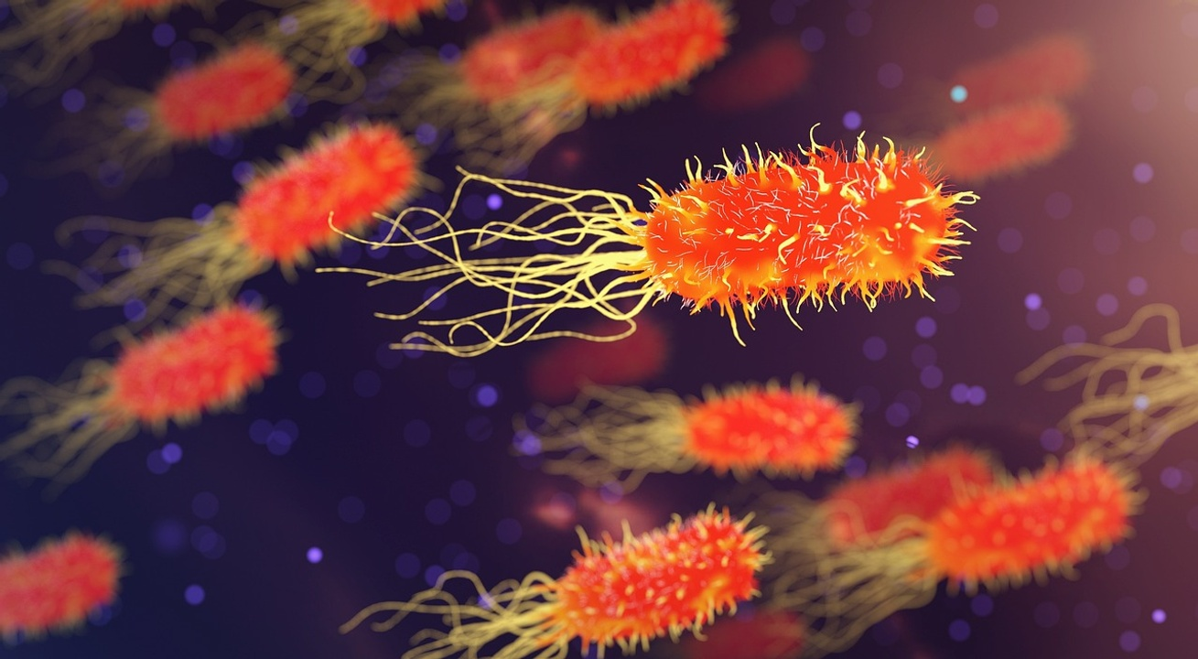
4
Genetic Recombination Mechanics
01
Chromosome Crossing Over
02
Random Genetic Material Distribution
Process where homologous chromosomes exchange genetic material
Increases genetic diversity by creating new combinations of genes
During meiosis, chromosomes align randomly, leading to varied genetic combinations
Results in unique offspring with diverse traits
03
Creating Unique Genetic Combinations
Fusion of genetic material from two parents
Generates offspring with distinct genetic profiles
Exploring Genetic Diversity

Slide 8
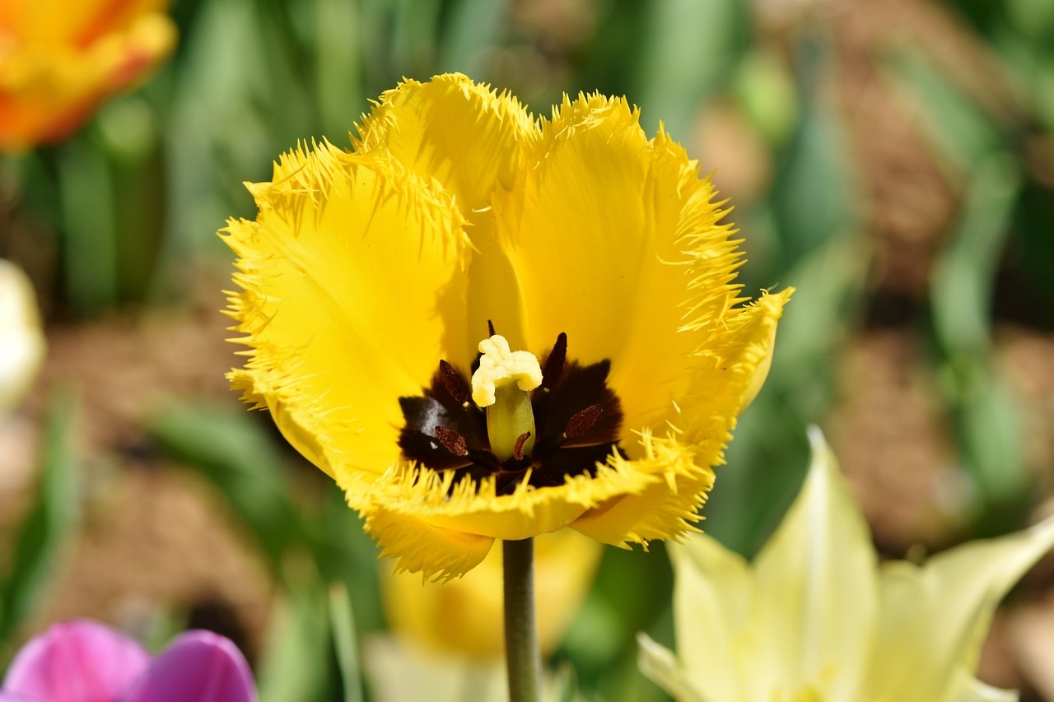
5
Fertilization - Creating Genetic Uniqueness
01
Fertilization - Creating Genetic Uniqueness
02
46 chromosomes formed
Sperm and egg cell combination
Fusion of male and female gametes
Combination of 23 chromosomes from each parent
03
Unique genetic blueprint created
Resulting in a genetically distinct individual
Exploring Genetic Diversity

Slide 9
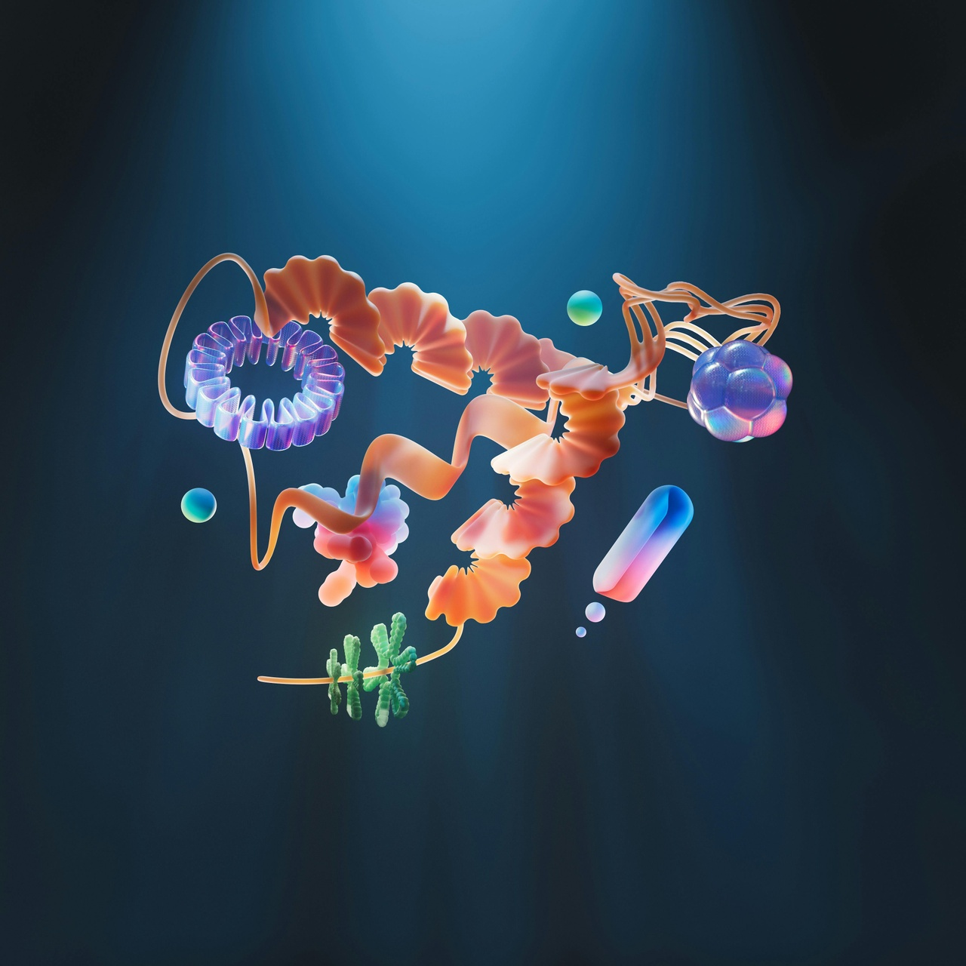
6
Genetic Variation Sources
01
Random Chromosome Assortment
02
Genetic Crossing Over
Chromosomes randomly distributed during gamete formation
Leads to unique combinations of genetic material
Exchange of genetic material between homologous chromosomes
Increases genetic diversity within offspring
03
Mutation Potential
Spontaneous changes in DNA sequence
Introduces new genetic variations into populations
Exploring Genetic Diversity

Slide 10
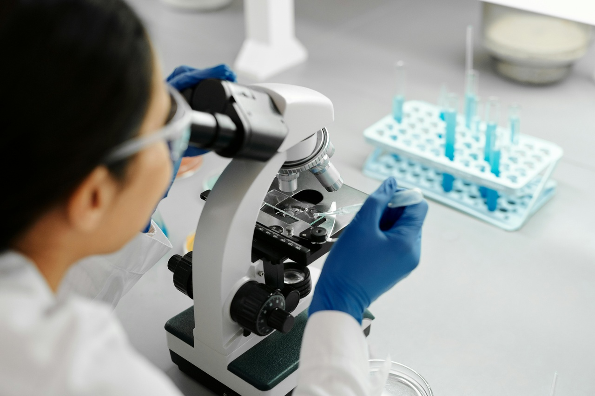
7
Probability of Genetic Combinations
8M
Exponential
Genetic Combinations
Variation Potential
Approximately 8 million possible genetic combinations
Approximately 8 million possible genetic combinations
Exploring Genetic Diversity

Slide 11
8
Inheritance Patterns
Dominant-recessive inheritance
Codominance
One allele masks the expression of another
Dominant allele represented by uppercase letter (e.g., A)
Recessive allele represented by lowercase letter (e.g., a)
Both alleles are expressed in the phenotype
Example: Blood type AB where A and B alleles are both expressed
Exploring Genetic Diversity

Slide 12
9
Real-World Genetic Diversity
01
Population Genetics Studies
02
Medical Genetics Applications
03
Forensic Genetics
Analyzing genetic variations within and between populations
Understanding evolutionary processes and adaptation
Genetic testing for hereditary diseases
Personalized medicine based on genetic profiles
DNA profiling for criminal investigations
Identification of individuals through genetic markers
04
Agricultural Genetics
05
Conservation Genetics
Breeding programs for crop improvement
Preservation of genetic diversity in livestock
Studying genetic diversity in endangered species
Implementing strategies for biodiversity conservation
Exploring Genetic Diversity

Slide 13

10
Technological Applications
01
Genetic Screening
02
Reproductive Technologies
Utilized for identifying genetic disorders or predispositions.
Enables early detection and intervention for hereditary conditions.
Assists in assisted reproductive procedures like IVF.
Enhances fertility treatments and family planning options.
03
Medical Research
Supports advancements in personalized medicine.
Contributes to understanding genetic diseases and developing targeted therapies.
Exploring Genetic Diversity

Slide 14

11
Ethical Considerations
01
Genetic Privacy
02
Potential Medical Applications
Importance of safeguarding individuals' genetic information
Risks of unauthorized access and misuse of genetic data
Ethical dilemmas in genetic testing for disease predisposition
Balancing benefits of early detection with psychological impacts
03
Societal Implications
Addressing disparities in access to genetic technologies
Ethical considerations in genetic enhancement and designer babies
Exploring Genetic Diversity

Slide 15
12
Conclusion: The Miracle of Genetic Diversity
Conclusion: The Miracle of Genetic Diversity
Uniqueness of Genetic Inheritance
Ongoing Scientific Exploration
Complexity of Cellular Reproduction
Each individual inherits a distinct genetic blueprint
Constant discovery of new genetic variations
Exploring Genetic Diversity

Slide 16

13
Q&A and Further Exploration
01
Suggested Resources
02
Additional Learning Opportunities
Online genetic diversity databases
Scientific journals on genetic variation
Educational websites on meiosis and fertilization
Virtual lab simulations on meiosis
Genetics workshops and seminars
Genetic diversity research projects
03
Contact Information
04
Provocative closing question about genetic potential
Email: genetics@researchinstitute.com
Phone: +1-XXX-XXX-XXXX
Website: www.geneticexploration.com
How can understanding genetic diversity shape the future of healthcare and biodiversity conservation?
Exploring Genetic Diversity

Slide 17
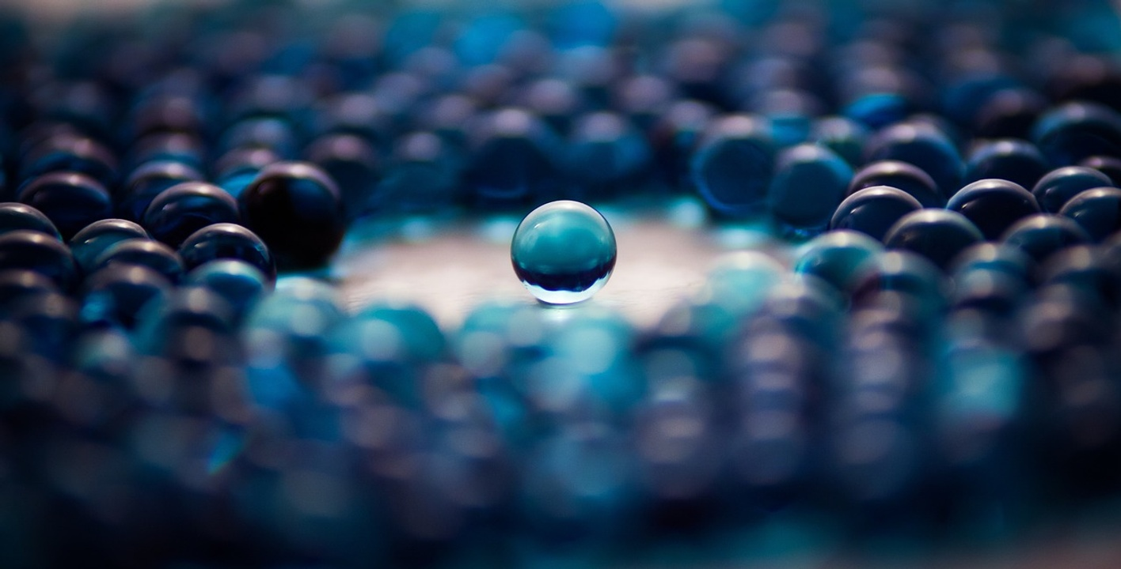
14
Why We're All Different
Why We're All Different
Random Chromosome Assortment
Genetic Crossing Over
Mutation Potential
Exploring Genetic Diversity

Slide 18
15
Genetic Combination Mathematics
23
2^23
8 million
Each human gamete carries 23 chromosomes.
The number of possible genetic combinations can be calculated using the formula 2^n, where n is the number of chromosome pairs.
For humans, this results in approximately 8 million unique genetic combinations.
Exploring Genetic Diversity

Slide 19
16
How Traits Are Passed Down
Dominant-Recessive Inheritance
Codominance
Dominant traits mask recessive traits
Example: Brown eyes (dominant) vs. blue eyes (recessive)
Both alleles contribute to the phenotype
Example: Blood type AB (A and B alleles expressed)
Exploring Genetic Diversity

Slide 20
17
Genetic Variation in Action
Sibling Differences
Trait Inheritance Patterns
Siblings inherit different combinations of genes from their parents, leading to variations in physical traits and characteristics.
Traits such as eye color, height, and blood type are inherited through genetic variations passed down from parents to offspring.
Exploring Genetic Diversity

Slide 21
18
Genetics in Modern Science
01
Advancements in Genetic Sequencing
02
CRISPR-Cas9 Gene Editing
03
Genomic Data Analysis
Next-generation sequencing technologies
Precision medicine applications
Targeted genetic modifications
Potential for treating genetic disorders
Big data analytics in genetics
Identifying disease risk factors
04
Gene Therapy Innovations
05
Ethical Considerations in Genetic Research
Viral vector delivery systems
Correcting genetic mutations
Informed consent and privacy concerns
Equity in access to genetic technologies
Exploring Genetic Diversity

Slide 22
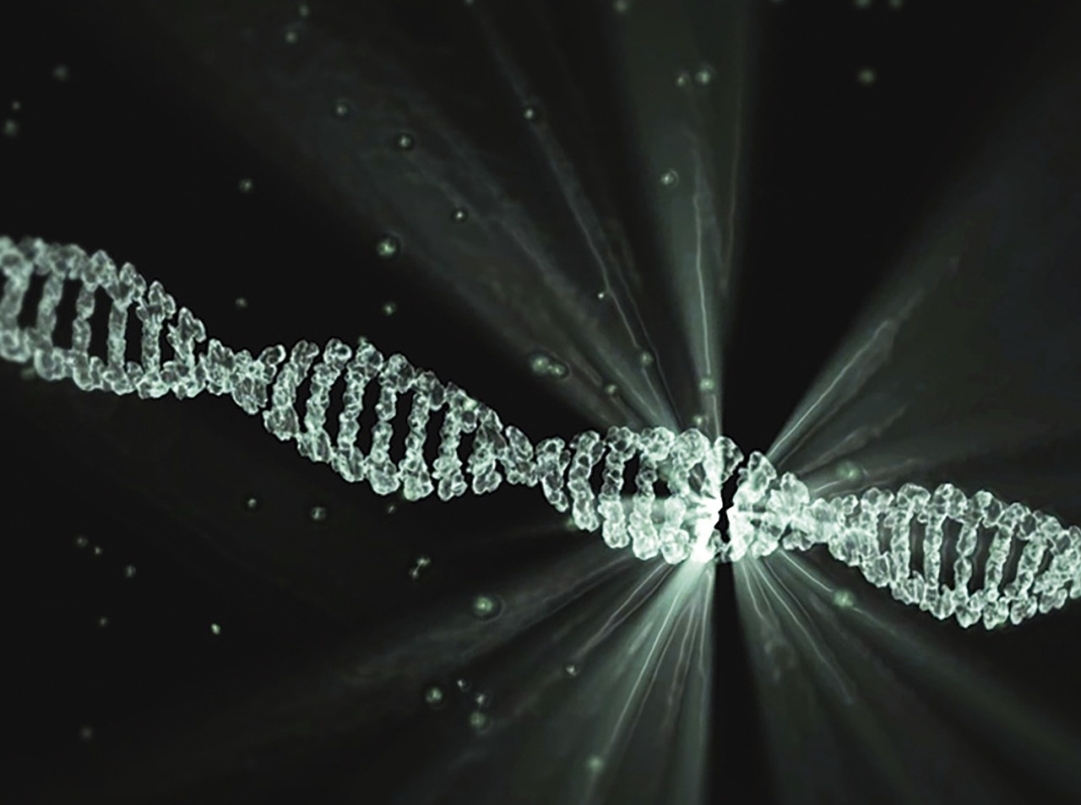
19
Genetic Research Ethics
01
Informed Consent
02
Confidentiality
Ensuring participants understand risks and benefits
Respecting autonomy and decision-making
Safeguarding genetic information
Protecting privacy of individuals and families
03
Beneficence
04
Justice
Maximizing benefits and minimizing harm
Considering well-being of research subjects
Fair distribution of research benefits and burdens
Avoiding exploitation and discrimination
Exploring Genetic Diversity

Slide 23
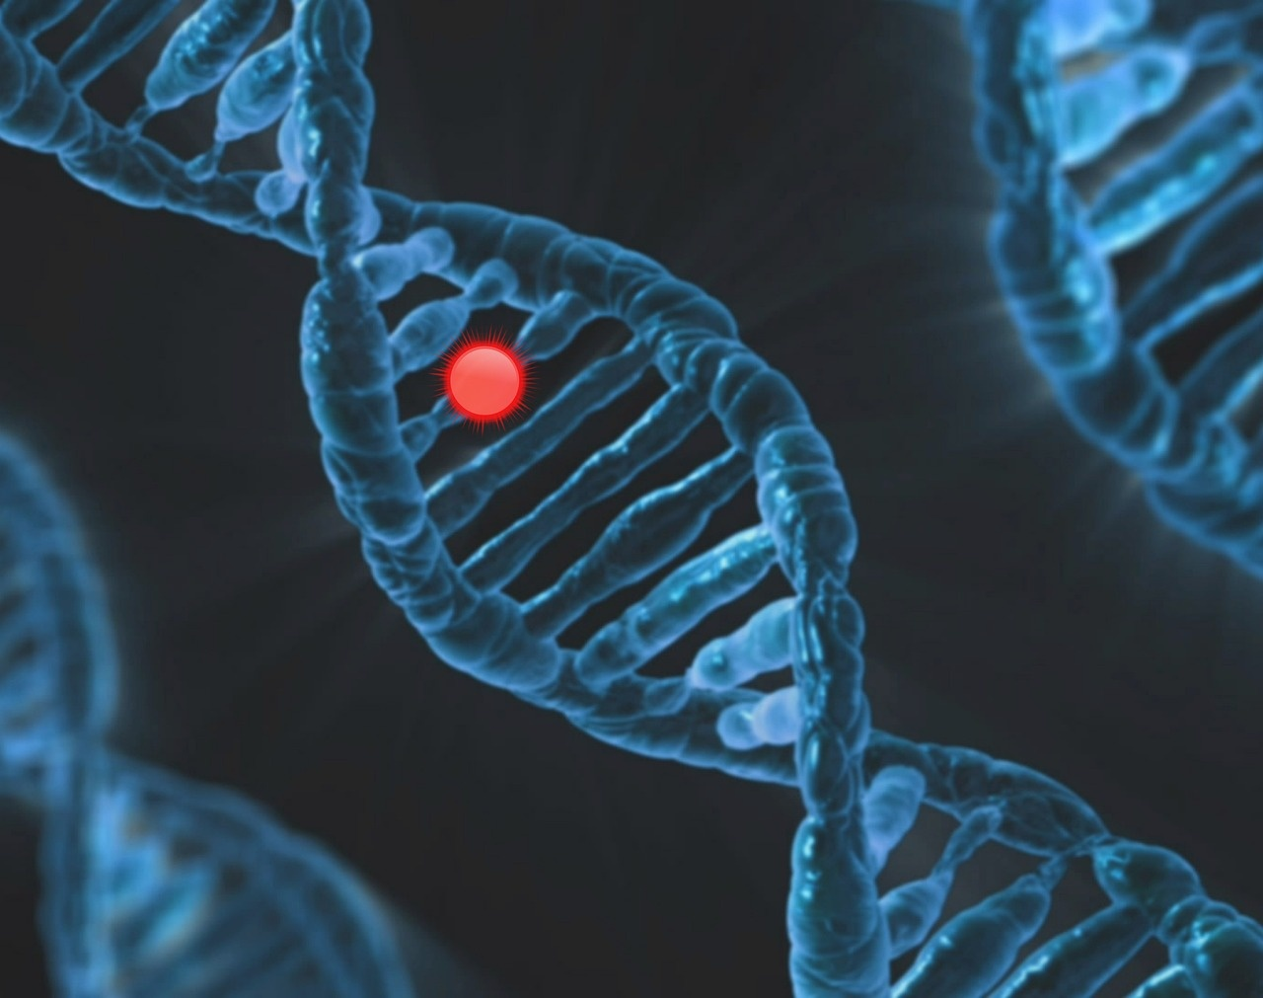
20
The Moment of Genetic Fusion
46
Chromosomes Formed
Unique genetic blueprint created
Exploring Genetic Diversity

