Slide 1
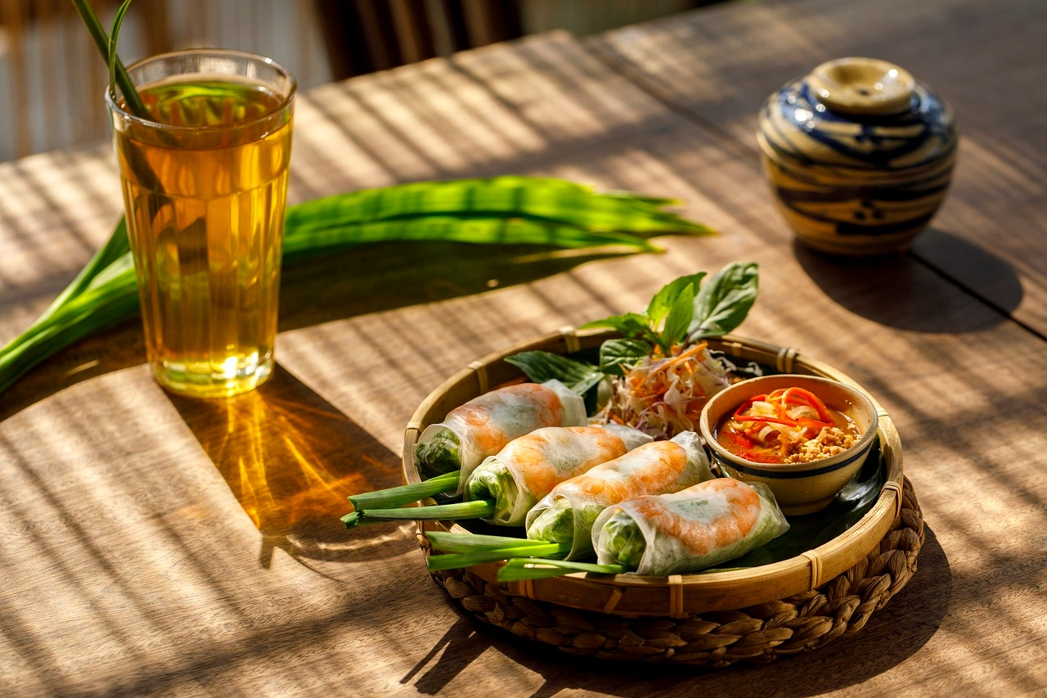
Exploring Culinary Anthropology
A Journey Through Food, Culture, and Identity

Slide 2
Table of contents
01
02
03
04
05
06
07
08
09
10
11
Lesson Overview
What is Culinary Anthropology?
Food as Cultural Identity
Global Culinary Migration
Psychological Significance of Food
Case Studies in Culinary Culture
Common Misconceptions
Interactive Learning Approaches
Technology and Culinary Exploration
Assessment and Reflection
Key Takeaways

Slide 3
Table of contents
12
13
14
15
Conclusion
Design Recommendations
Technical Notes
Export Requirements

Slide 4

1
Lesson Overview
Key Objectives
Understand food as a cultural communication system
Explore how cuisine reflects societal narratives
Develop cross-cultural empathy and understanding
Exploring Culinary Anthropology

Slide 5
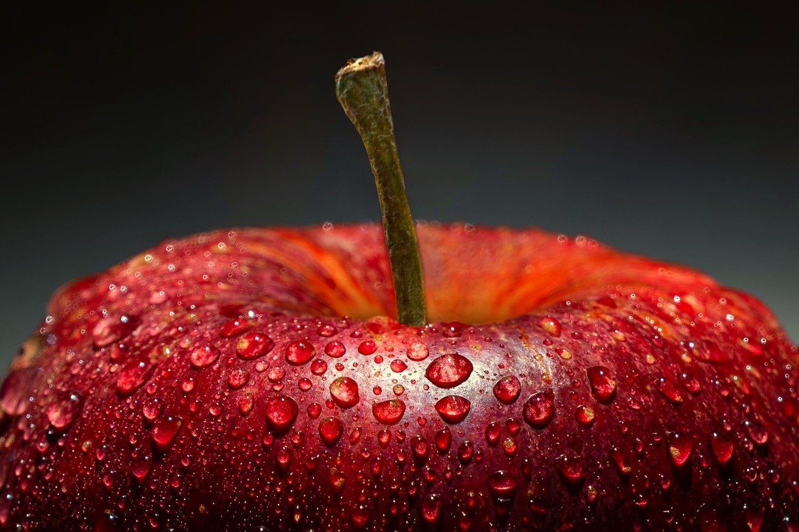
2
What is Culinary Anthropology?
01
Definition
02
Key Concepts
The scientific study of food's cultural significance
Food as more than nutrition
Cuisine as a living cultural narrative
Ingredients tell stories of migration and history
Exploring Culinary Anthropology

Slide 6
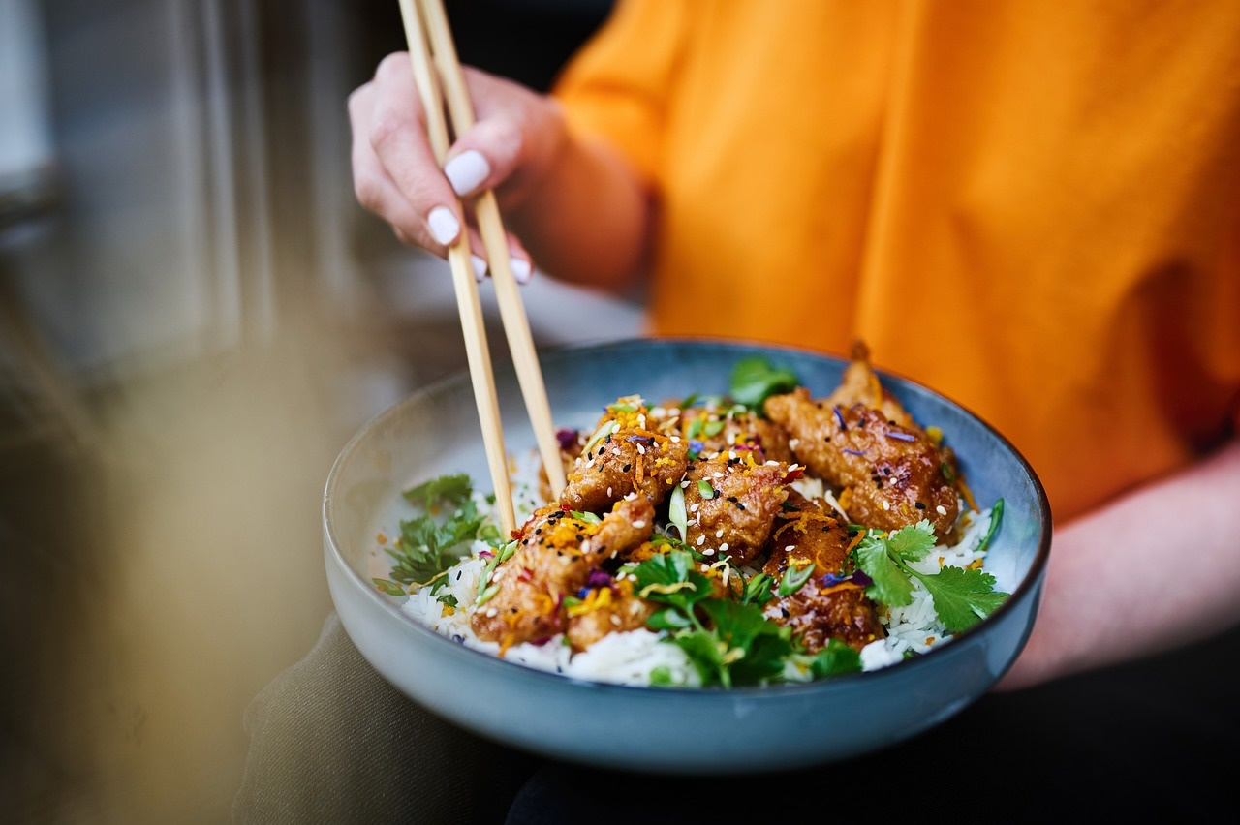
3
Food as Cultural Identity
01
Food represents collective memory
02
Cooking techniques reveal cultural values
03
Meal structures communicate social hierarchies
Exploring Culinary Anthropology

Slide 7
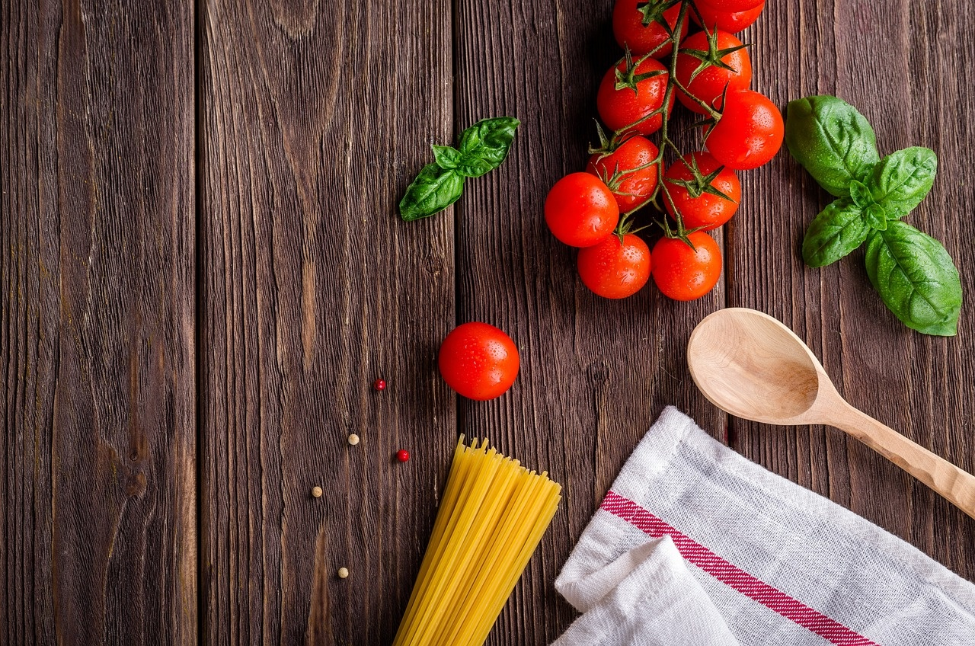
4
Global Culinary Migration
01
Spice routes
02
Colonial food exchanges
03
Cultural fusion through cuisine
Exploring Culinary Anthropology

Slide 8
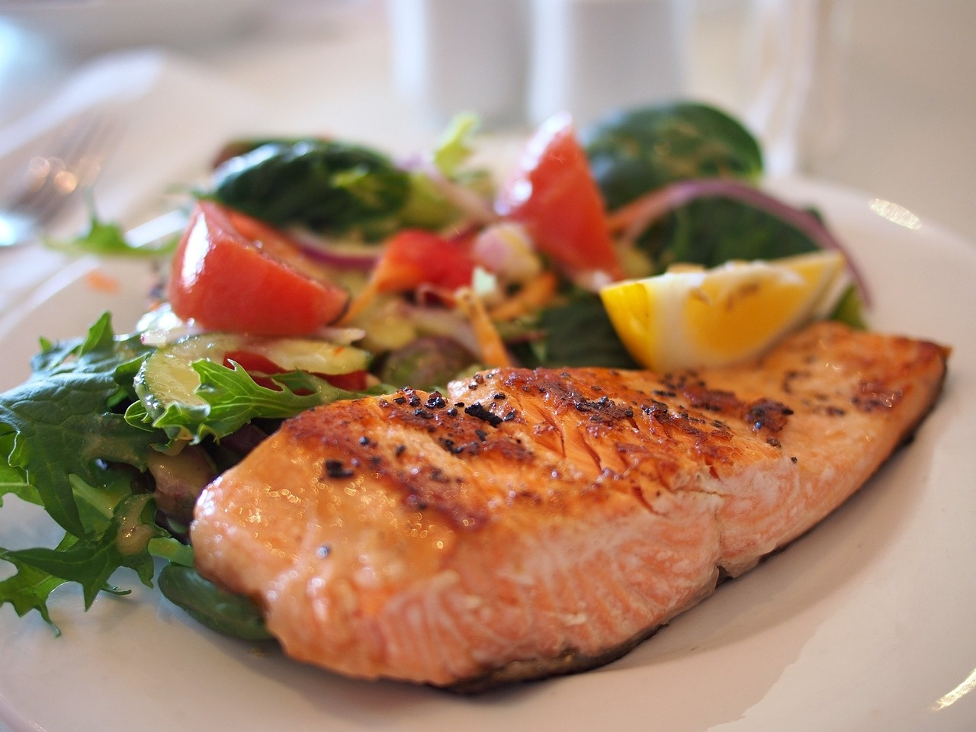
5
Psychological Significance of Food
Psychological Significance of Food - Emotional Connections
Food as memory preservation
Culinary traditions and family bonds
Comfort and cultural belonging
Exploring Culinary Anthropology

Slide 9

6
Case Studies in Culinary Culture
01
Japanese Washoku
02
Mexican Corn Cultivation
Precision and Harmony
Historical Narrative
03
Indian Spice Blending
04
Nordic Foraging
Social Mapping
Ecological Understanding
Exploring Culinary Anthropology

Slide 10
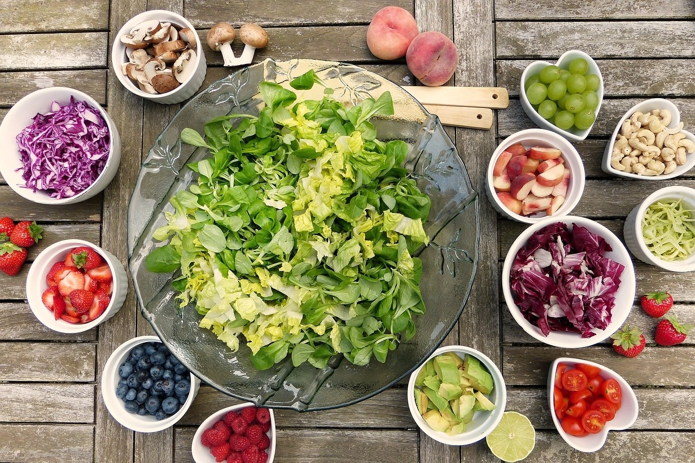
7
Common Misconceptions
01
Myth: Food is just nutrition
02
Myth: Culinary traditions are static
Reality: Food is a complex cultural language
Reality: Cuisines continuously evolve
Exploring Culinary Anthropology

Slide 11

8
Interactive Learning Approaches
01
Cultural Food Mapping
02
Sensory Exploration
Students explore different cultures through their cuisines.
Mapping out traditional dishes from various regions.
Understanding the historical and cultural significance of these dishes.
Engaging students' senses to explore different foods.
Tasting sessions to identify flavors and ingredients.
Using sensory experiences to learn about food textures and aromas.
03
Comparative Culinary Analysis
04
Personal Heritage Projects
Comparing and contrasting dishes from different cultures.
Analyzing the ingredients, cooking methods, and presentation styles.
Understanding the similarities and differences in culinary traditions.
Students research and present their own cultural food heritage.
Sharing family recipes and stories behind them.
Creating a personal connection to the subject matter through food.
Exploring Culinary Anthropology

Slide 12
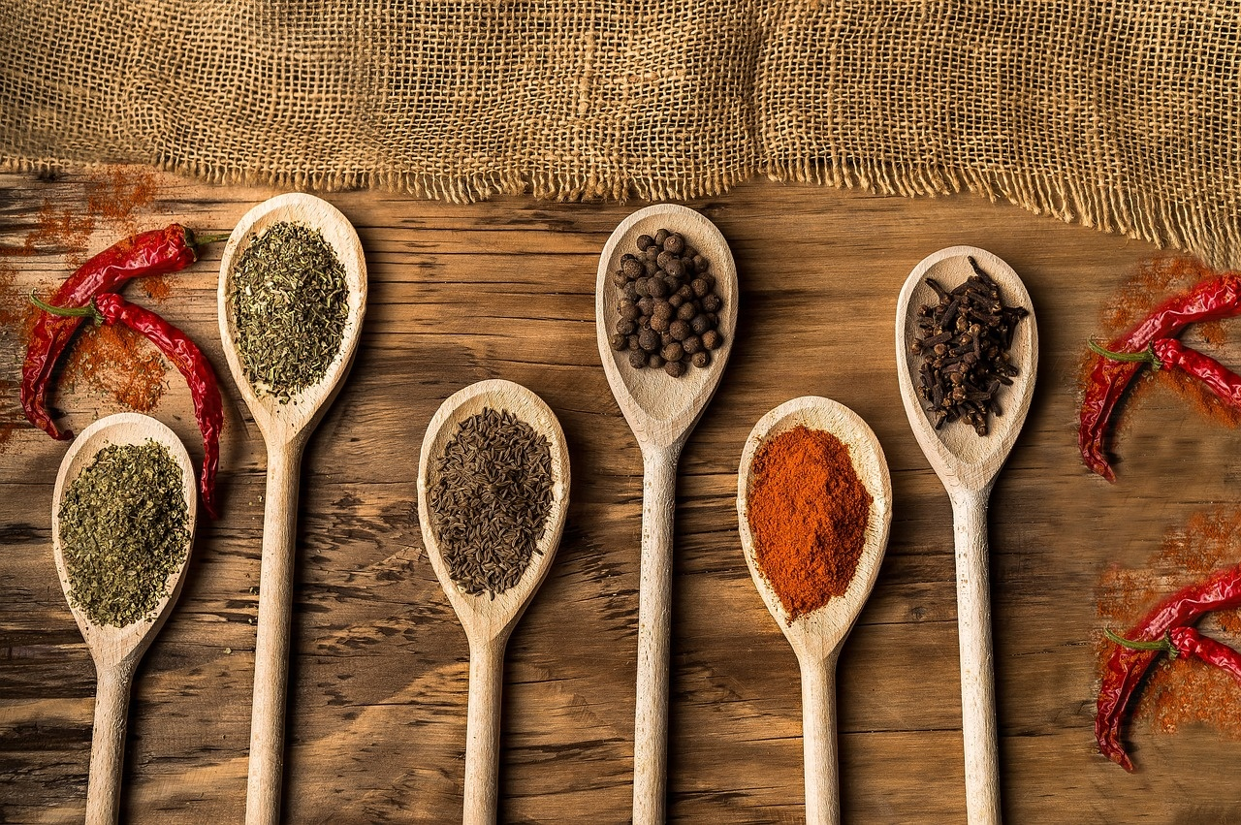
9
Technology and Culinary Exploration
Digital Tools
Interactive global cuisine mapping
Augmented reality cooking demonstrations
Virtual cultural food documentaries
Exploring Culinary Anthropology

Slide 13

10
Assessment and Reflection
01
Reflective Cultural Narrative
02
Multimedia Cultural Food Documentary
Exploring personal and collective cultural identities through food.
Reflecting on how food traditions shape and are shaped by cultural experiences.
Creating a documentary that showcases diverse cultural food practices.
Using multimedia elements to capture the essence of cultural food traditions.
03
Comparative Culinary Analysis
04
Interactive Cultural Food Exhibition
Analyzing similarities and differences between various cultural cuisines.
Understanding the historical and social contexts behind culinary practices.
Designing an exhibition that allows participants to engage with cultural food artifacts.
Incorporating interactive elements to enhance the learning experience.
Exploring Culinary Anthropology

Slide 14

11
Key Takeaways
01
Food as Cultural Communication
02
Cuisine and Societal Narratives
Food serves as a powerful tool for cultural communication.
Understanding cuisine helps in exploring societal narratives.
03
Cross-Cultural Empathy
Developing cross-cultural empathy is essential for global understanding.
Exploring Culinary Anthropology

Slide 15
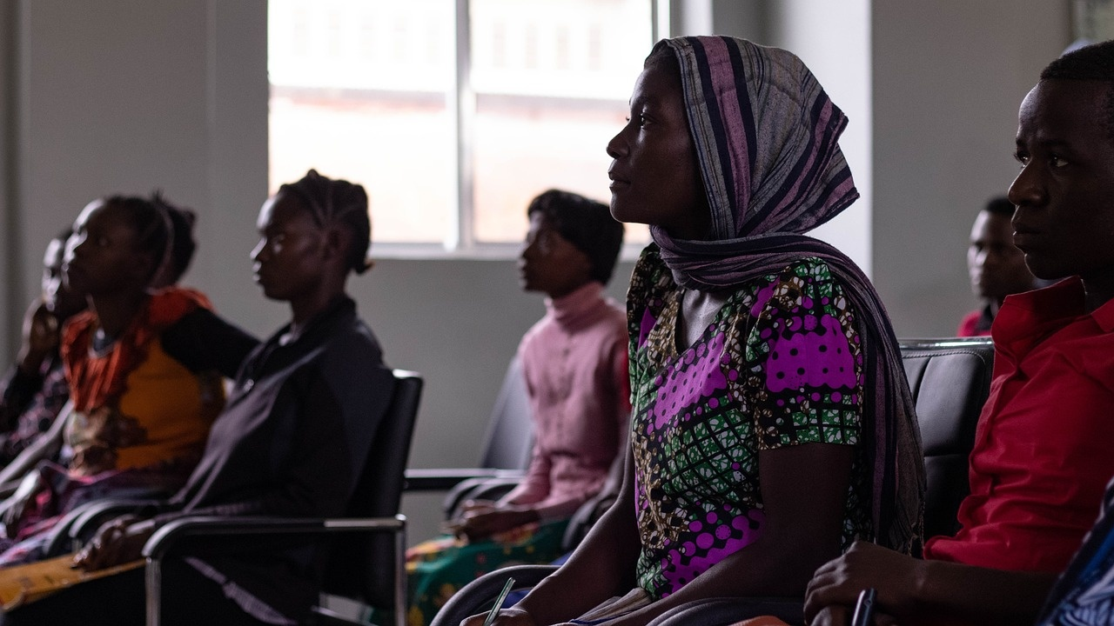
12
Conclusion
01
Cuisine as a Universal Language
02
Importance of Cultural Empathy
Food transcends borders and languages, connecting people through shared culinary experiences.
Understanding and respecting diverse food traditions fosters empathy and appreciation for different cultures.
03
Continued Exploration and Curiosity
Embracing culinary anthropology opens doors to endless learning opportunities and a deeper understanding of the world.
Exploring Culinary Anthropology

Slide 16

13
Design Recommendations
Design Recommendations
Use high-contrast, dyslexia-friendly color schemes
Ensure colors are easily distinguishable for all viewers
Large, clear typography
Opt for simple, easy-to-read fonts
Minimal text per slide
Exploring Culinary Anthropology

Slide 17

14
Technical Notes
01
Font Selection
02
Visual Elements
OpenDyslexic or Arial
Use of icons and infographics
Incorporate multicultural imagery
03
Accessibility
Ensure color-blind friendly palette
Exploring Culinary Anthropology

Slide 18
15
Export Requirements
01
Regulatory Compliance
02
Packaging Specifications
03
Quality Standards
Ensure adherence to import/export regulations
Obtain necessary permits and certifications
Comply with labeling requirements
Use appropriate packaging materials for preservation
Meet quality control criteria
Conduct inspections to ensure product integrity
04
Documentation
05
Shipping Logistics
Prepare accurate export documentation
Include invoices, certificates of origin, and shipping details
Coordinate with freight forwarders
Arrange for timely delivery and tracking
Exploring Culinary Anthropology

