Slide 1
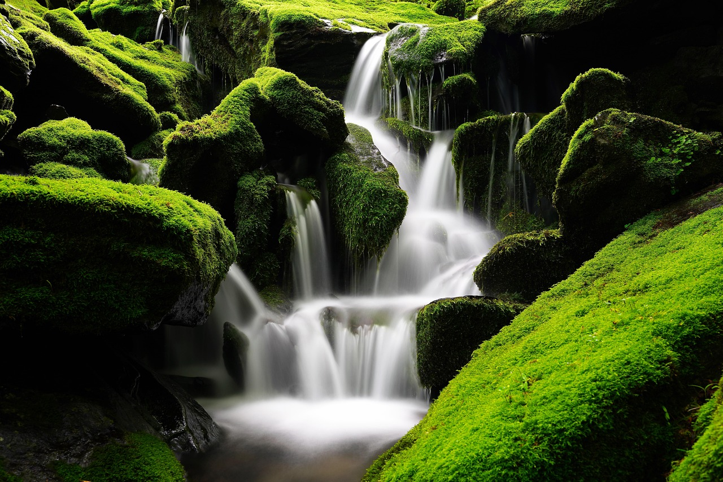
Water Conservation and Quality: Understanding and Protecting Our Vital Resource
Exploring the Water Cycle, Human Impact, Filtration, and Conservation Strategies for a Sustainable Future

Slide 2
Table of Contents
Introduction to Water Conservation
What is the Water Cycle?
Human Impact on Water Quality
Sensory Play Activity: Water Filtration
Water Conservation Strategies
Importance of Water in Daily Life
Water Cycle Simulation
Water Pollution Sorting
Simple Filtration Systems
Water Conservation Role-Play
Water Quality Monitoring
Independent Practice: Water Conservation Poster
Independent Practice: Design a Water Filter
04
05
06
07
08
09
10
11
12
13
14
15
16

Slide 3
Table of Contents
Independent Practice: Water Conservation Campa…
Conclusion and Summary
Assessment and Evaluation
Extension Activities
Parent Engagement and Community Involvement
Teaching Tips and Reflection Questions
Next Steps and Follow-Up Lessons
17
18
19
20
21
22
23

Slide 4
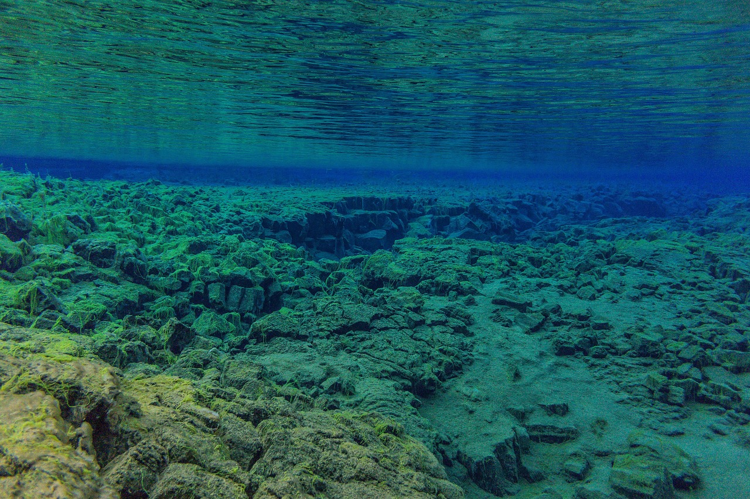
Introduction to Water Conservation
The Importance of Water
Human Impact on Water Systems
Our Role in Conservation
Water is essential for our planet and our lives.
Human actions can impact local water systems.
Human actions can impact local water systems.
We can all contribute to water conservation.
We can all contribute to water conservation.
Water is essential for our planet and our lives.
4
Water Conservation and Quality: Understanding and Protecting Our Vital Resource

Slide 5
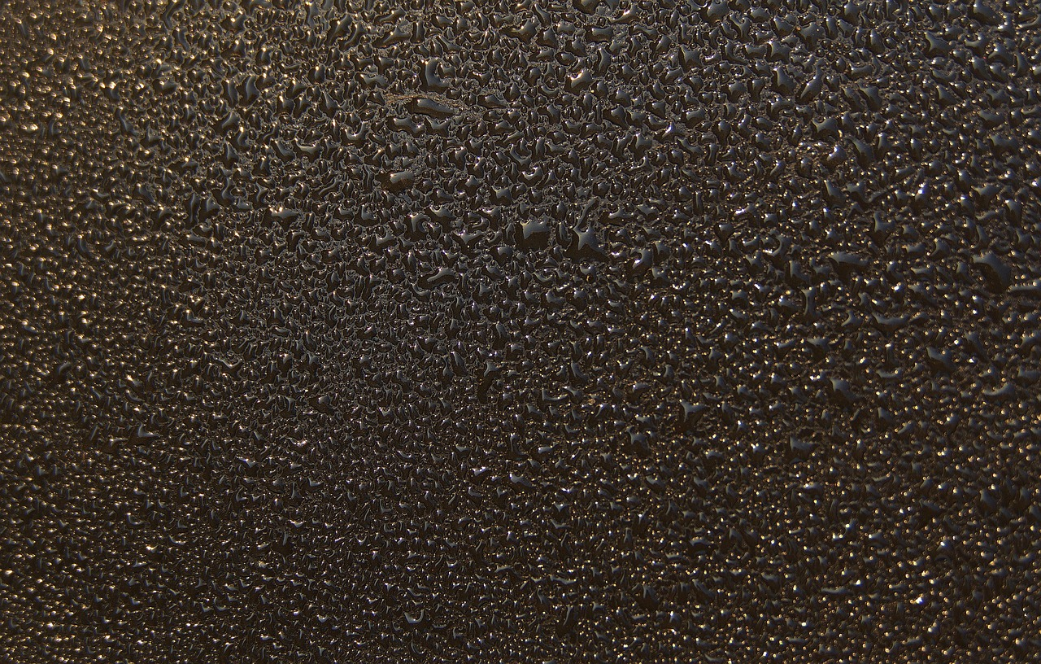
What is the Water Cycle?
Evaporation
Condensation
Water turns into vapor.
This is the first step of the water cycle.
Vapor turns into liquid.
This process forms clouds in the atmosphere.
Precipitation
Collection
Water falls back to Earth.
This includes rain, snow, sleet, or hail.
Water flows across land into bodies of water.
This completes the water cycle by replenishing lakes, rivers, and oceans.
5
Water Conservation and Quality: Understanding and Protecting Our Vital Resource

Slide 6
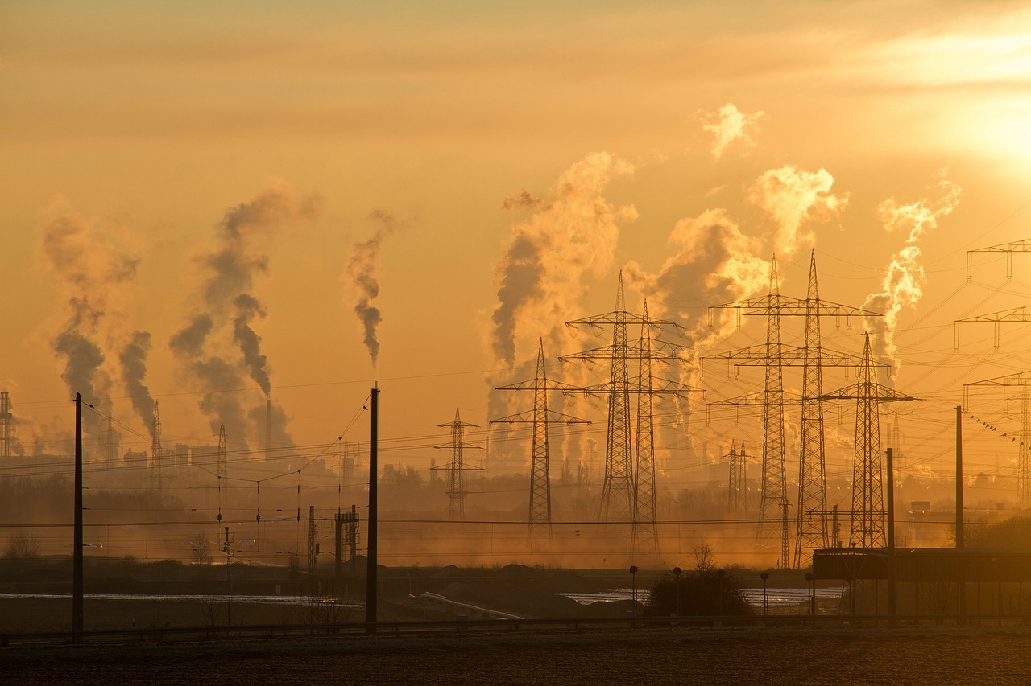
Human Impact on Water Quality
Pollution
Runoff
Conservation
Harmful substances in water.
Runoff: Water carries pollutants into water bodies.
Water carries pollutants into water bodies.
Conservation: Protecting water for future use.
Protecting water for future use.
Harmful substances in water.
6
Water Conservation and Quality: Understanding and Protecting Our Vital Resource

Slide 7
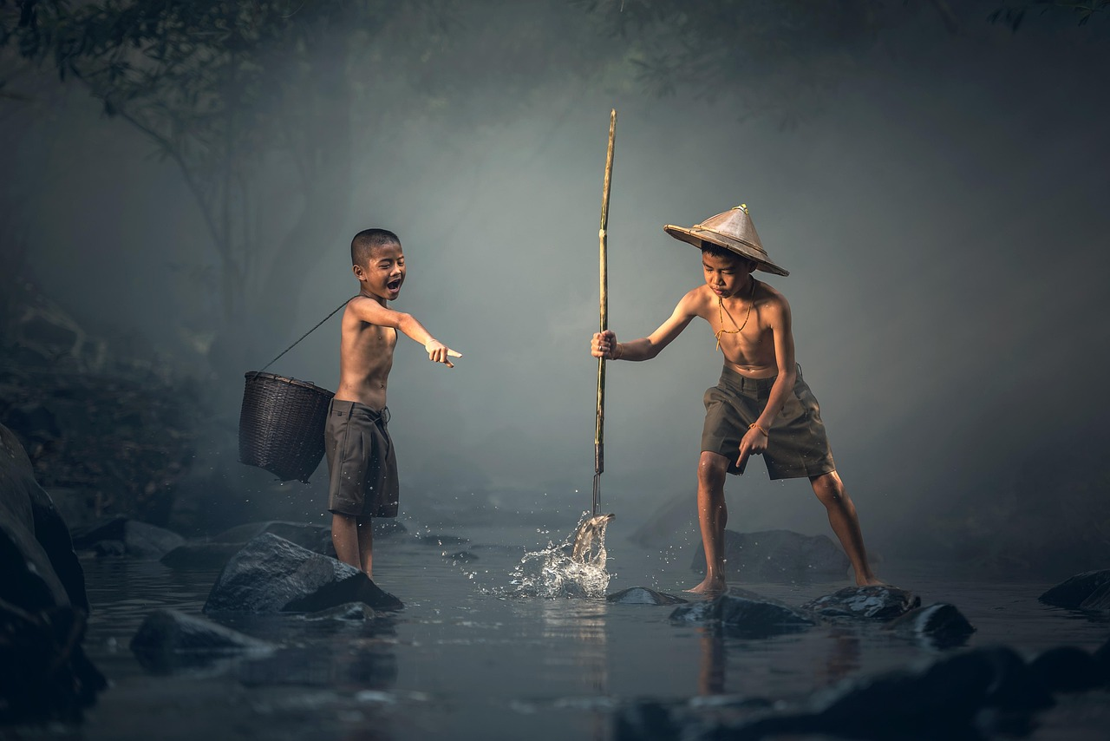
Sensory Play Activity: Water Filtration
Group Collaboration
Filtration Challenge
Divide students into groups.
Provide materials: sand, charcoal, cloth, and polluted water.
Challenge: Design a simple filtration system.
Encourage creativity and teamwork in the process.
Material Effectiveness
Importance of Clean Water
Discuss: What materials worked best?
Analyze the reasons behind their effectiveness.
Discuss: Why is clean water important?
Highlight its role in health and sustainability.
7
Water Conservation and Quality: Understanding and Protecting Our Vital Resource

Slide 8
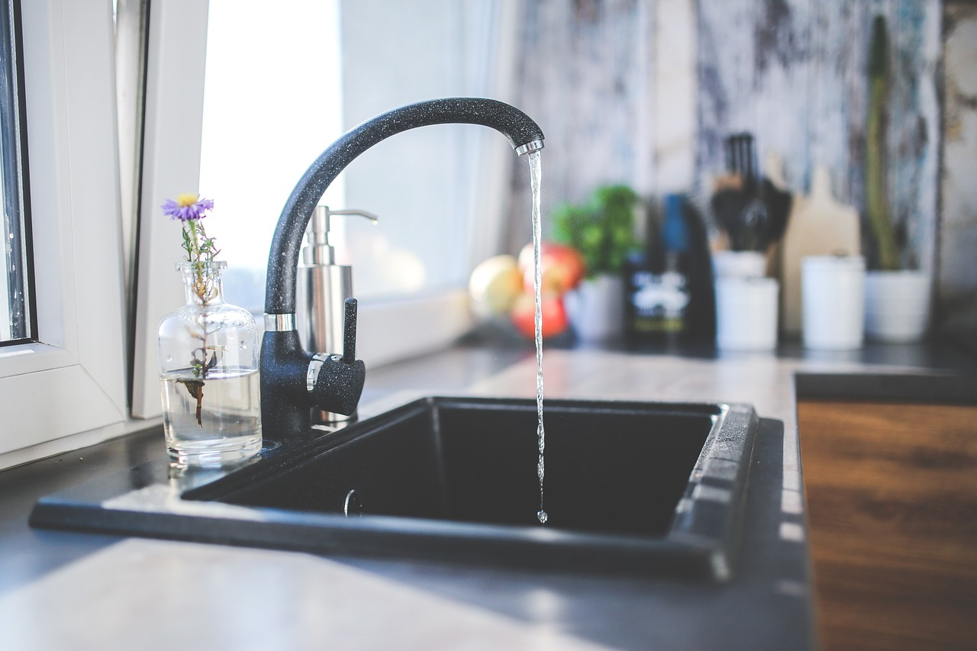
Water Conservation Strategies
01
Turn Off Taps
Turn off taps while brushing teeth.
This simple action can save gallons of water daily.
02
Shorter Baths
Take shorter baths.
Reducing bath time helps conserve significant amounts of water.
03
Fix Leaks
Fix leaks.
Leaky faucets and pipes waste water and increase utility bills.
04
Water-Efficient Appliances
Use water-efficient appliances.
These appliances reduce water usage without compromising performance.
8
Water Conservation and Quality: Understanding and Protecting Our Vital Resource

Slide 9
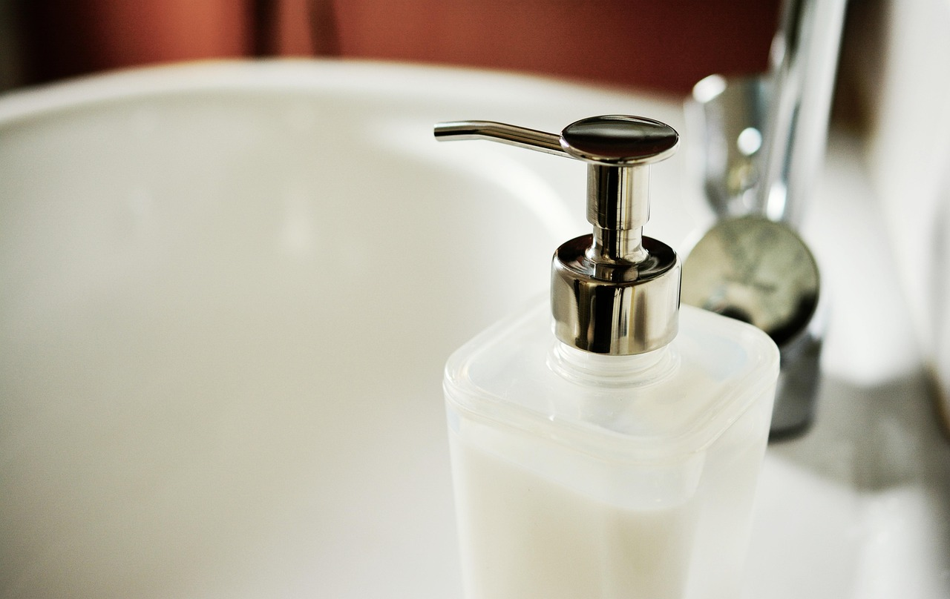
Importance of Water in Daily Life
1
Drinking Water
Water is essential for hydration and maintaining bodily functions.
Access to clean drinking water is crucial for health and survival.
2
Hygiene and Cleanliness
Water is vital for personal hygiene and sanitation.
It helps prevent the spread of diseases and maintains cleanliness.
3
Recreation and Ecosystem Health
Water bodies provide recreational opportunities like swimming and boating.
They also support biodiversity and maintain ecological balance.
9
Water Conservation and Quality: Understanding and Protecting Our Vital Resource

Slide 10
Water Cycle Simulation
Materials Needed
Key Processes Demonstrated
Impact on Daily Life
Use a plastic container, water, ice, and a heat source.
These items are essential to simulate the water cycle effectively.
Demonstrate evaporation, condensation, and precipitation.
These processes are fundamental to understanding the water cycle.
Discuss: How does the water cycle affect our daily lives?
This discussion helps connect the simulation to real-world implications.
10
Water Conservation and Quality: Understanding and Protecting Our Vital Resource

Slide 11
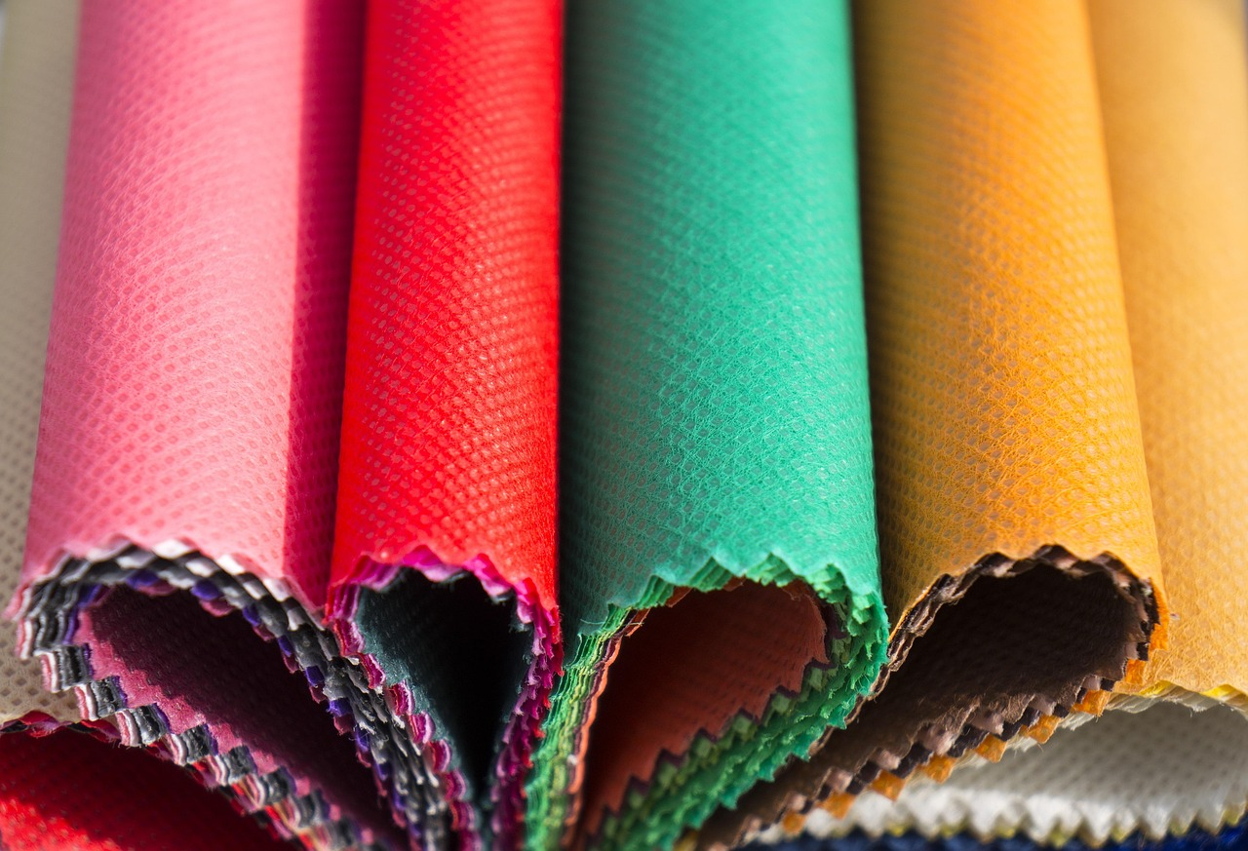
Water Pollution Sorting
1
Sorting Materials
Sort materials into biodegradable and non-biodegradable categories.
Discuss: How do different materials affect water quality?
2
Impact on Water Quality
Discuss: How do different materials affect water quality?
Introduce vocabulary: pollution, contaminant, ecosystem.
3
Key Vocabulary
Introduce vocabulary: pollution, contaminant, ecosystem.
Sort materials into biodegradable and non-biodegradable categories.
11
Water Conservation and Quality: Understanding and Protecting Our Vital Resource

Slide 12

Simple Filtration Systems
1
2
3
Using Everyday Materials
Design and Testing
Improving Water Quality
Use everyday materials: sand, charcoal, cloth.
These materials can be used to create a basic filtration system.
Design and test a simple filtration system.
Experiment with different configurations to see what works best.
Discuss: How can we improve water quality?
Explore ways to enhance the effectiveness of filtration systems.
12
Water Conservation and Quality: Understanding and Protecting Our Vital Resource

Slide 13
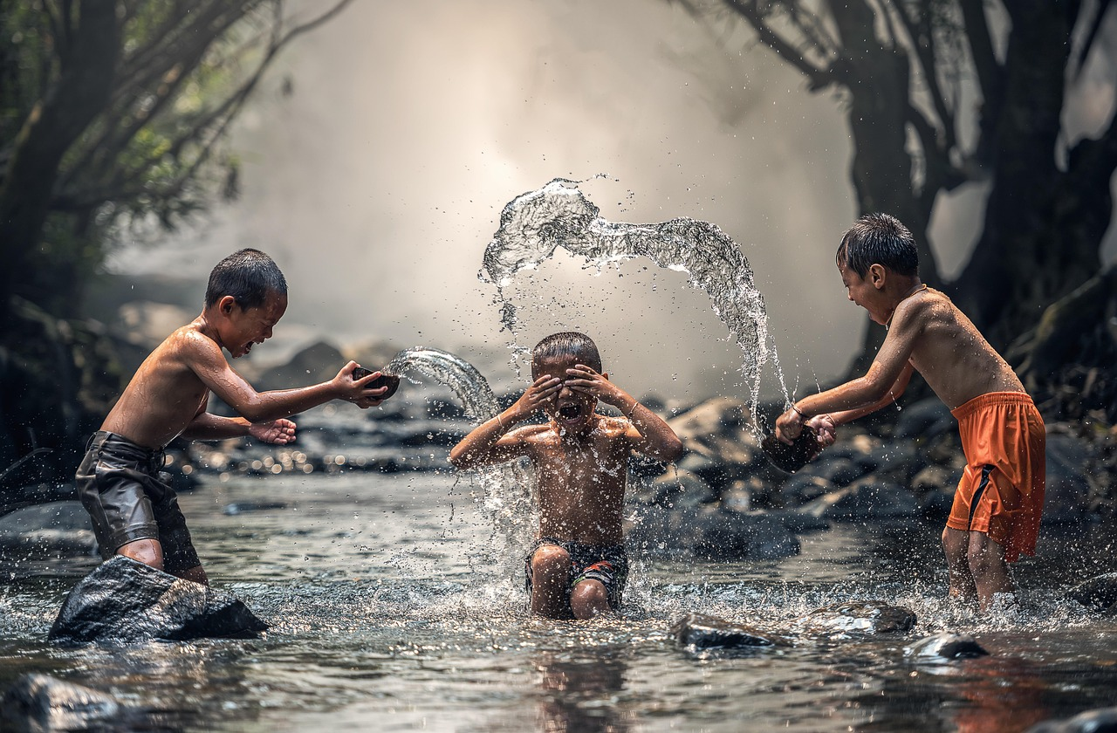
Water Conservation Role-Play
Engaging in Water-Saving Practices
Understanding Key Vocabulary
Exploring the Importance of Conservation
Practice water-saving strategies: washing hands, brushing teeth.
Discuss: Why is water conservation important?
Introduce vocabulary: conservation, sustainable, stewardship.
Discuss the meaning and importance of these terms in daily life.
Discuss: Why is water conservation important?
Highlight the role of individuals in ensuring sustainable water use.
13
Water Conservation and Quality: Understanding and Protecting Our Vital Resource

Slide 14
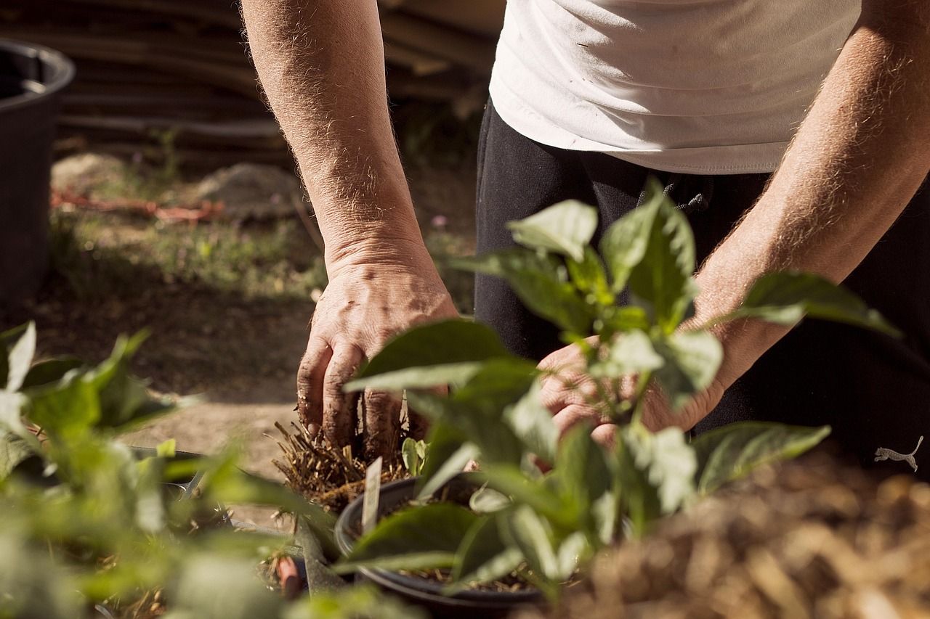
Water Quality Monitoring
Simulating Water Quality Testing
Factors and Improvements in Water Quality
Key Vocabulary for Water Quality
Simulate water quality testing using pH strips or similar.
This hands-on activity helps understand the basics of water quality assessment.
Discuss: What affects water quality? How can we improve it?
Engage in a conversation to explore human and natural influences on water quality.
Introduce vocabulary: pH, pollutant, ecosystem health.
Learn essential terms to better understand water quality and its impact.
14
Water Conservation and Quality: Understanding and Protecting Our Vital Resource

Slide 15

Independent Practice: Water Conservation Poster
1
Create a Water Conservation Poster
Create a poster illustrating one way to conserve water.
Use pictures and simple sentences.
2
Success Criterion for the Poster
Ensure the poster clearly depicts a water-saving strategy.
Focus on clarity and simplicity in your design.
3
Purpose of the Activity
This activity promotes awareness about water conservation.
It encourages creativity and practical thinking.
15
Water Conservation and Quality: Understanding and Protecting Our Vital Resource

Slide 16

Independent Practice: Design a Water Filter
1
Task Overview
Design and draw a water filtration system.
Consider effective materials for cleaning polluted water.
2
Success Criterion
Include at least three materials in your design.
Provide a brief explanation for each material chosen.
3
Objective
Create a system that effectively filters polluted water.
Focus on practical and innovative material choices.
16
Water Conservation and Quality: Understanding and Protecting Our Vital Resource

Slide 17
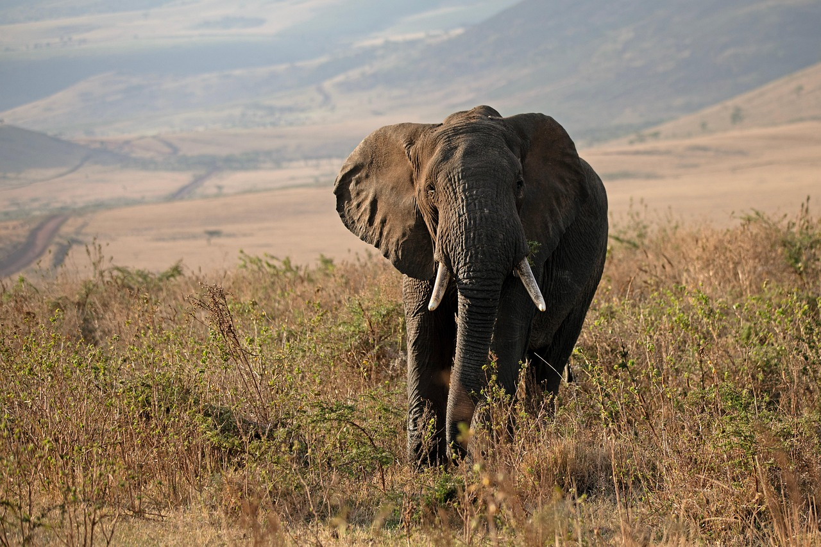
Independent Practice: Water Conservation Campaign
1
2
3
Campaign Design Elements
Success Criteria
Objective of the Campaign
Design a campaign to promote water conservation.
Include a poster, slogan, and short presentation script.
Creativity, effectiveness, and clear presentation are key.
Ensure the campaign meets these standards.
The campaign aims to raise awareness about water conservation.
It should inspire actionable steps among the audience.
17
Water Conservation and Quality: Understanding and Protecting Our Vital Resource

Slide 18
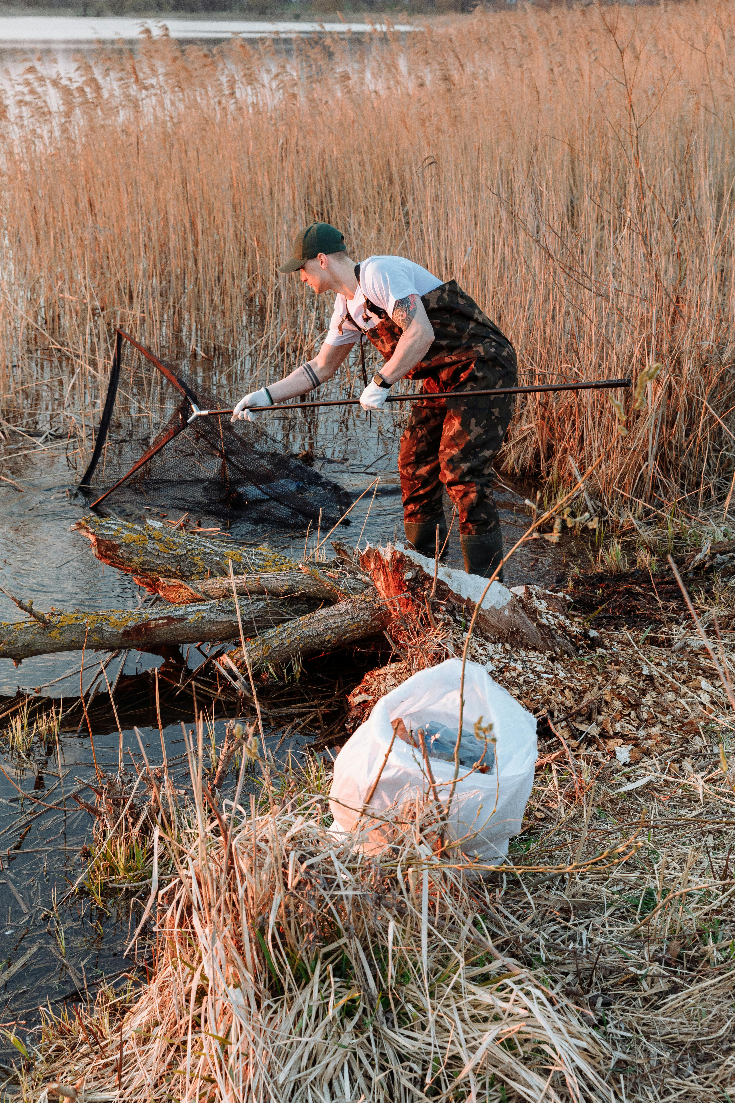
Conclusion and Summary
Key Concepts Recap
Protecting Local Water Systems
Community and Individual Actions
Recap key concepts: water cycle, human impact, conservation.
These are essential for understanding the broader implications of water system management.
Discuss: What can we do to protect local water systems?
This question encourages reflection on actionable steps for sustainability.
Emphasize individual actions and community involvement.
These efforts are crucial for fostering long-term environmental stewardship.
18
Water Conservation and Quality: Understanding and Protecting Our Vital Resource

Slide 19
Assessment and Evaluation
Formative Quizzes and Discussions
Sensory Play Participation
Filtration Systems and Posters
Formative quizzes and class discussions are integral to assessment.
They provide insights into students' understanding and engagement.
Observation of participation in sensory play activities is crucial.
It helps evaluate students' interaction and creativity.
Reviewing student-designed filtration systems and posters is essential.
This process assesses their problem-solving skills and presentation abilities.
19
Water Conservation and Quality: Understanding and Protecting Our Vital Resource

Slide 20
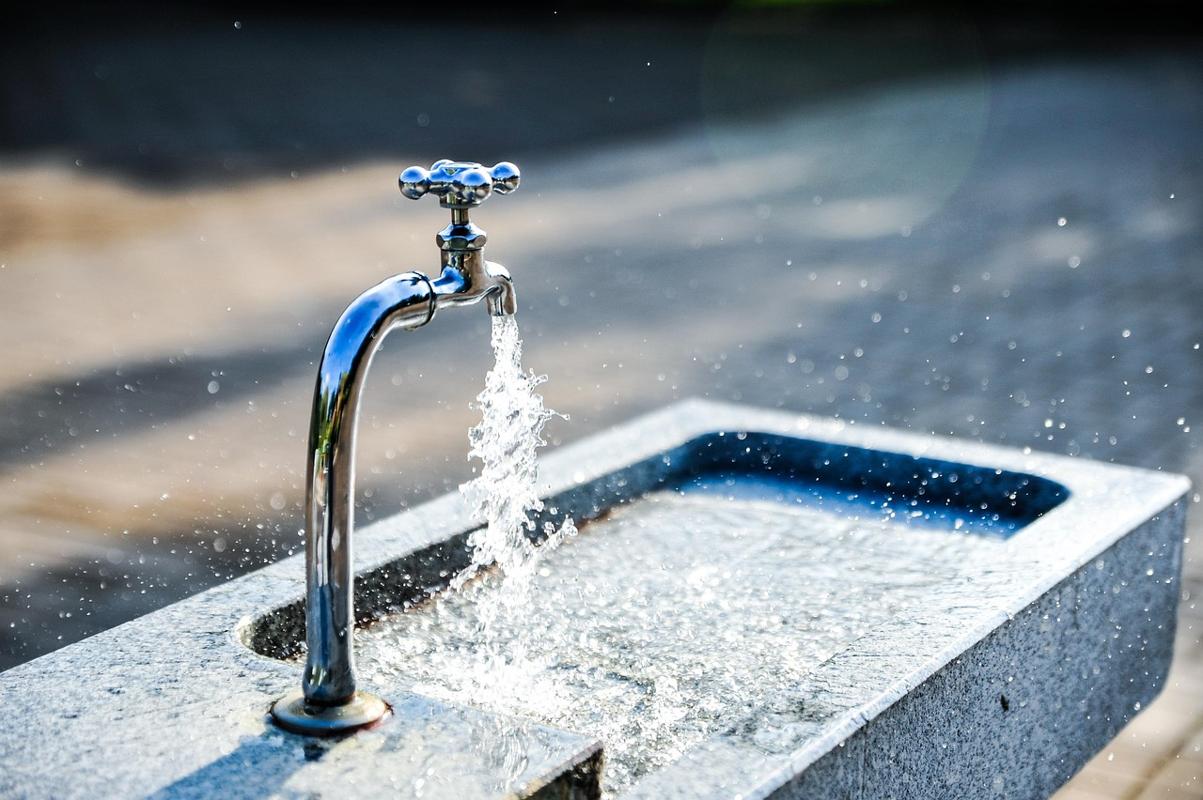
Extension Activities
Designing a Water Filtration System
Promoting Water Conservation
Conducting a Water Audit
Learn how to create a water filtration system using everyday materials.
This activity encourages innovation and understanding of water purification processes.
Develop a public service announcement to raise awareness about water conservation.
This task highlights the importance of preserving water resources for future generations.
Perform a water audit at home or in the classroom to assess water usage.
This exercise helps identify areas for improvement in water conservation practices.
20
Water Conservation and Quality: Understanding and Protecting Our Vital Resource

Slide 21
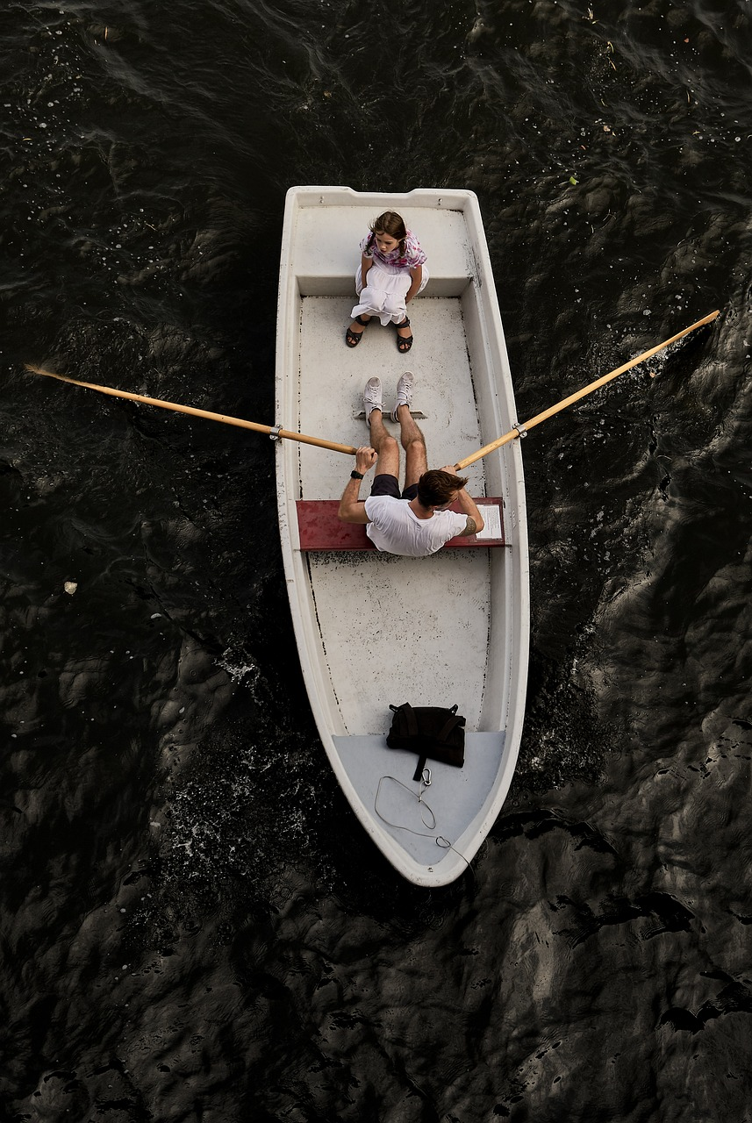
Parent Engagement and Community Involvement
1
Engaging Parents in Water Conservation
Invite parents to participate in water conservation activities.
Encourage families to implement water-saving practices at home.
2
Community Event for Water Conservation
Organize a community event to promote water conservation.
Encourage families to implement water-saving practices at home.
3
Family Practices for Water Saving
Encourage families to implement water-saving practices at home.
Invite parents to participate in water conservation activities.
21
Water Conservation and Quality: Understanding and Protecting Our Vital Resource

Slide 22
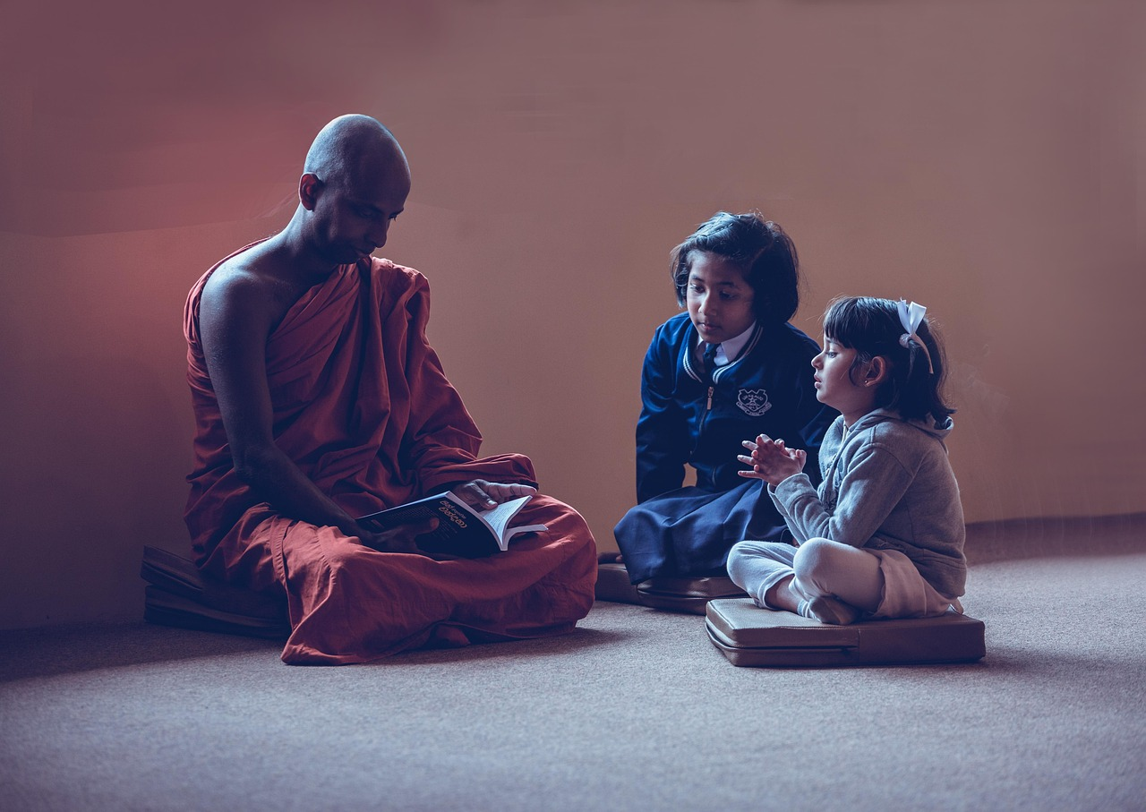
Teaching Tips and Reflection Questions
Differentiated Instruction Strategies
Support for English Language Learners
Teacher Reflection and Growth
Differentiated instruction for mixed-ability groups.
This approach ensures that all students, regardless of their skill levels, can engage and learn effectively.
ELL support and resources.
These tools help non-native speakers grasp the material and participate fully in class.
Reflection questions for teacher self-evaluation and lesson improvement.
These questions guide educators in assessing their teaching methods and identifying areas for enhancement.
22
Water Conservation and Quality: Understanding and Protecting Our Vital Resource

Slide 23
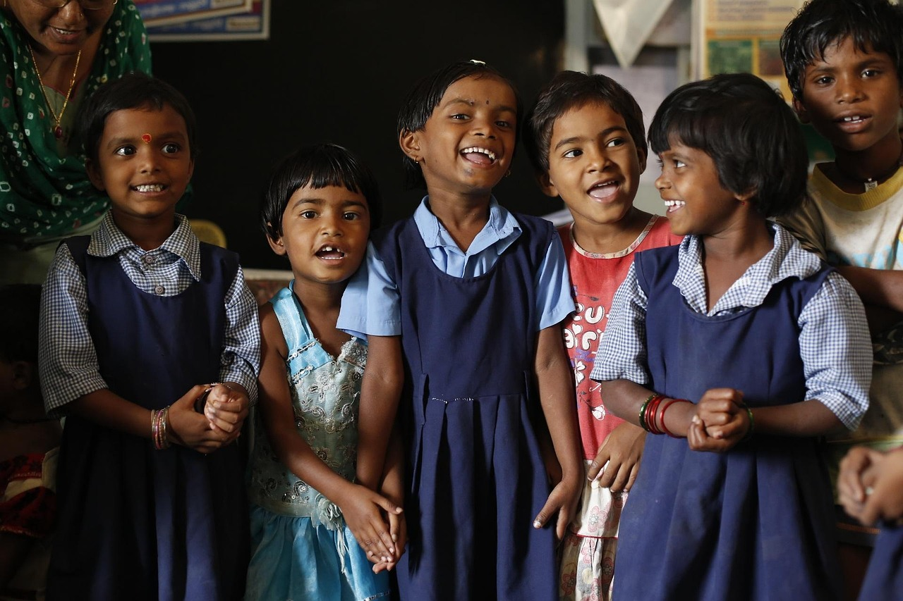
Next Steps and Follow-Up Lessons
1
Water Cycle and Ecosystems
Lesson on water cycle and ecosystems.
Understanding the interconnectedness of natural processes.
2
Community Conservation Efforts
Community water conservation project.
Engaging in activities to promote sustainable water use.
3
Interactive Learning Opportunities
Exploring local water systems through field trips and guest speakers.
Hands-on experiences to deepen understanding of water systems.
23
Water Conservation and Quality: Understanding and Protecting Our Vital Resource

