Slide 1

Global Shifts: Post-World War II
Exploring the Impact and Legacy of Historical Transformations

Slide 2
Table of contents
01
02
03
04
05
06
07
08
09
10
11
Title Slide: Global Transformation After World War II
Introduction - World War II Aftermath
The Holocaust - Historical Context
Cold War Emergence
Decolonization Movements
International Political Restructuring
Technological and Scientific Transformation
Long-Term Global Implications
Key Vocabulary
Learning Objectives
Interactive Learning Strategies

Slide 3
Table of contents
12
13
14
15
16
17
18
Reflection and Discussion
Conclusion
Additional Resources
Credits and References
Design Recommendations
Presentation Delivery Tips
Export Requirements

Slide 4

1
Title Slide: Global Transformation After World War II
Global Transformation After World War II
Understanding Geopolitical Shifts (1945-1960)
Global Shifts: Post-World War II

Slide 5

2
Introduction - World War II Aftermath
01
Transformative global event
02
Reshaped human civilization
World War II had a profound impact on countries worldwide, leading to significant changes in political, social, and economic structures.
The aftermath of World War II saw the rebuilding of nations, the establishment of new alliances, and the emergence of superpowers that shaped the modern world.
03
Fundamental changes in power dynamics
The war altered the balance of power among nations, with the United States and the Soviet Union emerging as the dominant forces in a new era of geopolitics.
Global Shifts: Post-World War II

Slide 6
3
The Holocaust - Historical Context
01
Introduction
02
Market Analysis
03
Strategy
Overview of the project
Objectives and goals
Current market trends
Target audience
Competitor analysis
Marketing strategy
Sales strategy
Product development
04
Financials
05
Conclusion
Revenue projections
Cost analysis
Profit margins
Summary of key points
Future outlook
Global Shifts: Post-World War II

Slide 7

4
Cold War Emergence
Main Characteristics
USA vs Soviet Union ideological conflict
Bipolar world structure
Proxy wars and diplomatic tensions
Global Shifts: Post-World War II

Slide 8

5
Decolonization Movements
01
Challenging Colonial Power Structures
02
Independence in Africa and Asia
Colonized nations demanding independence
Resistance against oppressive colonial rule
Ghana's independence in 1957
India's independence in 1947
03
Emergence of New Nation-States
Formation of new governments post-independence
Transition from colonial rule to self-governance
Global Shifts: Post-World War II

Slide 9
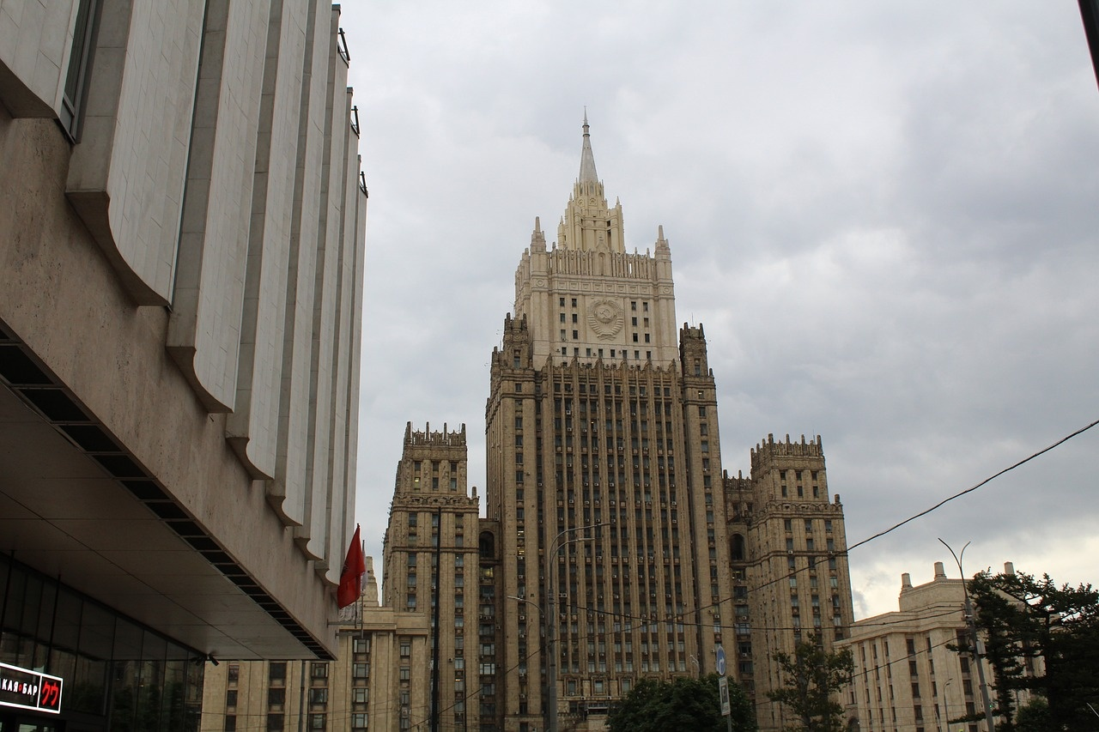
6
International Political Restructuring
01
United Nations Formation
02
New Global Governance Mechanisms
Established in 1945
Promotes international cooperation and peace
Creation of specialized UN agencies
Development of international treaties and agreements
03
Human Rights Frameworks
Universal Declaration of Human Rights in 1948
Advocacy for fundamental human rights globally
Global Shifts: Post-World War II

Slide 10

7
Technological and Scientific Transformation
01
Computer Technology Advancements
02
Aerospace Engineering Developments
Development of the first electronic general-purpose computer, ENIAC, in 1946.
Introduction of the concept of stored-program computers by the Manchester Baby in 1948.
The beginning of the Space Age with the launch of the Soviet satellite Sputnik in 1957.
NASA's establishment in 1958, leading to the Apollo program and the moon landing in 1969.
03
Medical Research Breakthroughs
Discovery of the double-helix structure of DNA by Watson and Crick in 1953.
Development of the first successful polio vaccine by Jonas Salk in 1955.
Global Shifts: Post-World War II

Slide 11

8
Long-Term Global Implications
Long-Term Global Implications
Critical Outcomes
Transformed international relationships, Established new diplomatic frameworks, Redistributed global economic influence
Global Shifts: Post-World War II

Slide 12
9
Key Vocabulary
01
Decolonization
02
Cold War
03
Geopolitical Structures
The process of colonies gaining independence from colonial powers
Ideological conflict between the USA and Soviet Union without direct military confrontation
Arrangement of power and influence in global politics
04
Holocaust
05
Sovereignty
Systematic genocide of 6 million Jewish people by the Nazis during World War II
Independent authority over a territory, free from external control
Global Shifts: Post-World War II

Slide 13

10
Learning Objectives
01
Understand historical transformations post-World War II
02
Analyze geopolitical shifts during the period of 1945-1960
Explore the impact of global events on societies and nations.
Examine changes in power dynamics and international relations.
03
Develop critical thinking skills through historical analysis
04
Recognize the interconnectedness of the global landscape
Evaluate the significance of key events and decisions.
Connect historical developments to contemporary challenges.
Global Shifts: Post-World War II

Slide 14

11
Interactive Learning Strategies
01
Role-playing simulations
02
Primary source analysis
Engage students in immersive scenarios to deepen understanding.
Encourage critical thinking by examining authentic historical materials.
03
Multimedia research projects
04
Collaborative discussions
Foster creativity and digital literacy skills through interactive assignments.
Promote teamwork and diverse perspectives in learning environments.
Global Shifts: Post-World War II

Slide 15

12
Reflection and Discussion
01
Reshaping Global Structures
02
Lessons Learned
Formation of the United Nations
Decolonization and the end of empires
Bipolar world order: USA vs. USSR
Economic recovery plans like the Marshall Plan
The importance of international cooperation
The dangers of totalitarian regimes
The value of human rights and democracy
The need for economic stability and development
03
Connecting History to Today
Ongoing geopolitical tensions
The role of international organizations
Economic interdependence
Human rights issues and advocacy
Global Shifts: Post-World War II

Slide 16
13
Conclusion
Power Restructuring
Human Rights Importance
Global Interconnectedness
Shifting power dynamics in global politics
Universal declaration of human rights
Economic interdependence
Global Shifts: Post-World War II

Slide 17

14
Additional Resources
01
Books
02
Documentaries
"Postwar: A History of Europe Since 1945" by Tony Judt
"The Cold War: A New History" by John Lewis Gaddis
"The World at War" - A comprehensive documentary series on World War II
"The Fog of War" - Examines the complexities of war and decision-making
03
Online Archives
04
Museum Resources
The National WWII Museum's online collection
United Nations Digital Library for historical documents
Imperial War Museums for exhibits on global conflicts
Smithsonian National Museum of American History for Cold War artifacts
Global Shifts: Post-World War II

Slide 18

15
Credits and References
01
Citation Information
02
Educational Development Credits
Proper citation of sources used in the presentation.
Adherence to citation styles (APA, MLA, etc.).
Acknowledgment of contributors to the educational content.
Recognition of institutions and organizations involved.
03
Image and Resource Acknowledgments
Credits for images used in the presentation.
Acknowledgment of online and offline resources.
Global Shifts: Post-World War II

Slide 19
16
Design Recommendations
01
Consistent Color Palette
02
Incorporate Historical Photographs
03
Maintain Clean, Professional Design
Utilize blues, grays, and muted tones for a cohesive look.
Enhance visual appeal with relevant historical images.
Ensure a polished and organized layout for a professional presentation.
04
Engaging Visual Elements
05
Minimal Text per Slide
Use visuals to captivate audience interest and aid in comprehension.
Avoid overcrowding slides with excessive text for better readability.
Global Shifts: Post-World War II

Slide 20
17
Presentation Delivery Tips
01
Encourage interactive discussions
02
Use multimedia elements
03
Provide context for complex topics
Engage the audience by encouraging questions and participation.
Incorporate visuals, videos, and interactive tools to enhance engagement.
Break down complex information into digestible segments for better understanding.
04
Maintain age-appropriate content
05
Foster critical thinking
Tailor the presentation to the audience's age group for maximum impact.
Encourage analytical thinking and problem-solving skills through thought-provoking questions and activities.
Global Shifts: Post-World War II

Slide 21

18
Export Requirements
01
Compliance Documentation
02
Product Classification
Ensure all necessary export documentation is complete.
Verify compliance with international trade regulations.
Determine the correct export classification for products.
Classify goods according to Harmonized System codes.
03
Customs Clearance
04
Shipping Regulations
Understand customs procedures for exporting goods.
Prepare documentation for smooth customs clearance processes.
Familiarize with shipping regulations of destination countries.
Comply with packaging and labeling requirements for exports.
Global Shifts: Post-World War II

