Slide 1

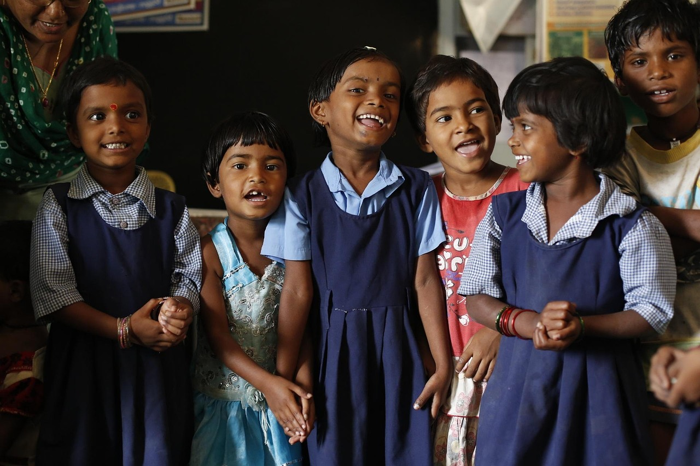
Building Literacy Foundations: Word Building and Rhyming
Engaging Strategies and Activities to Support Emerging Readers

Slide 2
Table of Contents
Introduction to Word Building and Rhyming
Importance of Word Building
Introduction to Rhyming
Differentiated Activities for Mixed-Ability Gr…
Word Building Activities
Rhyming Games and Activities
Movement Activities for Word Building and Rhym…
Technology Integration
Assessment and Evaluation
Conclusion
Next Steps
Reflection Questions
Teaching Tips
04
05
06
07
08
09
10
11
12
13
14
15
16

Slide 3
Table of Contents
Key Takeaways
Parent Engagement
Safety Considerations
Homework and Extension Activities
17
18
19
20

Slide 4
Introduction to Word Building and Rhyming
Importance of Word Building and Rhyming
Benefits of These Skills
Lesson Plan Highlights
Word building and rhyming are fundamental skills for emerging readers.
These skills help develop phonological awareness, vocabulary, and fine motor skills.
The lesson plan includes differentiated activities for mixed-ability groups.
4
Building Literacy Foundations: Word Building and Rhyming

Slide 5
Importance of Word Building
Understanding Sound-Letter Relationships
Enhancing Phonological Awareness
Adapting to Learning Styles
Interactive Learning Tools
Word building helps students understand the relationship between sounds and letters.
It develops phonological awareness and decoding skills.
Word building activities can be adapted for different learning styles and abilities.
Examples include using magnetic letters, word blocks, and letter tiles.
5
Building Literacy Foundations: Word Building and Rhyming

Slide 6
Introduction to Rhyming
Phonological Awareness
Engaging Activities
Examples of Rhyming Words
Rhyming helps students develop phonological awareness and recognize word patterns.
Rhyming activities can be fun and engaging, such as rhyming games and songs.
Examples include identifying rhyming words, such as "cat" and "hat".
6
Building Literacy Foundations: Word Building and Rhyming

Slide 7
Differentiated Activities for Mixed-Ability Groups
Adapting Activities for Diverse Learners
Incorporating Various Tools
Activities can be adapted for students with different learning styles and abilities.
Examples include using visual aids, manipulatives, and technology.
Engaging Differentiated Activities
Providing Tailored Support
Differentiated activities can include word building, rhyming games, and movement activities.
Teachers can provide extra support or challenges for students as needed.
7
Building Literacy Foundations: Word Building and Rhyming

Slide 8
Word Building Activities
Magnetic Letters
Building simple words like "cat" and "dog".
Word Blocks
Building words by changing the initial sound or adding prefixes and suffixes.
Letter Tiles
Building words by changing the initial sound or adding prefixes and suffixes.
Examples for Different Learning Styles
Examples of word building activities for different learning styles and abilities.
8
Building Literacy Foundations: Word Building and Rhyming

Slide 9
Rhyming Games and Activities
Rhyming Bingo
Rhyming Scavenger Hunt
Matching words that rhyme, such as 'dog' and 'log'.
Finding objects that rhyme with given words.
Rhyming Stories and Poems
Examples for Different Learning Styles
Reading and creating rhyming texts.
Examples of rhyming games and activities for different learning styles and abilities.
9
Building Literacy Foundations: Word Building and Rhyming

Slide 10

Movement Activities for Word Building and Rhyming
Rhyming Walk
Word Building Obstacle Course
Examples of Movement Activities
Finding objects that rhyme with given words while moving around the classroom.
Building words while navigating an obstacle course.
Examples of movement activities for word building and rhyming.
10
Building Literacy Foundations: Word Building and Rhyming

Slide 11
Technology Integration
Educational Apps
Using apps like "Rhyming Bingo" or "Word Families" to practice word building and rhyming.
Online Games
Playing online games that focus on word building and rhyming.
Technology Integration Examples
Examples of technology integration for word building and rhyming.
11
Building Literacy Foundations: Word Building and Rhyming

Slide 12
Assessment and Evaluation
Formative Assessment
Summative Assessment
Observing students during activities and providing feedback.
Evaluating student understanding through quizzes and games.
Assessment Methods
Using Assessment Data
Examples of assessment and evaluation methods for word building and rhyming.
Using assessment data to inform future instruction.
12
Building Literacy Foundations: Word Building and Rhyming

Slide 13

Conclusion
Importance of Foundational Skills
Enhancing Learning Through Innovation
Word building and rhyming are essential skills for emerging readers.
Differentiated activities and technology integration can support student learning and engagement.
13
Building Literacy Foundations: Word Building and Rhyming

Slide 14
Next Steps
Introduction to Blending Sounds
Teaching students to blend individual sounds together to form simple words.
Exploring Word Families
Introducing students to different word patterns and having them read and write words using these patterns.
Rhyming Stories and Poetry
Using rhyming stories and poetry to further develop phonological awareness and vocabulary.
14
Building Literacy Foundations: Word Building and Rhyming

Slide 15
Reflection Questions
Effective Strategies for Student Engagement
Differentiated Activities for Diverse Abilities
Formative Assessment Opportunities
What strategies were most effective in engaging students and promoting their understanding of word building and rhyming concepts?
How did the differentiated activities support the learning of students with varying abilities?
What opportunities were there for formative assessment during the lesson, and how can the data collected be used to inform future instruction?
15
Building Literacy Foundations: Word Building and Rhyming

Slide 16
Teaching Tips
Visual Aids and Manipulatives
Movement and Action
Music and Rhyme
Differentiation and Adaptation
Use visual aids and manipulatives to support student learning.
Incorporate movement and action into the lesson.
Utilize music and rhyme to develop phonological awareness.
Provide opportunities for differentiation and adaptation.
16
Building Literacy Foundations: Word Building and Rhyming

Slide 17

Key Takeaways
Fundamental Skills for Emerging Readers
Supporting Student Learning and Engagement
Reflective Teaching Practices
Word building and rhyming are fundamental skills for emerging readers.
Differentiated activities and technology integration can support student learning and engagement.
Teachers should reflect on their practice and adjust instruction to meet the needs of all learners.
17
Building Literacy Foundations: Word Building and Rhyming

Slide 18
Parent Engagement
Importance of Word Building and Rhyming Skills
Home Activities and Resources
Teacher-Parent Communication
Inform parents about the importance of word building and rhyming skills.
Provide parents with activities and resources to support their child's learning at home.
Encourage parents to communicate with teachers about their child's progress and needs.
18
Building Literacy Foundations: Word Building and Rhyming

Slide 19
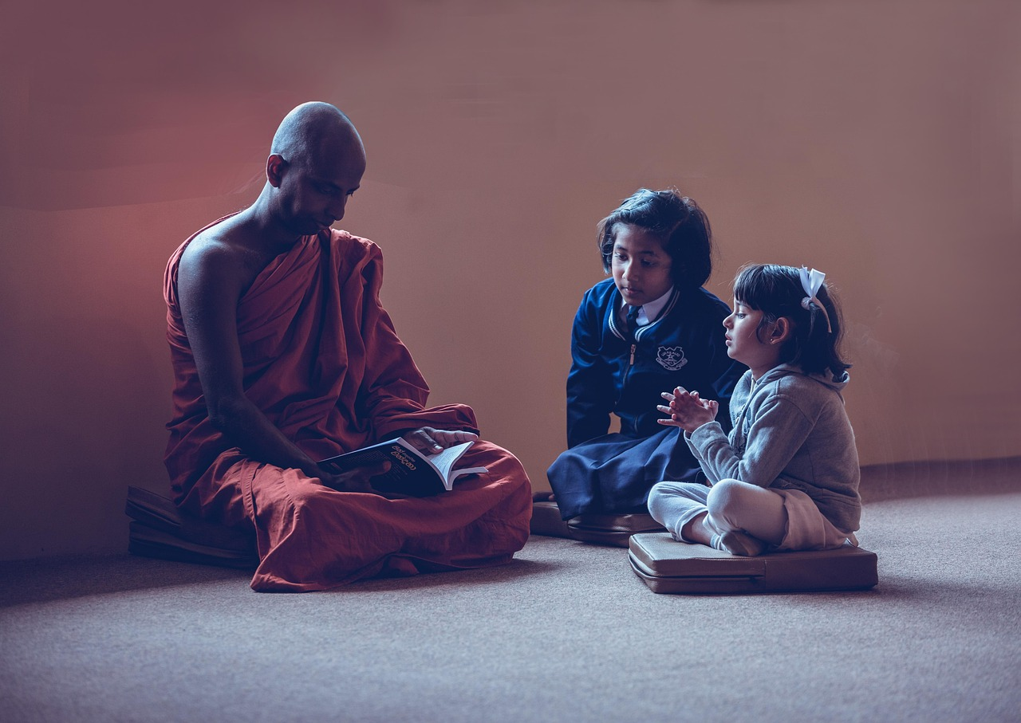
Safety Considerations
Safe Classroom Environment
Ensure the classroom environment is safe and free from hazards.
Supervision and Guidance
Supervise students during activities and provide guidance on safe behavior.
Emergency Preparedness
Be aware of students' medical conditions and allergies, and have a plan in place for emergencies.
19
Building Literacy Foundations: Word Building and Rhyming

Slide 20
Homework and Extension Activities
Reinforcing Word Skills
Advanced Learner Challenges
Sharing and Feedback
Provide homework activities that reinforce word building and rhyming skills, such as rhyming bingo or word building with magnetic letters.
Offer extension activities for advanced learners, such as creating rhyming stories or word building challenges.
Encourage students to share their work and provide feedback and guidance.
20
Building Literacy Foundations: Word Building and Rhyming

