Slide 1

Mastering Business Communication: From Greetings to Proficiency
A Comprehensive Guide to Professional English Communication Skills

Slide 2
Table of contents
01
02
03
04
05
06
07
08
09
10
11
Professional Business Greetings & Basic English Structure
Learning Objectives
Basic Sentence Structure
Personal Pronouns & Verb "To Be"
Formal vs. Informal Greetings
Video Presentation (3 minutes)
Practice Activities Timeline
Speaking Practice (15 minutes)
Writing Exercise (10 minutes)
Listening Activity (10 minutes)
Reading Practice (10 minutes)

Slide 3
Table of contents
12
13
14
15
Homework Assignment
Additional Resources
Thank You
HOMEWORK SHEET: Professional Greetings & Basic Sentence Str…

Slide 4
1
Professional Business Greetings & Basic English Structure
1
A2
Professional Greetings
Basic English Structure
Mastering Business Communication: From Greetings to Proficiency

Slide 5
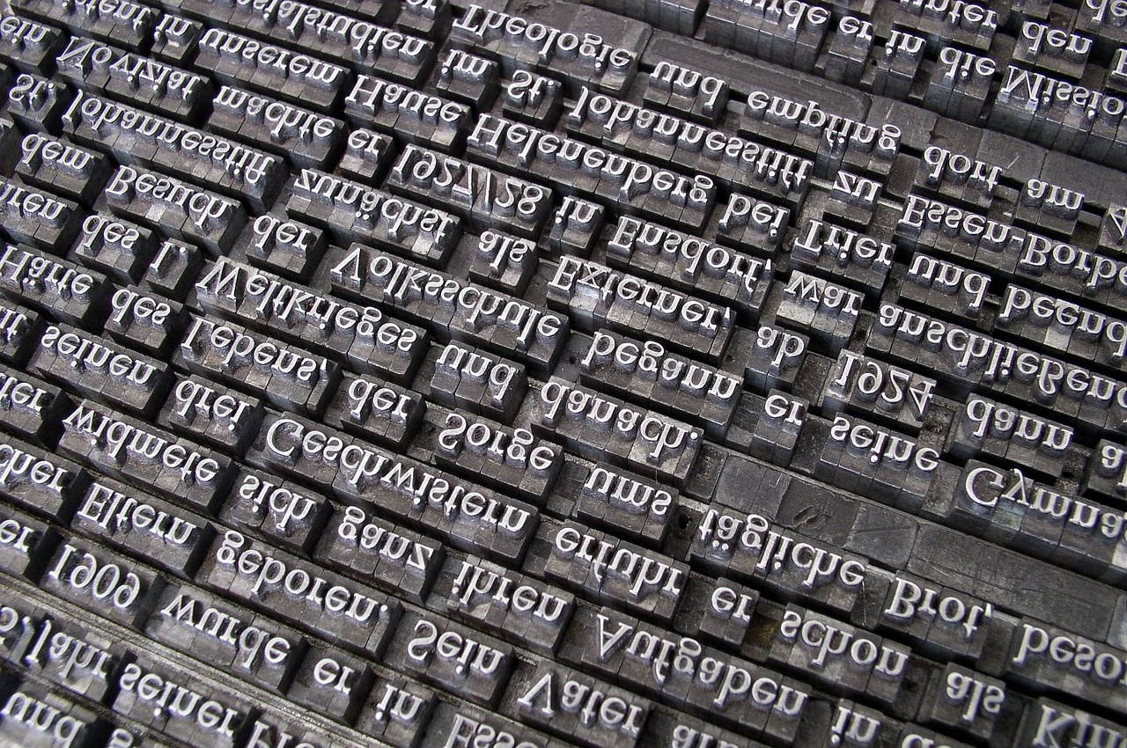
2
Learning Objectives
01
Understand basic sentence structure
02
Master the verb "to be" with personal pronouns
Subject + Verb + Object
03
Distinguish between formal and informal greetings
04
Practice professional business greetings
Mastering Business Communication: From Greetings to Proficiency

Slide 6

3
Basic Sentence Structure
01
Formula
02
Example
Subject + Verb + Object
"I am a manager"
Subject (I) + Verb (am) + Object (a manager)
Mastering Business Communication: From Greetings to Proficiency

Slide 7

4
Personal Pronouns & Verb "To Be"
Personal Pronouns & Verb "To Be"
I am
You are
He/She/It is
We are
You are
They are
Mastering Business Communication: From Greetings to Proficiency

Slide 8

5
Formal vs. Informal Greetings
01
Formal Greetings
02
Informal Greetings
Good morning/afternoon/evening
How do you do?
Pleased to meet you
Hi
Hey
What's up?
Mastering Business Communication: From Greetings to Proficiency

Slide 9

6
Video Presentation (3 minutes)
01
Introduction to the importance of professional greetings in business settings
02
Showcase of various formal business greetings in a video format
03
Examples of proper body language and tone during greetings
Mastering Business Communication: From Greetings to Proficiency

Slide 10
7
Practice Activities Timeline
01
02
03
04
05
Introduction and Warm-up (0-10 min)
Grammar Practice (10-20 min)
Video Analysis (20-30 min)
Speaking Practice (30-45 min)
Writing Exercise (45-55 min)
Brief overview of the lesson objectives
Icebreaker activity to engage participants
Review basic sentence structure (Subject + Verb + Object)
Practice using personal pronouns with the verb 'to be'
Watch video on professional business greetings
Discuss formal vs. informal greetings showcased in the video
Role-play scenarios:
Meeting a new client
Introducing yourself to your team
Greeting your manager
Write professional introductions using correct structure
Practice formal email greetings
Mastering Business Communication: From Greetings to Proficiency

Slide 11

8
Speaking Practice (15 minutes)
01
Meeting a new client
02
Introducing yourself to your team
Prepare a brief introduction about yourself and your role.
Discuss the client's needs and how you can assist.
Ask questions to understand the client's business better.
Share your background and experience.
Explain your role and responsibilities.
Express enthusiasm about working with the team.
03
Greeting your manager
Offer a polite and professional greeting.
Provide a quick update on your current tasks.
Ask for feedback or any immediate tasks.
Mastering Business Communication: From Greetings to Proficiency

Slide 12

9
Writing Exercise (10 minutes)
01
Task 1: Professional Introductions
02
Task 2: Formal Email Greetings
Good morning, I am the new project manager.
Pleased to meet you, I am the sales director.
Good afternoon, I am the marketing coordinator.
Hello, I am the HR manager.
How do you do? I am the CEO of the company.
Subject: "Formal Email Greetings Practice"
Body: "Dear [Recipient's Name], I hope this email finds you well. I am writing to introduce myself as [Your Name] from [Company Name]. I look forward to collaborating with you on [specific project/task]. Best regards, [Your Name]"
Mastering Business Communication: From Greetings to Proficiency

Slide 13

10
Listening Activity (10 minutes)
Audio Dialogues of Business Greetings
Listen to various business greetings in formal and informal settings.
Pay attention to the tone, language, and expressions used.
Comprehension Questions
What are some examples of formal greetings you heard?
How do informal greetings differ from formal ones?
Can you identify the key phrases used in the dialogues?
Mastering Business Communication: From Greetings to Proficiency

Slide 14
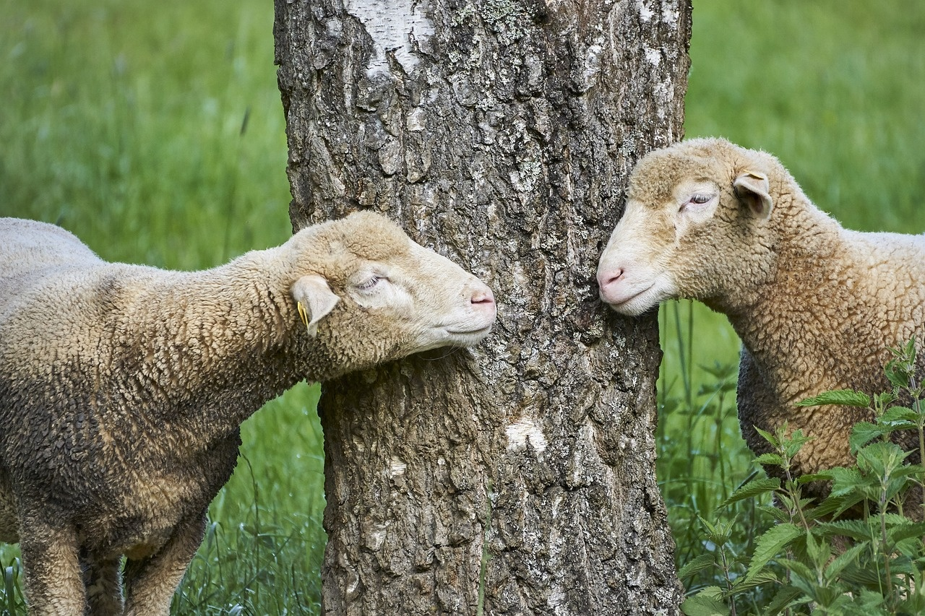
11
Reading Practice (10 minutes)
01
Reading Practice (10 minutes)
02
Identify the formal and informal elements in each dialogue:
Read the following short business dialogue texts:
1. Formal: "Good morning, Mr. Smith. It's a pleasure to meet you."
2. Informal: "Hey, Sarah! What's new with you?"
Formal elements: Greeting with title, polite language
Informal elements: Casual greeting, use of first names
03
Sample dialogue text
![Sample dialogue text](insert_image_link_here)
Mastering Business Communication: From Greetings to Proficiency

Slide 15
12
Homework Assignment
01
02
03
04
Step 1
Step 2
Step 3
Step 4
Write 5 formal business introductions using the correct sentence structure (S+V+O):
Example: "I am the sales manager at XYZ Company."
Record a 1-minute video introducing yourself professionally, including:
Formal greeting
Your name and position
Company name
Area of expertise
Complete the following online exercises at [website]:
Personal pronouns quiz
Verb "to be" practice
Business greetings matching exercise
Submit all assignments through the learning platform by [date].
Mastering Business Communication: From Greetings to Proficiency

Slide 16

13
Additional Resources
01
Online Practice Links
02
Grammar Reference Sheets
Online practice links for business English proficiency
Grammar reference sheets for sentence structure and greetings
03
Business English Vocabulary List
Business English vocabulary list for effective communication
Mastering Business Communication: From Greetings to Proficiency

Slide 17
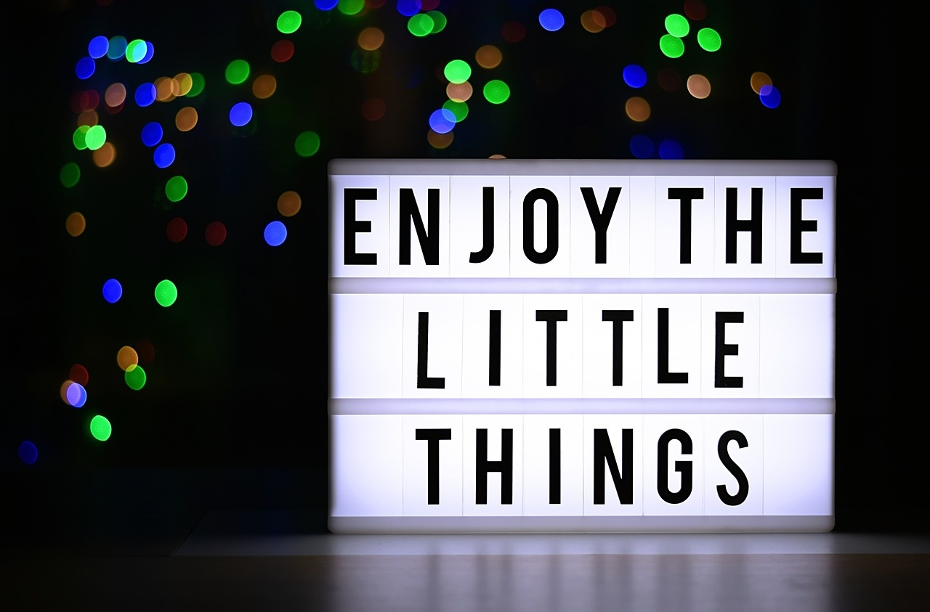
14
Thank You
Thank You
Thank you for your active participation and engagement in today's lesson.
We appreciate your dedication to improving your business English communication skills.
Feel free to reach out if you have any questions or need further clarification.
Contact Information: Email - info@businessenglish.com, Phone - +1 (555) 123-4567
Next Lesson Preview: "Mastering Formal Email Communication in Business" with a focus on writing professional emails.
Mastering Business Communication: From Greetings to Proficiency

Slide 18

15
HOMEWORK SHEET: Professional Greetings & Basic Sentence Structure
01
Writing Task
02
Video Assignment
Create 5 formal business introductions using the correct sentence structure (S+V+O):
1. ___________________________
2. ___________________________
3. ___________________________
4. ___________________________
5. ___________________________
Record a 1-minute video introducing yourself professionally, including:
Formal greeting
Your name and position
Company name
Area of expertise
03
Online Practice
04
Submission
Complete the following exercises at [website]:
Personal pronouns quiz
Verb "to be" practice
Business greetings matching exercise
Submit all assignments through the learning platform by [date].
Mastering Business Communication: From Greetings to Proficiency

