Slide 1

Mastering Inverse Operations
Exploring Concepts, Applications, and Teaching Strategies

Slide 2
Table of Contents
Welcome to Inverse Operations!
What are Inverse Operations?
Types of Inverse Operations
Using Inverse Operations to Solve Problems
Real-Life Applications of Inverse Operations
Visual Aids for Inverse Operations
Games and Puzzles for Inverse Operations
Collaborative Learning for Inverse Operations
Technology Integration for Inverse Operations
Assessing Understanding of Inverse Operations
Common Misconceptions about Inverse Operations
Teaching Tips for Inverse Operations
Conclusion
04
05
06
07
08
09
10
11
12
13
14
15
16

Slide 3
Table of Contents
Next Steps
Reflection Questions
Key Takeaways
Final Thoughts
17
18
19
20

Slide 4
Welcome to Inverse Operations!
Understanding Inverse Operations
Exploring Applications
Learning Outcomes
Inverse operations are a fundamental concept in mathematics that helps us solve problems and check our work.
They involve using one operation to reverse the effect of another, such as addition and subtraction.
In this lesson, we will explore how to use inverse operations to solve simple math problems and puzzles.
This approach allows us to verify solutions and understand relationships between operations.
By the end of this lesson, you will be able to apply inverse operations to solve addition and subtraction problems.
This skill is essential for developing problem-solving strategies and mathematical reasoning.
4
Mastering Inverse Operations

Slide 5
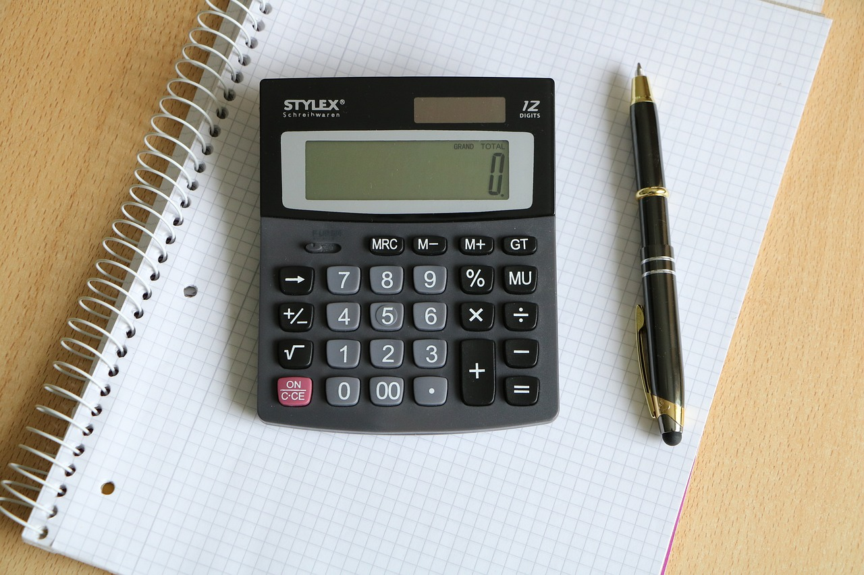
What are Inverse Operations?
Definition of Inverse Operations
Example of Inverse Operations
Inverse operations are two operations that "undo" each other, such as addition and subtraction.
These operations are fundamental in mathematics for solving equations and understanding relationships between numbers.
For example, the inverse operation of 2 + 3 = 5 is 5 - 3 = 2.
This demonstrates how one operation can reverse the effect of another, maintaining balance in equations.
5
Mastering Inverse Operations

Slide 6

Types of Inverse Operations
Inverse Operations in Arithmetic
Applications of Inverse Operations
Addition and subtraction are inverse operations.
Multiplication and division are also inverse operations.
Inverse operations can be used to solve equations.
They are also useful for checking our work in calculations.
Importance in Mathematics
Conceptual Understanding
Inverse operations are essential for building a strong foundation in mathematics.
Understanding them helps in mastering basic and advanced mathematical concepts.
Inverse operations demonstrate the relationship between different arithmetic operations.
They provide a method to reverse or undo a mathematical process.
6
Mastering Inverse Operations

Slide 7
Using Inverse Operations to Solve Problems
1
2
3
Understanding Inverse Operations
Example of Using Inverse Operations
Applications of Inverse Operations
To solve a problem using inverse operations, identify the operation and use its inverse to check the answer.
This approach ensures the solution is verified and accurate.
For example, if the problem is 2 + 3 = ?, use the inverse operation of subtraction to check the answer.
This demonstrates how inverse operations can validate results effectively.
Inverse operations can be used to solve a range of math problems, from simple addition and subtraction to more complex equations.
This versatility makes them a valuable tool in mathematical problem-solving.
7
Mastering Inverse Operations

Slide 8
Real-Life Applications of Inverse Operations
1
Daily Life Applications
Inverse operations are used in everyday life, such as measuring ingredients for a recipe or calculating the cost of items at a store.
These operations simplify tasks and ensure accuracy in daily activities.
2
Scientific and Professional Uses
Inverse operations are also used in science, engineering, and finance to solve problems and make predictions.
They are essential tools for professionals in these fields to achieve precise results.
3
Enhancing Mathematical Understanding
By mastering inverse operations, you will be able to apply mathematical concepts to real-world situations.
This skill bridges theoretical knowledge with practical applications.
8
Mastering Inverse Operations

Slide 9
Visual Aids for Inverse Operations
Using Number Lines for Inverse Operations
Understanding Addition and Subtraction with Hundreds Charts
Number lines can be used to visualize the concept of inverse operations.
They provide a clear representation of how numbers relate to each other in addition and subtraction.
Hundreds charts can also be used to help students understand the relationship between addition and subtraction.
These charts offer a structured way to observe numerical patterns and relationships.
9
Mastering Inverse Operations

Slide 10

Games and Puzzles for Inverse Operations
Engaging Games for Practicing Inverse Operations
Puzzles for Enhancing Problem-Solving Skills
Making Learning Fun with Games and Puzzles
Games like 'Math War' and '24 Game' can be used to practice inverse operations.
These games provide a fun and interactive way to reinforce mathematical concepts.
Puzzles like Sudoku and KenKen can also be used to develop problem-solving skills.
They challenge players to think critically and apply logical reasoning.
Inverse operations can be made fun and engaging through games and puzzles.
This approach combines entertainment with educational value, fostering a positive learning experience.
10
Mastering Inverse Operations

Slide 11

Collaborative Learning for Inverse Operations
Benefits of Collaborative Learning
Pairing Students for Math Activities
Collaborative learning can help students learn from each other and develop communication skills.
This approach fosters a supportive environment where students can share knowledge and insights.
Pairing students up to work on math problems and puzzles can help build confidence and fluency.
Such activities encourage teamwork and enhance problem-solving abilities.
11
Mastering Inverse Operations

Slide 12

Technology Integration for Inverse Operations
Utilizing Online Resources
Interactive Math Applications
Online resources and tools can be used to support learning and practice inverse operations.
These platforms offer diverse methods to enhance understanding and application of mathematical concepts.
Math apps and websites can provide interactive and engaging activities for students.
Such tools make learning more accessible and enjoyable, fostering better educational outcomes.
12
Mastering Inverse Operations

Slide 13

Assessing Understanding of Inverse Operations
Utilizing Quizzes and Tests
Observations and Discussions
Providing Feedback and Support
Quizzes and tests can be used to assess students' understanding of inverse operations.
These tools provide measurable insights into students' grasp of the concept.
Observations and class discussions can also be used to evaluate students' understanding.
These methods allow for real-time assessment and engagement with students.
Feedback and support can be provided to students who need extra help.
This ensures that all students have the opportunity to improve their understanding.
13
Mastering Inverse Operations

Slide 14

Common Misconceptions about Inverse Operations
Confusion Between Addition and Multiplication
Challenges with Fractions and Decimals
Some students may confuse the inverse operation of addition with the inverse operation of multiplication.
This misunderstanding can lead to errors in solving equations and understanding mathematical relationships.
Others may struggle with the concept of inverse operations in the context of fractions or decimals.
These difficulties often arise due to the complexity of operations involving non-whole numbers.
14
Mastering Inverse Operations

Slide 15
Teaching Tips for Inverse Operations
1
Illustrating with Real-Life Examples
Use real-life examples to illustrate the concept of inverse operations.
This approach helps students relate mathematical concepts to everyday situations.
2
Enhancing Learning with Visual Aids
Provide visual aids and hands-on activities to support learning.
These tools make abstract concepts more tangible and easier to understand.
3
Fostering Engagement through Collaboration
Encourage collaborative learning and technology integration to make learning fun and engaging.
This strategy promotes teamwork and leverages modern tools for effective education.
15
Mastering Inverse Operations

Slide 16

Conclusion
Understanding Inverse Operations
Benefits of Mastering Inverse Operations
Inverse operations are a fundamental concept in mathematics that helps us solve problems and check our work.
They allow us to reverse calculations and verify the accuracy of our solutions.
By mastering inverse operations, you will be able to build a strong foundation in mathematics.
This skill also aids in developing critical thinking abilities essential for problem-solving.
16
Mastering Inverse Operations

Slide 17

Next Steps
Upcoming Lesson Focus
Future Topics Preview
The next lesson will cover using inverse operations to solve multi-digit math problems.
This will provide foundational skills for understanding mathematical relationships.
Future lessons will also cover introduction to multiplication and division as inverse operations.
These topics will expand on the concept of inverse operations in mathematics.
17
Mastering Inverse Operations

Slide 18

Reflection Questions
1
Supporting Students with Inverse Operations
What strategies can you use to support students who struggle with understanding the concept of inverse operations?
Consider methods such as step-by-step demonstrations, visual aids, and interactive activities to enhance comprehension.
2
Enhancing Engagement through Real-Life Examples
How can you incorporate more real-life examples and puzzles into the lesson to make it more engaging and interactive?
Integrate scenarios and challenges that relate to students' everyday experiences to foster interest and participation.
18
Mastering Inverse Operations

Slide 19

Key Takeaways
Understanding Inverse Operations
Applications of Inverse Operations
Benefits of Mastering Inverse Operations
Inverse operations are used to 'undo' an operation.
They are fundamental in solving mathematical problems and puzzles.
Inverse operations can be applied to solve simple math problems.
They are also useful in tackling various puzzles effectively.
Mastering inverse operations builds a strong foundation in mathematics.
It also enhances critical thinking skills essential for problem-solving.
19
Mastering Inverse Operations

Slide 20

Final Thoughts
Mastering Inverse Operations
Inverse operations are a powerful tool for solving math problems and checking our work.
With practice and patience, you can master inverse operations and become a proficient problem-solver.
20
Mastering Inverse Operations

