Slide 1

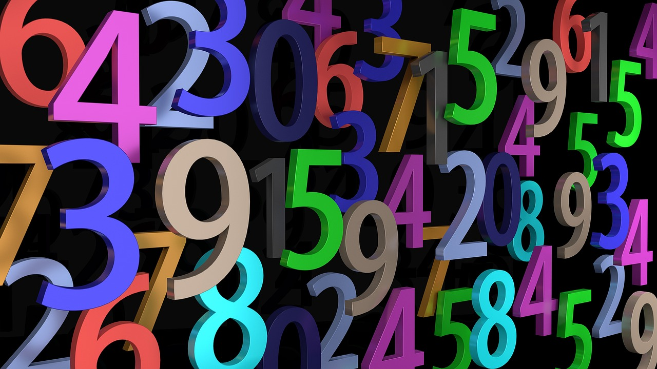
Understanding and Applying Number Patterns in Mathematical Modeling
Exploring Types, Real-World Applications, and Problem-Solving Techniques

Slide 2
Table of Contents
Introduction to Applying Number Patterns
What are Number Patterns?
Types of Number Patterns
Mathematical Modeling
Real-World Applications of Number Patterns
How to Apply Number Patterns
Example: Population Growth
Example: Financial Modeling
Common Errors and Misconceptions
FAQs
Objectives and Outcomes
Vocabulary
Resources
04
05
06
07
08
09
10
11
12
13
14
15
16

Slide 3
Table of Contents
Prior Knowledge
Group Activities
Digital Integration
Conclusion
Next Steps
Reflection Questions
Teaching Tips
17
18
19
20
21
22
23

Slide 4

Introduction to Applying Number Patterns
Welcome to Number Patterns
Lesson Objectives
Exploring Real-Life Applications
Welcome to the world of number patterns and mathematical modeling!
In this lesson, we will explore how number patterns are used in real-life problems and mathematical modeling.
By the end of this lesson, you will be able to recognize, create, and apply number patterns.
These skills will help you solve real-world problems effectively.
Number patterns are not just theoretical; they have practical uses.
We will delve into how they are applied in various real-life scenarios.
4
Understanding and Applying Number Patterns in Mathematical Modeling

Slide 5

What are Number Patterns?
Definition of Number Patterns
Types of Number Patterns
A number pattern is a sequence of numbers that follows a specific rule or relationship.
These patterns help in identifying and predicting numerical trends.
Examples of number patterns include arithmetic and geometric sequences.
These sequences are foundational concepts in mathematics.
Applications of Number Patterns
Importance of Recognizing Patterns
Number patterns are all around us and are used in various fields, such as science, engineering, and finance.
They play a significant role in solving real-world problems.
Recognizing number patterns is crucial to making informed decisions in these fields.
This skill enhances problem-solving and analytical capabilities.
5
Understanding and Applying Number Patterns in Mathematical Modeling

Slide 6
Types of Number Patterns
Arithmetic Sequences
Geometric Sequences
Other Number Patterns
A sequence of numbers in which each term is obtained by adding a fixed constant to the previous term.
This type of pattern is widely used in mathematics and real-world applications like calculating interest rates.
A sequence of numbers in which each term is obtained by multiplying the previous term by a fixed constant.
These patterns are essential in understanding exponential growth and decay phenomena.
Other types of number patterns include Fibonacci sequences and fractals.
These patterns often appear in nature and are studied for their unique properties and applications.
6
Understanding and Applying Number Patterns in Mathematical Modeling

Slide 7

Mathematical Modeling
Understanding Mathematical Modeling
Techniques in Mathematical Modeling
Applications of Mathematical Modeling
Mathematical modeling is the process of using mathematical concepts and techniques to describe and analyze real-life phenomena.
It provides a structured approach to understanding and solving complex problems.
Mathematical modeling involves using number patterns, algebraic equations, and graphical representations to solve problems.
These techniques help in simplifying and visualizing real-world scenarios.
Mathematical modeling is used in various fields, such as science, engineering, and finance, to make informed decisions and predictions.
Its versatility makes it a valuable tool across diverse disciplines.
7
Understanding and Applying Number Patterns in Mathematical Modeling

Slide 8
Real-World Applications of Number Patterns
Population Growth
Financial Modeling
Scientific Simulations
Engineering Applications
Number patterns are used to model and predict population growth.
This helps in understanding demographic changes and planning resources accordingly.
Number patterns are used to analyze and predict financial transactions, such as stock prices and investment returns.
This aids in making informed investment decisions and managing risks.
Number patterns are used to model and analyze scientific phenomena, such as weather patterns and climate change.
These simulations help in forecasting and preparing for environmental changes.
Number patterns are used to design and optimize systems, such as bridges and buildings.
This ensures safety, efficiency, and cost-effectiveness in engineering projects.
8
Understanding and Applying Number Patterns in Mathematical Modeling

Slide 9
How to Apply Number Patterns
1
2
3
Recognizing Number Patterns
Modeling with Mathematics
Solving and Predicting
Identify the number pattern: recognize the type of number pattern and its characteristics.
This step is crucial for understanding the foundation of the problem.
Create a mathematical model: use algebraic equations and graphical representations to model the number pattern.
This allows for a structured approach to analyzing the pattern.
Apply the model: use the mathematical model to solve the real-world problem and make predictions.
This step bridges the gap between theory and practical application.
9
Understanding and Applying Number Patterns in Mathematical Modeling

Slide 10

Example: Population Growth
Population Growth Rate
Mathematical Prediction
Future Implications
A city's population is growing at a rate of 10% per year.
The current population is 100,000.
Using a mathematical model, we can predict the population in 5 years.
This model helps in understanding future growth trends.
Population growth impacts city planning and resource allocation.
Accurate predictions are essential for sustainable development.
10
Understanding and Applying Number Patterns in Mathematical Modeling

Slide 11

Example: Financial Modeling
Investment Growth Projection
Risk Analysis
Return on Investment Evaluation
An investment of $1,000 is expected to grow at a rate of 5% per year.
Using a mathematical model, we can predict the value of the investment in 10 years.
We can analyze the risk associated with the investment.
This involves studying number patterns and their implications.
Mathematical modeling helps evaluate the return on investment.
It provides insights into potential financial outcomes.
11
Understanding and Applying Number Patterns in Mathematical Modeling

Slide 12

Common Errors and Misconceptions
1
Contextual Oversights
Failing to consider the context and constraints of the problem.
This can lead to solutions that are impractical or irrelevant.
2
Formula Misapplication
Misusing mathematical formulas and equations.
This often results in incorrect or misleading outcomes.
3
Scaling Challenges
Struggling with scaling and units.
This can cause significant errors in calculations and interpretations.
12
Understanding and Applying Number Patterns in Mathematical Modeling

Slide 13

FAQs
1
Linear vs Exponential Models
What is the difference between a linear and exponential model?
Linear models grow by constant amounts, while exponential models grow by constant factors.
2
Choosing the Right Formula
How do I know which mathematical formula or equation to use?
The choice depends on the context and the type of relationship between variables.
3
Avoiding Common Errors
What are some common pitfalls or errors to avoid when applying number patterns to real-life problems?
Misinterpreting the pattern or applying the wrong model can lead to inaccurate conclusions.
13
Understanding and Applying Number Patterns in Mathematical Modeling

Slide 14
Objectives and Outcomes
Understanding Number Patterns
Real-Life Applications of Number Patterns
Solving Problems with Number Patterns
Evaluating Effectiveness of Number Patterns
Define and explain the concept of number patterns, including arithmetic and geometric sequences.
Number patterns form the foundation for identifying relationships and trends in numerical data.
Identify and describe real-life applications of number patterns, such as population growth and financial modeling.
These applications demonstrate the practical utility of mathematical concepts in everyday scenarios.
Apply number patterns to solve mathematical modeling problems, such as predicting population growth and calculating interest rates.
This approach enables accurate forecasting and decision-making in various fields.
Analyze and evaluate the effectiveness of number patterns in solving real-life problems.
Such analysis helps in understanding the limitations and potential of mathematical models.
14
Understanding and Applying Number Patterns in Mathematical Modeling

Slide 15
Vocabulary
01
02
03
04
05
Number Pattern
Arithmetic Sequence
Geometric Sequence
Mathematical Modeling
Variable
A sequence of numbers that follows a specific rule or relationship.
It helps in identifying and predicting the next numbers in the sequence.
A sequence of numbers in which each term is obtained by adding a fixed constant to the previous term.
This constant difference is known as the common difference.
A sequence of numbers in which each term is obtained by multiplying the previous term by a fixed constant.
This constant multiplier is referred to as the common ratio.
The process of using mathematical concepts and techniques to describe and analyze real-life phenomena.
It is widely used in fields like physics, economics, and engineering.
A symbol or letter that represents a value that can change.
Variables are fundamental in forming equations and expressions.
15
Understanding and Applying Number Patterns in Mathematical Modeling

Slide 16
Resources
1
Digital Tool
GeoGebra software.
A versatile tool for mathematical visualization and exploration.
2
Textbook
"Mathematics for Life" by [Author].
A comprehensive guide for understanding mathematical concepts.
3
Online Resource
Khan Academy website.
An accessible platform for learning and practicing mathematics.
16
Understanding and Applying Number Patterns in Mathematical Modeling

Slide 17
Prior Knowledge
Understanding Algebraic Foundations
Exploring Geometric Patterns
Visualizing Data Effectively
Algebraic expressions and equations form the basis of mathematical problem-solving.
They are essential for understanding relationships between variables and solving real-world problems.
Geometric sequences and series help in identifying patterns and calculating sums.
These concepts are widely used in fields like architecture, finance, and computer science.
Graphing and data analysis enable the interpretation of complex information.
They are crucial for making informed decisions based on trends and patterns.
17
Understanding and Applying Number Patterns in Mathematical Modeling

Slide 18

Group Activities
Pattern Puzzles
Work in pairs to solve puzzles that require identifying and creating number patterns.
This activity encourages collaboration and sharpens pattern recognition skills.
Mathematical Modeling Challenge
Work in small groups to solve a real-world problem using mathematical modeling.
This task promotes teamwork and the application of mathematical concepts to practical scenarios.
Number Pattern Charades
Play a game of charades to identify and create number patterns.
This fun activity combines creativity with mathematical thinking.
18
Understanding and Applying Number Patterns in Mathematical Modeling

Slide 19

Digital Integration
1
2
3
Mathematical Modeling Software
Online Pattern Games
Virtual Field Trips
Use software such as GeoGebra or Mathematica to develop and explore mathematical models.
These tools allow for dynamic visualization and deeper understanding of mathematical concepts.
Use online resources such as Khan Academy or Math Playground to practice identifying and creating number patterns.
These platforms offer interactive exercises to enhance pattern recognition skills.
Take virtual field trips to explore real-world applications of number patterns and mathematical modeling.
These experiences provide insights into how mathematics is applied in various fields.
19
Understanding and Applying Number Patterns in Mathematical Modeling

Slide 20

Conclusion
Number Patterns in Everyday Life
The Role of Mathematical Modeling
Applications and Decision-Making
Number patterns are all around us and are used in various fields, such as science, engineering, and finance.
They help us understand and interpret the world in a structured way.
Mathematical modeling is a powerful tool for solving real-world problems, and number patterns play a critical role in this process.
It allows us to represent complex systems and phenomena in a simplified manner.
By applying number patterns and mathematical modeling, we can make informed decisions and predictions in various fields.
This approach enhances our ability to address challenges and seize opportunities effectively.
20
Understanding and Applying Number Patterns in Mathematical Modeling

Slide 21

Next Steps
Exploring Advanced Patterns
Real-World Applications
Interactive Simulations
Explore more complex number patterns, such as fractals and chaos theory.
These patterns reveal intricate structures and behaviors in mathematics.
Apply mathematical modeling techniques to solve real-world problems involving number patterns.
This approach bridges theoretical concepts with practical solutions.
Use technology to create interactive models and simulations of real-world systems.
These tools enhance understanding and engagement with complex systems.
21
Understanding and Applying Number Patterns in Mathematical Modeling

Slide 22

Reflection Questions
1
Effective Engagement Strategies
What strategies were most effective in engaging students and promoting their understanding of number patterns and mathematical modeling?
How did students demonstrate their understanding of number patterns and mathematical modeling?
2
Student Demonstrations of Understanding
How did students demonstrate their understanding of number patterns and mathematical modeling?
What opportunities were provided for students to apply number patterns to real-world problems?
3
Real-World Applications
What opportunities were provided for students to apply number patterns to real-world problems?
What strategies were most effective in engaging students and promoting their understanding of number patterns and mathematical modeling?
22
Understanding and Applying Number Patterns in Mathematical Modeling

Slide 23
Teaching Tips
1
Real-World Examples
Use real-world examples to illustrate the concept of number patterns and mathematical modeling.
This approach helps students connect abstract concepts to practical applications.
2
Technology Integration
Incorporate technology to support student learning and engagement.
Tools like educational apps and interactive simulations can make learning more dynamic.
3
Collaborative Learning
Encourage collaboration and group work to promote critical thinking and problem-solving skills.
Group activities foster teamwork and allow students to learn from diverse perspectives.
23
Understanding and Applying Number Patterns in Mathematical Modeling

