Slide 1

Harnessing the Power of Positive Self-Talk
Transforming Mindsets for Resilience and Growth

Slide 2


Table of contents
Introduction to Positive Self-Talk
What is Positive Self-Talk?
The Importance of Positive Self-Talk
Negative Self-Talk and Its Effects
Recognizing and Challenging Negative Self-Talk
Practicing Positive Self-Talk
Benefits of Positive Self-Talk
Applying Positive Self-Talk in Daily Life
Overcoming Challenges and Setbacks
Building Resilience and Perseverance
Conclusion
Reflection and Next Steps
Additional Resources
01
02
03
04
05
06
07
08
09
10
11
12
13

Slide 3
Table of contents
Final Thoughts
References
14
15

Slide 4

Introduction to Positive Self-Talk
Encouraging Dialogue
Boosting Confidence
Daily Impact
Positive self-talk fosters a supportive inner dialogue.
It encourages individuals to challenge negative thoughts.
Engaging in positive self-talk can significantly enhance self-esteem.
It empowers individuals to face challenges with a positive mindset.
Positive self-talk can transform daily experiences and interactions.
It contributes to overall mental well-being and resilience.
1
Harnessing the Power of Positive Self-Talk

Slide 5

What is Positive Self-Talk?
Supportive Language
Focus on Strengths
Using kind and encouraging words can uplift your spirit.
Supportive language fosters a positive mindset.
Recognizing your strengths helps build confidence.
Celebrate your accomplishments, no matter how small.
Growth Mindset
Encouraging Phrases
Embracing challenges as opportunities for growth is essential.
A growth mindset encourages resilience and perseverance.
Phrases like 'I can do this' motivate and inspire action.
Saying 'I'll try my best' reinforces a positive attitude towards challenges.
2
Harnessing the Power of Positive Self-Talk

Slide 6
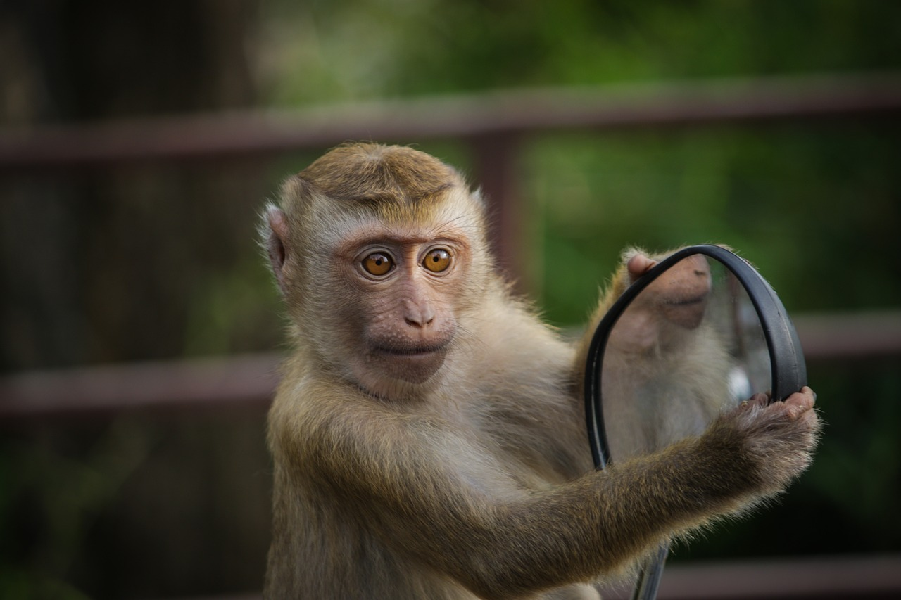
The Importance of Positive Self-Talk
Boosts Confidence
Enhances Performance
Improves Relationships
Positive self-talk can significantly improve self-esteem.
It encourages a more optimistic view of oneself.
Engaging in positive self-talk can lead to better focus and motivation.
It helps individuals achieve their goals more effectively.
Positive self-talk fosters a more compassionate attitude towards others.
It can lead to healthier and more supportive interactions.
3
Harnessing the Power of Positive Self-Talk

Slide 7

Negative Self-Talk and Its Effects
Self-Criticism
Mental Health Risks
Common Phrases
Negative self-talk is when individuals criticize or belittle themselves.
Negative self-talk undermines self-esteem and confidence.
It can lead to decreased self-esteem and increased stress.
It raises the risk of anxiety and depression.
Common phrases associated with negative self-talk include:
- 'I'm not good enough.'
- 'I'll never be able to do this.'
- 'I'm a failure.'
These phrases can reinforce negative beliefs and hinder personal growth.
4
Harnessing the Power of Positive Self-Talk

Slide 8

Recognizing and Challenging Negative Self-Talk
Identify Patterns
Replace Negativity
Embrace Kindness
Recognize negative self-talk patterns, such as self-criticism or pessimism.
Pay attention to recurring thoughts that undermine your confidence.
Challenge negative self-talk by replacing it with positive and encouraging phrases.
Use affirmations to counteract self-doubt and foster a positive mindset.
Practice self-compassion and treat oneself with kindness and understanding.
Acknowledge your feelings without judgment and offer yourself support.
5
Harnessing the Power of Positive Self-Talk

Slide 9

Practicing Positive Self-Talk
Notice Your Thoughts
Practice Mindfulness
Become aware of your inner dialogue and identify negative self-talk.
Replace these thoughts with positive affirmations to shift your mindset.
Engage in mindfulness exercises to stay present and reduce anxiety.
Cultivate self-compassion to foster a more positive outlook.
Use Affirmations
Track Your Progress
Incorporate positive self-talk phrases into your daily routine.
Use them before challenging tasks or during stressful moments.
Maintain a positive self-talk journal to document your journey.
Reflect on your experiences and celebrate your growth.
6
Harnessing the Power of Positive Self-Talk

Slide 10

Benefits of Positive Self-Talk
Self-Esteem Boost
Performance Gains
Positive self-talk enhances self-esteem and confidence, allowing individuals to believe in their abilities.
It fosters a more positive self-image, leading to greater self-acceptance.
Engaging in positive self-talk can lead to improved performance in various tasks and challenges.
It helps individuals focus on their strengths, resulting in higher achievement levels.
Stronger Relationships
Resilience Growth
Positive self-talk contributes to better communication and understanding in relationships.
It encourages empathy and reduces negative interactions with others.
Practicing positive self-talk increases resilience, enabling individuals to cope with setbacks more effectively.
It promotes a growth mindset, encouraging persistence in the face of challenges.
7
Harnessing the Power of Positive Self-Talk

Slide 11

Applying Positive Self-Talk in Daily Life
Pre-Task Affirmations
Daily Encouragement
Sharing Positivity
Use positive self-talk before a challenging task to boost confidence.
Remind yourself of past successes to reduce stress.
Practice positive self-talk during daily activities like exercise.
Encourage yourself with affirmations while engaging in hobbies.
Share your positive self-talk with friends to inspire them.
Encourage family members to adopt positive affirmations.
8
Harnessing the Power of Positive Self-Talk

Slide 12

Overcoming Challenges and Setbacks
Reframe Challenges
Practice Kindness
Build Confidence
Use positive self-talk to view challenges as opportunities for growth.
Shift your perspective to see setbacks as learning experiences.
Treat yourself with compassion and understanding during tough times.
Acknowledge your feelings and give yourself permission to feel.
Focus on your strengths and past successes to boost your self-esteem.
Recognize that resilience is built through overcoming difficulties.
9
Harnessing the Power of Positive Self-Talk

Slide 13

Building Resilience and Perseverance
Growth Mindset
Positive Self-Talk
Celebrate Progress
Embrace challenges as opportunities to learn and grow.
View failures as stepping stones to success.
Use affirmations to boost your confidence.
Replace negative thoughts with constructive ones.
Acknowledge small achievements along the way.
Focus on the journey rather than just the destination.
10
Harnessing the Power of Positive Self-Talk

Slide 14

Conclusion
Empower Yourself
Achieve Your Goals
Positive self-talk is a powerful tool for building confidence and resilience.
It fosters a supportive relationship with yourself.
Practicing positive self-talk helps you stay focused on your objectives.
It enhances your ability to overcome challenges and reach your aspirations.
11
Harnessing the Power of Positive Self-Talk

Slide 15

Reflection and Next Steps
Self-Talk Reflection
Commitment to Practice
Examine how your internal dialogue influences your interactions with others.
Identify specific instances where your self-talk could be more uplifting.
Set aside time each day to foster a positive inner voice.
Discover new resources like podcasts or online courses to support your journey.
12
Harnessing the Power of Positive Self-Talk

Slide 16

Additional Resources
Self-Talk Books
Resilience Workshops
Well-Being Apps
Explore transformative books that foster positive self-talk and mindfulness.
These resources offer practical strategies for enhancing your mental well-being.
Join online courses designed to build resilience and boost your confidence.
Equip yourself with tools to navigate life's challenges effectively.
Discover mobile apps and games that promote positive self-talk.
Support your mental wellness journey with these engaging tools.
13
Harnessing the Power of Positive Self-Talk

Slide 17

Final Thoughts
Self-Talk Journey
Step-by-Step
Guideline Reminder
Positive self-talk is a continuous journey that requires time and effort.
Take small steps towards improving your self-talk. Each step counts.
Keep in mind the guidelines for effective self-talk. They will help you stay on track.
Embrace Progress
Stay Positive
Celebrate your progress, no matter how small it may seem.
Focus on positive affirmations to uplift your mindset.
14
Harnessing the Power of Positive Self-Talk

Slide 18

References
Source List
Further Learning
Smith, J. (2023). Understanding Data Science. A practical guide to the key concepts and tools in data science.
Johnson, A. (2022). The Future of AI. Insights into the latest advancements and their implications.
Coursera: Data Science Specialization by Johns Hopkins University. A structured program that equips learners with essential data science skills.
edX: AI for Everyone by Andrew Ng. An accessible introduction to AI, covering its impact and applications across various sectors.
15
Harnessing the Power of Positive Self-Talk

