Slide 1


Reflecting on Achievements and Building Confidence
Developing Self-Awareness, Setting Goals, and Cultivating a Growth Mindset for Personal Success

Slide 2
Table of Contents
Introduction to Reflecting on Achievements and…
What is Confidence?
Why is Reflecting on Achievements Important?
How to Reflect on Achievements
Positive Self-Talk
Goal-Setting
Overcoming Obstacles
Building Resilience
Celebrating Successes
Reflecting on Progress
Conclusion
Additional Resources
Homework Assignment
04
05
06
07
08
09
10
11
12
13
14
15
16

Slide 3
Table of Contents
Extension Activity
Parent Engagement
Conclusion and Final Thoughts
Final Slide
17
18
19
20

Slide 4

Introduction to Reflecting on Achievements and Building Confidence
Welcome to the Lesson
Lesson Objectives
Expected Outcomes
Welcome to our lesson on reflecting on achievements and building confidence!
This lesson is designed to help you develop a positive self-image, set goals, and strive for excellence.
By the end of this lesson, you will be able to identify your strengths and weaknesses, set realistic goals, and develop a growth mindset.
4
Reflecting on Achievements and Building Confidence

Slide 5

What is Confidence?
Definition of Confidence
Importance of Confidence
Building Confidence
Confidence is the feeling of self-assurance and faith in one's abilities.
It's essential to have confidence to take risks, try new things, and achieve our goals.
Confidence can be developed and improved through practice, positive self-talk, and self-reflection.
5
Reflecting on Achievements and Building Confidence

Slide 6
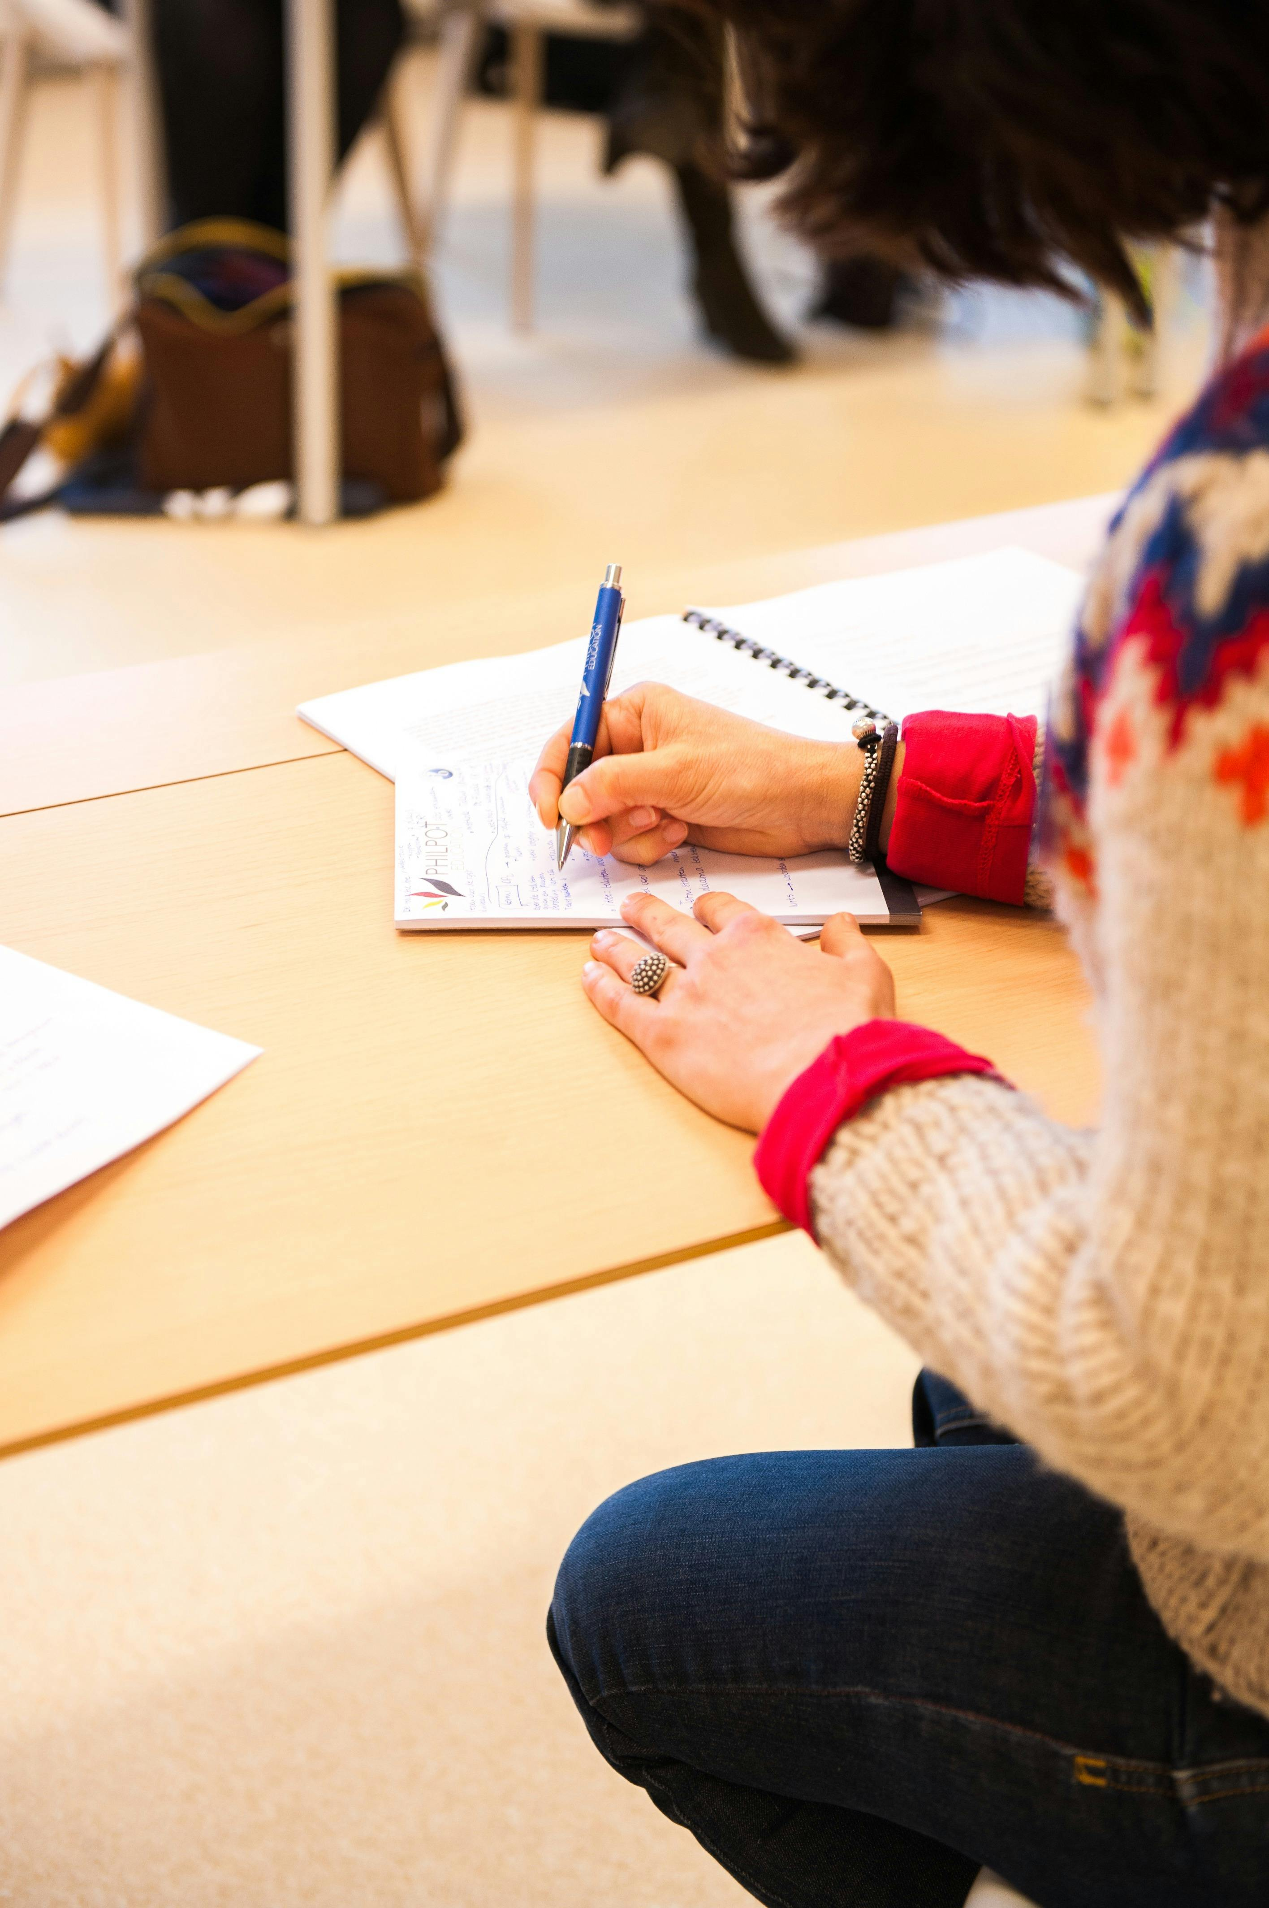
Why is Reflecting on Achievements Important?
Identifying Strengths and Weaknesses
Reflecting on achievements helps us identify our strengths and weaknesses.
Setting Goals and Growth Mindset
It helps us set realistic goals and develop a growth mindset.
Building Self-Awareness and Self-Esteem
Reflecting on achievements also helps us develop a sense of self-awareness and self-esteem.
6
Reflecting on Achievements and Building Confidence

Slide 7

How to Reflect on Achievements
Maintain a Journal
Keep a journal or diary to record your thoughts, feelings, and experiences.
Celebrate Accomplishments
Write down three things you're proud of accomplishing each day or week.
Analyze and Improve
Reflect on what you did well and what you could improve on in the future.
7
Reflecting on Achievements and Building Confidence

Slide 8

Positive Self-Talk
Understanding Positive Self-Talk
Benefits of Positive Self-Talk
Examples of Positive Self-Talk
Positive self-talk is the practice of speaking kindly and encouragingly to oneself.
It helps to build confidence, self-esteem, and a growth mindset.
Examples of positive self-talk include "I can do this," "I'm capable and competent," and "I'm proud of myself."
8
Reflecting on Achievements and Building Confidence

Slide 9
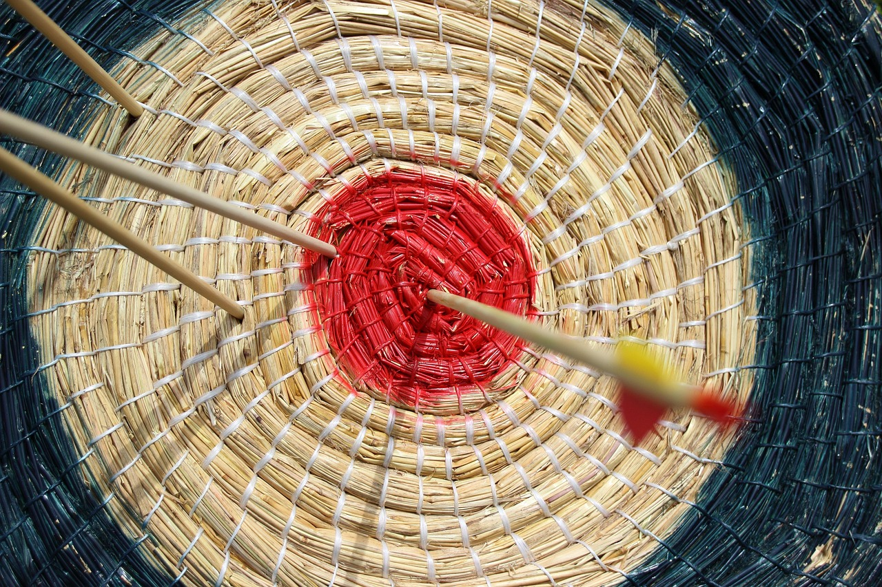
Goal-Setting
Understanding Goal-Setting
Benefits of Goal-Setting
Examples of Goal-Setting
Goal-setting is the process of identifying and setting specific, achievable objectives.
It helps to create a sense of direction and purpose.
Examples of goal-setting include setting academic, personal, or career goals.
9
Reflecting on Achievements and Building Confidence

Slide 10
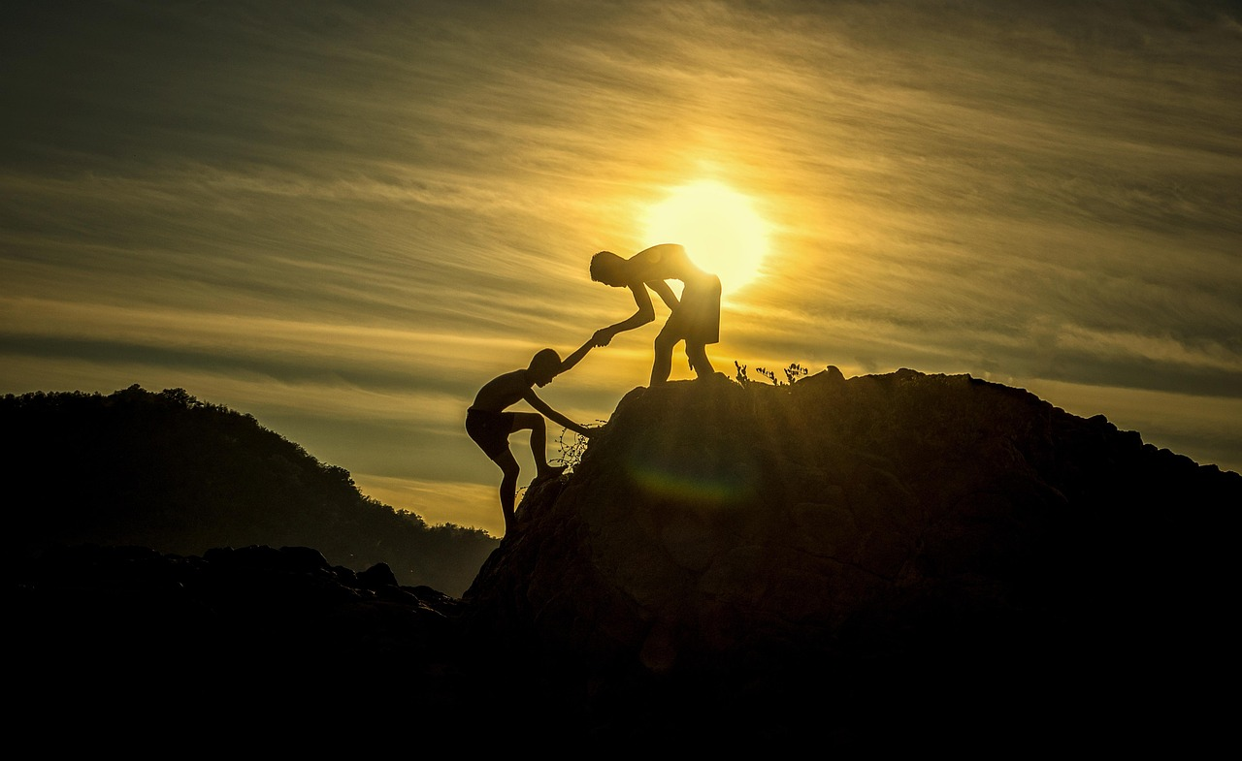
Overcoming Obstacles
Definition of Obstacles
Strategies to Overcome Obstacles
Examples of Common Obstacles
Obstacles are challenges or barriers that prevent us from achieving our goals.
We can overcome obstacles by using positive self-talk, seeking support from others, and developing a growth mindset.
Examples of obstacles include fear, self-doubt, and negative self-talk.
10
Reflecting on Achievements and Building Confidence

Slide 11
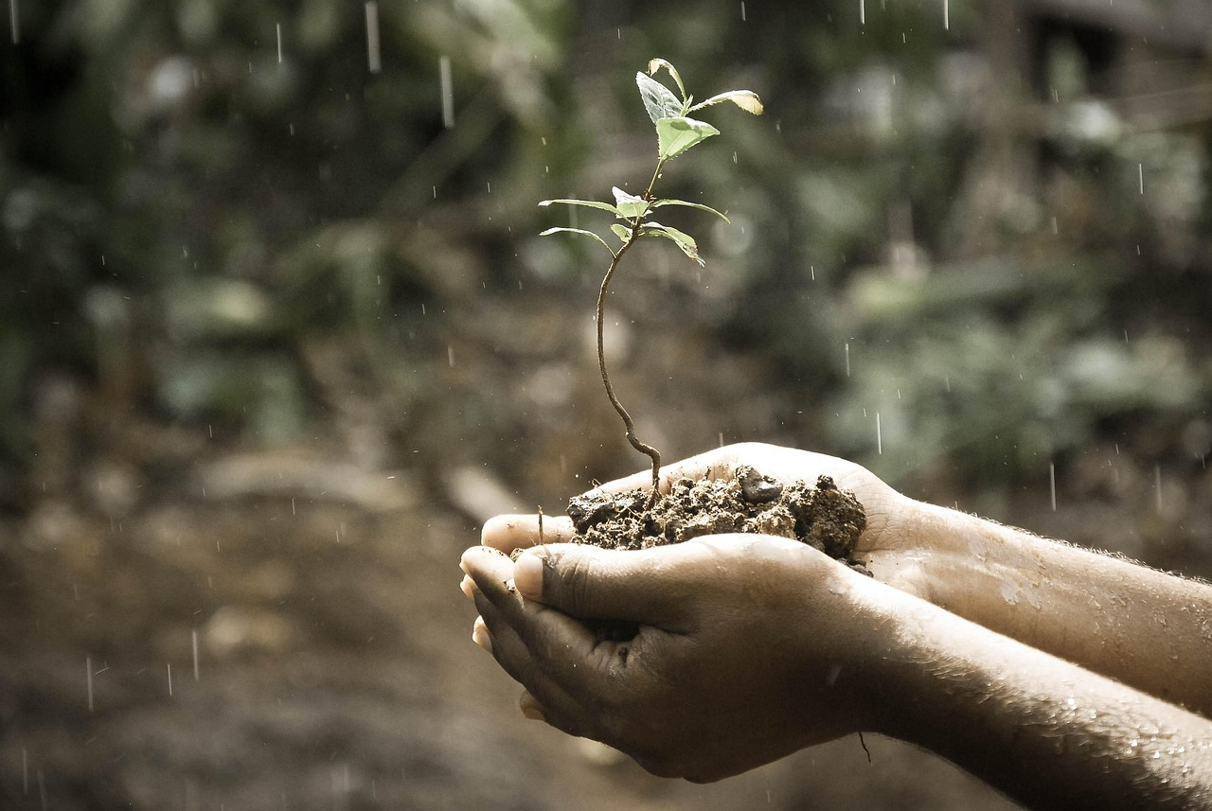
Building Resilience
Understanding Resilience
Resilience is the ability to bounce back or recover from challenges or setbacks.
Ways to Build Resilience
We can build resilience by developing a growth mindset, practicing self-care, and seeking support from others.
Examples of Resilience
Examples of resilience include coping with failure, overcoming adversity, and persevering through difficult times.
11
Reflecting on Achievements and Building Confidence

Slide 12
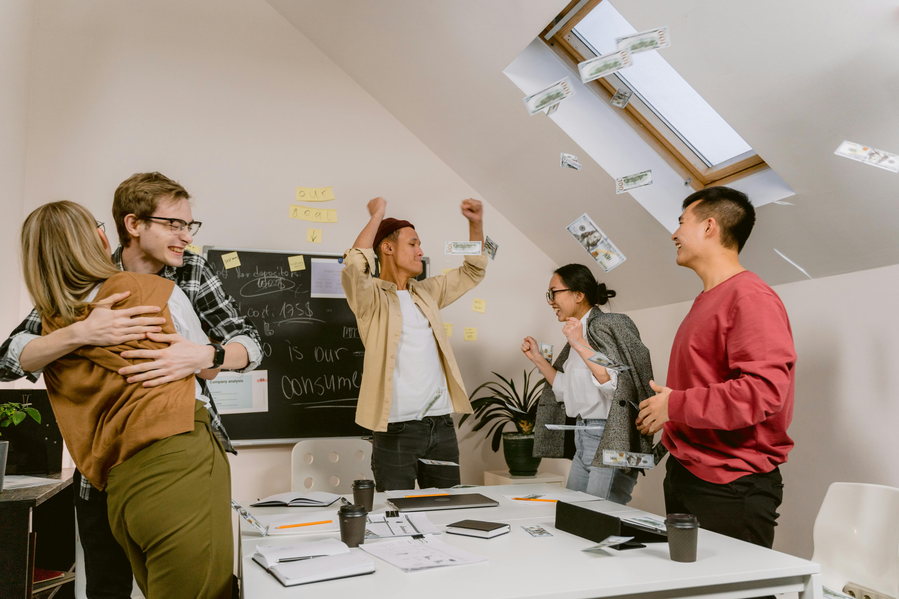
Celebrating Successes
The Importance of Celebrating Successes
Celebrating successes helps to build confidence, self-esteem, and a sense of accomplishment.
Ways to Celebrate Achievements
We can celebrate successes by acknowledging and rewarding ourselves, sharing our achievements with others, and reflecting on what we did well.
Examples of Celebrating Successes
Examples of celebrating successes include treating ourselves to something special, sharing our achievements on social media, and writing in a journal.
12
Reflecting on Achievements and Building Confidence

Slide 13
Reflecting on Progress
Importance of Reflecting on Progress
Methods for Reflection
Examples of Reflection Practices
Reflecting on progress helps us to identify areas for improvement and develop a growth mindset.
We can reflect on progress by keeping a journal, seeking feedback from others, and evaluating our achievements.
Examples of reflecting on progress include writing in a journal, asking for feedback from teachers or peers, and evaluating our grades or performance.
13
Reflecting on Achievements and Building Confidence

Slide 14
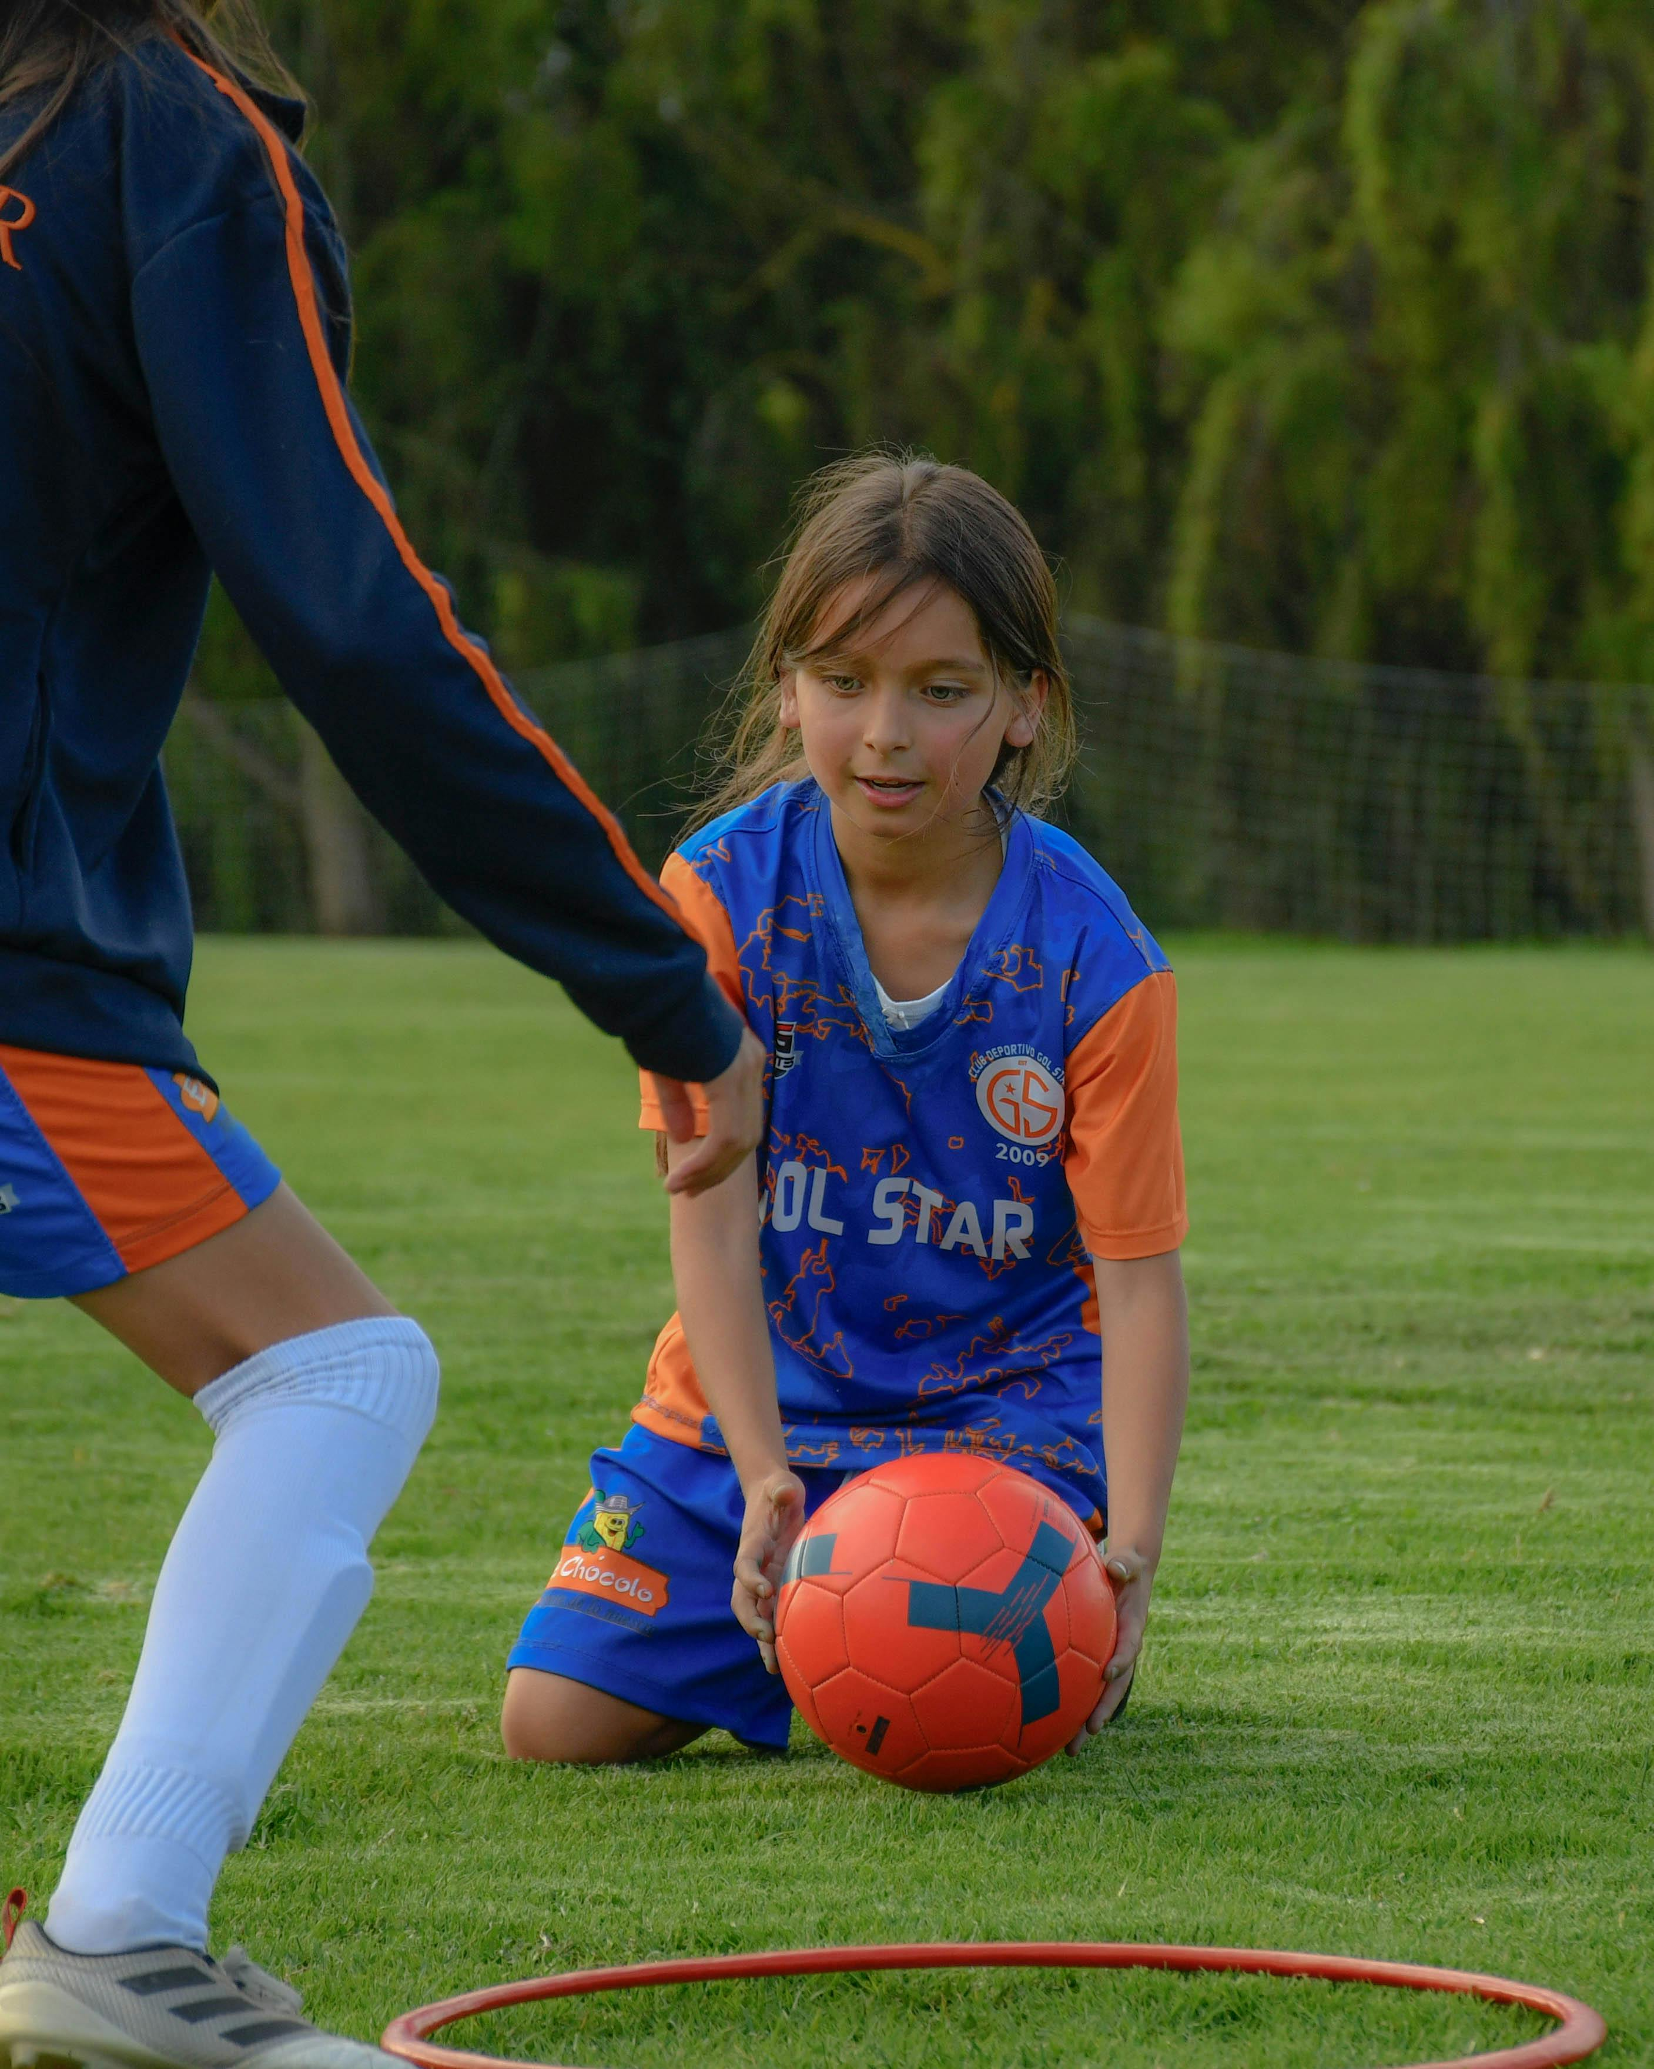
Conclusion
Reflecting on Achievements
Strategies for Positive Growth
Celebrate and Reflect
Reflecting on achievements and building confidence is an ongoing process that requires patience, persistence, and practice.
By using the strategies and techniques learned in this lesson, you can develop a positive self-image, set goals, and strive for excellence.
Remember to always be kind to yourself, celebrate your successes, and reflect on your progress.
14
Reflecting on Achievements and Building Confidence

Slide 15

Additional Resources
Visit Our Website
Explore Online Tools
Prioritize Mental Health
For additional support and resources, please visit our website or consult with a teacher or counselor.
You can also find many online resources and tools to help you build confidence and reflect on your achievements.
Remember to always prioritize your mental health and well-being.
15
Reflecting on Achievements and Building Confidence

Slide 16
Homework Assignment
Keep a Journal or Diary
Daily or Weekly Accomplishments
Reflection and Improvement
For your homework assignment, please keep a journal or diary for one week to record your thoughts, feelings, and experiences.
Write down three things you're proud of accomplishing each day or week.
Reflect on what you did well and what you could improve on in the future.
16
Reflecting on Achievements and Building Confidence

Slide 17
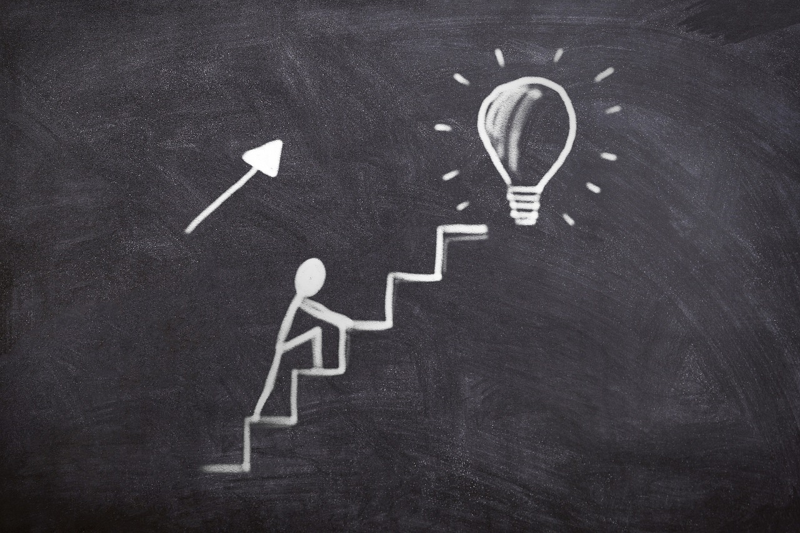
Extension Activity
Create a Vision Board or Collage
Incorporate Inspiring Elements
Share and Explain Your Vision
For an extension activity, please create a vision board or collage that represents your goals and aspirations.
Include images, words, and symbols that inspire and motivate you.
Share your vision board or collage with a friend or family member and explain why you chose each item.
17
Reflecting on Achievements and Building Confidence

Slide 18
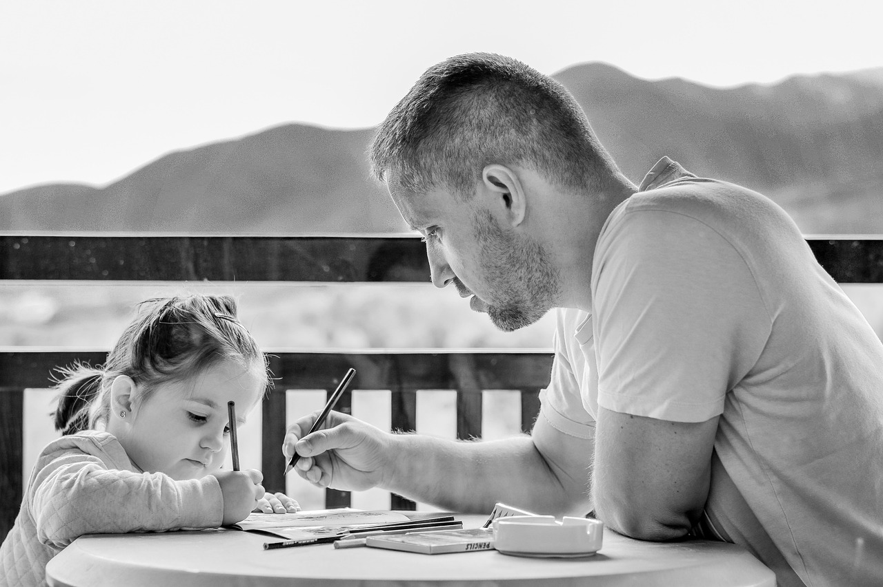
Parent Engagement
Encouraging Reflection and Confidence
Parents and guardians can support their child's learning by encouraging them to reflect on their achievements and build confidence.
Engaging in Conversations
Please ask your child about their experiences and provide feedback and support.
Goal Setting and Growth Mindset
You can also help your child set goals and develop a growth mindset.
18
Reflecting on Achievements and Building Confidence

Slide 19

Conclusion and Final Thoughts
Reflecting on Achievements
In conclusion, reflecting on achievements and building confidence is an essential life skill that can help you achieve your goals and strive for excellence.
Celebrating Successes
Remember to always be kind to yourself, celebrate your successes, and reflect on your progress.
Practicing and Persevering
Keep practicing and persevering, and you will see improvement and growth over time.
19
Reflecting on Achievements and Building Confidence

Slide 20
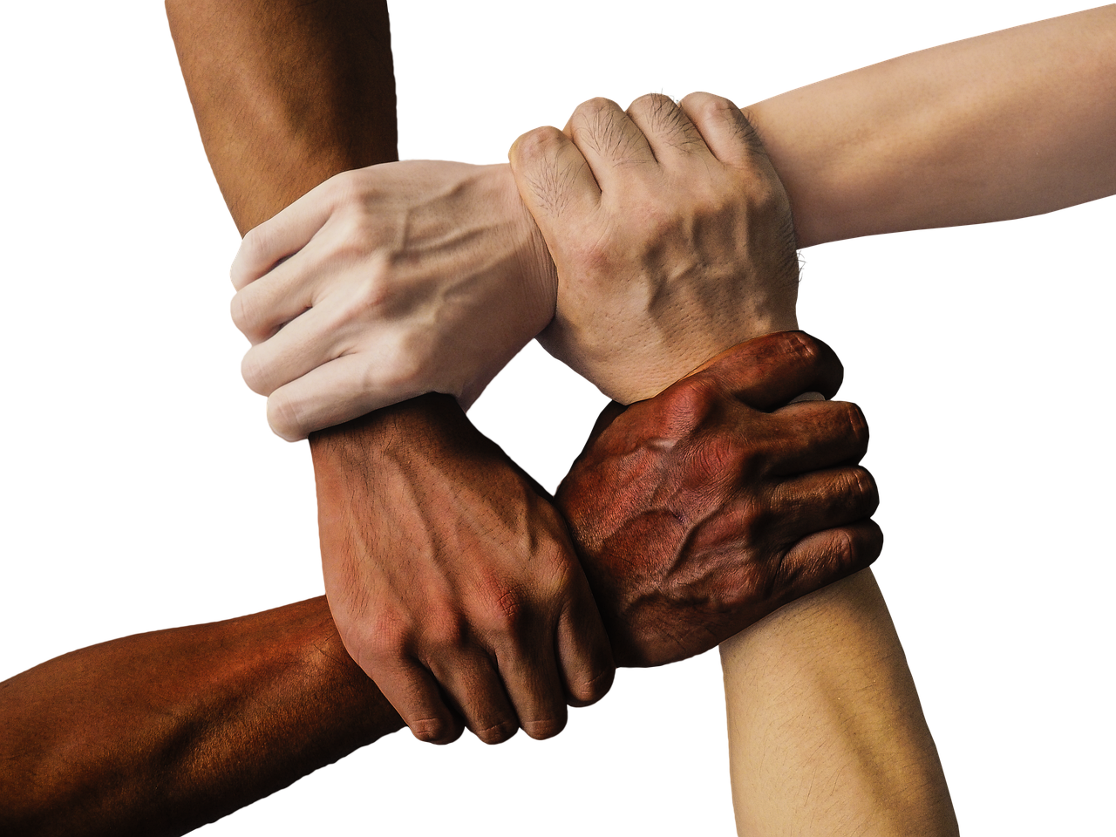
Final Slide
Final Slide
Thank you for participating in this lesson on reflecting on achievements and building confidence.
We hope you found it helpful and informative.
Please don't hesitate to reach out if you have any questions or need further support.
20
Reflecting on Achievements and Building Confidence

