Slide 1












Exploring Human Nature in Lord of the Flies
An In-Depth Analysis of Societal Breakdown, Psychological Archetypes, Power Dynamics, and Moral Philosophy

Slide 2

Table of contents
Lesson Introduction - Lord of the Flies Critical An…
Subject Knowledge - Societal Breakdown and Human Na…
Subject Knowledge - Psychological Archetypes (Part …
Subject Knowledge - Power Dynamics and Psychologica…
Subject Knowledge - Symbolic Landscape and Moral Ph…
Activity 1 - Character Motivation Mapping (5 Minute…
Activity 2 - Symbolic Object Reconstruction (5 Minu…
Activity 3 - Ethical Scenario Simulation (5 Minutes)
Reflection and Critical Thinking
Deeper Reflection and Personal Insights
01
02
03
04
05
06
07
08
09
10

Slide 3
Table of contents
Next Steps - Advanced Exploration Pathways
Conclusion and Key Takeaways
11
12

Slide 4

Lesson Introduction - Lord of the Flies Critical Analysis
Unraveling Human Nature's Dark Depths
Novel published post-World War II
Profound exploration of human psychology
Examination of societal breakdown mechanisms
Challenges fundamental assumptions about human nature
Exploring Human Nature in Lord of the Flies

Slide 5
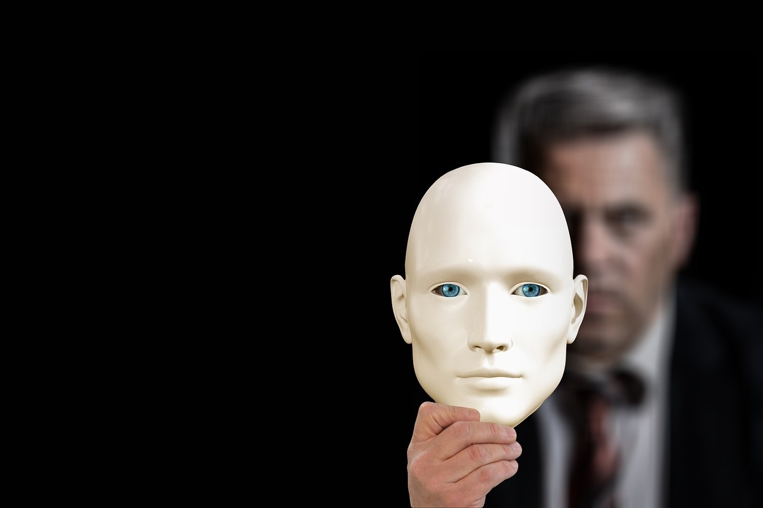
Subject Knowledge - Societal Breakdown and Human Nature (Part 1)
Key Concepts
Detailed Breakdown
Civilization is a carefully maintained construct.
Thin veneer separating order from chaos.
Primal instincts lurk beneath social conditioning.
Institutional frameworks prevent primitive behaviors.
Removal of accountability triggers rapid social disintegration.
Individual survival mechanisms override collective welfare.
Psychological Mechanism Diagram
Visual Concept
Structured Society → Removed Constraints → Primitive Survival Mode
Image depicting a society crumbling under the weight of primal instincts, with civilization fading into chaos.
Exploring Human Nature in Lord of the Flies

Slide 6

Subject Knowledge - Psychological Archetypes (Part 2)
Ralph: Democratic Leadership
Jack: Authoritarian Dominance
Piggy: Intellectual Rationality
Represents rational thinking
Embodies civilization's constructive potential
Attempts to maintain structured governance
Personifies aggressive power consolidation
Demonstrates tribal leadership mechanisms
Exploits emotional manipulation
Symbolizes scientific reasoning
Represents vulnerable intellectual approach
Highlights logic's fragility in chaotic environments
Exploring Human Nature in Lord of the Flies

Slide 7

Subject Knowledge - Power Dynamics and Psychological Regression (Part 3)
Leadership Emergence Mechanisms
Charismatic manipulation strategies can sway group dynamics significantly.
Fear often serves as a primary motivational trigger for individuals and groups.
Emotional resonance can sometimes supersede rational governance in decision-making processes.
Psychological Regression Processes
Survival instincts have the potential to override learned behaviors in challenging situations.
Rapid transformation of social norms can occur under extreme circumstances.
The breakdown of individual moral constraints may lead to unexpected behaviors within a group setting.
Key Research Insights
Group dynamics play a crucial role in altering individual behavior patterns.
Emotional triggers are often more potent in influencing actions than rational arguments.
Survival needs can generate complex behavioral mutations, showcasing the adaptability of human nature.
Exploring Human Nature in Lord of the Flies

Slide 8
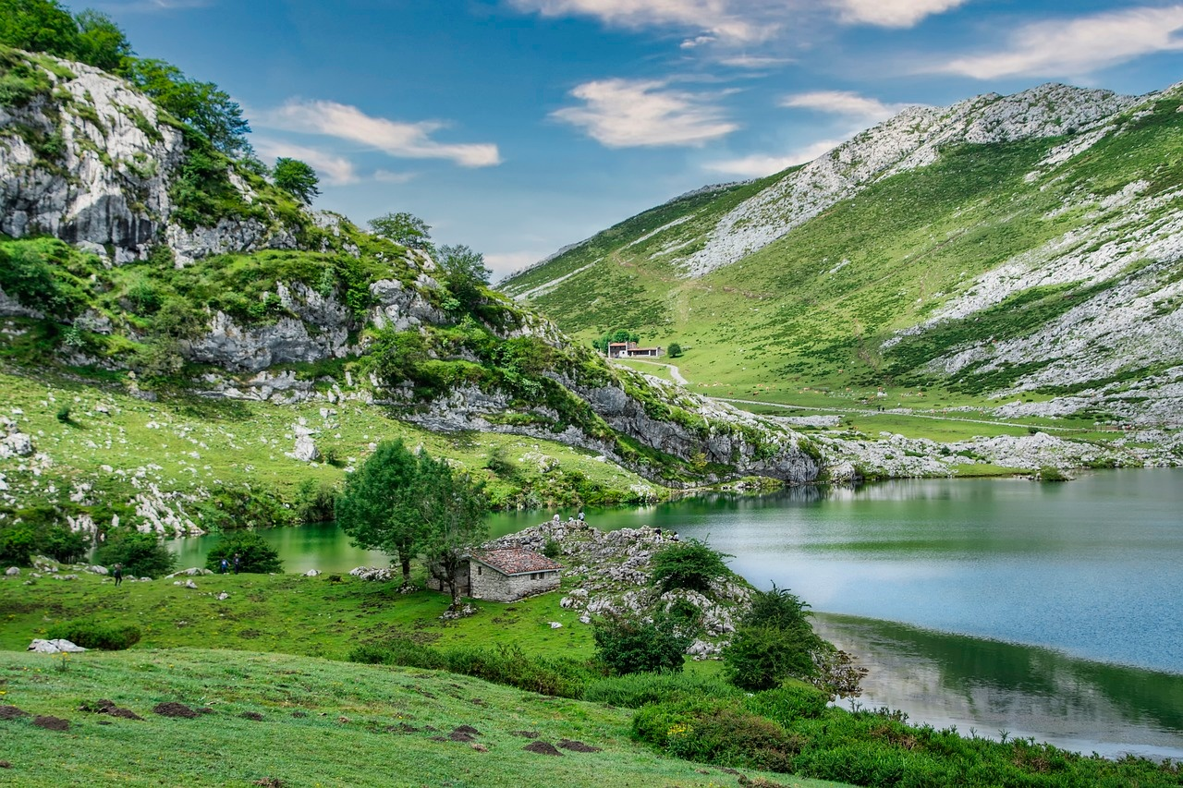
Subject Knowledge - Symbolic Landscape and Moral Philosophy (Part 4)
Environmental Symbolism
Moral Philosophical Exploration
Theoretical Frameworks
The island as a psychological metaphor reflecting inner turmoil.
The landscape mirrors the characters' internal psychological states.
The natural environment actively participates in the narrative progression.
Challenging romanticized notions of human innocence in the face of adversity.
Exploring the inherent human capacity for both creation and destruction.
Investigating the origins of moral behavior - learned or intrinsic?
Contrasting Rousseau's belief in innate human goodness with Hobbes' view of inherent selfishness.
Viewing civilization as a fragile construct of the human psyche.
Delving into the intricate moral complexities that define human nature.
Exploring Human Nature in Lord of the Flies

Slide 9

Activity 1 - Character Motivation Mapping (5 Minutes)
Objective
Analyze Psychological Transformations
Activity Structure
Provide character motivation worksheets
Guided mapping of psychological changes
Small group collaborative analysis
Key Focus Areas
Tracking individual character development
Identifying psychological trigger points
Understanding motivational shifts
Exploring Human Nature in Lord of the Flies

Slide 10
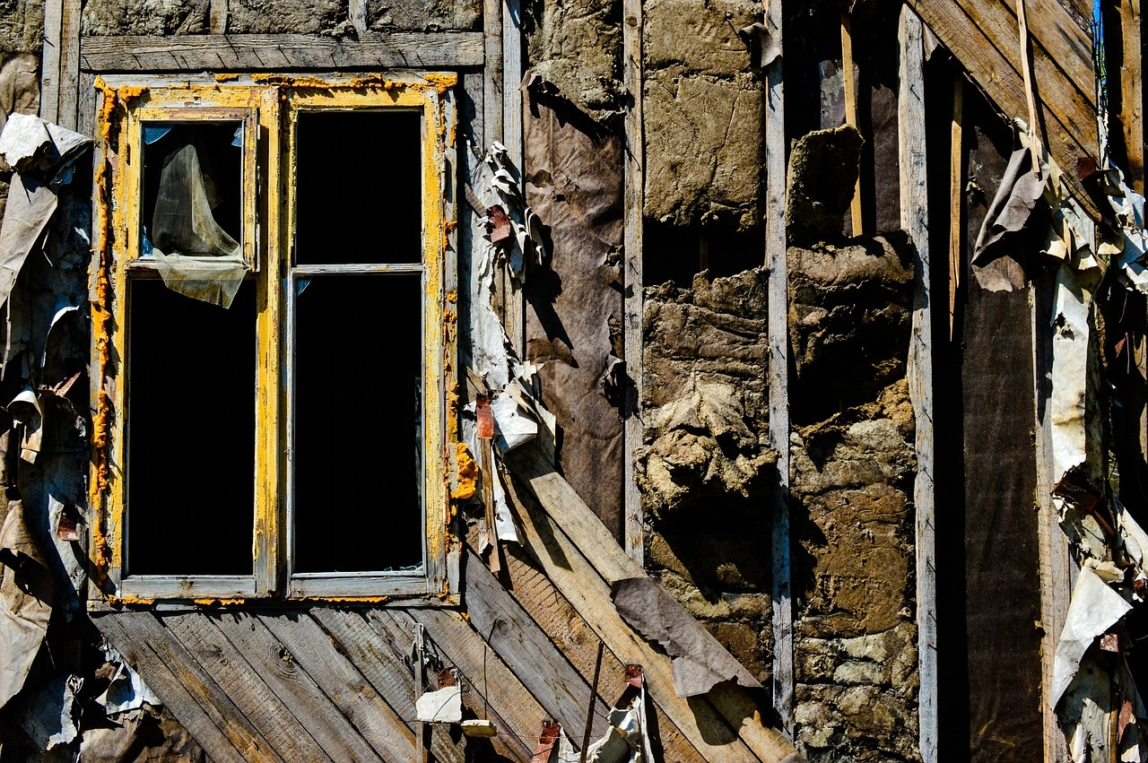
Activity 2 - Symbolic Object Reconstruction (5 Minutes)
Objective
Activity Components
Learning Outcomes
Metaphorical Interpretation Exercise
Recreate key symbolic objects: Conch (Symbol of authority and order), Glasses (Representation of intellect and vision)
Develop multi-perspective interpretations: Discuss various symbolic meanings with peers, Explore how objects evolve throughout the novel
Create visual representations: Draw or craft symbolic objects in groups, Present interpretations through artistic mediums
Enhanced symbolic thinking skills
Improved creative interpretation abilities
Deeper understanding of the text's symbolic layers
Exploring Human Nature in Lord of the Flies

Slide 11

Activity 3 - Ethical Scenario Simulation (5 Minutes)
Objective
Explore Moral Decision-Making
Simulation Design
Present complex ethical dilemmas
Encourage perspective-taking
Structured argumentative approach
Key Exploration Areas
Individual vs. collective moral choices
Psychological pressure points
Ethical reasoning development
Exploring Human Nature in Lord of the Flies

Slide 12

Reflection and Critical Thinking
Guided Reflection Questions
Personal Assessment Framework
How do individual psychological characteristics influence group dynamics?
What mechanisms trigger moral compromise?
How do symbolic representations reveal psychological truths?
Self-analysis of ethical boundaries
Exploration of leadership potential
Understanding collective behavior patterns
Exploring Human Nature in Lord of the Flies

Slide 13
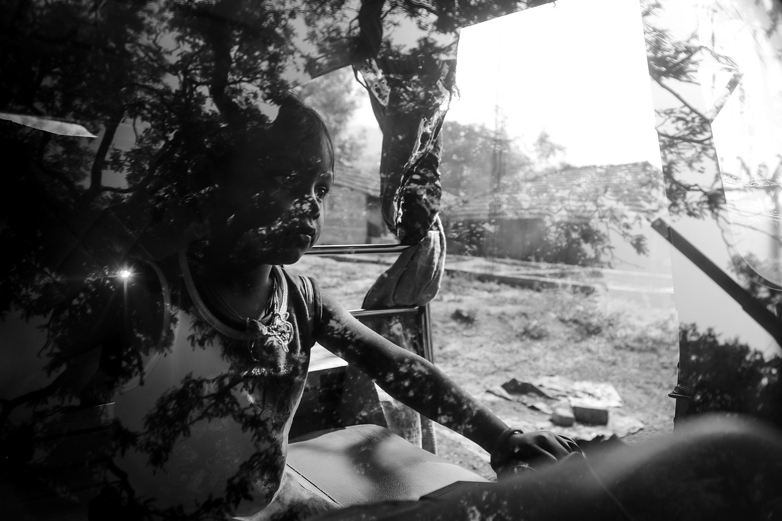
Deeper Reflection and Personal Insights
Self-Reflection Journey
Emotional Intelligence Development
Engage in introspection to understand personal biases and triggers.
Reflect on moments of moral compromise and ethical decision-making.
Explore how individual characteristics influence group dynamics.
Enhance emotional awareness to navigate complex social interactions.
Cultivate empathy to understand diverse perspectives and motivations.
Develop strategies for managing emotional responses in challenging situations.
Ethical Decision-Making Skills
Psychological Resilience Building
Personal Growth and Transformation
Analyze ethical dilemmas to practice critical thinking and moral reasoning.
Evaluate the impact of personal values on decision-making processes.
Consider the long-term consequences of ethical choices on oneself and others.
Identify sources of inner strength and coping mechanisms during adversity.
Learn to adapt to changing circumstances with resilience and flexibility.
Cultivate a growth mindset to embrace challenges as opportunities for growth.
Recognize the potential for personal agency in shaping one's narrative.
Embrace the journey of self-discovery and continuous self-improvement.
Harness newfound insights to navigate future challenges with wisdom and clarity.
Exploring Human Nature in Lord of the Flies

Slide 14

Next Steps - Advanced Exploration Pathways
Advanced Psychological Analysis Workshop
Dive deeper into psychological theories and their application in literary analysis.
Explore the intricacies of human behavior and motivations in complex narratives.
Engage in hands-on activities to analyze characters' psychological transformations.
Comparative Literature Exploration
Compare and contrast themes of human nature in different literary works.
Analyze how various authors depict societal breakdown and psychological archetypes.
Gain a broader perspective on the exploration of human nature across different cultures and time periods.
Ethical Decision-Making Simulation
Participate in simulated scenarios to navigate complex moral dilemmas.
Develop critical thinking skills in evaluating ethical choices and consequences.
Enhance your ability to make sound ethical decisions under pressure.
Social Dynamics Research Project
Conduct a research project on the impact of social dynamics on individual behavior.
Explore how group interactions influence decision-making processes.
Present findings on the role of societal structures in shaping human nature.
Creative Narrative Reconstruction
Engage in a creative project to reconstruct a narrative exploring human nature themes.
Utilize storytelling techniques to convey psychological insights and character developments.
Showcase your interpretation of human nature through a unique narrative lens.
Exploring Human Nature in Lord of the Flies

Slide 15
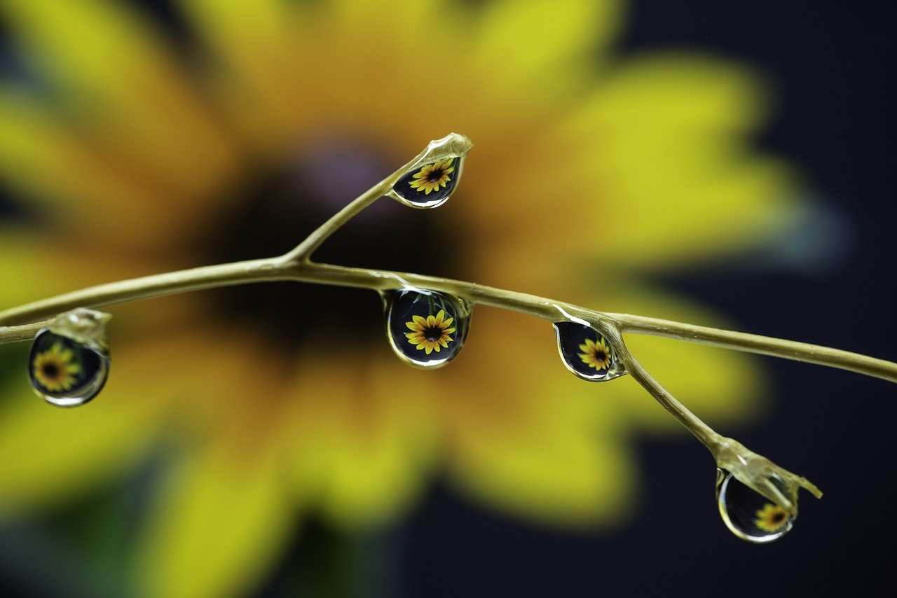
Conclusion and Key Takeaways
Human Nature's Complexity
Psychological Mechanisms
Lord of the Flies showcases the intricate layers of human nature.
William Golding's exploration delves into the depths of psychological complexities.
Understanding human behavior requires a nuanced approach.
The novel highlights the interplay between individual psychology and group dynamics.
Psychological triggers influence decision-making and behavior.
Unraveling these mechanisms is crucial for comprehending societal interactions.
Importance of Psychological Awareness
Continuous Self-Reflection
Provocative Statement
Recognizing one's own psychological tendencies is essential for personal growth.
Self-reflection aids in understanding motivations and actions.
Developing emotional intelligence enhances interpersonal relationships.
Engaging in regular introspection fosters personal development.
Evaluating moral compass and ethical boundaries is a lifelong journey.
Growth stems from a willingness to confront and learn from one's experiences.
In the tapestry of human nature, threads of darkness and light intertwine to weave the fabric of our existence.
Exploring Human Nature in Lord of the Flies

