Slide 1

Advancing the Future: AI in Natural Language Processing and Robotics
Exploring Transformative Technologies, Applications, and Challenges in AI-powered NLP and Robotics

Slide 2
Table of Contents
Introduction to Advanced AI Applications
What is Natural Language Processing (NLP)?
What is Robotics?
Machine Learning Algorithms
Deep Learning Techniques
Robotics and Computer Vision
Human-Robot Interaction
Applications of AI in NLP and Robotics
Challenges and Limitations
Future of AI in NLP and Robotics
Conclusion
References
Glossary
04
05
06
07
08
09
10
11
12
13
14
15
16

Slide 3
Table of Contents
Further Reading
Summary
Final Thoughts
Call to Action
Thank You
17
18
19
20
21

Slide 4
Introduction to Advanced AI Applications
Transforming Industries with AI
Exploring AI in NLP and Robotics
Comprehensive Understanding of AI
Advanced AI Applications in Natural Language Processing (NLP) and Robotics are transforming industries and revolutionizing the way we live and work.
This presentation will explore the key concepts, techniques, and applications of AI in NLP and Robotics.
This presentation will explore the key concepts, techniques, and applications of AI in NLP and Robotics.
By the end of this presentation, you will have a comprehensive understanding of how AI is revolutionizing NLP and Robotics.
By the end of this presentation, you will have a comprehensive understanding of how AI is revolutionizing NLP and Robotics.
Advanced AI Applications in Natural Language Processing (NLP) and Robotics are transforming industries and revolutionizing the way we live and work.
4
Advancing the Future: AI in Natural Language Processing and Robotics

Slide 5

What is Natural Language Processing (NLP)?
Definition of NLP
Interdisciplinary Nature
NLP is a subfield of artificial intelligence that deals with the interaction between computers and humans in natural language.
It enables machines to process, understand, and generate human language.
NLP combines computer science, linguistics, and cognitive psychology.
This interdisciplinary approach allows for a deeper understanding of human language.
Applications of NLP
Real-World Use Cases
Applications of NLP include language translation, text summarization, and sentiment analysis.
These applications are widely used in various industries.
NLP has many real-world applications, including virtual assistants, chatbots, and language translation software.
These tools enhance user experience and improve communication.
5
Advancing the Future: AI in Natural Language Processing and Robotics

Slide 6
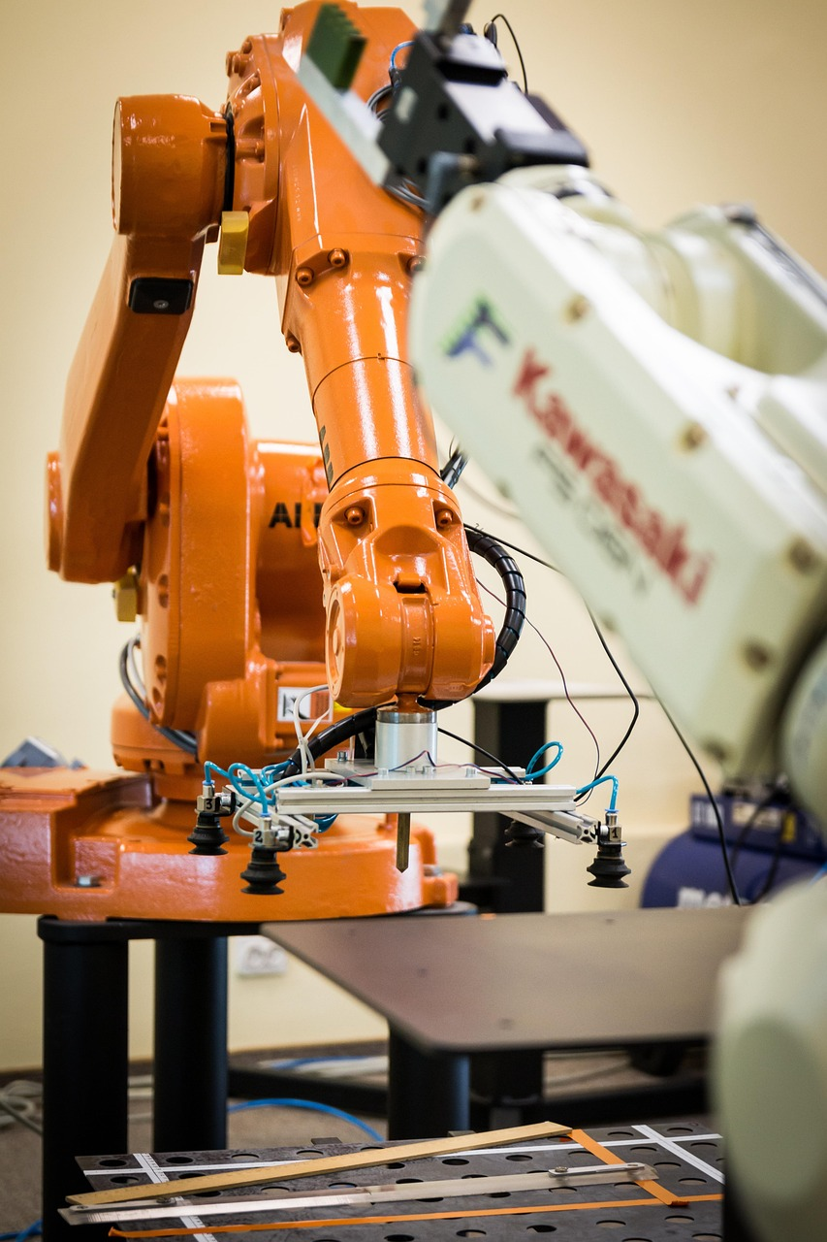
What is Robotics?
Introduction to Robotics
Applications in Manufacturing and Logistics
Robotics is a field of artificial intelligence that deals with the design, construction, and operation of robots.
It combines computer science, engineering, and mathematics to enable robots to interact with and understand their environment.
Applications of robotics include manufacturing, logistics, and healthcare.
Robots are used to streamline processes and improve efficiency in these industries.
Autonomous Vehicles and Robotic Arms
Robotic Surgery in Healthcare
Robotics has many real-world applications, including autonomous vehicles and robotic arms.
These technologies are transforming industries by enhancing precision and automation.
Robotic surgery is a significant application of robotics in healthcare.
It allows for minimally invasive procedures with greater accuracy and control.
6
Advancing the Future: AI in Natural Language Processing and Robotics

Slide 7
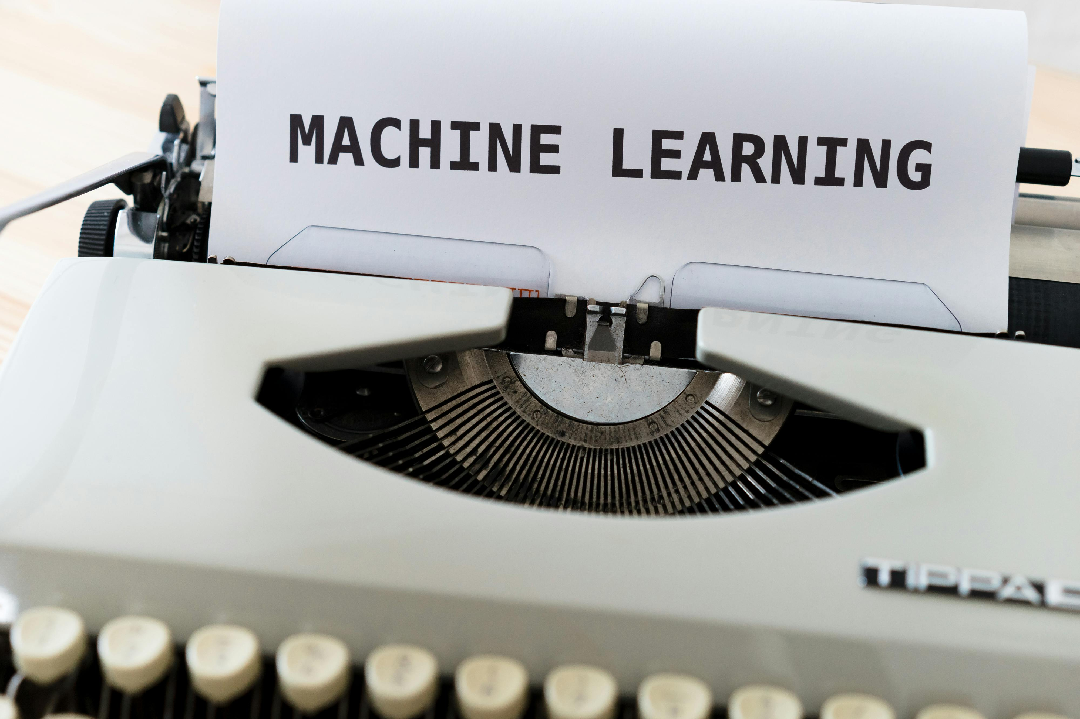
Machine Learning Algorithms
Introduction to Machine Learning Algorithms
Types of Machine Learning
Applications in Recognition Technologies
Machine learning algorithms are a type of artificial intelligence that enables computers to learn from data without being explicitly programmed.
They are designed to identify patterns and make decisions based on data inputs.
Types of machine learning algorithms include supervised, unsupervised, and reinforcement learning.
Each type serves different purposes and is used in various applications.
Applications of machine learning algorithms include image recognition, speech recognition, and natural language processing.
These technologies are widely used in modern software and devices.
Real-World Implementations
Role in Robotics
Machine learning algorithms have many real-world applications, including virtual assistants, chatbots, and self-driving cars.
These implementations showcase the versatility and impact of machine learning in daily life.
Machine learning algorithms are used in robotics to enable robots to learn from their environment and make decisions.
This capability allows robots to adapt and perform tasks in dynamic settings.
7
Advancing the Future: AI in Natural Language Processing and Robotics

Slide 8
Deep Learning Techniques
Understanding Deep Learning Techniques
Real-World Applications of Deep Learning
Deep Learning in Robotics
Impact of Deep Learning on Technology
Deep learning techniques are a type of machine learning algorithm that uses neural networks with multiple layers to analyze and interpret complex data.
Applications of deep learning techniques include image recognition, speech recognition, and natural language processing.
Deep learning techniques have many real-world applications, including virtual assistants, chatbots, and self-driving cars.
These technologies rely on deep learning to process and respond to complex data inputs effectively.
Deep learning techniques are used in robotics to enable robots to learn from their environment and make decisions.
This allows robots to adapt to dynamic situations and perform tasks autonomously.
Deep learning techniques are revolutionizing various industries by enhancing data analysis capabilities.
They are integral to advancements in artificial intelligence and automation.
8
Advancing the Future: AI in Natural Language Processing and Robotics

Slide 9
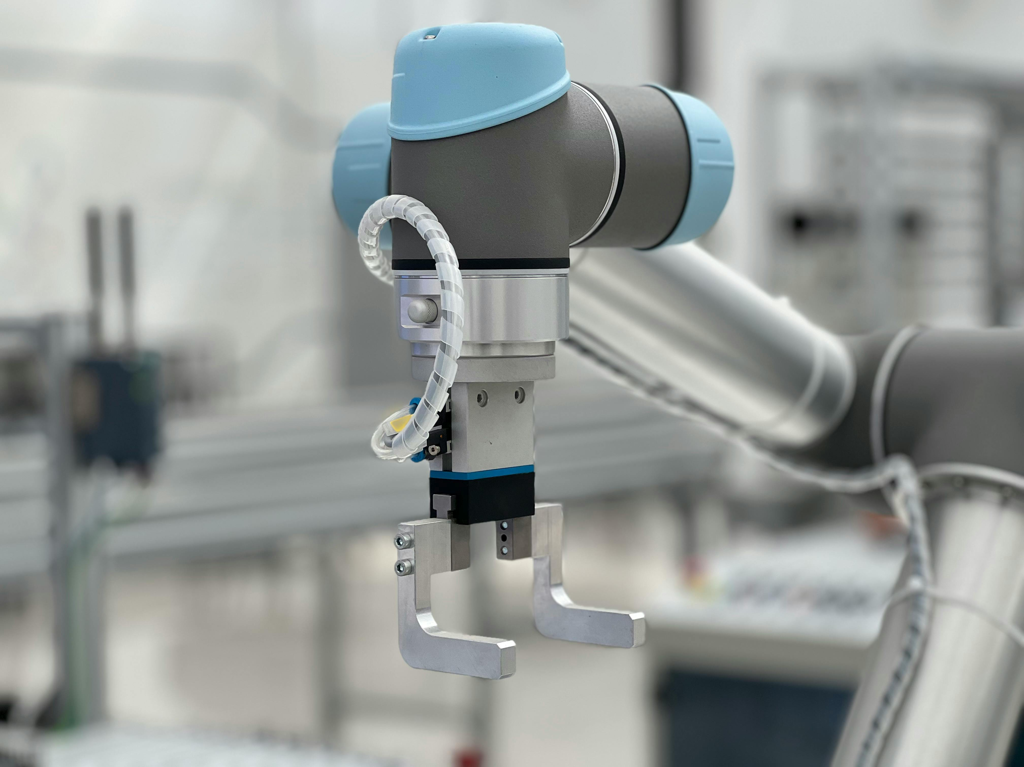
Robotics and Computer Vision
Understanding Computer Vision
Computer vision is a subfield of robotics that deals with the interpretation and understanding of visual data from the environment.
Computer vision is used in robotics to enable robots to interact with and understand their environment.
Applications in Object Recognition
Applications of computer vision include object recognition, tracking, and detection.
These capabilities allow robots to identify and follow objects in their surroundings.
Real-World Implementations
Computer vision has many real-world applications, including autonomous vehicles, robotic arms, and robotic surgery.
These technologies rely on visual data to perform complex tasks with precision.
Enhancing Robotic Interaction
Computer vision enables robots to interact with their environment effectively.
This technology is crucial for tasks requiring environmental awareness and adaptability.
9
Advancing the Future: AI in Natural Language Processing and Robotics

Slide 10
Human-Robot Interaction
Introduction to HRI
Applications in Assistance
Human-robot interaction (HRI) is a field of artificial intelligence that deals with the interaction between humans and robots.
HRI combines computer science, psychology, and engineering to enable robots to interact with humans in a natural and intuitive way.
Applications of HRI include robotic assistants, robotic surgery, and robotic rehabilitation.
These technologies aim to improve human lives by providing support in various domains.
Virtual and Conversational Agents
Autonomous Systems
HRI has many real-world applications, including virtual assistants and chatbots.
These systems are designed to communicate effectively with humans.
Self-driving cars are a significant application of HRI.
They rely on advanced interaction models to ensure safety and efficiency.
10
Advancing the Future: AI in Natural Language Processing and Robotics

Slide 11
Applications of AI in NLP and Robotics
Real-World Applications
Industry Utilization
Revolutionizing Work and Life
Benefits of AI Integration
Challenges in Implementation
AI-powered NLP and Robotics have many real-world applications, including virtual assistants, chatbots, and self-driving cars.
These technologies are transforming everyday interactions and automating complex tasks.
AI-powered NLP and Robotics are used in industries such as healthcare, finance, and transportation.
They enable innovative solutions and improve operational efficiency across sectors.
AI-powered NLP and Robotics have the potential to revolutionize the way we live and work.
Their advancements are reshaping societal norms and professional landscapes.
AI-powered NLP and Robotics have many benefits, including increased efficiency, productivity, and accuracy.
These advantages drive growth and enhance decision-making processes.
AI-powered NLP and Robotics also have challenges, including data quality, bias, and explainability.
Addressing these issues is crucial for ethical and effective deployment.
11
Advancing the Future: AI in Natural Language Processing and Robotics

Slide 12
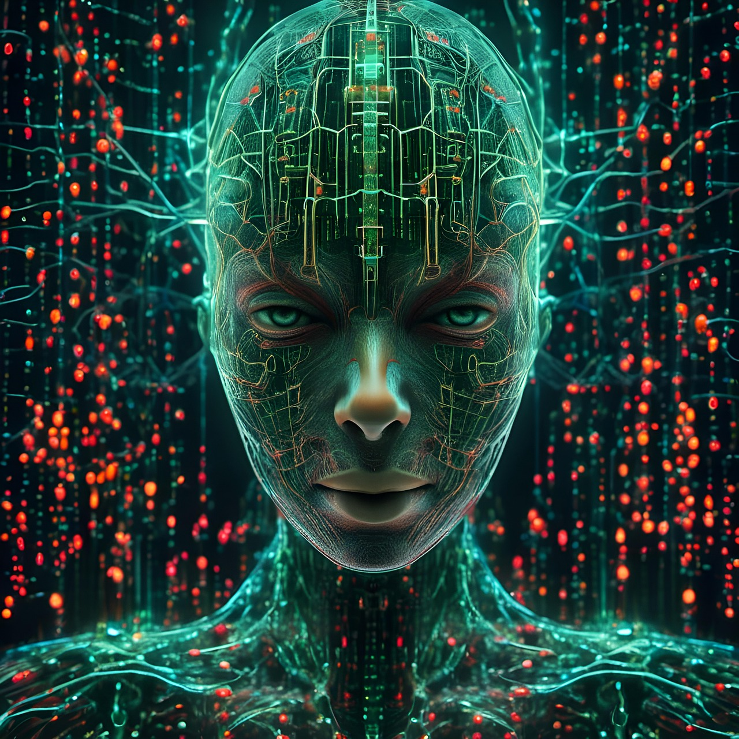
Challenges and Limitations
Data Quality Challenges
Data quality is a major challenge in AI-powered NLP and Robotics, as high-quality data is required to train accurate models.
Without reliable data, the performance and reliability of AI systems can be compromised.
Bias in AI Models
Bias is another challenge in AI-powered NLP and Robotics, as biased models can perpetuate existing social inequalities.
Addressing bias is crucial to ensure fairness and ethical AI applications.
Explainability Issues
Explainability is also a challenge in AI-powered NLP and Robotics, as complex models can be difficult to interpret and understand.
Improving explainability is essential for building trust and transparency in AI systems.
Broader Implications of Challenges
AI-powered NLP and Robotics face many challenges, including data quality, bias, and explainability.
These challenges highlight the need for ongoing research and development to overcome limitations.
12
Advancing the Future: AI in Natural Language Processing and Robotics

Slide 13
Future of AI in NLP and Robotics
Exciting Evolution
The future of AI in NLP and Robotics is exciting and rapidly evolving.
AI-powered NLP and Robotics have the potential to revolutionize the way we live and work.
Autonomous Innovations
Future applications of AI in NLP and Robotics include autonomous vehicles.
These innovations promise to transform transportation and logistics.
Robotic Assistance
Robotic assistants are a key future application of AI in Robotics.
They aim to enhance productivity and provide support in various tasks.
Challenges Ahead
Future challenges of AI in NLP and Robotics include data quality, bias, and explainability.
Addressing these challenges is crucial for the responsible development of AI technologies.
13
Advancing the Future: AI in Natural Language Processing and Robotics

Slide 14
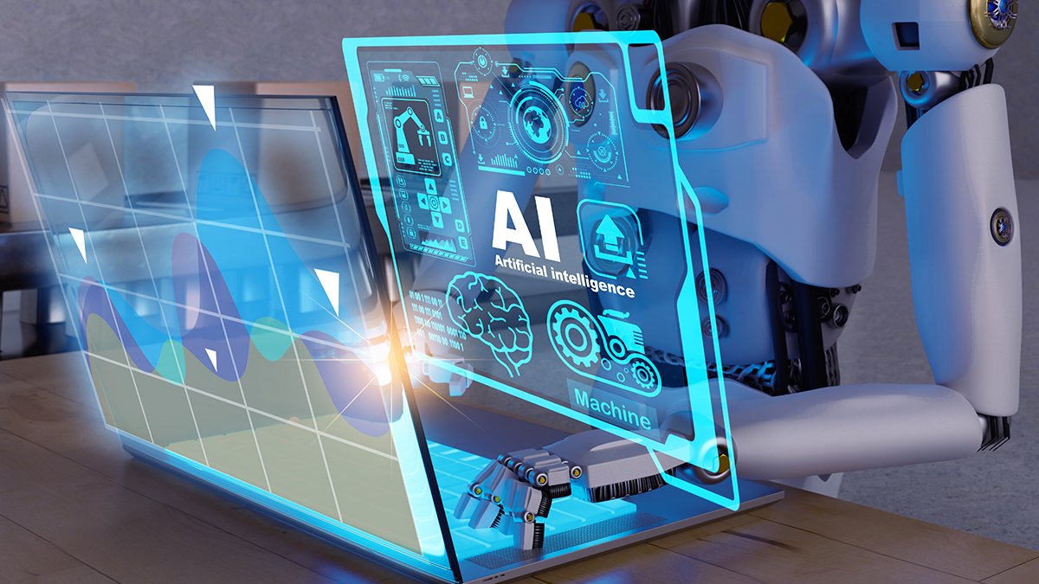
Conclusion
Transforming Industries
Future Potential
Real-World Applications
In conclusion, AI-powered NLP and Robotics are transforming industries and revolutionizing the way we live and work.
AI-powered NLP and Robotics have many real-world applications, including virtual assistants, chatbots, and self-driving cars.
The future of AI in NLP and Robotics is exciting and rapidly evolving, with many potential applications and challenges.
AI-powered technologies continue to push boundaries, offering innovative solutions to complex problems.
AI-powered NLP and Robotics have many real-world applications, including virtual assistants, chatbots, and self-driving cars.
These technologies are reshaping how humans interact with machines and the environment.
14
Advancing the Future: AI in Natural Language Processing and Robotics

Slide 15
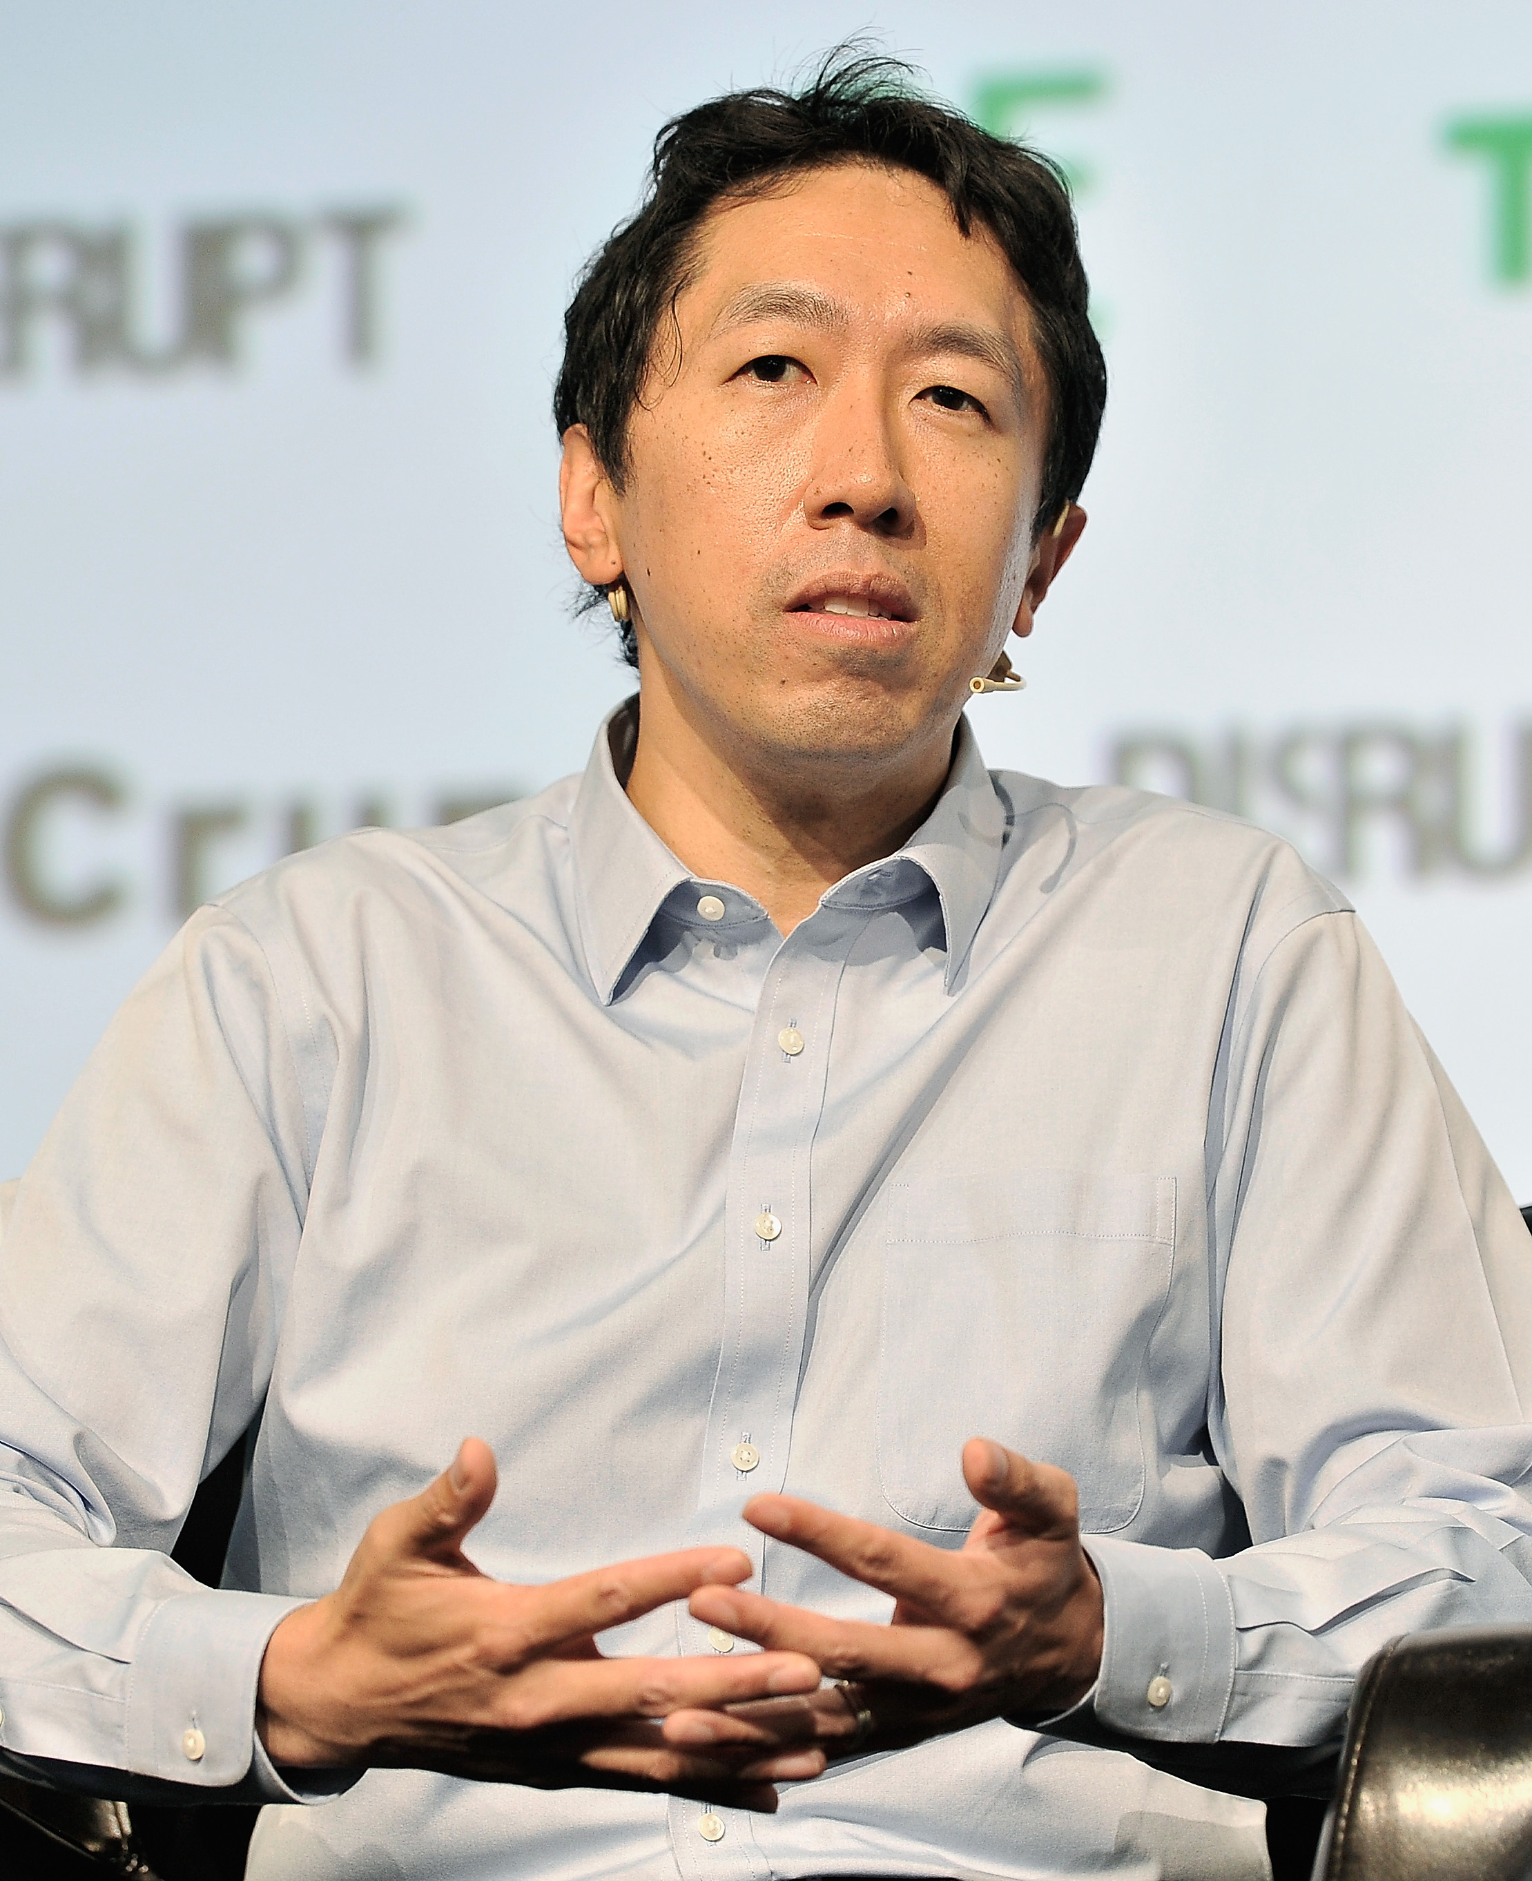
References
Stanford University's NLP Insights
MIT's Robotics Expertise
Andrew Ng's Machine Learning Contributions
Natural Language Processing (NLP) is a field explored by Stanford University.
It focuses on enabling machines to understand and process human language.
Robotics is a domain extensively studied at MIT.
This field involves the design, construction, and operation of robots.
Machine Learning is a subject taught by Andrew Ng.
It emphasizes algorithms that allow computers to learn from and make predictions based on data.
Ian Goodfellow's Deep Learning Innovations
Carnegie Mellon's Human-Robot Interaction Studies
Deep Learning is a specialized area covered by Ian Goodfellow.
It deals with neural networks and their applications in solving complex problems.
Human-Robot Interaction is a research area at Carnegie Mellon University.
This field examines how humans and robots can effectively collaborate and communicate.
15
Advancing the Future: AI in Natural Language Processing and Robotics

Slide 16
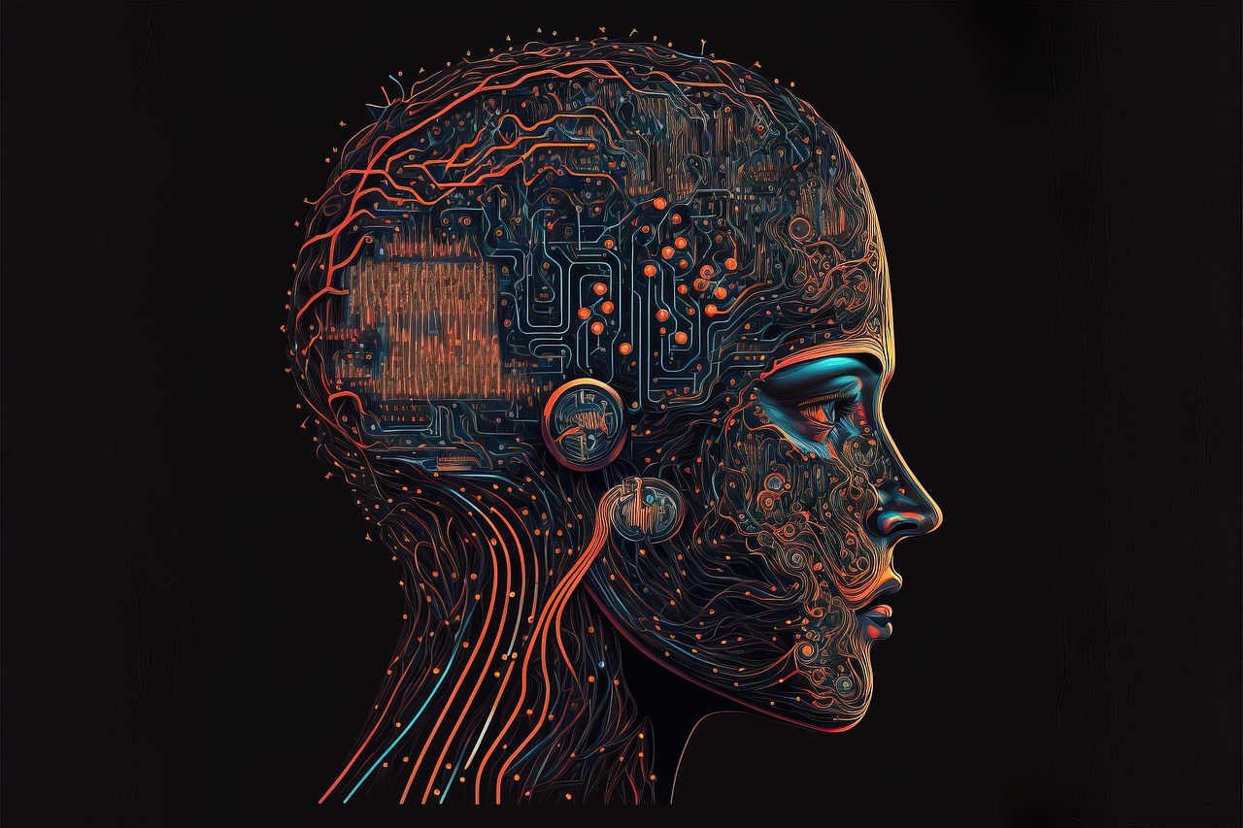
Glossary
Artificial Intelligence (AI)
Natural Language Processing (NLP)
Artificial Intelligence (AI): The development of computer systems that can perform tasks that typically require human intelligence.
AI encompasses a wide range of applications, from speech recognition to decision-making systems.
Natural Language Processing (NLP): A subfield of AI that deals with the interaction between computers and humans in natural language.
NLP enables machines to understand, interpret, and respond to human language effectively.
Robotics
Machine Learning
Robotics: A field of AI that deals with the design, construction, and operation of robots.
This field integrates mechanical engineering, electrical engineering, and computer science to create intelligent machines.
Machine Learning: A type of AI that enables computers to learn from data without being explicitly programmed.
It uses algorithms to identify patterns and make predictions or decisions based on data.
Deep Learning
Deep Learning: A type of machine learning that uses neural networks with multiple layers to analyze and interpret complex data.
This approach is particularly effective for tasks like image and speech recognition.
16
Advancing the Future: AI in Natural Language Processing and Robotics

Slide 17

Further Reading
Exploring NLP
Advancing Robotics
Dive into 'Natural Language Processing (NLP)' by Stanford University.
This resource provides foundational insights into computational linguistics.
Discover 'Robotics' by MIT for cutting-edge developments.
This material covers innovations in autonomous systems and mechanical design.
Mastering Machine Learning
Understanding Deep Learning
Learn from 'Machine Learning' by Andrew Ng, a comprehensive guide.
It offers practical approaches to algorithms and data-driven solutions.
Explore 'Deep Learning' by Ian Goodfellow for neural network expertise.
This book delves into the principles and applications of deep learning technologies.
Human-Robot Interaction Insights
Study 'Human-Robot Interaction' by Carnegie Mellon University.
This resource examines the dynamics between humans and robotic systems.
17
Advancing the Future: AI in Natural Language Processing and Robotics

Slide 18
Summary
Transforming Industries
Real-World Applications
AI-powered NLP and Robotics are transforming industries and revolutionizing the way we live and work.
They are reshaping traditional processes and introducing innovative solutions.
AI-powered NLP and Robotics have many real-world applications, including virtual assistants, chatbots, and self-driving cars.
These technologies are becoming increasingly integrated into our daily lives.
Future Potential
Efficiency and Productivity
The future of AI in NLP and Robotics is exciting and rapidly evolving, with many potential applications and challenges.
This evolution promises groundbreaking advancements in various fields.
AI-powered NLP and Robotics have the potential to increase efficiency, productivity, and accuracy in many industries.
Their implementation can lead to significant improvements in operational outcomes.
18
Advancing the Future: AI in Natural Language Processing and Robotics

Slide 19
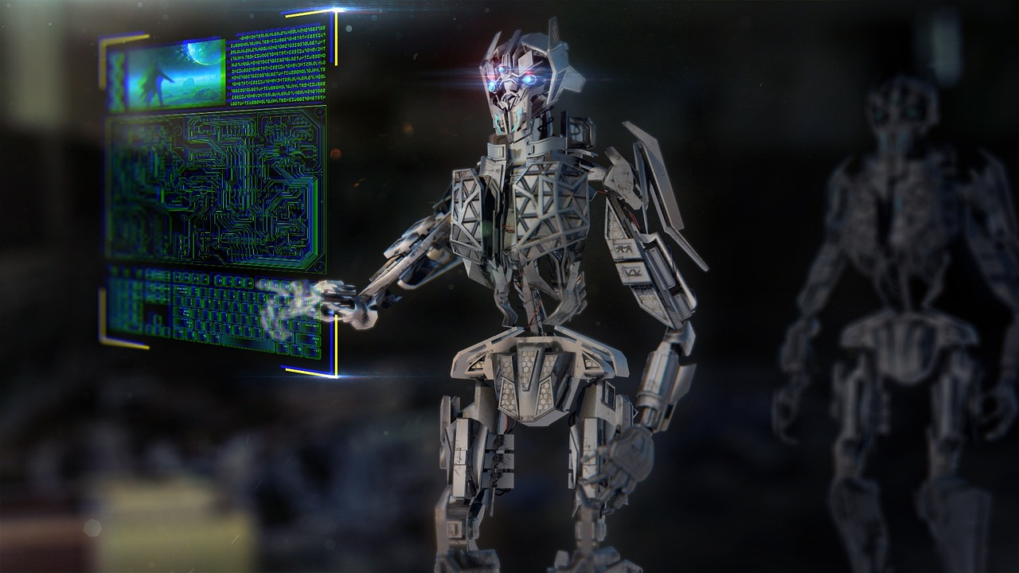
Final Thoughts
Exciting Developments in AI
Bright Future Ahead
Addressing Challenges
AI-powered NLP and Robotics are exciting and rapidly evolving fields.
They offer many potential applications and challenges.
The future of AI in NLP and Robotics is bright.
There are many potential benefits and opportunities to explore.
It is essential to consider potential challenges and limitations in AI-powered NLP and Robotics.
These include data quality, bias, and explainability.
19
Advancing the Future: AI in Natural Language Processing and Robotics

Slide 20
Call to Action
Explore AI-powered NLP and Robotics
Discover Opportunities in AI
We encourage you to learn more about AI-powered NLP and Robotics and their many applications and challenges.
Join us in exploring the exciting and rapidly evolving field of AI-powered NLP and Robotics.
Discover the many potential benefits and opportunities that AI-powered NLP and Robotics has to offer.
Engage with this transformative technology to unlock its full potential.
20
Advancing the Future: AI in Natural Language Processing and Robotics

Slide 21

Thank You
Thank You
Thank you for joining us on this journey into the exciting and rapidly evolving field of AI-powered NLP and Robotics.
21
Advancing the Future: AI in Natural Language Processing and Robotics

