Slide 1

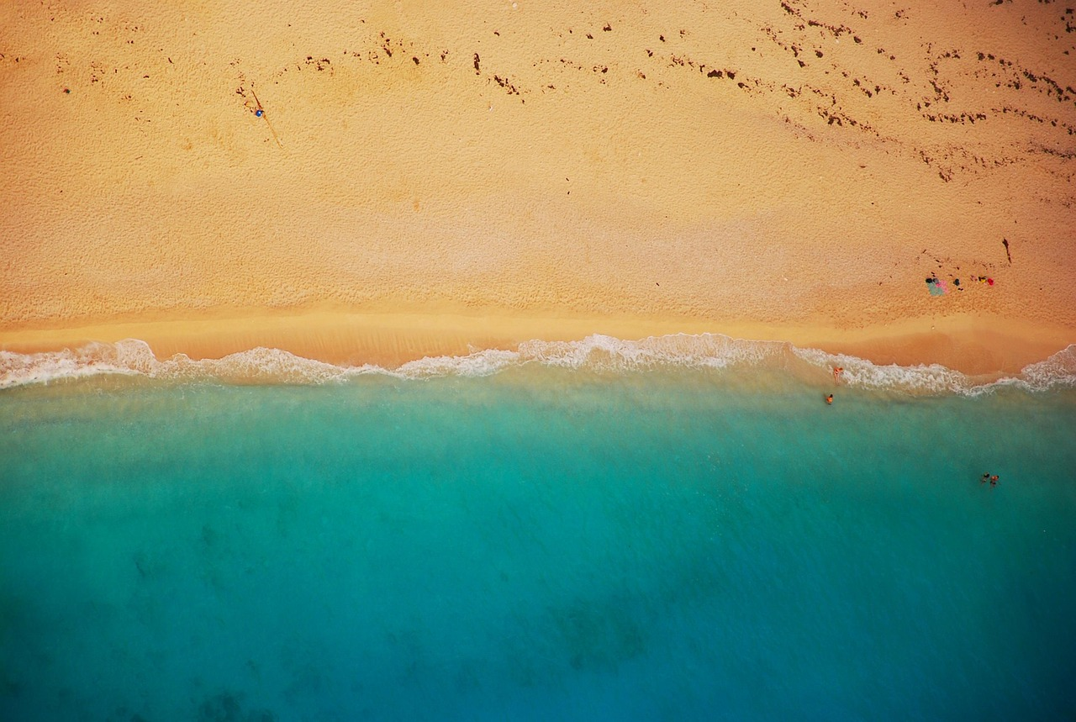
Island Landforms: Geological Processes, Ecosystems, and Human Interactions
Exploring the Formation, Mapping, and Management of Islands through Oceanic, Tectonic, and Geopolitical Perspectives

Slide 2
Table of Contents
Introduction to Island Landforms
Types of Island Landforms
Geography Mapping Tasks
Transect Creation
Cross Section Analysis
Oceanic and Tectonic Processes
Geopolitics and Oceanography
Case Study: Hawaiian Islands
Case Study: Maldives
Conclusion
Assessment and Evaluation
Extension Activities
Parent Engagement
04
05
06
07
08
09
10
11
12
13
14
15
16

Slide 3
Table of Contents
Reflection Questions
Next Steps
Key Takeaways
Teaching Tips
Summary
References
17
18
19
20
21
22

Slide 4
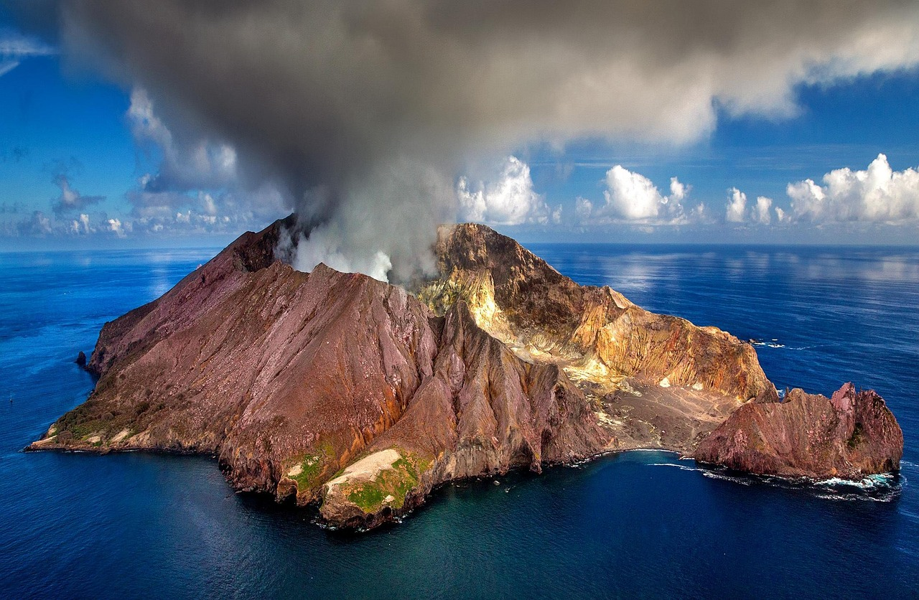
Introduction to Island Landforms
Definition of Island Landforms
Importance of Studying Island Landforms
Formation Processes of Islands
Island landforms are areas of land that are surrounded by water, ranging from small coral atolls to large continental islands.
They are formed through a combination of geological processes, including volcanic activity, erosion, and deposition.
Understanding island landforms is important for a range of applications, including geography, geology, and environmental science.
These studies help in comprehending the dynamic processes shaping our planet.
Island landforms are created through geological processes such as volcanic activity, erosion, and deposition.
These processes contribute to the diversity and uniqueness of island ecosystems.
4
Island Landforms: Geological Processes, Ecosystems, and Human Interactions

Slide 5
Types of Island Landforms
Continental Islands
Oceanic Islands
Coral Islands
Volcanic Islands
Continental islands are formed when a piece of land is separated from the mainland.
This separation can occur due to tectonic activity or rising sea levels.
Oceanic islands are created when volcanoes erupt underwater.
These eruptions build up landmass over time, eventually forming islands.
Coral islands develop when coral reefs grow around a volcanic island.
Over time, the volcanic island may erode, leaving behind the coral structure.
Volcanic islands are formed when volcanoes erupt on land.
The lava and ash from these eruptions solidify to create new landforms.
5
Island Landforms: Geological Processes, Ecosystems, and Human Interactions

Slide 6
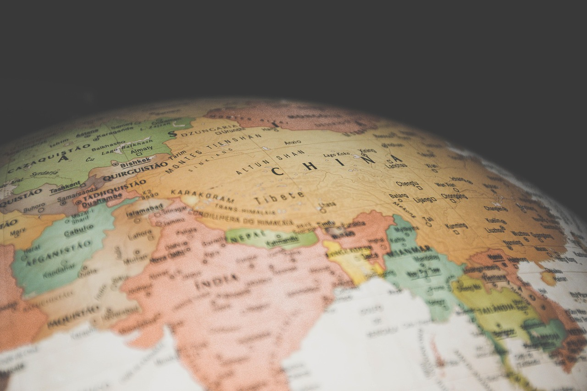
Geography Mapping Tasks
Task Overview
Learning Objectives
Materials Provided
Students will complete a geography mapping task, identifying and labeling different types of islands.
They will use a world map and a handout with definitions of different types of islands.
The task will help students develop their spatial awareness.
It will also enhance their understanding of geographical concepts.
Students will receive a world map for the activity.
They will also be given a handout containing definitions of different types of islands.
6
Island Landforms: Geological Processes, Ecosystems, and Human Interactions

Slide 7
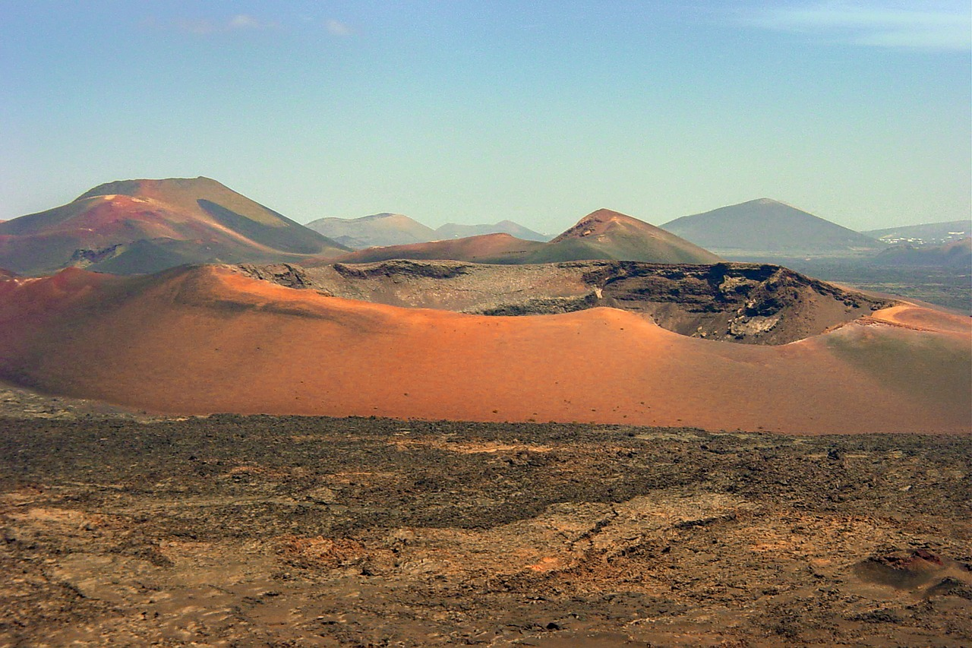
Transect Creation
1
Understanding Transects
A transect is a cross-sectional view of a landscape or landform, used to represent the geological features and processes that shape the area.
The transect will help students understand the relationships between geological processes and island landforms.
2
Creating Island Transects
Students will learn how to create a transect of an island landform, using a diagram or map to identify key features such as coastlines, mountains, and valleys.
This process involves careful observation and interpretation of geological features.
3
Geological Insights
By studying transects, students can gain insights into the dynamic processes that shape island landforms.
This knowledge is essential for understanding the interplay between natural forces and the environment.
7
Island Landforms: Geological Processes, Ecosystems, and Human Interactions

Slide 8
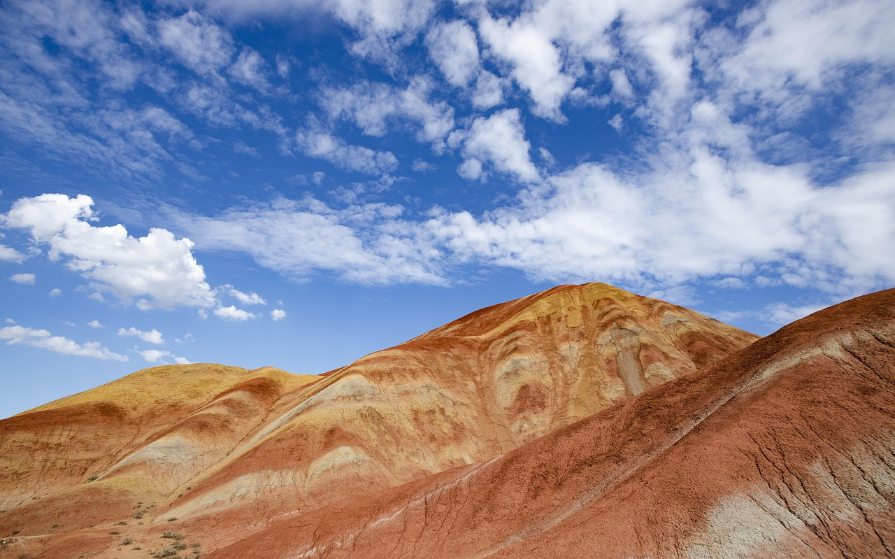
Cross Section Analysis
1
Understanding Cross Sections
A cross section is a two-dimensional representation of a three-dimensional landform, used to show the internal structure of the landform.
The cross section will help students understand the complex relationships between geological processes and island landforms.
2
Analyzing Island Landforms
Students will learn how to analyze and interpret a cross section of an island landform.
This analysis involves identifying patterns and relationships between geological processes and island features.
3
Geological Insights
The study of cross sections provides insights into the internal structure of landforms.
It reveals the interplay between geological processes and the formation of island features.
8
Island Landforms: Geological Processes, Ecosystems, and Human Interactions

Slide 9

Oceanic and Tectonic Processes
1
2
3
Shaping Coastlines and Landforms
Tectonic Forces at Work
Analyzing Interactions
Oceanic processes, such as erosion and deposition, shape the coastline and surrounding landforms.
These processes play a crucial role in the external formation of island landscapes.
Tectonic processes, such as plate movement and volcanic activity, shape the internal structure of the landform.
These forces contribute to the dynamic evolution of the Earth's crust.
Students will learn how to identify and analyze the relationships between oceanic and tectonic processes and island landforms.
This understanding is key to comprehending the interconnected nature of Earth's systems.
9
Island Landforms: Geological Processes, Ecosystems, and Human Interactions

Slide 10
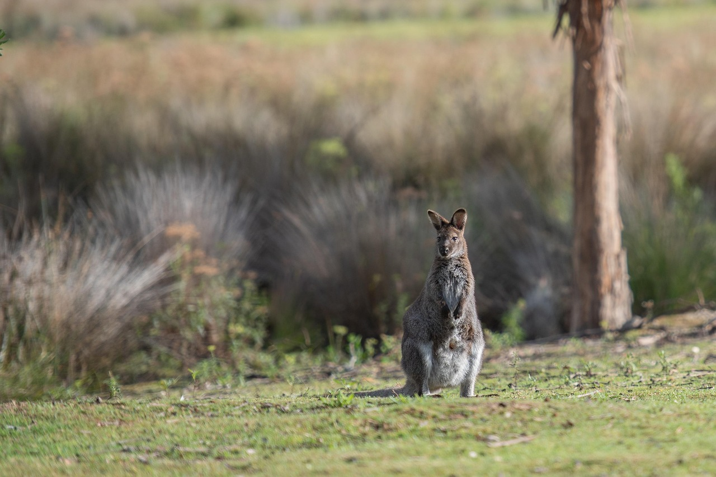
Geopolitics and Oceanography
Role of Geopolitics and Oceanography
Human Impact on Island Ecosystems
Case Studies and Mitigation Strategies
Geopolitics and oceanography play a crucial role in shaping island landforms and their relationships with the surrounding environment.
Understanding these dynamics is essential for comprehending the broader implications on ecosystems.
Students will learn how to consider the impact of human activities on island ecosystems and the importance of sustainable management practices.
This knowledge is vital for fostering responsible stewardship of natural resources.
They will analyze case studies of island landforms and develop strategies for mitigating the impacts of human activities on the environment.
These strategies aim to balance development with ecological preservation.
10
Island Landforms: Geological Processes, Ecosystems, and Human Interactions

Slide 11
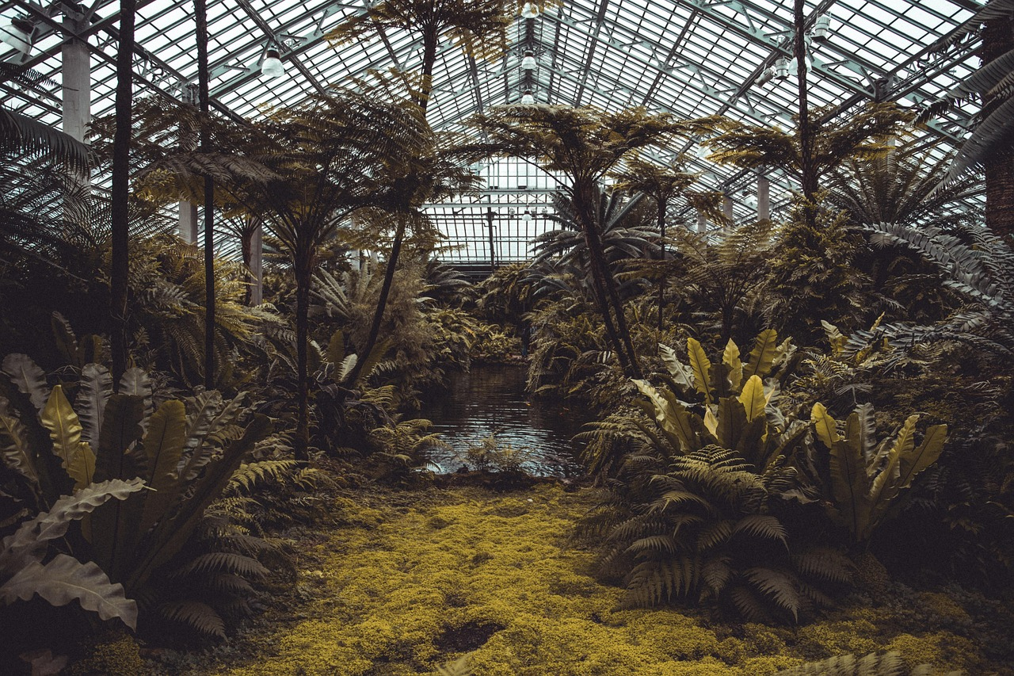
Case Study: Hawaiian Islands
Formation of the Hawaiian Islands
Human Impact on Ecosystems
Strategies for Sustainable Management
The Hawaiian Islands are a chain of volcanic islands that have formed as a result of plate movement and volcanic activity.
Students will analyze the geological processes that have shaped the islands, including volcanic activity, erosion, and deposition.
They will consider the impact of human activities on the islands' ecosystems.
Students will explore how these activities affect biodiversity and natural habitats.
Students will develop strategies for sustainable management and conservation.
These strategies aim to balance human needs with the preservation of the islands' unique ecosystems.
11
Island Landforms: Geological Processes, Ecosystems, and Human Interactions

Slide 12
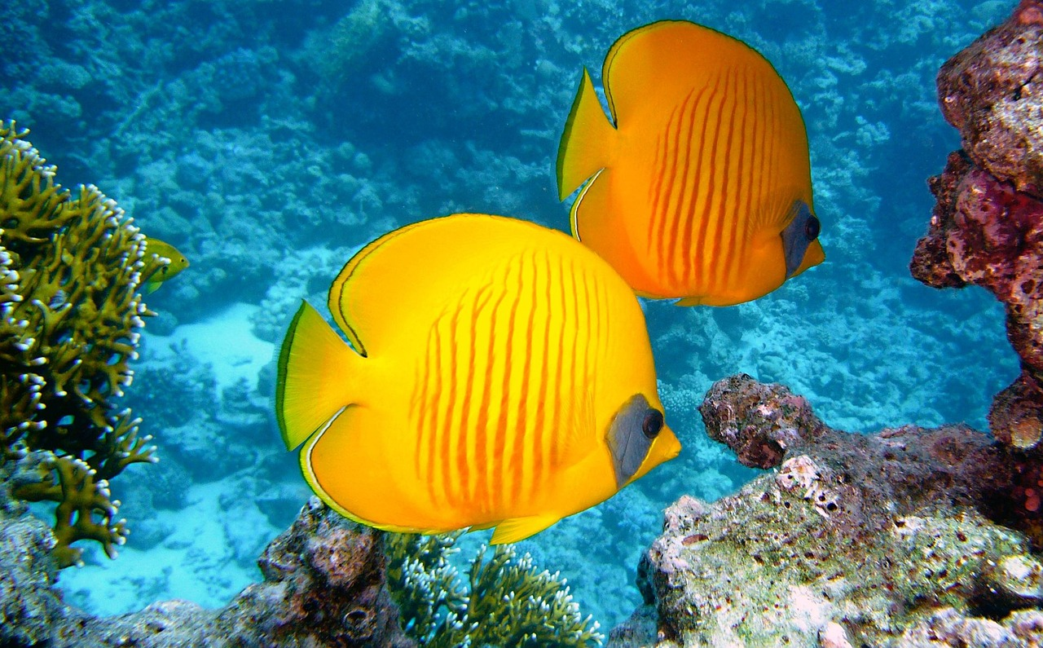
Case Study: Maldives
Vulnerability to Climate Change
Human Impact on Ecosystems
Geological Processes of the Maldives
The Maldives is a coral island nation that is vulnerable to the impacts of climate change.
Students will analyze the geological processes that have shaped the islands, including coral reef growth and sea level rise.
They will consider the impact of human activities on the islands' ecosystems.
Students will develop strategies for mitigating the impacts of climate change.
Students will analyze the geological processes that have shaped the islands.
This includes coral reef growth and sea level rise.
12
Island Landforms: Geological Processes, Ecosystems, and Human Interactions

Slide 13

Conclusion
1
Valuable Learning Experience
Creating transects and cross sections of island landforms is a valuable learning experience for year 10 students.
This activity provides hands-on engagement with geographical concepts.
2
Skill Development
Students develop essential skills in critical thinking, problem-solving, and collaboration.
These skills are crucial for academic and personal growth.
3
Understanding Complex Relationships
They gain a deeper understanding of the complex relationships between oceanic and tectonic processes, island landforms, and human activities.
This knowledge fosters a holistic view of environmental systems.
13
Island Landforms: Geological Processes, Ecosystems, and Human Interactions

Slide 14
Assessment and Evaluation
Assessment Criteria
Evaluation Methods
Focus Areas
Students will be assessed on their ability to create accurate transects and cross sections of island landforms.
They will be evaluated on their understanding of oceanic and tectonic processes and their relationships with island landforms.
The assessment will include a combination of quizzes, tests, and project-based evaluations.
These methods aim to comprehensively measure students' grasp of the subject matter.
Key focus areas include the interplay between oceanic and tectonic processes.
Students' skills in representing island landforms accurately will also be emphasized.
14
Island Landforms: Geological Processes, Ecosystems, and Human Interactions

Slide 15

Extension Activities
1
Simulated Coastal Ecosystem Management
Students can participate in a simulated scenario where they have to manage a coastal ecosystem.
This activity allows them to understand the challenges and strategies involved in ecosystem management.
2
Research and Presentation on Island Landforms
They can research and create a presentation on a real-world example of an island landform.
This helps them explore geographical features and their significance in the environment.
3
3D Model Creation of Island Landforms
They can create a 3D model of an island landform using materials such as clay or paper mache.
This hands-on activity encourages creativity and a deeper understanding of landform structures.
15
Island Landforms: Geological Processes, Ecosystems, and Human Interactions

Slide 16
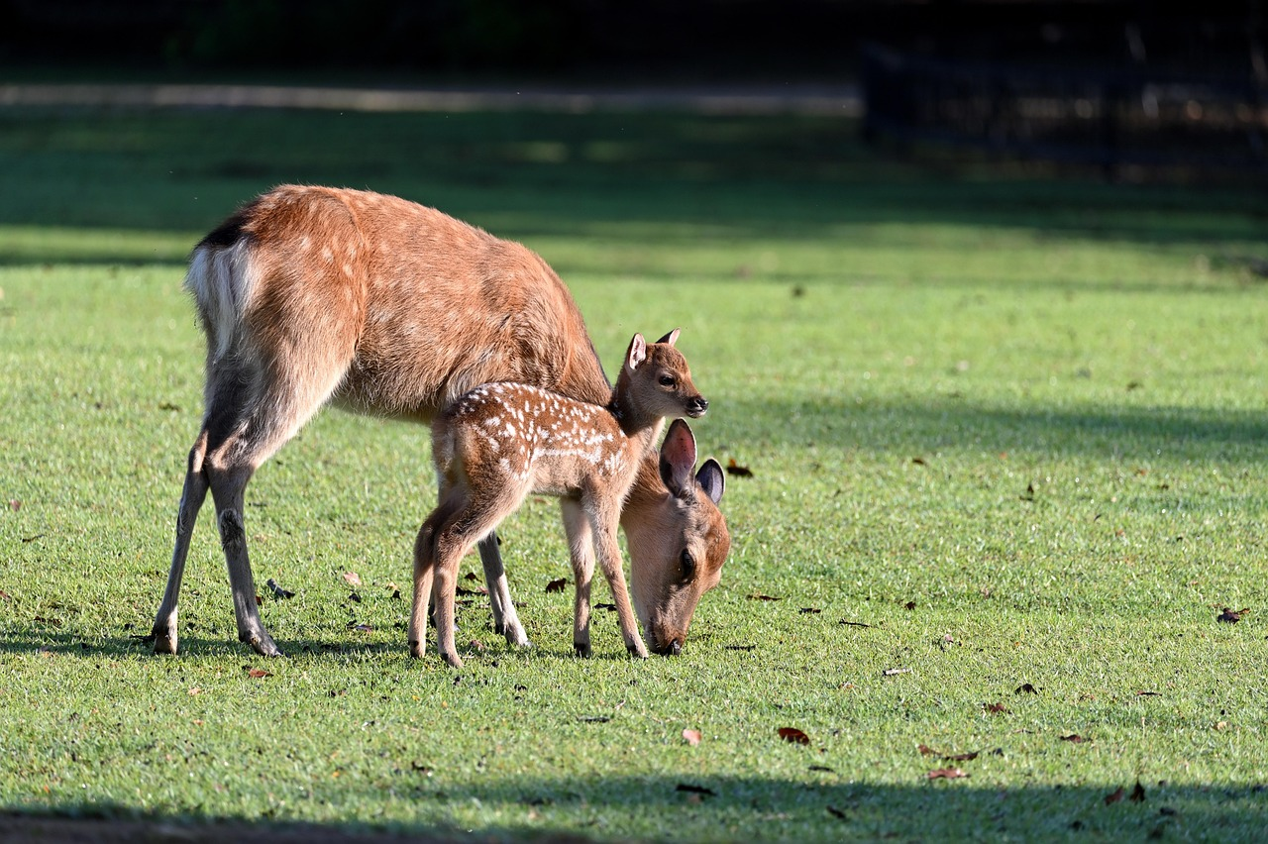
Parent Engagement
1
2
3
Encouraging Research and Creativity
Providing Constructive Feedback
Engaging in Parent-Teacher Conferences
Parents can support their child's learning by encouraging them to research and create presentations on island landforms.
This activity fosters creativity and enhances their understanding of geographical concepts.
They can provide feedback on their child's work and help them develop their critical thinking and problem-solving skills.
This involvement strengthens the child's ability to analyze and improve their work.
They can participate in parent-teacher conferences to discuss their child's progress and provide feedback on the lesson.
This collaboration ensures alignment between home and school efforts for the child's development.
16
Island Landforms: Geological Processes, Ecosystems, and Human Interactions

Slide 17

Reflection Questions
Supporting Struggling Students
Adapting Lessons for Real-World Relevance
Applying Knowledge to Real-World Scenarios
What strategies can be used to support students who struggle with creating accurate transects and cross sections?
This question explores methods to assist learners in overcoming challenges in understanding and applying these concepts effectively.
How can the lesson be adapted to incorporate more real-world examples and case studies?
This inquiry focuses on enhancing lesson plans to make them more applicable and engaging through practical applications.
What opportunities can be provided for students to apply their knowledge and skills to real-world problems and scenarios?
This question emphasizes creating avenues for students to connect theoretical learning with practical problem-solving.
17
Island Landforms: Geological Processes, Ecosystems, and Human Interactions

Slide 18
Next Steps
1
2
3
Exploring Oceanic Processes
Investigating Tectonic Processes
Applying Geopolitics and Oceanography
A Deep Dive into Coastal Erosion and Deposition.
This topic examines the intricate dynamics shaping our coastlines.
A Case Study of Plate Movement and Volcanic Activity.
This study delves into the forces driving Earth's geological transformations.
A Simulation-Based Approach to Real-World Scenarios.
This approach integrates scientific and geopolitical insights for practical applications.
18
Island Landforms: Geological Processes, Ecosystems, and Human Interactions

Slide 19
Key Takeaways
1
Geological Processes Shaping Islands
Island landforms are shaped by a combination of geological processes, including volcanic activity, erosion, and deposition.
These processes contribute to the unique and diverse structures of islands around the world.
2
Geography and Mapping Skills
Geography mapping tasks and transect creation are essential skills for understanding island landforms.
These skills help analyze their relationships with oceanic and tectonic processes.
3
Oceanography and Geopolitical Influence
Oceanography and geopolitics play a crucial role in shaping island landforms.
They also influence the relationships between islands and their surrounding environments.
19
Island Landforms: Geological Processes, Ecosystems, and Human Interactions

Slide 20

Teaching Tips
Real-World Examples and Case Studies
Technology Integration in Learning
Promoting Student Collaboration
Use real-world examples and case studies to illustrate the concepts of oceanic and tectonic processes.
These practical applications help students understand complex geological phenomena effectively.
Incorporate technology, such as GIS software or online mapping tools, to support student learning.
These tools provide interactive and visual aids to enhance comprehension of spatial data.
Encourage collaboration among students by assigning group projects or tasks that require teamwork and communication.
Collaborative activities foster interpersonal skills and a deeper understanding of the subject matter.
20
Island Landforms: Geological Processes, Ecosystems, and Human Interactions

Slide 21
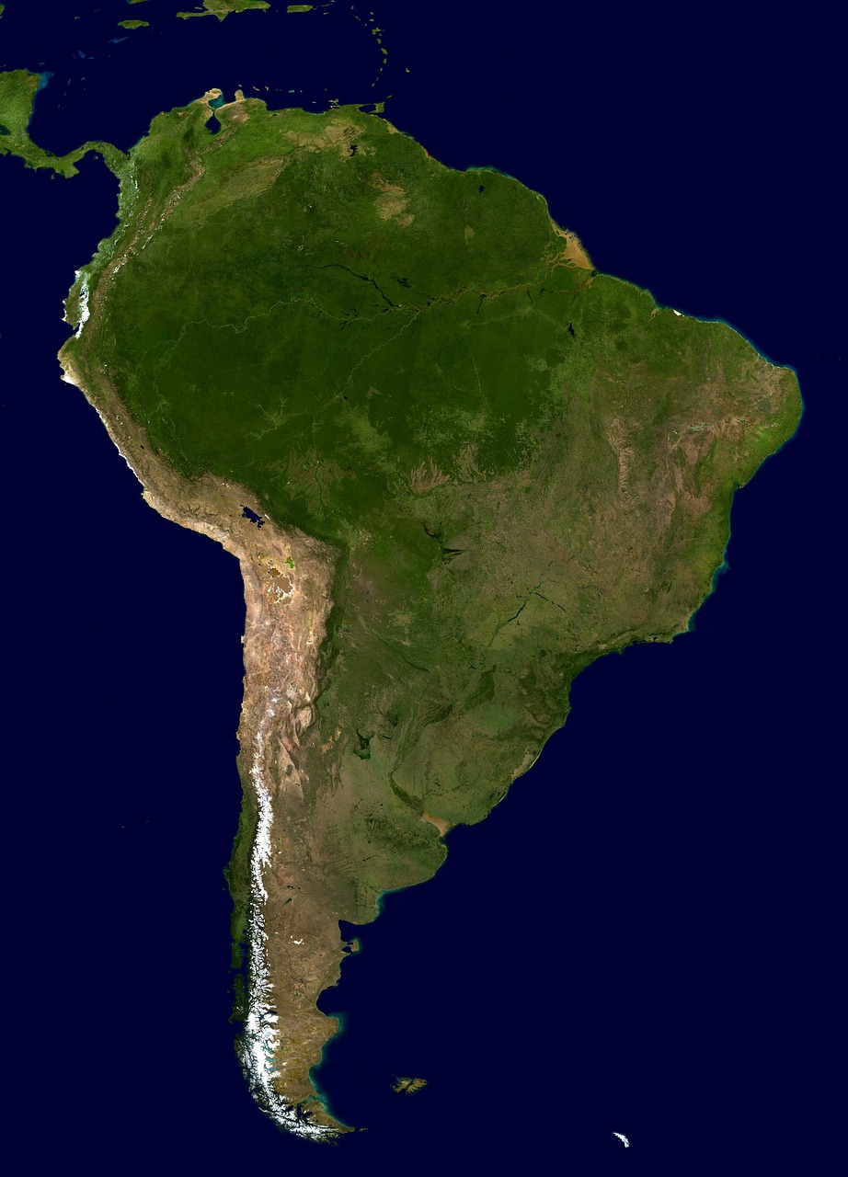
Summary
1
Target Audience and Focus
The lesson on creating transects and cross sections of island landforms is designed for year 10 students.
The lesson focuses on oceanography and geopolitics in the region, and includes geography mapping tasks and transect creation.
2
Skill Development Goals
The lesson aims to develop essential skills in critical thinking, problem-solving, and collaboration.
It provides a deeper understanding of the complex relationships between oceanic and tectonic processes, island landforms, and human activities.
3
Educational Context
The lesson integrates geography and geopolitics to explore regional dynamics.
It emphasizes the interplay between natural processes and human activities.
21
Island Landforms: Geological Processes, Ecosystems, and Human Interactions

Slide 22
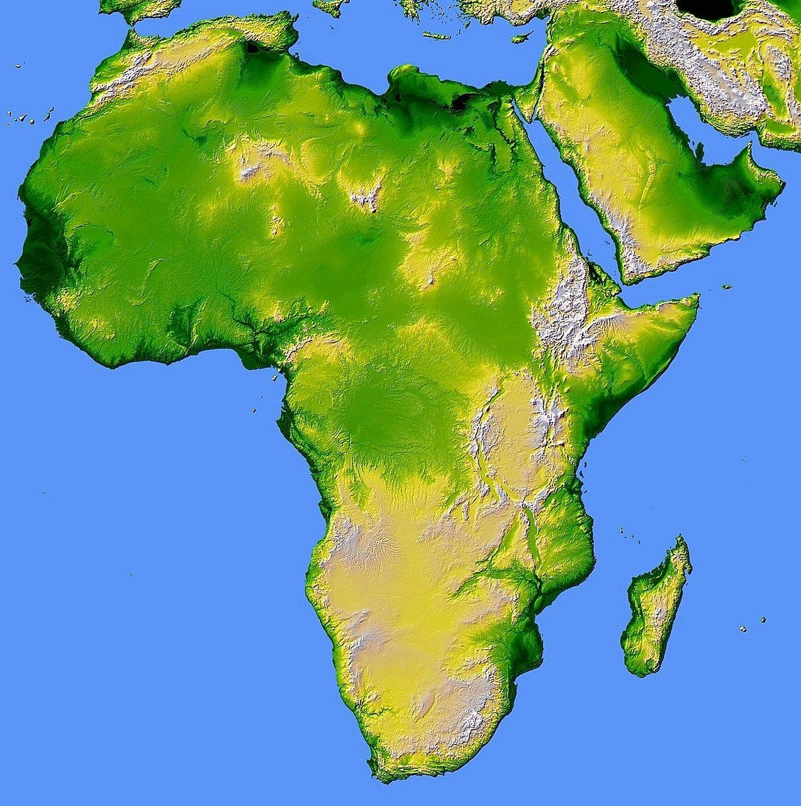
References
1
National Geographic Insights
National Geographic: Island Landforms.
A comprehensive resource for understanding the diverse features of island landforms.
2
USGS Contributions
United States Geological Survey (USGS): Island Landforms.
Provides scientific data and analysis on island formation and characteristics.
3
Encyclopedia Britannica Overview
Encyclopedia Britannica: Island Landforms.
Offers detailed explanations and historical context for various island landforms.
22
Island Landforms: Geological Processes, Ecosystems, and Human Interactions

