Slide 1
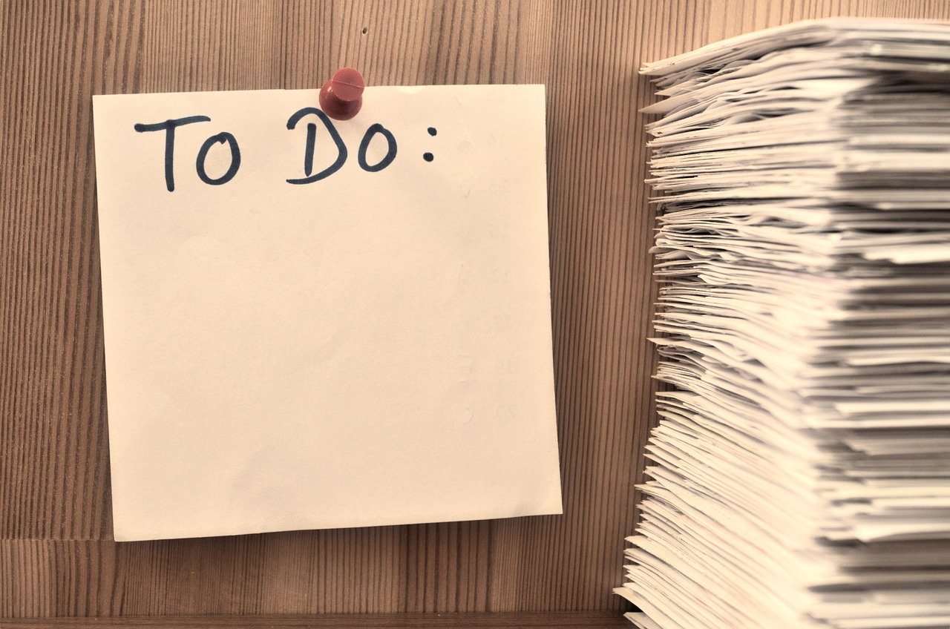
Comprehensive Strategies for Effective Reading Plans
From Goal Setting to Assessment and Engagement

Slide 2
Table of Contents
Introduction to Reading Plan and Setting Goals
Why Create a Reading Plan?
Setting Realistic Goals
Using School Journals
Creating a Personalized Reading Plan
Guided Practice: Creating a Reading Plan
Independent Practice: Writing a Reflection
Differentiated Activities for Mixed-Ability Gr…
Extension Tasks for Advanced Learners
Assessment and Evaluation
Conclusion
Next Steps
Reflection Questions
04
05
06
07
08
09
10
11
12
13
14
15
16

Slide 3
Table of Contents
Parent Engagement
Safety Considerations
Teaching Tips
Key Takeaways
Final Thoughts
17
18
19
20
21

Slide 4

Introduction to Reading Plan and Setting Goals
Welcome to the Reading Plan
Creating Personalized Plans
Tracking Progress and Reflection
Welcome to our 9-week reading plan and goal-setting journey!
This program is designed to help you develop a structured approach to reading and achieving your goals.
In this lesson, we will learn how to create a personalized reading plan and set achievable goals.
These plans will be tailored to your interests and designed to maximize your learning experience.
We will use school journals to track our progress and reflect on our experiences.
This practice will help us understand our growth and make adjustments to our plans as needed.
4
Comprehensive Strategies for Effective Reading Plans

Slide 5

Why Create a Reading Plan?
Fostering a Love for Reading
Setting Goals and Tracking Progress
A reading plan helps us develop a love for reading.
It also improves our literacy skills, enhancing our ability to understand and communicate effectively.
A reading plan enables us to set realistic goals.
It allows us to monitor our progress, ensuring we stay motivated and on track.
Taking Ownership of Learning
Developing Essential Life Skills
Through a reading plan, we can take ownership of our learning.
This empowers us to make informed decisions about our reading habits and preferences.
Creating a reading plan helps us develop skills such as time management and self-regulation.
It also fosters self-motivation, which is crucial for personal and professional growth.
5
Comprehensive Strategies for Effective Reading Plans

Slide 6

Setting Realistic Goals
Understanding SMART Goals
Aligning Goals with Interests
Tracking Progress Effectively
We need to set specific, measurable, achievable, relevant, and time-bound (SMART) goals.
These criteria help ensure our goals are clear and attainable.
Our goals should align with our reading interests and abilities.
This ensures that our objectives are both engaging and realistic.
We can use our school journals to track our progress and reflect on our achievements.
This practice helps us stay motivated and recognize our growth.
6
Comprehensive Strategies for Effective Reading Plans

Slide 7

Using School Journals
1
Tracking Reading Progress
School journals are a valuable tool for tracking our reading progress and reflecting on our experiences.
They allow us to monitor our development and understand our reading habits effectively.
2
Recording Books and Thoughts
We can use our journals to record the books we've read, note our thoughts and opinions.
This practice helps us engage more deeply with the material and articulate our perspectives.
3
Identifying Improvements and Celebrating Achievements
Our journals will help us identify areas for improvement and celebrate our achievements.
By reviewing our entries, we can recognize our growth and set new goals.
7
Comprehensive Strategies for Effective Reading Plans

Slide 8

Creating a Personalized Reading Plan
Introduction to Personalized Reading Plans
Components of the Reading Plan
We will create a personalized reading plan that suits our interests and reading level.
This plan will be tailored to enhance our reading experience and skills.
Our plan will include our goals, reading schedule, and strategies for improving our reading skills.
These elements will help us structure our reading activities effectively.
Tools for Creating the Plan
Reviewing and Adjusting the Plan
We can use a template or create our own plan using our school journals.
These resources provide a framework for organizing our reading objectives.
We will review and adjust our plan regularly to ensure we're on track to meet our goals.
This iterative process allows us to refine our approach and achieve better results.
8
Comprehensive Strategies for Effective Reading Plans

Slide 9

Guided Practice: Creating a Reading Plan
Collaborative Reading Plan Creation
Feedback and Suggestions
Purpose of the Activity
Let's work together to create a sample reading plan.
We will use a template to guide us and make sure we include all the necessary information.
We will share our plans with a partner or in a small group.
This will help us get feedback and suggestions to improve our reading plans.
The goal is to collaboratively develop effective reading plans.
This ensures all necessary elements are included and plans are optimized.
9
Comprehensive Strategies for Effective Reading Plans

Slide 10

Independent Practice: Writing a Reflection
1
Create Your Reading Plan
Now it's your turn to create your own reading plan and write a reflection on your goals and progress.
This activity will help you organize your thoughts and set clear objectives for your learning journey.
2
Utilize Your School Journal
Use your school journal to write about what you've learned and what you're looking forward to achieving.
This journal serves as a personal space to document your reflections and aspirations.
3
Personalize Your Journal
Don't forget to decorate your journal and make it your own.
Adding personal touches will make your journal more engaging and enjoyable to use.
10
Comprehensive Strategies for Effective Reading Plans

Slide 11

Differentiated Activities for Mixed-Ability Groups
01
Advanced Learners
Create a more complex reading plan.
Include specific strategies for improving reading comprehension and vocabulary.
02
Struggling Learners
Use a simplified template.
Provide extra support and guidance.
03
English Language Learners
Provide additional resources and support.
Include visual aids and bilingual materials.
04
Students with Learning Difficulties
Offer one-on-one instruction.
Adapt the reading plan to meet their individual needs.
11
Comprehensive Strategies for Effective Reading Plans

Slide 12

Extension Tasks for Advanced Learners
Book Review or Poster Creation
Research on Authors or Book Series
Reading-Themed Project Development
Create a book review or a reading-themed poster to share with the class.
This task encourages learners to express their thoughts and creativity about their reading experiences.
Research and present on a favorite author or book series.
This activity allows learners to delve deeper into literary works and their creators.
Develop a reading-themed project, such as a diorama or a book-inspired craft.
This task combines artistic skills with literary appreciation to create engaging projects.
12
Comprehensive Strategies for Effective Reading Plans

Slide 13

Assessment and Evaluation
1
2
3
Progress Assessment
Goal Evaluation
Reflective Practices
We will assess our progress and understanding through regular reading conferences.
Journal checks will be conducted to monitor comprehension and engagement.
We will evaluate our reading plans and goals to ensure we're on track.
This process helps us align our efforts with our objectives effectively.
We will use our school journals to reflect on our experiences.
This reflection aids in identifying areas for improvement and growth.
13
Comprehensive Strategies for Effective Reading Plans

Slide 14

Conclusion
Completion of Introduction
Congratulations on completing our introduction to reading plans and goal-setting!
This marks a significant step in enhancing your reading habits and achieving your literary goals.
Review and Adjust
Remember to review and adjust your reading plan regularly to ensure you're on track to meet your goals.
Periodic evaluation helps maintain alignment with your objectives and adapt to any changes.
Enjoy Reading
Keep reading and enjoying your favorite books!
Let your reading journey be both fulfilling and enjoyable.
14
Comprehensive Strategies for Effective Reading Plans

Slide 15

Next Steps
Focus on Reading Comprehension
Our next lesson will focus on reading comprehension strategies.
We will explore techniques to enhance understanding and engagement with texts.
Learning Key Strategies
We will learn how to summarize, visualize, and make connections to the texts we read.
These strategies aim to improve our ability to analyze and interpret written material.
Applying New Skills
Get ready to apply your new skills and strategies to your reading plan!
This will help integrate the learned techniques into your regular reading practices.
15
Comprehensive Strategies for Effective Reading Plans

Slide 16

Reflection Questions
Learning About Reading Plans and Goals
Utilizing Your School Journal
Anticipating and Overcoming Challenges
What did you learn about creating a reading plan and setting goals?
This question encourages reflection on strategies for effective planning and goal setting.
How will you use your school journal to track your progress and reflect on your experiences?
This question prompts consideration of methods for monitoring and evaluating personal development.
What challenges do you anticipate facing, and how will you overcome them?
This question invites analysis of potential obstacles and strategies for addressing them.
16
Comprehensive Strategies for Effective Reading Plans

Slide 17

Parent Engagement
Encouraging Regular Reading
Setting Realistic Goals
Collaborative Efforts for Literacy
Parents and guardians can support their child's reading plan by encouraging them to read regularly.
Discussing their progress helps reinforce their commitment to their goals.
Parents can assist their child in setting achievable reading goals.
Providing feedback on their reading plan fosters improvement and motivation.
Together, we can help students develop a love for reading.
Achieving literacy goals is a shared responsibility between educators and families.
17
Comprehensive Strategies for Effective Reading Plans

Slide 18

Safety Considerations
Classroom Rules and Respect
Encouragement and Support
Seeking Guidance
Remember to always follow classroom rules and respect your peers' personal space and property.
Maintaining a respectful environment ensures safety and comfort for everyone.
Be kind and supportive of one another, and encourage each other to reach your reading goals.
Positive interactions foster a collaborative and motivating atmosphere.
If you have any concerns or questions, don't hesitate to ask your teacher or a trusted adult.
Open communication is key to addressing issues and ensuring understanding.
18
Comprehensive Strategies for Effective Reading Plans

Slide 19

Teaching Tips
Explicit Instruction and Modeling
Differentiated Activities and Extension Tasks
Student Reflection and Self-Assessment
Provide explicit instruction and modeling to support student understanding.
This approach ensures clarity and provides a framework for students to follow.
Offer differentiated activities and extension tasks to meet the needs of mixed-ability groups.
These tasks cater to diverse learning needs and promote inclusive education.
Encourage student reflection and self-assessment to promote metacognition and self-regulation.
This practice helps students develop awareness of their learning processes and improve their skills.
19
Comprehensive Strategies for Effective Reading Plans

Slide 20
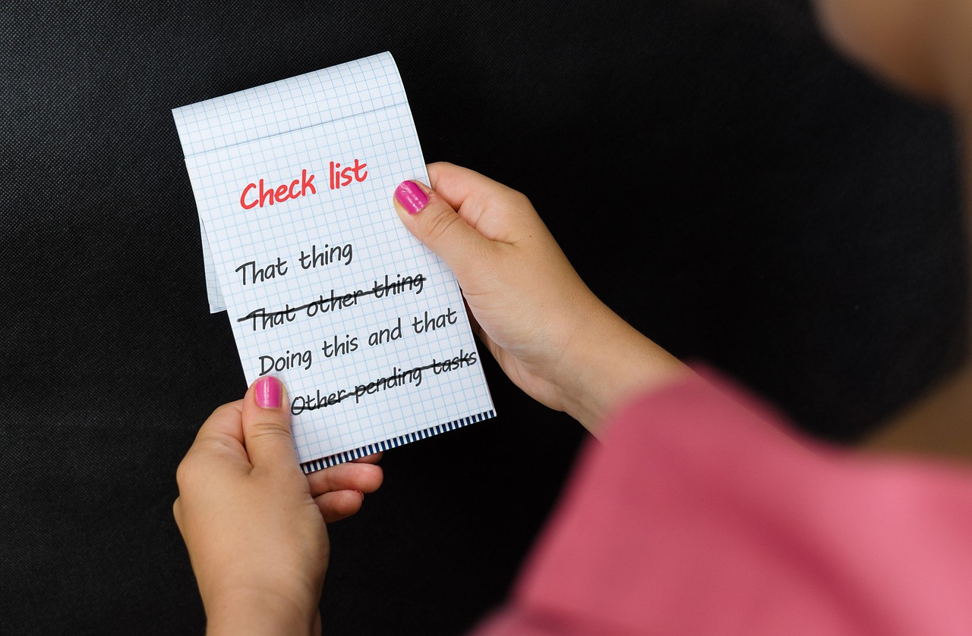
Key Takeaways
Personalized Reading Plans
Goal Setting and Progress Tracking
Reflective Practices with Journals
Creating a personalized reading plan helps us develop a love for reading.
It also improves our literacy skills effectively.
Setting realistic goals and tracking our progress helps us stay motivated.
This approach keeps us focused on our reading objectives.
Using school journals to reflect on our experiences identifies areas for improvement.
This practice develops essential skills such as self-regulation and self-motivation.
20
Comprehensive Strategies for Effective Reading Plans

Slide 21

Final Thoughts
Embrace the Journey
Practice Makes Perfect
Enjoy the Experience
Reading is a journey, and it's okay to make mistakes.
Learning from these mistakes is part of the process.
Keep practicing to improve your reading skills.
Achieving literacy goals comes with consistent effort.
Happy reading to everyone!
Let's make the process fun and enjoyable.
21
Comprehensive Strategies for Effective Reading Plans

