Slide 1


Mastering Triangle Congruence Proofs
A Comprehensive Guide to Proof Writing and Differentiation Strategies

Slide 2
Table of contents
Lesson Overview
Triangle Congruence Fundamentals
Proof Writing Basics
Warm-up Activity Examples
Proof Writing Strategies
Practice Problem 1
Solution Walkthrough
Advanced Proof Challenge
Differentiation Strategies
Assessment Approach
01
02
03
04
05
06
07
08
09
10

Slide 3
Table of contents
Real-World Connections
Lesson Conclusion
Additional Slide 1
Additional Slide 2
Additional Slide 3
Additional Slide 4
Additional Slide 5
Additional Slide 6
Additional Slide 7
Additional Slide 8
11
12
13
14
15
16
17
18
19
20

Slide 4

Lesson Overview
Grade Level
Duration
10th Grade Geometry
60 minutes
Learning Objective
Master triangle congruence proofs
Mastering Triangle Congruence Proofs

Slide 5

Triangle Congruence Fundamentals
Triangle Congruence Fundamentals
Key Congruence Postulates
1. SSS (Side-Side-Side)
2. SAS (Side-Angle-Side)
3. ASA (Angle-Side-Angle)
4. AAS (Angle-Angle-Side)
Mastering Triangle Congruence Proofs

Slide 6

Proof Writing Basics
Proof Structure Components
1. Given information
2. Prove statement
3. Reasons for each step
4. Logical reasoning flow
Mastering Triangle Congruence Proofs

Slide 7
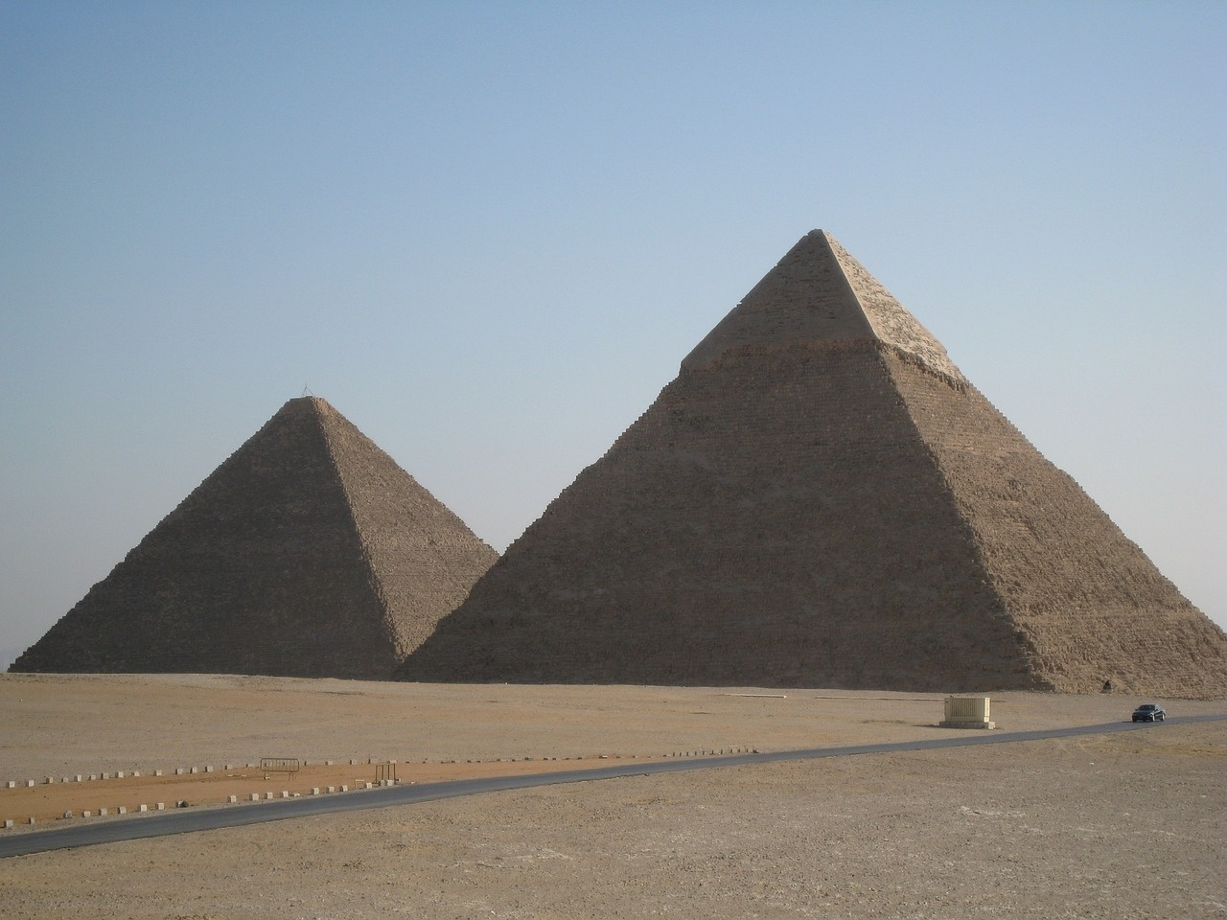
Warm-up Activity Examples
Triangle Congruence Matching
Match congruent triangle pairs based on given information.
Identify corresponding characteristics such as side lengths and angles.
Determine the congruence criteria that justify the matching.
Example
Given: Triangle ABC and Triangle DEF
AB = DE, Angle B = Angle E, AC = DF
Prove: Triangles are congruent
Mastering Triangle Congruence Proofs

Slide 8

Proof Writing Strategies
Proof Techniques
Start with given information
Use congruence postulates
Apply geometric reasoning
Justify each step
Reach conclusion
Mastering Triangle Congruence Proofs

Slide 9

Practice Problem 1
Practice Problem 1
Problem
Triangle Congruence Challenge
Triangle ABC and Triangle DEF
Given:
AB = DE
Angle B = Angle E
AC = DF
Diagram
Diagram of triangles with given measurements
![Diagram of triangles with given measurements](image_triangles_given_measurements.png)
Mastering Triangle Congruence Proofs

Slide 10

Solution Walkthrough
Solution Steps
List given information
Apply SAS congruence postulate
Identify matching sides and angle
Conclude triangle congruence
Mastering Triangle Congruence Proofs

Slide 11

Advanced Proof Challenge
Complex Scenario
Quadrilateral with diagonal
Prove specific angle relationships
Use triangle congruence techniques
Steps
Identify given information
Apply appropriate congruence postulates
Break down the proof into smaller triangles
Utilize geometric reasoning to establish relationships
Justify each step with logical reasoning
Mastering Triangle Congruence Proofs

Slide 12

Differentiation Strategies
Scaffolded Proof Templates
Visual Learning Aids
Provide varying levels of support for students to structure their proofs.
Utilize diagrams, color-coding, and shapes to enhance understanding of geometric concepts.
Digital Proof Writing Tools
Collaborative Problem-Solving
Integrate interactive platforms for hands-on practice and immediate feedback.
Encourage group work to foster peer learning and diverse problem-solving approaches.
Mastering Triangle Congruence Proofs

Slide 13
Assessment Approach
Exit Ticket Challenges
Self-Assessment Rubric
Reflection on Reasoning
Multiple Assessment Formats
1
2
3
4
Quick assessments at the end of the lesson. Test understanding of triangle congruence proofs. Immediate feedback for students.
Students evaluate their own proof writing skills. Reflect on strengths and areas for improvement. Encourages self-reflection and goal setting.
Encourage students to explain their thought process. Analyze the logic behind each step in the proof. Enhance critical thinking skills.
Varied assessment methods (written, oral, visual). Cater to different learning styles. Comprehensive evaluation of mastery.
Mastering Triangle Congruence Proofs

Slide 14

Real-World Connections
Engineering Design
Architectural Planning
Utilizing triangle congruence proofs in structural planning and analysis.
Ensuring stability and symmetry in building designs through geometric reasoning.
Scientific Problem-Solving
Logical Thinking Skills
Applying triangle congruence principles in research and experimentation.
Enhancing problem-solving abilities and critical thinking in various real-world scenarios.
Mastering Triangle Congruence Proofs

Slide 15
Lesson Conclusion
Triangle Congruence
Proof Writing
Geometric Reasoning
Advanced Mathematics
1
2
3
4
Understand and apply SSS, SAS, ASA, AAS, and HL postulates.
Learn to construct clear and logical geometric proofs.
Use geometric principles to solve problems.
Build a strong foundation for future math courses.
Mastering Triangle Congruence Proofs

Slide 16

Additional Slide 1
SSS (Side-Side-Side)
SAS (Side-Angle-Side)
Three sides of one triangle are congruent to three sides of another triangle.
Two sides and the included angle of one triangle are congruent to two sides and the included angle of another triangle.
ASA (Angle-Side-Angle)
AAS (Angle-Angle-Side)
Two angles and the included side of one triangle are congruent to two angles and the included side of another triangle.
Two angles and a non-included side of one triangle are congruent to two angles and the corresponding non-included side of another triangle.
Mastering Triangle Congruence Proofs

Slide 17

Additional Slide 2
Triangle Congruence Fundamentals
Key Congruence Postulates
1. SSS (Side-Side-Side)
2. SAS (Side-Angle-Side)
3. ASA (Angle-Side-Angle)
4. AAS (Angle-Angle-Side)
Mastering Triangle Congruence Proofs

Slide 18

Additional Slide 3
Proof Writing Basics
Given information
Prove statement
Reasons for each step
Logical reasoning flow
Next Steps
Identify given information
Establish the statement to prove
Justify each step with congruence postulates
Ensure logical flow in the proof
Mastering Triangle Congruence Proofs

Slide 19

Additional Slide 4
Warm-up Activity Examples
Match congruent triangle pairs
Identify matching characteristics
Determine congruence criteria
Mastering Triangle Congruence Proofs

Slide 20
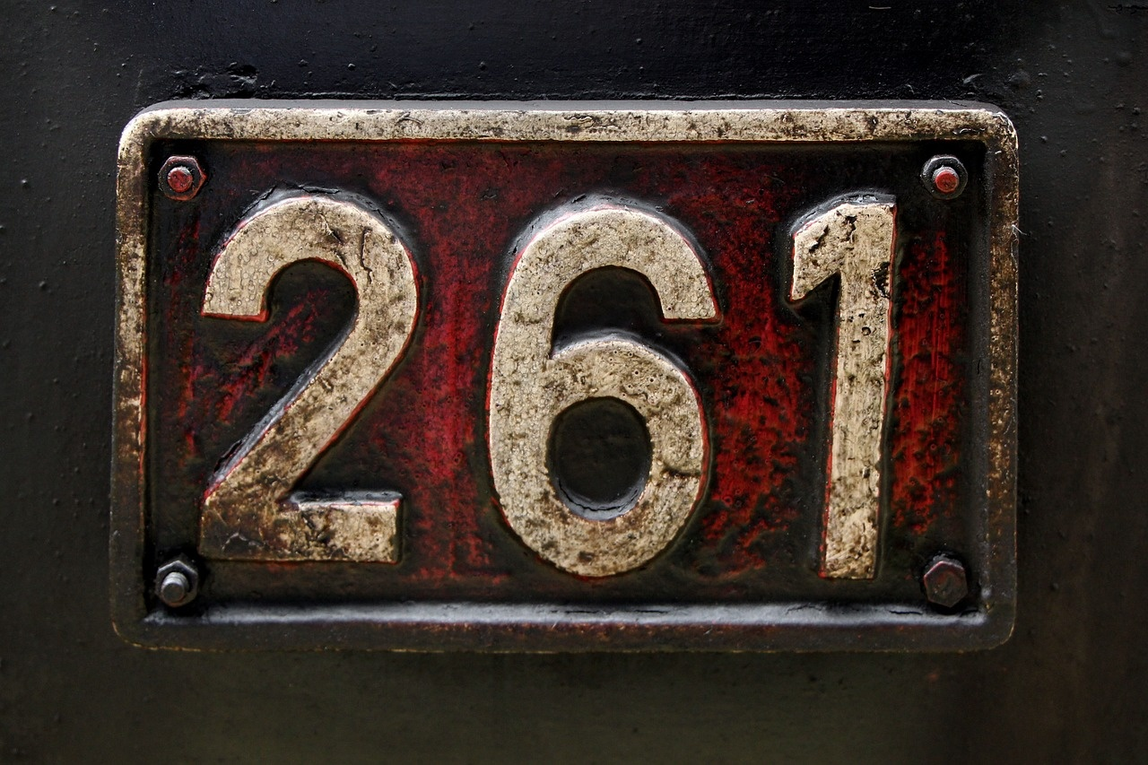
Additional Slide 5
Proof Techniques
Start with given information
Use congruence postulates
Apply geometric reasoning
Justify each step
Reach conclusion
Mastering Triangle Congruence Proofs

Slide 21

Additional Slide 6
Practice Problem 1: Triangle Congruence Challenge
Problem:
Triangle ABC and Triangle DEF
Given:
AB = DE
Angle B = Angle E
Mastering Triangle Congruence Proofs

Slide 22

Additional Slide 7
Proof Solution Steps
List given information
Apply SAS congruence postulate
Identify matching sides and angle
Conclude triangle congruence
Mastering Triangle Congruence Proofs

Slide 23

Additional Slide 8
Advanced Proof Challenge
Complex Scenario: Quadrilateral with diagonal
Prove specific angle relationships
Use triangle congruence techniques
Mastering Triangle Congruence Proofs

