Slide 1


Mastering Punctuation: A Comprehensive Guide
Exploring the Use of Common Punctuation Marks

Slide 2
Table of contents
Lesson Introduction
Subject Knowledge
Punctuation marks
The most common punctuation marks
Period
Comma
Question mark
Exclamation point
Apostrophe
Quotation marks
01
02
03
04
05
06
07
08
09
10

Slide 3

Lesson Introduction
Punctuation Marks
Punctuation marks are the symbols we use to organize and clarify the meaning of written language.
They help to separate words, phrases, and sentences, and indicate the flow of ideas.
Common Punctuation Marks
The most common punctuation marks are the period (.), comma (,), question mark (?), exclamation point (!), apostrophe ('), and quotation marks (" ").
Each mark serves a specific purpose and helps to convey the intended message effectively.
Mastering Punctuation: A Comprehensive Guide

Slide 4
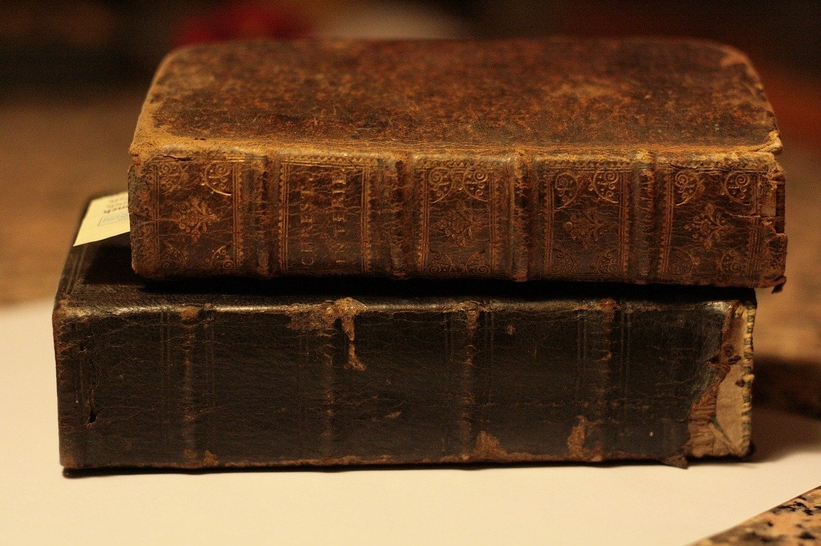
Subject Knowledge
Definition
Punctuation marks are the symbols we use to organize and clarify the meaning of written language.
They help to separate words, phrases, and sentences, and indicate the flow of ideas.
Common Punctuation Marks
Period (.)
Comma (,)
Question mark (?)
Exclamation point (!)
Apostrophe (')
Quotation marks (" ")
Mastering Punctuation: A Comprehensive Guide

Slide 5
Punctuation marks
01
02
03
04
05
Period (.)
Comma (,)
Question Mark (?)
Exclamation Point (!)
Apostrophe (')
Used to indicate the end of a sentence.
Separates items in a list or clauses in a sentence.
Denotes a question or uncertainty.
Shows strong emotion or emphasis.
Indicates possession or contraction.
Mastering Punctuation: A Comprehensive Guide

Slide 6
The most common punctuation marks
Period (.)
Comma (,)
Question Mark (?)
Used to indicate the end of a sentence.
Used to separate items in a list or to separate clauses in a sentence.
Used to indicate a question.
Exclamation Point (!)
Apostrophe (')
Used to show strong emotion or emphasis.
Used to indicate possession or to show where letters have been omitted.
Mastering Punctuation: A Comprehensive Guide

Slide 7
Period
01
02
03
04
05
Definition
Function
Placement
Abbreviations
Clarity
The period (.) is a punctuation mark used at the end of a sentence to indicate a full stop or a complete thought.
It signals the reader to pause and helps in separating sentences or indicating abbreviations.
The period is always placed at the end of a sentence, directly after the final word.
Periods are also used in abbreviations, such as "Mr." for Mister or "etc." for et cetera.
Using periods correctly is crucial for clear and effective communication in writing.
Mastering Punctuation: A Comprehensive Guide

Slide 8
Comma
Introduction to the Comma
Separating Items in a List
Joining Independent Clauses
The comma is a versatile punctuation mark that helps to clarify meaning and improve readability in written language.
Use commas to separate items in a list, such as fruits (e.g., apples, oranges, bananas) or adjectives (e.g., tall, dark, handsome).
Commas are used to join independent clauses in a compound sentence, along with coordinating conjunctions like "and," "but," or "or."
Setting Off Introductory Elements
Appositives and Non-Restrictive Clauses
Introductory phrases or clauses are set off by commas to provide clarity and signal the beginning of the main sentence.
Commas are used to offset appositives (noun phrases that rename a noun) and non-restrictive clauses (additional information that can be omitted without changing the meaning).
Mastering Punctuation: A Comprehensive Guide

Slide 9
Question mark
01
02
03
04
05
Definition
Usage
Clarity
Intonation
Examples
The question mark (?) is a punctuation mark used at the end of a sentence to indicate a direct question.
It signals to the reader that the sentence is interrogative and prompts a response.
Use a question mark at the end of a sentence that is asking a direct question.
For example, "What time is the meeting?" or "Are you coming to the party?"
The question mark helps to clearly distinguish between statements and questions in written communication.
It adds nuance and tone to the text, guiding the reader on how to interpret the information.
In spoken language, the question mark corresponds to a rising intonation at the end of a sentence, indicating an inquiry.
When writing, the question mark serves the same purpose by signaling the interrogative nature of the sentence.
"How are you feeling today?"
"Where did you park the car?"
"Have you finished your homework?" Each of these sentences ends with a question mark to denote a question being asked.
Mastering Punctuation: A Comprehensive Guide

Slide 10
Exclamation point
Conveying Strong Emotions
Adding Emphasis
Avoid Overuse
The exclamation point (!) is used to convey strong emotions such as excitement, surprise, or urgency in writing.
It adds emphasis to a sentence and can change the tone from neutral to enthusiastic or forceful.
Avoid overusing exclamation points as it can diminish their impact and make the writing seem less professional.
Formal Writing
Informal Writing
Use exclamation points sparingly in formal writing, such as academic papers or business correspondence.
In informal writing, like emails or text messages, exclamation points can help convey tone and mood effectively.
Mastering Punctuation: A Comprehensive Guide

Slide 11
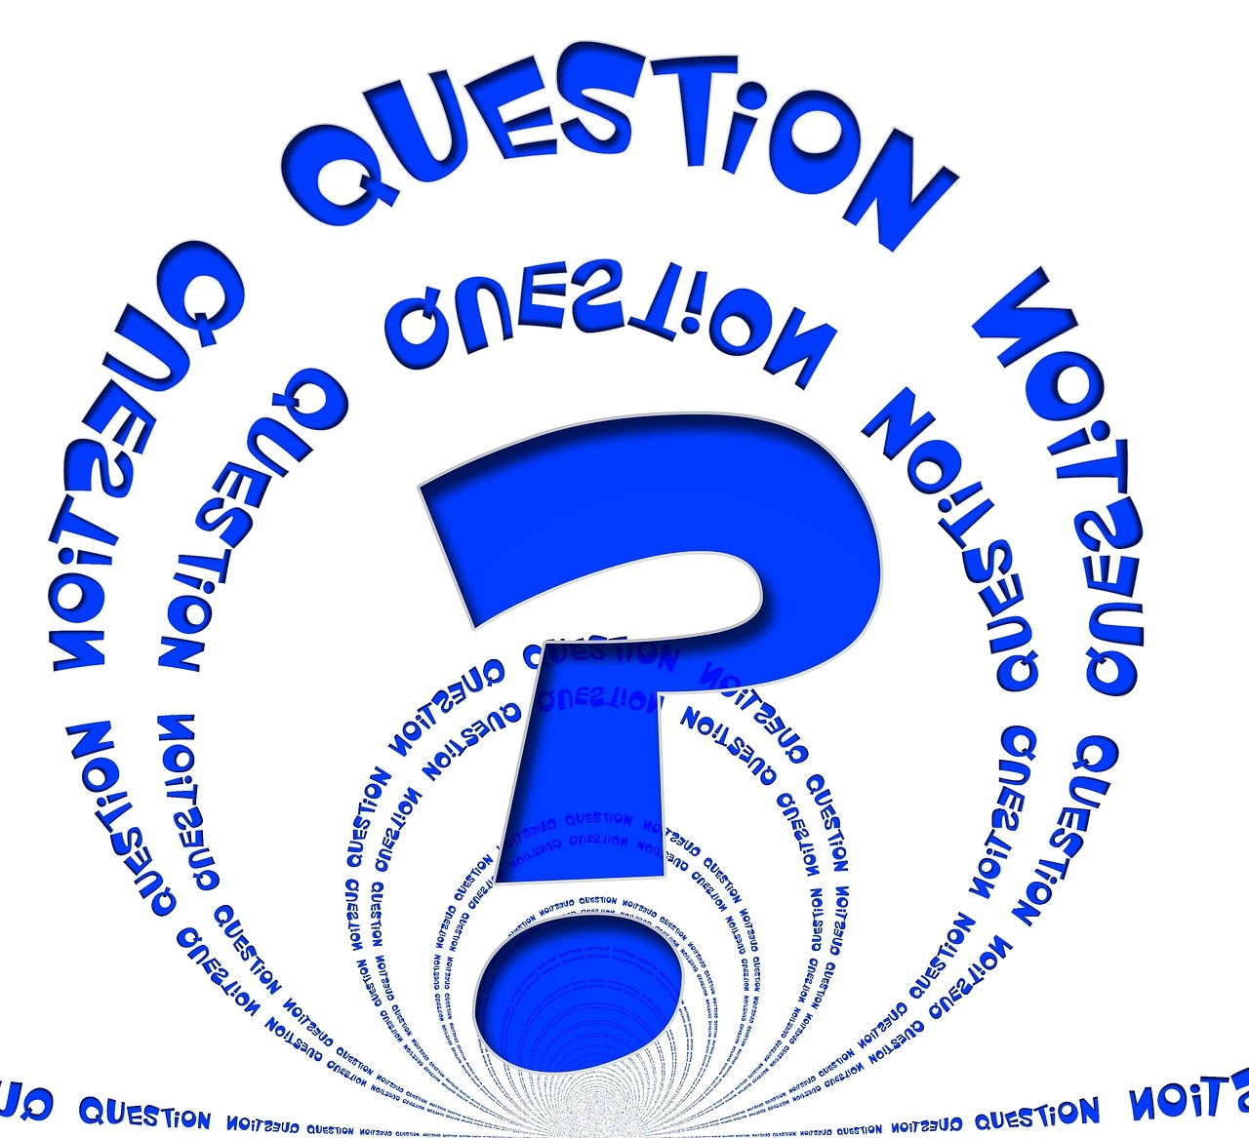
Apostrophe
Apostrophe Usage
The apostrophe ('), when used as a punctuation mark, serves two main purposes:
To indicate contractions, such as "can't" (cannot) and "won't" (will not).
To show possession, such as "Sarah's book" (the book belonging to Sarah).
Contractions
Contractions are formed by combining two words and replacing missing letters with an apostrophe.
"It's" is a contraction of "it is."
"I'm" is a contraction of "I am."
Possessive Forms
Possessive forms are created by adding an apostrophe and an "s" ('s) to the noun.
"The cat's toy" indicates that the toy belongs to the cat.
"The students' project" shows that the project belongs to the students.
Apostrophes and Plurals
The apostrophe is not used to form plurals.
Plurals are created by simply adding an "s" or "es" to the noun without an apostrophe.
"Apples" is the plural form of "apple."
"Dogs" is the plural of "dog."
Importance of Correct Usage
Understanding when to use apostrophes correctly is crucial for maintaining clarity and precision in writing.
Practice identifying contractions and possessive forms to master the use of apostrophes effectively.
Mastering Punctuation: A Comprehensive Guide

Slide 12
Quotation marks
Definition
Types
Usage with Punctuation
Quotation marks, also known as inverted commas, are punctuation marks used to indicate direct speech, a quotation, or to highlight a specific word or phrase.
There are two types of quotation marks: single quotation marks (') and double quotation marks (").
In American English, double quotation marks are more commonly used.
When using quotation marks, always place periods and commas inside the closing quotation mark, while colons and semicolons go outside the closing quotation mark.
Titles and Emphasis
Accuracy
Quotation marks are also used to denote the titles of short works such as articles, poems, and short stories.
Quotation marks are used to emphasize words or phrases in a sentence.
Remember to use quotation marks accurately to avoid misinterpretation and ensure clarity in your writing.
Mastering Punctuation: A Comprehensive Guide

