Slide 1












Understanding Fast Fashion: Impact, Ethics, and Solutions
Exploring the Environmental, Ethical, and Consumer Aspects of the Fashion Industry

Slide 2

Table of contents
Lesson Introduction
Subject Knowledge: The Rise of Fast Fashion
Subject Knowledge: Environmental Impact
Subject Knowledge: Ethical Concerns
Subject Knowledge: Consumer Behavior
Subject Knowledge: Sustainable Alternatives
Subject Knowledge: Industry Practices
Subject Knowledge: Call to Action
Subject Knowledge: Case Studies
Conclusion
01
02
03
04
05
06
07
08
09
10

Slide 3



Lesson Introduction
Understanding the Ethical Dilemma
Empowering Conscious Consumers
Promoting Informed Choices
01
Fast fashion presents a complex ethical dilemma, balancing consumer demand for affordable, trendy clothing with the industry's environmental and social impacts.
02
This lesson aims to empower learners with the knowledge and critical thinking skills needed to navigate the ethical challenges of fast fashion.
03
By the end of this lesson, participants will be equipped to make more informed choices as conscious consumers, contributing to a more sustainable fashion industry.
Understanding Fast Fashion: Impact, Ethics, and Solutions

Slide 4
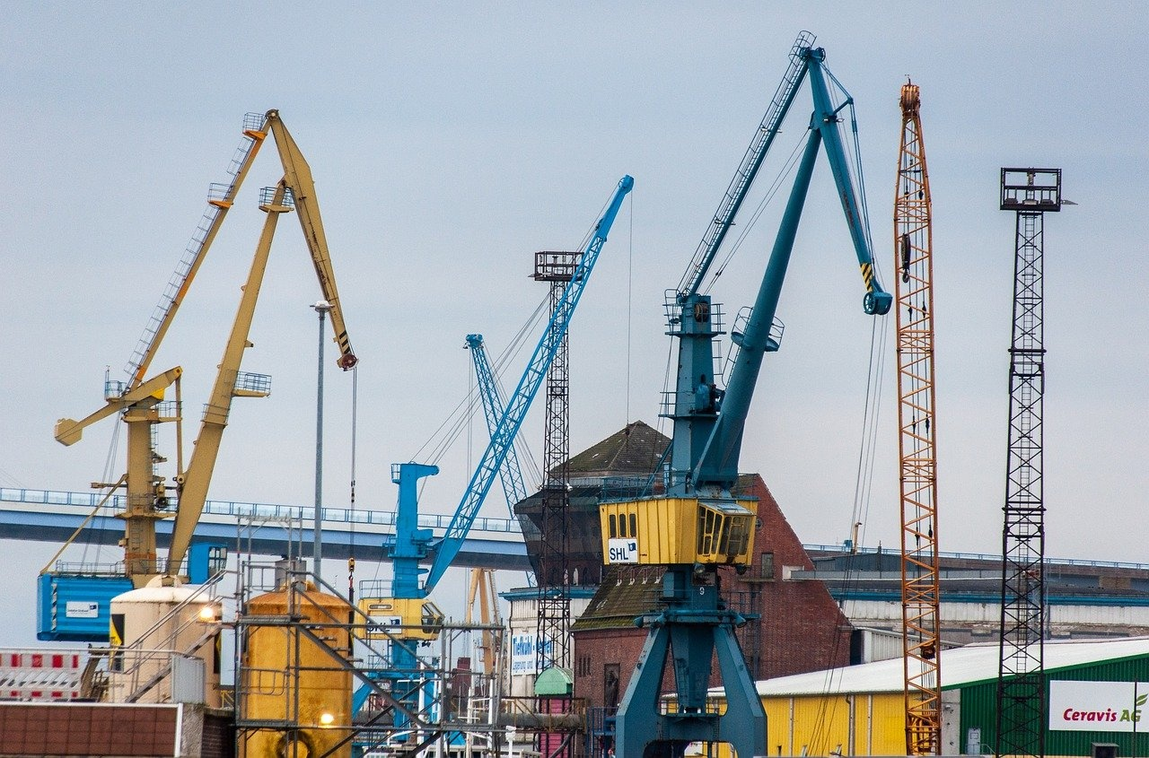
Subject Knowledge: The Rise of Fast Fashion
The Rise of Fast Fashion
Textile Waste
Environmental Impact
Fast fashion refers to the rapid production and consumption of clothing, driven by the constant demand for new styles and trends.
This business model has led to a significant increase in textile waste, with garments often being worn only a few times before being discarded.
The fast fashion industry is a major contributor to environmental degradation, from the use of harmful chemicals in textile production to the carbon footprint of transportation and waste disposal.
Understanding Fast Fashion: Impact, Ethics, and Solutions

Slide 5

Subject Knowledge: Environmental Impact
The Rise of Fast Fashion
Environmental Impact
Fast fashion: rapid production and consumption of clothing driven by demand for new styles.
Result: significant increase in textile waste, garments often worn only a few times before disposal.
Fast fashion industry: major contributor to environmental degradation.
Use of harmful chemicals in textile production.
Statistics: X% increase in textile waste over the past decade.
Understanding Fast Fashion: Impact, Ethics, and Solutions

Slide 6

Subject Knowledge: Ethical Concerns
The Rise of Fast Fashion
Environmental Impact
Fast fashion refers to the rapid production and consumption of clothing, driven by the constant demand for new styles and trends.
This business model has led to a significant increase in textile waste, with garments often being worn only a few times before being discarded.
The fast fashion industry is a major contributor to environmental degradation, from the use of harmful chemicals in textile production to the massive carbon footprint generated by transportation and manufacturing processes.
Labor Exploitation
Lack of Transparency
Impact on Local Communities
Many fast fashion brands outsource production to countries with lax labor laws, leading to poor working conditions, low wages, and exploitation of workers, including child labor in some cases.
One of the key ethical concerns in fast fashion is the lack of transparency in the supply chain.
Consumers often have little to no information about where and how their clothes are made, making it difficult to assess the ethical practices of brands.
The rapid pace of fast fashion production can have detrimental effects on local communities, from pollution of water sources due to textile dyeing processes to displacement of traditional artisans and small-scale producers.
Understanding Fast Fashion: Impact, Ethics, and Solutions

Slide 7

Subject Knowledge: Consumer Behavior
Consumer Trends
Psychological Factors
Consumers are increasingly seeking transparency and sustainability in the fashion industry.
The rise of social media influencers has influenced purchasing decisions and promoted fast fashion culture.
Impulse buying and the fear of missing out (FOMO) drive fast fashion purchases.
The desire for instant gratification and the thrill of getting a good deal impact consumer behavior.
Consumer Trends
Psychological Factors
Consumers are increasingly seeking transparency and sustainability in the fashion industry.
The rise of social media influencers has influenced purchasing decisions and promoted fast fashion culture.
Impulse buying and the fear of missing out (FOMO) drive fast fashion purchases.
The desire for instant gratification and the thrill of getting a good deal impact consumer behavior.
Understanding Fast Fashion: Impact, Ethics, and Solutions

Slide 8

Subject Knowledge: Sustainable Alternatives
Upcycling and Repurposing
Slow Fashion Movement
Embrace creativity by transforming old or unused clothing into new pieces
Reduce the need for new purchases
Divert textiles from landfills
Support brands that prioritize quality over quantity
Produce timeless pieces with sustainable materials
Ethical manufacturing practices
Rental and Second-Hand Platforms
Sustainable Fabrics
Local and Ethical Brands
Explore renting clothes for special occasions
Shop from thrift stores
Extend the lifecycle of garments
Reduce overall consumption
Opt for clothing made from eco-friendly materials like organic cotton, hemp, or recycled polyester
Minimize environmental impact
Promote a circular economy
Support local designers and brands
Prioritize fair wages, safe working conditions, and transparency throughout the supply chain
Understanding Fast Fashion: Impact, Ethics, and Solutions

Slide 9

Subject Knowledge: Industry Practices
The Rise of Fast Fashion
Rapid production and consumption of clothing
Driven by constant demand for new styles and trends
Significant increase in textile waste
Environmental Impact
Major contributor to environmental degradation
Use of harmful chemicals in textile production
Massive carbon footprint from transportation and manufacturing
Labor Practices
Emphasis on low costs leads to exploitative labor practices
Workers in developing countries face long hours, low wages, and unsafe conditions
Supply Chain Transparency
Lack of transparency in supply chains
Difficult for consumers to trace origins of clothing
Challenges in understanding production conditions
Sustainable Alternatives
Rising demand for sustainable and ethical alternatives
Eco-friendly materials and fair trade practices
Transparent supply chains
Understanding Fast Fashion: Impact, Ethics, and Solutions

Slide 10
Subject Knowledge: Call to Action
Educate Yourself
Support Ethical Brands
Extend the Lifespan of Your Clothes
Advocate for Change
Shop Mindfully
Take the time to research and understand the impact of fast fashion on the environment and society.
Stay informed about the latest developments in sustainable fashion practices.
Choose to support brands that prioritize ethical and sustainable practices in their production processes.
Look for certifications like Fair Trade or organic materials.
Instead of constantly buying new items, focus on caring for and repairing the clothes you already own.
This simple act can significantly reduce textile waste.
Use your voice to advocate for transparency and accountability in the fashion industry.
Support initiatives that promote fair wages, safe working conditions, and environmental sustainability.
Before making a purchase, consider the true cost of the item beyond its price tag.
Think about the resources used, the labor involved, and the potential impact on the planet and people.
01
02
03
04
05
Understanding Fast Fashion: Impact, Ethics, and Solutions

Slide 11
Subject Knowledge: Case Studies
Introduction to Fast Fashion
Consequences of Fast Fashion
Environmental Impact
01
Rapid production and consumption
Driven by demand for new styles
02
Significant increase in textile waste
Garments worn only a few times
03
Major contributor to environmental degradation
Use of harmful chemicals in textile production
Understanding Fast Fashion: Impact, Ethics, and Solutions

Slide 12
Conclusion
Fast Fashion's Impact
Environmental Concerns
Conscious Consumerism
Stay Informed
Collective Effort
Rapid production and consumption lead to excessive textile waste.
Short garment lifespans contribute to environmental degradation.
Extensive use of harmful chemicals in textile production.
Opt for sustainable and ethical fashion choices.
Support brands with transparency, fair labor practices, and eco-friendly methods.
Advocate for positive change in the fashion industry.
Embrace quality over quantity for a sustainable wardrobe.
Together, we can make a difference in the fashion industry's ethical landscape.
01
02
03
04
05
Understanding Fast Fashion: Impact, Ethics, and Solutions

