Slide 1
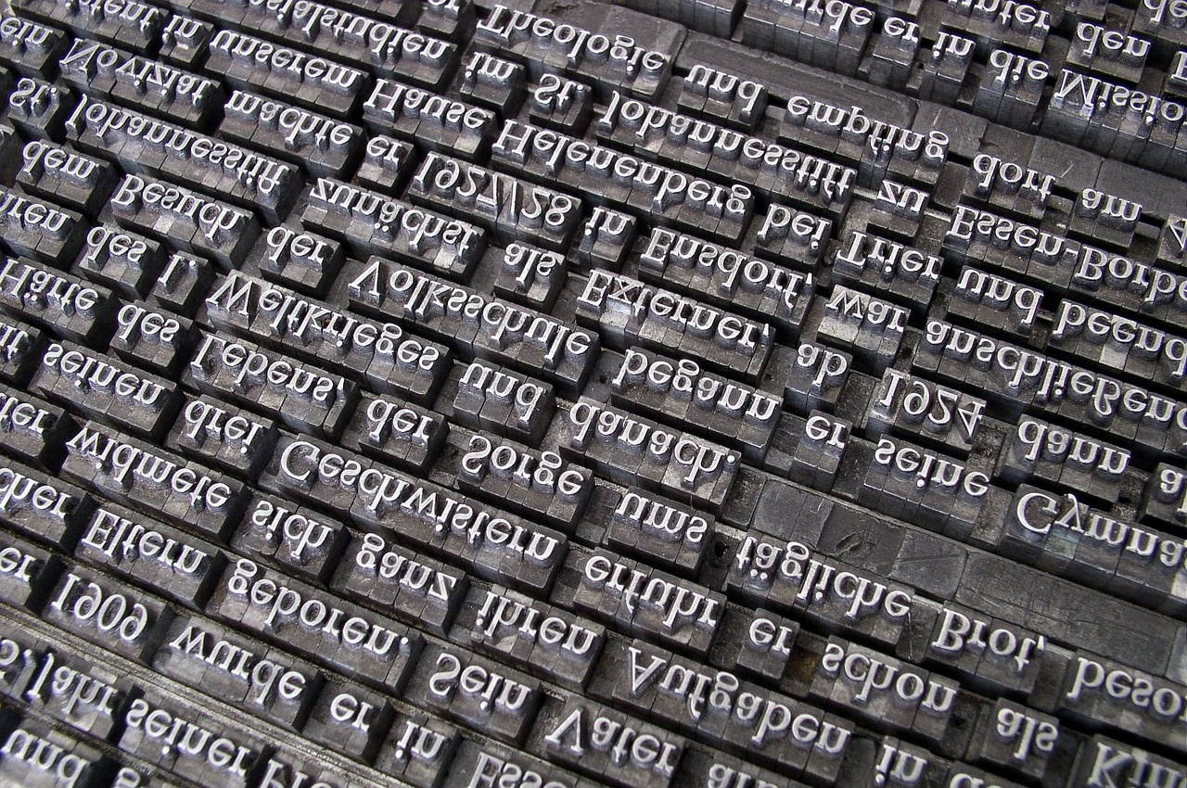
Exploring Ukrainian Language: Mastering Simple Present Tense
A Comprehensive Journey Through Language Learning and Cultural Understanding

Slide 2
Table of contents
01
02
03
04
05
06
07
08
09
10
11
Title Slide: Ukrainian Language Exploration: Simple Present…
Lesson Objectives
What is Simple Present Tense?
Verb Conjugation Basics
Grammatical Persons
Interactive Learning Strategies
Common Challenges
Cultural Context
Technology Integration
Assessment Approach
Homework and Practice

Slide 3
Table of contents
12
13
14
15
16
Parent Engagement
Extension Activities
Key Takeaways
Reflection and Next Steps
Resources and Support

Slide 4

1
Title Slide: Ukrainian Language Exploration: Simple Present Tense Mastery
Ukrainian Language Exploration: Simple Present Tense Mastery
A Dynamic Learning Journey for Young Teenage Learners
Exploring Ukrainian Language: Mastering Simple Present Tense

Slide 5
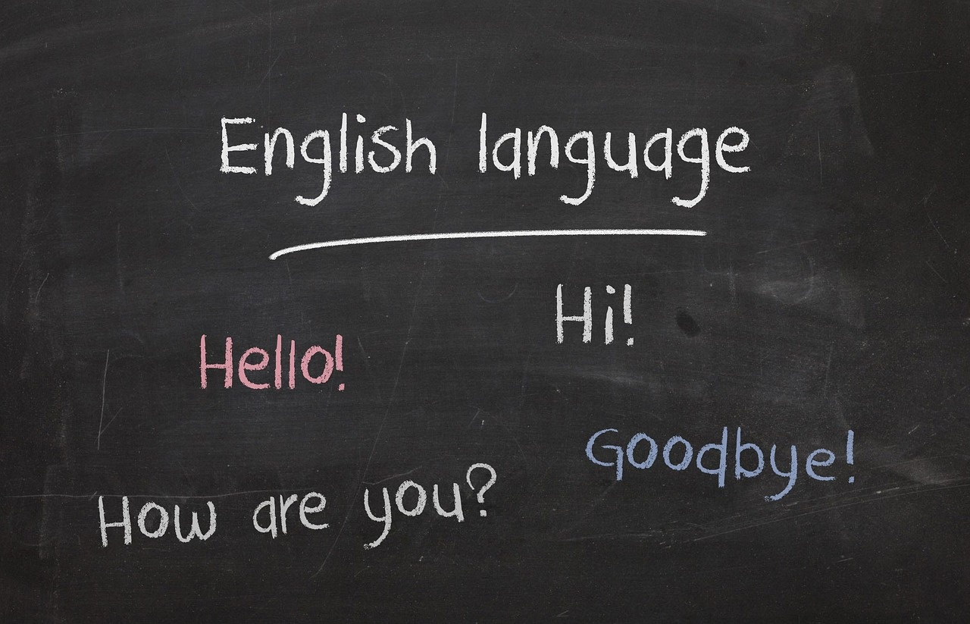
2
Lesson Objectives
01
Master basic Ukrainian simple present tense verb conjugations
02
Construct grammatically correct Ukrainian sentences
Practice conjugating regular verbs in the simple present tense.
Learn to form sentences using subject-verb agreement in Ukrainian.
03
Develop confidence in basic linguistic communication
04
Understand fundamental Ukrainian grammatical structures
Engage in speaking exercises to enhance language fluency.
Explore the syntax and word order in Ukrainian sentences.
Exploring Ukrainian Language: Mastering Simple Present Tense

Slide 6

3
What is Simple Present Tense?
01
Definition
02
Key Features
Expressing current actions, habitual activities
Describes daily routines
Communicates general truths
Fundamental communication structure
03
Visual
Verb transformation diagram
Exploring Ukrainian Language: Mastering Simple Present Tense

Slide 7
4
Verb Conjugation Basics
01
02
03
Verb Conjugation Basics
Conjugation Steps
Example: "читати" (to read)
Regular -ати Verb Pattern
Identify verb stem
Remove -ати ending
Add personal endings
Я читаю (I read)
Ти читаєш (You read)
Exploring Ukrainian Language: Mastering Simple Present Tense

Slide 8
5
Grammatical Persons
01
First Person Singular
02
First Person Plural
03
Second Person Singular
I am
I have
I do
We are
We have
We do
You are
You have
You do
04
Second Person Plural
05
Third Person Singular
You (all) are
You (all) have
You (all) do
He/She/It is
He/She/It has
He/She/It does
Exploring Ukrainian Language: Mastering Simple Present Tense

Slide 9
6
Interactive Learning Strategies
01
Verb Conjugation Games
02
Pronunciation Challenges
03
Sentence Construction Exercises
Engage students in fun activities to practice conjugating Ukrainian verbs.
Encourage students to practice correct pronunciation through interactive exercises.
Provide opportunities for students to create their own sentences using the simple present tense.
04
Digital Language Learning Tools
05
Peer Collaborative Activities
Integrate online resources and apps to enhance language learning outside the classroom.
Foster a collaborative learning environment where students can practice speaking and writing in Ukrainian together.
Exploring Ukrainian Language: Mastering Simple Present Tense

Slide 10

7
Common Challenges
01
Incorrect verb endings
02
Misunderstanding aspectual distinctions
Mistakes in conjugating verbs according to tense, mood, and aspect.
Common in languages with complex verb conjugation rules.
Confusion between perfective and imperfective aspects.
Difficulty in expressing actions' completeness or duration.
03
Pronoun usage complexities
Errors in selecting the correct pronoun for the context.
Challenges with gendered pronouns and formal/informal distinctions.
Exploring Ukrainian Language: Mastering Simple Present Tense

Slide 11

8
Cultural Context
01
Language as Cultural Bridge
02
Ukrainian Communication Nuances
Language serves as a vital link connecting different cultures.
Facilitates mutual understanding and cooperation.
Direct and expressive communication style.
High value on politeness and respect.
03
Historical Linguistic Evolution
04
Importance of Contextual Understanding
Influence of various languages over centuries.
Development of unique linguistic characteristics.
Context is crucial for accurate interpretation.
Avoids misunderstandings and fosters better communication.
Exploring Ukrainian Language: Mastering Simple Present Tense

Slide 12

9
Technology Integration
01
Interactive Conjugation Apps
02
Augmented Reality Verb Visualization
Enhance verb learning through interactive exercises.
Provide instant feedback and corrections.
Track progress over time.
Visualize verb conjugations in 3D space.
Engage learners with immersive experiences.
Bridge the gap between theory and practice.
03
Online Conversation Simulators
04
Multimedia Storytelling Platforms
Practice real-life conversations in a virtual environment.
Receive feedback on pronunciation and grammar.
Build confidence in speaking skills.
Combine text, audio, and video for comprehensive learning.
Engage learners with interactive stories.
Enhance retention through multimedia content.
Exploring Ukrainian Language: Mastering Simple Present Tense

Slide 13

10
Assessment Approach
01
Formative Assessment Strategies
02
Summative Evaluation Criteria
Regular quizzes to gauge understanding
Interactive exercises for immediate feedback
Written tests on verb conjugation
Oral presentations to demonstrate sentence construction skills
03
Performance Tracking Methods
04
Personalized Learning Pathways
Individual progress charts
Peer evaluation for collaborative activities
Tailored assignments based on strengths and weaknesses
Goal-setting for language proficiency growth
Exploring Ukrainian Language: Mastering Simple Present Tense

Slide 14
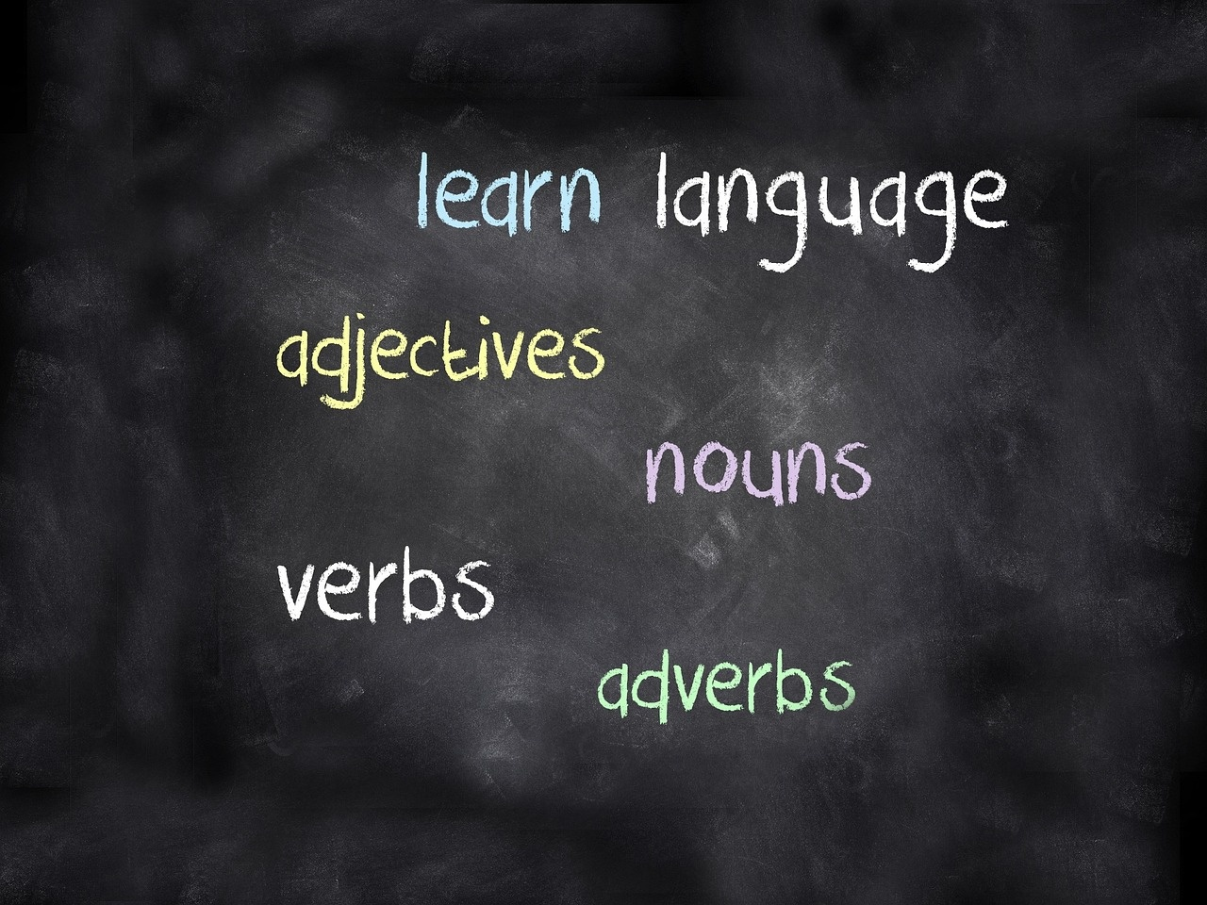
11
Homework and Practice
01
Complete daily routine journaling in Ukrainian
02
Conduct a family verb conjugation interview in Ukrainian
Write about your daily activities
Use new vocabulary words
Practice sentence structure
Interview family members
Focus on verb conjugation
Record and review the interview
03
Engage in digital storytelling projects using Ukrainian language
04
Continuously explore and practice Ukrainian language skills
Create digital stories
Use Ukrainian language
Share with peers
Use language apps
Join language groups
Practice speaking and writing
Exploring Ukrainian Language: Mastering Simple Present Tense

Slide 15

12
Parent Engagement
01
Family Language Challenge Program
02
Digital Progress Tracking
Encourage parents to participate in language learning activities with their children.
Provide resources and guidance for families to practice Ukrainian language together.
Share tools and platforms for parents to monitor their child's language learning progress.
Foster a sense of achievement and motivation through tracking milestones.
03
Collaborative Learning Resources
04
Supporting Home Language Practice
Offer suggestions for interactive language learning materials that parents can use at home.
Facilitate communication between parents and educators to support language development.
Provide tips and strategies for parents to create a language-rich environment at home.
Emphasize the importance of consistent practice and reinforcement outside of the classroom.
Exploring Ukrainian Language: Mastering Simple Present Tense

Slide 16

13
Extension Activities
Advanced Verb Conjugation Research
Explore complex verb conjugation patterns in Ukrainian literature.
Analyze historical evolution of verb forms in Ukrainian language.
Exploring Ukrainian Language: Mastering Simple Present Tense

Slide 17

14
Key Takeaways
Key Takeaways
Understanding the foundational aspects of Ukrainian grammar
Recognizing patterns in verb conjugation for simple present tense
Developing cultural communication competence
Embracing a continuous learning mindset
Exploring Ukrainian Language: Mastering Simple Present Tense

Slide 18

15
Reflection and Next Steps
01
Reflection on Progress
02
Areas for Improvement
Reviewed basic conjugation rules
Practiced with common verbs
Completed exercises with 80% accuracy
Expand vocabulary
Improve pronunciation
Increase practice frequency
03
Goals for Advancement
04
Practice Plan
Learn past and future tenses
Understand irregular verbs
Practice complex sentence structures
Daily verb conjugation drills
Weekly speaking sessions with a tutor
Monthly progress assessments
Exploring Ukrainian Language: Mastering Simple Present Tense

Slide 19

16
Resources and Support
01
Recommended Learning Platforms
02
Additional Study Materials
Ukrainian Language Learning App
Online Ukrainian Grammar Courses
Ukrainian Verb Conjugation Guidebook
Ukrainian Language Workbook
03
Contact Information
04
Ongoing Support Mechanisms
Email: ukrainianlanguage@learninghub.com
Phone: +1-800-123-4567
Live Chat Support on Learning Platforms
Weekly Virtual Study Groups
Exploring Ukrainian Language: Mastering Simple Present Tense

