Slide 1


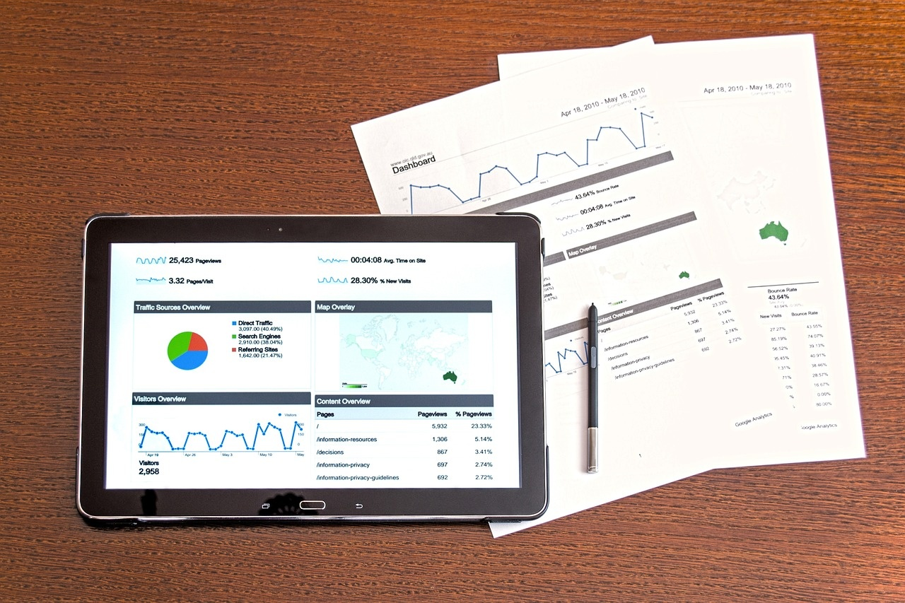
Navigating the Data Landscape
Exploring Concepts, Infrastructure, and Applications

Slide 2
TABLE OF
CONTENTS
Course Overview
Core Concepts
Technical Infrastructure
Data Processing Paradigms
Analytics and Visualization
Implementation Considerations
Practical Applications
Best Practices
Future Trends
Learning Outcomes
Key Features
Benefits of Adoption
Steps to Implementation
Timeline of Events
SWOT Analysis
01
02
03
04
05
06
07
08
09
10
11
12
13
14
15

Slide 3
TABLE OF
CONTENTS
Revenue Growth in 2023
Challenges and Solutions
Industry Case Studies
Data Security Measures
Data Visualization Techniques
16
17
18
19
20

Slide 4
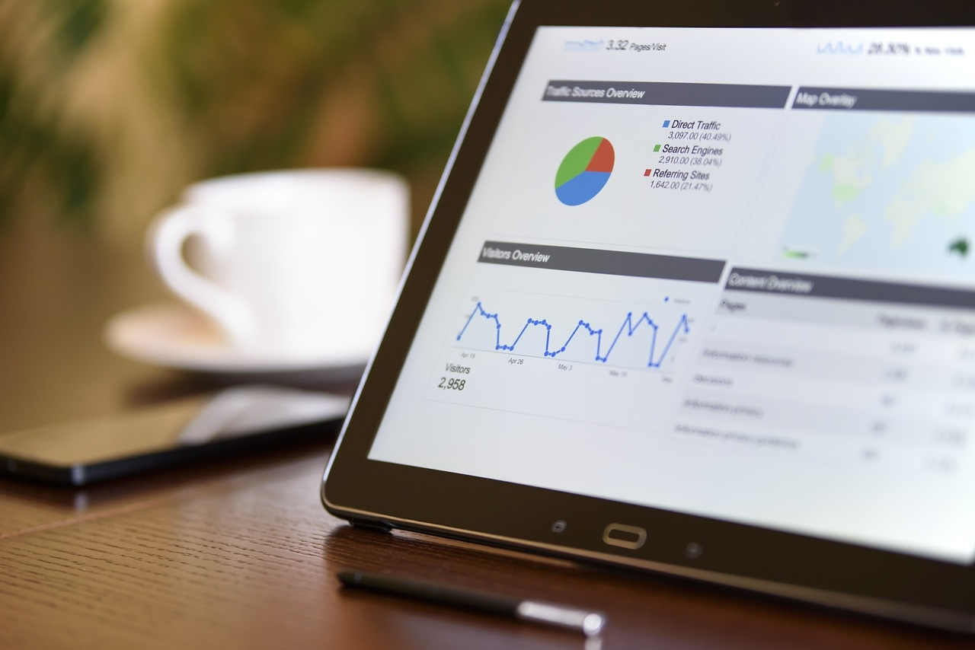
Navigating the Data Landscape
Course Overview
Comprehensive exploration of Big Data fundamentals
Focus on data-driven decision making
Real-world applications and case studies
Hands-on technical implementation
Industry-standard tools and frameworks

Slide 5

Navigating the Data Landscape
Core Concepts
The Five V's of Big Data
Data Architecture Fundamentals
Volume
Velocity
Variety
Veracity
Value
Analytics Frameworks
Implementation Strategies

Slide 6

Navigating the Data Landscape
Technical Infrastructure
Storage Solutions
Processing Frameworks
HDFS
NoSQL Databases
Cloud Storage
Hadoop
Spark
Stream Processing

Slide 7

Navigating the Data Landscape
Data Processing Paradigms
Batch Processing
Processing large volumes of data at once
Suitable for non-time-sensitive tasks
Examples: End-of-day reports, data warehousing
Stream Processing
Continuous data processing
Handles data in real-time
Examples: Fraud detection, live analytics
Lambda Architecture
Combines batch and stream processing
Balances latency, throughput, and fault-tolerance
Examples: Real-time data processing with historical data
Real-time Analytics
Immediate insights from data
Requires low-latency processing
Examples: Monitoring dashboards, alerting systems
ETL Workflows
Extract, Transform, Load
Prepares data for analysis
Examples: Data migration, data integration

Slide 8

Navigating the Data Landscape
Analytics and Visualization
Statistical Analysis Methods
Machine Learning Integration
Visualization Tools
Reporting Frameworks
Tableau
Power BI
Custom Dashboards

Slide 9

Navigating the Data Landscape
Implementation Considerations
Scalability Planning
Design for growth
Implement load balancing
Use scalable resources
Security Measures
Encrypt data
Implement access controls
Regular security audits
Data Governance
Establish data policies
Ensure data quality
Implement data stewardship
Privacy Compliance
Adhere to regulations
Implement data anonymization
Conduct privacy impact assessments
Performance Optimization
Optimize code
Use caching
Monitor performance

Slide 10

Navigating the Data Landscape
Practical Applications
Business Intelligence
Transforming raw data into meaningful insights
Supporting decision-making processes
Enhancing strategic planning
Customer Analytics
Understanding customer behavior
Personalizing marketing efforts
Improving customer satisfaction
Predictive Modeling
Forecasting future trends
Identifying potential opportunities
Mitigating risks
Risk Assessment
Evaluating potential risks
Implementing risk mitigation strategies
Ensuring business continuity
Operational Optimization
Streamlining business processes
Enhancing efficiency and productivity
Reducing operational costs

Slide 11

Navigating the Data Landscape
Best Practices
Data Quality Management
Ensure accuracy and consistency of data
Implement data validation and cleansing processes
System Architecture Design
Design scalable and flexible systems
Use modular and reusable components
Performance Monitoring
Regularly monitor system performance
Identify and address bottlenecks
Error Handling
Implement robust error handling mechanisms
Log and track errors for analysis
Documentation Standards
Maintain clear and comprehensive documentation
Regularly update documentation to reflect changes

Slide 12

Navigating the Data Landscape
Future Trends
Edge Computing
Decentralized data processing
Reduced latency
Enhanced security
AI Integration
Seamless AI incorporation
Improved decision making
Enhanced user experience
Real-time Processing
Instant data analysis
Quick response times
Improved efficiency
Automated Analytics
Self-service analytics
Reduced human error
Faster insights
Cloud-Native Solutions
Scalable infrastructure
Cost-effective
Enhanced collaboration

Slide 13

Navigating the Data Landscape
Learning Outcomes
Technical Proficiency
Analytical Skills
Problem-Solving Abilities
Implementation Experience
Industry Knowledge

Slide 14

Navigating the Data Landscape
Key Features
Comprehensive exploration of Big Data fundamentals
Understanding the core principles and concepts of Big Data
Exploring the Five V's of Big Data: Volume, Velocity, Variety, Veracity, Value
Focus on data-driven decision making
Leveraging data insights to drive strategic business decisions
Implementing data-driven strategies for improved outcomes
Real-world applications and case studies
Learning from practical examples and real-life scenarios
Applying theoretical knowledge to actual industry challenges
Hands-on technical implementation
Practical experience in working with Big Data tools and technologies
Developing technical skills through hands-on projects and exercises
Industry-standard tools and frameworks
Utilizing popular tools like Hadoop, Spark, Tableau, and more
Understanding the latest trends and technologies in the Big Data landscape

Slide 15
Navigating the Data Landscape
Benefits of Adoption
Increased Efficiency
Cost Savings
Enhanced Decision-Making
Competitive Advantage
X%
X%
X%
X%
Streamlining data processes can lead to a X% increase in operational efficiency.
Adopting efficient data management practices can result in a X% reduction in overall costs.
Access to real-time data analytics can improve decision-making processes by X%.
Leveraging data effectively can provide a competitive edge, leading to X% increase in market share.

Slide 16





Navigating the Data Landscape
Steps to Implementation
Define Objectives
Assess Current Infrastructure
Select Appropriate Tools
Develop Implementation Plan
Pilot Testing
Clearly outline the goals and outcomes you aim to achieve with the implementation.
Evaluate existing systems and resources to identify gaps and requirements for the new implementation.
Choose the right technologies and frameworks that align with your objectives and infrastructure.
Create a detailed roadmap with timelines, tasks, and responsibilities for a smooth execution.
Conduct small-scale testing to validate the implementation before full deployment.

Slide 17

Navigating the Data Landscape
Timeline of Events
2003
Introduction of Hadoop by Doug Cutting and Mike Cafarella
2009
Apache Spark developed at UC Berkeley's AMPLab
2010
Introduction of Lambda Architecture by Nathan Marz
2012
Apache Kafka becomes open-source
2014
Rise of real-time analytics with the advent of Apache Flink

Slide 18




Navigating the Data Landscape
SWOT Analysis
Strengths
Weaknesses
Strong data processing capabilities
Skilled data analytics team
Robust infrastructure for handling large datasets
Limited data visualization tools
Lack of real-time processing capabilities
Data security vulnerabilities
Opportunities
Threats
Integration of AI for advanced analytics
Expansion into new market segments
Collaboration with industry leaders for data insights
Increasing competition in the data analytics market
Data privacy regulations impacting operations
Rapid technological advancements challenging current systems

Slide 19
Navigating the Data Landscape
Revenue Growth in 2023
Projected Revenue Increase
Percentage Growth
Investment Allocation
Strategic Partnerships
$10 million
15%
30%
3
Expected growth in revenue for 2023.
Represents the percentage increase in revenue compared to the previous year.
30% in marketing, 20% in R&D, 50% in operational efficiency.
Collaboration with industry leaders, Joint ventures for market penetration, Alliances for technological advancements.

Slide 20

Navigating the Data Landscape
Challenges and Solutions
Data Security Challenges
Data Quality Issues
Increasing cyber threats and data breaches
Compliance with data protection regulations
Solution: Implement robust encryption protocols and access controls
Inaccurate or incomplete data sets
Data inconsistency across sources
Solution: Establish data quality monitoring processes and data cleansing routines
Scalability Concerns
Complex Data Integration
Managing large volumes of data growth
Ensuring system performance under heavy loads
Solution: Utilize scalable cloud infrastructure and distributed computing systems
Integrating data from diverse sources and formats
Ensuring data compatibility and consistency
Solution: Implement data integration tools and standardized data formats

Slide 21

Navigating the Data Landscape
Industry Case Studies
Retail Sector
Utilizing big data analytics for personalized marketing strategies
Enhancing customer experience through data-driven insights
Optimizing inventory management and supply chain operations
Healthcare Industry
Improving patient outcomes with predictive analytics
Enhancing medical research and drug development processes
Implementing data-driven decision-making in healthcare administration
Financial Services
Fraud detection and prevention using advanced analytics
Risk assessment and compliance management through data analysis
Personalized financial recommendations based on customer behavior
Manufacturing Sector
Predictive maintenance to reduce downtime and optimize production
Supply chain optimization through real-time data monitoring
Quality control and defect detection using machine learning algorithms

Slide 22

Navigating the Data Landscape
Data Security Measures
Encryption Protocols
Access Control Mechanisms
Use of advanced encryption standards
Data encryption at rest and in transit
Role-based access control
Multi-factor authentication
Regular Security Audits
Data Masking Techniques
Scheduled security assessments
Vulnerability scanning and penetration testing
Masking sensitive data in non-production environments
Dynamic data masking for real-time protection

Slide 23

Navigating the Data Landscape
Data Visualization Techniques
Bar Charts
Represent data with rectangular bars of varying lengths.
Pie Charts
Display data in a circular graph divided into slices to show proportions.
Line Graphs
Connect data points with lines to show trends over time.
Scatter Plots
Plot points to show the relationship between two variables.
Heat Maps
Use colors to represent data values in a matrix format.

