Slide 1



AI Strategy: Navigating the Future
Exploring the Landscape, Integration, Readiness, and Governance

Slide 2
TABLE OF
CONTENTS
Title Slide: Navigating the Future with AI Strategy
Learning Objectives
Understanding AI Strategy
AI Strategic Landscape
Strategic AI Integration Framework
Organizational AI Readiness
Ethical AI Governance
Implementation Challenges
Technology Ecosystem Mapping
Future Trends
Case Study: AI Strategy in Action
Practical Implementation Roadmap
Key Success Metrics
Ethical Considerations Checklist
Conclusion
01
02
03
04
05
06
07
08
09
10
11
12
13
14
15

Slide 3
TABLE OF
CONTENTS
Q&A and Resources
Design Recommendations
Visual Content Suggestions
Recommended Presentation Techniques
SWOT Analysis of AI Strategy
Revenue Growth Forecast
AI Technology Ecosystem Diagram
Strategic Implementation Flowchart
Comparative Technology Analysis
Ethical Framework Illustrations
16
17
18
19
20
21
22
23
24
25

Slide 4


AI Strategy: Navigating the Future
Title Slide: Navigating the Future with AI Strategy
Navigating the Future: Comprehensive AI Strategy Development
A Strategic Guide for Emerging Business Professionals

Slide 5





AI Strategy: Navigating the Future
Learning Objectives
Understand AI's transformative potential
Develop comprehensive AI strategy frameworks
Explore ethical AI implementation
Master strategic technological integration
Build forward-thinking leadership capabilities
Learn about the impact of AI on various industries
Identify key areas where AI can drive innovation
Analyze case studies of successful AI implementations
Understand the components of an AI strategy
Learn how to align AI strategy with business goals
Create a roadmap for AI adoption
Understand the importance of ethics in AI
Learn about ethical guidelines and frameworks
Analyze the impact of AI on society and privacy
Learn how to integrate AI with existing technologies
Understand the challenges of AI integration
Develop solutions for seamless technological integration
Understand the role of leadership in AI adoption
Learn about the skills needed for AI leadership
Develop strategies for leading AI initiatives

Slide 6
AI Strategy: Navigating the Future
Understanding AI Strategy
Technological infrastructure
Organizational readiness
Ethical considerations
Implementation roadmap
Hardware and software requirements
Data storage and management
Scalability and flexibility
Skillset and training
Change management
Leadership support
Bias and fairness
Transparency
Accountability
Short-term goals
Long-term vision
Monitoring and evaluation

Slide 7

AI Strategy: Navigating the Future
AI Strategic Landscape
Current Technological Trends
Industry Transformation Indicators
Advancements in machine learning algorithms
Increased adoption of natural language processing
Growth of AI-powered automation in various industries
Shift towards data-driven decision-making processes
Integration of AI in customer service and personalized marketing
Rise of predictive analytics for operational efficiency
Competitive Positioning Opportunities
Emerging Technology Ecosystems
Leveraging AI for product innovation and customization
Enhancing customer experiences through AI-driven insights
Improving operational efficiency and cost savings with AI solutions
Development of AI-driven IoT applications
Integration of AI in cybersecurity for threat detection
Exploration of AI in healthcare for personalized treatment options

Slide 8
AI Strategy: Navigating the Future
Strategic AI Integration Framework
Assessment Phase
Technology Mapping
Capability Evaluation
Implementation Planning
Continuous Improvement Mechanisms
Conduct comprehensive AI readiness assessment
Identify organizational goals and challenges
Evaluate current technological capabilities
Map AI technologies to business objectives
Analyze potential impact on operations
Identify key technology partners and vendors
Assess internal skill sets and expertise
Determine training and development needs
Evaluate potential for AI-driven innovation
Develop a detailed roadmap for AI integration
Define key milestones and timelines
Allocate resources and budget effectively
Establish feedback loops for ongoing optimization
Monitor performance metrics and KPIs
Implement agile methodologies for adaptive strategies

Slide 9
AI Strategy: Navigating the Future
Organizational AI Readiness
Technological Infrastructure Assessment
Skill Gap Analysis
Cultural Adaptation Requirements
Resource Allocation Strategies
Evaluate current IT systems and capabilities
Identify gaps in infrastructure for AI integration
Assess scalability and compatibility with AI technologies
Identify existing skill sets within the organization
Determine training needs for AI implementation
Plan for upskilling or hiring to fill skill gaps
Assess organizational culture towards innovation and change
Identify potential resistance to AI adoption
Develop strategies to foster a culture supportive of AI initiatives
Determine budget allocation for AI implementation
Allocate resources for training, infrastructure upgrades, and AI tools
Establish governance structures for overseeing resource allocation

Slide 10

AI Strategy: Navigating the Future
Ethical AI Governance
Transparency Principles
Bias Mitigation Strategies
Implement clear communication about AI systems' capabilities and limitations.
Develop processes to detect and address biases in AI algorithms.
Privacy Protection Frameworks
Accountability Mechanisms
Ensure data privacy compliance and safeguard user information.
Establish mechanisms to hold individuals and organizations accountable for AI decisions.

Slide 11

AI Strategy: Navigating the Future
Implementation Challenges
Complexity of Integration
AI integration requires coordination across departments.
Data Quality and Accessibility
Ensuring data accuracy and availability for AI algorithms.
Resource Constraints
Limited budget and expertise for AI implementation.
Regulatory Compliance
Navigating legal frameworks for AI usage.

Slide 12

AI Strategy: Navigating the Future
Technology Ecosystem Mapping
AI Technology Categories
Potential Business Applications
Machine Learning
Natural Language Processing
Computer Vision
Robotics
Expert Systems
Customer Service Automation
Predictive Analytics
Image and Video Analysis
Autonomous Vehicles
Decision Support Systems
Comparative Technology Analysis
Strategic Integration Points
Performance Metrics
Cost-Benefit Analysis
Scalability
Integration Complexity
User Adoption
Customer Experience Enhancement
Operational Efficiency
Product Innovation
Risk Management
Market Expansion

Slide 13

AI Strategy: Navigating the Future
Future Trends
Emerging AI Technologies
Quantum computing
AI-driven automation
Natural language processing advancements
Predicted Technological Convergence
Integration of AI with IoT, blockchain, and augmented reality for enhanced capabilities
Long-term Strategic Implications
Shift towards AI-first business models
Increased efficiency and productivity
New job roles and skill requirements
Competitive Positioning Strategies
Early adoption of AI innovations
Strategic partnerships for technology advancement

Slide 14

AI Strategy: Navigating the Future
Case Study: AI Strategy in Action
Real-world Implementation Example
Strategic Decision Points
Integration of AI-powered chatbots in customer service operations.
Selecting the right AI vendor
Defining chatbot functionalities
Ensuring seamless integration with existing systems.
Outcomes and Lessons Learned
Key Takeaways
Increased customer satisfaction
Reduced response times
Improved operational efficiency
Importance of continuous monitoring and refining AI algorithms.
Strategic alignment of AI initiatives with business goals
Proactive stakeholder engagement
Significance of data quality in AI implementation.

Slide 15
AI Strategy: Navigating the Future
Practical Implementation Roadmap
Phase 1: Assessment
Phase 2: Strategy Development
Phase 3: Pilot Implementation
Phase 4: Scaling and Optimization
Conduct thorough evaluation of current technological landscape
Identify organizational strengths and weaknesses related to AI integration
Assess readiness of key stakeholders for strategic implementation
Define clear AI strategy objectives aligned with business goals
Develop detailed roadmap for technology adoption and integration
Establish key performance indicators (KPIs) for measuring success
Select pilot projects to test AI applications in controlled environments
Monitor and evaluate pilot outcomes for insights and adjustments
Gather feedback from users and stakeholders for continuous improvement
Scale successful AI initiatives across the organization
Implement training programs to upskill employees on AI technologies
Continuously optimize AI systems based on performance data and feedback

Slide 16
AI Strategy: Navigating the Future
Key Success Metrics
Key Success Metrics
ROI Measurement
Strategic Impact Assessment
Continuous Improvement Frameworks
4
ROI
Strategic Impact
Continuous Improvement
Track accuracy improvements, efficiency gains, and customer satisfaction metrics.
Calculate return on investment from AI implementation in terms of cost savings and revenue growth.
Evaluate the alignment of AI initiatives with overall business goals and strategic objectives.
Implement feedback loops and agile methodologies to drive ongoing enhancements in AI strategy.

Slide 17
AI Strategy: Navigating the Future
Ethical Considerations Checklist
Transparency Requirements
Bias Detection Protocols
Privacy Protection Strategies
Accountability Frameworks
Clearly communicate AI usage to stakeholders
Provide understandable explanations of AI decision-making processes
Regularly audit AI algorithms for biases
Implement mechanisms to address and mitigate biases in AI systems
Ensure data protection and user privacy compliance
Establish robust data security measures to safeguard sensitive information
Define roles and responsibilities for AI governance
Establish mechanisms for oversight and accountability in AI decision-making

Slide 18

AI Strategy: Navigating the Future
Conclusion
Recap of Strategic AI Integration Principles
Emphasize the Future of Technological Leadership
Call to Action for Strategic Innovation

Slide 19

AI Strategy: Navigating the Future
Q&A and Resources
Additional Learning Resources
Contact Information
Online courses on AI strategy development
Webinars on ethical AI implementation
Whitepapers on strategic technological integration
AI strategy consultants for personalized guidance
Industry experts for Q&A sessions
AI technology providers for implementation support
Recommended Reading
Further Exploration Opportunities
"Artificial Intelligence: A Modern Approach" by Stuart Russell & Peter Norvig
"The AI Advantage" by Thomas H. Davenport
"Ethics of Artificial Intelligence and Robotics" edited by Vincent C. Müller
AI strategy workshops for hands-on learning
AI conferences for networking and insights
AI strategy toolkits for practical implementation guidance

Slide 20

AI Strategy: Navigating the Future
Design Recommendations
Utilize a clean, modern design template
Incorporate tech-inspired color schemes
Blues
Whites
Subtle gradients
Use icons and infographics to illustrate complex concepts
Maintain consistent typography and layout
Include high-quality, relevant imagery

Slide 21
AI Strategy: Navigating the Future
Visual Content Suggestions
AI Technology Ecosystem Diagrams
Strategic Implementation Flowcharts
Comparative Technology Analysis Graphics
Ethical Framework Illustrations
Implementation Roadmap Timelines

Slide 22
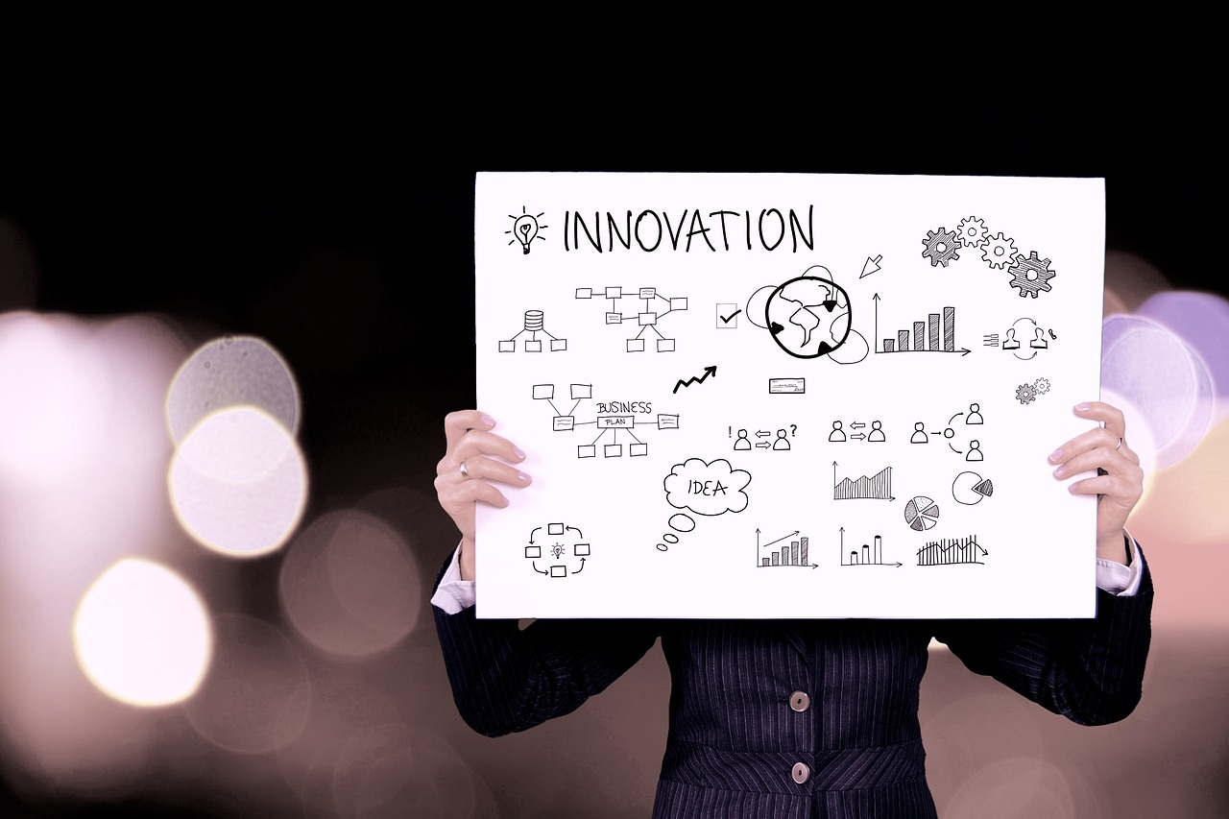
AI Strategy: Navigating the Future
Recommended Presentation Techniques
Use Progressive Reveal Techniques
Gradually unveil information to maintain audience engagement
Enhance understanding by revealing key points step by step
Incorporate Interactive Elements
Engage audience with polls, quizzes, or interactive Q&A sessions
Foster participation and create a dynamic presentation experience
Include Real-World Case Study Snippets
Illustrate theoretical concepts with practical examples
Showcase successful AI strategy implementations for better comprehension
Provide Actionable Insights
Offer tangible takeaways for audience application
Empower listeners with practical strategies and next steps
Balance Theoretical Concepts with Practical Applications
Combine theoretical knowledge with real-world relevance
Ensure a comprehensive understanding of AI strategy implementation

Slide 23




AI Strategy: Navigating the Future
SWOT Analysis of AI Strategy
Strengths
Weaknesses
Advanced data processing capabilities
Enhanced decision-making efficiency
Improved customer experience through personalization
Potential for cost savings and operational optimization
Dependence on quality and quantity of data
Initial high implementation costs
Ethical concerns surrounding data privacy and bias
Need for continuous training and upskilling of workforce
Opportunities
Threats
Expansion into new markets with AI-driven products/services
Collaboration with tech partners for innovation
Integration of AI in existing processes for enhanced performance
Potential for creating new revenue streams through AI solutions
Cybersecurity risks and data breaches
Regulatory challenges and compliance issues
Resistance to change within the organization
Competition from tech-savvy disruptors

Slide 24
AI Strategy: Navigating the Future
Revenue Growth Forecast
Projected Revenue Increase
Key Revenue Drivers
Revenue Growth Strategy
Forecasted Revenue Impact
25%
AI-driven
AI analytics
$10M
Year-over-year growth
Product enhancements, expanded market reach
Leveraging for targeted marketing campaigns
Incremental revenue by end of next fiscal year

Slide 25

AI Strategy: Navigating the Future
AI Technology Ecosystem Diagram
AI Technology Categories
Potential Business Applications
Machine Learning
Natural Language Processing
Computer Vision
Robotics
Expert Systems
Customer Service Automation
Predictive Analytics
Image and Video Analysis
Autonomous Vehicles
Decision Support Systems
Comparative Technology Analysis
Strategic Integration Points
Performance Metrics
Scalability
Cost Efficiency
Ease of Integration
Security
Data Infrastructure
Talent Acquisition
Regulatory Compliance
Partnerships and Collaborations
Continuous Learning and Improvement

Slide 26
AI Strategy: Navigating the Future
Strategic Implementation Flowchart
Assessment Phase
Technology Mapping
Capability Evaluation
Implementation Planning
Continuous Improvement Mechanisms
Conduct thorough analysis of current AI capabilities and limitations.
Identify AI technologies that align with strategic objectives.
Assess organizational readiness and skill gaps for AI implementation.
Develop a detailed roadmap for integrating AI into existing processes.
Establish feedback loops for ongoing optimization and innovation.

Slide 27

AI Strategy: Navigating the Future
Comparative Technology Analysis
AI Technology Categories
Potential Business Applications
Machine Learning
Natural Language Processing
Computer Vision
Robotics
Predictive Analytics
Customer Service Automation
Fraud Detection
Supply Chain Optimization
Comparative Technology Analysis
Strategic Integration Points
Performance Metrics Comparison
Scalability Assessment
Integration Complexity Evaluation
Data Security Considerations
Interoperability with Existing Systems
Alignment with Business Objectives

Slide 28

AI Strategy: Navigating the Future
Ethical Framework Illustrations
Transparency Requirements
Clear communication of AI use
Disclosure of data sources
Openness about decision-making processes
Bias Detection Protocols
Regular bias audits
Implementing bias detection algorithms
Addressing bias in training data
Privacy Protection Strategies
Data anonymization techniques
Secure data storage protocols
Compliance with data protection regulations
Accountability Frameworks
Establishing clear lines of responsibility
Implementing oversight mechanisms
Enforcing consequences for unethical AI use

