Slide 1

Introduction to Storytelling with Counting and Rhymes
Engaging Young Learners in Creativity, Language, and Numeracy through Simple Stories

Slide 2
Table of Contents
Introduction to Creating Simple Stories with C…
Importance of Storytelling in Early Childhood …
Lesson Objectives
Teaching Script
Guided Practice
Independent Practice
Subject Knowledge
Extended Knowledge
Common Errors and Misconceptions
Common FAQs
Objectives and Vocabulary
Resources and Prior Knowledge
Differentiation Strategies
04
05
06
07
08
09
10
11
12
13
14
15
16

Slide 3
Table of Contents
Cross-Curricular Links
Group Activities
Digital Integration
Review and Reflection
Formative and Summative Assessment
Example Questions and Homework
Extension Activities and Parent Engagement
17
18
19
20
21
22
23

Slide 4

Introduction to Creating Simple Stories with Counting and Rhymes
Welcome to Storytelling
Lesson Objective
Engaging Young Minds
Welcome to the world of storytelling, where numbers come alive and rhymes fill the air!
This lesson is designed for 6-year-old beginners to introduce them to the magical world of storytelling, incorporating counting and rhymes.
By the end of this lesson, students will be able to create their own simple stories.
These stories will incorporate counting and rhymes to make learning fun and engaging.
This lesson aims to spark creativity and imagination in young learners.
Through storytelling, children will explore the joy of numbers and the rhythm of rhymes.
4
Introduction to Storytelling with Counting and Rhymes

Slide 5

Importance of Storytelling in Early Childhood Education
Enhancing Language and Literacy Skills
Developing Cognitive Foundations
Storytelling enhances language and literacy skills, fostering creativity and imagination.
It provides a platform for social and emotional learning among young learners.
It helps develop cognitive skills, memory, and language abilities.
This sets a strong foundation for more complex learning in the future.
Encouraging Creativity and Interaction
Building Future Academic Skills
Storytelling encourages creativity, imagination, and social interaction.
It makes the classroom a vibrant and inclusive learning environment.
Storytelling lays the groundwork for future literacy and numeracy skills.
It enhances students' ability to comprehend complex texts and solve mathematical problems.
5
Introduction to Storytelling with Counting and Rhymes

Slide 6
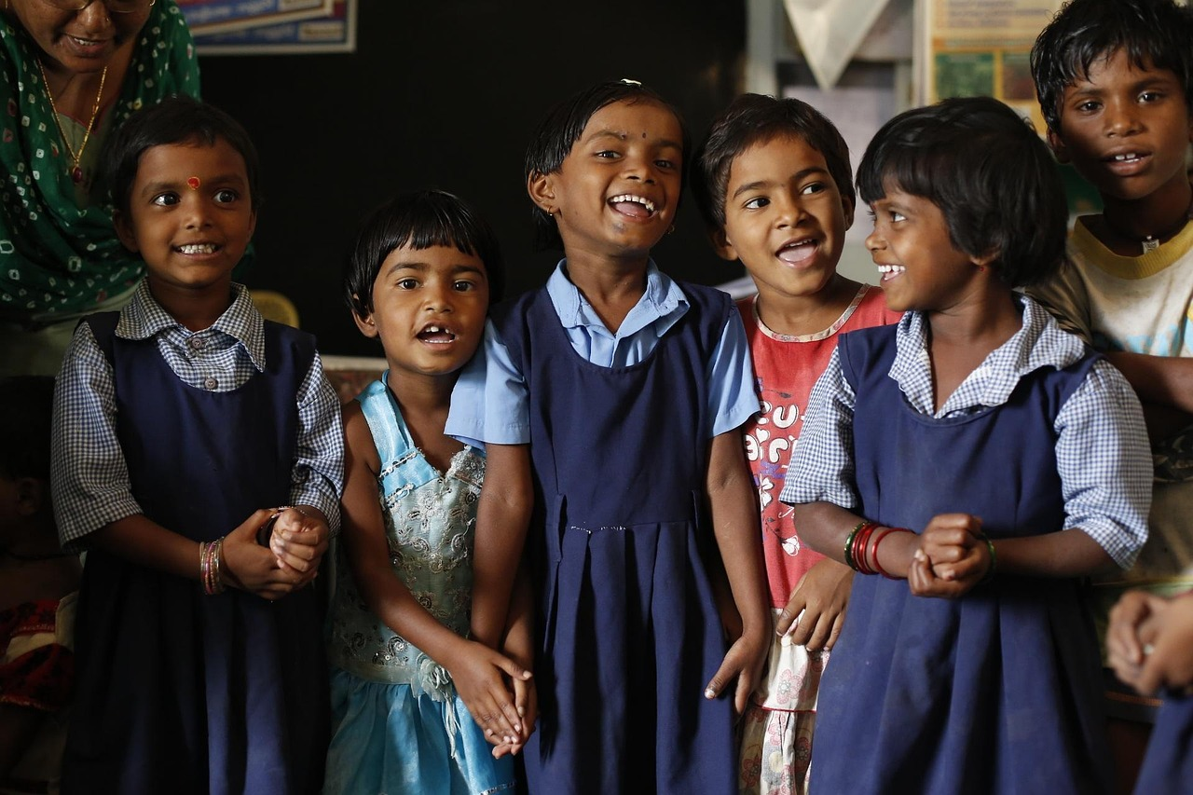
Lesson Objectives
Understanding Basic Concepts
Analyzing Storytelling Elements
Students will be able to recall and identify basic counting concepts (1-10) and recognize rhyming patterns in simple stories.
This foundational knowledge will help them engage with the lesson content effectively.
Students will demonstrate an understanding of how counting and rhymes are used in storytelling by describing the role of these elements in a simple narrative.
This analysis will deepen their comprehension of narrative structures.
Creating Original Stories
Showcasing Creativity
Students will apply their knowledge of counting and rhymes by creating their own simple story that incorporates these elements.
This activity encourages hands-on learning and application of concepts.
Students will exhibit creativity in their storytelling by using imaginative characters, settings, and plot twists while maintaining the use of counting and rhymes.
This fosters innovation and personal expression in their work.
6
Introduction to Storytelling with Counting and Rhymes

Slide 7
Teaching Script
01
02
03
04
05
Introduction and Engagement
Exploring Counting in Stories
Rhyming Fun
Creating Our Own Story
Storytelling Time
Begin the lesson with a warm welcome and an engaging story that incorporates counting and rhymes.
This sets a positive tone and captures students' attention right from the start.
Introduce the concept of counting in stories using visual aids such as number lines, counting blocks, or pictures.
This helps students visualize and understand the role of counting in storytelling.
Move on to the concept of rhymes, explaining what rhymes are and how they are used in stories and songs.
This activity makes learning about rhymes interactive and enjoyable.
Guide students in creating their own simple story that includes counting and rhymes.
This encourages creativity and reinforces the concepts learned earlier in the lesson.
Allow students to share their stories, either individually or in groups, depending on class size and time.
This provides an opportunity for students to practice storytelling and build confidence.
7
Introduction to Storytelling with Counting and Rhymes

Slide 8
Guided Practice
1
Counting Characters
4
Counting and Rhyming Scavenger Hunt
Practice counting skills within the context of a story by reading a story with a specific number of characters.
Ask students to count the characters together.
Apply counting and rhyming skills in a real-world context by creating a scavenger hunt.
Use clues that involve counting and rhyming riddles to engage students.
2
Rhyming Bingo
5
Group Storytelling
Recognize and create rhymes by playing a bingo game with pictures or words that rhyme.
This activity helps students identify rhyming patterns in a fun way.
Practice creating simple stories with counting and rhymes collaboratively in small groups.
Provide a prompt for each group to contribute to a story.
3
Story Sequencing
Understand story structure and sequence by cutting out scenes from a simple story.
Ask students to sequence the events in order to reinforce comprehension.
8
Introduction to Storytelling with Counting and Rhymes

Slide 9
Independent Practice
Count and Rhyme Match
Create Your Own Rhyming Story
Rhyming Story Sequencing Challenge
Rhyming Bingo with Visual Aids
Create a Rhyming Story Book
Match pictures or words that rhyme and involve counting.
This activity helps students connect rhyming words with numerical concepts.
Write a short story that includes counting and rhymes.
This encourages creativity and reinforces both rhyming and counting skills.
Sequence a set of story scenes that involve counting and rhymes and then create a new story by changing one element.
This task develops sequencing skills and allows for creative modifications.
Play a simplified version of rhyming bingo using visual aids and one-to-one support for struggling students.
This game provides an engaging way to practice rhyming with additional support.
Write and illustrate a short story book that incorporates counting and rhymes for advanced students.
This project combines artistic expression with advanced literacy and numeracy skills.
9
Introduction to Storytelling with Counting and Rhymes

Slide 10

Subject Knowledge
The Role of Storytelling in Early Education
Counting in Stories for Development
Storytelling is a powerful tool in early childhood education, enhancing language and literacy skills, fostering creativity and imagination, and providing a platform for social and emotional learning.
It helps children connect with their emotions and develop interpersonal skills through engaging narratives.
Incorporating counting into stories offers numerous developmental benefits for young children, enhancing their understanding of numerical concepts.
It improves their ability to recognize and create patterns, laying the foundation for more complex mathematical skills.
Rhyming and Phonological Awareness
Storytelling Across the Curriculum
Recognizing and creating rhymes helps children develop their linguistic skills, including vocabulary, syntax, and pronunciation.
This practice strengthens their phonological awareness, which is crucial for reading and language development.
Storytelling can be integrated across the curriculum to enhance learning in various subjects, such as mathematics, science, and social studies.
It provides a creative approach to teaching, making abstract concepts more relatable and engaging for young learners.
10
Introduction to Storytelling with Counting and Rhymes

Slide 11

Extended Knowledge
Rhyming Patterns in Storytelling
Rhymes not only make stories more engaging and fun but also help children develop phonological awareness.
This skill is crucial for reading and writing development in young learners.
Counting in Stories
Incorporating counting into stories can be done through numerical sequences.
Characters in the story count objects or perform actions a certain number of times.
Contextualizing Stories for Engagement
Understanding the context in which stories are told is vital.
Stories reflecting everyday experiences or interests are more engaging and relatable for 6-year-olds.
Enhancing Storytelling with Visual Aids
Incorporating visual aids and props can make storytelling more interactive.
This approach enhances the engagement and learning experience for young learners.
11
Introduction to Storytelling with Counting and Rhymes

Slide 12

Common Errors and Misconceptions
Rhyming vs. Meaning
Numerical Sequence Challenges
Originality Misconception
Difficulty in distinguishing between rhyming words and actual word meanings.
This can lead to confusion in understanding the context of stories or rhymes.
Challenge in maintaining a consistent numerical sequence in a story.
This often disrupts the logical flow and coherence of the narrative.
Belief that stories must be entirely original and not based on familiar tales or rhymes.
This misconception can hinder creativity and the use of well-known frameworks.
Narrative Structuring Struggles
Lack of Engagement
Struggling with the concept of storytelling itself, finding it hard to structure a narrative with a beginning, middle, and end.
This makes it difficult to create engaging and complete stories.
Oversight of making the learning experience fun and engaging, leading to a lack of interest and participation from students.
This can result in reduced effectiveness of storytelling as a teaching tool.
12
Introduction to Storytelling with Counting and Rhymes

Slide 13
Common FAQs
Introducing Rhyming to Young Learners
Addressing Memory Challenges
Using Familiar Stories
Encouraging Creativity
Understanding Rhymes and Meanings
What is the best way to introduce the concept of rhyming to 6-year-olds?
How can I help my child create their own simple stories with counting and rhymes?
What if my child struggles with remembering the sequence of numbers in a story?
How can I make sure my child understands the difference between rhyming words and their meanings?
Can I use known stories or rhymes as a basis for our storytelling activities?
How often should we practice creating simple stories with counting and rhymes?
How can I help my child create their own simple stories with counting and rhymes?
What is the best way to introduce the concept of rhyming to 6-year-olds?
How can I make sure my child understands the difference between rhyming words and their meanings?
What if my child struggles with remembering the sequence of numbers in a story?
13
Introduction to Storytelling with Counting and Rhymes

Slide 14
Objectives and Vocabulary
Learning Objectives
Application and Creativity
Key Vocabulary
Lesson Goals
The learning objectives for this lesson include recalling and identifying basic counting concepts.
Students will also demonstrate an understanding of how counting and rhymes are used in storytelling.
Students will apply knowledge of counting and rhymes in their activities.
They will also exhibit creativity in storytelling as part of the lesson.
Key terms include rhyme, counting, story, imagination, pattern, sequence, character, setting, plot, narrative, and phonological awareness.
Understanding these terms will help students engage more effectively with the lesson.
The objectives and vocabulary are designed to guide the lesson.
This ensures students achieve a comprehensive understanding of creating simple stories with counting and rhymes.
14
Introduction to Storytelling with Counting and Rhymes

Slide 15
Resources and Prior Knowledge
Recommended Digital Tools
Physical Materials for Learning
Recommended resources include digital tools such as Storybird and Book Creator.
These tools can enhance creativity and engagement in the learning process.
Physical materials like counting blocks and whiteboards are essential.
They provide hands-on opportunities for students to grasp concepts effectively.
Importance of Prior Knowledge
Creating an Engaging Experience
Prior knowledge required for this lesson includes basic counting skills, rhyming awareness, story sequencing, and creative writing basics.
Teachers should assess and build upon these prerequisite concepts to ensure a solid foundation for the lesson.
The resources and prior knowledge are essential for creating an engaging and effective learning experience.
This ensures that students are well-prepared and motivated to participate in the lesson.
15
Introduction to Storytelling with Counting and Rhymes

Slide 16
Differentiation Strategies
Advanced Challenges for Gifted Students
Technology Integration for Diverse Learning Styles
Visual aids for learners with special needs can enhance understanding and engagement.
These tools help in making the learning process more accessible and inclusive.
Kinesthetic activities for active learners can include acting out stories or using counting blocks to represent numbers in a story.
These methods cater to their need for movement and hands-on learning.
Language Support for English Language Learners
Technology Integration for Diverse Learning Styles
Advanced challenges for gifted students can include creating more complex stories or using higher-level vocabulary.
Such tasks stimulate their intellectual growth and creativity.
Technology integration can cater to different learning styles and abilities, providing an interactive and engaging learning experience.
It serves as a versatile tool to address varied educational needs.
Kinesthetic Activities for Active Learners
Language support for English language learners can involve providing bilingual resources and simplifying instructions.
This approach helps in bridging language barriers and improving comprehension.
16
Introduction to Storytelling with Counting and Rhymes

Slide 17

Cross-Curricular Links
Mathematics Integration
Language Arts Enhancement
The counting aspect of the lesson directly links to mathematics.
It teaches students to apply numerical concepts in a real-world context.
The focus on rhymes and story creation strengthens language arts skills.
This includes phonological awareness, vocabulary, and creative writing.
Music and Movement Connection
Cross-Curricular Opportunities
Incorporating rhyming songs and dances connects the lesson to music and physical education.
This promotes kinesthetic learning and creativity.
The lesson offers numerous opportunities for cross-curricular links.
These links enhance the depth and breadth of learning.
17
Introduction to Storytelling with Counting and Rhymes

Slide 18
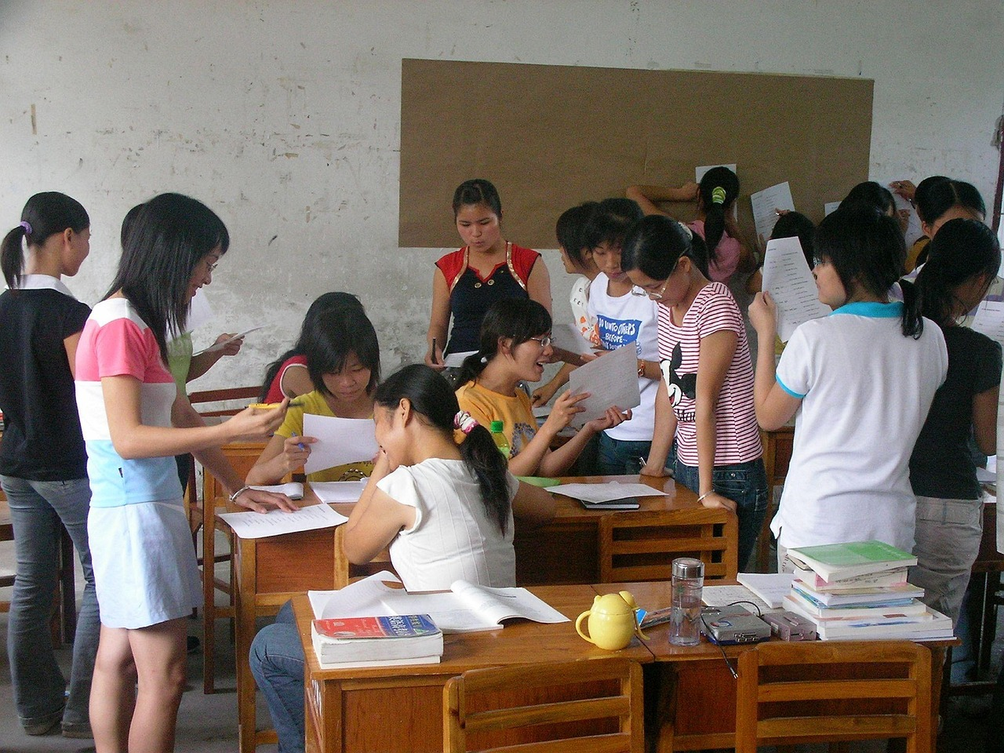
Group Activities
01
Story Chain Activity
Divide the class into small groups and have each group start telling a story that includes counting and rhymes.
The story is passed on to the next group to continue, fostering creativity and collaboration.
02
Rhyme Time Challenge
Organize students into pairs and provide each pair with a set of word cards that include rhyming words.
Challenge them to come up with as many rhyming words as possible within a set time frame.
03
Counting Story Sequencing
Prepare a set of story sequence cards that depict a narrative involving counting.
Ask each group to sequence the cards in order, enhancing their understanding of story structure.
04
Mathematical Storytelling
Divide the class into small groups and provide each group with a scenario that involves mathematical concepts.
Ask them to create a short story that incorporates the mathematical problem, blending creativity with problem-solving.
18
Introduction to Storytelling with Counting and Rhymes

Slide 19
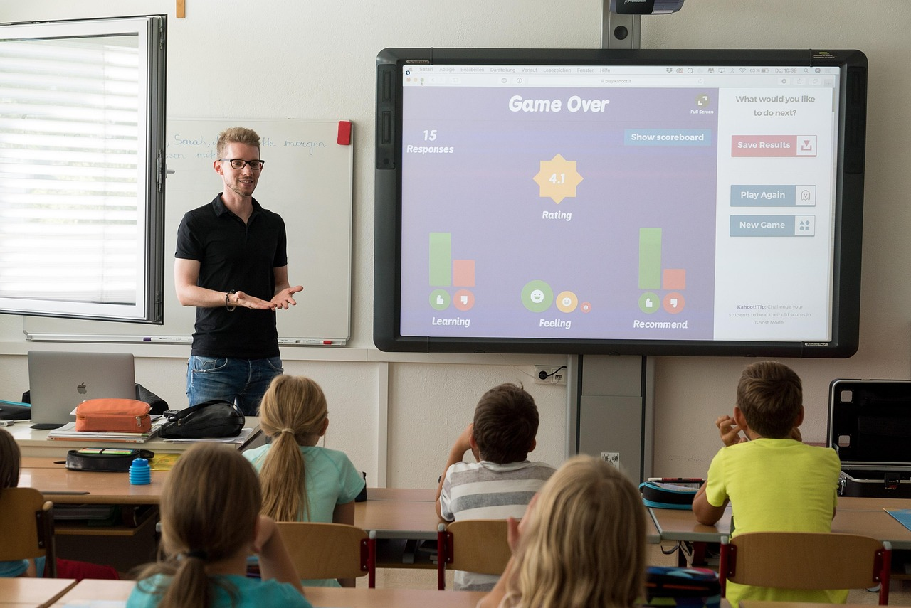
Digital Integration
Digital Storytelling Tools
Math Apps for Counting
Rhyming Games and Activities
Digital storytelling tools like Book Creator or Storybird can be used to have students create their own digital stories.
These tools allow students to combine text, images, and audio to craft personalized narratives.
Math apps such as 'Endless Numbers' or 'Toca Life: Hospital' can be used to create scenarios that involve counting and storytelling.
These apps provide interactive and engaging ways for students to practice math skills.
Online platforms like PBS Kids or Starfall offer rhyming games and activities to reinforce the concept of rhymes.
These interactive tools make learning rhymes fun and engaging for students.
Audio Storytelling
Interactive Whiteboard Activities
Audio storytelling can be used to record students telling their stories and create a class audio book.
This method encourages creativity and helps students improve their speaking skills.
Interactive whiteboard activities can be used to create virtual number lines or rhyming games.
These activities provide a hands-on approach to learning and make lessons more dynamic.
19
Introduction to Storytelling with Counting and Rhymes

Slide 20
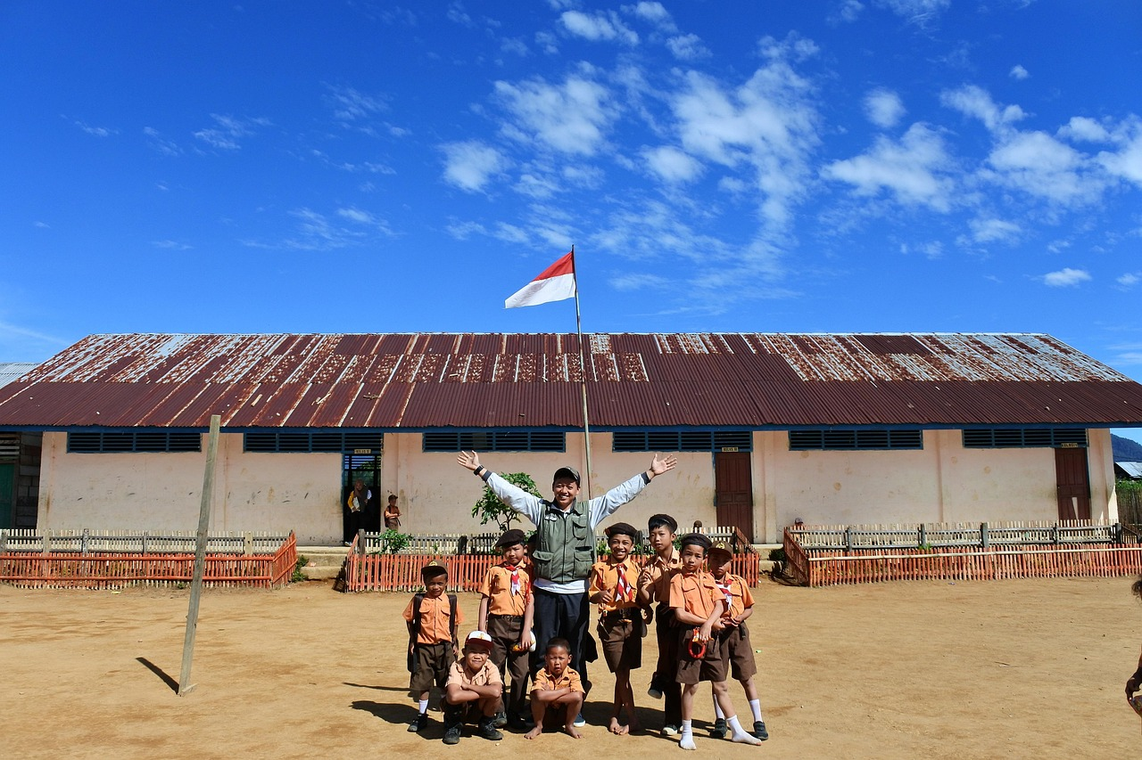
Review and Reflection
01
Importance of Review
Reviewing and reinforcing the concepts learned is crucial for solidifying understanding and promoting long-term retention.
This ensures that students can build a strong foundation for future learning.
02
Effective Review Strategies
Strategies for review include daily rhyming activities, counting scavenger hunts, peer story sharing, and self-evaluation checklists.
These activities make the learning process engaging and interactive.
03
Role of Reflection Questions
Reflection questions can help teachers evaluate the effectiveness of the lesson and identify areas for improvement.
This process supports continuous improvement in teaching methods.
04
Benefits of Review and Reflection
By incorporating review and reflection into the lesson, teachers can ensure that students have a comprehensive understanding of the concepts.
This approach enables students to apply their knowledge in different contexts.
20
Introduction to Storytelling with Counting and Rhymes

Slide 21

Formative and Summative Assessment
01
Formative Assessment Strategies
03
Comprehensive Evaluation Approach
Formative assessment strategies include observation, class discussions, peer feedback, and self-assessment.
These methods help teachers monitor student progress and provide immediate feedback.
By using a combination of formative and summative assessments, teachers can get a comprehensive picture of student learning and understanding.
This approach ensures a balanced evaluation of both process and outcomes.
02
Summative Assessment Methods
04
Purpose of Assessments
Summative assessment methods include a story creation project, a counting and rhyming quiz, a storytelling presentation, and a reflective journal.
These assessments evaluate students' understanding and application of the concepts learned.
The assessments are designed to evaluate students' understanding and application of the concepts learned throughout the lesson.
They aim to provide insights into both individual and group learning progress.
21
Introduction to Storytelling with Counting and Rhymes

Slide 22

Example Questions and Homework
Assessing Understanding Through Questions
Example questions can be used to assess students' understanding of the concepts learned, such as 'What is a rhyme?' or 'Can you give an example of a counting sequence in a story?'
These questions help gauge comprehension and encourage critical thinking about the lesson topics.
Engaging Homework Activities
Homework assignments can include activities such as counting story sequencing, rhyming word match, creating your own counting story, and illustrating a favorite story.
These tasks are designed to make learning interactive and enjoyable for students.
Reinforcing Lesson Concepts
The homework assignments are designed to reinforce the learning from the lesson and encourage further exploration of storytelling, counting, and rhymes at home.
This approach helps students solidify their understanding and apply their knowledge in creative ways.
Encouraging Deeper Understanding
By providing opportunities for students to practice and apply what they have learned, teachers can help students develop a deeper understanding of the concepts.
Such practices foster a connection between classroom learning and real-world application.
22
Introduction to Storytelling with Counting and Rhymes

Slide 23

Extension Activities and Parent Engagement
Creative Extension Activities
Strategies for Involving Parents
Extension activities can include creating a storytelling puppet show, a rhyming scavenger hunt, an illustrated counting book, and a class storybook.
These activities provide students with opportunities to apply their learning in engaging and imaginative ways.
Strategies for parent engagement include regular progress updates, volunteer opportunities, home learning activities, and workshops or parent-teacher conferences.
These methods encourage active participation and collaboration between parents and teachers.
Importance of Parent Engagement
Benefits of Collaboration
Parent engagement is crucial for reinforcing the learning experience and creating a supportive educational environment.
It helps bridge the gap between school and home, ensuring a cohesive approach to education.
By working together with parents, teachers can ensure that students receive consistent support and reinforcement.
This collaboration leads to a more effective and enriching learning experience for students.
23
Introduction to Storytelling with Counting and Rhymes

