Slide 1

Exploring Human Suffering: From Historical Trauma to Contemporary Lessons
A Journey Through World War II, the Holocaust, and Beyond

Slide 2
Table of contents
01
02
03
04
05
06
07
08
09
10
11
Title Slide: Understanding Human Suffering
Historical Context: World War II Overview
Understanding the Holocaust: Definition and Statistics
Human Experiences: Personal Narratives
Mechanisms of Discrimination: Propaganda and Dehumanization
Civilian Experiences: Daily Life and Displacement
Resistance and Survival: Acts of Courage and Community Supp…
Long-Term Social Impacts: Intergenerational Trauma and Memo…
Contemporary Relevance: Human Rights Lessons and Global Res…
Critical Reflection: Importance of Empathy and Personal Res…
Learning Objectives: Cognitive Understanding and Emotional …

Slide 3
Table of contents
12
13
14
Resources for Further Learning: Museums and Survivor Testim…
Closing Thoughts: Message of Hope and Collective Healing
Q&A and Discussion: Reflection Prompts and Emotional Support

Slide 4
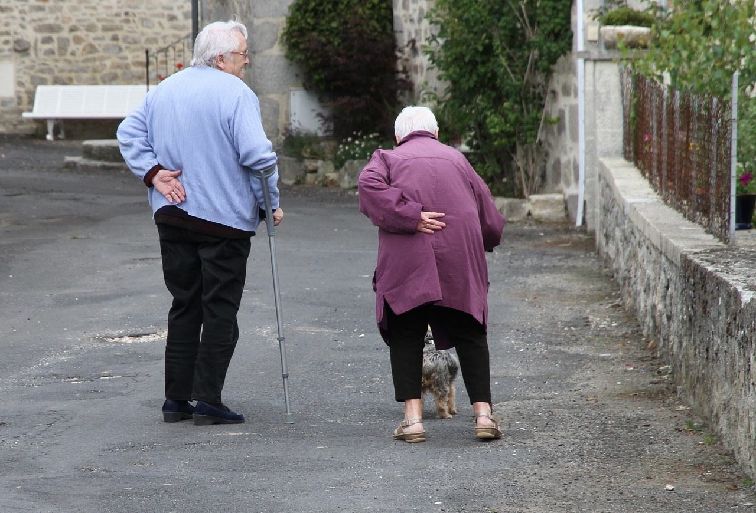
1
Title Slide: Understanding Human Suffering
Exploring Human Suffering: From Historical Trauma to Contemporary Lessons
A Compassionate Journey Through the Depths of Human Experience
Exploring Human Suffering: From Historical Trauma to Contemporary Lessons

Slide 5
2
Historical Context: World War II Overview
01
World War II: 1939-1945
02
Key Regions Affected
03
Total Global Casualties
Global conflict involving major world powers
Sparked by the invasion of Poland by Germany in 1939
Europe, Asia, Africa, and the Pacific
Battles fought across multiple continents
Estimated over 70 million fatalities
Civilian and military casualties combined
04
Demographic Transformation Map
05
Key Visual: Interactive timeline highlighting critical events
Shifts in population due to displacement and casualties
Impact on various ethnic groups and nations
Visual representation of key milestones during World War II
Exploring Human Suffering: From Historical Trauma to Contemporary Lessons

Slide 6

3
Understanding the Holocaust: Definition and Statistics
01
Introduction to Machine Learning
02
Types of Machine Learning
Definition and importance of Machine Learning
Applications in various industries
Future trends in Machine Learning
Supervised Learning
Unsupervised Learning
Reinforcement Learning
03
Key Algorithms
Linear Regression
Decision Trees
Neural Networks
Exploring Human Suffering: From Historical Trauma to Contemporary Lessons

Slide 7

4
Human Experiences: Personal Narratives
01
Survivor Stories
02
Resilience and Courage
Hear firsthand accounts of individuals who endured unimaginable hardships during times of conflict and persecution.
Discover the strength and determination displayed by those who faced adversity with unwavering bravery.
03
Psychological Impact
04
Hope and Healing
Explore the lasting effects of trauma on the human psyche and the ways individuals cope and heal.
Learn about the power of hope and resilience in overcoming even the darkest of times.
Exploring Human Suffering: From Historical Trauma to Contemporary Lessons

Slide 8
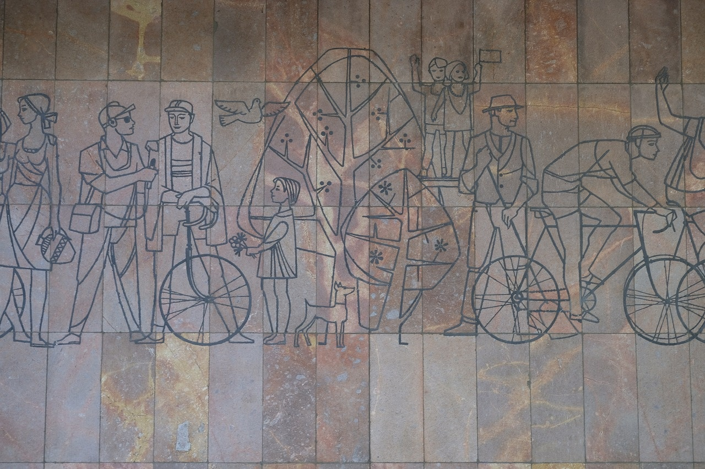
5
Mechanisms of Discrimination: Propaganda and Dehumanization
Propaganda Techniques
Definition and Purpose
Examples from History
Exploring Human Suffering: From Historical Trauma to Contemporary Lessons

Slide 9

6
Civilian Experiences: Daily Life and Displacement
01
Daily Life During Wartime
02
Population Displacement
Rationing of essential goods
Curfews and restrictions on movement
Fear and uncertainty in everyday activities
Forced relocation due to conflict
Loss of homes and communities
Struggles with adapting to new environments
03
Economic Disruption
04
Psychological Stress
Loss of livelihoods and employment
Inflation and scarcity of resources
Bartering and informal economies emerging
Trauma from witnessing violence
Anxiety and fear of the unknown
Coping mechanisms and mental health challenges
Exploring Human Suffering: From Historical Trauma to Contemporary Lessons

Slide 10

7
Resistance and Survival: Acts of Courage and Community Support
01
Individual Acts of Courage
02
Underground Movements
Stories of bravery and defiance against oppression
Examples of individuals risking their lives to save others
Secret networks working to resist and sabotage oppressive regimes
Covert operations to protect vulnerable populations
03
Rescue Efforts
04
Community Support Strategies
Organized missions to save targeted groups from persecution
Humanitarian initiatives providing aid and shelter to those in need
Collective efforts to provide safety and solidarity
Mutual aid networks offering support and resources to survivors
Exploring Human Suffering: From Historical Trauma to Contemporary Lessons

Slide 11

8
Long-Term Social Impacts: Intergenerational Trauma and Memory
01
Intergenerational Trauma
02
Cultural Reconstruction
Definition: Transmission of trauma across generations
Psychological Effects: Impact on mental health and coping mechanisms
Rebuilding cultural identity post-trauma
Preservation of heritage and traditions
03
Memory and Reconciliation
04
Psychological Healing Processes
Importance of remembering past atrocities
Healing through acknowledgment and forgiveness
Therapeutic approaches for trauma survivors
Community support for mental health recovery
Exploring Human Suffering: From Historical Trauma to Contemporary Lessons

Slide 12

9
Contemporary Relevance: Human Rights Lessons and Global Responsibility
01
Human Rights Lessons
02
Preventing Future Atrocities
Importance of upholding fundamental human rights
Impact of human rights violations on individuals and societies
Strategies for early intervention and prevention
Role of education and awareness in promoting human rights
03
Global Responsibility
04
Ongoing Social Justice Efforts
Collective responsibility to address human rights abuses
Advocacy for justice and equality on a global scale
Initiatives promoting equality and inclusivity
Support for marginalized communities and vulnerable populations
Exploring Human Suffering: From Historical Trauma to Contemporary Lessons

Slide 13
10
Critical Reflection: Importance of Empathy and Personal Responsibility
01
Empathy in Understanding Human Suffering
02
Personal Responsibility in Addressing Suffering
03
Impact of Empathy and Personal Responsibility
Empathy as a tool for connecting with the experiences of others
Importance of putting oneself in the shoes of those who have endured trauma
Acknowledging individual roles in promoting empathy and understanding
Taking action to prevent future atrocities through education and awareness
How empathy can lead to positive social change and healing
The significance of personal responsibility in shaping a more compassionate society
04
Challenges in Practicing Empathy and Personal Responsibility
05
Building Empathy and Personal Responsibility
Overcoming biases and prejudices to truly empathize with diverse experiences
Balancing personal responsibility with systemic change for long-term impact
Strategies for cultivating empathy in personal interactions and community engagement
Encouraging accountability and ethical decision-making in everyday life
Exploring Human Suffering: From Historical Trauma to Contemporary Lessons

Slide 14
11
Learning Objectives: Cognitive Understanding and Emotional Intelligence
01
02
03
04
05
Cognitive Understanding of the Holocaust
Emotional Intelligence through Empathy
Critical Thinking on Discrimination
Historical Empathy in Wartime
Understanding Resistance and Survival
Analyze the systematic persecution mechanisms employed during this dark period.
Explore the demographic shifts and targeted populations affected by the Holocaust.
Cultivate empathy towards the human experiences and personal narratives of survivors.
Understand the psychological impact of trauma and resilience in the face of adversity.
Evaluate the role of propaganda techniques in promoting discrimination and hatred.
Reflect on the dehumanization processes and their impact on society.
Examine the daily life challenges, population displacement, and economic disruptions.
Understand the psychological stress endured by individuals living in war-torn regions.
Explore individual acts of courage, underground movements, and rescue efforts.
Analyze the long-term social impacts of intergenerational trauma and cultural reconstruction.
Exploring Human Suffering: From Historical Trauma to Contemporary Lessons

Slide 15

12
Resources for Further Learning: Museums and Survivor Testimonies
01
Museums
02
Documentary Suggestions
United States Holocaust Memorial Museum (USHMM)
Yad Vashem in Jerusalem, Israel
Auschwitz-Birkenau State Museum in Poland
"Shoah" by Claude Lanzmann
"The Pianist" directed by Roman Polanski
"Night and Fog" by Alain Resnais
03
Academic Resources
04
Survivor Testimony Archives
"Maus" by Art Spiegelman
"Ordinary Men" by Christopher R. Browning
"The Diary of a Young Girl" by Anne Frank
USC Shoah Foundation's Visual History Archive
Holocaust Survivors Memoirs Project
Fortunoff Video Archive for Holocaust Testimonies
Exploring Human Suffering: From Historical Trauma to Contemporary Lessons

Slide 16
13
Closing Thoughts: Message of Hope and Collective Healing
01
Embracing Hope
02
Unity in Healing
03
Renewing Human Dignity
Despite the depths of suffering explored, there is always room for hope to flourish and guide us towards healing.
Collective healing is a powerful force that transcends individual pain, fostering resilience and strength within communities.
By acknowledging the dignity inherent in every individual, we pave the way for mutual respect and understanding.
04
Continued Learning and Growth
05
Empathy as a Catalyst
Our journey towards healing is ongoing, marked by a commitment to learning from the past and shaping a more compassionate future.
Cultivating empathy towards others and ourselves is key to fostering healing and building a more empathetic society.
Exploring Human Suffering: From Historical Trauma to Contemporary Lessons

Slide 17

14
Q&A and Discussion: Reflection Prompts and Emotional Support
01
Reflection Prompts
02
Discussion Guidelines
What emotions did you experience while learning about historical trauma?
How can understanding past suffering help us navigate present challenges?
In what ways can we support individuals dealing with intergenerational trauma?
Respect differing perspectives and experiences during discussions.
Encourage active listening and empathy towards others' viewpoints.
Create a safe space for sharing personal reflections and emotions.
03
Emotional Support Resources
04
Contact Information
Provide contact information for mental health professionals or support hotlines.
Offer guidance on self-care practices during emotionally challenging discussions.
Suggest engaging in community support groups for further emotional assistance.
Mental Health Hotline: 1-800-273-TALK
Email: support@empathyresources.org
Website: www.copingtogether.com
Exploring Human Suffering: From Historical Trauma to Contemporary Lessons

